Slide 1
FIRM UPDATE 2023
Shared Service Department

Slide 2
Employment Act Changes and TnC Revision

Slide 3


EMPLOYMENT ACT
At a Glance of the Employment Act (Amended) 2022
w.e.f January 2023
Any person who has entered into a contract of service
ALL
45
hours
working hours
per week
98 days
Maternity Leave
Sexual Harassment protection
RM4,000
and below
74 days
Medical Leave and Hospitalisation Leave
Flexible Working Arrangements
Overtime
entitlement
7 days
Paternity Leave
Employment Discrimination

Slide 4
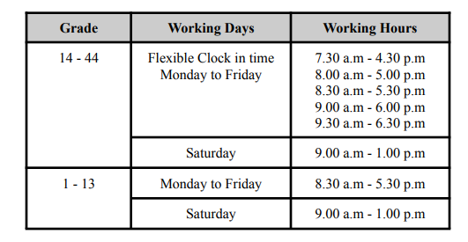
T&C REVISION
TNC 01,Clause 1.11 (Working days and Office Hours)
Changes on clause Section 60A Hours of Work, Basic hours from 48 hours change to 45 hours
CURRENT TERMS | NEW EMPLOYMENT ACT | REVISION TERMS
Malaysia Employment Act, 1955, § 60A.
45 hours per week
Every employee shall be allowed each week a rest day of 1 whole day as may be determined from time to time by the employer.
8 hours a day, but where an employee works less than 8 hours on one or more days, he can be required to work up to 9 hours on other days in the week,
a spread over a period of 10 hours in one day.
45 hours in one week.
Applicable to executive above (8 - 44)

Slide 5
T&C REVISION
TNC 03,Clause 3.3 & 3.4 (Sick Leave & Hospitalization Leave)
Changes on clause Section 60F Sick Leave
HOSPITALIZATION LEAVE
60 DAYS + MEDICAL LEAVE ENTITLEMENT

Slide 6
JUSTIFICATION & PROPOSAL
TNC 03,Clause 3.7 (Maternity Leave)
Changes on clause Section 37 Maternity Leave
CURRENT TERMS | NEW EMPLOYMENT ACT | REVISION TERMS
3.7.1 All married female staff shall be granted for 360 days maternity leave in a whole service period.
3.7.2 Paid maternity leave will be granted at a minimum sixty (60) consecutive days up to a maximum of ninety (90) consecutive days per calendar year inclusive of rest day and public holidays.
3.7.3 Utilization above 60 days maternity leave is subject to approval by the Head of Department
Increase length of maternity leave from 60 days to 98 days.
Every female employee shall be entitled to:
to maternity leave for an eligible period in respect of each confinement
1.To amend clause 3.7.1 and 3.7.2
2. To remove clause 3.7.3
To Add:
Female staffs are allowed to utilize maternity leave 2 weeks in advance prior to the maternity due date.
Flexibility in utilization 98 days:
Female staffs can opt to spread the usage of maternity leave for the period of 9 Months.
To entitled for the paid maternity leave employee must serve the firm for a period duration of 120 days.

Slide 7
JUSTIFICATION & PROPOSAL
TNC 03,Clause 3.7 (Maternity Leave)
Changes on clause Section 37 Maternity Leave
CURRENT TERMS | NEW EMPLOYMENT ACT | REVISION TERMS
3.7.4 Maternity leave may only commence on or after the 28th week of pregnancy and absence from work due to any illness in relation to pregnancy or miscarriage before the 28th week of pregnancy will be considered as sick leave.
3.7.5 For administrative records, the Human Resource Department should be informed in writing at least two (2) months before the scheduled maternity leave.
the process of giving birth to a child or children, alive or dead after 22 weeks of pregnancy.
To be amended accordingly clause 3.7.4 Maternity leave may only commence on or after the 22th week of pregnancy and absence from work due to any illness in relation to pregnancy or miscarriage before the 22th week of pregnancy will be considered as sick leave.
To be amended accordingly clause 3.7.5, Human Resource should be informed once the antenatal book has been issued to the staffs

Slide 8
JUSTIFICATION & PROPOSAL
TNC 03,Clause 3.9 b Special Leave (Paternity Leave)
New Clause section 60 fa Paternity Leave
CURRENT TERMS | NEW EMPLOYMENT ACT | REVISION TERMS
7 consecutive days in respect of each confinement
Restricted to five confinements irrespective of the number of spouse.
A married male employee shall be entitled to paternity leave from his employe if:
Has been employed by the same employer at least twelve months before the commencement of such paternity leave
has notified his employer his wife’s pregnancy at least 30 days from the expected confinement or as early as possible after the birth
Birth of child
Entitlement upon confirmation of employment
Three (3) consecutive working days
To be amended accordingly section 3.9b in line with the Employment Act.
To add:
Male staff employed less than 12 months entitled 3 consecutive paternity leave.

Slide 9
JUSTIFICATION & PROPOSAL
TNC 04,Section 4.3 Overtime
Purpose
1. To define company’s overtime policy in line with prevailing employment regulations.
2. To ensure employees are consistently and correctly compensated for the work done beyond normal hours of work.
Definition
1. The below work shall be classified as overtime and work beyond normal hours of work;
a. Work done after normal hours of work in a normal workday
b. Work done on rest days
c. Work done on public holidays
Applicability
1. The overtime policy applies to the below employees:
a. Wages up to RM 4,000 per month
b. Engaged in manual labour irrespective wages
c. Engaged in operation or maintenance of any mechanically propelled vehicle irrespective of wages
d. Supervising or overseeing other employees engaged in manual labour irrespective of wages
Notes:
Overtime will be converted into leave entitlement (1 hour OT = 1 hour leave/ 8 hours OT = 1 days leave), this entitlement shall be applicable for salary above 4k limit to grade 22 (Senior Executive)

Slide 10
JUSTIFICATION & PROPOSAL
TNC 04,Section 4.3 Overtime
Changes in First Schedule
CURRENT TERMS | NEW EMPLOYMENT ACT | REVISION TERMS
4.3.2 Overtime will be calculated subject to the clock in time as per below table:
First Schedule
Covers all private sectors workers regardless of wages
Provision not applicable to Section:
Overtime Payment Section 60A(3), 60C(2A)
Work during rest day Section 60(3)
Work during Public Holiday 60D(3), 60D(4)
To proposed cooling down for overtime one (1) hour and Flexi clock in time started with grade 8.
Flexible Clock in Time | Overtime
7.30 am - 4.30 pm | 5.00 pm
8.00 am - 5.00 pm | 5.30 pm
8.30 am - 5.30 pm | 6.00 pm
9.00 am - 6.00 pm | 6.30 pm
9.30 am - 6.30 pm | 7.00 pm
Flexible Clock in Time | Overtime
7.30 am - 5.30 pm | 6.30 pm
8.00 am - 6.00 pm | 7.00 pm
8.30 am - 6.30 pm | 7.30 pm
9.00 am - 7.00 pm | 8.00 pm
9.30 am – 7.30 pm | 8.30 pm
Notes:
Overtime will be converted into leave entitlement (1 hour OT = 1 hour leave/ 8 hours OT = 1 days leave), this entitlement shall be applicable for salary above 4k limit to grade 22 (Senior Executive)

Slide 11
JUSTIFICATION & PROPOSAL
TNC 04,Section 4.3 Overtime
Changes in First Schedule
CURRENT TERMS | NEW EMPLOYMENT ACT | REVISION TERMS
4.3.3 Overtime applicable for grade 1 - 26. Employee earnings more than RM 2000.00 a month, overtime will be converted into leave entitlement ( 1 hour OT = 1 hour leave/ 8 hours OT = 1 days leave), this entitlement shall be applicable for grade 7 - 26.
First Schedule
Covers all private sectors workers regardless of wages
Provision not applicable to Section:
Overtime Payment Section 60A(3), 60C(2A)
Work during rest day Section 60(3)
Work during Public Holiday 60D(3), 60D(4)
To be amended accordingly section 4.3.3 in line with the Employment Act.
Overtime Eligible to employee with wages RM4,000.00 and Below.
Overtime policy shall not applicable to employee wages above RM 4,000 per month
To Add:
Employee who need to work overtime must obtain approval from engagement manager.
Overtime Calculation will take effect one hour after official clock out time.
Minimum hour for overtime - 1 hour
Maximum overtime 104 hours a month.

Slide 12
JUSTIFICATION & PROPOSAL
TNC 14 (Flexible Working Arrangement)
New Section 60P Flexible Working Arrangement
CURRENT TERMS | NEW EMPLOYMENT ACT | REVISION TERMS
Only managers (including assistant managers), directors, and partners are eligible to request for FWA. It is however not a contractual right.
Notwithstanding Clause 3.1.1, eligibility may be extended to other employees on a case-by-case basis.
All eligible employees are to apply to their Head of Department (HoD) in writing to participate in an FWA as set out in this procedure
To act clause :
EMPLOYEES POLICIES & PROCEDURES – FLEXIBLE WORKING ARRANGEMENT PROCEDURES
Open FWA to all grade ( 8 - 44)
Approval to apply FWA:
Engagement Manager - 1 Month
Head of Department - More than 1 month
To Add: FWA - Refusal Application
Poor performer
Employee has conduct issue
Employee role is not suitable for FWA
Employee is unable to provide assurance that his place of work at home has the necessary facilities such as stable internet connection
Employees may apply for a flexible working arrangement to vary the hours of work, days of work or place of work.
This must be responded by the employer within 60 days. Reasons must be provided in writing if the application is rejected.

Slide 13
JUSTIFICATION & PROPOSAL
TNC CLAUSE 03 ANNUAL LEAVE
CURRENT TERMS | EMPLOYMENT ACT | REVISION TERMS
Category | Grade 31 - 44 | Grade 23 - 30 | Grade 7 - 22 | Grade 1 - 6
First 24 months of service | 20 days | 16 days | 14 days | 12 days
Additional leave | Additional 1 days leave for every 2 years of service , but not exceeding the maximum entitlement
Maximum entitlement in a year | 30 days | 28 days | 26 days | 24 days
8 days : for every 12 months of continuous service with the same employers for less than 2 years
12 days : for every 12 months of continuous service with the same employers for less than 5 years
16 days : for every 12 months of continuous service, employed for 5 years and more.
To remove maximum entitlement in a year and additional leave,basic in implementation Flexible Working Arrangement and declaration of saturday off day
Proposed to add new AL Entitlement without Maximum and Additional Leave.
Category | Grade 31 - 44 | Grade 23 - 30 | Grade 7 - 22 | Grade 1 - 6
Annual Leave | 22 days | 16 days | 12 days | 10 days
Contract
1 day per month for all levels
Contract
1 day per month for all levels

Slide 14
JUSTIFICATION & PROPOSAL
TNC CLAUSE 4.0 STAFF WELFARE
CURRENT TERMS | REVISION TERMS
4.8 a Token for marriage of staff worth up to RM500. To be eligible, the staff must serve the firm for at least one year . For those staff who served less than 1 year it’s subject to management discretion.
500 ALLW 400 GIFT
4.8 e New born token to all married staff worth up to 5 th child amounting to RM500.00. To be eligible, the staff must serve the firm at least one (1) year. For those staff who served less than 1 year it’s subject to management discretion.
500 ALLW 200 GIFT
RM 1000
(Staffs must serve the SALIHIN at least one year)
RM 500.00 allowance
(Staffs must serve the SALIHIN at least one year)

Slide 15
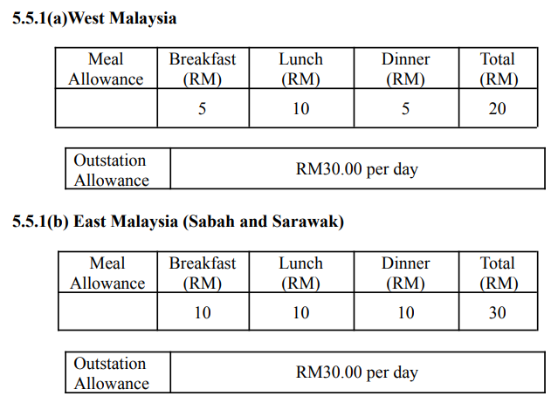
JUSTIFICATION & PROPOSAL
TNC CLAUSE 5.5 SUBSISTENCE ALLOWANCE
CURRENT TERMS | REVISION TERMS
West Malaysia & Sabah Sarawak
Breakfast (RM) | lunch (RM) | Dinner (RM) | Total (RM)
10.00 | 15.00 | 15.00 | 40.00
Outstation Allowance | RM 30.00 per day

Slide 16
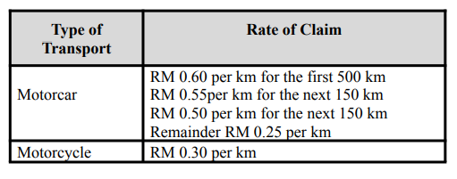
JUSTIFICATION & PROPOSAL
TNC CLAUSE 5.5 SUBSISTENCE ALLOWANCE
CURRENT TERMS | REVISION TERMS
4.2.1 Staffs who are authorized to travel in their own vehicles on official Company business may claim mileage at the following rates:
New rate:
Motorcar:
RM 0.80 per km for the first 500KM
RM 0.70 per km for the next 150KM
RM 0.60 per km for the first 50KM
Motorcycle: RM 0.40/KM

Slide 17
PERKS & BENEFITS
to review and revise other SALIHIN terms and conditions to streamline with the current scenario and practice.
CLAUSE 6.4 DENTAL & OPTICAL
Grade | Coverage | Annual Entitlement
39 - 44 | Staff and Family | 2,000.00
23 - 38 | Staff and Family | 1,000.00
1 - 22 | Staff only | 500.00
CLAUSE 6.2 GENERAL OUTPATIENT TREATMENT
Grade | Coverage | Annual Entitlement
39 - 44 | Staff and Family | 3,000.00
31 - 38 | Staff and Family | 2,500.00
23 - 30 | Staff and Family | 1,500.00
1 - 22 | Staff only | 1,000.00

Slide 18
PERKS & BENEFITS
to review and revise other SALIHIN terms and conditions to streamline with the current scenario and practice.
DRESSING ALLOWANCE
Grade | Coverage | Annual Entitlement
39 - 44 | staff Only | 2,500.00
30 - 38 |  | 1,000.00
PROFESSIONAL AFFILIATION/MEMBERSHIPS FEE​
Grade​ | Registration Fees​ | Total Annual Subscription Fees​ | Service Bond Period​
39 - 44​ | As per invoice​ | 5,000.00​ | 1 year​
07 - 38 ​ | As per invoice​ | 2,000.00​
GADGET ALLOWANCE
Grade | Coverage | Annual Entitlement
39 - 44 | Associate Director / Executive Director / Partner | 3,000.00 (bi yearly)

Slide 19
Calendar 2023

Slide 20
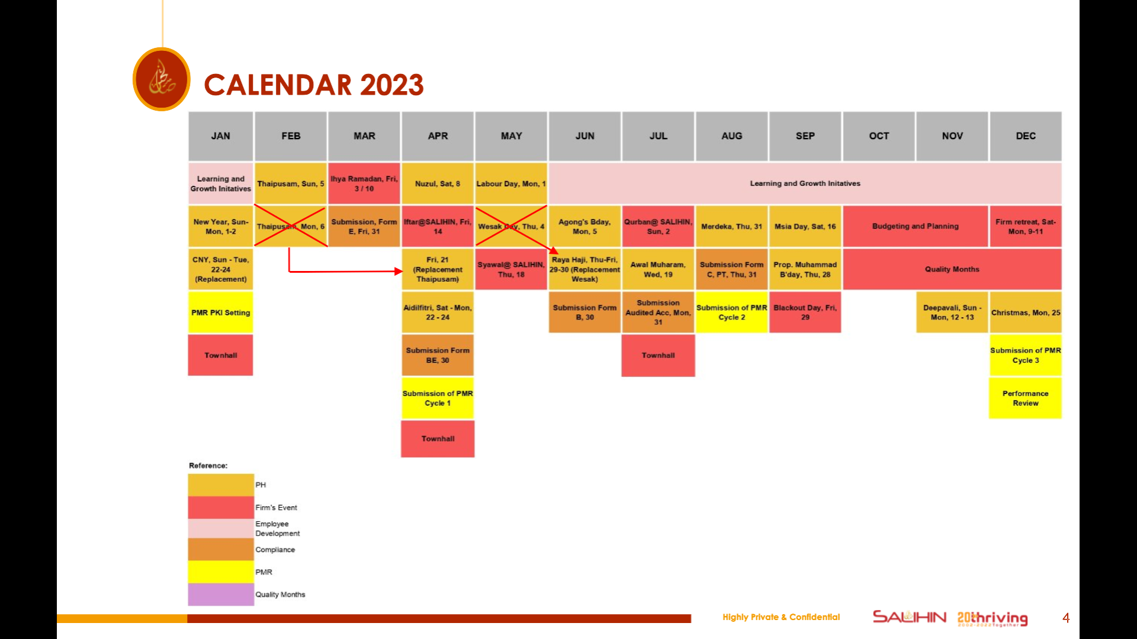
CALENDAR 2023

Slide 21

Thank You
Selangor (HQ)
555, Jalan Samudra Utara 1,Taman Samudra,
68100 Batu Caves,
Selangor Darul Ehsan.
+603 6185 9970
+603 6184 2524
info@salihin.com.my

