Slide 1
3 Level Chart of Account

Slide 2
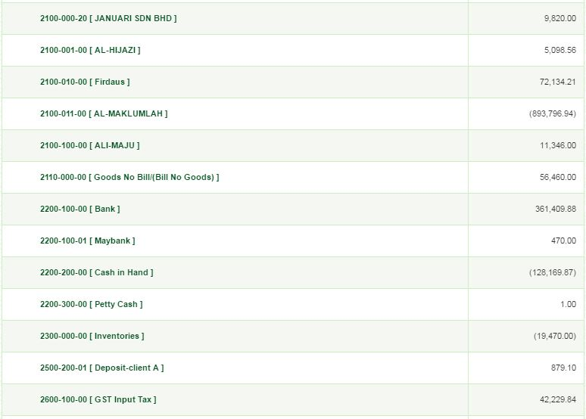
STATEMENT OF FINANCIAL POSITION
2200-100-00 [Bank & Cash Balance] 361,409.88

Slide 3
CASH AND BANK BALANCES
As At
30/06/2016
2200-101-00 [Bank Balance] 349,479.88
2200-102-00 [Cash Balance] 11,930.00
Total
361,409.88
Print
Back

Slide 4
BANK BALANCES
As At
30/06/2016
2200-101-01 [Maybank] 161,549.17
2200-101-02 [CIMB] 78,980.91
2200-101-01 [BIMB] 97,019.80
2200-101-02 [Bank Rakyat] 11,930.00
Total
349,479.88
Print
Back

Slide 5
CASH BALANCES
As At
30/06/2016
2200-102-00 [Cash Balance] 11,930.00
Total
11,930.00
Print
Back

Slide 6
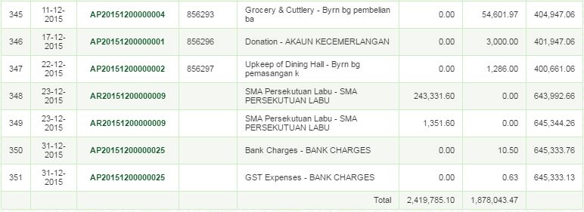
Maybank
Print
Back

Slide 7
CIMB
Print
Back

Slide 8
Bank Islam
Print
Back

Slide 9
Bank Rakyat
Print
Back

Slide 10
Cash Balance
Print
Back

