Slide 1



SALIHIN PREMIER SOLUTIONS
Smart Media Partnership Business Proposal
Prepared for:
Prepared by:

Slide 2
TABLE OF CONTENTS
1.0 ABOUT US 03
2.0 ABOUT SALIHIN PREMIER SOLUTIONS (SPS) 15
3.0 OUR PROPOSAL 20
4.0 CONTACT US 48
5.0 OUR CREDENTIALS 48
6.0 APPENDIXES 52

Slide 3

1.0 ABOUT US

Slide 4




AT A GLANCE
ABOUT US|FIRM’S DESCRIPTION
SALIHIN introduced its name to the world on January, 2002. The genesis of our 12 years’ journey began with an ardent determination to spread our wings and make our presence felt. Since then, each year that passes confirms and demonstrates our commitment to our vision.
The past decade spent witnessed continuing effort to build our brand, which has now become identical to our commitment to integrity and high quality services. SALIHIN is MSC Status Company and a certified company of 1-innocert and Enterprise 50.
In addition, SALIHIN is an established boutique firm specialising in all aspects of corporate finance advisory and investment management, providing services to the Government, Ministries, Multinational Companies, Public Listed Companies and Government Linked Institutions, Commercial Banks and Private Companies.
We are licensed by the Securities Commission Malaysia to advise on Corporate Finance under the Capital Market and Services Act 2007. We have performed various engagements from Strategic Transaction Advisory, Fund Raising Exercise for both Debt & Equity Markets, Strategic and Financial Advisory on Public Private Partnership and Corporate Restructuring.
For further info, visit www.SALIHIN.com.my

Slide 5
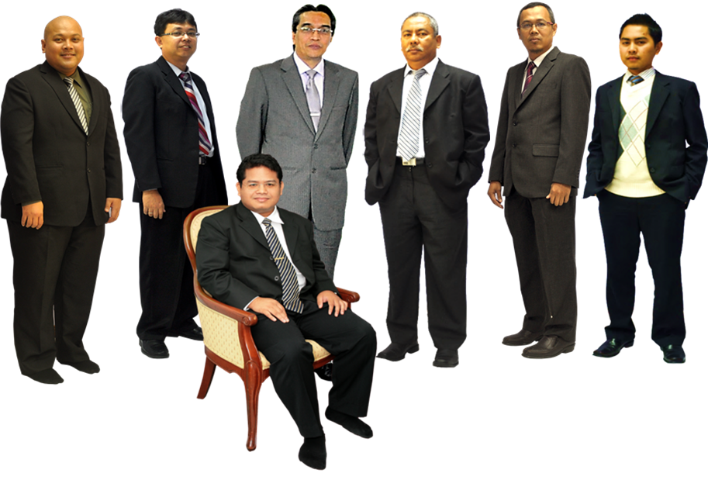
ABOUT US|KEY PERSONNEL
In front: Salihin Abang
Left to right: Ahmad Izwan Adnan, Faizul Nizan Zulkefli, Tuan Haji Abd. Aziz Abu Bakar, Ahmad Aljafree Razalli, Mohd Faried Jamil, Abdussalam Shokhawi

Slide 6


ABOUT US|SERVICE & OFFICES
AUDIT & ASSURANCE
GOODS AND SERVICES TAX (GST)
FINANCIAL ACCOUNTING SERVICES
Financial Statement Audit
Compliance Audit
Operational Audit
Forensic Audit
GST Compliance and Advisory
GST Preparation and Filing
GST Audit and Investigation
GST Training
Accounting System Development and
Implementation
Financial Statements Review
Business Process Outsourcing
TAXATION
CORPORATE SECRETARIAL SERVICES
Tax Compliance
Corporate Tax Advisory
Indirect Tax Services
Tax Audit and Investigation
Real Property Gain Tax
Company Incorporation
Other valuable Secretarial Services
Registration with Ministry of Finance
and other Government Agencies
CORPORATE FINANCE &
TRANSACTION SERVICES
ISLAMIC ACCOUNTING & AUDITING
Due Diligence
Internal Audit and Forensic Accounting
Valuation
Capital Market
Managerial Finance
Mergers & Acquisitions
Shariah Compliance Audit
Advisory Services
Zakat - Alms Giving
Waqf - Islamic Endowment
BATU CAVES . KUALA LUMPUR . JOHOR BAHRU . KUCHING

Slide 7
ABOUT US|VISION & MISSION
VISION
  SALIHIN aspires to become a ‘glocal’ consulting firm serving both local and international clients. Its glocal strategic move is not just to spread its wings but to make its presence felt as the preferred and leading global national firm of Malaysian origin in business consultation and other non-traditional services.
MISSION
  SALIHIN is dedicated to create value by focusing on customer satisfaction and growth, excellent internal business processes and superior human resource development. Without compromising our professional integrity and independence, we strive to offer the highest quality and value added services to our clients.

Slide 8
ABOUT US|CORE VALUES
KNOWLEDGE
Cherish competencies, skills, continuous learning and innovations to better serve dynamism of clients’ expectation
HARMONY
Harmonise knowledge and accountability that will enable us to excel in serving clients
ACCOUNTABILITY
Approach our duties with ownership and responsibility

Slide 9





ABOUT US|CORE VALUES
The following are key reasons why we should be your organization’s preferred choice:
We have the right ‘hands-on’ team with vast knowledge and relevant experience.
We would be able to provide complete and comprehensive reports in tandem to your key areas of concern.
Our Engagement Partner, Board of Advisors and Managers will be involved in closed co-operation to ensure of best services.
We offer ‘value for money’ without compromising on the quality and timeliness of our services.
We will apply our considerable experience to ensure minimal disruption to clients’ daily operations.

Slide 10

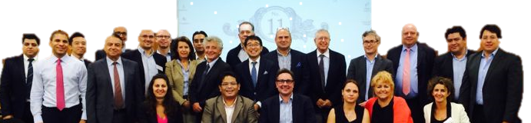

ABOUT US|INTERNATIONA LINKS/NETWORK
Today’s globalization and increasing complexity in the business environment call for strategic alliances. While providing firms with flexibility, they also allow firms to leverage resources and capabilities to achieve objectives that might otherwise beyond their reach.
http://www.i2an.com/
Eying international reach, SALIHIN is a member firm of i2an, a reputable global network of financial professionals which currently has over 500 professionals present in the major financial centres in Europe, the United States and Asia.

Slide 11















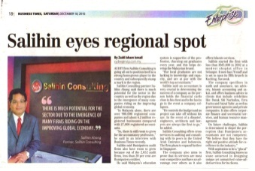
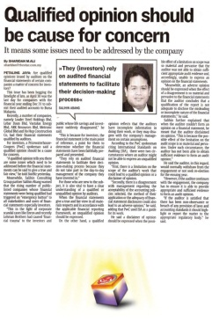



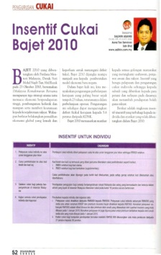

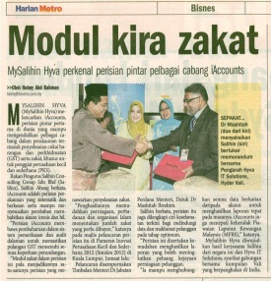

ABOUT US|AWARDS & RECOGNITION
GOLD SPONSOR
MAIN SPONSOR
SILVER SPONSOR
CO- SPONSOR

Slide 12

ABOUT US|CLIENTELE OVERVIEW
serves diverse clients including corporate companies, foundations/non-profit organisations, government bodies and government-linked companies. Their diversity spans across different sectors of the economy.

Slide 13

ABOUT US|SALIHIN CLIENTELE OVERVIEW

Slide 14
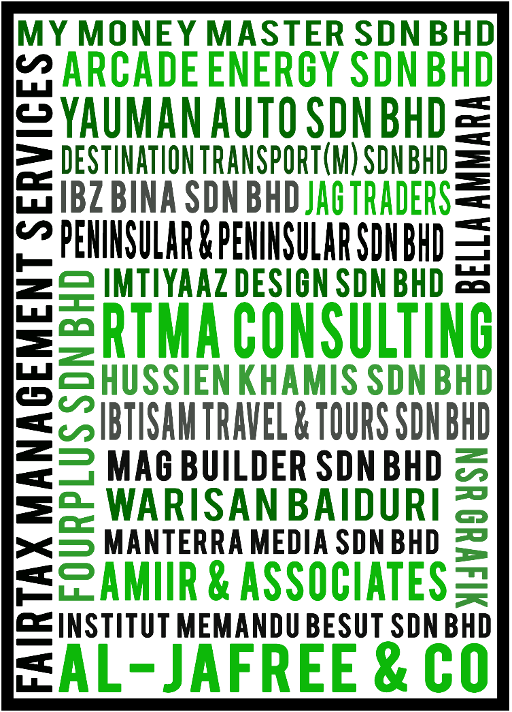









ABOUT US|SPS CLIENTELE OVERVIEW

Slide 15
2.0 SALIHIN PREMIER SOLUTIONS (SPS)

Slide 16
ABOUT US|SPS BACKGROUND
The SALIHIN PREMIER SOLUTIONS also know as SPS, the intelligent software in the world that can manage numerous aspects of financial accounting including Goods and Services Tax (GST) and Zakat calculation, customized specially for Small and Medium Enterprises (SMEs).
SPS is an efficient and effective accounting software that accommodates changes affecting invoicing and billing system of the business process. The software is powered by the latest security features to secure data or information for optimal integrity and confidentiality. It is tailor made for small and medium industries by professional accountants.
The Zakat module makes SPS the first comprehensive accounting software with Zakat solution. It will make it easier than ever for Muslim businesses, corporations and organizations to determine the amount payable as Zakat. With Zakat feature built in, it is simply the best accounting software yet.

Slide 17
SPS|MODULES IN SPS
There is 5 main modules that makes the SPS Accounting software like no other’s.
Financial Module
Inventory Module
GST Module
Zakat Module
Waqf / Endowment Module

Slide 18

SPS|CORE FEATURES
SPS Installer Faster & Easier
Predefined Accounting Chart
Default GST Setup
Biz Dashboard
Regulate User Access
GST-03 Online Submission
Dynamic Graph Propagation
Void Unconfirmed Transaction
Auto Notification of
any New Update
Zakat Calculation Enhancement
Simplified Tax Invoice
Auto Calculation Wakaf
Self Billed Tax Invoice

Slide 19

SPS| FUTURE ENHANCEMENT
Cash Book System
POS System
Fixed Asset Management
Payroll System
CRM System

Slide 20
3.0 OUR PROPOSAL : SMART MEDIA PARTNERSHIP PROPOSAL

Slide 21
EXECUTIVE SUMMARY
SALIHIN CONSULTING GROUP (SALIHIN) would like to propose a smart media partnership with KUMPULAN UTUSAN in exploring a new business segment utilizing SALIHIN range of Business Applications and Corporate Advisory & Services.
This smart partnership will provide KUMPULAN UTUSAN a variety of business related products and services as a new potential revenue stream.

Slide 22

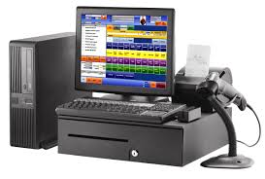
PRODUCT OFFERINGS
SALIHIN offers the following services:-
SPS Business Solutions
SPS Business Advisory & Professional Services
Accounting Software
AUDIT & ASSURANCE
CORPORATE SECRETARIAL SERVICES
Financial Statement Audit
Compliance Audit
Operational Audit
Forensic Audit
Company Incorporation
Other valuable Secretarial Services
Registration with Ministry of Finance
and other Government Agencies
CORPORATE FINANCE &
TRANSACTION SERVICES
SPS Point of Sales
Due Diligence
Internal Audit and Forensic Accounting
Valuation
Capital Market
Managerial Finance
Mergers & Acquisitions
TAXATION
Tax Compliance
Corporate Tax Advisory
Indirect Tax Services
Tax Audit and Investigation
Real Property Gain Tax
GOODS AND SERVICES TAX (GST)
ISLAMIC ACCOUNTING & AUDITING
SPS Accounting Training
SPS GST Training
MATA GST Course (In Collaboration with RMCD)
GST Compliance and Advisory
GST Preparation and Filing
GST Audit and Investigation
GST Training
Shariah Compliance Audit
Advisory Services
Zakat - Alms Giving
Waqf - Islamic Endowment

Slide 23
TARGET MARKET/ USER
No of Companies registered with Royal Malaysian Customs Department (RMCD) as at 1st April 2015
363,584 Registered Companies
No of Companies registered with RMCD and downloaded GST e-Vouchers as at 26th March 2015
95,000 Registered Companies
Source http://gstpedia.my/news/all-systems-go-at-customs-help-centre-on-first-day-of-gst-the-star/
Source http://gstpedia.my/news/govt-urges-55000-smes-to-redeem-gst-e-voucher-nst/
No of Companies registered with RMCD and Not Claimed for GST Vouchers
250,000 Registered Companies
* 5,845,823 Registered Business Owner in Malaysia
TARGET USERS
* 1.137,387 Companies Registered in Malaysia.
Tax Agents
Accounting Firms
*Source: https://www.ssm.com.my/statistic-total-business-companies

Slide 24
BENEFITS
Benefits of the SALIHIN-KUMPULAN UTUSAN Smart Media Partnership:
A Platform for a win-win smart partnership
An venue in exploring new business segment
Opportunities in generating new revenue stream

Slide 25
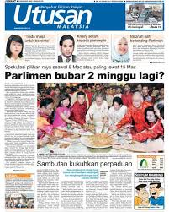

PROPOSED PROCESS FLOW
Our partnership proposal is based on building a smart working relationship, utilizing SALIHIN’s SPS Services to capitalize on KUMPULAN UTUSAN customer base via KUMPULAN UTUSAN’s media coverage (Utusan Malaysia, Kosmo, 12 magazines & Utusan Online resources-where applicable).
KUMPULAN UTUSAN publish about SPS Services at their own marketing channel either online/offline
Interested client will call or contact KUMPULAN UTUSAN via online form or dedicated phone number.
SPS will contact client and furnish the business requirement.
Client will be billed when the service delivery is completed.
KUMPULAN UTUSAN’s commission will be settled upon receipt of full payment from the clients.
Client will choose the the service i.e SPS business application or SPS professional services
1
OR
6
Interested client direct call or contact SALIHIN by produce unique promotional code ID
2
5
3
4

Slide 26
BUSINESS MODEL
SALIHIN would like to propose a revenue sharing business model for KUMPULAN UTUSAN’s consideration.
SPS Business Application
Revenue Sharing Apportionment
SPS Business Advisory & Professional services
Revenue Sharing Apportionment
SALIHIN : 70%
KUMPULAN UTUSAN: 30%
SALIHIN : 80%
KUMPULAN UTUSAN: 20%
Responsibilities of Each Party:
KUMPULAN UTUSAN : Responsible for the advertisement and promotion of the SPS Services.
All A&P cost will be borne by KUMPULAN UTUSAN.
SALIHIN : Responsible for SPS services development, operation and maintenance.
All development, operation and maintenance cost will be borne by SALIHIN.

Slide 27

COMMERCIAL ARRANGEMENT
In the spirit of business collaboration between SALIHIN and KUMPULAN UTUSAN, we will support KUMPULAN UTUSAN in providing quality products and services with the highest degree of customer satisfaction.
BRANDING
PARTICIPATION
GST ARTICLES
SALIHIN will allow KUMPULAN UTUSAN to market all SPS Services agreed upon by both parties
SALIHIN will participate proactively in any event especially in conducting training related to financial and GST
SALIHIN will provide financial and GST articles as part of indirect promotion strategy
SALIHIN-KUMPULAN UTUSAN will share the success stories of entrepreneurs on monthly basis in Utusan Malaysia/ Kosmo.
SALIHIN will do the selection of the SME award winner lists based on agreed criteria.
An event will be held to celebrate the winners.
Award will be sponsored by SALIHIN.
We will propose Government Agencies responsible for entrepreneurs to sponsor the event and entrepreneurs segment in Utusan Malaysia/ Kosmo
*SME AWARD
Joint program between
SALIHIN-KUMPULAN UTUSAN
* Arrangement still under pre-negotiation between SALIHIN and respective parties.

Slide 28
PROJECTED REVENUE
Revenue Projection for SPS Mart Media Partnership
SPS Accounting (A) | M1 | M2 | M3 | M4 | M5 | M6 | M7 | M8 | M9 | M10 | M11 | M12 | Total Year
No of Users | 2 | 3 | 3 | 4 | 5 | 6 | 9 | 14 | 21 | 31 | 46 | 70 | 213
Gross Revenue | 5,760 | 7,200 | 9,000 | 11,250 | 14,063 | 17,578 | 26,367 | 39,551 | 59,326 | 88,989 | 133,484 | 200,226 | 612,794
SPS P.O.S (B) | M1 | M2 | M3 | M4 | M5 | M6 | M7 | M8 | M9 | M10 | M11 | M12 | Total Year
No of Users | 2 | 3 | 3 | 4 | 5 | 6 | 9 | 14 | 21 | 31 | 46 | 70 | 213
Gross Revenue | 7,760 | 9,700 | 12,125 | 15,156 | 18,945 | 23,682 | 35,522 | 53,284 | 79,926 | 119,888 | 179,832 | 269,749 | 825,569
SPS Business Advisory (C) | M1 | M2 | M3 | M4 | M5 | M6 | M7 | M8 | M9 | M10 | M11 | M12 | Total Year
No of Users | 2 | 2 | 2 | 2 | 2 | 3 | 4 | 6 | 9 | 13 | 19 | 29 | 93
Audit | 3,600 | 3,780 | 3,969 | 4,167 | 4,376 | 4,595 | 6,892 | 10,338 | 15,507 | 23,260 | 34,890 | 52,336 | 167,710
GST | 3,600 | 3,780 | 3,969 | 4,167 | 4,376 | 4,595 | 6,892 | 10,338 | 15,507 | 23,260 | 34,890 | 52,336 | 167,710
Financial Accounting | 3,600 | 3,780 | 3,969 | 4,167 | 4,376 | 4,595 | 6,892 | 10,338 | 15,507 | 23,260 | 34,890 | 52,336 | 167,710
Taxation | 3,600 | 3,780 | 3,969 | 4,167 | 4,376 | 4,595 | 6,892 | 10,338 | 15,507 | 23,260 | 34,890 | 52,336 | 167,710
Corporate Secretarial | 3,600 | 3,780 | 3,969 | 4,167 | 4,376 | 4,595 | 6,892 | 10,338 | 15,507 | 23,260 | 34,890 | 52,336 | 167,710
Corporate Finance | 3,600 | 3,780 | 3,969 | 4,167 | 4,376 | 4,595 | 6,892 | 10,338 | 15,507 | 23,260 | 34,890 | 52,336 | 167,710
Islamic Accounting | 3,600 | 3,780 | 3,969 | 4,167 | 4,376 | 4,595 | 6,892 | 10,338 | 15,507 | 23,260 | 34,890 | 52,336 | 167,710
Training | 3,600 | 3,780 | 3,969 | 4,167 | 4,376 | 4,595 | 6,892 | 10,338 | 15,507 | 23,260 | 34,890 | 52,336 | 167,710
Gross Revenue | 28,800 | 30,240 | 31,752 | 33,340 | 35,007 | 36,757 | 55,135 | 82,703 | 124,055 | 186,082 | 279,123 | 418,684 | 1,341,677
KUMPULAN UTUSAN Share of Revenue Apportionment
SPS Business Application (A + B) | 4,056 | 5,070 | 6,338 | 7,922 | 9,902 | 12,378 | 18,567 | 27,850 | 41,776 | 62,663 | 93,995 | 140,992 | 431,509
SPS Business Advisory (C) | 5,760 | 6,048 | 6,350 | 6,668 | 7,001 | 7,351 | 11,027 | 16,541 | 24,811 | 37,216 | 55,825 | 83,737 | 268,335
Total Gross Revenue (A+B+C) | 9,816 | 11,118 | 12,688 | 14,590 | 16,904 | 19,729 | 29,594 | 44,391 | 66,586 | 99,880 | 149,819 | 224,729 | 699,844
This forecast is based on assumption below
No of companies did'nt claim for RMCD Vouchers
1 % are reading Sihar Harian
0.05 % buy SPS and POS concurrently
Growth rate for SPS Business Solutions is expected at 25% for the first 6 month and 50% on following month onward
Growth rate for SPS Business Advisory & Corporate services is expected at 5% for the first 6 month and 50% on following month onward
Based Charges for business advisory is assume at RM 1,800.00

Slide 29
SUMMARY
SALIHIN believes in providing the best and most efficient business solutions technology and professional services to your organization. We look forward to an opportunity to work with you and welcome future collaborations.

Slide 30

CONTACT US
CORPORATE CENTRE:
KL Sentral Office
Unit 2A-1, Level 1
Tower 2A, Plaza Sentral
Jalan Stesen Sentral 5
KL Sentral
50470, Kuala Lumpur
Tel: +603 2261 4180
Fax: +603 2261 4182
CONSULTANT: WAN MOHD ISKANDAR WAN OMAR
EMAIL: wanmohdiskandar@salihin.com.my
Official Website : www.salihin.com.my
Customer Service : www.salihinpremier.com
E-mail : sales@salihinpremier.com
Careline : 1 300 88 5678

Slide 31

Official Website : www.salihin.com.my
Customer Service : www.salihinpremier.com
E-mail : sales@salihinpremier.com

Slide 32
APPENDIXES

