Slide 2
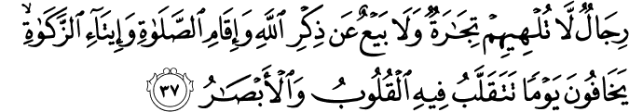
"Men who are not too absorbed with their trading and selling but remember Allah and pray, also remember to pay Zakat. They are afraid that there are days where their vision can be shaken or turn upside down.
(Surah An Nur : Verse 37)

Slide 3
CONDITIONS OF ZAKAT BUSINESS ASSETS
Only Muslim needs to pay zakat
Complete Ownership
Assets Must be for business purposes
Valuation
Must have complete haul
Nisab (Minimum Amount)
Zakat Rate
Zakat is payable only on Muslim share of the business wealth. Where a company is owned by Muslim and non-Muslim, the zakat is chargeable on the Muslim’s percentage share of the business assets.
A substance together with benefits. The ownership must be complete. The owner(s) must have complete ownership over the property especially the power to dispose.
Property acquired with the intent and purpose of the trade is zakatable. Assets acquired for business purposes and the assets must be used in business activities. Thus, fixed assets are not zakatable unless they are sold as part of main trading activities.
Items for zakat must be valued at their market selling prices, i.e. cash equivalent value, NOT historical cost.
Haul is the fiscal period of zakat based on Islamic lunar calendar. However, businesses may follow their financial calendar.
Nisab is the amount exceeding amount which zakat becomes payable. For business working capital, the nisab is the monetary equivalent of 85 grams of gold. The nisab is determined and published by the Majlis Agama Islam of each state.
The zakat rate for the Islamic calendar is 2.5%. However, if the company is using its financial year, the rate is 2.5775%.

Slide 4
ZAKAT CALCULATION METHOD
There are two main methods of zakat calculation, the Capital Growth Method and the Working Capital Method. Thus, the current version of SPS uses the working capital approach.
Working Capital = Current Assets minus Current Liabilities
Zakat on Working Capital = Working Capital +/- Adjustment x% Muslim Share x 2.5775%
Adjustments:
These are adjustments needed in the current assets and current liabilities.
Items Deducted from Current Assets (-):
Items that are not Zakat obligated
Items such as interest, gambling and liquor are to be excluded from the zakat calculations because they are items or products that are non-permissible i.e. ‘haram’.
Limited Ownership
Water, telephone, electrical and its similar kinds of deposit shall be deducted as it does not comply with the requirements of full rights.
Loan Receivable
The money on loan to a borrower is based on the characteristics of full ownership that has been transferred to the borrower. The borrower then possesses the full right and freedom to exploit and manage the loaned financial resources for his own interest and gain. Thus the borrower is obligated to perform Zakat on the amount of money loaned and NOT the Company.
No items are to be paid Zakat for, twice.
The dividend income that has already been deducted for Zakat may be zakat exempted.
Current Assets must be productive
Bad Debts, expired stocks and depreciation that is permanent are exempted.

Slide 5
Charitable Funds
Charitable funds such as khairat and education funds in current assets may be exempted from Zakat. Nevertheless, charitable funds that are business in nature such as a Qardhul Hassan loan, the amount exempted from Zakat is the principal value while funds that are charitable in nature such as donations and khairat, only the balance amount is exempted.
Inventory / Stock category
Only the end product is subjected to Zakat. Raw materials or any work-in-progress items are exempted from Zakat.
Items Added to Current Assets (+):
All contributions, donations and alms made by any of the business entity at the end of financial year (the last quarter) shall be added again (with the assumption that the donations made will not affect the company’s liquidity) into the current assets. This is because any amount channeled for charitable purposes, are still obligatory to Zakat unless the source is from a charitable fund.
Items Added to Current Liabilities (+):
According to Imam Shafie, there are no debt requirements that pre-determine on whether the assets are qualified for the nisab or not. Imam Shafii’s opinion is that financial loans (not commercial liabilities) do not affect the obligations of Zakat.
Thus, adjustments only involve those items that are not deductible such as:
Those not in the form of business operations such as financial loans and the classifications of scheduled refinance.
Dividends payable
Overdraft
Financial / Capital Lease
To qualify for nisab, the current liabilities that can be deducted are those operational in nature that includes:
Trade creditors
Operating payables such as salaries, electrical and phone bills etc
Taxes based on current assessment
ACCOUNTING TREATMENT & DISCLOSURE
Zakat is treated as non-operating expense in the Statement of Comprehensive Income of the business
Unpaid zakat is treated as a liability and disclosed in the Statement of Financial Position of the business.
The zakat method used and the details of zakat are disclosed in the notes to the accounts.
[Current Assets - Current Liabilities] * x % Shares owned by Muslim x 2.5%

Slide 6
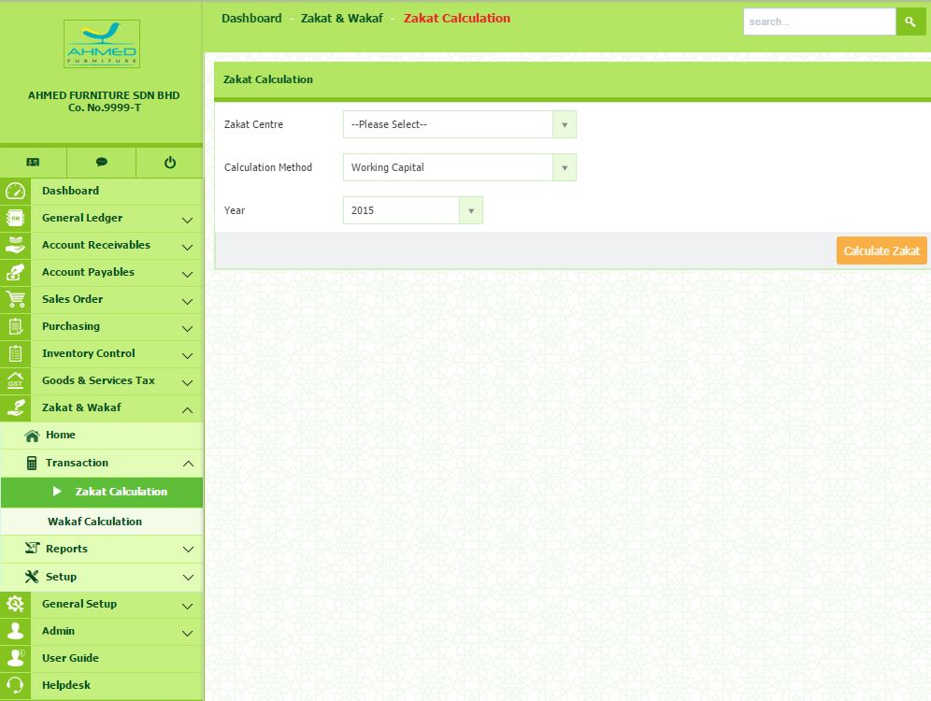

Slide 7
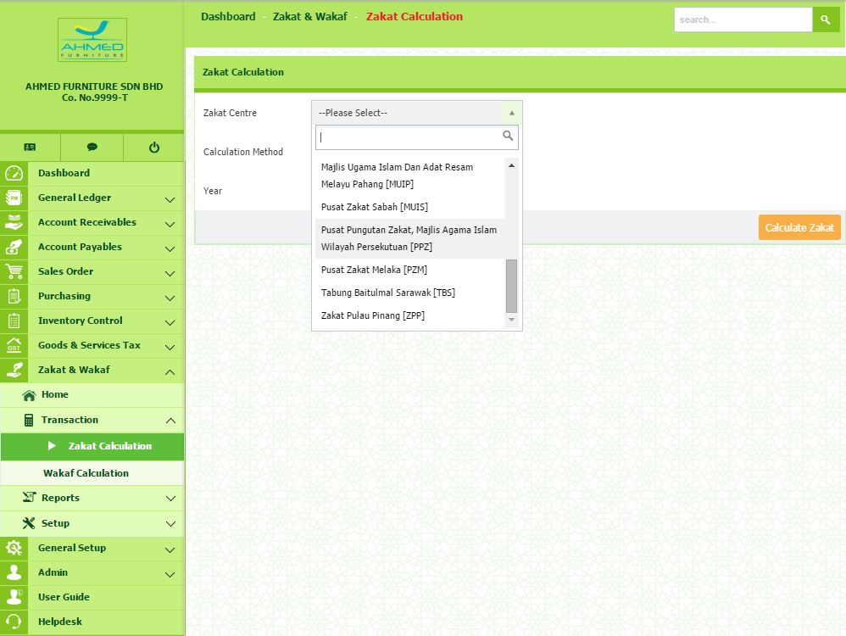

Slide 8
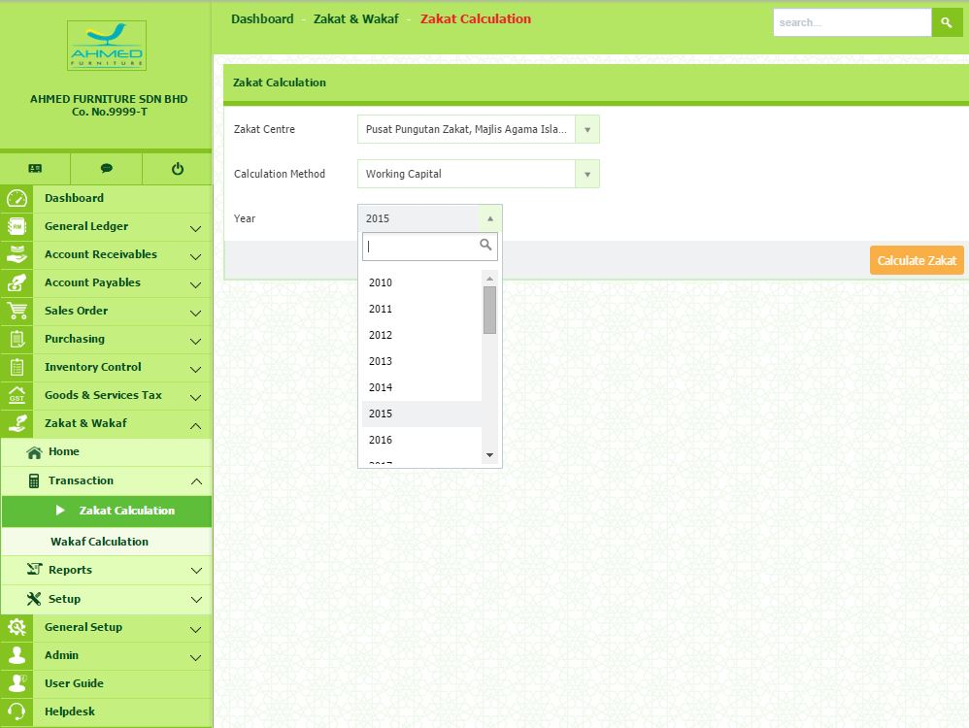

Slide 9
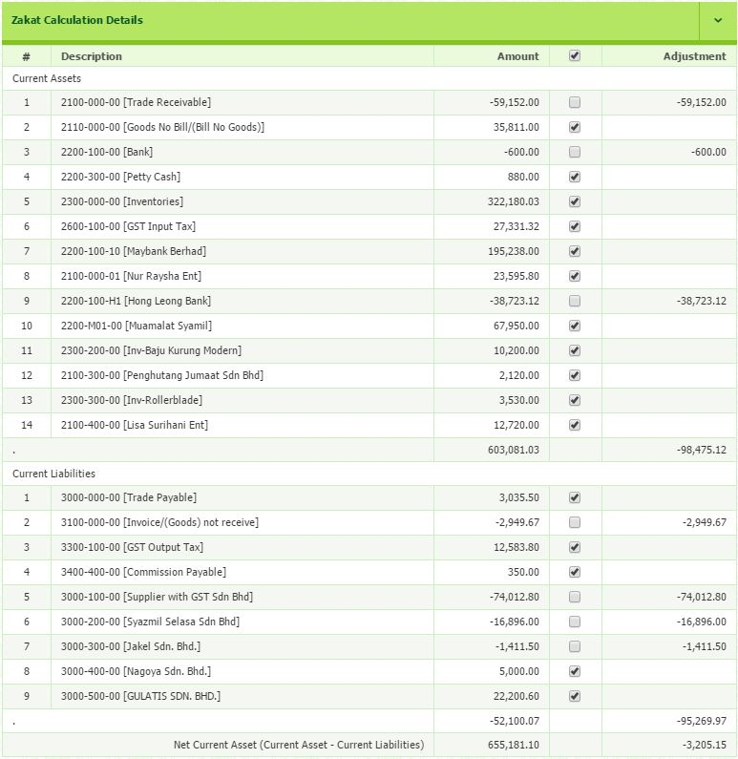

Slide 10
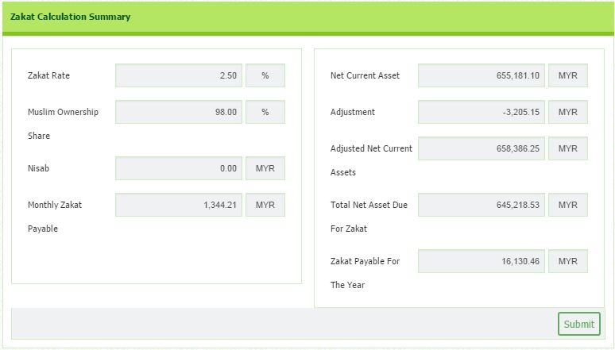

Slide 11
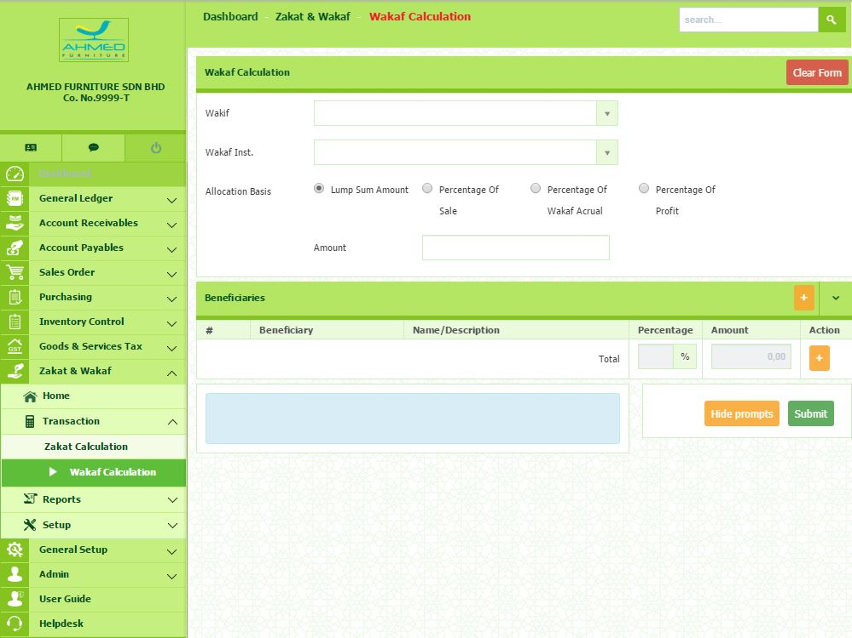

Slide 12
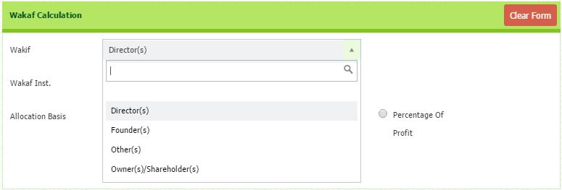

Slide 13
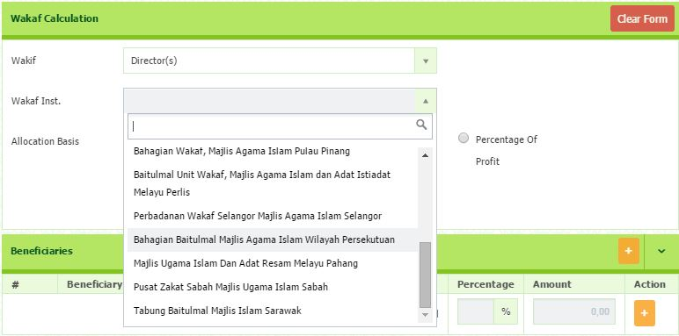

Slide 14
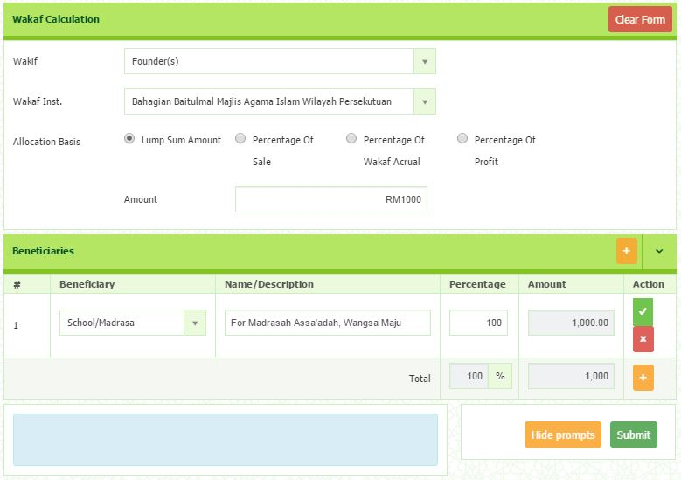

Slide 15
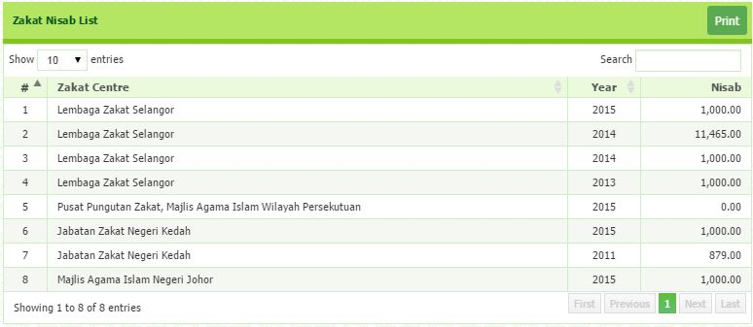

Slide 16
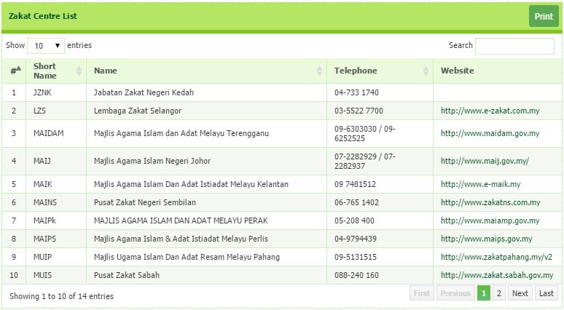

Slide 17
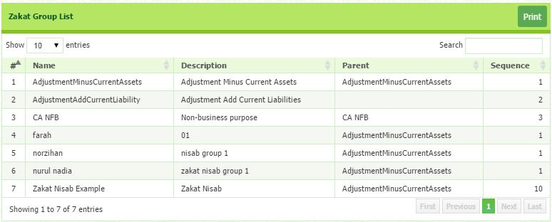

Slide 18
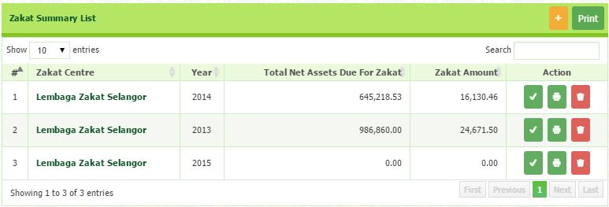

Slide 19


Slide 20
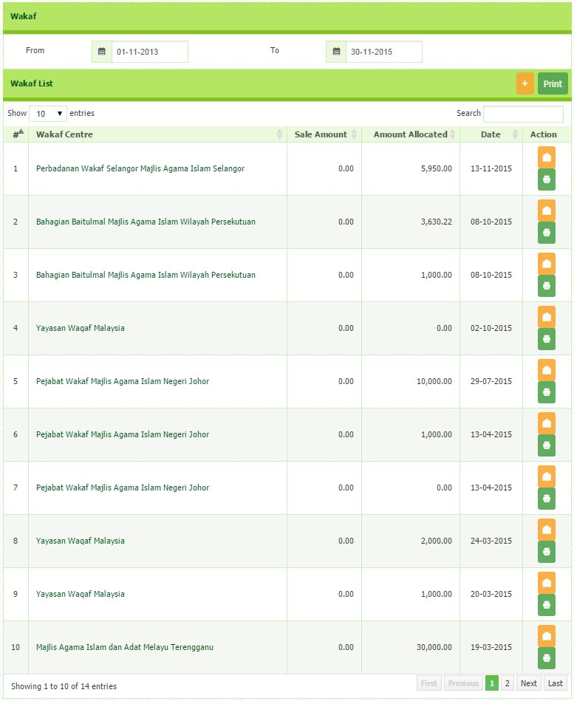

Slide 21
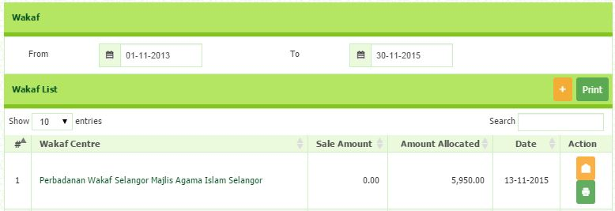

Slide 22
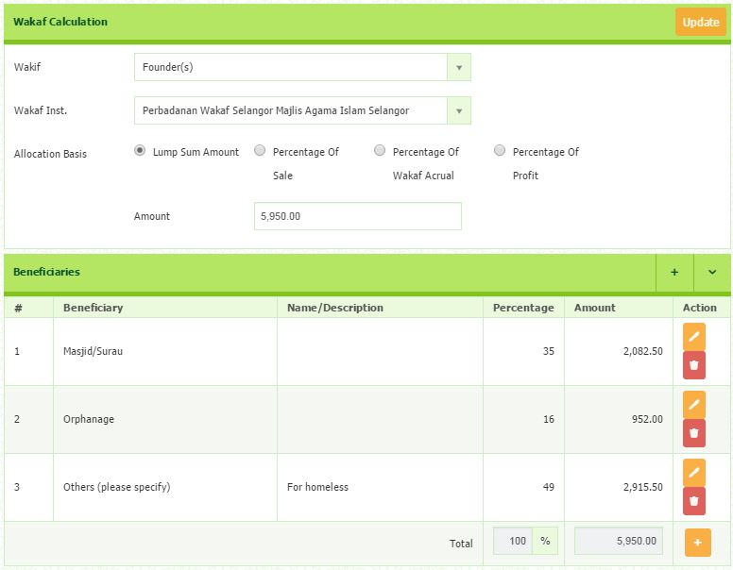

Slide 23
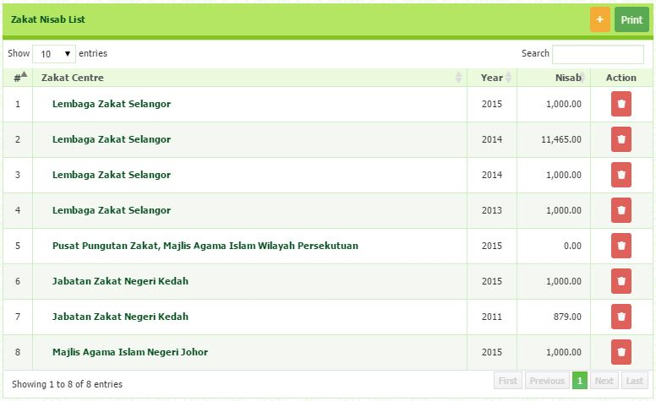

Slide 24
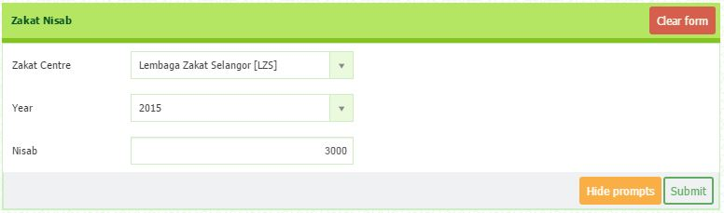

Slide 25
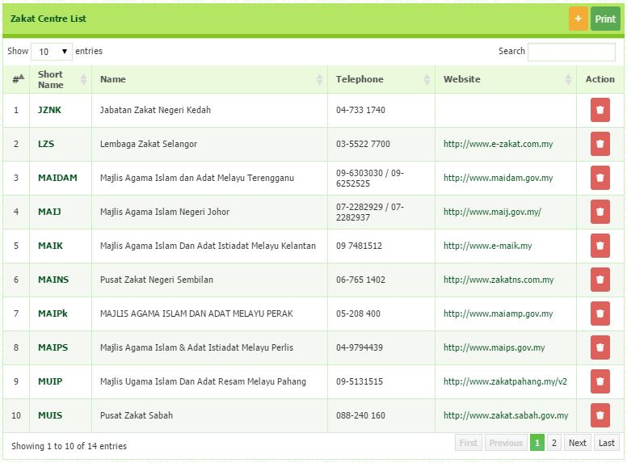

Slide 26
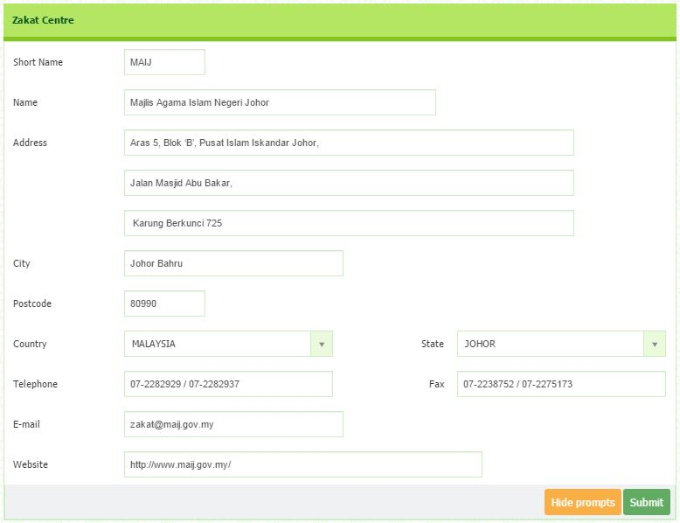

Slide 27
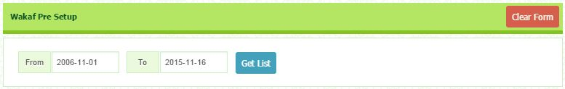

Slide 28
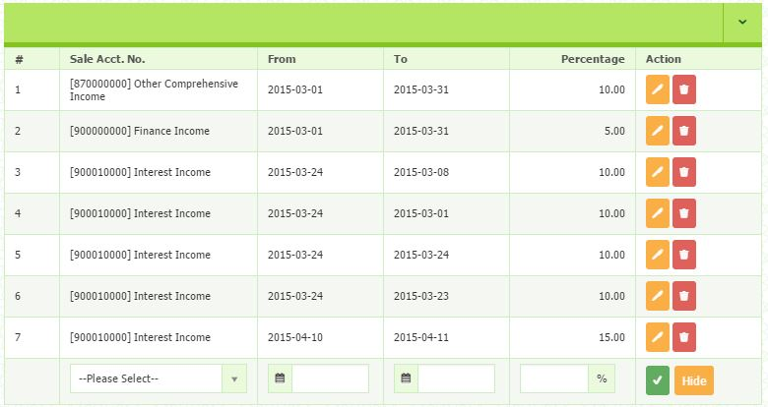

Slide 29
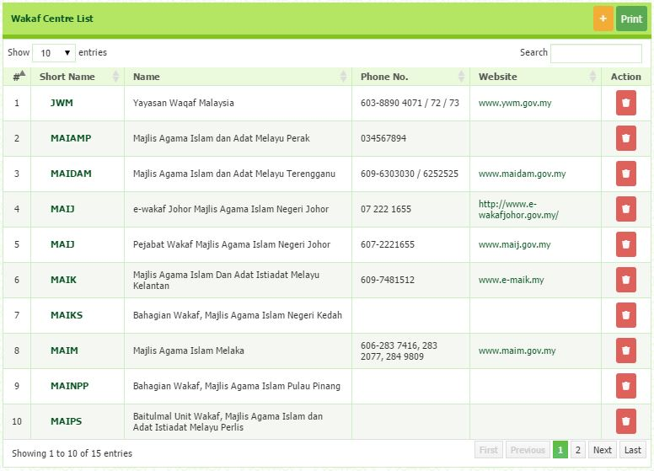

Slide 30
