Slide 1
It department
Orientation Program Aug ‘16
Presented by :
En. Akmaluddin Bin Mustajid
IT Manager

Slide 2

Department Description

Slide 3

Today’s business landscape is largely dictated by Information Technology (IT).
Competitive pressures mounted on firms by IT are cushioned by sound, efficient and effective IT management and governance.
has assembled a competent and experienced team of IT professionals to assist clients to remain competitive and to minimize IT related risks.

Slide 4
Business Core

Slide 5
offers the following IT management and consultancy related to:
Enterprise Resource Planning (ERP)
IT Strategy and assessment
IT Governance and Planning
IT Project Management and Advisory
Data Management
Personal Data Protection
IT Sourcing/Outsourcing
Business Intelligence
IT Internal Audit
IT Risk Management and Assurance
Software Development and Customization
Website Design and Development

Slide 6
Organizational Chart

Slide 7
Wan Mohd Iskandar
Farhana Zahari
IT Executive
Mohd Norhijrah
Muhd Hanif Ngarisan
Muhd Firdaus
Fadhirul Hilmi
Senior Programmer
Mohd Aizat
Mohd Fikri
Farid Firdaus
Syed Asyrani
Mohd Akmaluddin
Nur Salikeen
Senior Programmer

Slide 8
Software Development

Slide 9
implements the following software development process
Proof of Concept
Business Requirement Study
Design Prototype
Get Approval or Redesign Prototype
Data Modelling
Coding
Functional Testing
Model Office
User Guide
Installation and Implementation
Training
Reevaluation

Slide 10
Support Helpdesk

Slide 11
STANDARD OPERATING PROCEDURES (SOP) – SUPPORT SYSTEM
SALIHIN IT SOLUTIONS SDN BHD delivers the resources you need to achieve Long-term success with our products. We take our support services very seriously and continually reviewing ways in which to ask our customers what they think of our services and what we could do to make things even better.
Helpdesk
End User Support
(Support Engineer/Product Consultant/Marketing)
Programmer

Slide 12
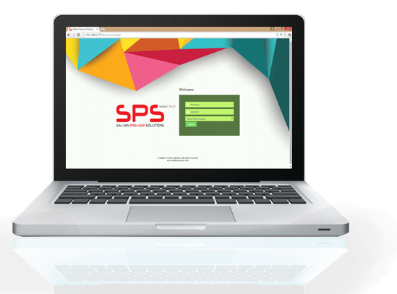
TYPES OF SUPPORT
On-Site Support
TeamViewer
Helpdesk Support

Slide 13
SUPPORT INDICATOR
SELECTING URGENCY
Each tickets submitted have urgency level. There are 4 types of urgency level :-
Urgency Level | Description
Critical | NA
High | When the SPS issue is causing significant disruption of business operations; workaround is inadequate.
Medium | When the SPS issue’s impact on business operations is moderate to low; a workaround or alternative is available.
Low | When the SPS issue is a minor inconvenience and does not impact business operations in any significant way; issues with little or no time sensitivity.

Slide 14
SUPPORT CHARTER
SUPPORT CHARTER
Indicator | Description | PIC
Admin Support | Billing, Quotation | SHIMA
Technical Support (Low) | SPS Installation, SPS Activation Key, SPS Licensing, SPS Re-Issue License, User Manual, E-mail (Upgrade Version), Tutorial Online (PDF) | FARHANA
Technical Support (Medium/High) | SPS issues on Financial Module, GST Module, Zakat & Waqaf | FIRDAUS, IZUWAN, HIJRAH + TEAM DEVELOPMENT
Technical Support - Sales | SPS Product Demo, SPS Promotion, SPS Training Support | EN.ISKANDAR, HANIF, FARHANA

Slide 15


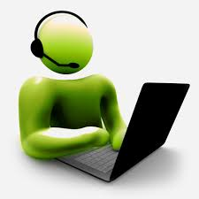
CUSTOMER LOG REPORT FEEDBACK
Call and log report on
SPS problem
Transfer call to related Support Engineer
LEVEL 1
CUSTOMER
IT ADMIN
LEVEL 2
LEVEL 3
Support Engineer & Programmer will debug and fix the problem
Via phone and TeamViewer

Slide 16
SPS TRAINING SCHEDULE
SPS Product Training will be on Tuesday & Thursday
(2 days a week)
Training Details | Day and Time
How to Install SPS ? How to Setup SPS ? How to Use SPS ? (Theory & Practical) | Tuesday 9.00 – 5.00
Based of the list of upgrade version | Thursday 3.30 – 5.00
** Tuesday : For New SPS User
** Thursday : For current Dealer/Client.
Training modules is based on the list of upgrade version

Slide 17


OUR RESPONSIBILITIES
Taking ownership of technical issues, and working with development group to resolve more advanced issues when necessary.
Documenting troubleshooting and problem resolution steps.
Testing and fixing faulty equipment
Logging and keeping records of customer/employee queries

Slide 18
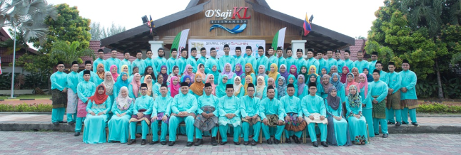


www.salihinpremier.com
www.facebook.com/salihinpremier
www.instagram.com/salihinpremier
www.twitter.com/salihinpremier

