Slide 1



PROPOSAL FOR STRATEGIC COLLABORATION
IN LEARNING & GRADUATE SKILLS ENHANCEMENT
PREPARED BY:
SUBMITTED TO:
Notes:
Font Type: Open Sans
Font Size: Proposal Title (60), Proposal Details (40)
Business unit & Client logo: Small size

Slide 2
1.0 Executive Summary
Enhancing learning experience with SPS
With the current shift towards efficient governance, the implementation of GST resulted in the requirement of further understanding of the tax structure in accounting. As one of the prestigious university in Malaysia, UITM can lead the shift through utilization of accounting information system(AIS) as a practical tool in demonstrating tax structure in accounting.
This requires certified accounting software, developed with direct input from the customs department, the Salihin Premier Solution (SPS) will provide the competitive edge for UITM to enhance the learning experience of its accounting students in gaining the practical understanding on GST implementations and its impacts in financial reports.
It can be implemented as a learning tool in Accounting Information System subject.
Notes:
Font Type: Open Sans
Font Size: Executive Summary Content (36)

Slide 3
Table of Content
1.0
Executive Summary 2
2.0
About Us 4
3.0
The Proposal 13
4.0
Contact Us 34
Notes:
Font Type: Open Sans Light
Font Size: Table of Content (44)
Attention: Please change the table of content and page numbering accordingly. Thank you very much ☺

Slide 4
About Us
—
SALIHIN
2.0 About Us
Key Management Team
Services
Salihin Premier Solutions (SPS)
Our Diverse Clients
Our Local & International Networks
Why SALIHIN?
Notes:
Font Type: Open Sans (Bold)
Font Size: About Us (60)

Slide 5



About Us
Founded in 2002, SALIHIN is the brand name of a group of independent and separate legal entities, deploying wide spectrum of capabilities to help clients see and tap opportunities in the areas of transaction and corporate finance, taxation (direct tax and GST), auditing and assurance, shariah auditing and advisory, corporate governance, IT consultancy and business accounting solution.
As one of the fastest growing home-nurtured and bumiputera firms, SALIHIN is having close to 200 competent professionals from different background with diverse thoughts, expertise and experience serving in 9 offices nationwide.
In addition to relevant licenses/certifications for its capabilities, SALIHIN is having MSC Status, Audit Oversight Board (AOB) registered as an Auditor of Public Interest Entity, licensed Capital Market Service provider by Securities Commission, and Approved Training Provider from Human Resources Development Fund (HRDF).
We have a proven track record credited to a sustained quality service delivery to our clients without compromising our professional integrity. SALIHIN continues to build on its successes. It became the first in the world to introduce Teaching Accountancy Firm (TAF) to bridge the gap between accountancy theory and practice.
Vision
To become the preferred national accountancy firm of Malaysia.
Mission
SALIHIN is dedicated to creating value by focusing on customer satisfaction and growth, excellent internal business process and superior human capital resource development.
Notes:
Attention: Please don’t change any content here. Thank you very much ☺

Slide 6
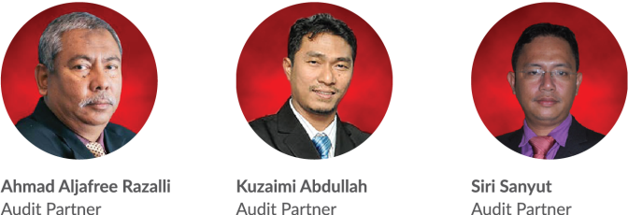
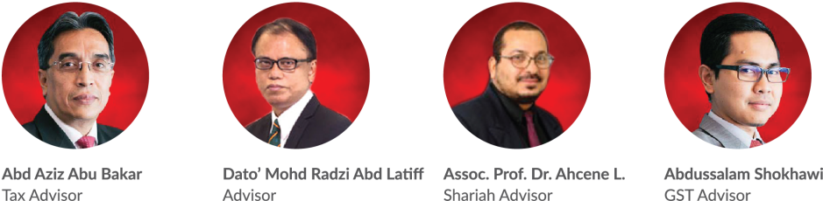
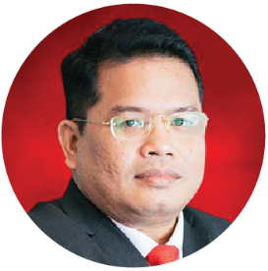
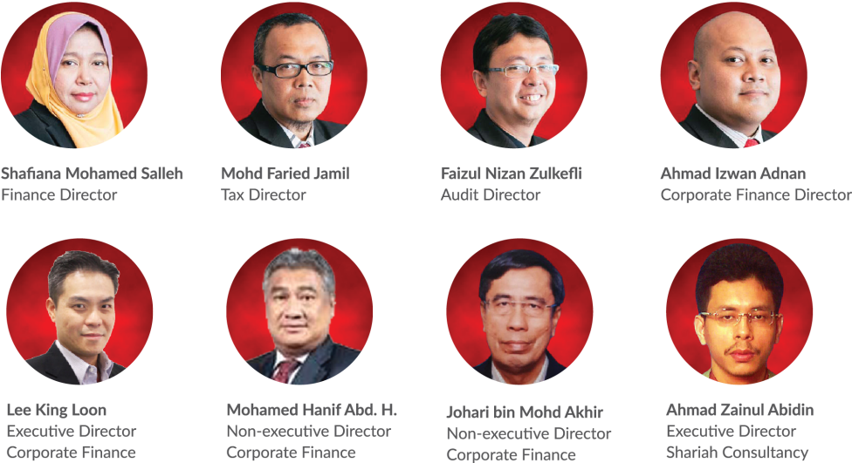
Key Management Team
Salihin Abang
Founder/Managing Partner/CEO
Notes:
Attention: Please don’t change any content here. Thank you very much ☺

Slide 7
Services
SALIHIN offers wide spectrum value for money services:
AUDIT & ASSURANCE
GST & BUSINESS
ACCOUNTING SOLUTION
GST ADVISORY
Statutory Financial Statement Audit
Review Engagements
Compilation Engagement
MPERS / MFRS Training
Agreed Upon Procedures
Preparation & Submission: GST-03
GST Accounting and Review for users of SPS
Preparation of Full Sets Accounts
Preparation of Management Account or Reports
Forensic Accounting
GST Strategic Planning
Cash Flow Planning & Pricing Strategy
GST Bad Debt Management
GST Record Keeping and Internal Control
GST Special Transaction
GST-IT Advisory
Transfer of Going Concern
GST Audit and Investigation
Advice on GST Ruling & Appeal
GST-03 Monthly Submission Review
Monitoring TAP System
GST Annual Adjustment
GST Training & Education Services
GST Accounting Software
DIRECT TAXATION
Mergers and Acquisition Tax Advisory
Corporate Tax Compliance and Planning
Transfer Pricing Advisory
Transfer Pricing Documentation
Tax Audit, Investigation & Appeal
International Tax Consulting
Real Property Gain Tax
Tax Accounting
Tax Risk Management
Notes:
Attention: Please don’t change any content here. Thank you very much ☺

Slide 8
Services (Cont.)
SALIHIN offers wide spectrum value for money services:
GOVERNANCE &
CORPORATE SECRETARIAL
IT CONSULTANCY
SHARIAH AUDIT & ADVISORY
Company Incorporation
Filing Annual Return
Updating Information
Certifying Company Documents
Striking Off Company
Legal Due Diligence
Registration with Relevant Government Agencies
Corporate Governance Advisory
Secretarial Due Diligence and Management
IT Audit & Due Diligence
IT Governance and Planning
IT Project Management
IT Risk Management & Strategy and Assessment
Business Intelligence
IT Sourcing/Outsourcing
Enterprise Resource Planning (ERP)
Software Development and Customisation
Islamic Banking Product Structuring
Islamic Securities: Sukuk Issuance & Structure
Islamic Fund, Wealth & Asset Management
Islamic Private Equity
Establishment of Islamic Bank
Zakat & Waqf Accounting Software (SPS)
Shariah Compliance Training Program
Shariah Training & Education
Shariah Research and Development
Shariah Review & Screening
Shariah Internal Audit
Shariah External Audit
Shariah Risk Management
Shariah Legal Advisory
Shariah Convernance & Supervision
Shariah Accounting
TRANSACTION & CORPORATE FINANCE
Internal Auditing
Enterprise Risk Management
Due Diligence
Business Valuation
Financial Statement Analysis
Raising Seed/Start-Up Capital
Agreed Upon Procedures
Management Buy-In(MBI)/Buy-Out(MBO)
Project and Infrastructure Finance
Pre and Post IPO Advisory
Raising and Restructuring of Debt
Governance and Compliance Advisory
Forensic Audit
Merges, Acquisition and Demergers
Notes:
Attention: Please don’t change any content here. Thank you very much ☺

Slide 9
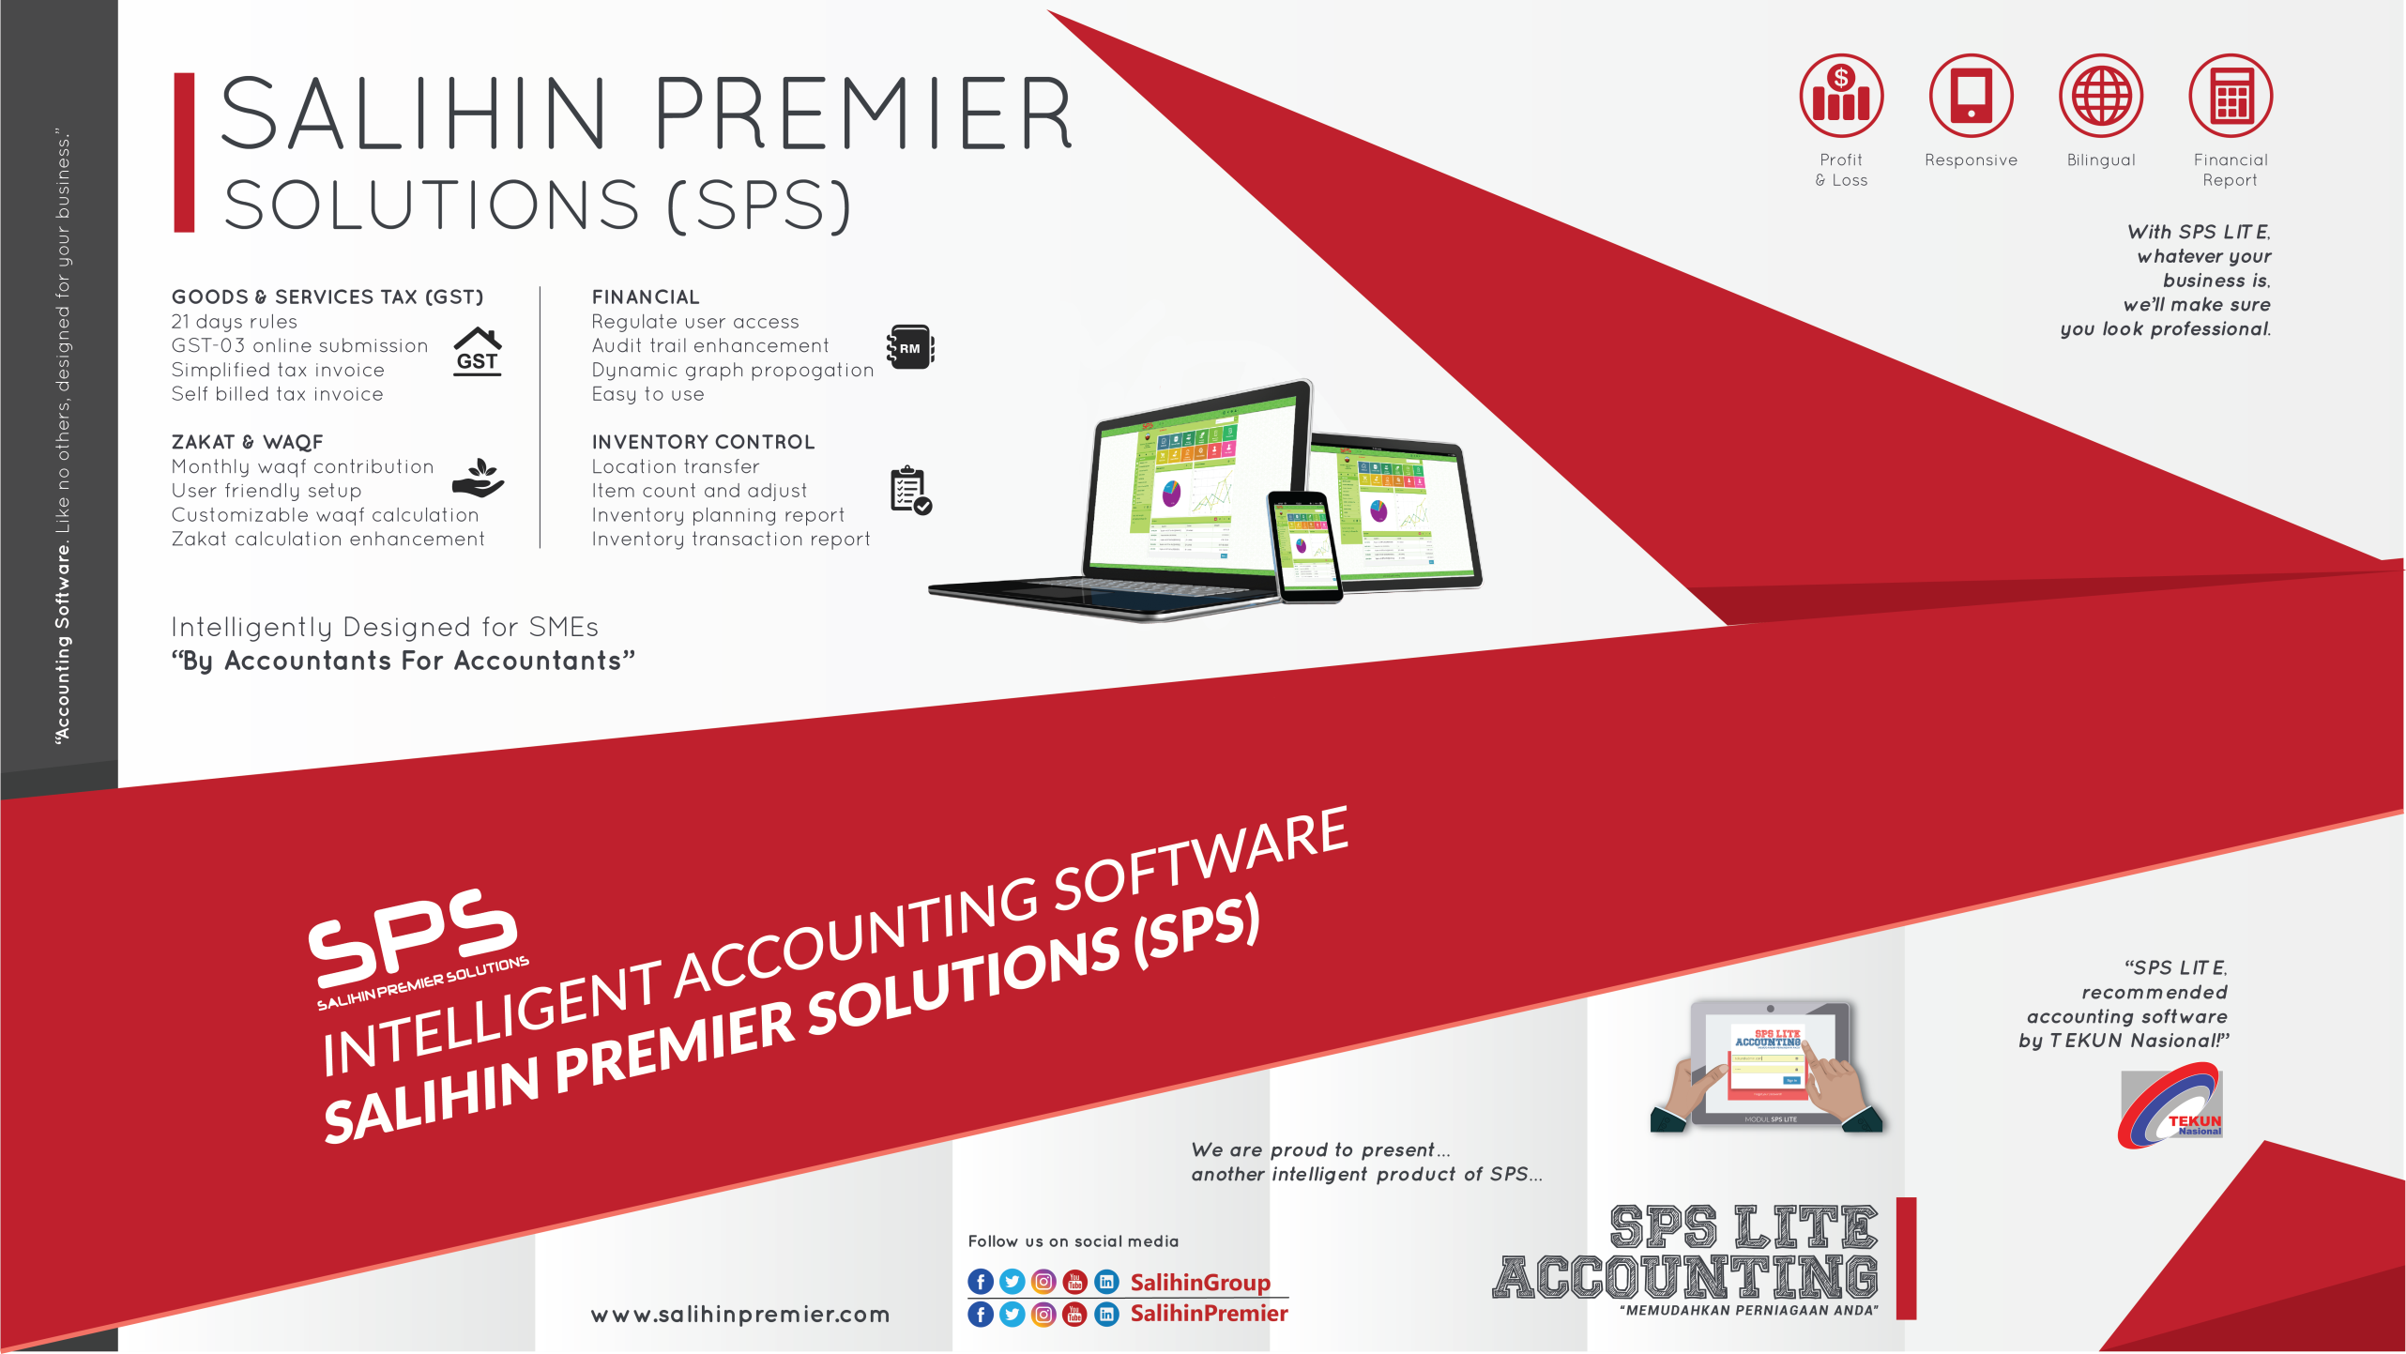
Notes:
Attention: Please don’t change any content here. Thank you very much ☺

Slide 10








































Our Diverse Clients
SALIHIN serves diverse clients including corporate companies, foundations / non-profit organisations, government bodies, government linked companies and educational institutions. Their diversity spans across different sectors of the economy.
Notes:
Attention: Please don’t change any content here. Thank you very much ☺

Slide 11




Our Local & International Networks
Buenos Aires
Mexico
Boston
Los Angeles
Miami
New York
San Francisco
Europe
Batu Caves
Johor Bahru
Kuching
Kuala Terengganu (TAF)
Vienna
Brussels
Limassol
Paris
Frankfurt
Milan
Rrome
Luxemborg
Bucharest
Moscow
Barcelona
Madrid
Lausanne
Rotterdam
London
Kyiv
SALIHIN is a member firm of i2an,
a reputable global network of accountants which have presence in America, Asia and Europe as well as all the international financial centres.
Asia
Shanghai
Hong Kong
Tokyo Kuala Lumpur
Singapore
Dubai
Sydney
New Delhi
Ramat Gan
Taiwan
America
Our Local Branches
Notes:
Attention: Please don’t change any content here. Thank you very much ☺

Slide 12



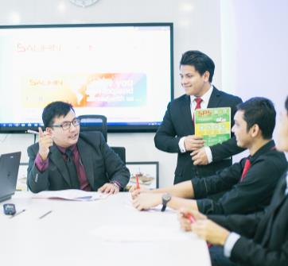

Why SALIHIN?
The following are key reasons why SALIHIN should be your firm’s preferred choice:
01.
Experienced Employees
We have the right ‘hands-on’ team with vast knowledge and relevant experience.
02.
Comprehensive Reports
We would be able to provide complete and comprehensive reports in tandem to your key areas of concern.
03.
Quality Service Delivery
Our Engagement Partner, Board of Advisors and Managers will be involved in closed co-operation for quality service delivery.
04.
Value for Money
We offer ‘value for money’ without compromising on the quality and timeliness of our services.
05.
Minimal Disruption
We will apply our considerable experience to ensure minimal disruption to clients’ daily operations.
Notes:
Attention: Please don’t change any content here. Thank you very much ☺

Slide 13
The Proposal
—
PROPOSAL FOR STRATEGIC COLLABORATION
IN LEARNING & GRADUATE SKILLS ENHANCEMENT
3.0 The Proposal
Main Objective
Proposed Modules - Summary
Proposed Modules - Details
Target Course
Proposed Pricing
Expected Outcomes & Deliverables
UPM Academic Calendar
Proposed Implementation Plan
Roles & Responsibility
SPS Background
Notes:
Font Type: Open Sans & Open Sans Light
Font Size: The Proposal (60), Content (36)
Proposal Title’s Example (at the right-top of the red box) : Audit Proposal (For Audit Dept.) or GST Proposal (For GST Dept.)

Slide 14
The Proposal
Main Objective: Enhancing Graduates
CAPACITY BUILDING
SKILLS ENHANCEMENT
INDUSTRIAL
RELEVANCE
To equip UPM graduate student with value added accounting software skills
To provide avenue for UPM to enhance graduate skills and accreditations
To provide practical expertise and experience for UPM in delivering courses relevant to current and future industrial practices.
Notes:
Font Type: Open Sans Light
Font Size: Content (36)
Content suggestion: Client and proposal background.

Slide 15
The Proposal
SPS As Optional Learning Tool
SPS is used to support the curriculum based on self initiatives by student with the assistance from lecturers.
For better positioning of SPS, exam will be given as an optional (to test student understanding of each particular subject)
Exam, Marking & Certification will be provided by SALIHIN (For those who seat for exam).
Part of
Up Scaling
Not Bound to University Program
Does Not Require Senate Permission
SPS Student Manual & Installer
SPS as Optional Learning Tool
1 Hour Online Exam
Separate Session in Lab
SPS Certification
Lecturer’s Decision
Student’s Willingness
Monitoring & Marking By SALIHIN
Notes:
Font Type: Open Sans Light
Font Size: Content (36)

Slide 16
The Proposal
Proposed Modules - Summary
SPS Modules | Setup & Operate Admin & General Setup Module General Ledger Module Account Receivables Module Account Payables Module GST Module Zakat & Waqf Modules
Notes:
Font Type: Open Sans Light
Font Size: Content (36)

Slide 17
The Proposal
Proposed Modules - Details
Setup & Operate General Setup Module
    How to setup a company
    How to setup employee
    How to setup agent
    How to setup master code
    How to setup project
    How to setup terms
    How to setup bank
    How to setup ship to (location)
    How to setup a graph
Setup & Operate Admin Module
    How to add/edit & authorization of access for each user
    How to search & produce log report
    How to perform a backup
    How to upgrade license & version
Notes:
Font Type: Open Sans Light
Font Size: Content (36)

Slide 18
The Proposal
Proposed Modules - Details
Setup General Ledger Module
    How to setup financial year, chart of account, opening balance & other sub modules
    How to perform transaction
    How to generate and produce report
4. Setup Account Receivables Module
    How to setup customers
    How to setup historical customer invoice
    How to perform sales transaction
    How to generate & produce report
5. Setup Account Payables Module
    How to setup supplier
    How to setup historical supplier invoice
    How to perform purchases transaction
    How to generate & produce report
Notes:
Font Type: Open Sans Light
Font Size: Content (36)

Slide 19
The Proposal
Proposed Modules - Details
Setup & Operate GST Module
    How to setup GST requirement
    How to perform GST transaction
    How to generate & produce GST report
    How to generate & submit GST-03
Setup & Operate Zakat & Waqf Modules
    How to setup zakat nisab & centre
    How to setup waqf & waqf centre
    How to perform zakat calculation
    How to perform waqf calculation
    How to generate & produce zakat & waqf report
Notes:
Font Type: Open Sans Light
Font Size: Content (36)

Slide 20
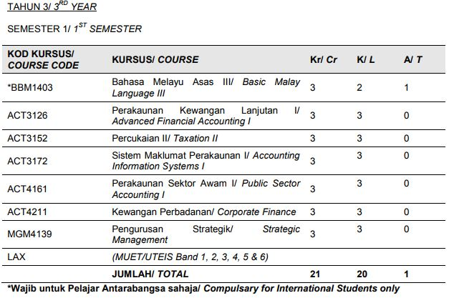
The Proposal
Target Course
Notes:
Font Type: Open Sans Light
Font Size: Content (36)

Slide 21
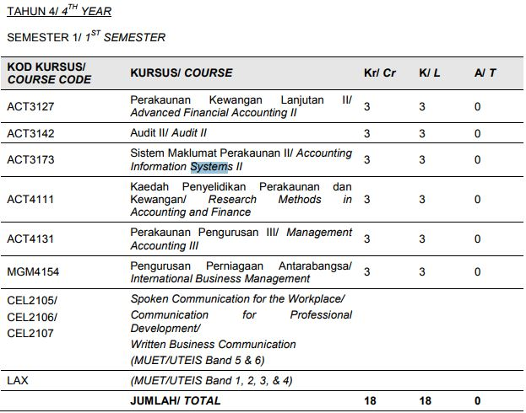
The Proposal
Target Course
Notes:
Font Type: Open Sans Light
Font Size: Content (36)

Slide 22
The Proposal
Proposed Pricing
Proposed pricing for UPM Accounting Student:
    RM60.00 per pax.
Participated student will be provided with (Student Kits):
    SPS Student Installer/ Cloud-based ID access
    SPS Student Manual
    SPS Exercise Book
Notes:
Font Type: Open Sans Light
Font Size: Content (36)

Slide 23
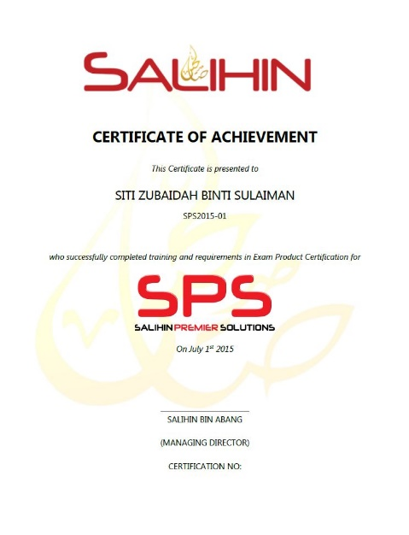
The Proposal
Expected Outcomes & Deliverables
At the end of the programme, we expect each graduates
would be able to:
  Operate and utilize SPS Software (Install, configure & operate).
  Provide consultation & training on SPS.
SALIHIN deliverables to partipated graduates:
  SPS Certifications
      SPS Consultant Certificate
  1 Year Free SPS License
  1 Year Free SPS Support Service
Notes:
Font Type: Open Sans Light
Font Size: Content (36)

Slide 24
The Proposal
UPM Academic Calendar
Details | Degree
Intake | 2017/2018
Academic Session | Sep 17 – Jan 18
Lecture | 11/09/17 - 13/10/17 23/10/17 – 24/12/17
Mid-Semester Break | 14/10/17 - 22/10/17
Revision | 25/12/17 - 01/01/18
Examination | 02/01/18 - 14/01/18
Semester Break | 15/01/18 - 11/02/18
Next Semester Academic Session | Februari 2018 – September 2018
Notes:
Font Type: Open Sans Light
Font Size: Content (36)

Slide 25
The Proposal
Proposed Implementation Plan
4th Quarter 2017
MOU signing
Train the trainer
Finalize course syllabus
SPS kit installation
User manual & documentation preparation
1st Quarter 2018
ToT Kick off
    Jan 2018
Pilot program kick off
    Jan – Feb 2018
2nd Quarter 2018
Program kick off
    February-September 2018
Notes:
Font Type: Open Sans Light
Font Size: Content (36)

Slide 26
The Proposal
Roles & Responsibility
UPM | SALIHIN
To fully utilized SPS as main teaching tools / software. | To provide education version software
Provide facilities i.e classes & computer lab | Train the trainer (Lecturers) On site (2 -3 Days) In house (30 Days)
Provide trainers/ lecturers | Provide user manual (text book), exercise book, exam , scoring, marking & certification.
Assist SALIHIN to promote SPS to students | Provide full support & hotline no.
Uitm to allow SALIHIN to use UPM brand, image recognition in promotional and advertising purposes
Expand new coursework program (where applicable)
Notes:
Font Type: Open Sans Light
Font Size: Content (36)

Slide 27
SPS Background
Salihin Premier Solutions
The SALIHIN PREMIER SOLUTIONS also known as SPS, the intelligent software in the world that can manage numerous aspects of financial accounting including Goods and Services Tax (GST) and Zakat calculation, customized specially for Small and Medium Enterprises (SMEs).
SPS is an efficient and effective accounting software that accommodates changes affecting invoicing and billing system of the business process. The software is powered by the latest security features to secure data or information for optimal integrity and confidentiality. It is tailor made for small and medium industries by professional accountants.
The Zakat module makes SPS the first comprehensive accounting software with Zakat solution. It will make it easier than ever for Muslim businesses, corporations and organizations to determine the amount payable as Zakat. With Zakat feature built in, it is simply the best accounting software yet.
Notes:
Font Type: Open Sans Light
Font Size: Content (36)

Slide 28
SPS Background
The Main Modules
Financial Module
Inventory Module
GST Module
Zakat Module
Waqf / Endowment Module
There are
5
main modules of SPS
Notes:
Font Type: Open Sans Light
Font Size: Content (36)

Slide 29

SPS Background
Function And Features
SPS
Predefined Accounting Chart
Default GST Setup
Biz Dashboard
Regulate User Access
GST-03 Online Submission
Dynamic Graph Propagation
Void Unconfirmed Transaction
Auto Notification of
any New Update
Zakat Calculation Enhancement
Simplified Tax Invoice
Auto Calculation Wakaf
Self Billed Tax Invoice
Notes:
Font Type: Open Sans Light
Font Size: Content (36)

Slide 30

Product Comparisons
SPS vs Other Accounting Software
Notes:
Font Type: Open Sans Light
Font Size: Content (36)

Slide 31

SPS Background
Future Developments
POS System
Fixed Asset Management
Payroll System
CRM System
Cash Book System
Notes:
Font Type: Open Sans Light
Font Size: Content (36)

Slide 32
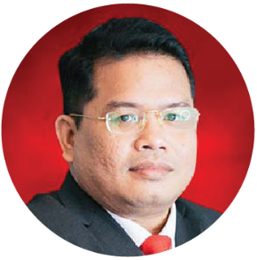
Our Credentials
Key Engagement Team
Approved Company Auditor under Ministry of Finance (MoF)
Approved Tax Agent under Ministry of Finance (MoF)
Approved Cooperative Auditor under Malaysian Cooperative Commission
Approved Auditor Labuan Offshore Financial Services Authority (LOFSA)
Chartered Accountant CA (M) with Malaysian Institute of Accountant (MIA)
Elected Council Member of the MIA
Member of MIA’s Investigation Committee (Statutory)
Member of MIA’s Taxation Practice Committee (Technical)
Member of MIA’s Public Practice Committee
Member of MIA’s Small & Medium Practice Committee (SMPC)
Elected President of Malaysia Accounting Firm’s Association (MAFA)
Fellow Member of Chartered Tax Institute of Malaysia (FCTIM)
Associate Member of Certified Public Accountant (CPA Australia)
Member of Malaysian Association of Certified Financial Planner (CFP)
Certified GST Agent and Trainer
Executive committee member of Malay Chartered Accountants Firms Malaysia
Executive committee of Malaysian Association of Tax Accountants
Bachelor and Master Degree holder in Accounting from International Islamic University Malaysia
Salihin Abang
Managing Partner
Notes:
Attention: Please don’t change any content here. Thank you very much ☺

Slide 33
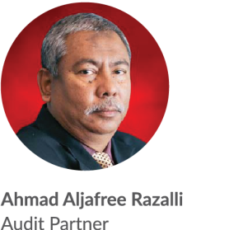
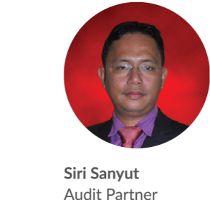
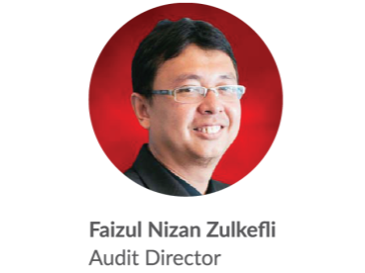
Our Credentials
Key Engagement Team (Cont.)
Approved Company Auditor Under the Companies Act 1965
Approved Cooperative Auditor from Malaysian Cooperative Commission
Member of Malaysian Institute of Accountants (MIA)
Bachelor of Accounting from Universiti Teknologi MARA
Master Degree in Accounting and Finance from UK
Approved Company Auditor Under the Companies Act 1965
Approved Cooperative Auditor from Malaysian Cooperative Commission
Member of Malaysian Institute of Accountants (MIA)
Associate with Chartered Tax Institute of Malaysia (CTIM)
Bachelor of Accounting from Universiti Malaysia Sabah (UMS)
Member of Malaysian Institute of Accountants (MIA)
Bachelor of Accounting from International Islamic University Malaysia (IIUM)
Notes:
Font Type: Open Sans Light
Font Size: Content (28)
Attention: Please insert the details of the project team members appropriately.
Directory: Pictures can be obtained from PUBLIC/SALIHINAlbum/ProposalPictures

Slide 34

4.0 Contact Us
Headquarters
—
555, Jalan Samudra Utara 1,
Taman Samudra,
68100 Batu Caves,
Selangor, Malaysia.
Tel: +603-6185 9970
Fax: +603-6184 2524
Email: info@salihin.com.my
Follow us on social media
Notes:
Font Type: Open Sans Light
Font Size: Content (28)
Attention: You may add / edit this section.

Slide 35
www.salihin.com.my | www.salihinpremier.com
Careline: 1 300 88 5678
Notes:
Attention: Please don’t change any content here. Thank you very much ☺

