Slide 1



PROPOSAL FOR STRATEGIC COLLABORATION
Prepared for:
Prepared by:
© 2014 SALIHIN. All Rights Reserved

Slide 2
  TABLE OF CONTENT
1.0 ABOUT US 03
2.0 ABOUT SALIHIN PREMIER SOLUTIONS (SPS) 11
3.0 FEATURING SALIHIN PREMIER SOLUTION 22
4.0 SPS MODULE 27
5.0 SPS EVENTS & PROGRAMME 31
6.0 OUR CREDENTIALS 37
7.0 CONTACT US 39
© SALIHIN 2015. Strictly Private & Confidential

Slide 3

1.0 ABOUT US
© SALIHIN 2015. Strictly Private & Confidential

Slide 4




AT THE GLANCE
        ABOUT US
        FIRM’S DESCRIPTION
Founded in 2002, SALIHIN is a professional business consultancy firm specializing in Auditing and Assurance, Shariah Auditing, Taxation (Direct Tax and GST), Corporate Advisory, and Accounting and Business Management Software.
The past decade has witnessed our continuing effort in brand building through commitment to integrity, high quality and business excellence in providing exceptional end-to-end services.
From grass to grace, our endless effort did not go unnoticed when we are certified as MSC status, 1-Innocert and Enterprise 50 company. As we progress, we grow along with our valued clients, looking forward to a more mature business relationship.
We are certified by the Royal Malaysian Customs Department (RMCD as approved GST Trainer and by the Pembangunan Sumber Manusia Berhad (PSMB) as one of the approved trainers under Human Resources Development Fund (HRDF) which allows our clients to claim 100% training expenses.
© SALIHIN 2015. Strictly Private & Confidential

Slide 5
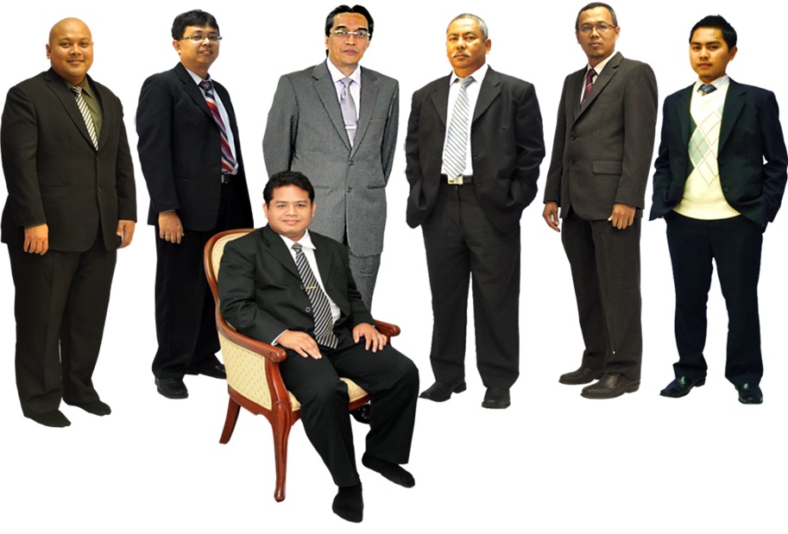
    ABOUT US
    KEY PERSONNEL
  ABOUT US
  KEY PERSONNAL
In Front: Salihin Abang
L-R: Ahmad Izwan Adnan, Faizul Nizan Zulkefli ,
Tuan Haji Abd. Aziz Abu Bakar, Ahmad Aljafree Razalli,
Mohd Faried Jamil, Abdussalam Shokhawi
© SALIHIN 2015. Strictly Private & Confidential

Slide 6

  ABOUT US
  SERVICES AND OFFICES
AUDIT & ASSURANCE
GOODS AND SERVICES TAX (GST)
FINANCIAL ACCOUNTING SERVICES
Financial Statement Audit
Compliance Audit
Operational Audit
Forensic Audit
GST Compliance and Advisory
GST Preparation and Filing
GST Audit and Investigation
GST Training
Accounting System Development and
Implementation
Financial Statements Review
Business Process Outsourcing
TAXATION
CORPORATE SECRETARIAL SERVICES
Tax Compliance
Corporate Tax Advisory
Indirect Tax Services
Tax Audit and Investigation
Real Property Gain Tax
Company Incorporation
Other valuable Secretarial Services
Registration with Ministry of Finance
and other Government Agencies
CORPORATE FINANCE &
TRANSACTION SERVICES
ISLAMIC ACCOUNTING & AUDITING
Due Diligence
Internal Audit and Forensic Accounting
Valuation
Capital Market
Managerial Finance
Mergers & Acquisitions
Shariah Compliance Audit
Advisory Services
Zakat - Alms Giving
Waqf - Islamic Endowment
BATU CAVES . KUALA LUMPUR . JOHOR BAHRU . KUCHING
© SALIHIN 2015. Strictly Private & Confidential

Slide 7



  ABOUT US
  WHY SALIHIN?
The following are key reasons why SALIHIN should be the preferred choice:
Salihin is Chartered Accountant with more than 14 years experience since 2002.
Comprehensive Accounting Software : Full set Accounting, GST, Zakat and Waqf
We have the right ‘hands-on’ team with vast GST knowledge and training experience.
We are certified GST Trainers by RMCD.
As approved HRDF Training Provider, training expenses are 100% claimable.
© SALIHIN 2015. Strictly Private & Confidential

Slide 8
  ABOUT US
  CLIENTELE OVERVIEW
ABOUT US
CLIENTELE OVERVIEW
SALIHIN serves diverse clients including corporate companies, foundations/non-profit organisations, government bodies and government-linked companies. Their diversity spans across different sectors of the economy.
© SALIHIN 2015. Strictly Private & Confidential

Slide 9

ABOUT US
CLIENTELE OVERVIEW (CONTD.)
© SALIHIN 2015. Strictly Private & Confidential
9

Slide 10

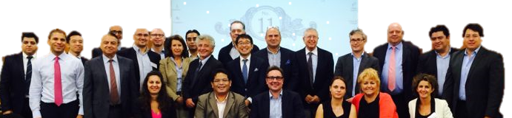

ABOUT US
INTERNATIONAL LINKS/NETWORK
Today’s globalization and increasing complexity in the business environment call for strategic alliances. While providing firms with flexibility, they also allow firms to leverage resources and capabilities to achieve objectives that might otherwise beyond their reach.
http://www.i2an.com/
Eying international reach, SALIHIN is a member firm of i2an, a reputable global network of financial professionals which currently has over 500 professionals present in the major financial centres in Europe, the United States and Asia.
© SALIHIN 2015. Strictly Private & Confidential

Slide 11
2.0 ABOUT SALIHIN PREMIER SOLUTIONS (SPS)
© SALIHIN 2015. Strictly Private & Confidential

Slide 12
ABOUT US
SALIHIN PREMIER SOLUTIONS BACKGROUND
The SALIHIN PREMIER SOLUTIONS also know as SPS SOFTWARE , the intelligent software in the world that can manage numerous aspects of financial accounting including Goods and Services Tax (GST) and Zakat calculation, customised specially for Small and Medium Enterprises (SMEs).
SPS SOFTWARE is an efficient and effective accounting software that accommodates changes affecting invoicing and billing system of the business process. The software is powered by the latest security features to secure data or information for optimal integrity and confidentiality. It is tailor made for small and medium industries by professional accountants.
The Zakat module makes SPS SOFTWARE the first comprehensive accounting software with Zakat solution. It will make it easier than ever for Muslim businesses, corporations and organizations to determine the amount payable as Zakat. With Zakat feature built in, it is simply the best accounting software yet.
© SALIHIN 2015. Strictly Private & Confidential

Slide 13
SPS
Modules in SPS
There is 5 main modules that makes the SPS Accounting software like no other’s.
Financial Module
Inventory Module
GST Module
Zakat Module
Waqf / Endowment Module
© SALIHIN 2015. Strictly Private & Confidential

Slide 14
SPS
Core Features
1
Easy To Use
With its user friendly interfaces, SPS requires minimum skill knowledge in accounting.
2
Predefined Accounting Chart
SPS comes with 19 industry standards predefined accounting chart and has flexibility to tailor according to business needs.
3
Biz Dashboard
Data updates are real-time for better business decision making.
4
Drill Down
Analysis and investigate from surface report drill down to the source of transaction..
5
Fully Responsive
Interactive and fully responsive for all devices and screen resolutions..
7
Regulate User Access
Provide the double layer security, all the right control of functionality to regulate the user accessibility to each module system. Can view by online anywhere and any places , and it is web based.
8
Multi Languages supported
SPS is ready to support latest business nature in multiple languages.
9
Super Search
Provides an integrated search engine that enabled users to find information related to transaction in the fastest and easiest way.
Ensure that an accurate record of activities or events is captured
Comprehensive Audit Trail
10

Slide 15
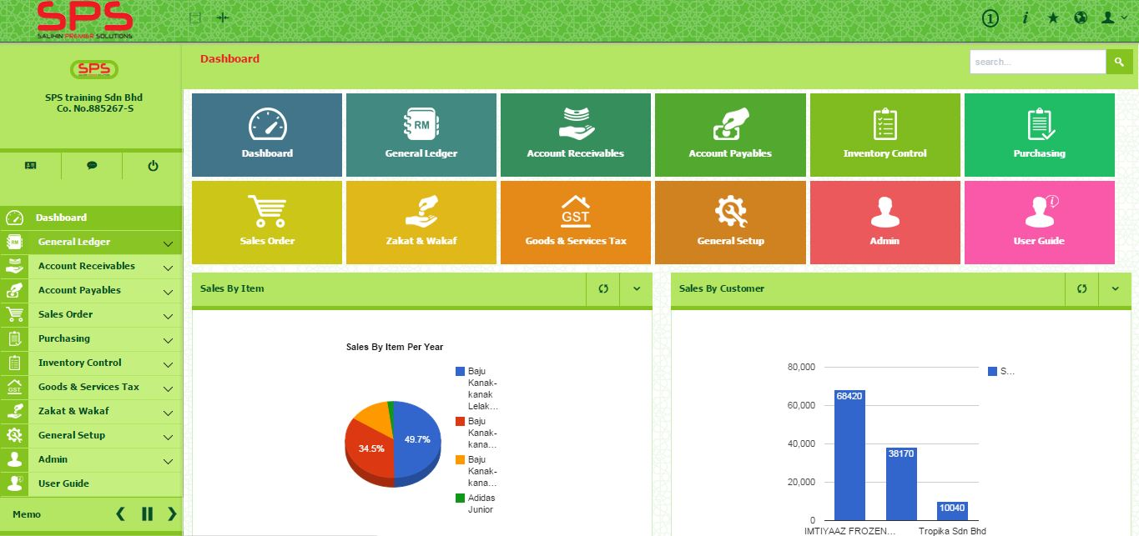
SPS
SPS ACCOUNTING SOFTWARE REVIEW

Slide 16
THE PROPOSAL
VISION AND MISSION
Vision
To equip fresh graduate student from higher learning institution in Malaysia with high value added accounting software skill.
Build long lasting reputation and commitment through excellence.
Mission
Facilitate the expansion and integration of knowledge
Going beyond and influence changes towards improvement.
Provide solution that foster dedicated bonding between SALIHIN and UNITEN
© SALIHIN 2015. Strictly Private & Confidential

Slide 17
THE PROPOSAL
OBJECTIVES OF THIS PROPOSAL
To strategically collaborate with UNITEN to equip and develop the students with skill sets required by the Industry in Malaysia. To this end, we are expecting the following :
Multi skills for talent pool of UNITEN graduates with practical knowledge in accounting, accounting system, GST, Zakat and Waqf.
Utilizing of SPS as comprehensive teaching and learning tools for accounting students.
Expanding the scope of studying course in accounting management, accounting information system (AIS), business module and related subjects.
Enhancing accounting graduates marketability with our SPS Certification.
Building a good partnership between SALIHIN and UNITEN.
Providing industry-ready entry-level talent from UNITEN for high-skilled jobs.
© SALIHIN 2015. Strictly Private & Confidential

Slide 18
THE PROPOSAL
COLLABORATION MODEL
National
Perspective
----------------------------------------------------------------------------------------------------------------------------------------------------
Industry
Perspective
----------------------------------------------------------------------------------------------------------------------------------------------------
Higher Learning
Institution
Perspective
----------------------------------------------------------------------------------------------------------------------------------------------------
Learning and
Growth Perspective
Productivity Strategy
Long-Term Human Capital Value
Growth Strategy
Improve Professional Skill
Increase Human Capital Utilization
Expand Opportunities
Enhance Human Resource Value
Industry Value Proposition
Employment
Quality
Availability
Selection
Functionality
Service
Partnership
Brand
Product/Services Attributes
Relationship
Image
Lecture Learning Processes | Tutorial and Assignment Processes | Industrial Training Processes | Professional Certificate Processes
SPS as the accounting software tools Train the Trainer Train the Student | Configuration Course work Assessment | Apply SPS into a real business Entrepreneur programme | Certified SPS Engineer Certified SPS Consultant Certified SPS Trainer
HUMAN CAPITAL
ORGANIZATION CAPITAL
( Culture , Leadership, Alignment, Teamwork)
© SALIHIN 2015. Strictly Private & Confidential

Slide 19
THE PROPOSAL
COLLABORATION MODEL
LECTURER/STUDENT
  Commitment
  Proactive participation
UNIVERSITY
  Expand new coursework programme
  To provide high quality, comprehensive educational facilities.
  Students engagement and participation.
  Other support as and when needed.
SALIHIN
  SPS Training Provider and Technical Support
  Latest SPS as learning tools for accounting students
  Provide the professional certified SPS certificate

Slide 20
GST CERTIFICATION PROGRAM
COLLABORATION MODEL
BENEFIT TO UNITEN AND UNITEN GRADUATES
Increasing the marketability and employability of graduate students
UNITEN will become a “Knowledge Centre” for SMEs and SMIs in theory & technical.
As Accountancy Talent Pool for Industries
Trainer Pool development for Lecturers and Students
© SALIHIN 2015. Strictly Private & Confidential

Slide 21
MOVING FORWARD
Working hand in hand to acquire grant.
To produce a much more versatile graduate in line with the country’s vision 2020 and international needs e.g, OICs countries
Establishment of Professional school complete with professional accredited program syllabus.
Seek due consideration from the UNITEN to award the concession to operate and manage the program to the public.
© SALIHIN 2015. Strictly Private & Confidential

Slide 22
3.0 Featuring SALIHIN Premier Solution
© SALIHIN 2015. Strictly Private & Confidential

Slide 23

www.salihinpremier.com

Slide 24
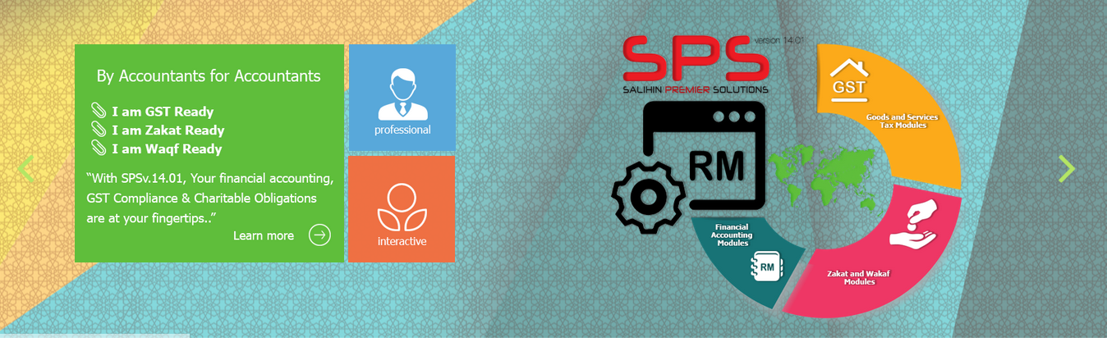
GST,ZAKAT AND WAKAF MODULE

Slide 25

EASY ACCESS

Slide 26
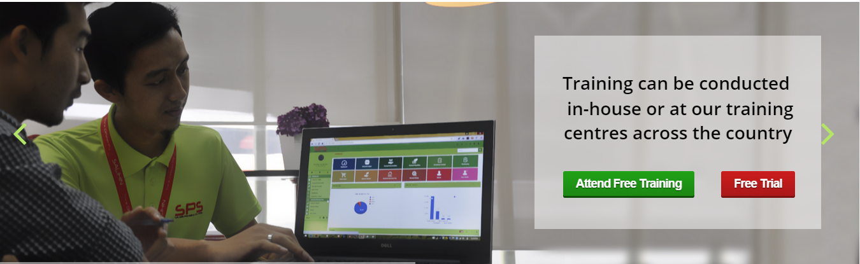
FREE TRAINING

Slide 27
4.0 SPS MODULE
© SALIHIN 2015. Strictly Private & Confidential

Slide 28

WEB-BASED LOGIN

Slide 29
FRIENDLY INTERFACE

Slide 30
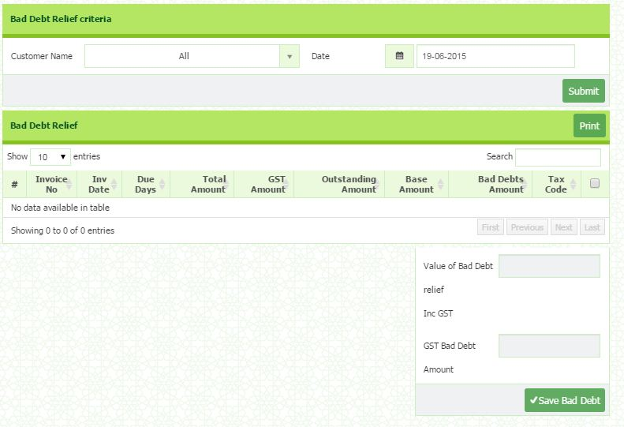
GST FEATURES

Slide 31
5.0 SPS EVENTS & PROGRAMME
© SALIHIN 2015. Strictly Private & Confidential

Slide 32
SALIHIN PREMIER SOLUTION (SPS) PREVIOUS EVENTS AND PROGRAMME
No. | Date | Event | Time | Location
1 | 26 – 28 May | ASEAN SME Showcase & Conference 2015 | 9.00am - 5.00pm | KL Convention Centre, Kuala Lumpur
2 | 2 - 5 June 2015 | SME Week 2015 | 9.00am - 5.00pm | SME Corp, Atrium Platinum Sentral
3 | 8 - 9 June 2015 | Roadshow with MATA Programme | 8.30am - 5.00pm | Pullman Hotel, Kuching
4 | 13 - 15 June 2015 | Roadshow with MATA Programme | 8.30am - 5.00pm | TH Hotel, Kuala Terengganu
5 | 16 - 17 June 2015 | Roadshow with MATA Programme | 8.30am - 5.00pm | Renaissance Hotel, Kuala Lumpur
6 | 23 - 24 June 2015 | Roadshow with MATA Programme | 9.00am - 4.30pm | Seri Pacific Hotel, Kuala Lumpur

Slide 33
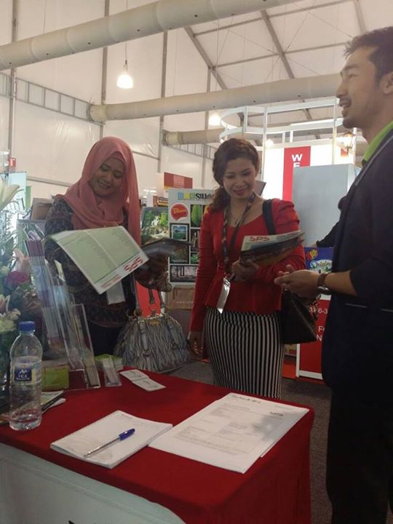

ASEAN SME Showcase & Conference 2015
Summary & Outcome
The turnout for the 3 days event was around 7000+ participants and visitors. During the event, SPS team had a chance to engaged with various personnel from different spectrum of business as well as the media. This was the biggest event for the team so far and the opportunity to exchanged business cards and acknowledge them about SALIHIN.

Slide 34
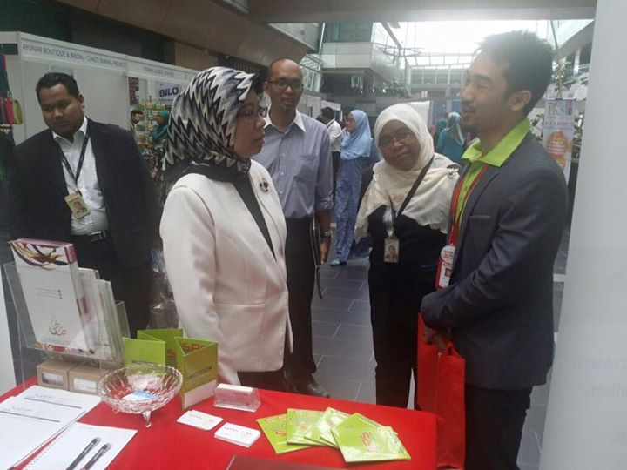
Small Medium Entrepreneur Week 2015
This roadshow is held at SME Corp. The SPS team had a chance to get meet and greet with the CEO of SME Corp Malaysia Dato’ Hafsah Hashim and had the chances to briefly explain to her about our software and its functions. The turnout for these event is about 1000+ visitors and booth owners from different business nature.

Slide 35
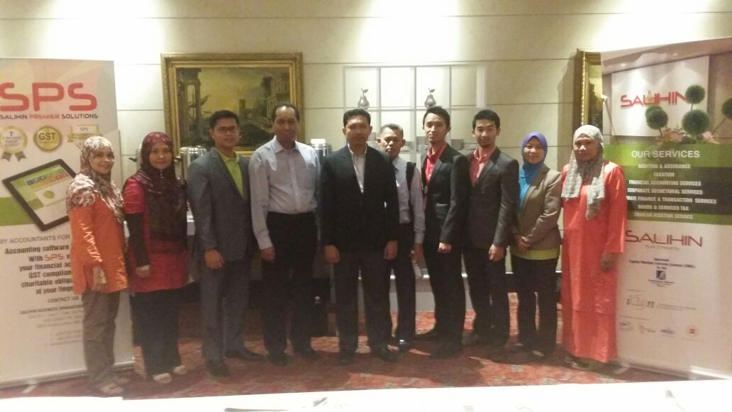
MATA Roadshows ( Kuching, Terengganu, Renaissance Kuala Lumpur and PWTC)

Slide 36
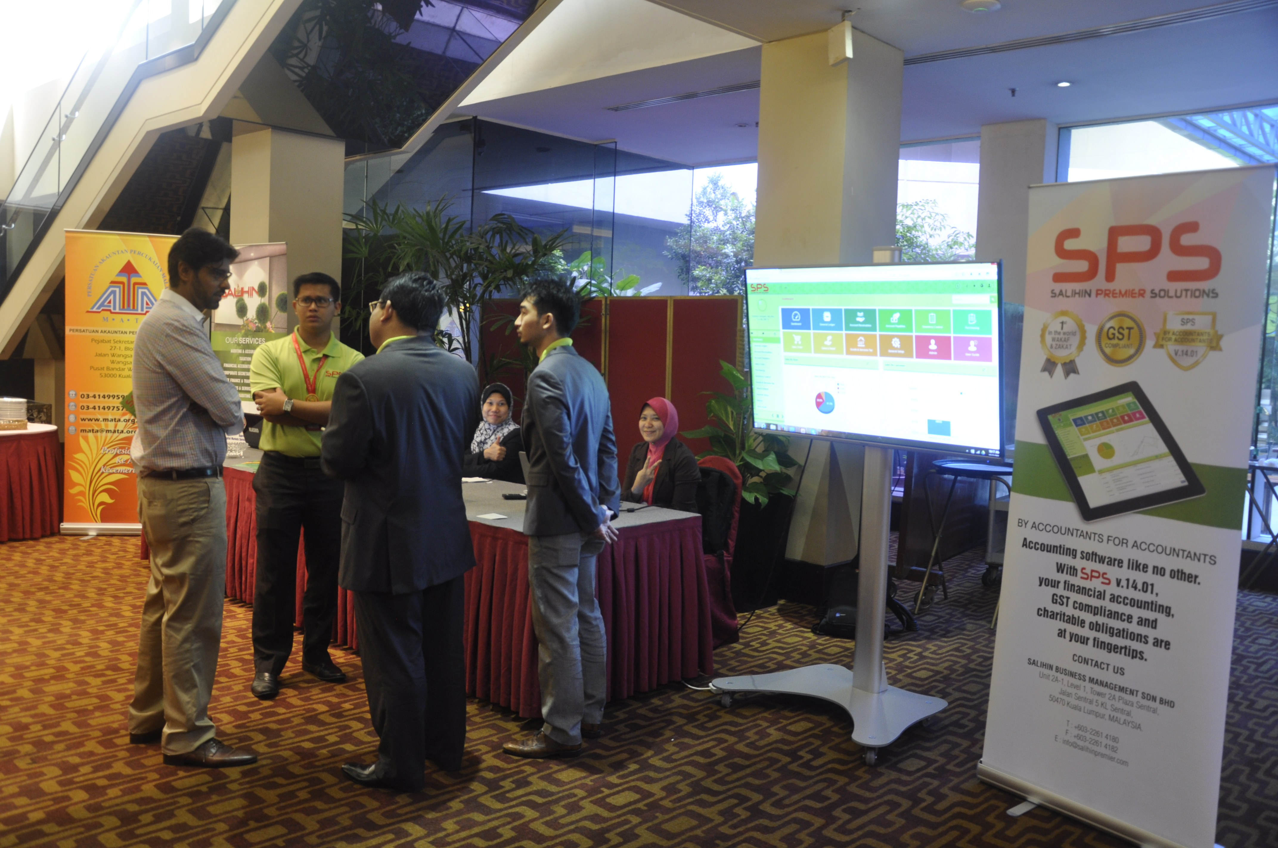
Based on the event at all the venue, there are about 350 participants all over Malaysia that participated in MATA event. Many potential clients that showed their interest not only with SPS but also SALIHIN’s services such as auditing and company secretary.

Slide 37
6.0 OUR CREDENTIALS
© SALIHIN 2015. Strictly Private & Confidential

Slide 38
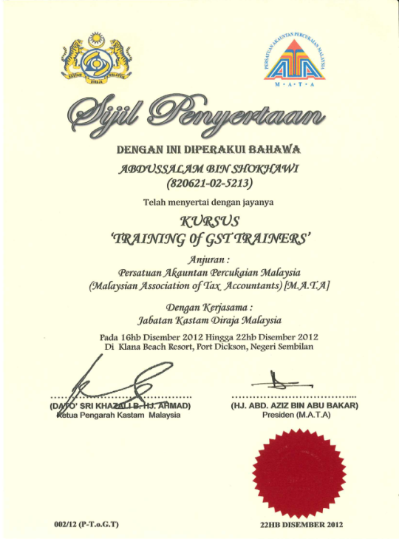
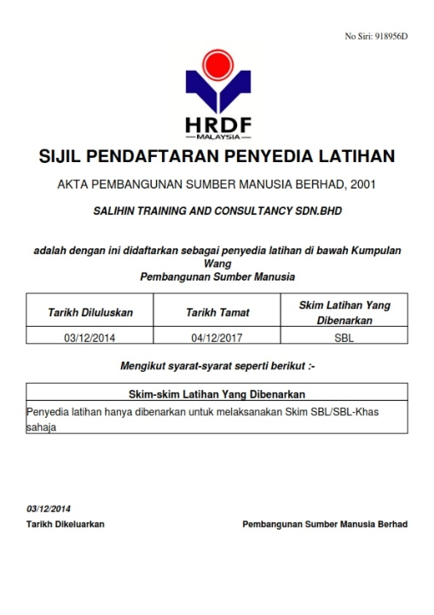
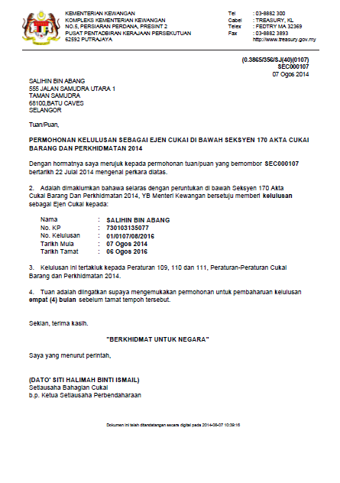

OUR CREDENTIALS
A structured approach with approved HRDF training modules approved by HRDF.
Approved GST Agents and Qualified GST Trainers that have vast GST knowledge and experience of various industries.
Experienced IT consultants that can review and provide technical assistance for GST system compliance; accounting for GST.
© SALIHIN 2015. Strictly Private & Confidential

Slide 39
7.0 CONTACT US
© SALIHIN 2015. Strictly Private & Confidential

Slide 40

CONTACT US
OFFICIAL ADDRESS & CONTACT PERSON
CORPORATE CENTRE:
KL Sentral Office
Unit 2A-1, Level 1
Tower 2A, Plaza Sentral
Jalan Stesen Sentral 5
KL Sentral
50470, Kuala Lumpur
Tel: +603 2261 4180
Fax: +603 2261 4182
CONSULTANT: MOHD AIZAT JAMIL
EMAIL: aizat@salihin.com.my
Official Website : www.salihin.com.my
Customer Service : www.salihinpremier.com
E-mail : info@salihin.com.my
Careline : 1 300 88 5678
© SALIHIN 2015. Strictly Private & Confidential

Slide 41

www.salihin.com.my | www.salihinpremier.com
1 300 88 5678
Copyright Controlled 2012 @ SALIHIN

