Slide 1


SALIHIN PREMIER SOLUTIONS
SPS ACCOUNTING SOFTWARE ver 14.1
PREPARED BY:
SUBMITTED TO:
TERENGGANU KITCHEN SDN. BHD.
Notes:
Font Type: Open Sans
Font Size: Proposal Title (60), Proposal Details (40)
Business unit & Client logo: Small size

Slide 2
Table of Content
1.0
About Us 4
2.0
The Proposal 12
3.0
Contact Us 27
4.0
Notes:
Font Type: Open Sans Light
Font Size: Table of Content (44)
Attention: Please change the table of content and page numbering accordingly. Thank you very much ☺

Slide 3
About Us
—
SALIHIN
2.0 About Us
Key Management Team
Services
Salihin Premier Solutions (SPS)
Our Diverse Clients
Our Local & International Networks
Why SALIHIN?
Notes:
Font Type: Open Sans (Bold)
Font Size: About Us (60)

Slide 4
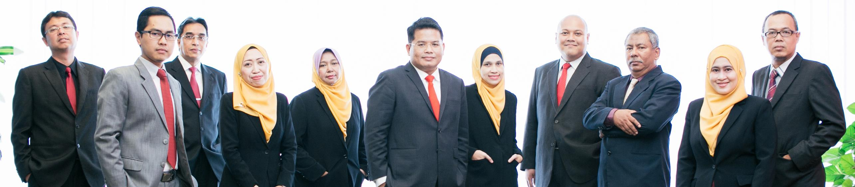


About Us
Founded in 2002, SALIHIN is the brand name of a group of independent and separate legal entities, deploying wide spectrum of capabilities to help clients see and tap opportunities in the areas of transaction and corporate finance, taxation (direct tax and GST), auditing and assurance, shariah auditing and advisory, corporate governance, IT consultancy and business accounting solution.
As one of the fastest growing home-nurtured and bumiputera firms, SALIHIN is having close to 200 competent professionals from different background with diverse thoughts, expertise and experience serving in 9 offices nationwide.
In addition to relevant licenses/certifications for its capabilities, SALIHIN is having MSC Status, Audit Oversight Board (AOB) registered as an Auditor of Public Interest Entity, licensed Capital Market Service provider by Securities Commission, and Approved Training Provider from Human Resources Development Fund (HRDF).
We have a proven track record credited to a sustained quality service delivery to our clients without compromising our professional integrity. SALIHIN continues to build on its successes. It became the first in the world to introduce Teaching Accountancy Firm (TAF) to bridge the gap between accountancy theory and practice.
Vision
To become the preferred national accountancy firm of Malaysia.
Mission
SALIHIN is dedicated to creating value by focusing on customer satisfaction and growth, excellent internal business process and superior human capital resource development.
Notes:
Attention: Please don’t change any content here. Thank you very much ☺

Slide 5
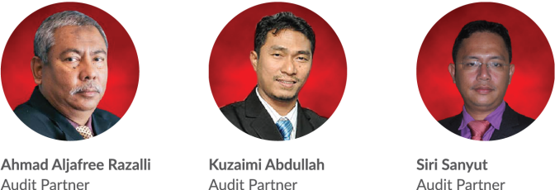
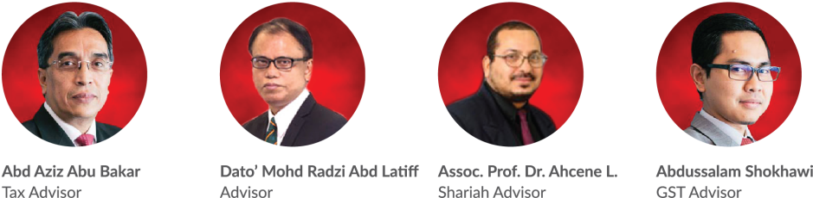
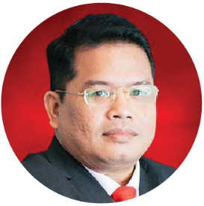
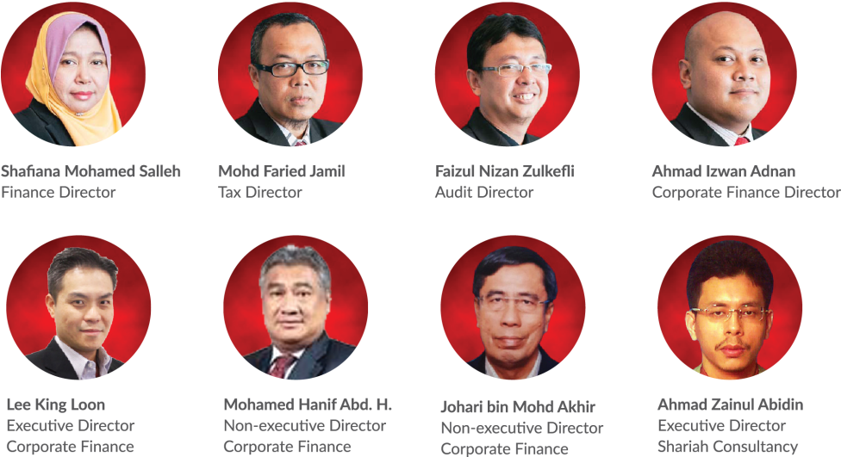
Key Management Team
Salihin Abang
Founder/Managing Partner/CEO
Notes:
Attention: Please don’t change any content here. Thank you very much ☺

Slide 6
Services
SALIHIN offers wide spectrum value for money services:
AUDIT & ASSURANCE
GST & BUSINESS
ACCOUNTING SOLUTION
GST ADVISORY
Statutory Financial Statement Audit
Review Engagements
Compilation Engagement
MPERS / MFRS Training
Agreed Upon Procedures
Preparation & Submission: GST-03
GST Accounting and Review for users of SPS
Preparation of Full Sets Accounts
Preparation of Management Account or Reports
Forensic Accounting
GST Strategic Planning
Cash Flow Planning & Pricing Strategy
GST Bad Debt Management
GST Record Keeping and Internal Control
GST Special Transaction
GST-IT Advisory
Transfer of Going Concern
GST Audit and Investigation
Advice on GST Ruling & Appeal
GST-03 Monthly Submission Review
Monitoring TAP System
GST Annual Adjustment
GST Training & Education Services
GST Accounting Software
DIRECT TAXATION
Mergers and Acquisition Tax Advisory
Corporate Tax Compliance and Planning
Transfer Pricing Advisory
Transfer Pricing Documentation
Tax Audit, Investigation & Appeal
International Tax Consulting
Real Property Gain Tax
Tax Accounting
Tax Risk Management
Notes:
Attention: Please don’t change any content here. Thank you very much ☺

Slide 7
Services (Cont.)
SALIHIN offers wide spectrum value for money services:
GOVERNANCE &
CORPORATE SECRETARIAL
IT CONSULTANCY
SHARIAH AUDIT & ADVISORY
Company Incorporation
Filing Annual Return
Updating Information
Certifying Company Documents
Striking Off Company
Legal Due Diligence
Registration with Relevant Government Agencies
Corporate Governance Advisory
Secretarial Due Diligence and Management
IT Audit & Due Diligence
IT Governance and Planning
IT Project Management
IT Risk Management & Strategy and Assessment
Business Intelligence
IT Sourcing/Outsourcing
Enterprise Resource Planning (ERP)
Software Development and Customisation
Islamic Banking Product Structuring
Islamic Securities: Sukuk Issuance & Structure
Islamic Fund, Wealth & Asset Management
Islamic Private Equity
Establishment of Islamic Bank
Zakat & Waqf Accounting Software (SPS)
Shariah Compliance Training Program
Shariah Training & Education
Shariah Research and Development
Shariah Review & Screening
Shariah Internal Audit
Shariah External Audit
Shariah Risk Management
Shariah Legal Advisory
Shariah Convernance & Supervision
Shariah Accounting
TRANSACTION & CORPORATE FINANCE
Internal Auditing
Enterprise Risk Management
Due Diligence
Business Valuation
Financial Statement Analysis
Raising Seed/Start-Up Capital
Agreed Upon Procedures
Management Buy-In(MBI)/Buy-Out(MBO)
Project and Infrastructure Finance
Pre and Post IPO Advisory
Raising and Restructuring of Debt
Governance and Compliance Advisory
Forensic Audit
Merges, Acquisition and Demergers
Notes:
Attention: Please don’t change any content here. Thank you very much ☺

Slide 8
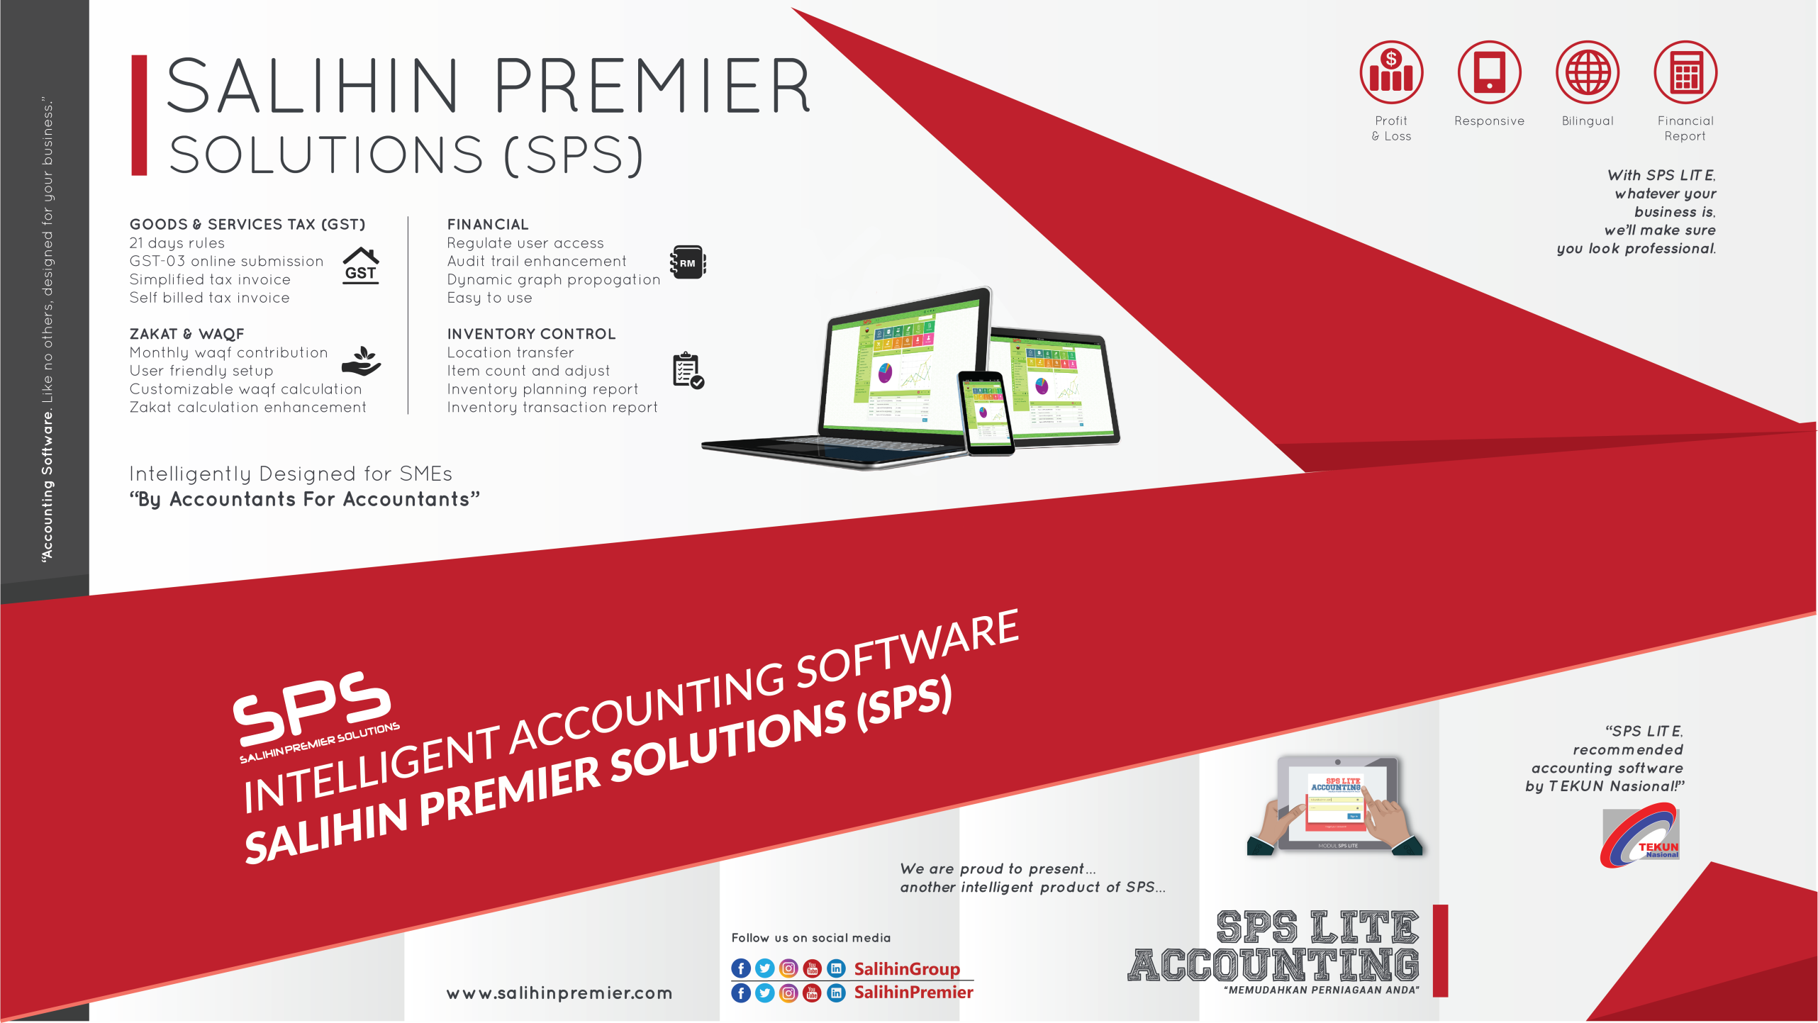
Notes:
Attention: Please don’t change any content here. Thank you very much ☺

Slide 9








































Our Diverse Clients
SALIHIN serves diverse clients including corporate companies, foundations / non-profit organisations, government bodies, government linked companies and educational institutions. Their diversity spans across different sectors of the economy.
Notes:
Attention: Please don’t change any content here. Thank you very much ☺

Slide 10




Our Local & International Networks
Buenos Aires
Mexico
Boston
Los Angeles
Miami
New York
San Francisco
Europe
Batu Caves
Johor Bahru
Kuching
Kuala Terengganu (TAF)
Vienna
Brussels
Limassol
Paris
Frankfurt
Milan
Rrome
Luxemborg
Bucharest
Moscow
Barcelona
Madrid
Lausanne
Rotterdam
London
Kyiv
SALIHIN is a member firm of i2an,
a reputable global network of accountants which have presence in America, Asia and Europe as well as all the international financial centres.
Asia
Shanghai
Hong Kong
Tokyo Kuala Lumpur
Singapore
Dubai
Sydney
New Delhi
Ramat Gan
Taiwan
America
Our Local Branches
Notes:
Attention: Please don’t change any content here. Thank you very much ☺

Slide 11



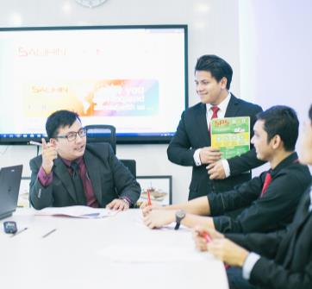

Why SALIHIN?
The following are key reasons why SALIHIN should be your firm’s preferred choice:
01.
Experienced Employees
We have the right ‘hands-on’ team with vast knowledge and relevant experience.
02.
Comprehensive Reports
We would be able to provide complete and comprehensive reports in tandem to your key areas of concern.
03.
Quality Service Delivery
Our Engagement Partner, Board of Advisors and Managers will be involved in closed co-operation for quality service delivery.
04.
Value for Money
We offer ‘value for money’ without compromising on the quality and timeliness of our services.
05.
Minimal Disruption
We will apply our considerable experience to ensure minimal disruption to clients’ daily operations.
Notes:
Attention: Please don’t change any content here. Thank you very much ☺

Slide 12
The Proposal
—
SPS Accounting Software 14.1
3.0 The Proposal
SPS Overview
SPS Module, Diagram & Flowchart
After Sales Support
Notes:
Font Type: Open Sans & Open Sans Light
Font Size: The Proposal (60), Content (36)
Proposal Title’s Example (at the right-top of the red box) : Audit Proposal (For Audit Dept.) or GST Proposal (For GST Dept.)

Slide 13


The Proposal
SPS Overview
MSC
SALIHIN PREMIER SOLUTIONS also known as SPS SOFTWARE , the intelligent software in the world that can manage numerous aspects of financial accounting including Goods and Services Tax (GST) and Zakat calculation, customized especially for Small and Medium Enterprises (SMEs).
GST
SYSTEM
SME’S
ACCOUNTING
DEVELOPMENT
TECHNOLOGY
WAQF
ZAKAT
ENTREPRENUER
INTELLIGENT
SOLUTIONS
SPS SOFTWARE is an efficient and effective accounting software that accommodate invoicing and billing system of business process. The software is powered by the latest security features to secure data for optimal integrity and confidentiality. It is tailor made for small and medium industries by professional accountants.
Notes:
Font Type: Open Sans Light
Font Size: Content (36)
Content suggestion: Client and proposal background.

Slide 14

The Proposal
WHY CHOOSE SPS
100% DEVELOPED & OWNED
BY MALAY BUMIPUTERA
TAILOR MADE FOR SME’S
BY ACCOUNTANTS FOR ACCOUNTANTS
GST COMPLIANT
CERTIFIED AND COMPLIED WITH RMCD’S REQUIREMENT
1st IN THE WORLD THAT OFFER ZAKAT & WAQF MODULE
Notes:
Font Type: Open Sans Light
Font Size: Content (36)

Slide 15









The Proposal
CLIENTELE OVERVIEW
Notes:
Font Type: Open Sans Light
Font Size: Content (36)

Slide 16

The Proposal
SPS CORE FEATURES
SPS Installer Faster & Easier
Predefined
Accounting Chart
Default GST Setup
Biz Dashboard
Regulate User Access
GST-03 Online
Submission
Dynamic Graph
Propagation
Void Unconfirmed
Transaction
Auto Notification of
Any New Update
Zakat Calculation
Enhancement
Simplified Tax Invoice
Auto Calculation Wakaf
Self Billed Tax Invoice
Notes:
Font Type: Open Sans Light
Font Size: Content (36)

Slide 17
The Proposal
SPS SYSTEM REQUIREMENT
INTERNET
HARDWARE
SOFTWARE
Win 7 and above
Important note: Win XP & Win 2003 are not supported
Microsoft Office 2010 and above
A broadband internet connection will be required only for WAN environment and usage within an office will require a basic LAN configuration
1 GHz processor or faster
1 GB of RAM
10 GB of hard disk space
OPERATING SYSTEM
Notes:
Font Type: Open Sans Light
Font Size: Content (36), Date (32)

Slide 18
The Proposal
SPS MAIN MODULES
SPS Modules | Admin & General Setup Module General Ledger Module Account Receivables Module Account Payables Module Operate Sales Order Module Purchasing Module Inventory Control Module GST Module Zakat & Waqf Modules
SETUP GENERAL LEDGER MODULE | Setup financial year, chart of account, opening balance & other sub modules Perform transaction Generate and produce report
SETUP ADMIN MODULE | Add/edit & authorization of access for each user Search & produce log report Perform a backup Upgrade license & version
SETUP GENERAL MODULES | Set up a company Set up employee Set up agent Set up bank Setup terms Set up ship to (location) Setup graph
Notes:
Font Type: Open Sans Light
Font Size: Content (36), Date (32)

Slide 19
The Proposal
SPS MAIN MODULES - cont
SETUP ACCOUNT RECEIVABLES MODULE | Setup customers Setup historical customer invoice Perform sales transaction Generate and produce report
SETUP ACCOUNT PAYABLES MODULE | Setup supplier Setup historical supplier invoice Perform purchases transaction Generate and produce report
SETUP SALES ORDER MODULE | Setup sales price Perform sales quotation and delivery order Generate and produce report
SETUP PURCHASING MODULE | Setup purchase price & supplier lists Perform purchase order and purchase receive Generate and produce report
SETUP INVENTORY CONTROL MODULE | Setup inventory items Perform location transfer and stock take Generate and produce report
SETUP GST MODULE | Setup GST requirement Perform GST transaction Generate and produce GST report Generate and submit GST-03
SETUP ZAKAT & WAQF MODULES | Setup zakat nisab and centre Setup waqf and waqf centre Perform zskat calculation Perform waqf calculation Generate and produce zakat report Generate and produce waqf report
Notes:
Font Type: Open Sans Light
Font Size: Content (36), Date (32)

Slide 20
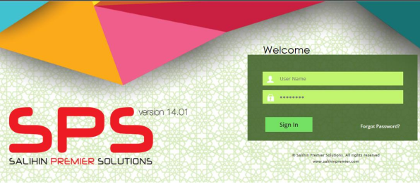
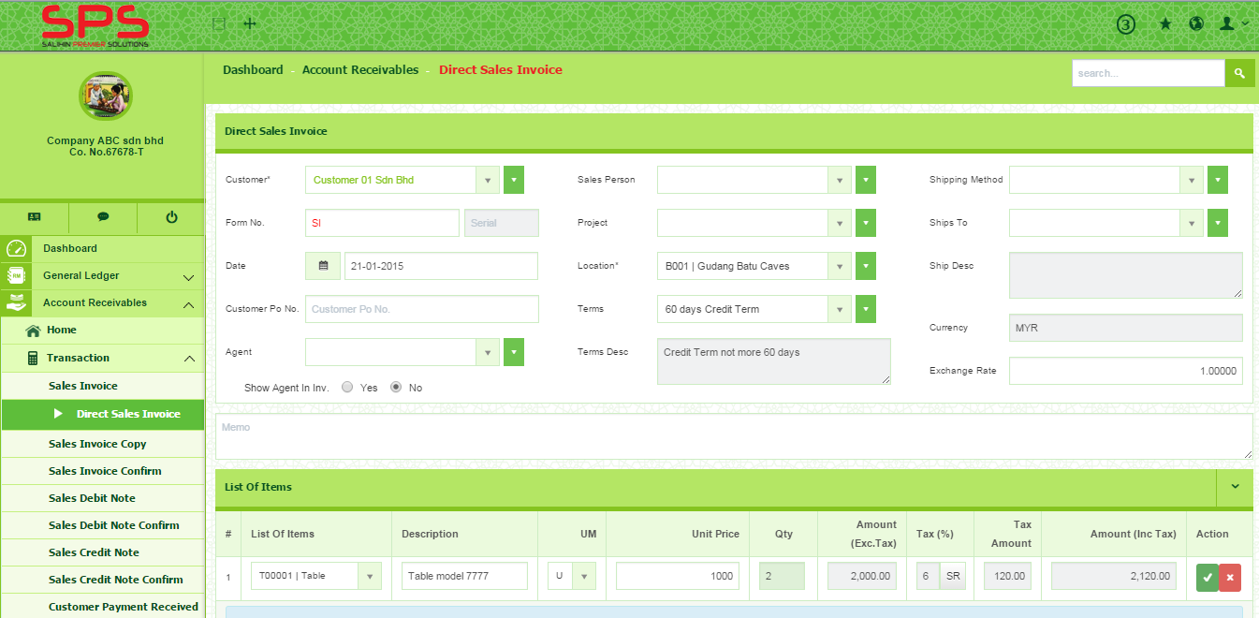
The Proposal
SPS USER INTERFACE
SPS Login Page
SPS Main Panel
Notes:
Font Type: Open Sans Light
Font Size: Content (36), Date (32)

Slide 21
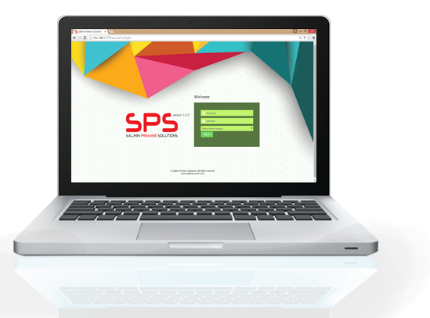
The Proposal
AFTER SALES SUPPORT
On-Site Support
TeamViewer
Helpdesk Support
Notes:
Font Type: Open Sans Light
Font Size: Content (36), Date (32)

Slide 22
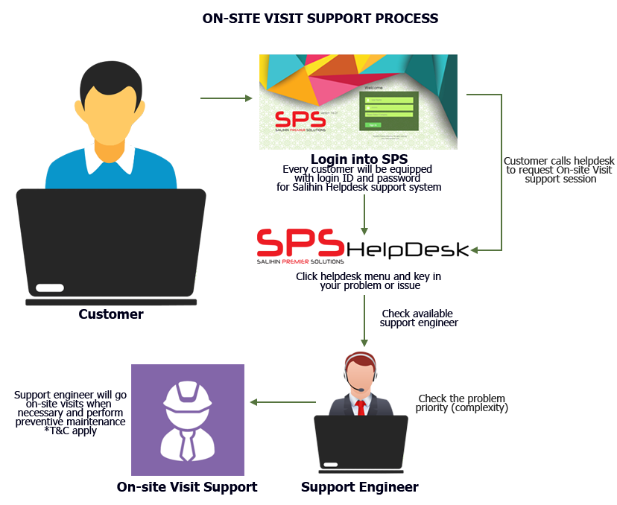
The Proposal
ON-SITE VISIT SUPPORT PROCESS
Notes:
Font Type: Open Sans Light
Font Size: Content (36), Date (32)

Slide 23
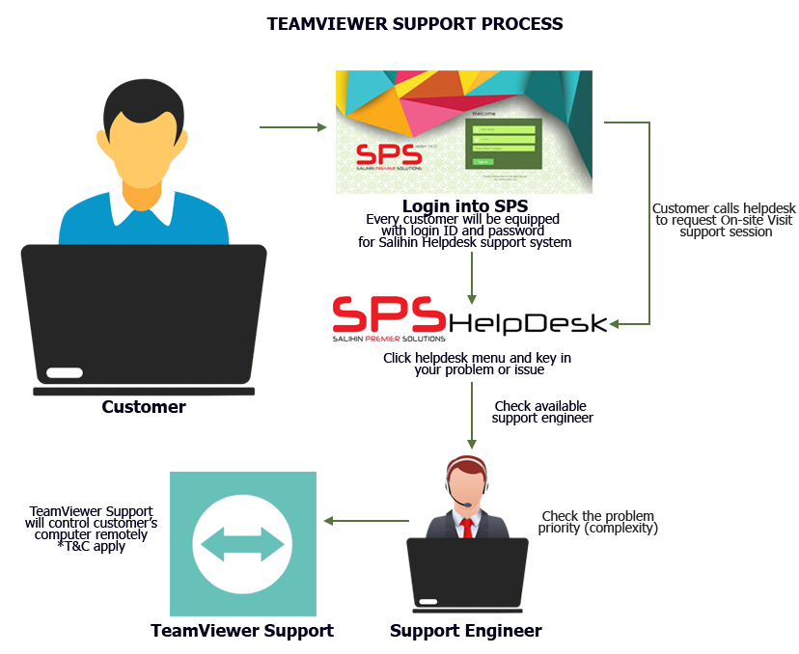
The Proposal
TEAMVIEWER SUPPORT PROCESS
Notes:
Font Type: Open Sans Light
Font Size: Content (36), Date (32)

Slide 24
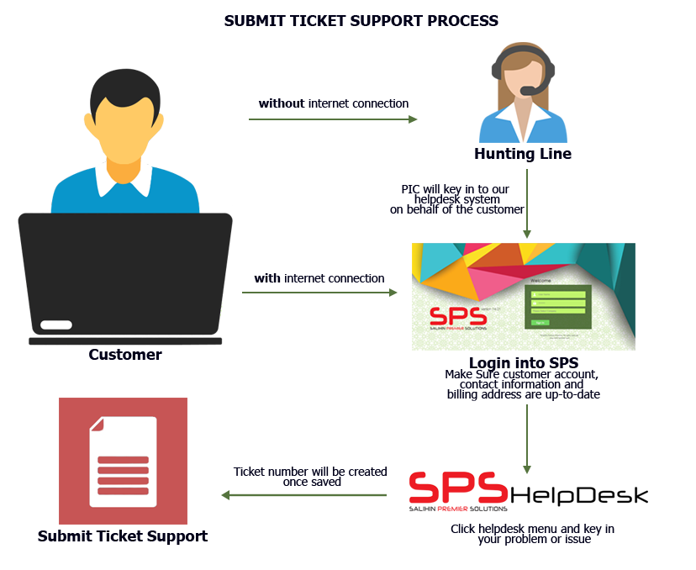
The Proposal
PHONE/HELPDESK SUPPORT PROCESS
Notes:
Font Type: Open Sans Light
Font Size: Content (36), Date (32)

Slide 25
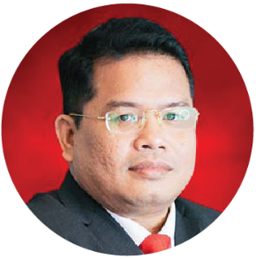
Our Credentials
Key Engagement Team
Approved Company Auditor under Ministry of Finance (MoF)
Approved Tax Agent under Ministry of Finance (MoF)
Approved Cooperative Auditor under Malaysian Cooperative Commission
Approved Auditor Labuan Offshore Financial Services Authority (LOFSA)
Chartered Accountant CA (M) with Malaysian Institute of Accountant (MIA)
Elected Council Member of the MIA
Member of MIA’s Investigation Committee (Statutory)
Member of MIA’s Taxation Practice Committee (Technical)
Member of MIA’s Public Practice Committee
Member of MIA’s Small & Medium Practice Committee (SMPC)
Elected President of Malaysia Accounting Firm’s Association (MAFA)
Fellow Member of Chartered Tax Institute of Malaysia (FCTIM)
Associate Member of Certified Public Accountant (CPA Australia)
Member of Malaysian Association of Certified Financial Planner (CFP)
Certified GST Agent and Trainer
Executive committee member of Malay Chartered Accountants Firms Malaysia
Executive committee of Malaysian Association of Tax Accountants
Bachelor and Master Degree holder in Accounting from International Islamic University Malaysia
Salihin Abang
Managing Partner
Notes:
Attention: Please don’t change any content here. Thank you very much ☺

Slide 26
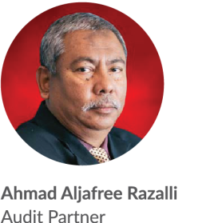
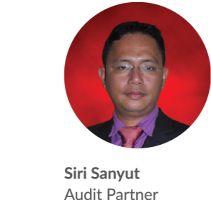
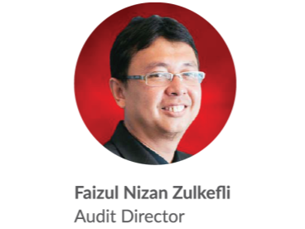
Our Credentials
Key Engagement Team (Cont.)
Approved Company Auditor Under the Companies Act 1965
Approved Cooperative Auditor from Malaysian Cooperative Commission
Member of Malaysian Institute of Accountants (MIA)
Bachelor of Accounting from Universiti Teknologi MARA
Master Degree in Accounting and Finance from UK
Approved Company Auditor Under the Companies Act 1965
Approved Cooperative Auditor from Malaysian Cooperative Commission
Member of Malaysian Institute of Accountants (MIA)
Associate with Chartered Tax Institute of Malaysia (CTIM)
Bachelor of Accounting from Universiti Malaysia Sabah (UMS)
Member of Malaysian Institute of Accountants (MIA)
Bachelor of Accounting from International Islamic University Malaysia (IIUM)
Notes:
Font Type: Open Sans Light
Font Size: Content (28)
Attention: Please insert the details of the project team members appropriately.
Directory: Pictures can be obtained from PUBLIC/SALIHINAlbum/ProposalPictures

Slide 27

3.0 Contact Us
Headquarters
—
555, Jalan Samudra Utara 1,
Taman Samudra,
68100 Batu Caves,
Selangor, Malaysia.
Tel: +603-6185 9970
Fax: +603-6184 2524
Email:
support@salihinpremier.com
Follow us on social media
Notes:
Font Type: Open Sans Light
Font Size: Content (28)
Attention: You may add / edit this section.

Slide 28
www.salihin.com.my | www.salihinpremier.com
Careline: 1 300 88 5678
Notes:
Attention: Please don’t change any content here. Thank you very much ☺

