Slide 1



PROPOSAL FOR STRATEGIC COLLABORATION
IN LEARNING & GRADUATE SKILLS ENHANCEMENT
Prepared for:
Prepared by:

Slide 2
EXECUTIVE SUMMARY
Enhancing learning experience with SPS
With the current shift towards efficient governance, the implementation of GST resulted in the requirement of further understanding of the tax structure in accounting. As one of the prestigious university in Malaysia, UITM can lead the shift through utilization of accounting information system(AIS) as a practical tool in demonstrating tax structure in accounting.
This requires certified accounting software, developed with direct input from the customs department, the Salihin Premier Solution (SPS) will provide the competitive edge for UITM to enhance the learning experience of its accounting students in gaining the practical understanding on GST implementations and its impacts in financial reports.
It can be implemented as a learning tool in Accounting Information System subject.

Slide 3
THE PROPOSAL
Main Objective: Enhancing Graduates
CAPACITY BUILDING
SKILLS ENHANCEMENT
INDUSTRIAL
RELEVANCE
To equip UiTM graduate student with value added accounting software skills
To provide avenue for UiTM to enhance graduate skills and accreditations
To provide practical expertise and experience for UiTM in delivering courses relevant to current and future industrial practices.

Slide 4
THE PROPOSAL
SPS As Optional Learning Tool
SPS is used to support the curriculum based on self initiatives by student with the assistance from lecturers.
For better positioning of SPS, exam will be given as an optional (to test student understanding of each particular subject)
Exam, Marking & Certification will be provided by SALIHIN (For those who seat for exam).
Part of
Up Scaling
Not Bound to University Program
Does Not Require Senate Permission
SPS Student Manual & Installer
SPS as Optional Learning Tool
1 Hour Online Exam
Separate Session in Lab
SPS Certification
Lecturer’s Decision
Student’s Willingness
Monitoring & Marking By SALIHIN

Slide 5
THE PROPOSAL
Proposed Modules - Summary
SPS Modules | Setup & Operate Admin & General Setup Module General Ledger Module Account Receivables Module Account Payables Module GST Module Zakat & Waqf Modules

Slide 6
THE PROPOSAL
Proposed Modules - Details
Setup & Operate General Setup Module
  How to setup a company
  How to setup employee
  How to setup agent
  How to setup master code
  How to setup project
  How to setup terms
  How to setup bank
  How to setup ship to (location)
  How to setup a graph
Setup & Operate Admin Module
  How to add/edit & authorization of access for each user
  How to search & produce log report
  How to perform a backup
  How to upgrade license & version

Slide 7
THE PROPOSAL
Proposed Modules - Details
Setup General Ledger Module
  How to setup financial year, chart of account, opening balance & other sub modules
  How to perform transaction
  How to generate and produce report
4. Setup Account Receivables Module
  How to setup customers
  How to setup historical customer invoice
  How to perform sales transaction
  How to generate & produce report
5. Setup Account Payables Module
  How to setup supplier
  How to setup historical supplier invoice
  How to perform purchases transaction
  How to generate & produce report

Slide 8
THE PROPOSAL
Proposed Modules - Details
Setup & Operate GST Module
  How to setup GST requirement
  How to perform GST transaction
  How to generate & produce GST report
  How to generate & submit GST-03
Setup & Operate Zakat & Waqf Modules
  How to setup zakat nisab & centre
  How to setup waqf & waqf centre
  How to perform zakat calculation
  How to perform waqf calculation
  How to generate & produce zakat & waqf report

Slide 9
THE PROPOSAL
Target Market
Degree (No of Student: XXXX)
  Bachelor of Accountancy (hons) -AC220
    Puncak Alam, Selangor
    Kota Samarahan, Sarawak
    Machang, Kelantan
    Sg. Petani, Kedah
    Alor Gajah, Melaka

Slide 10
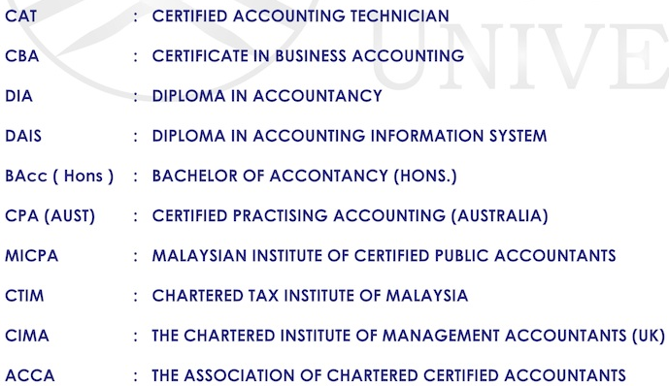
THE PROPOSAL
Target Course

Slide 11
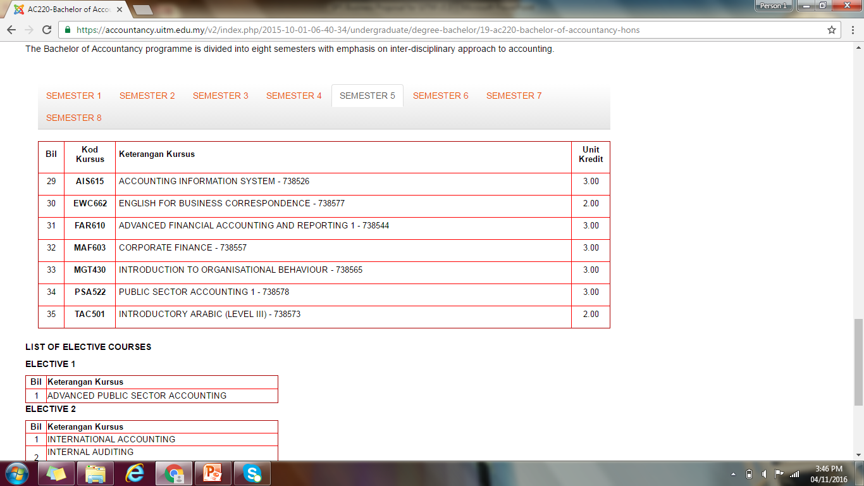
THE PROPOSAL
Target Course
  Bachelor’s of Accountancy –AC220

Slide 12
THE PROPOSAL
Target Modules - Summary
Degree Students
  Bachelor of Accountancy (hons) -AC220
    AIS615 – Accounting Information System
Diploma Students
  Diploma in Accounting Information System -AC120
    AIS205 – Computerized Accounting
  Diploma in Accountancy -AC110
    AIS205 – Computerized Accounting
    AIS255 – Accounting Information System
Future Planning

Slide 13

THE PROPOSAL
Proposed Pricing
Proposed pricing for UiTM Accounting Student:
  RM60.00 per pax.
Participated student will be provided with (Student Kits):
  SPS Student Installer/ Cloud-based ID access
  SPS Student Manual
  SPS Exercise Book

Slide 14
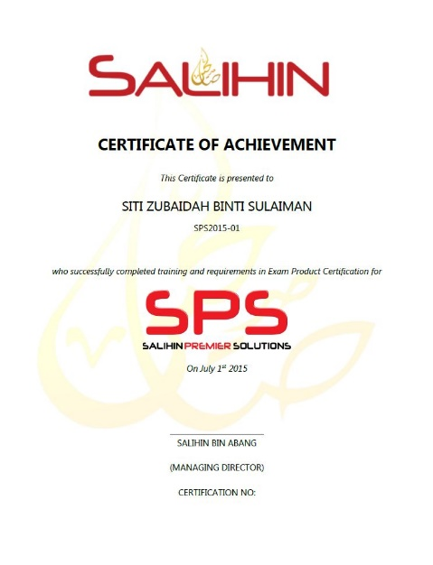
THE PROPOSAL
Expected Outcomes & Deliverables
At the end of the programme, we expect each graduates would be able to:
  Operate and utilize SPS Software (Install, configure & operate).
  Provide consultation & training on SPS.
SALIHIN deliverables to partipated graduates:
  SPS Certifications
    SPS Consultant Certificate
  1 Year Free SPS License
  1 Year Free SPS Support Service

Slide 15
THE PROPOSAL
UiTM Academic Calendar
Details | Degree, Master & Doctorate
Intake | 2016/2017
Academic Session | Sep 16 – Jan 16
Lecture | 05/09/16 - 11/09/16 18/09/16 – 27/11/16
Mid-Semester Break | 27/11/16 - 04/12/16
Lecture | 05/12/16 - 24/12/16
Special Leave | 30/05/16 - 05/06/15
Revision | 25/12/16 - 28/06/16
Examination | 29/12/16 - 21/01/17
Special Exam | 27/02/17 – 01/03/17
Semester Break | 22/01/17 - 05/03/17
Next Semester Academic Session | March 2017 – July 2017

Slide 16
THE PROPOSAL
Proposed Implementation Plan
4th Quarter 2016
MOU signing
Train the trainer
Finalize course syllabus
SPS kit installation
User manual & documentation preparation
1st Quarter 2017
ToT Kick off
  Jan 2017
Pilot program kick off
  Jan – Feb 2017
2nd Quarter 2017
Program kick off
  March-July 2017

Slide 17
THE PROPOSAL
Roles & Responsibility
UiTM | SALIHIN
To fully utilized SPS as main teaching tools / software. | To provide education version software
Provide facilities i.e classes & computer lab | Train the trainer (Lecturers) On site (2 -3 Days) In house (30 Days)
Provide trainers/ lecturers | Provide user manual (text book), exercise book, exam , scoring, marking & certification.
Assist SALIHIN to promote SPS to students | Provide full support & hotline no.
Uitm to allow SALIHIN to use UiTM brand, image recognition in promotional and advertising purposes
Expand new coursework program (where applicable)

Slide 18
SPS Background
Salihin Premier Solutions
The SALIHIN PREMIER SOLUTIONS also known as SPS, the intelligent software in the world that can manage numerous aspects of financial accounting including Goods and Services Tax (GST) and Zakat calculation, customized specially for Small and Medium Enterprises (SMEs).
SPS is an efficient and effective accounting software that accommodates changes affecting invoicing and billing system of the business process. The software is powered by the latest security features to secure data or information for optimal integrity and confidentiality. It is tailor made for small and medium industries by professional accountants.
The Zakat module makes SPS the first comprehensive accounting software with Zakat solution. It will make it easier than ever for Muslim businesses, corporations and organizations to determine the amount payable as Zakat. With Zakat feature built in, it is simply the best accounting software yet.

Slide 19
SPS Background
The Main Modules
There is 5 main modules of SPS
Financial Module
Inventory Module
GST Module
Zakat Module
Waqf / Endowment Module

Slide 20

SPS Background
Function And Features
SPS
Predefined Accounting Chart
Default GST Setup
Biz Dashboard
Regulate User Access
GST-03 Online Submission
Dynamic Graph Propagation
Void Unconfirmed Transaction
Auto Notification of
any New Update
Zakat Calculation Enhancement
Simplified Tax Invoice
Auto Calculation Wakaf
Self Billed Tax Invoice

Slide 21

Product Comparisons
SPS vs Other Accounting Software

Slide 22

SPS Background
Future Developments
POS System
Fixed Asset Management
Payroll System
CRM System
Cash Book System

Slide 23

CONTACT US
OFFICIAL ADDRESS & CONTACT PERSON
BUSINESS CENTRE:
555 Jalan Samudra Utara 1,
Taman Samudra,
68100 Batu Caves
Selangor Malaysia
Tel: +603 6185 9970
Fax: +603 6184 2524
CONSULTANT: WAN MOHD ISKANDAR B. WAN OMAR
EMAIL: wanmohdiskandar@salihin.com.my
Official Website : www.salihin.com.my
Customer Service : www.salihinpremier.com
E-mail : info@salihin.com.my
Careline : 1 300 88 5678

