Slide 1
SALIHIN PREMIER SOLUTIONS (SPS)
BY ACCOUNTANTS FOR ACCOUNTANTS

Slide 2
SPS SOFTWARE TRAINING
TIME | PROGRAMME
08.45 am – 09.00 am | Registration
09.00 am – 10.30 am | Installation/Setup Process
10.30 am – 11.00 am | Break
11.00 am – 01.00 pm | Account Payables/Receivables
01.00 pm – 02.00 pm | Lunch
02.00 pm – 04.00 pm | General Ledger/Report/GST
04.00 pm – 04.30 pm | Q & A / Closing

Slide 3
SPS MODULES
GENERAL LEDGER
ACCOUNT RECEIVABLES
ACCOUNT PAYABLES
SALES ORDER
PURCHASING
INVENTORY CONTROL
GOODS & SERVICE TAX
ZAKAT & WAKAF
GENERAL SETUP
ADMIN

Slide 4
SPS INSTALLATION
SYSTEM REQUIREMENTS
Minimum System Requirements
Operating system must be Windows 7 and above
Important note: Win XP and Win 2003 are not supported
1 GHz processor or higher
1GB or higher for RAM
10GB of hard disk space
Microsoft Office 2010 and above
A broadband internet connection will be required only for WAN environment and usage within an office will require a basic LAN configuration

Slide 5
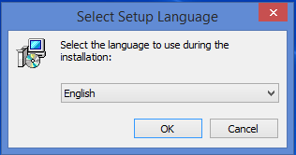
INSTALLATION STEPS
STEP 1
First of all, please insert or plug-in your SPS thumb drive into your machine.
Select the language that you prefer to use during the installation either in English or Malay.

Slide 6
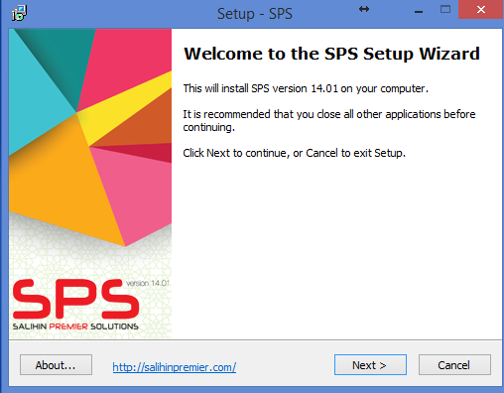
INSTALLATION STEPS
STEP 2
Welcome to the SPS Setup Wizard. This installer will install the SPS Version 14.01 on your computer. It is recommended that you close all the other applications before continuing. Click Next to continue, or Cancel to exit the installation setup.

Slide 7
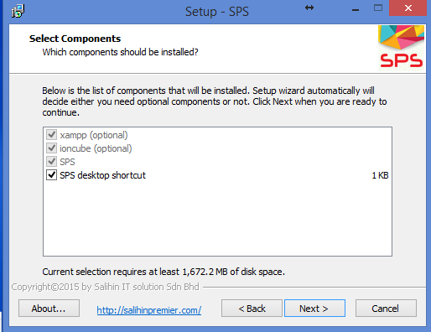
INSTALLATION STEPS
STEP 3
Click Next to continue with the installation, or click Back button if you want to review or change any settings.

Slide 8
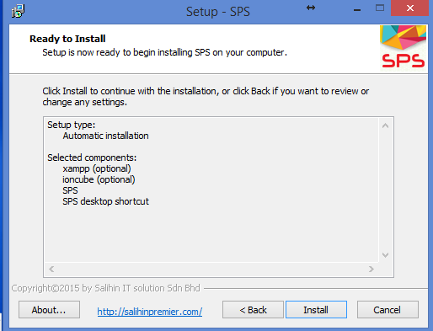
INSTALLATION STEPS
STEP 4
Click Install button to continue with the installation, or click Back button if you want to review or change any settings.

Slide 9
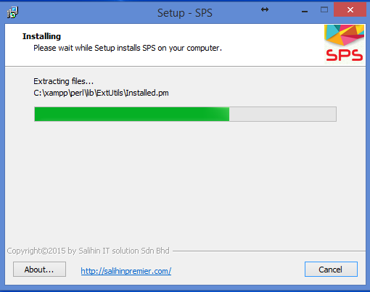
INSTALLATION STEPS
STEP 5
Please wait while Setup install SPS on your computer.

Slide 10
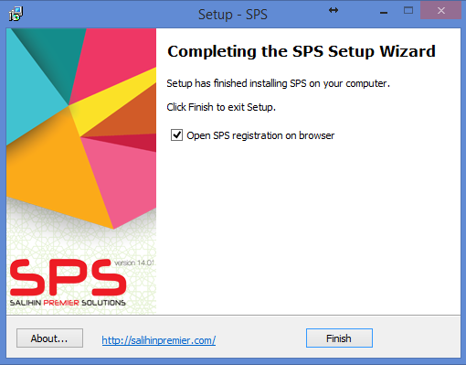
INSTALLATION STEPS
STEP 6
Congratulation! Setup has finished installing SPS on your computer. Please make sure that you RESTART your XAMPP before you tick the Open SPS registration on browser localhost/sps/installation option. Click Finish to exit Setup.

Slide 11
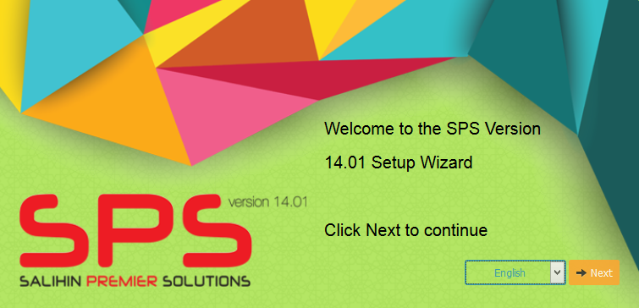
INSTALLATION STEPS
STEP 7
Type localhost/sps/installation. You will see the Welcome to the SPS Version 14.01 Setup Wizard. Click Next to continue

Slide 12
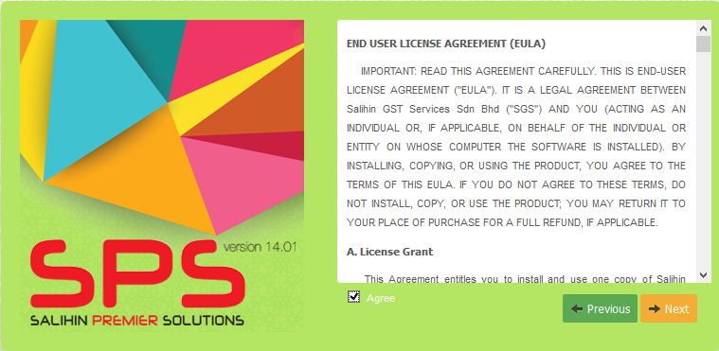
INSTALLATION STEPS
STEP 8
To continue, you have to accept the software license agreement by clicking the box. If you do not agree with the license agreement, the Next button will be disabled.

Slide 13
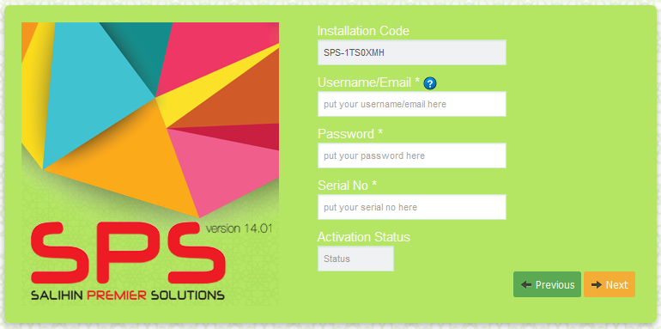
INSTALLATION STEPS
Auto generate installation code
Activation status will be change to ‘Active’ with green colour if you enter the right information.
STEP 9
Check your email, we have send Username/Email and Password. You need to enter your Username/Email, Password and Serial No that located at your SPS Packaging. Then, click Next button to continue.
Notes:
Auto generate installation code

Slide 14
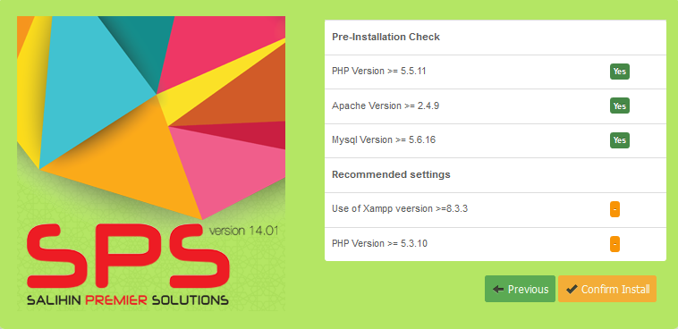
INSTALLATION STEPS
STEP 10
Check the Pre-Installation. Click Confirm Install button to continue.
Notes:
Auto generate installation code

Slide 15
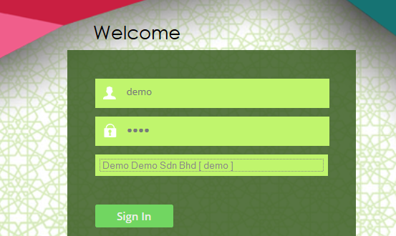
INSTALLATION STEPS
Username: demo
Password: demo
Company: Demo Demo Sdn Bhd [demo]
STEP 11
Once finished, you will see this interface. Entered the temporary information such as username, password and company. You are not allowed to re-edit or delete the temporary details.
Notes:
Auto generate installation code

Slide 16
BASIC SETTING UP
COMPANY SETUP
Company Setup
User Setup
User Right Setup
Log Out
Chart of Account Setup
System &General Setup
Financial Year Calender
Log in with New user ID & Company
Notes:
Auto generate installation code

Slide 17
BASIC SETTING UP
COMPANY SETUP - CONT
Employee Setup
Agent Setup
Master Setup
Term Setup
Bank Setup
Notes:
Auto generate installation code

Slide 18
BASIC SETTING UP
INVENTORY SETUP
Item category
Item Type
Item Setup
Location Master
Unit of Measures
Notes:
Auto generate installation code

Slide 19
ACCOUNT PAYABLES
PURCHASING
Optional
PURCHASE PRICING
SUPPLIER LIST
PURCHASE ORDER
PURCHASE ORDER CONFIRM
Good Received Note (GRN)
PURCHASE RECEIVE
PURCHASE RECEIVE CONFIRM
INVENTORY
REPORTING
Inventory Control
  Inventory list
Statement of Financial Position
  Trade Payable
POSTING JOURNAL
Decrease Stock (purchase return)
Increase Stock
(additional purchase)
DEBIT NOTE
CREDIT NOTE
ACCOUNT PAYABLE
PURCHASE INVOICE CONFIRM
PURCHASE INVOICE
Trade Payable
POSTING JOURNAL
(Auto create GRN)
DIRECT PURCHASE INVOICE
PURCHASE INVOICE CONFIRM
Notes:
Auto generate installation code

Slide 20
ACCOUNT RECEIVABLES
SALES ORDER
Optional
SALES PRICE
SALES QUOTATION
SALES ORDER
Delivery Order
(DO)
DELIVERY ORDER
DELIVERY ORDER CONFIRM
INVENTORY
REPORTING
Inventory Control
  Inventory list
Statement of Financial Position
  Trade Receivable
POSTING JOURNAL
Decrease Stock (additional sales)
Increase Stock
(sales return)
DEBIT NOTE
CREDIT NOTE
ACCOUNT RECEIVABLES
SALES INVOICE CONFIRM
SALES INVOICE
Trade Receivable
POSTING JOURNAL
(Auto create DO)
DIRECT SALES INVOICE
SALES INVOICE CONFIRM
Notes:
Auto generate installation code

Slide 21

CONTACT US
CORPORATE CENTRE:
KL Sentral Office
Unit 2A-1, Level 1
Tower 2A, Plaza Sentral
Jalan Stesen Sentral 5
KL Sentral
50470, Kuala Lumpur
Tel: +603 2261 4180
Fax: +603 2261 4182
CONSULTANT: FARHANA BT ZAHARI
EMAIL: farhana@salihin.com.my
Official Website : www.salihin.com.my
Customer Service : www.salihinpremier.com
E-mail : sales@salihinpremier.com
Careline : 1 300 88 5678

Slide 22

Official Website : www.salihin.com.my
Customer Service : www.salihinpremier.com
E-mail : sales@salihinpremier.com

