Slide 1



PREPARED BY:
*Insert Business Unit Logo Here
SUBMITTED TO:
*Insert Client Logo Here
Notes:
Font Type: Open Sans
Font Size: Proposal Title (60), Proposal Details (40)
Business unit & Client logo: Small size

Slide 2
1.0 Executive Summary
*Insert the executive summary here
Notes:
Font Type: Open Sans
Font Size: Executive Summary Content (36)

Slide 3
Table of Content
1.0
Executive Summary 4
2.0
About Us 16
3.0
The Proposal 20
4.0
Contact Us 24
Notes:
Font Type: Open Sans Light
Font Size: Table of Content (44)
Attention: Please change the table of content and page numbering accordingly. Thank you very much ☺

Slide 4
About Us
—
SALIHIN
1.0 About Us
Notes:
Font Type: Open Sans (Bold)
Font Size: About Us (60)

Slide 5
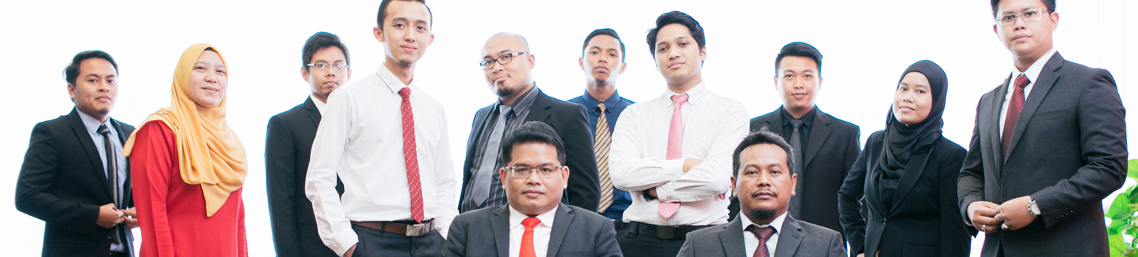


About Us
Founded in 2002, SALIHIN is the brand name of a group of independent and separate legal entities, deploying wide spectrum of capabilities to help clients see and tap opportunities in the areas of transaction and corporate finance, taxation (direct tax and GST), auditing and assurance, shariah auditing and advisory, corporate governance, IT consultancy and business accounting solution.
As one of the fastest growing home-nurtured and bumiputera firms, SALIHIN is having close to 200 competent professionals from different background with diverse thoughts, expertise and experience serving in 9 offices nationwide.
In addition to relevant licenses/certifications for its capabilities, SALIHIN is having MSC Status, Audit Oversight Board (AOB) registered as an Auditor of Public Interest Entity, licensed Capital Market Service provider by Securities Commission, and Approved Training Provider from Human Resources Development Fund (HRDF).
We have a proven track record credited to a sustained quality service delivery to our clients without compromising our professional integrity. SALIHIN continues to build on its successes. It became the first in the world to introduce Teaching Accountancy Firm (TAF) to bridge the gap between accountancy theory and practice.
Vision
To become the preferred national accountancy firm of Malaysia.
Mission
SALIHIN is dedicated to creating value by focusing on customer satisfaction and growth, excellent internal business process and superior human capital resource development.
Notes:
Attention: Please don’t change any content here. Thank you very much ☺

Slide 6
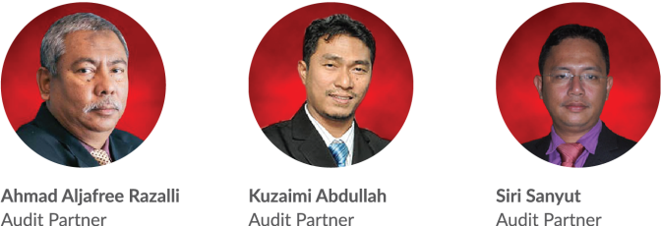
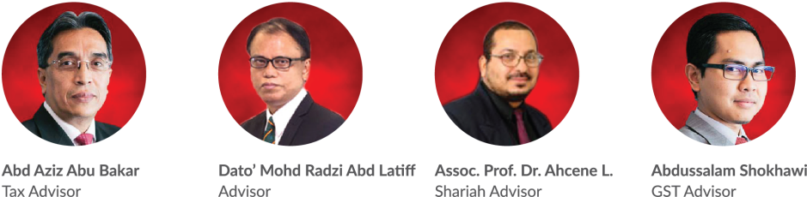
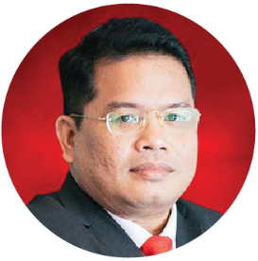
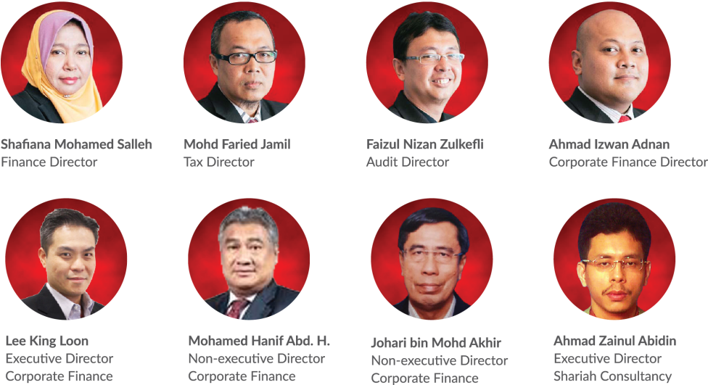
Key Management Team
Salihin Abang
Founder/Managing Partner/CEO
Notes:
Attention: Please don’t change any content here. Thank you very much ☺

Slide 7
Services
SALIHIN offers wide spectrum value for money services:
AUDIT & ASSURANCE
GST & BUSINESS
ACCOUNTING SOLUTION
GST ADVISORY
Statutory Financial Statement Audit
Review Engagements
Compilation Engagement
MPERS / MFRS Training
Agreed Upon Procedures
Preparation & Submission: GST-03
GST Accounting and Review for users of SPS
Preparation of Full Sets Accounts
Preparation of Management Account or Reports
Forensic Accounting
GST Strategic Planning
Cash Flow Planning & Pricing Strategy
GST Bad Debt Management
GST Record Keeping and Internal Control
GST Special Transaction
GST-IT Advisory
Transfer of Going Concern
GST Audit and Investigation
Advice on GST Ruling & Appeal
GST-03 Monthly Submission Review
Monitoring TAP System
GST Annual Adjustment
GST Training & Education Services
GST Accounting Software
DIRECT TAXATION
Mergers and Acquisition Tax Advisory
Corporate Tax Compliance and Planning
Transfer Pricing Advisory
Transfer Pricing Documentation
Tax Audit, Investigation & Appeal
International Tax Consulting
Real Property Gain Tax
Tax Accounting
Tax Risk Management
Notes:
Attention: Please don’t change any content here. Thank you very much ☺

Slide 8
Services (Cont.)
SALIHIN offers wide spectrum value for money services:
GOVERNANCE &
CORPORATE SECRETARIAL
IT CONSULTANCY
SHARIAH AUDIT & ADVISORY
Company Incorporation
Filing Annual Return
Updating Information
Certifying Company Documents
Striking Off Company
Legal Due Diligence
Registration with Relevant Government Agencies
Corporate Governance Advisory
Secretarial Due Diligence and Management
IT Audit & Due Diligence
IT Governance and Planning
IT Project Management
IT Risk Management & Strategy and Assessment
Business Intelligence
IT Sourcing/Outsourcing
Enterprise Resource Planning (ERP)
Software Development and Customisation
Islamic Banking Product Structuring
Islamic Securities: Sukuk Issuance & Structure
Islamic Fund, Wealth & Asset Management
Islamic Private Equity
Establishment of Islamic Bank
Zakat & Waqf Accounting Software (SPS)
Shariah Compliance Training Program
Shariah Training & Education
Shariah Research and Development
Shariah Review & Screening
Shariah Internal Audit
Shariah External Audit
Shariah Risk Management
Shariah Legal Advisory
Shariah Convernance & Supervision
Shariah Accounting
TRANSACTION & CORPORATE FINANCE
Internal Auditing
Enterprise Risk Management
Due Diligence
Business Valuation
Financial Statement Analysis
Raising Seed/Start-Up Capital
Agreed Upon Procedures
Management Buy-In(MBI)/Buy-Out(MBO)
Project and Infrastructure Finance
Pre and Post IPO Advisory
Raising and Restructuring of Debt
Governance and Compliance Advisory
Forensic Audit
Merges, Acquisition and Demergers
Notes:
Attention: Please don’t change any content here. Thank you very much ☺

Slide 9

Notes:
Attention: Please don’t change any content here. Thank you very much ☺

Slide 10








































Our Diverse Clients
SALIHIN serves diverse clients including corporate companies, foundations / non-profit organisations, government bodies, government linked companies and educational institutions. Their diversity spans across different sectors of the economy.
Notes:
Attention: Please don’t change any content here. Thank you very much ☺

Slide 11




Our Local & International Networks
Buenos Aires
Mexico
Boston
Los Angeles
Miami
New York
San Francisco
Europe
Batu Caves
Johor Bahru
Kuching
Kuala Terengganu (TAF)
Vienna
Brussels
Limassol
Paris
Frankfurt
Milan
Rrome
Luxemborg
Bucharest
Moscow
Barcelona
Madrid
Lausanne
Rotterdam
London
Kyiv
SALIHIN is a member firm of i2an,
a reputable global network of accountants which have presence in America, Asia and Europe as well as all the international financial centres.
Asia
Shanghai
Hong Kong
Tokyo Kuala Lumpur
Singapore
Dubai
Sydney
New Delhi
Ramat Gan
Taiwan
America
Our Local Branches
Notes:
Attention: Please don’t change any content here. Thank you very much ☺

Slide 12



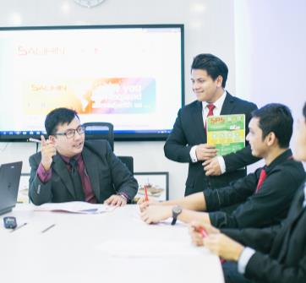

Why SALIHIN?
The following are key reasons why SALIHIN should be your firm’s preferred choice:
01.
Experienced Employees
We have the right ‘hands-on’ team with vast knowledge and relevant experience.
02.
Comprehensive Reports
We would be able to provide complete and comprehensive reports in tandem to your key areas of concern.
03.
Quality Service Delivery
Our Engagement Partner, Board of Advisors and Managers will be involved in closed co-operation for quality service delivery.
04.
Value for Money
We offer ‘value for money’ without compromising on the quality and timeliness of our services.
05.
Minimal Disruption
We will apply our considerable experience to ensure minimal disruption to clients’ daily operations.
Notes:
Attention: Please don’t change any content here. Thank you very much ☺

Slide 13
The Proposal
—
*Insert Proposal Title Here
2.0 The Proposal
Introduction
Objectives
Scope of Work
Methodology & Approach
Time Frame & Deliverables
Professional Fee
Notes:
Font Type: Open Sans & Open Sans Light
Font Size: The Proposal (60), Content (36)
Proposal Title’s Example (at the right-top of the red box) : Audit Proposal (For Audit Dept.) or GST Proposal (For GST Dept.)

Slide 14
The Proposal
Introduction
*Insert content here
Notes:
Font Type: Open Sans Light
Font Size: Content (36)
Content suggestion: Client and proposal background.

Slide 15
The Proposal
Objectives
*Insert content here
Objective 1
Objective 2
Objective 3
Notes:
Font Type: Open Sans Light
Font Size: Content (36)

Slide 16
The Proposal
Scope of Work
*Insert content here
Phase 1
Phase 2
Phase 3
Notes:
Font Type: Open Sans Light
Font Size: Content (36)

Slide 17
The Proposal
Methodology & Approach
*Insert content here
Phase 1
Phase 2
Phase 3
Notes:
Font Type: Open Sans Light
Font Size: Content (36)

Slide 18
The Proposal
Time Frame & Deliverables
Proposal
Meeting
Report
Review
Complete
06/09/2016
10/09/2016
17/09/2016
18/09/2016
20/09/2016
*Insert notes here
Notes:
Font Type: Open Sans Light
Font Size: Content (36), Date (32)

Slide 19
The Proposal
Professional Fee
  The philosophy of SALIHIN is to provide the maximum in client service and individual staff capabilities at the minimum cost, which can be achieved within the highest professional standards and competence levels.
Our fees are based on the complexities of the assignment, the state of books and records kept, the level of staff and experience required and the time committed on the assignment by the partners/advisors and our staff as well as the level of skills and responsibilities involved to complete the work. You have our assurance that we will endeavor to keep the cost as low as possible to commensurate with the work involved.
Engagement | Total Fee
xxx Engagement | RM xx, xxx.xx
Notes:
Font Type: Open Sans
Font Size: Engagement’s content (36)
Attention: You may add additional row/slide depending on your needs.
In the case of progress fee, you may use this phrase: *The fees are based on deliverables at each stage of advisory work.

Slide 20
The Proposal
Professional Fee (Cont.)
Term and conditions
The fees are subject to 6% GST and out of pocket expenses such as printing and stationery, telecommunication charges and other expenses which will be charged to you at cost.
The proposed fee is negotiable and valid within 30 days from the date of proposal submission.
Should there be any additional work that would cause our billing to be significantly higher than the above estimate or should you at later stage indicate that you wish to add or change the scope of our agreed work or include other modules which will incur additional time cost on our part, we will be pleased to discuss with you and obtain your prior agreement on the revised amount on the addition/variation of the scope of work. Our fees shall be payable irrespective of the outcome of the transaction.
Payment terms:
50 % before commencing of work
50 % after completion of work
Notes:
Font Type: Open Sans
Font Size: Term & conditions (36)

Slide 21
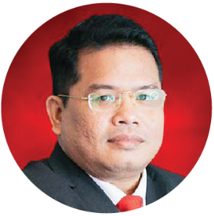
Our Credentials
Key Engagement Team
Approved Company Auditor under Ministry of Finance (MoF)
Approved Tax Agent under Ministry of Finance (MoF)
Approved Cooperative Auditor under Malaysian Cooperative Commission
Approved Auditor Labuan Offshore Financial Services Authority (LOFSA)
Chartered Accountant CA (M) with Malaysian Institute of Accountant (MIA)
Elected Council Member of the MIA
Member of MIA’s Investigation Committee (Statutory)
Member of MIA’s Taxation Practice Committee (Technical)
Member of MIA’s Public Practice Committee
Member of MIA’s Small & Medium Practice Committee (SMPC)
Elected President of Malaysia Accounting Firm’s Association (MAFA)
Fellow Member of Chartered Tax Institute of Malaysia (FCTIM)
Associate Member of Certified Public Accountant (CPA Australia)
Member of Malaysian Association of Certified Financial Planner (CFP)
Certified GST Agent and Trainer
Executive committee member of Malay Chartered Accountants Firms Malaysia
Executive committee of Malaysian Association of Tax Accountants
Bachelor and Master Degree holder in Accounting from International Islamic University Malaysia
Salihin Abang
Managing Partner
Notes:
Attention: Please don’t change any content here. Thank you very much ☺

Slide 22
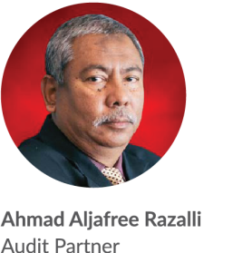
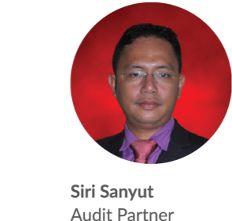
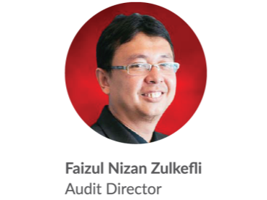
Our Credentials
Key Engagement Team (Cont.)
Approved Company Auditor Under the Companies Act 1965
Approved Cooperative Auditor from Malaysian Cooperative Commission
Member of Malaysian Institute of Accountants (MIA)
Bachelor of Accounting from Universiti Teknologi MARA
Master Degree in Accounting and Finance from UK
Approved Company Auditor Under the Companies Act 1965
Approved Cooperative Auditor from Malaysian Cooperative Commission
Member of Malaysian Institute of Accountants (MIA)
Associate with Chartered Tax Institute of Malaysia (CTIM)
Bachelor of Accounting from Universiti Malaysia Sabah (UMS)
Member of Malaysian Institute of Accountants (MIA)
Bachelor of Accounting from International Islamic University Malaysia (IIUM)
Notes:
Font Type: Open Sans Light
Font Size: Content (28)
Attention: Please insert the details of the project team members appropriately.
Directory: Pictures can be obtained from PUBLIC/SALIHINAlbum/ProposalPictures (Audry’s Action)

Slide 23

Contact Us
—
555, Jalan Samudra Utara 1,
Taman Samudra,
68100 Batu Caves,
Selangor, Malaysia.
Tel: +603-6185 9970
Fax: +603-6184 2524
Email: info@salihin.com.my
Follow us on social media

Slide 24
www.salihin.com.my | www.salihinpremier.com
Careline: 1 300 88 5678
Notes:
Attention: Please don’t change any content here. Thank you very much ☺

