Slide 1
Research METHODOLOGY
Comparative Analysis Between Change Effort Estimation Models and Characteristics of Software Development Project

Slide 2
Contents
1 | Introduction
2 | Effort Estimation Models
3 | Characteristics of Software Development Project
4 | Statement of Problem
5 | Research Hypothesis
6 | Research Questions
7 | Research Objectives
8 | Significance of Research
9 | Conceptual Framework
10 | Methodology

Slide 3
Introduction
Requirement change is an unavoidable software development activity (Ali & Lai, 2016).
It may happens at any phase of software development life cycle (SDLC).
A change may cause cost overrun and project delay.
Without an effective decision made by Software Project Manager (SPM) may lead towards the failure of software development project.
Therefore, effort estimation is used as a process of predicting the most realistic amount of effort (expressed in terms of person-hours or money).
If amount of effort is estimated at early of software development, project will running smoothly.
However, there is different type of characteristics of software development project which affect the utilization of effort estimation models.

Slide 4
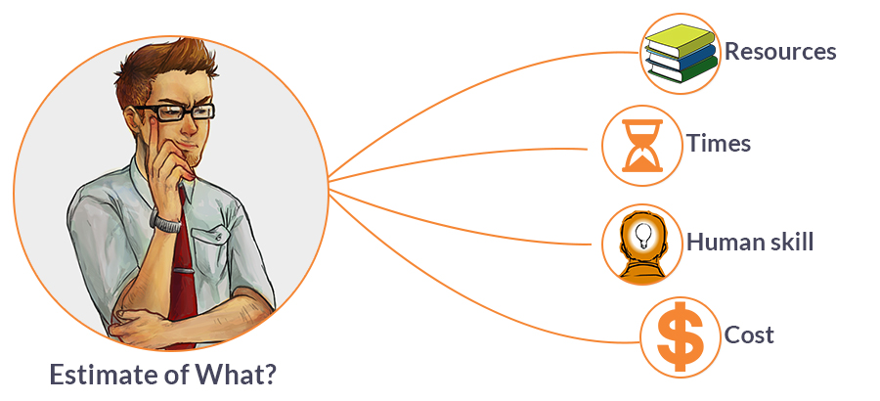
The Current Effort Estimation Models
Lines of Code (LOC)
Function Point Analysis (FPA)
Use Case Point (UCP)
Change Effort (CEPM)

Slide 5


The Selected Characteristics of Software Development Project
Size of project
Complexity of project
Programming experience
Language and tools experience

Slide 6
Which
Effort Estimation Models
should be used by SPM in
software development
project?

Slide 7
Research Hypothesis
Not all effort estimation models are suit to the different characteristics of software development project.
What suit stands for?
A reliable and effective of an effort estimation model for the characteristics of software development project.

Slide 8
Research Questions
What are the current change effort estimation models in software development project?
What are the characteristics of software development project?
How to perform the comparative analysis between the characteristics of software development project and the current change effort estimation models?
What the effort estimation models that suit the characteristics of software development project?

Slide 9
Research Objectives
To analyse current change effort estimation models for software development phase.
To identify list of characteristics of software development project.
To perform comparative analysis between the characteristics of software development project and the current change effort estimation models.
To identify the best effort estimation models that suit to the characteristics of software development project?

Slide 10
Significance of Research
To help SPM make an effective decision by:
Gaining an information of which effort estimation models that suit to the characteristics of software development project at early of software development phase.
Reducing time and cost to predict the amount of effort required in software development project.

Slide 11
Conceptual Framework
Software Development
Change Management
Language & Tools Experience
Characteristics
Programming Experience
Size
At early phase
Complexity
At any phase
Software Change
Impact Analysis
Effort Estimation
Dynamic Analysis
Static Analysis
Non-Algorithmic
Algorithmic
LOC
FPA
UCP
CEPM

Slide 12
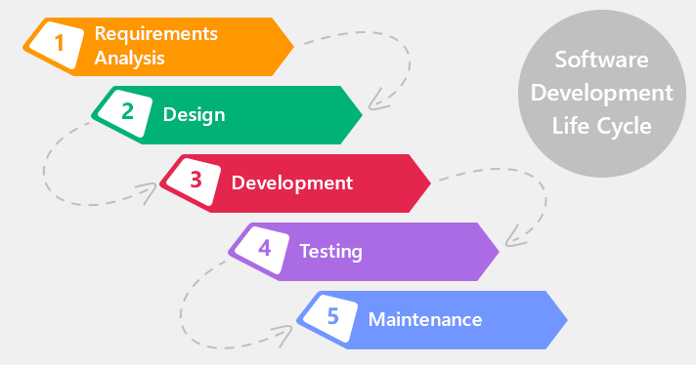
Methodology
Data
Collection
Interview with the users and define requirements
Meet Expert
Data
Analysis
System testing
Data analysis
Evaluation
Testing result
Questionnaire
Literature Review
Statement
of Problem
Define problems
Define needs and constrains
llustrate literature review
Internet
Discussion with supervisor
Waterfall Model

Slide 13
Evaluation Form
Effort Estimation Models/ Characteristics of Software Development Project | Size |  |  | Complexity |  |  | Programming experience |  |  | Language and Tools experience
 | Small | Medium | Large | Simple | Average | Complex | Entry | Intermediate | Expert | Entry | Intermediate | Expert
LOC
FPA
UCP
CEPM

Slide 14
Schedule
 |  | 2016 |  |  |  |  | 2017
No | Activity | Feb - Apr | Apr - Jun | Jun - Aug | Aug - Oct | Oct - Dec | Dec - Feb | Feb - Apr | Apr - Jun | Jun - Aug
1 | Planning
2 | Problem Statement
3 | Literature Review
4 | Data Collection
5 | Data Analysis
6 | Evaluation
7 | Documentation

Slide 15

Thank you
Q&A

