Slide 1


Industrial Training: Primalcom Enterprise Sdn Bhd
By Muhammad afiq zulhafiz b zulkifli (2012611308)

Slide 2
Company Background
Information Technology solution company driven to produce business value for their clients through the groundbreaking application of innovative engineering sciences.
More than 15 years of experience
Location: Bandar Baru Klang, Selangor
** 21-3, Jalan Tiara 3, Bandar Baru Klang, 41150, Klang, Selangor, Malaysia.

Slide 3
Organizational
Structure
Managing Director
Lim Yong Thye
Executive Director & Financial
Lim Lye Seng
Sales Director
Lim Yong Sing
Business Manager
Chia Chin Siang
Marketing Manager
Noorshida Kamarullbahrin
Marketing Team
Tan Kai Hun
Accountant
Ms Gan
Technical Team
Afiq Zulhafiz
IT Support and Administrative
Nazirah Bakri

Slide 4
Department Function
Keep up-to-date with the upcoming carry product
Make sure all the IT hardware or PC in the office is working fine
Must know all functions of each product
Prepare a technical spec of each product for tender spec/proposal
Assist officemate in any problem regarding IT problem

Slide 5
Training Activities
Study and create a solution for:
  video wall
  video extender
  Environment Monitoring System solution
  Ubi Interactive
  Mersive Solstice
Join meeting for the project at customer site
Create and complete a proposal & tender doc for project submission
Do the installation at customer site
Give Training to customer / partner
Maintain all IT hardware in the office
Troubleshoot faulty unit
Assist colleague if there has any problem regarding technical part

Slide 6
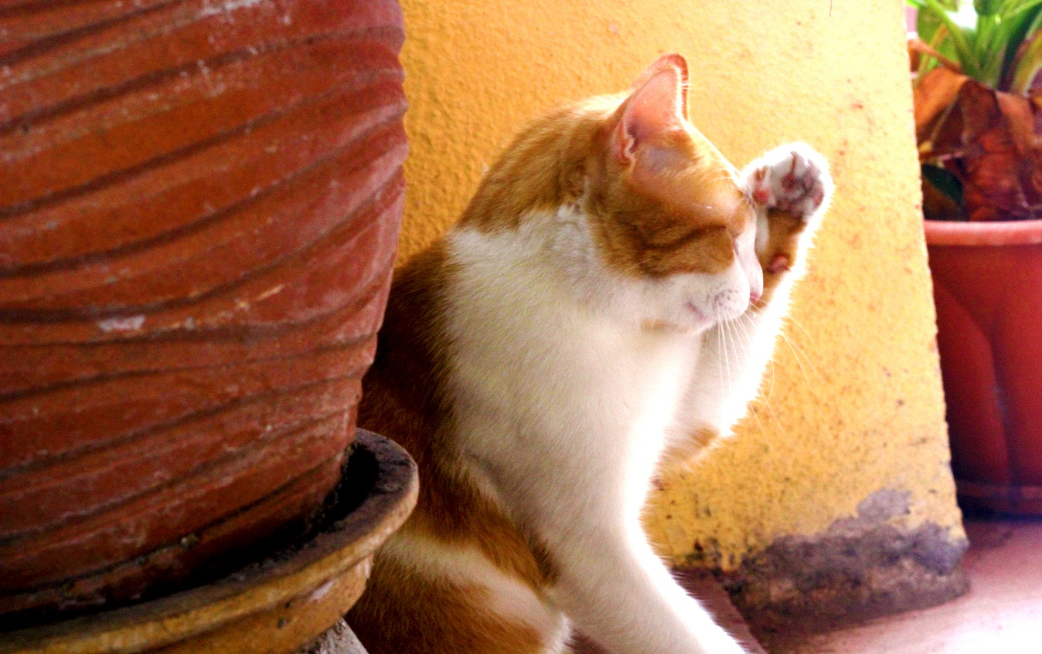
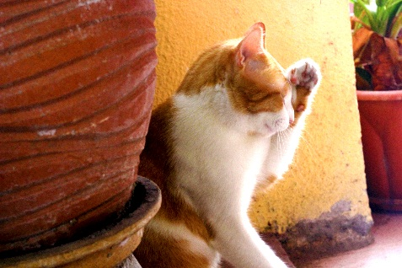
Video Wall
Many display connect together in order to make a ONE big display

Slide 7

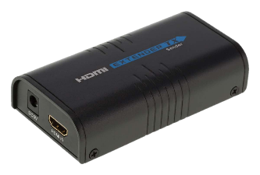
Video Extender
Extend a video up into 150 meter
HDMI Cable
Network Cable (up to 150 meter)
HDMI Cable

Slide 8
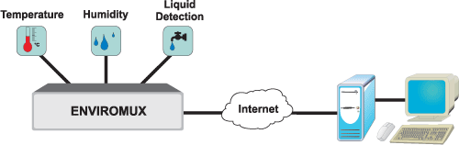
Environment Monitoring System
Monitor humidity, temperature, water leak, smoke and other.

Slide 9
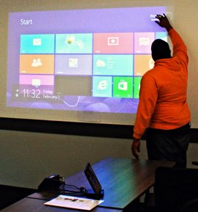
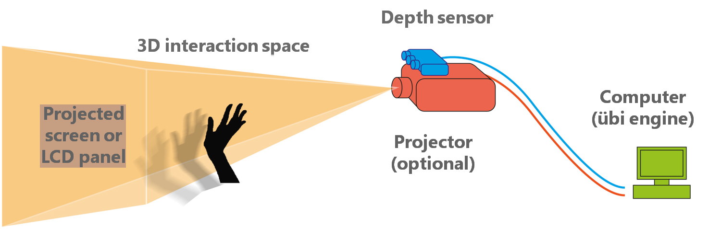
Ubi Interactive
Software that allow user to make any surface to become touch display

Slide 10
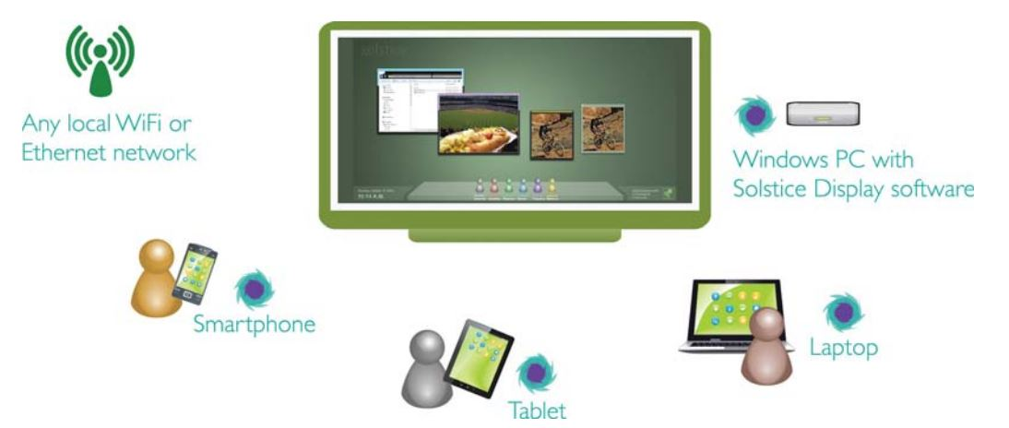
Mersive Solstice
Is a software that allow unlimited people in the same network to share everything in one display

Slide 11
Take a short break with Videos!

Slide 12
Wait! There has one more!

Slide 13
Special Project
Video Wall
  ASTRO
  Telekom Malaysia (TM)
  Nestle
Environment Monitoring System
  Martin Brower
LCD Touch Screen
  Putrajaya Sentral

Slide 14
ASTRO: Video Wall
Meeting with ASTRO
Study and create a solution
POC at ASTRO
Pending…
Install a DEMO unit
Site Visit
** POC = Proof of Concept

Slide 15
Meeting with ASTRO
Meeting with ASTRO
Discuss about what kind of solution that ASTRO required
Place:
  Unit Facilities
Requirement:
  Video Wall
  3 x 2 Display (6 display)
  8 – 10 input sources

Slide 16
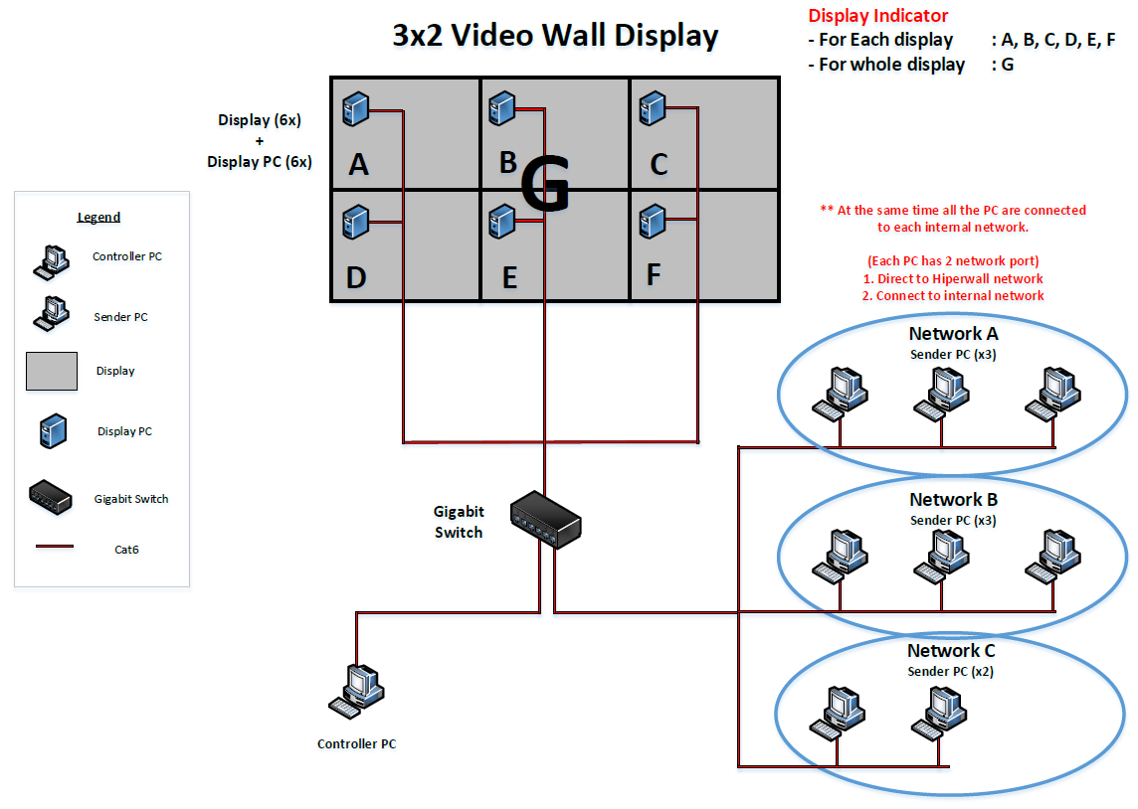
Study and create a solution
Meeting with ASTRO
Study and create a solution
Draw a connection Diagram
Test the solution
Make a confirmation
Solution:
  Hiperwall
  AdderView

Slide 17
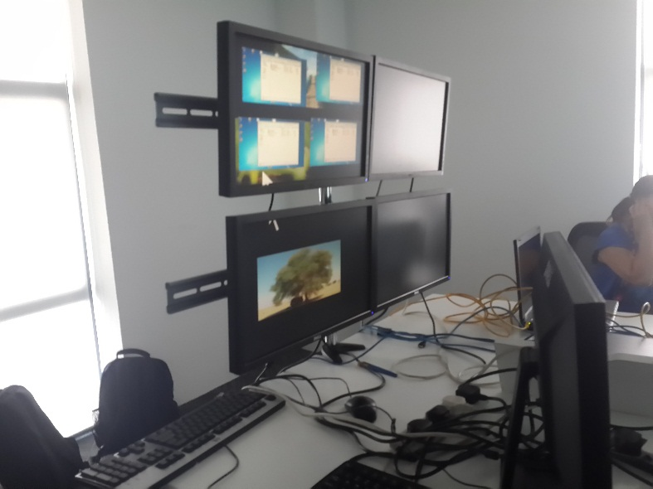
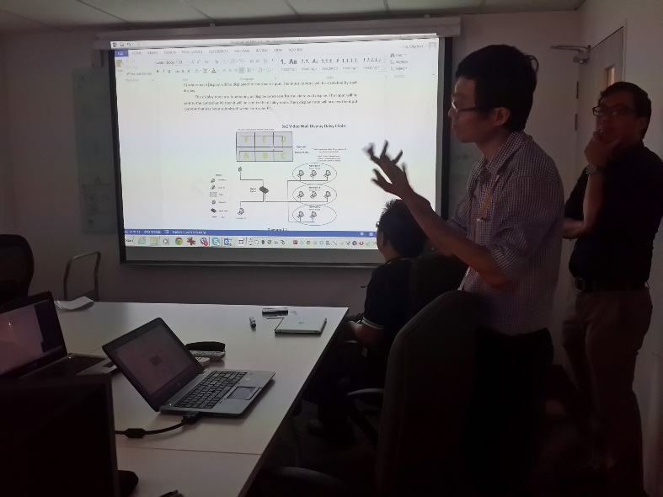
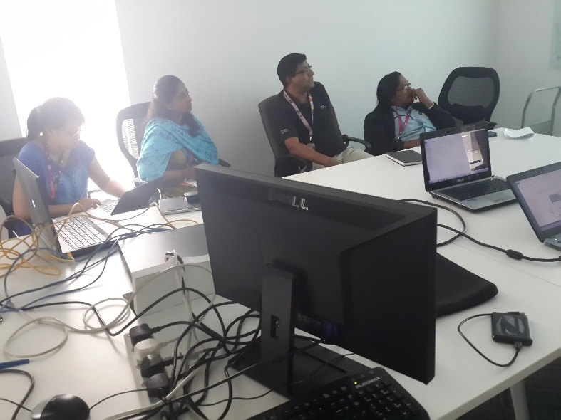
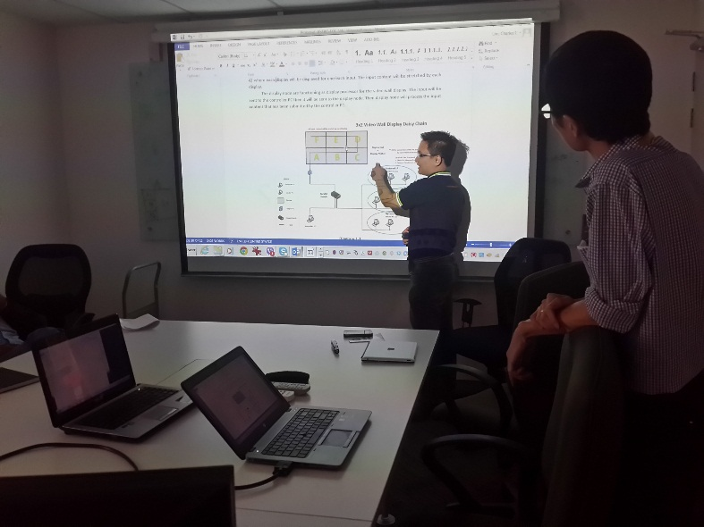
POC at ASTRO
Meeting with ASTRO
Study and create a solution
POC at ASTRO

Slide 18
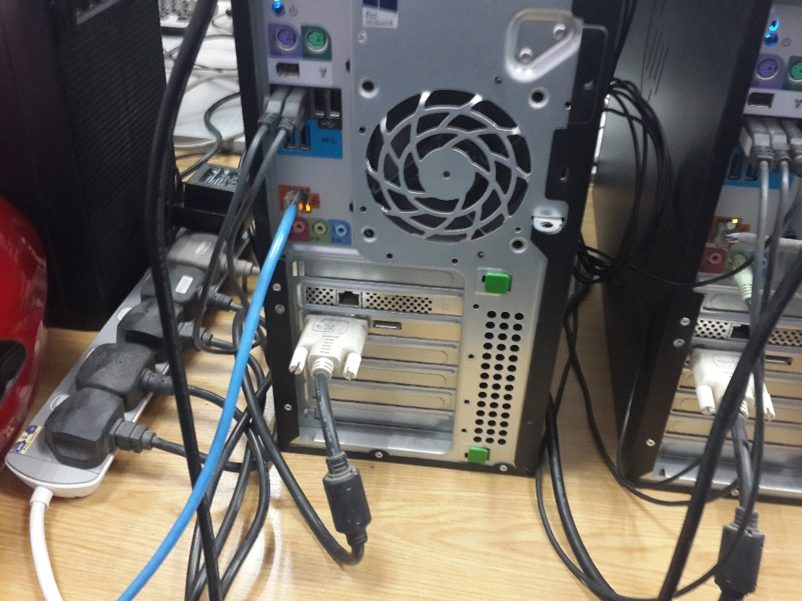
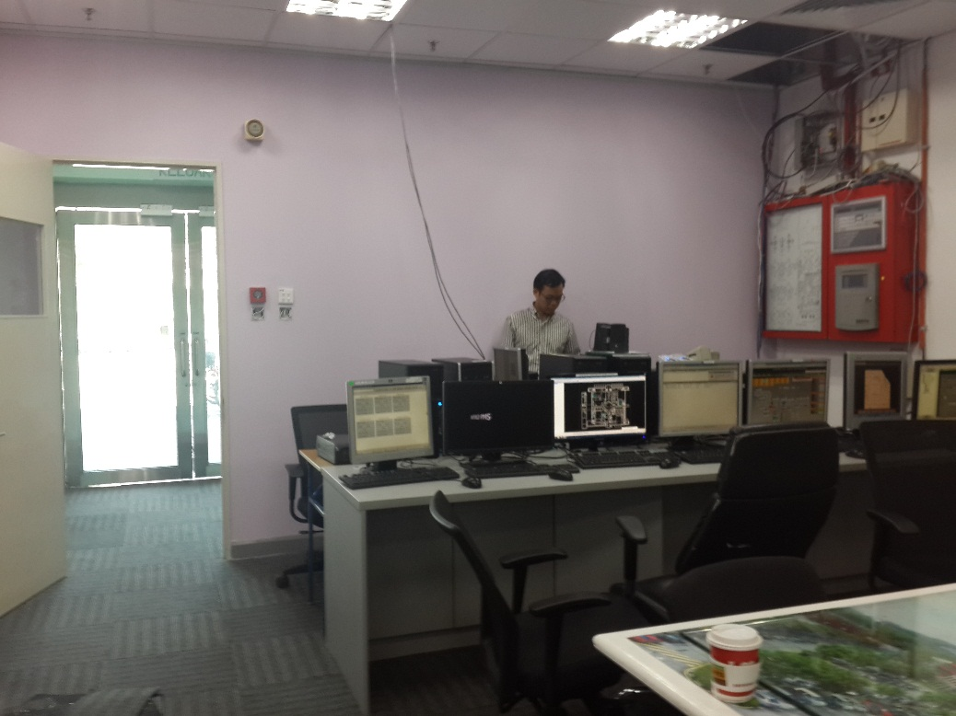
Site Visit
Meeting with ASTRO
Measure dimension for video wall area
Check network structure
Check the input sources
Study and create a solution
POC at ASTRO
Site Visit

Slide 19
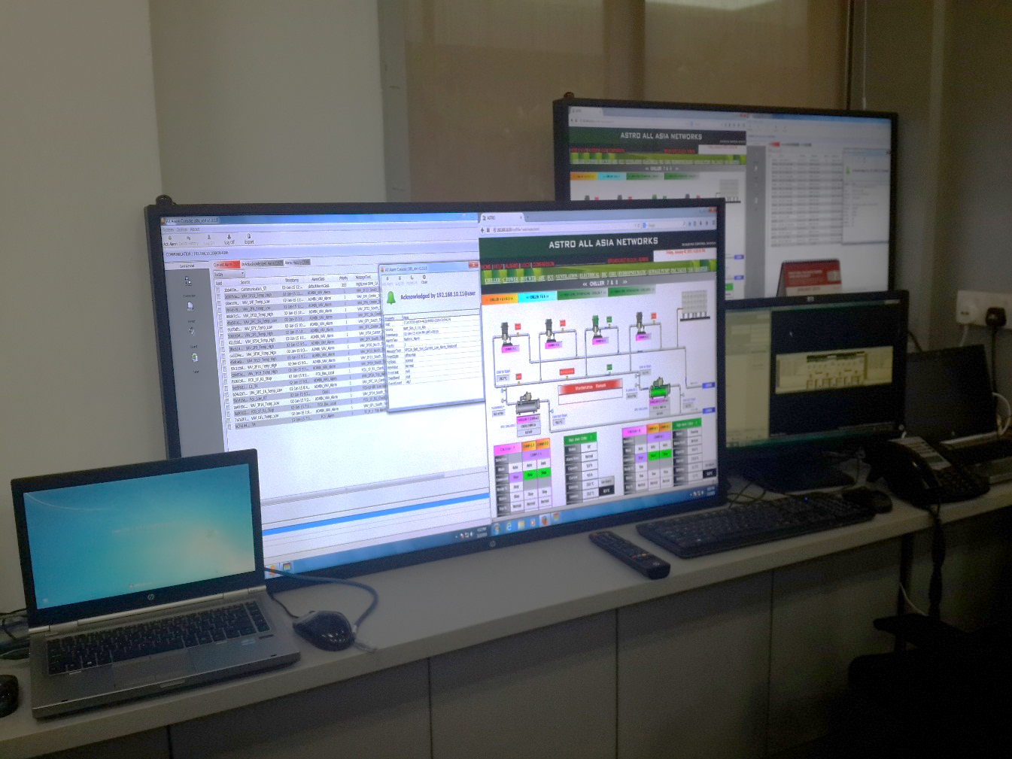
Install a DEMO unit
Meeting with ASTRO
Study and create a solution
POC at ASTRO
Site Visit
Install a DEMO unit

Slide 20
Pending…
Meeting with ASTRO
Study and create a solution
POC at ASTRO
Site Visit
Install a DEMO unit
Pending…

Slide 21
Experience from ASTRO project
Know how to handle difficult customer
Work hard and work smart
Creativity and brain storming skills is important
Never ever panic in front customer
Make a confirmation first before tell others

Slide 22
Experience from company
Know how to handle difficult customer
Work hard and work smart
Creativity and brain storming skills is important
Never ever panic in front customer
Make a confirmation first before tell others
Know how to cooperate with others
Improve time management
Improve English language
More confident

Slide 23
Limitation & Recommedation
Recommendation
  The have existing management system, but they did not utilize it. It is better for them to practice in using the system to improve their office management
Limitation
  The equipment for testing purpose is not complete. So it is difficult to do a testing.

Slide 24
Thank you…

