Slide 1

SPS TRAINING AND PROGRAMME MODULE

Slide 2
Fact sheet
The 3 days education/ training program it’s not perceived only as 3 days training program, but it is essentially a 3 days fundamental training program + 5 years of continuous learning.
SPS Learning & Job Matching Platform aims to provide PI1M community a learning opportunities as well as employment opportunities.
  It consists of a short, free, high quality, self-directed, support focused functions and activities for PI1M participants to go for an extra miles in CPC Product Offerings as well as professional and personal development.
  Courses are developed by CPC subject matter experts and participation academician from our TAF participating universities. The Learning platform is made available at all times for all PI1M participants.
  Simultaneously, the above will be made accessible for all potential employers and all academician to assess potential candidates for their further engagement.

Slide 3
E-Learning Materials
No | LIST OF TRAININGS
1. | Business Documentation Training
2. | SPS Basic Training
3. | SPSLite Training
4. | SPSLite Website Training (Basic)
5. | SPSLite Website Training (Advance)
No | TYPE OF CONTENT
1. | Web Online Seminar (Webinar)
2. | Video Training & Tutorial
3. | Online Training Materials (Web & Mobile)
4. | Online Test & Examination
5. | Online Certification

Slide 4
The SYSTEM modules
Proposed Modules :-
  User Registration & Management Module
  Employer Registration & Management Module
  E-Learning Management Module
  Exam & Certification Management Module
  Job Matching Management Module
  Reporting Management Modules
Proposed Database
  MySql
Proposed Service Repository
  Cloud Based/ Web Hosting Service
User Registration
Employer Registration
E-Learning
Exam & Certification
Job Match
Reporting

Slide 5
cpc training & Certification
To nurture local economies and bring about greater shared prosperity and social change to underserved communities
CPC Training Program is part of Content Provider Contractor (CPC) 5 Years Pi1M Content Empowerment Proposal
01
Catalyze underserved growth
Communities
Transformation
02
Closing
Skills
Gaps
Bridging skills and knowledge gap
Accelerate
Rate of
Change
03
Economy
vs Education
Demand
Bringing industries close to communities

Slide 6


CPC training & certification
CPC’s Training & Certification Program entail an aggressive educational program that tests the level of competence in the principles and practices of SALIHIN PREMIER SOLUTIONS (SPS) & SPSLite CashBook Softwares.
The Certification will only be issued to participants whom passed the exam, while others will be issued the participation certificates. These principles and practices are closely monitor by reputable bodies.

Slide 7

CPC continuous learning
NO. | TRAINING MODULES | METHOD OF TRAINING | SYLLABUS
DAY 1 | Basic Accounting & Business Documentation | Class Room Online Seminar (Webinar) Online Training Video & Tutorial Online Training Material Online Test & Examinations | Objective: To Maintain Systematic Records of Business Transaction in Order to Generate Various Report. Company Setup User Setup User Access Right Chart of Account System & General Setup Form Setup Financial Year Calendar
 | SPSLite Training & Basic/ Advance SPSLite Website Training
DAY 2 | SPS Training
DAY 3 | Revision Examination
Anticipated Class Room Training for 600 PI1M Min 10-20 Participation Per Training 3 Modules (SPS, SPSLite & SPSWeb) 2 Days Training + 1 Day Exam 5 Years Continuous Learning

Slide 8

Trainer criteria
Diploma/ Degree Holder in Accounting or Business Management
Certified SPS Trainer
Minimal 2 Years Working Experience
Excellent in Public Speaking

Slide 9

Key competencies
Demonstrate Personal & Professional Accomplishment
Increase skills & Proficiency
Real Business Case Exposure
Endorsed by
Reputable
Bodies
(TAF UMT-UniKL-UiTM-UPM)
Structured & Practical Modules
Certification and Assessment

Slide 10





Training approach
Main Approach-Class Room Training
  Min 10-20 Participation
  3 Modules (SPS, SPSLite & SPSWeb)
  2 Days Training + 1 Day Exam
  Online Certification (.pdf format)
Optional Training Approach
  Web Based Training Seminar (Webinar)
  Video Training & Tutorials
  Mobile Video Training & Tutorials
  Online Training Materials

Slide 11


Training modules
We are proud to offer training and certification to support Pi1M needs including:
Business
Documentation
SPS Certification
SPS Basic Training
SPSLite
CashBook
SPSLite
Website Basic
SPSLite
Website Advance

Slide 12
Training modules……cont
No | LIST OF TRAINING | Class Room | Web/ Mobile Training Video & Tutorial | Webinar | Online Training Materials | Online Test & Examination
1 | Business Documentation Training | √ | √ | √ | √ | √
2 | SPS Basic Training | √ | √ | √ | √ | √
3 | SPSLite Training | √ | √ | √ | √ | √
4 | SPSLite Website Training (Basic) | √ | √ | √ | √ | √
5 | SPSLite Website Training (Advance) | √ | √ | √ | √ | √

Slide 13
Target audience…...cont
No. | TRAINING MODULES | TARGET USER | FREQUENCY | DURATION | RESOURCES
DAY 1 | Basic Accounting & Business Documentation | Micro Entrepreneurs SPS Leavers Under Graduates Graduates | Weekly | 1 1/2 Hours | 3 Persons
 | SPSLite Training & Basic/ Advance SPSLite Website Training |  |  | 1 1/2 Hours
DAY 2 | SPS Training |  |  | 3 hours
DAY 3 | 1 Full Day Examination

Slide 14
Program schedule
Details | 8.00 - 9.00 | Session I 9.00-10.30 | 10.30 - 11.00 | Session II 11.00-13.00 | 13.00 - 14.30 | Session III 14.30-17.00
Day 1 | Registration & Breakfast | Basic Accounting & Business Documentation | Tea Break | SPS Lite (Overview, Set Up Process & Expenses Modules) | Lunch | SPS Lite (Sales, general & Report Modules) SPS Web (Overview & Setup Modules)
Day 2 | Breakfast | SPS Full Set (Overview & Set Up Process Modules) |  | SPS Full Set (Inventory, Purchase & Account Payable Modules) |  | SPS Full Set (Sales, Account receivables, Other payment, GST & Financial Report Modules)
Day3 | Breakfast | Examination & Assessment |  |  | Lunch | Dismiss

Slide 15
Program breakdown
SPS Training Module Details
Day | Subjects
1 | Basic Accounting Knowledge Objective: To Expose the normal business process as well as basic accounting knowledge to participants. Flow of Accounting Documents Double Entry Balance Sheet Income Statement | SPS Lite Objective: To Familiarize participants with the basic book keeping system. Overview of SPS Lite Setup Process Company Setup Fixed Asset Bank Loan Expenses Expenses COGS Operating Expenses Purchase of Fixed Assets

Slide 16
Program breakdown
SPS Training Module Details
Day | Subjects
1 | Sales General Bank Transfer Loan Repayment Loan Receive Reports Profit & Loss Account Balance Summary Fixed Assets Report Loan Report SME Cash Flow Posted Journal | SPS Personal Web Objective: To Empower Business Marketing Tools Through Website. Overview of Personal Web Setup Process Front Page Menu About Product Testimoni Contact Us

Slide 17
Program breakdown
SPS Training Module Details
Day | Subjects
2 | SPS Accounting Software Objective: To Maintain Systematic Records of Business Transaction in Order to Generate Various Report. SPS Overview Overview of SPS Product Setup Process Company Setup User Setup User Access Right Chart of Account System & General Setup Form Setup Financial Year Calendar | Purchasing Supplier Setup Purchase Order Purchase receive Account Payable Purchase Invoice Purchase Debit/Credit Note Supplier Payment Report

Slide 18
Program breakdown
SPS Training Module Details
Day | Subjects
2 | Sales Customer Setup Sales Quotation Sales Order Delivery Order Account Receivables Sales Invoice Sales Debit & Credit Note Customer Payment Received Account Receivable Report | Other Payment & Other Receive Goods & Services Tax GST Setup Bad Debt Relief & Bad Debt Recover GST Report, GST -03 & Relevant Report Financial Report Trial Balance Profit & Loss Balance Sheet Zakat & Wakaf

Slide 19







SPS certification introduction
SPS Certification are categorized as follows:
Certification of Achievement
Certification of Participation
SPS PI1M training certification will be endorsed by below reputable institution depending on the location of the SPS PI1M program situated:

Slide 20
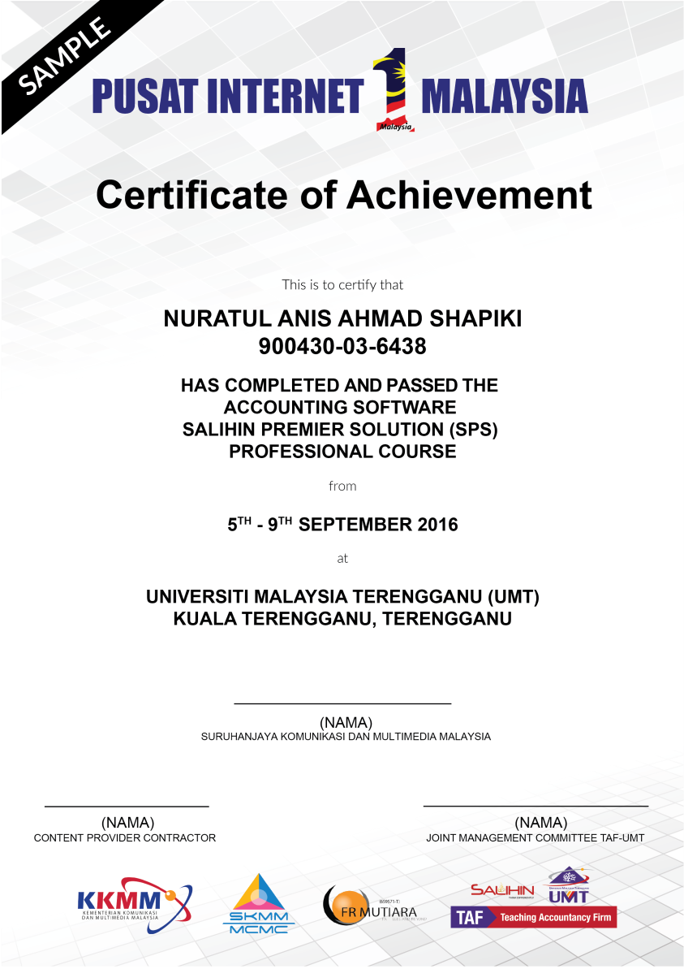
Certification of achievement
SPS Certification of achievement will be given for those participant whom full participate in the SPS PI1M training program and achieve minimum marking level set up in the examination.

Slide 21

Certification of participation
While on the other hand, SPS Certification of participation will be given for those participant whom full participate in the SPS PI1M training program and did not achieve minimum marking level set up in the examination.

