Slide 1

RETREAT 2017
Department : GST DEPARTMENT
Venue : Salihin’s HQ
Date : Saturday, 07 January 2017

Slide 2

2017 KPIs – Strategic Direction

Slide 3
Vision
To be the preferred GST advisor and consultant in Malaysia.
Mission
Providing high quality of GST services without compromising professional integrity.
Objectives
Providing high quality services with high quality people.
Providing GST-Accounting software solutions.
Generating high income value for SALIHIN Group.

Slide 4
KPI PERFORMANCE 2015

Slide 5

2016 Reflection
Service Revenue Performance as at Dec 16’
1,512,500
Stream:
GST Submission Review = Achieved
GST Advisory = Achieved
GST Training = Not achieve
GST Audit and Annual Adj. = Not achieve
Other services = Not achieve
1,285,324
1,186,200
Non-achievement factors (2016)?:-
GST Training : Competitor/Trainers
GST Audit and Annual Adj : leak of information for services
Target 2016
Actual 2016
Target 2017

Slide 6
KPI Monitoring- Financial 2016
Performance To-date (Jan – Dec)
Revenue Drivers | Revised KPI | Actual To Date (Invoice) | Balance/Deficit
GST Submission Review | 409,200 | 507,116 | (97,916)
GST Training & Education | 154,000 | 133,860 | 20,140
GST Audit and Annual Adjustment | 180,000 | 127,761 | 52,239
GST Advisory | 400,000 | 480,741 | (80,741)
GST Publication | - | - | -
Other services | 43,000 | 35,846 | 8,164
Total | 1,186,200 | 1,285,324 | (98,114)

Slide 7
PERFORMANCE 2016
NON-FINANCIAL PERFORMANCE
GOAL | OBJECTIVE | KPI for 2016
Community | To become first choice Bumiputera firm in taxation | X
Customer | To minimize customer complaint To ensure quick response to client To improve quality services | √ √ √
Internal process | Minimize delay Improving process efficiency and effectiveness | √ √
Human Resource | Harmonize working environment Outline career development programme Maintain lower staff turnover rate | √ √ < 20%

Slide 8
SWOT ANALYSIS

Slide 9
SWOT ANALYSIS
s
STRENGTHS
Good teamwork among staff.
Manage to finish job on time with existing staff.
GST expert – 3 persons are GST agent and certified GST agent.
Good rapport with Customs Authority.
Independent.
Good relationship with client.
w
WEAKNESSES
Fraternization- when interact with other staff from another department, we tend to change from work matter to personal matter.
Poor job management - Last minute job handling.
Lack of specialized industries expert.

Slide 10
SWOT ANALYSIS - SOLUTION
WEAKNESSES
Fraternization- when interact with other staff from another department, we tend to change from work matter to personal matter.
Poor job management - Last minute job handling.
Lack of specialized industries expert.
SOLUTION
Establish fraternization policies.
To develop time management skills.
Appoint each staff by specific industries and send them to specialized workshop in specialized industries.

Slide 11
SWOT ANALYSIS
o
T
OPPORTUNITIES
Potential client will tend to refer SALIHIN for our services which include GST as SALIHIN is well-known medium audit firm.
Non GST compliance companies- Company that are not complied with RMCD and facing many GST problem.
Customs enforcement – Active GST audit.
Changes in Government policies, regulation or legislation.
Carry enhancement
High impact job
THREATS
Many public listed company have knowledge about GST and implement by themselves.
Our existing clients have awareness on GST treatment and can independently manage their own GST
SALIHIN (authorize body) as a GST Agent hold responsibility for any clients fault.
Competitors with same business nature.
Market demands seasonal.
Changes in policies, regulation or legislation make the up-to-date process slowly and clients may need a time to adapt it.
Retention of key team members

Slide 12
SWOT ANALYSIS - SOLUTION
THREATS
Many public listed company have knowledge about GST and implement by themselves.
Our existing clients have awareness on GST treatment and can independently manage their own GST
SALIHIN (authorize body) as a GST Agent hold responsibility for any clients fault.
Competitors with same business nature.
Market demands seasonal.
Changes in policies, regulation or legislation make the up-to-date process slowly and clients may need a time to adapt it.
Retention of key team members
SOLUTION
Diversify services.
Engaging with potential clients proactively.
To develop disclaimer policy.
Improve quality of work.
Continuous research on industries to increase department’s income.
Frequent updates on changes in policies, regulation or legislation through Newsletter and provide in-house training.
Recognize and reward key team members by appreciating them with bonus

Slide 13
KPI SETTING 2017

Slide 14
KPI Monitoring – Financial 2016
Services | Forecast
GST Training and Education Services | RM90,000
GST Submission Review | RM489,000
GST Advisory | RM710,000
GST Compliance Audit & Annual Adjustment | RM185,000
Other Services | RM38,500
Total | RM1,512,500

Slide 15
Current Job : YR 2017
Existing clients/Secured Job
Services | Fee as at : 1st quarter of 2017 |  |  | : 2nd quarter 2017
 | January | February | March | April – June
GST Submission Review | 40,800 | 17,800 | 17,800 | 50,400
GST Advisory | 30,000 | 42,550 | - | 38,750
GST Annual Adjustment | - | - | - | 800
Total: | 70,800 | 60,350 | 17,800 | 89,950

Slide 16
Potential Client List
Proposal – Continue Services for GST Submission Review
Clients | Engagement | Proposed fee (RM)
TH Properties Group of Companies | Extension of GST Review Services | 23,600
NIOSH | Extension of GST Review Services | 5,000
Proposal – GST Advisory
Clients | Proposed fee (RM) | Propose date
National Farmers Organization (NAFAS) | 100,000 | 24/10/2016
Lembaga Hasil Dalam Negeri (LHDN) | 1,027,732 | 30/12/2016
Lembaga Penduduk dan Pembangunan Keluarga Negara (LPPKN) | 793,200 | 29/12/2016
Emax Synergy Sdn Bhd (ESSB) | 45,600 | 4/1/2017
DBKL | 1,200,000 | 30/11/2016

Slide 17
Client List
Proposal – Compliance Audit & Annual Adjustment
Clients | Compliance Audit | Proposed fee (RM) | Annual Adjustment | Proposed fee (RM) | Total fee (RM)
Yayasan Sarawak | / | 70,000.00 | / | 15,500.00 | 85,500.00
Petronesa Sdn Bhd | / | 40,000.00 | / | 15,000.00 | 55,000.00
Sanjung Etika Sdn Bhd | / | 14,000.00 | / | 10,000.00 | 24,000.00
Pometia Sdn Bhd | / | 10,000.00 | / | 7,000.00 | 17,000.00
YaPEIM (KYB) | / | 50,000.00 | / | 13,500.00 | 63,500.00
KOPTNB | / | 50,000.00 | / | 10,000.00 | 60,000.00
PELITA group of companies | / | 105,000.00 | / | 15,000.00 | 120,000.00
YPJH group of companies | / | 134,500.00 | / | 10,000.00 | 144,500.00
KOPETRO | / | 85,000.00 | / | 10,000.00 | 95,000.00
Majlis Agama Islam Selangor | / | 25,000.00 | / | 10,000.00 | 35,000.00

Slide 18
Client List
Proposal – Compliance Audit & Annual Adjustment
Clients | Compliance Audit | Proposed fee (RM) | Annual Adjustment | Proposed fee (RM) | Total fee (RM)
SAZEAN group of companies | / | 35,000.00 | / | 10,000.00 | 45,000.00
Lembaga Jurukur Tanah | / | 45,000.00 | X | - | 45,000.00
PRIMABAGUZ | / | 60,000.00 | X | - | 60,000.00
QUATRIZ | / | 13,000.00 | X | - | 13,000.00
SAINS | / | 45,000.00 | X | - | 45,000.00
Damini Corporation | / | 35,000.00 | X | - | 35,000.00
Jordone Groups | / | 40,000.00 | X | - | 40,000.00
Cradle Funds sdn. Bhd | / | 45,000.00 | X | - | 45,000.00
Mutiara Motor Sdn Bhd | / | 45,000.00 | X | - | 45,000.00
Hartasuci Sdn Bhd | / | 27,000.00 | X | - | 27,000.00

Slide 19
Client List
Proposal – Compliance Audit & Annual Adjustment
Clients | Compliance Audit | Proposed fee (RM) | Annual Adjustment | Proposed fee (RM) | Total fee (RM)
NATIONWIDE | / | 90,000.00 | X | - | 90,000.00
Delta Perdana Sdn. Bhd. | / | 25,000.00 | X | - | 25,000.00
Naza Tutti Frutti (M) Sdn Bhd | / | 20,000.00 | X | - | 20,000.00
Dongwha Malaysia Sdn Bhd | / | 50,000.00 | X | - | 50,000.00
Diagnostic Systems (M) Sdn. Bhd. | / | 30,000.00 | X | - | 30,000.00
K.Shah Energy Resources Sdn Bhd | / | 20,000.00 | X | - | 20,000.00
Ken West Sdn Bhd | / | 20,000.00 | X | - | 20,000.00
Alam Maritim Group | / | 174,000.00 | X | - | 174,000.00
Perbadanan Stadium Malaysia | / | 14,000.00 | / | 10,000.00 | 24,000.00

Slide 20
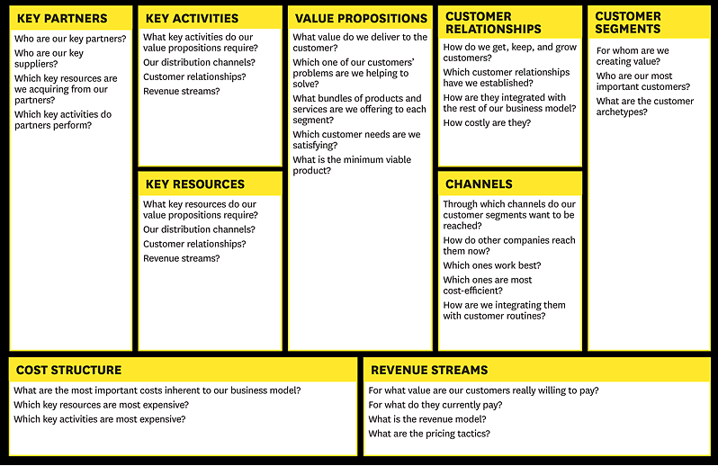
BUSINESS MODEL
Malaysian Association of Tax Accountants (MATA)
Software vendors (Salihin Premier Solutions (SPS),etc.)
Relation ship Royal Malaysian Customs Department (RMCD)
New market expansion.
Event management.
Sponsor management.
Facilitate businesses to better manage GST risks.
Any updates or information will be informed twice a month via email.
1.
Registered with Human Resource Development Fund (HRDF).
Fast build prospect list.
Niche expertise.
Good rapport with RMCD officers.
Complimentary GST e-Newsletter- Current updates on GST issues.
Business events.
Consulting.
Build brand.
Reliability of information
Customer website interaction
Government agencies
GLC companies
Local authorities
Private companies
Branding
Patents
People
Word of mouth.
Existing clients.
Email campaigns.
Social media e.g. website.
Staff
Training preparations
Payment revenues
Consulting fees

Slide 21
OUR PRIORITY STRATEGIES
Who |  | Our Priority Strategies | Deliverables
All GST Staffs | F1 | Financial – To maintain the company’s growth and maximize the profit Lowering production cost to increase profit margin | Affordable price
All GST Staffs | C1 | To gain clients loyalty by improvise and provide value added services. To offer new and continuous services | Newsletters GST training
All GST Staffs | P1 | To focus on quality and performance with optimal cost and efficient resources Expand our service into new market | Proposals

Slide 22
ACTION PLAN
 | Our Priority Strategies | Link
F1 | Financial – To maintain the company’s growth and maximize the profit Lowering production cost to increase profit margin | Action Plan 1
C1 | To gain clients loyalty by improvise and provide value added services. To offer new and continuous services | Action Plan 2
P1 | To focus on quality and performance with optimal cost and efficient resources Expand our service into new market | Action Plan 3

Slide 23
OUR MONITORING PLAN
When | Our Monitoring plan
Monthly | The leader will update status of action plan. The leader will highlight new issues/problems arising from the action plan. The leader will prepare monthly performance report – Timely deliverable, quality of services, financial and non-financial KPI etc.
Quarterly | The leader will discuss status of strategies and progress of action plan. The leader will revise the strategies and priorities strategies based on current performance.
Annually | The leader will list the post mortem on the performance achieve. The leader to make the necessary changes for next year budgeting and planning.

Slide 24
Thank You

