Slide 1


COMPANY PROFILE

Slide 2

Summary
Name of company | HNJ Pictures Sdn Bhd
SSM Registration no | 609622-P
MOF License no | 357-02048145 (Bumiputera Status)
FINAS Licenses no | PF 04/01379 * DF 05/00839
Business Premis | NEW ADDRESS No. 303A Lrg Perak, Melawati Sq Business Centre, 53100 Kuala Lumpur OLD ADDRESS No. 31-1A First Floor, Jalan UP 1/6, Ukay Perdana, 68000 Ampang, Hulu Kelang, Selangor Darul Ehsan.
Office Tel/Fax | Tel : +603-4108 8867 Fax: +603-4147 4022
Date Incorporated | 21ST March 2003
Authorized Capital | RM100,000.00
Paid-up Capital | RM50,000.00
Director | -YBhg Dato’ Mohd Radzi B. Abdul Latif H/P: 019-2323888 -Ahmad Al-Husna B. Abu Hassan H/P: 012-9199227 -Salihin B. Abang H/P: 013-3527678 -Noorlaily Nurulhuda Bt Mohd Yusoff H/P: 019-2055921 -Azriman B. Abdullah H/P: 019-2121025
Company Secretary | Hi-Kay Consult Sdn Bhd Lot 3.26 Tingkat 2, Medan MARA, Jalan Raja Laut, 50350 Kuala Lumpur. (Attn: En Shamsuddin) Tel : +603-26914916 / 27150433 Fax : +603-26916167
COMPANY PROFILE

Slide 3


Business Activities
Types of Programmes – TV, Webtv & Video Production
 | · Capsule · Corporate Video · Documentary · Drama · Magazine Programme · News & Current Affairs · Reality TV · Talk Show · Telemovies · Training Videos · TV Commercial · Special Event
COMPANY PROFILE

Slide 4


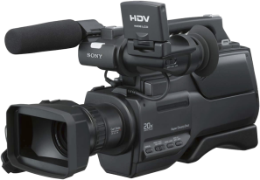


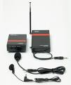

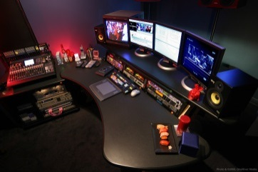
Equipment
Single Camera Production & Multiple Camera Production
 | SONY / PANASONIC HDV HD
Non-linear Editing System
 | FCP EDIUS 5
COMPANY PROFILE

Slide 5


Clientele
Companies
ABX EXPRESS SDN BHD | LEF RECREATION
AL HIJRAH MEDIA CORPORATION | MIMOS BERHAD
ATLAS DEFENCE TECHNOLOGY SDN BHD | MYNETWORKS SDN BHD
ADA VISION COMMUNICATION SDN BHD | NUR HIKMAH MULTIMEDIA SDN BHD
AVMC SOLUTIONS | SISTEM TELEVISYEN MALAYSIA BERHAD (TV3)
BURSATRA SDN BHD | SKF BEARING INDUSTRIES (MALAYSIA) SDN BHD
CH-9 MEDIA SDN BHD (TV9) | THE NEW STRAITS TIMES PRESS (M) BHD
GLOBAL ATLAS RESOURCES SDN BHD | TIME ENGINEERING BHD
HVD TELEVISION PRODUCTION SDN BHD | WHITE & ORANGE SDN BHD
IKE SERVICES (M) SDN BHD | WIZ COMMUNICATIONS
IRIS NETWORK SDN BHD | ZEAL HI-TEC SOLUTIONS SDN BHD
COMPANY PROFILE

Slide 6
Clientele
 | Government Agencies
 | INSTITUTE OF DIPLOMATIC & FOREIGN RELATIONS (IDFR)
 | KEMENTERIAN KOMUNIKASI & MULTIMEDIA – RTM (TV1, TV2, Tvi)
 | KEMENTERIAN KESIHATAN
 | PERBADANAN KEMAJUAN KRAFTANGAN MALAYSIA (Supplier/Contractor Co. Registration No. 091/09)
 | ROYAL MALAYSIAN AIR FORCE (RMAF)
 | UNIVERSITI TEKNOLOGI MARA (UiTM)
 | Non-govermental Organization (NGO)
 | PERGERAKAN WANITA UMNO MALAYSIA
 | MALAY RESEARCH & STRATEGIC FOUNDATION Yayasan Kajian & Strategi Melayu
COMPANY PROFILE

Slide 7

Track Record – Year 2014-2016
Title | Type / Duration | Language | Format | Client
PELABURAN HARTANAH BHD (Concept Creation) | Video Korporat 1 x 5min | Malay | HDD | MA Pictures Sdn Bhd
TUN RAZAK 40 TAHUN DALAM KENANGAN (Prdn Management) | Special Documentary 1 X 60’ | Malay | HDD | Medyavizyon Sdn Bhd (ASTRO)
DUNIAKU MALAYSIAKU (Editorial) | Majalah Remaja 13 x 30’ | Malay | HDD | TV Alhijrah
F.I.K.R. (Editorial, Prdn) | Majalah Remaja RTM 13 x 30’ | Malay | Beta Digital | Adept Media (M) Sdn Bhd (RTM)
BAWALAH AKU PULANG | Telemovie, Umum 1 x 90m | Malay | Beta Digital | Radio & Televisyen M’sia (RTM)
COMPANY PROFILE

Slide 8



Track Record – Year 2013
Title | Type / Duration | Language | Format | Client
BULUH, BAJU & BABA | Telemovie, Aidilfitri 2013 1 x 90m | Malay | Beta Digital | Radio & Televisyen M’sia (RTM)
PASPORT DUNIAWI | Telemovie Umum 1 x 90’ | Malay | Beta Digital | Al Hijrah Media Corporation (TV Al Hijrah)
SAYA SABAR | Telemovie, Umum 1 x 90m | Malay | Beta Digital | Al Hijrah Media Corporation (TV Al Hijrah)
COMPANY PROFILE

Slide 9



Track Record – Year 2012
Title | Type / Duration | Language | Format | Client
GELOMBANG MERAH SRI KANDI UMNO | Corporate Video 2 Versions x 20m | Malay English | HD DVD | Pergerakan Wanita UMNO Malaysia
Majlis Antipemerdagangan Orang dan Antipenyeludupan Migran (MAPO) | Corporate Video 2 Versions x 10m | Malay English | DVD | Home Pictures Sdn Bhd MAPO-KDN
3 JANJI | Drama (Serial) Slot Lestary 13 x 60m TX Every Tues 9pm w.e.f. 20 Mar 2012 | Malay | Beta Digital DVD VHS | Sistem Televisyen Malaysia Bhd (TV3)
SENANDUNG CINTA SEMALAM | Telemovie Slot Cerekarama 1 x 82m (TX Sat 16 May 2012 10pm-12pm) | Malay | Beta Digital DVD VHS | Sistem Televisyen Malaysia Bhd (TV3)
COMPANY PROFILE

Slide 10





Track Record – Year 2011
Title | Type / Duration | Language | Format | Client
BUNGA APRIL | Drama (Serial) Slot Samarinda 25 x 30m (TX Mon,Tue Wed !030pm 22 Nov 2011 – 10 Jan 2012) | Malay | Beta Digital DVD VHS | Sistem Televisyen Malaysia Bhd (TV3)
KEKASIHKU PUYU | Drama (Serial) Slot Lagenda 20 x 60m (TX Mon,Tue,WedThu 4pm 29 Aug – 29 Sep 2011) | Malay | Beta Digital DVD VHS | Sistem Televisyen Malaysia Bhd (TV3)
1000 CIPTA (INOVASI) | Magazine (Episodic) INOVASI 13 x 30m | Malay | Beta Digital DVD VHS | TV i Kementerian Penerangan, Komunikasi & Kebudayaan Malaysia
MAJLIS RUMAH TERBUKA MALAYSIA AIDILFITRI | MCP Location : Pulau Pinang | NA | Audio Video Signal for LED Screen Projection | Kementerian Penerangan, Komunikasi & Kebudayaan Malaysia
MIMOS | Integrated Learning Management System Video Wafer Fab Project | English Natural Sound | HDV HD | Mimos Berhad
COMPANY PROFILE

Slide 11
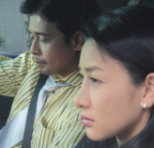
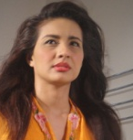
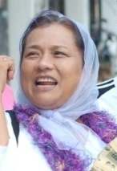
Track Record – Year 2010
Title | Type / Duration | Language | Format | Client
EDUWEBTV.COM | WEBTV Content Rencana 1Malaysia, 45 x 30m | Malay | 3CCD/ Data DVD | Zeal Hi-Tech Solutions, Ministry of Education (Aug-Dec 2010)
CIMA Cementing Nation Building | Corporate Video Script 1 x 7m | English | DVD Beta | Neo Reka / Cement Industries of M’sia Bhd
TELAPAK SYURGA | Telemovie 1 x 120m | Malay | Beta | Sistem Televisyen Malaysia Bhd (TV3)
 | SCP Events – Docu / Open Day / Agribazzar | NA | HDV | Mimos Berhad
SALJU DI HATI IBU | Telemovie Hari Ibu - Mei 2010 1 x 120m | Malay | Beta | Radio & Televisyen Malaysia (TV2)
EDUWEBTV.COM | WEBTV Content Documentary, 45 x 30m Akademik, 24 x 30m Interaktif, 39 x 10m | Malay / English | 3CCD/ Data DVD | Zeal Hi-Tech Solutions, Ministry of Education (Jan-Mac 2010)
COMPANY PROFILE

Slide 12



Track Record – Year 2009
Title | Type / Duration | Language | Format | Client
 | SCP 5 days Indoor / Outdoor Mimos Activities | Natural Sound | MDV | MIMOS Berhad
EDUWEBTV.COM | WEBTV Content Rencana, 30 x 30m Documentary, 24 x 30m Akademik, 20 x30m | Malay / English | 3CCD/ Data DVD | Zeal Hi-Tech Solutions, Ministry of Education
TV1 & TV2 NEWSPAPER AD | 1 DAY | MALAY | PRESS AD | RTM
KEMENTERIAN KESIHATAN Prosedur Penyediaan Makanan Di Hospital | VIDEO GUIDE 1x10m | Malay | DVD | Kementerian Kesihatan
COMPANY PROFILE

Slide 13


Track Record – Year 2008
Title | Type / Duration | Language | Format | Client
 | WEBTV Content Rencana, 70 x 30m Documentary, 35 x 30m | Malay / English | 3CCD/ Data DVD | Zeal Hi-Tech Solutions, Ministry of Education
MTDC | TVC, 30s | Malay | Digital Beta | CSG TV3, M’sian Tech. Dev. Corp.
DI SEBALIK BAYANG | Drama, 8 x 30m | Malay | Digital Beta | Ch-9 Media Sdn Bhd – TV9
MARKAS SISTEM ARMADA | Corporate Video, 10m | Malay | MDV | Global Atlas Resources, Royal Malaysian Navy
IKE SERVICES | Corporate Video, 10m | English | MDV | Ike Services
TORPEDO FIRING | Military Exercise, Lumut Naval Base, 8m | Natural Sound | MDV | IKE Services, Royal Malaysian Navy
SALAM CIKGU | Education TV Magazine, 11 x 30m | Malay | Digital Beta | Zeal Hi-Tec Solutions / TV3
COMPANY PROFILE

Slide 14
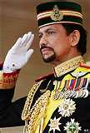



Track Record – Year 2007
Title | Type / Duration | Language | Format | Client
SYUKUR & MENJUNJUNG KASIH | Special Docu in conjunction of Sultan Brunei 61st Birthday, 11 x 10m | Malay | Beta | HVDTP, Radio & Televisyen Brunei
NSTP PRINTWORKS | Marketing Video, 7m | English | DVD | The New Straits Times Press (M) Bhd
Law Faculty | Interactive & Non-interactive Corporate Video, 2 x 15m | English, Malay | DVD, MDV | UiTM Law Faculty
Business Faculty | Video Launching, 15m | English | DVD, Beta | UiTM Business Faculty
SHIPBORNE MISSILE FIRING | Military Exercise, Lumut Naval Base, 8m | Natural Sound | DVD, MDV | Global Atlas Resources, Royal Malaysian Navy
AIRBORNE MISSILE FIRING | Military Exercise, Lumut Naval Base, 8m | Natural Sound | DVD, MDV | Global Atlas Resources, Royal Malaysian Navy
MARKAS SISTEM ARMADA | Corporate Video, 7m | Malay | DVD, MDV | Global Atlas Resources, Royal Malaysian Navy
KL FESTIVAL & MAKYONG | Event Compilation | Malay, English | Beta | Illusi Warna, KEKKWA
SENAMAN YG BETUL & SELAMAT | Video Guide, 15m | Malay, English | MDV, Beta | Ada Vision Communication, Kementerian Kesihatan
KALAMULLAH 30 JUZUK | Al-Quran Recital, Ramadan Special, 30 days | Malay, Arabic | Beta | Sistem Televisyen M’sia Bhd, TV3
NEWS SPECIAL REPORT | Selangor Special Report, 70 x 2m | Malay | MDV | K’jaan Negeri Selangor, Buletin Utama, TV3
COMPANY PROFILE

Slide 15


Track Record – Year 2006
Title | Type / Duration | Language | Format | Client
KEMENTERIAN PENGANGKUTAN | Corporate Video, 15m | Malay, English | Beta | Ada Vision Communication, Ministry of Transport
HERBATIK | TV Magazine, Herbal, 13 x 30m | Malay | Digi Beta | Mynetworks, Radio & Televisyen M’sia
WIRA TAK DIDENDANG | TV Documentary Series, Patriotism, 13 x 30m | Malay | Digi Beta | Mynetworks, Radio & Televisyen M’sia
SPECIAL KEYNOTE BY FELDA CHAIRMAN, TAN SRI DR YUSOF NOR | Video Speech, 30m | Malay | MDV, DVD | AVMC Solutions, Felda
FELDA 50th ANNIVERSARY EVENT LAUNCHING, SEMARAK | Multiple Camera Production, 3hrs | Natural Sound | Multimedia Projection | AVMC Solutions, Felda
FELDA INTERNATIONAL CONVENTION, HILTON SENTRAL | Single Camera Production, 2 days | Natural Sound | MDV | AVMC Solutions, Felda
NERACA, KISAH BENAR | Drama, 26 x 30m Season 8 & 9 | Malay | Beta | Iris Network Sdn Bhd, TV3
SAYAP INFO, SELANGOR MAJU | Prototype Flash, Interactive, 5 min | Malay | DVD | HVD Television Production
PERTANDINGAN PANTUN KORPORAT | Multiple Camera Production, 3hrs | Malay | Multimedia Projection | Kementerian Kebudayaan, Kesenian & Warisan, KEKKWA
PROFIL ANUGERAH SENI NEGARA | Docu, 60 min | Malay | Beta | Kementerian Kebudayaan, Kesenian & Warisan, KEKKWA
COMPANY PROFILE

Slide 16


Track Record – Year 2005
Title | Type / Duration | Language | Format | Client
HAMDOLOK | VCD Replication 10,000 copies x 60m | Malay | VCD | Kementerian Kebudayaan, Kesenian & Warisan, KEKKWA
KEKALKAN KEGEMILANGAN BANGSA MU | Video Campaign, 7m | Malay | VCD | Biro Keahlian & Latihan Umno
TIME WARISAN FAMILY DAY | Event, Port Dickson 300 copies x 60m | Malay | VCD | Lef Recreation, Time Engineering Bhd
SEMINAR ON FINANCIAL MARKET / ACCOUNTING FOR PLC’S | SCP, Istana Hotel, 1 day | Natural Sound | SCP & Video Projection | Bursatra Sdn Bhd
NERACA – KISAH BENAR | Drama, 26 x 30m Season 6 & 7 | Malay | Beta | Iris Network Sdn Bhd, TV3
DIGI TEAMBUILDING, PANGKOR ISLAND | Sports Event, 30m | Malay | VCD | Lef Recreation, Digi
MALAM KORPORAT PRIHATIN, SHANGRILA HOTEL | MCP, 3hrs | Natural Sound | Beta | Yayasan Kajian Strategi Melayu
RMN – NEW GENERATION PATROL VESSEL | SCP Aerial View, Onboard 3 days, Lumut Sea | Natural Sound | Beta | Atlas Defence Tech Sdn Bhd
SPECIAL KEYNOTE BY THE UMNO PRESIDENT | VCD Replication, 2000 x 60m | Malay | VCD | Yayasan Kajian Strategi Melayu
ACEH TSUNAMI FUND FOR THE ORPHAN | Fund raising video campaign, 10m | Malay | VCD | Yayasan Kajian Strategi Melayu
COMPANY PROFILE

Slide 17




Track Record – Year 2004
Title | Type / Duration | Language | Format | Client
DETEKTIF | Drama – crime 13 x 30m | Malay | Beta | Sistem Televisyen M’sia Bhd, TV3
OH AYAH! OH IBU! | Reality TV, 8 x 30m | Malay | Beta
FOOTBALL & PLAYGROUND | Drypers Infomercial, 2 x 30s | Malay | Beta | Sistem Televisyen M’sia Bhd, TV3
NERACA – KISAH BENAR Season 4 & 5 | Drama, 26 x 30m | Malay | Beta | Iris Network Sdn Bhd, TV3
BANTUAN LOGISTIK PROGRAM LATIHAN KHIDMAT NEGARA | Event, 30m | Natural Sound | DVD | RMAF, Ministry of Defense
AFFIN 4x4 TEAMBUILDING | Event, 20m | Natural Sound | VCD | Lef Recreation, Affin Bank
COMPANY PROFILE

Slide 18


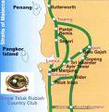
Track Record – Year 2003
Title | Type / Duration | Language | Format | Client
BISIKAN HATIKU, FAIR & LOVELY | Drama, 60m | Malay | Beta | CSG, Sistem Televisyen M’sia Bhd, TV3
NERACA – KISAH BENAR | Drama, 26 x 30m Season 2 & 3 | Malay | Beta | Iris Network Sdn Bhd, TV3
HARI PEKERJA SKF BEARING DGN PERDANA MENTERI | Event, 30m | Natural Sound | DVD | SKF Bearing Industries, Nilai
PANDUAN MENAIKI PESAWAT C130 TUDM | Video Guide, 10m | Malay, English | MDV, DVD | RMAF, Subang
ANUGERAH PANJI-PANJI SKUADRON TUDM – SULTAN PAHANG | Live Parade MCP, 3 hrs | Natural Sound | LED Panel Multimedia Projection | RMAF, Kuantan
4x4 TEAMBUILDING, RAUB | Event, 10m | Natural Sound | MDV | SKF Bearing Industries, Nilai
FERRARI & MASSERATTI TRACK DAY | Event, Sepang Circuit, 15m | Natural Sound | MDV | Next Car Sdn Bhd
RMAF LOGISTICS | Corporate Video, 20m | Malay | MDV,DVD | RMAF Logistics
KURSUS ASAS KOMANDO, BANTING | Training, Event, 30m | Natural Sound | MDV | RMAF
STERENG EMAS | Training Video, 20m | Malay | VCD, MDV | Pusat Latihan Pengurusan Logistik, RMAF Kinrara
PERISYTIHARAN MAJLIS PERBANDARAN MANJUNG | Corporate Video, 15m | Malay | MDV | Nur Hikmah Multimedia, Tiga Events
COMPANY PROFILE

Slide 19
KEY PERSONNEL
AHMAD AL-HUSNA BIN ABU HASSAN, Managing Director
Ahmad Al-Husna is a holder of Bachelor of Mass Communication (Journalism), from Universiti Teknologi MARA which he obtained in 1987.
He has vast experience in mass communication-related jobs that encompass reporting, producing, editing, scriptwriting, lecturing, researching, translating and managing.
After graduating from UiTM, he worked as a news reporter for Berita Harian and Berita Minggu. In 1988 he was seconded to TV3 as a reporter for the News and Current Affairs Department covering general news, special reports and the production of various segments for Majalah Tiga programme.
After a year, he was back with Berita Harian, assuming his job as a reporter for the newspaper as well as for the company’s sister newspapers that included Harian Metro and Berita Minggu. His area of coverage included general news, parliament sittings, Umno general assemblies, economics, crime, foreign news, and special reports.
From 1992-2000, he was attached to several production houses, where he had held various posts that included Chief Operating Officer, Director, Producer, Executive Producer as well as being coordinator for TV3 stinger from the Klang Valley. He was, then, the person-in-charge of monitoring the production of more than 800 episodes of various titles aired by the local tv stations, among others, 1,2,3 Lekuk (children-Metrovision), Dari BSKL (economy-TV3), Niaga (business-TV3), Asia Hebat (documentary-TV3), Saudagar Senja (documentary-TV3), Amanah Kasih (telefilm-TV3), LENSA (magazine-RTM), Belajar Jawi (magazine-RTM) & Life Line (docu-magazine-RTM).
Ahmad Al-Husna also gained experience as a news editor for RTM where he was responsible for editing news for various news slots aired over the station. He had also worked as a part-time scriptwriter for RTM on special documentary programmes, and at the same time doubling up as a researcher.
He was also given the opportunity to put his translation skill back to use when Measat Broadcast Networks System offered him the job of translating Astro Ria programmes that included Aquaventure, Islam in Britain, Debbie Travis, Home Style, Technology World, UK Today and Totally Awesome.
Having established his own company HNJ Pictures Sdn Bhd, in 2003, he has since produced a 13 episodes of a crime serial drama Detektif and a 8 episodes sponsored reality tv show Oh Ayah! Oh Ibu! aired at TV3. He is also the coordinator for the production of Neraca – Kisah Benar, for 9 seasons, which is jointly produced with Iris Network Sdn Bhd.
Due to his vast experience in broadcasting he also had the opportunity to lecture for the Diploma in Integrative Journalism & Diploma in Broadcasting students of Malaysia Institute of Integrative Media.
COMPANY PROFILE

Slide 20
KEY PERSONNEL
NOORLAILY NURULHUDA BTE MOHD YUSOFF, Director (Editorial / Administration)
Noorlaily Nurulhuda Mohd Yusoff, obtained her Diploma in Broadcasting from Malaysia Institute of Integrative Media ( MIIM ) in 2006 and acquired as the Best Student in Broadcasting.
Upon producing inhouse Multiple Camera Production (MCP) projects at MIIM, she acquired various achievements namely the BEST DIRECTOR for SITCOM, BEST PRODUCTION & BEST PROGRAMME for ENTERTAINMENT and SITCOM categories.
Further achievements was attained through her group final project entitled ‘Reproductive Biotechnology’ which was selected as The Best Top 5 in Documentary Category in the 2006 Malaysian Film Festival, and Top 3 at the 2006 Student Film Fair at ASWARA.
Noorlaily gained her experience in the broadcasting arena during her 3 months practical training in RTM Entertainment Department, under the Ministry of Information. Among others she had been exposed to the working discipline as an Assistant Producer in the government owned tv station for various programmes, i.e. Final Hits 1, Zoom In Bersama…..Vince, The Little Angel Symphony Orchestra, Zoom In Bersama…..Kristal, Zoom In Bersama…..Jaclyn Victor, Fiesta Hurra, Down Memory Lane Recording and Konsert 60 Tahun RTM.
She also had the opportunity to involved in the set making for the Siti Nurhaliza Hari Raya Programme Recording produced by Siti Nurhaliza Production for RTM at Green Cow Studio, Bandar Sri Damansara.
She is all set to pursue her career in the broadcasting arena and simultaneously joined as the Assistant Producer at HNJ Pictures Sdn Bhd after graduated from MIIM.
COMPANY PROFILE

Slide 21
KEY PERSONNEL
MOHAMAD ZALANI BIN KAMARUDDIN, Technical Producer
Mohammad Zalani Kamaruddin’s credential in broadcasting and production-related field was years of work with TV3 and various production houses. As a production assistant in the News and Current Affairs Department, he was exposed to news coverage, scriptwriting and live productions both in the studios and on locations. He had assisted in the production of news programmes and magazine-type programmes such as Sekapur Sirih, Majalah Tiga, Nona and Memo.
He left TV3 to work with various production houses that included Scene Creative Sdn Bhd, Prime Time Communications Sdn Bhd, and Paulmod Corporation Sdn Bhd. Between these production houses he had worked in the production of made-for-TV programmes such as Ad-din (a religious programme), Asia Hebat, Saudagar Senja (documentary), Life Line (semi-documentary), Belajar Jawi (educational), Dari BSKL, Muamalah, Niaga (economics), Doktor (pilot for a medical programme), Lensa (pilot for a current affairs programme), Lembah Fauna, 1,2,3 Lekuk, Andora (children’s programme), Hijau (environmental programme), and Wanita Hari Ini (for Suasana & Petua segments )
COMPANY PROFILE

Slide 22
KEY PERSONNEL
SYAHEEZAM BIN ZAKARIA, Production Manager/Scriptwriter
Syaheezam hold a Degree in Mass Communication (Advertising) from Universiti Teknologi MARA, 1997. He has vast experience in the field of Mass Communication, in relation with the field of production management and scriptwriting forte. After graduating from UiTM, he pursued various job functions as freelancer with local production houses.
EXPERIENCE
FREELANCE ( PRODUCTION MANAGER )
‘Kebaya Biru’ Telemovie (RTM –Makmur Megah Sdn Bhd), ‘Seharum Kasturi’ 13 Episodes Drama (RTM – Gemilang Network Sdn Bhd) ‘Teratak Impian’ 26 Episodes Drama (RTM-Shazs Distributions Sdn Bhd), ‘Dendam, Dosa Dan Doa’ 6 Episodes Drama (ASTRO – World Evolution Brain Sdn Bhd), ‘Rabunnya Cinta’ 13 Episodes Drama (ASTRO – World Evolution Brain Sdn Bhd), ‘Chinese New Year - Drinho’ Promo (8TV- Media Prima Sdn Bhd), Syahirah Keanggunan Sejati’ 6 Episodes Reality Make Over (TV9 – Media Prima Sdn Bhd), ‘Selamat Pagi Putera Puteri’ 26 Episodes MTV(RTM – Wayang Tinggi Produksi Sdn Bhd), ‘Atikah Najwa’ 13 Episodes Drama (RTM - NE Production / Teratak Pictures Sdn Bhd), ‘Hadiah Murni’ New Year Telemovie (RTM – Wayang Tinggi Produksi Sdn Bhd), ‘Impian Ijoi’ Raya Telemovie (RTM – Wayang Tinggi Produksi Sdn Bhd), ‘Tok Teh’ Drama Merdeka – Telemovie (RTM – Wayang Tinggi Produksi Sdn Bhd), NERACA KISAH BENAR – Drama 5 Episodes (Season 5) 6 Episodes (Season 8) (TV3 – Iris Network Sdn Bhd), ‘Akhirnya’ 13 Episodes Drama (RTM - HVD Entertainment Sdn Bhd)
FREELANCE ( SCRIPTWRITER )
Eduwebtv.com - Magazine – 26 Episodes (HNJ Pictures – Zeal Hi-Tech Solutions Sdn Bhd), Udin & Noni’ – Drama TV Pendidikan – 7 Episodes (TV9 – Syuhadah Advertising Sdn Bhd), ‘Keajaiban Healin’ – Documentary – 13 Episodes (TV3 – Home Media Agency), Video Presentation - Yayasan Pembangunan Ekonomi Islam Malaysia (Diva Orbit Integrated Sdn Bhd), ‘EQ-Lebih Dari Buku’ – Kids Programme - 4 Episodes (Singapore TV – Screenbox Ltd), ‘Bila Sampai Di Sini’ – Travelodge Programme – 13 Episodes (RTM – Wayang Tinggi Produksi Sdn Bhd), Neraca-Kisah Benar 5 Episodes (Season 5) 9 Episodes (Season 6) 6 Episodes (Season 7) 6 Episodes (Season 8) 2 Episodes (Season 9) (TV3 – Iris Network Sdn Bhd), Video Presentation - Majlis Perbandaran Selayang (MPS – Syuhadah Advertising Sdn Bhd), Video Presentation – Perbadanan Kemajuan Negeri Selangor (PKNS – Syuhadah Advertising Sdn Bhd), ‘Hadiah Murni’ – New Year Drama – Telemovie (RTM – Wayang Tinggi Produksi Sdn Bhd), ‘Impian Ijoi’ – Drama Raya – Telemovie (RTM – Wayang Tinggi Produksi Sdn Bhd), Kelas Malam – Sitcom - 8 Episodes (RTM – Bright Network Sdn Bhd), ‘Antara’ – Telemovie (RTM – Eurofine (M) Sdn Bhd), ‘Pudar Bibir Merah’ – Telemovie (RTM – Eurofine (M) Sdn Bhd) ‘Akhirnya’ – Drama – 13 Episodes (RTM - HVD Entertainment Sdn Bhd)
1997-1998 : Copywriter, Dentsu Young & Rubicam, Kuala Lumpur
Nov ‘00-Jun ‘01 : Asst Producer, Asst Production Manager, Bright Network Sdn. Bhd., Kuala Lumpur
Jul ‘01-Feb ‘05 : Manager, R&Z Networking Sdn. Bhd., Kuala Lumpur
Feb-Oct 2000 : Manager, Convenience Shopping Sdn. Bhd. Shah Alam
1998-1999 : Manager, Z Catering Services, Shah Alam
Jan-July 1994 : Temporary Teacher, Pengkalan Kubor Primary School, Kelantan
COMPANY PROFILE

Slide 23
KEY PERSONNEL
MOHD KAMARULDZAMAN BIN JAAFAR, Programme Director/Scriptwriter
Mohd Kamaruldzaman Jaafar hold a Degree in Mass Communication from Universiti Teknologi MARA, 1989.
He has vast experience in the field of Mass Communication, in relation with various writing skills forte, i.e. news reporting, editing, scriptwriting, researching and translating.
After graduating from UiTM, he joined a few tabloid paper companies such as Media Edar and Warisan Nasional as a reporter. His area of coverage include general news, politics, economies, crime, foreign and human interests.
He also attained management skills while working in the Human Resources Department for a foreign company in Seremban.
EXPERIENCE
1990-1991 : Reporter (News & Magazine) at Media Edar, Creative Master and Warisan Nasional. Wrote Futures Articles, Human Interest, Politics, Investigative, Economics and Social Report.
1991-1995 : Assistant Officer, Publishing & Public Relations Department, at Angkatan Koperasi Kebangsaan ( ANGKASA ) (M) SDN BHD. Job task was to publish inhouse magazine for the COOP members, which cover various activities i.e. training for the company members, interview and photography, motivation training and provide translation services for the international co-op reports & activities.
1995-1998 : Human Resource Officer at Samsung Electron Device (M) Sdn Bhd, Seremban. Job function were to handle interviewes and recruitment for the local and foreign workers, manpower scheduling/planning, workers transportation, which liaised with government department such as the Labour Department, Jabatan Tenaga Rakyat, Immigration Department and various embassies.
1999-2000 : Marketing Executive at Spiral Max Sdn Bhd, Seremban. Involved in the Futures Market Investment Plan and Market Research.
2001-2002 : TV Programme Coordinator at Kirawang Group of Companies. Job functions were to prepare the concept & proposals for new tv programmes for the stations, and had a hands-on as the scriptwriter, director, and supervised the editing process for various programmes, i.e. documentaries, magazine, entertainment and drama for RTM.
Since 2006 : Producer, Director & Scriptwriter at HNJ Pictures Sdn Bhd.
COMPANY PROFILE

Slide 24
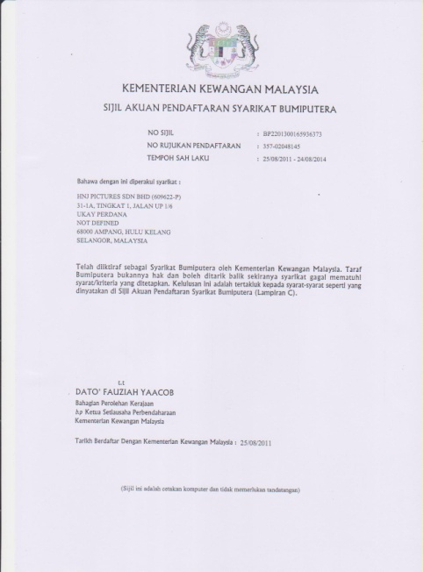
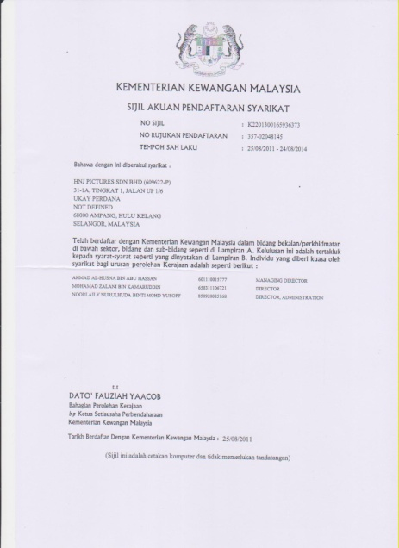
Lesen Bumiputera
Lesen Kewangan
COMPANY PROFILE

Slide 25
Kod Bidang
060100 Kamera/Peralatan
060200 Filem Siap Untuk Tayangan
220701 Pengeluaran Filem-filem
220702 Rakaman
220704 Audio Visual
221501 Media Elektronik (Tidak Termasuk Kerja Percetakan)
220502 Media Cetak (Tidak Termasuk Kerja Percetakan)
221503 Billboard
221710 Penterjemahan
COMPANY PROFILE

Slide 26
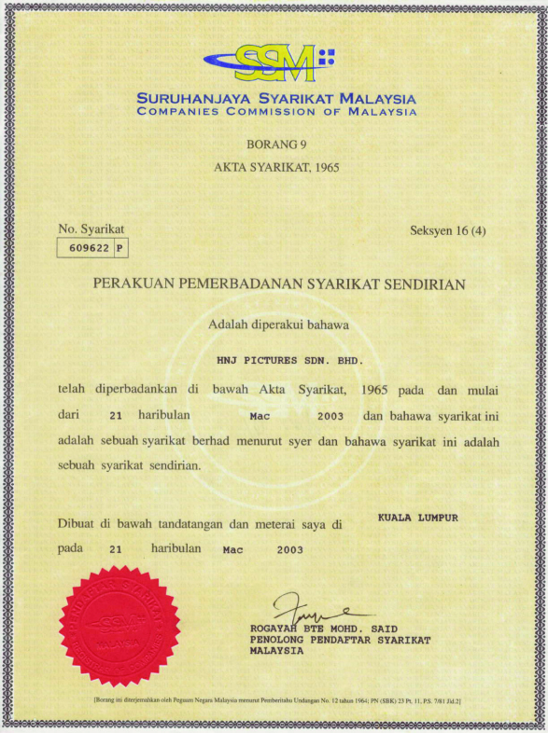
Lesen KKMM
Lesen Pendaftaran SSM
COMPANY PROFILE

Slide 27
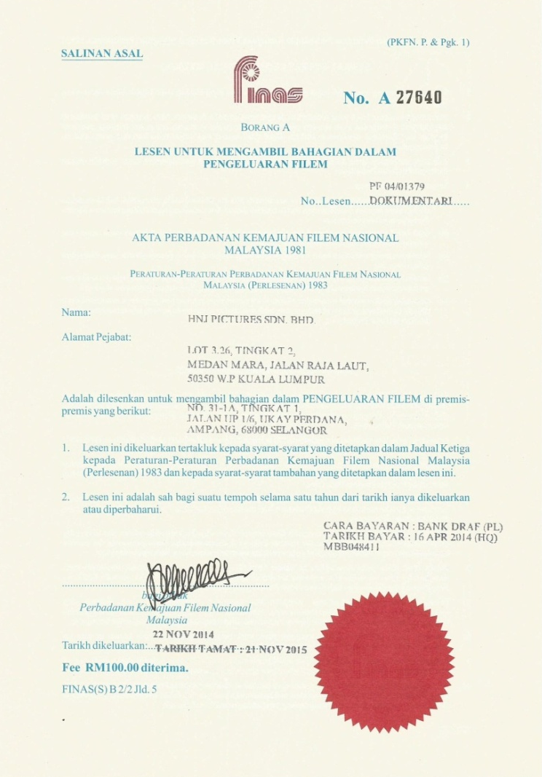
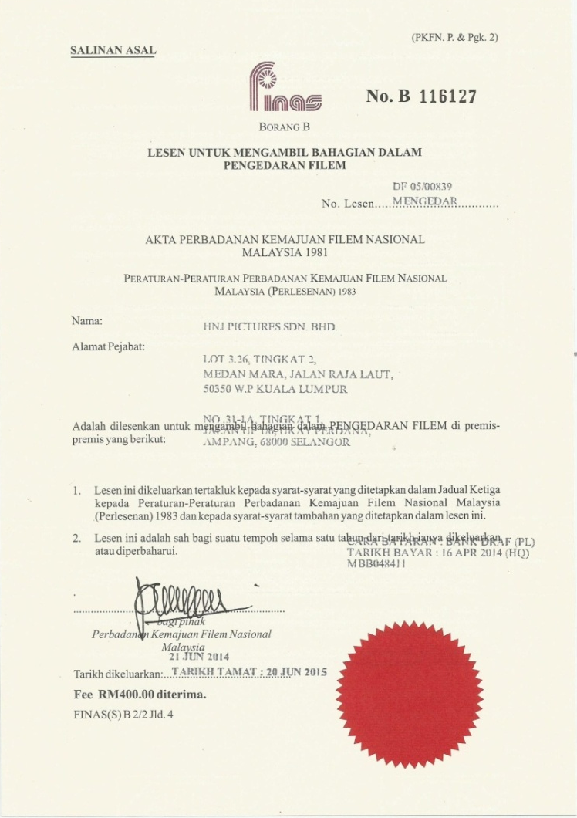
Lesen Finas Pengeluaran
Lesen Finas Pengedaran
COMPANY PROFILE

Slide 28
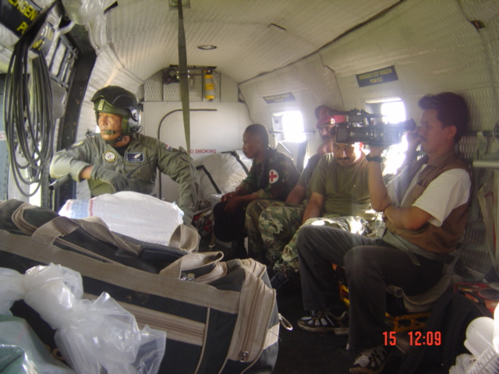
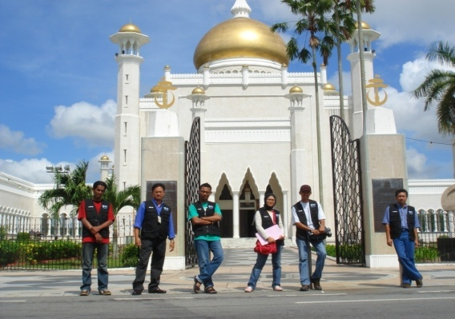
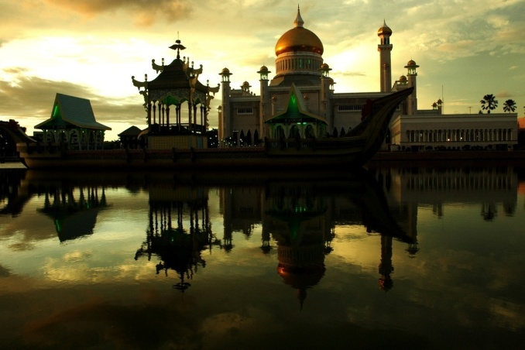
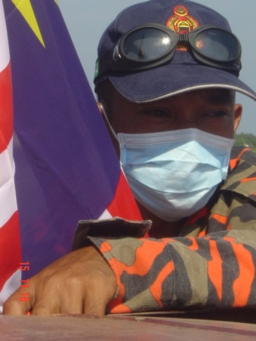
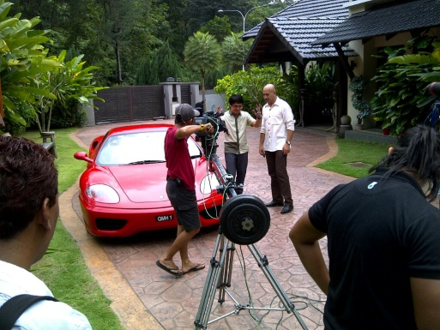
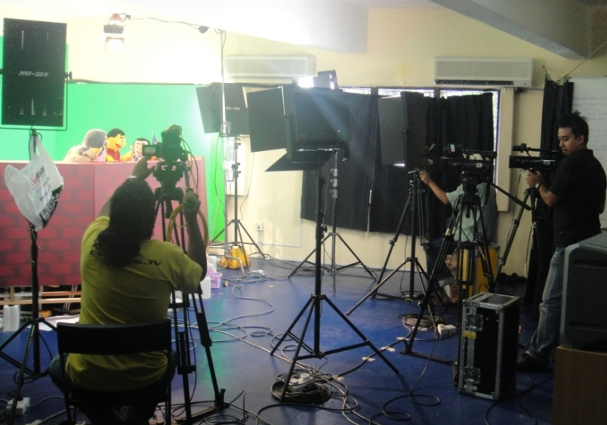
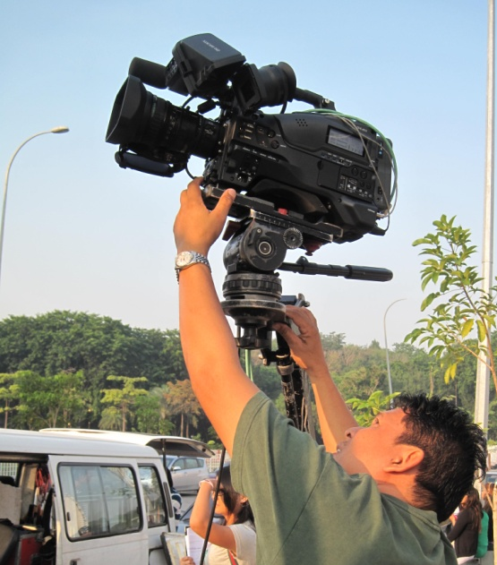

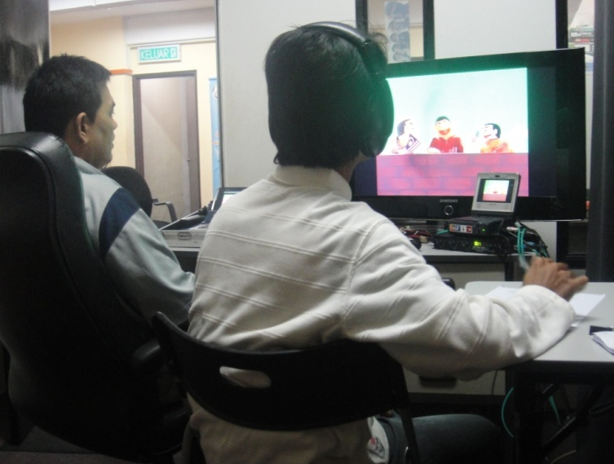

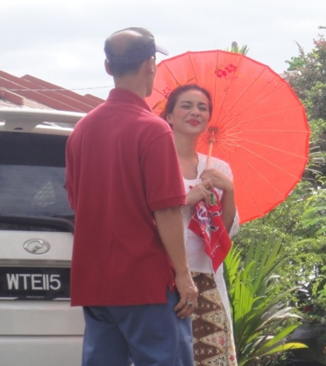
thank you...
HNJ PICTURES SDN BHD (609622-P)
No. 303A Lrg Perak, Melawati Square Business Centre,
53100 Kuala Lumpur
Tel : +603-4108 8867 Fax: +603-4147 4022
Email : alhus2000@yahoo.com

