Slide 1

SPS
SALIHIN PREMIER SOLUTIONS
BY ACCOUNTANTS FOR ACCOUNTANTS

Slide 2
  SPS SOFTWARE TRAINING
TIME | PROGRAMME
08.45 am – 09.00 am | Registration
09.00 am – 10.30 am | Installation/Setup Process
10.30 am – 11.00 am | Break
11.00 am – 01.00 pm | Account Payables/Receivables
01.00 pm – 02.00 pm | Lunch
02.00 pm – 04.00 pm | General Ledger/Report/GST
04.00 pm – 04.30 pm | Q & A / Closing

Slide 3
  TOPIC
INSTALLATION
SETUP PROCESS
  COMPANY SETUP
  INVENTORY SETUP
ACCOUNT PAYABLES
ACCOUNT RECEIVABLES
GENERAL LEDGER
REPORT
GST

Slide 4
  SPS MODULE
GENERAL LEDGER
ACCOUNT RECEIVABLES
ACCOUNT PAYABLES
SALES ORDER
PURCHASING
INVENTORY CONTROL
GOODS & SERVICE TAX
ZAKAT & WAKAF
GENERAL SETUP
ADMIN

Slide 5
  INSTALLATION VERSION II

Slide 6
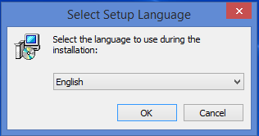
  INSTALLATION VERSION II
STEP 1: First of all, please insert or plug-in your SPS thumb drive into your machine. Select the language that you prefer to use during the installation.

Slide 7
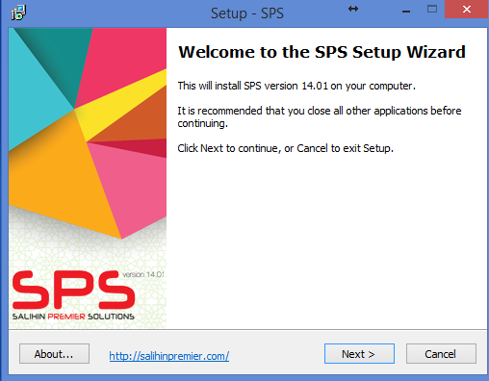
  INSTALLATION VERSION II
STEP 2: Welcome to the SPS Setup Wizard. This installer will install the SPS Version 14.01 on your computer. It is recommended that you close all the other applications before continuing. Click Next to continue, or Cancel to exit the installation setup.

Slide 8
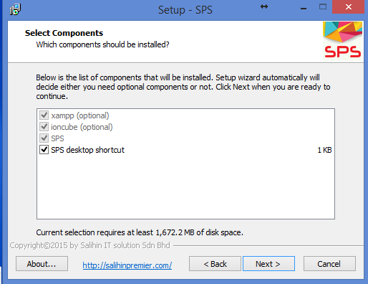
  INSTALLATION VERSION II
STEP 3: In this part, the list of component will be installed automatically. Then, click Next button.

Slide 9
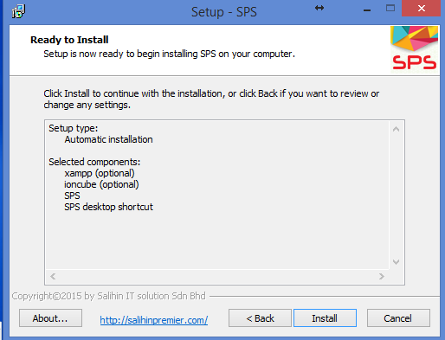
  INSTALLATION VERSION II
STEP 4: Click Install button to continue with the installation, or click Back button if you want to review or change any settings.

Slide 10
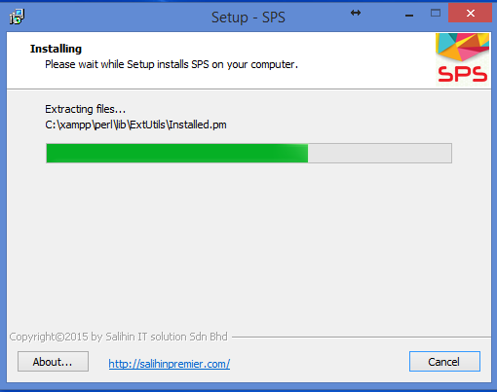
  INSTALLATION VERSION II
STEP 5: Please wait while Setup installs SPS on your computer.

Slide 11
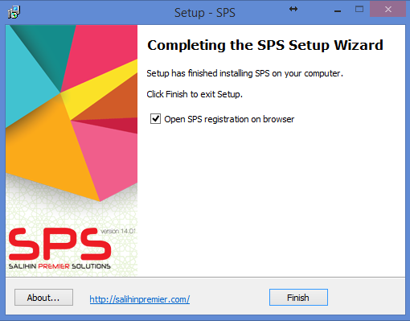
  INSTALLATION VERSION II
STEP 6: Congratulation! Setup has finished installing SPS on your computer. Please make sure that you RESTART your XAMPP before you tick the open in browser localhost/sps/installation option. Click Finish to exit Setup.

Slide 12

  INSTALLATION
STEP 8: Type localhost/sps/installation. You will see the Welcome to the SPS Version 14.01 Setup Wizard. Click Next to continue.
NOTE : If you have renamed the sps folder, once the browser opens, replace “sps” with the name you have used previously.
.

Slide 13
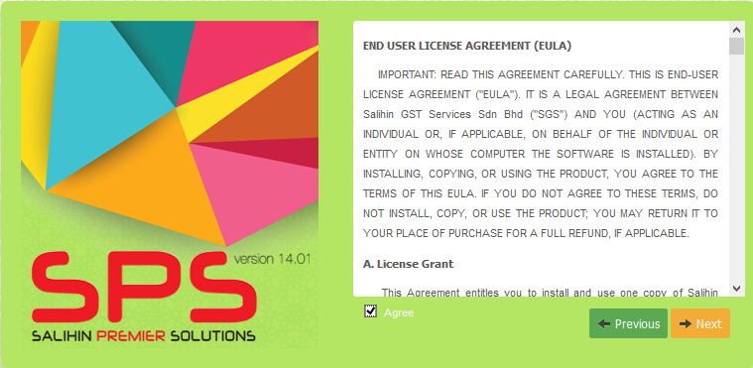
  INSTALLATION
STEP 9: To continue, you have to accept the software license agreement by clicking the box. If you do not agree with the license agreement, the Next button will be disabled.

Slide 14
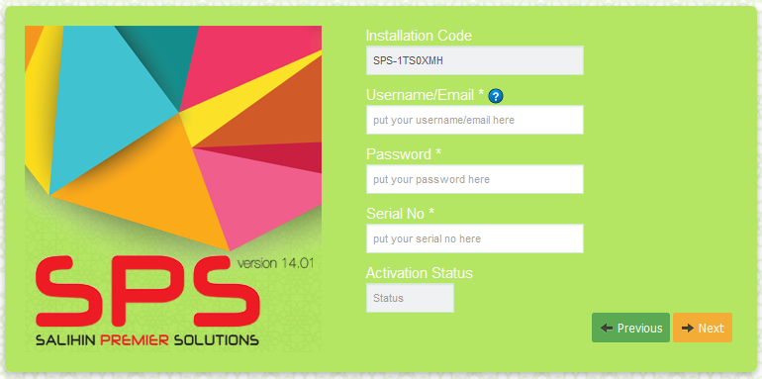
  INSTALLATION VERSION II
STEP 7: Check your email, we have send username/email and password. You need to enter this User Name/email, password and your Serial No that locate at your SPS Packaging. Click Next button.
Note: Make sure there is no SPACE when you copy and paste. IF you are failed to validate, please contact your Dealer.

Slide 15
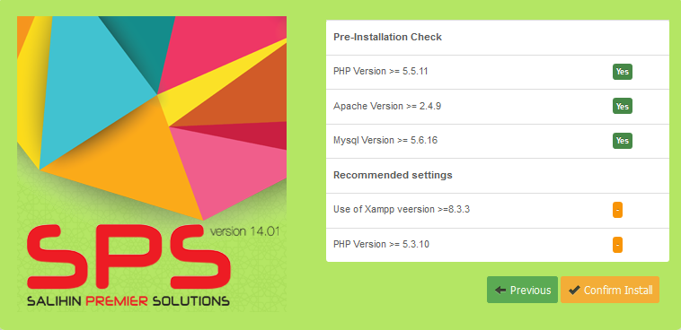
  INSTALLATION
STEP 12: Check the Pre-Installation. Click Confirm Install button to continue

Slide 16
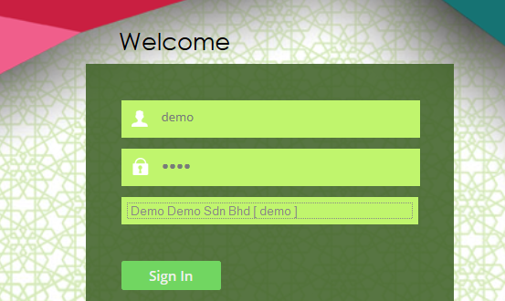
  INSTALLATION
STEP 13: Once finished, you will see this interface. Here, you will enter the following details:
Username : demo
Password : demo
Company : Demo Demo Sdn Bhd [demo]

Slide 17
  SETTING UP

Slide 18
  COMPANY SETUP
Company Setup
User Setup
User Right Setup
Log Out
Chart of Account Setup
System &General Setup
Financial Year Calender
Log in with New user ID & Company

Slide 19
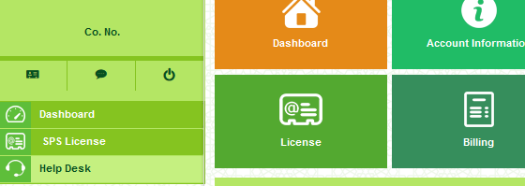
  REGISTER COMPANY
SCREEN: HOW TO GET COMPANY ACTIVATION KEY
To get your company activation key, please follow the steps below:
Open new browser and type demo.salihinpremier.com/ss-ss/customerlogin
Enter your username and password. (Please check your email OR you can call Support Team to get the details).
Next, click the SPS License as shown below.

Slide 20
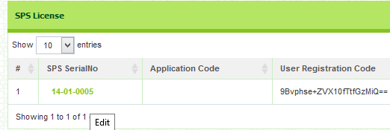
  REGISTER COMPANY
Next, click the link of SPS SerialNo. Then, click continue to proceed. You will directed to your SPS License details. Scroll down and go to SPS Registered Company Key section.

Slide 21
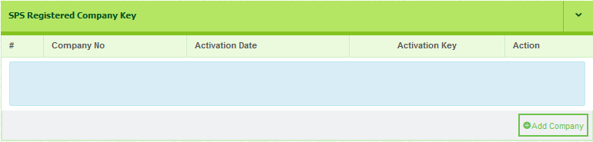
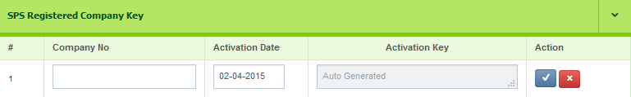
  REGISTER COMPANY
Go to SPS Registered Company Key. Then, click Add Company button. Once click, you may entered company details such as Company No. Next, click save button.

Slide 22
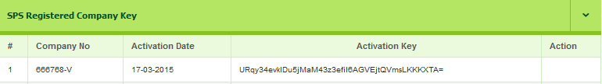
  REGISTER COMPANY
In this part, please CONFIRM your Company No. Then, click the save button. The Activation Key it is auto generated by the system.
Next, copy your Activation Key.

Slide 23
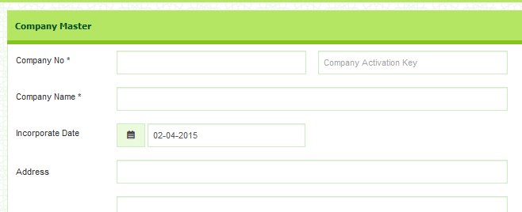
  REGISTER COMPANY
Then, open your Company Master page. Copy the Activation Key an paste the code into the related field.

Slide 24
  GENERAL SETUP
Employee Setup
Agent Setup
Master Setup
Term Setup
Bank Setup

Slide 25
  INVENTORY SETUP
Item category
Item Type
Item Setup
Location Master
Unit of Measures

Slide 26
  ACCOUNT PAYABLES
PURCHASING
Optional
PURCHASE PRICING
SUPPLIER LIST
PURCHASE ORDER
PURCHASE ORDER CONFIRM
Good Received Note (GRN)
PURCHASE RECEIVE
PURCHASE RECEIVE CONFIRM
INVENTORY
REPORTING
Inventory Control
  Inventory list
Statement of Financial Position
  Trade Payable
POSTING JOURNAL
Decrease Stock (purchase return)
Increase Stock
(additional purchase)
DEBIT NOTE
CREDIT NOTE
ACCOUNT PAYABLE
PURCHASE INVOICE CONFIRM
PURCHASE INVOICE
Trade Payable
POSTING JOURNAL
(Auto create GRN)
DIRECT PURCHASE INVOICE
PURCHASE INVOICE CONFIRM

Slide 27
  ACCOUNT RECEIVABLES
SALES ORDER
Optional
SALES PRICE
SALES QUOTATION
SALES ORDER
Delivery Order
(DO)
DELIVERY ORDER
DELIVERY ORDER CONFIRM
INVENTORY
REPORTING
Inventory Control
  Inventory list
Statement of Financial Position
  Trade Receivable
POSTING JOURNAL
Decrease Stock (additional sales)
Increase Stock
(sales return)
DEBIT NOTE
CREDIT NOTE
ACCOUNT RECEIVABLES
SALES INVOICE CONFIRM
SALES INVOICE
Trade Receivable
POSTING JOURNAL
(Auto create DO)
DIRECT SALES INVOICE
SALES INVOICE CONFIRM

