Slide 1


BSN-UiTM Micro Finance Entrepreneurs (MFE) Analytics Project
Notes:
Font Type: Open Sans
Font Size: Proposal Title (60), Proposal Details (40)
Business unit & Client logo: Small size

Slide 2
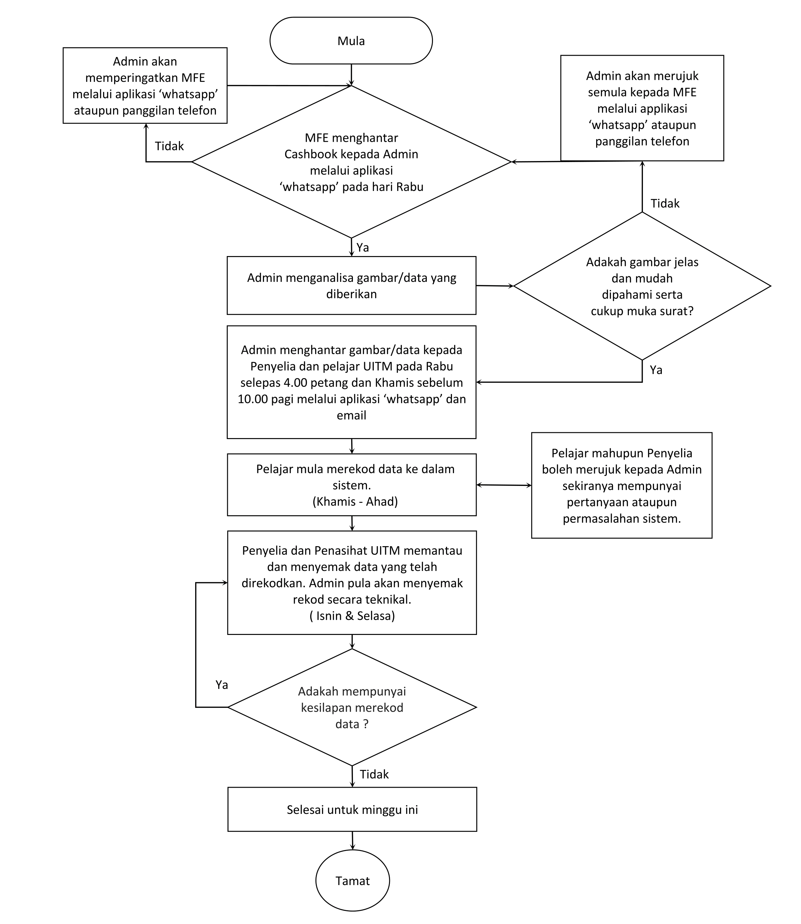
Carta Aliran
Mingguan
Notes:
Font Type: Open Sans
Font Size: Executive Summary Content (36)

Slide 3
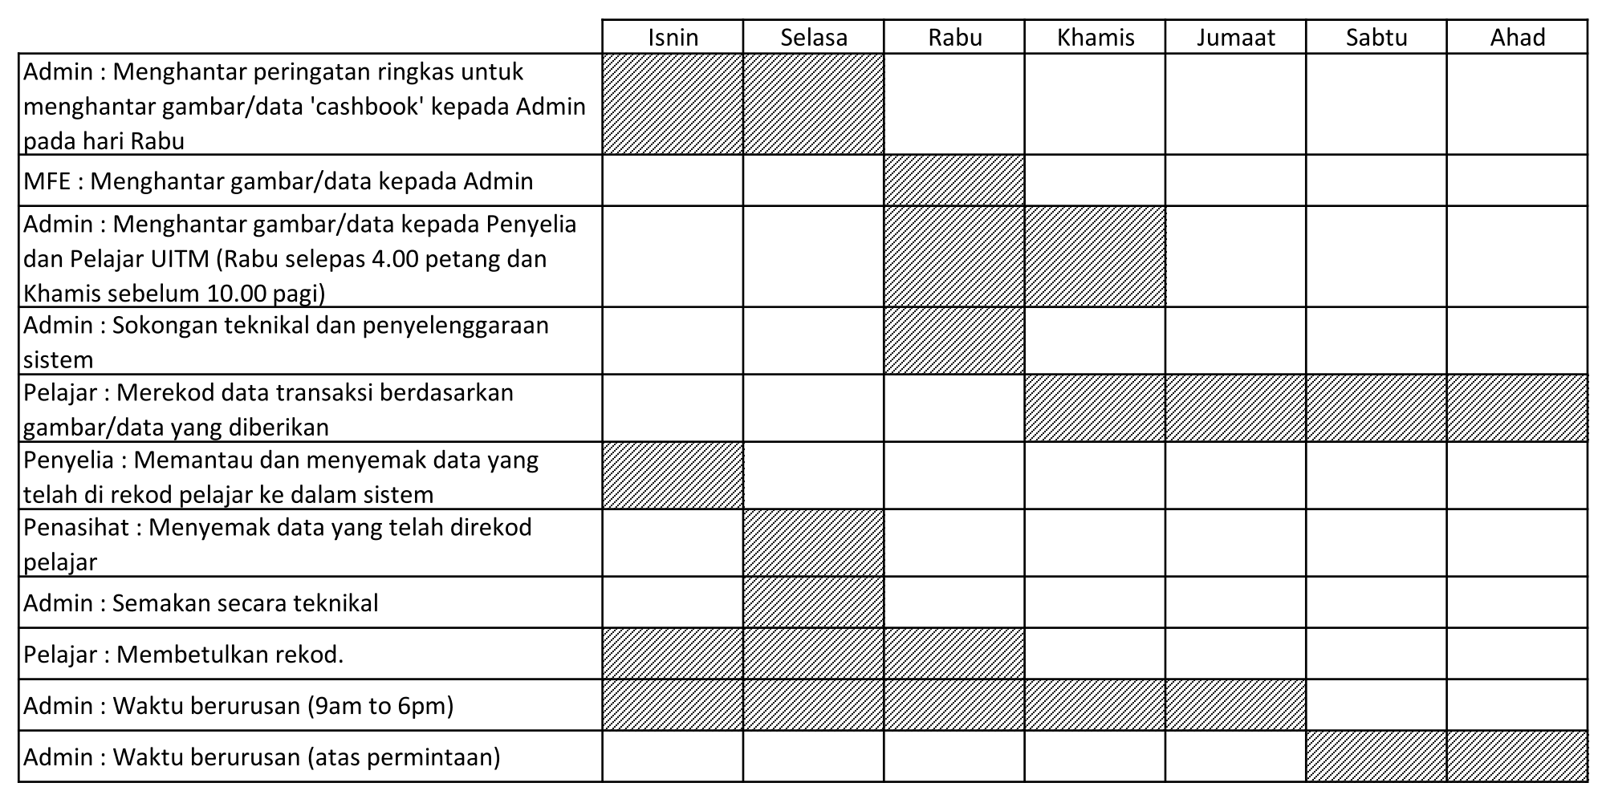
Carta Aliran Mingguan
Notes:
Font Type: Open Sans
Font Size: Executive Summary Content (36)

Slide 4
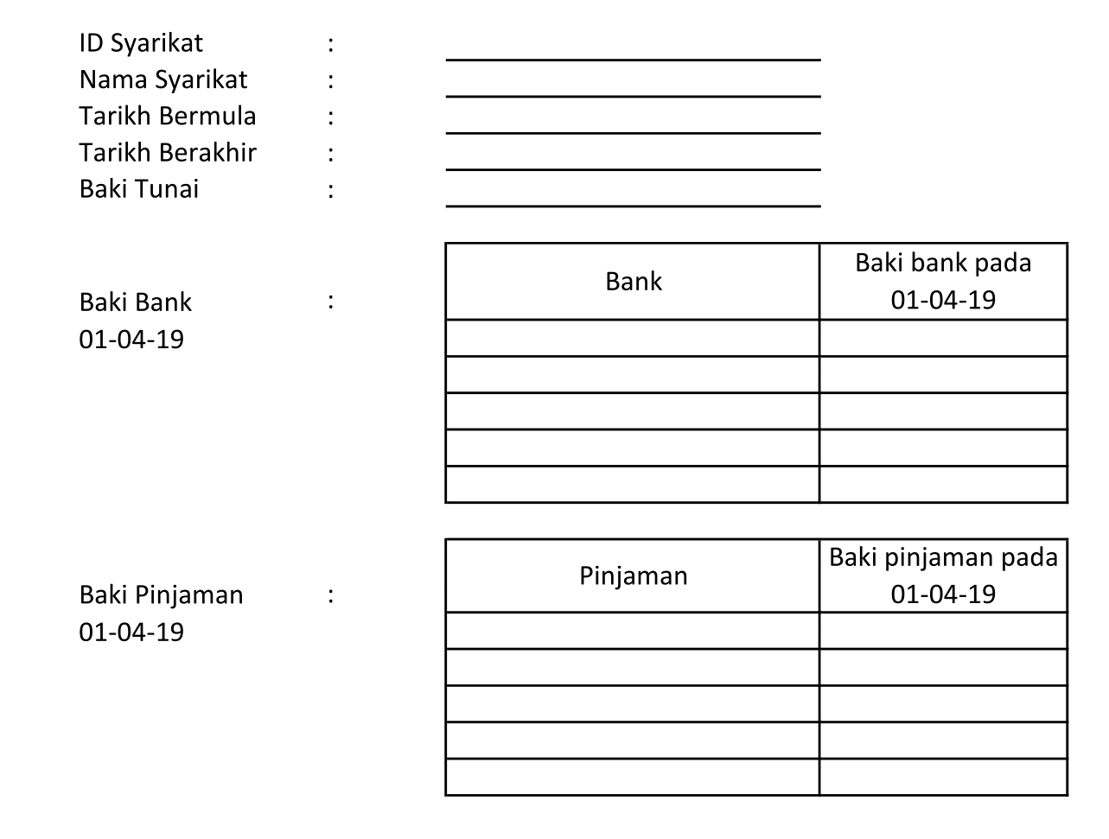
Cashbook
Notes:
Font Type: Open Sans
Font Size: Executive Summary Content (36)

Slide 5
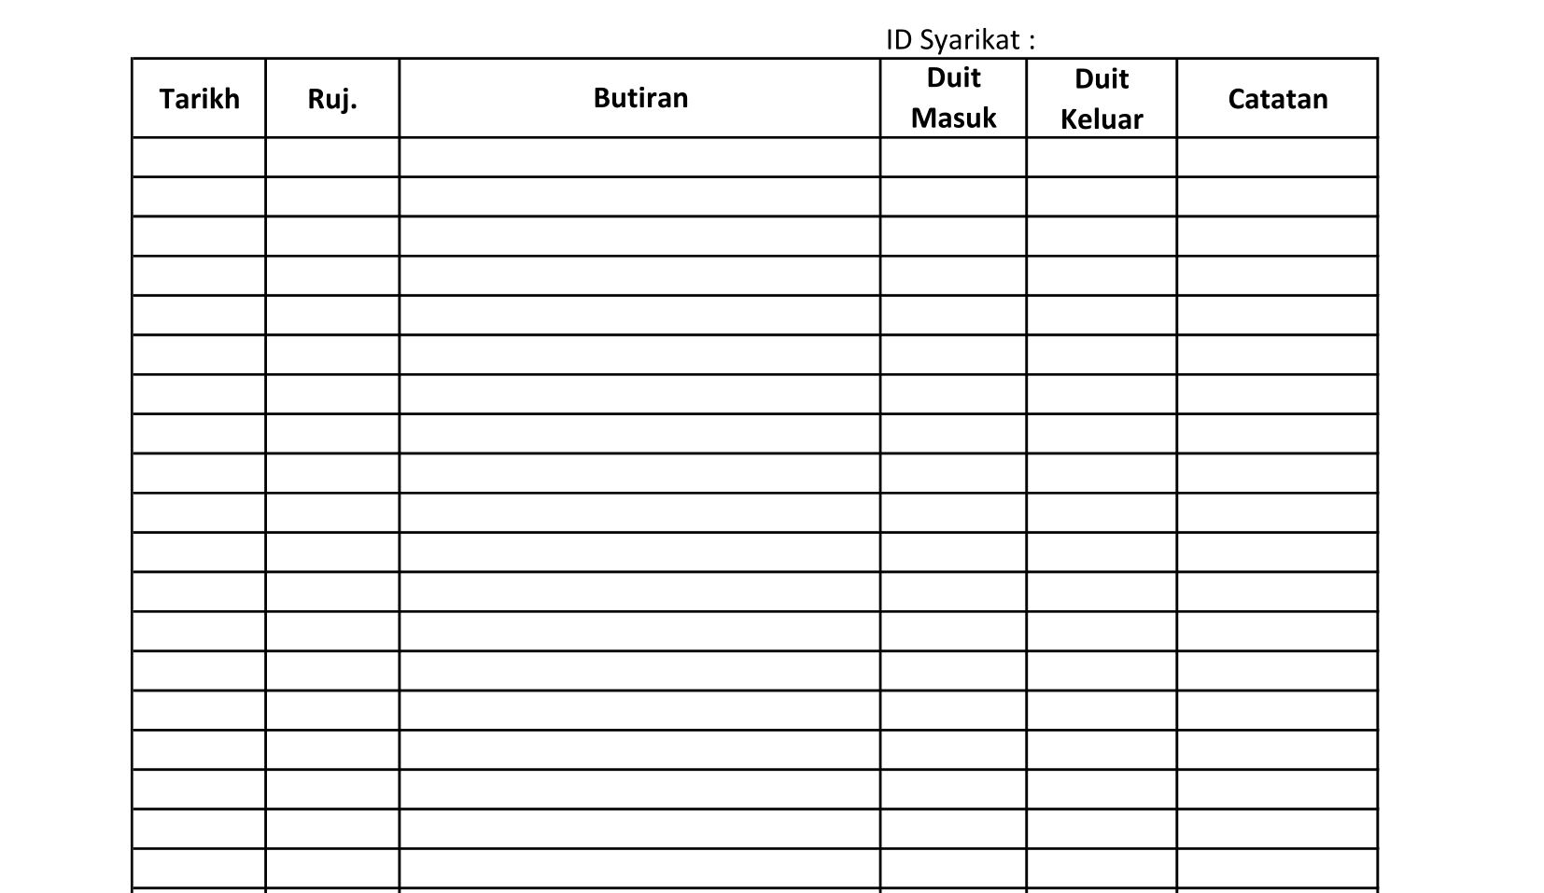
Cashbook
Notes:
Font Type: Open Sans
Font Size: Executive Summary Content (36)

Slide 6
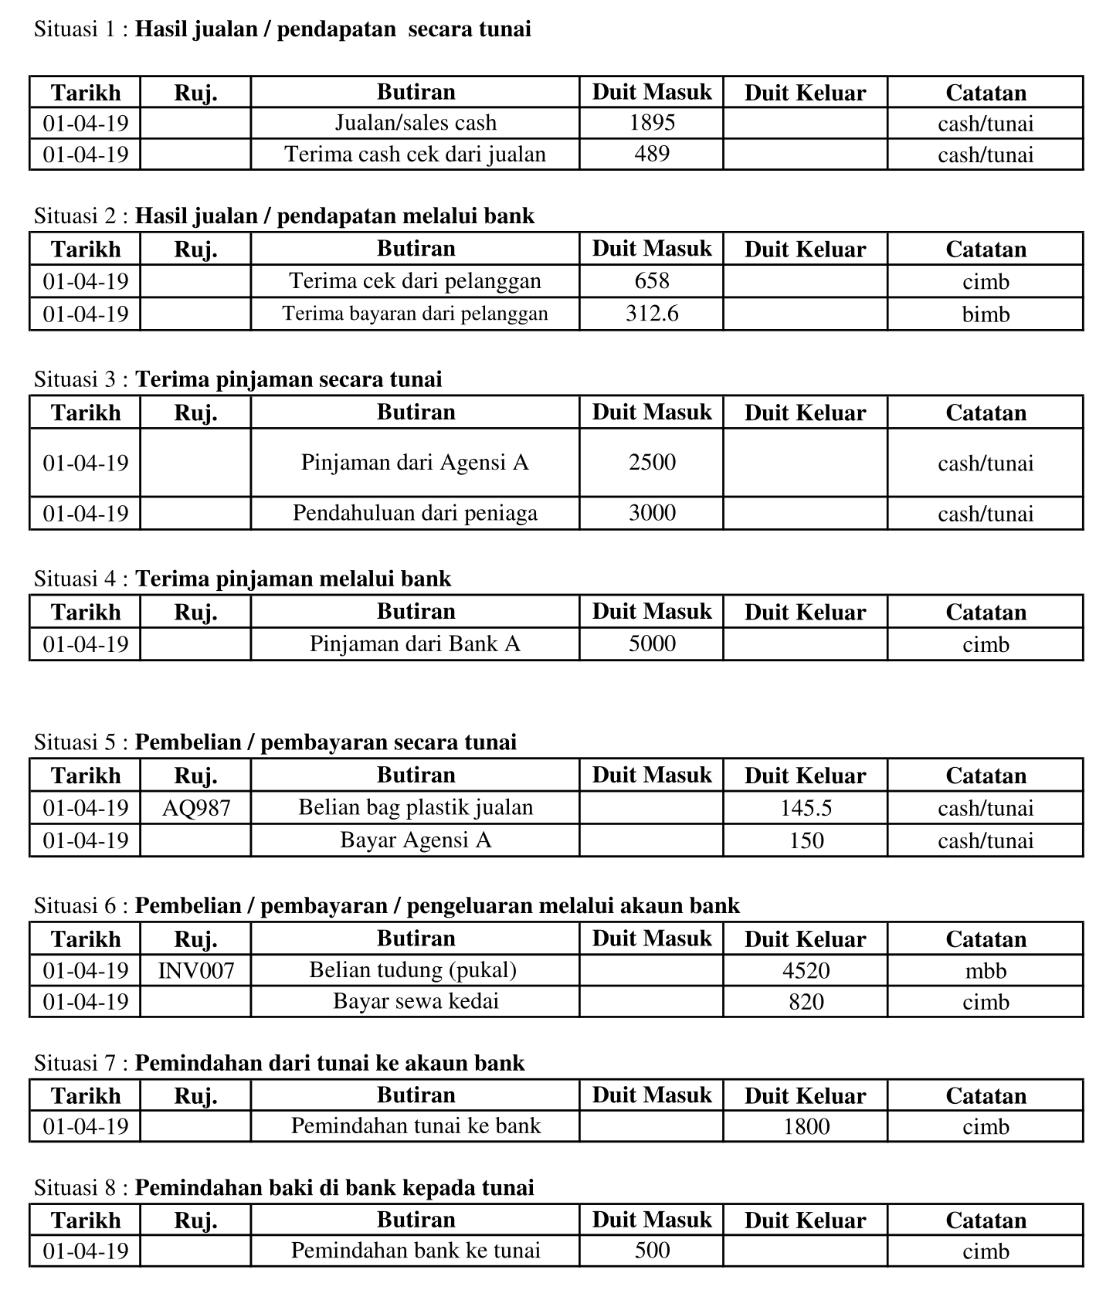
Contoh Rekod Cashbook
Notes:
Font Type: Open Sans
Font Size: Executive Summary Content (36)

