Slide 1

SPS DEALERSHIP PROGRAMME
Prepared by:
FARHANA BINTI ZAHARI
© 2014 SALIHIN. All Rights Reserved

Slide 2
  TABLE OF CONTENT
1.0 ABOUT US 03
2.0 ABOUT SALIHIN PREMIER SOLUTIONS (SPS) 11
3.0 DEALERSHIP PROGRAMME 17
4.0 PRODUCT PRICING DETAILS 23
5.0 OUR CREDENTIALS 29
6.0 CONTACT US 31
© SALIHIN 2015. Strictly Private & Confidential

Slide 3

1.0 ABOUT US
© SALIHIN 2015. Strictly Private & Confidential

Slide 4




AT THE GLANCE
        ABOUT US
        FIRM’S DESCRIPTION
Founded in 2002, SALIHIN is a professional business consultancy firm specializing in Auditing, Taxation, Advisory and IT Consultancy.
The past decade has witnessed our continuing effort in brand building through commitment to integrity, high quality and business excellence in providing exceptional end-to-end services.
From grass to grace, our endless effort did not go unnoticed when we are certified as MSC status, 1-Innocert and Enterprise 50 company. As we progress, we grow along with our valued clients, looking forward to a more mature business relationship.
We are certified by the Royal Malaysian Customs Department (RMCD as approved GST Trainer and by the Pembangunan Sumber Manusia Berhad (PSMB) as one of the approved trainers under Human Resources Development Fund (HRDF) which allows our clients to claim 100% training expenses.
© SALIHIN 2015. Strictly Private & Confidential

Slide 5
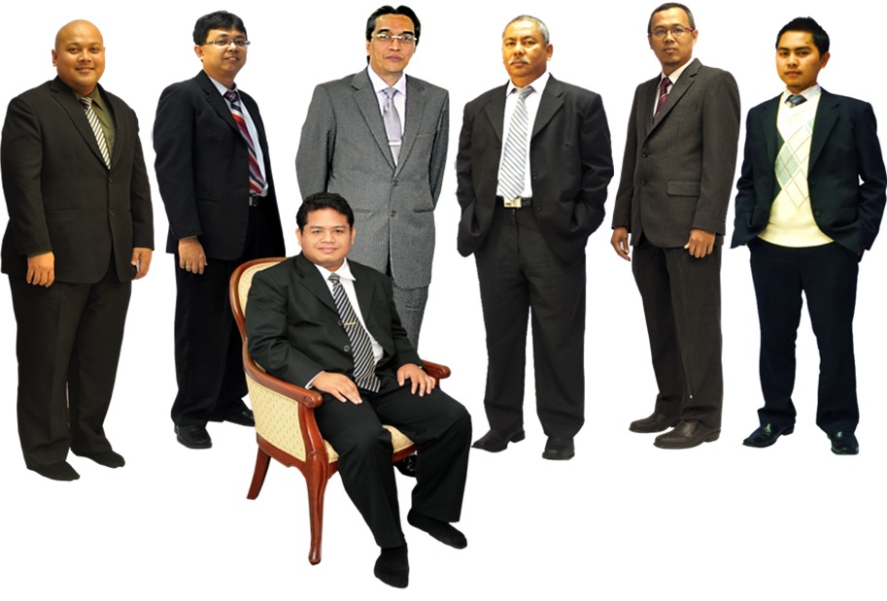
    ABOUT US
    KEY PERSONNEL
  ABOUT US
  KEY PERSONNAL
In Front: Salihin Abang
L-R: Ahmad Izwan Adnan, Faizul Nizan Zulkefli ,
Tuan Haji Abd. Aziz Abu Bakar, Ahmad Aljafree Razalli,
Mohd Faried Jamil, Abdussalam Shokhawi
© SALIHIN 2015. Strictly Private & Confidential

Slide 6

  ABOUT US
  SERVICE AND OFFICES
AUDIT & ASSURANCE
GOODS AND SERVICES TAX (GST)
FINANCIAL ACCOUNTING SERVICES
Financial Statement Audit
Compliance Audit
Operational Audit
Forensic Audit
GST Compliance and Advisory
GST Preparation and Filing
GST Audit and Investigation
GST Training
Accounting System Development and
Implementation
Financial Statements Review
Business Process Outsourcing
TAXATION
CORPORATE SECRETARIAL SERVICES
IT CONSULTANCY
Tax Compliance
Corporate Tax Advisory
Indirect Tax Services
Tax Audit and Investigation
Real Property Gain Tax
Company Incorporation
Other valuable Secretarial Services
Registration with Ministry of Finance
and other Government Agencies
Shariah Compliance Audit
Advisory Services
Zakat - Alms Giving
Waqf - Islamic Endowment
CORPORATE FINANCE &
TRANSACTION SERVICES
ISLAMIC ACCOUNTING & AUDITING
Due Diligence
Internal Audit and Forensic Accounting
Valuation
Capital Market
Managerial Finance
Mergers & Acquisitions
Shariah Compliance Audit
Advisory Services
Zakat - Alms Giving
Waqf - Islamic Endowment
BATU CAVES . KUALA LUMPUR . JOHOR BAHRU . KUCHING
© SALIHIN 2015. Strictly Private & Confidential

Slide 7





  ABOUT US
  WHY SALIHIN?
The following are key reasons why SALIHIN should be the preferred choice:
We have the right ‘hands-on’ team with vast GST knowledge and training experience.
We would be able to provide complete and comprehensive guidance on GST.
We are certified GST Trainers by RMCD.
We offer ‘value for money’ without compromising on the quality and timeliness of training.
As approved HRDF Training Provider, training expenses are 100% claimable.
© SALIHIN 2015. Strictly Private & Confidential

Slide 8
  ABOUT US
  CLIENTELE OVERVIEW
ABOUT US
CLIENTELE OVERVIEW
SALIHIN serves diverse clients including corporate companies, foundations/non-profit organisations, government bodies and government-linked companies. Their diversity spans across different sectors of the economy.
© SALIHIN 2015. Strictly Private & Confidential

Slide 9

ABOUT US
CLIENTELE OVERVIEW (CONTD.)
© SALIHIN 2015. Strictly Private & Confidential
9

Slide 10

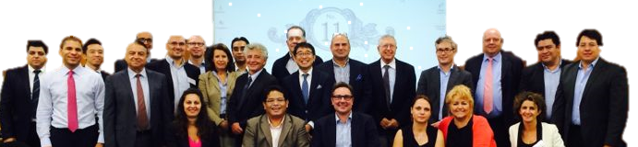

ABOUT US
INTERNATIONAL LINKS/NETWORK
Today’s globalization and increasing complexity in the business environment call for strategic alliances. While providing firms with flexibility, they also allow firms to leverage resources and capabilities to achieve objectives that might otherwise beyond their reach.
http://www.i2an.com/
Eying international reach, SALIHIN is a member firm of i2an, a reputable global network of financial professionals which currently has over 500 professionals present in the major financial centres in Europe, the United States and Asia.
© SALIHIN 2015. Strictly Private & Confidential

Slide 11
2.0 ABOUT SALIHIN PREMIER SOLUTIONS (SPS)
© SALIHIN 2015. Strictly Private & Confidential

Slide 12
ABOUT US
SALIHIN PREMIER SOLUTIONS BACKGROUND
The SALIHIN PREMIER SOLUTIONS also know as SPS SOFTWARE , the intelligent software in the world that can manage numerous aspects of financial accounting including Goods and Services Tax (GST) and Zakat calculation, customised specially for Small and Medium Enterprises (SMEs).
SPS SOFTWARE is an efficient and effective accounting software that accommodates changes affecting invoicing and billing system of the business process. The software is powered by the latest security features to secure data or information for optimal integrity and confidentiality. It is tailor made for small and medium industries by professional accountants.
The Zakat module makes SPS SOFTWARE the first comprehensive accounting software with Zakat solution. It will make it easier than ever for Muslim businesses, corporations and organizations to determine the amount payable as Zakat. With Zakat feature built in, it is simply the best accounting software yet.
© SALIHIN 2015. Strictly Private & Confidential

Slide 13
SPS
Modules in SPS
There is 5 main modules that makes the SPS Accounting software like no other’s.
Financial Module
Inventory Module
GST Module
Zakat Module
Waqf / Endowment Module
© SALIHIN 2015. Strictly Private & Confidential

Slide 14
SPS
Core Features
1
Easy To Use
With its user friendly interfaces, SPS requires minimum skill knowledge in accounting.
2
Predefined Accounting Chart
SPS comes with 19 industry standards predefined accounting chart and has flexibility to tailor according to business needs.
3
Biz Dashboard
Data updates are real-time for better business decision making.
4
Drill Down
Analysis and investigate from surface report drill down to the source of transaction..
5
Fully Responsive
Interactive and fully responsive for all devices and screen resolutions..
7
Regulate User Access
Provide the double layer security, all the right control of functionality to regulate the user accessibility to each module system.
8
Multi Languages supported
SPS is ready to support latest business nature in multiple languages.
9
Super Search
Provides an integrated search engine that enabled users to find information related to transaction in the fastest and easiest way.
10
Comprehensive Audit Trail
Ensure that an accurate record of activities or events is captured

Slide 15
PRODUCT SYSTEM REQUIREMENT
OPERATING SYSTEM
Win 7 and above
Important note: Win XP & Win 2003 are not supported
HARDWARE
1 GHz processor or faster
1 GB of RAM
SOFTWARE
Microsoft Office 2010 and above
10 GB of hard disk space
INTERNET
A broadband internet connection will be required only for WAN environment and usage within an office will require a basic LAN configuration
INTERNET
HARDWARE & SOFTWARE
SYSTEM REQUIREMENT
OPERATING SYSTEM

Slide 16
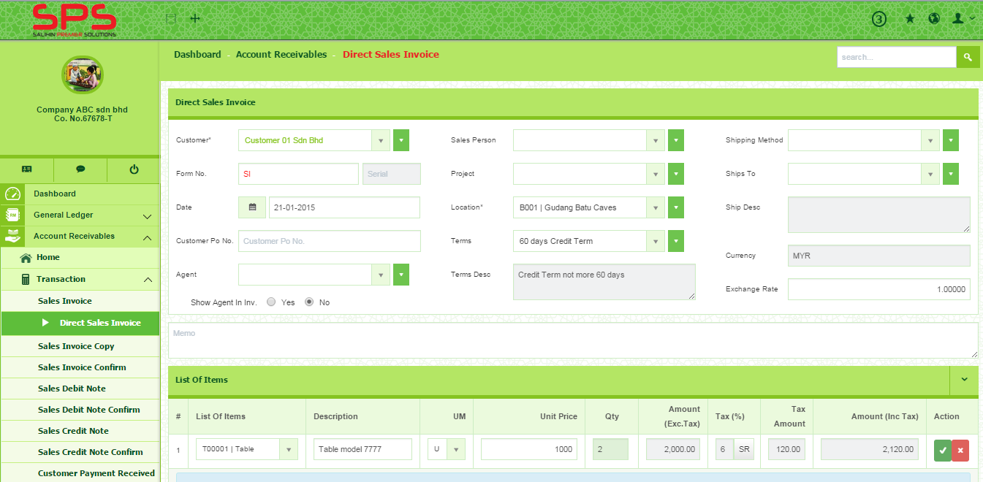
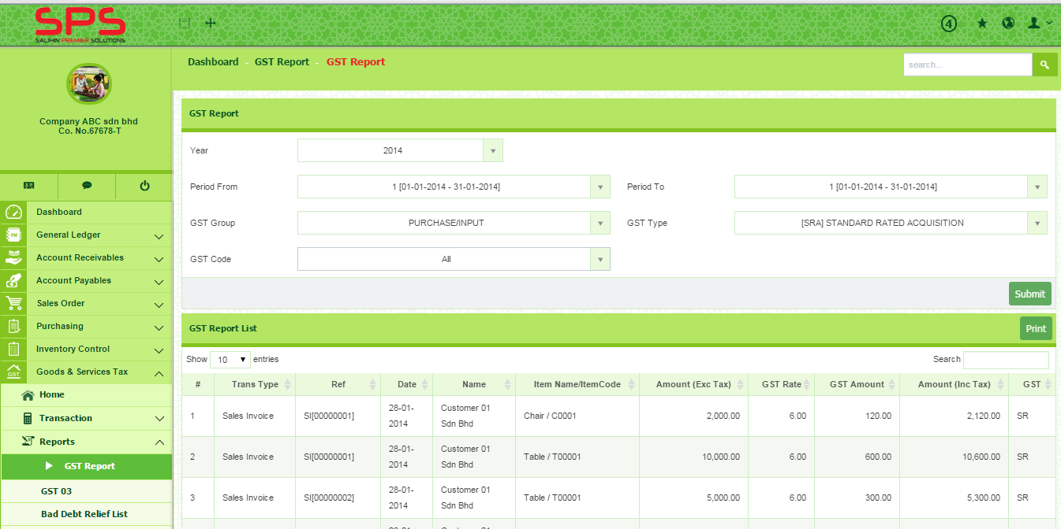
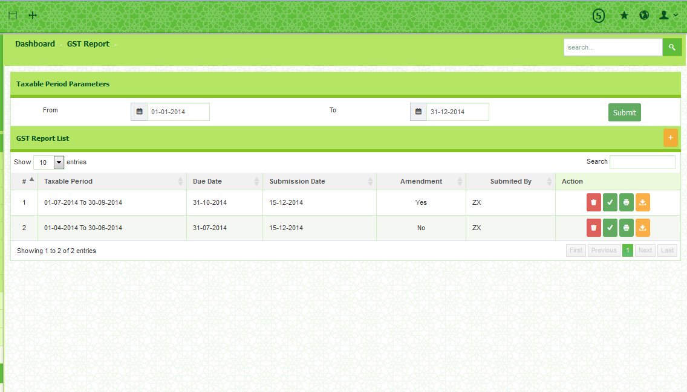
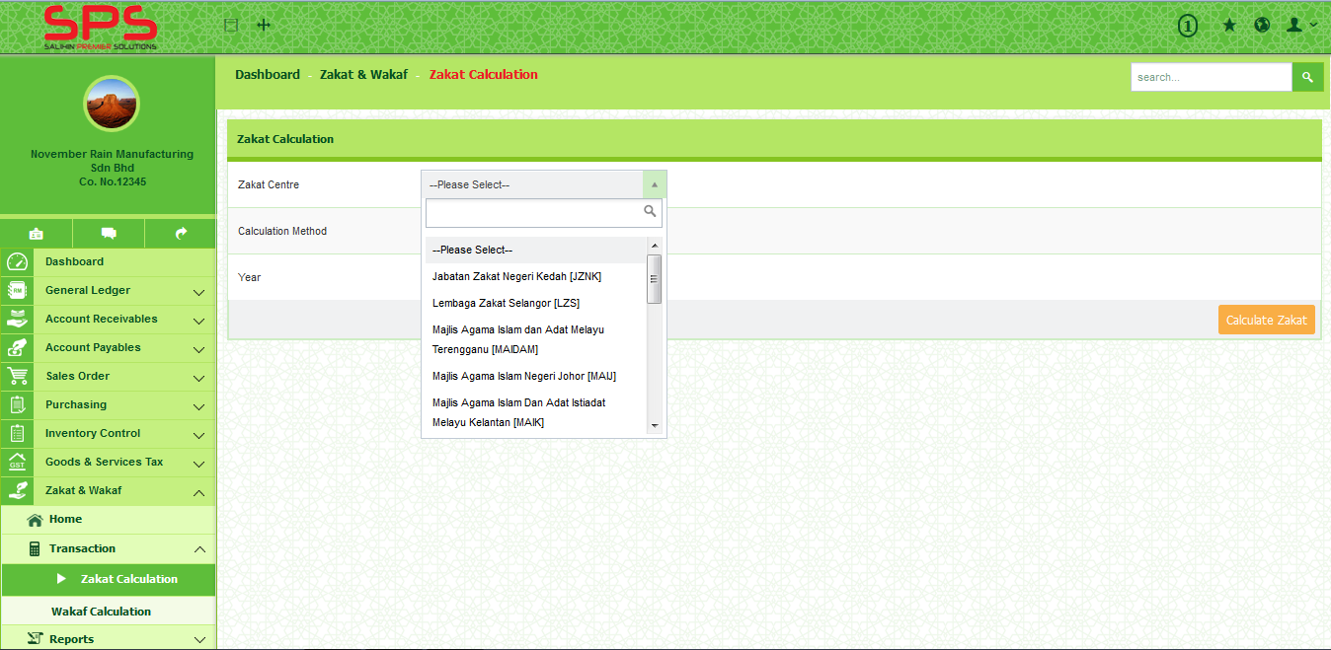
SPS
SPS ACCOUNTING SOFTWARE REVIEW

Slide 17
3.0 DEALERSHIP PROGRAMME
© SALIHIN 2015. Strictly Private & Confidential

Slide 18
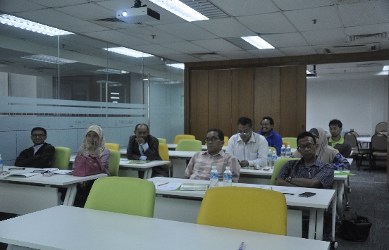

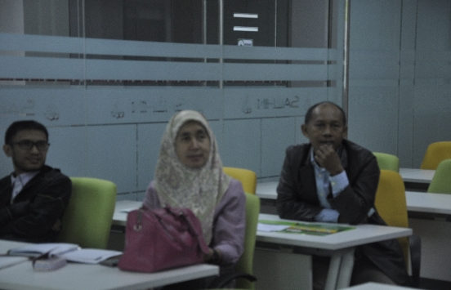
WHAT IS DEALER CRITERIA?
MUST BE MALAYSIAN
ABOVE 21 YEARS OLD
MUST PROVIDE ALL THE TRAINING KITS
INCLUDING TRAINING ROOM
COMPANY REGISTERED WITH SSM
OPERATE BUSINESS SOLUTION, COMPUTER
SOFTWARE AND HARDWARE, ACCOUNTING
FIRM, TAX, AUDIT, GST…
© SALIHIN 2015. Strictly Private & Confidential

Slide 19
DEALER BENEFITS
1
Bolstering market value
Strong accounting data from SPS, increased consumer confidence in market.
2
Become a credible and trusted partner in business
Put the trust with SPS and providing assists in all expect of accounting flow.
3
Enlarge and thus scrutinize a new business networking
Efforts to enhance networks promote productive collaboration, effective at sharing knowledge across boundaries.
4
Adhere to participate in promotion with active partner
Active partners will be invited to participate in the Salihin promotion and activity. For example, roadshow, training and etc.
5
Strong Recognition
More than half of market enquiries end up with a service centre extended market.
6
Broaden product range
Take full advantage of opportunities in market categories with high growth potential software.
© SALIHIN 2015. Strictly Private & Confidential

Slide 20
WHAT WILL WE PROVIDE?
SPS INSTALLER
SPS BROCHURE
SPS OFFICIAL WEBSITE
SPS HELPDESK
© SALIHIN 2015. Strictly Private & Confidential

Slide 21
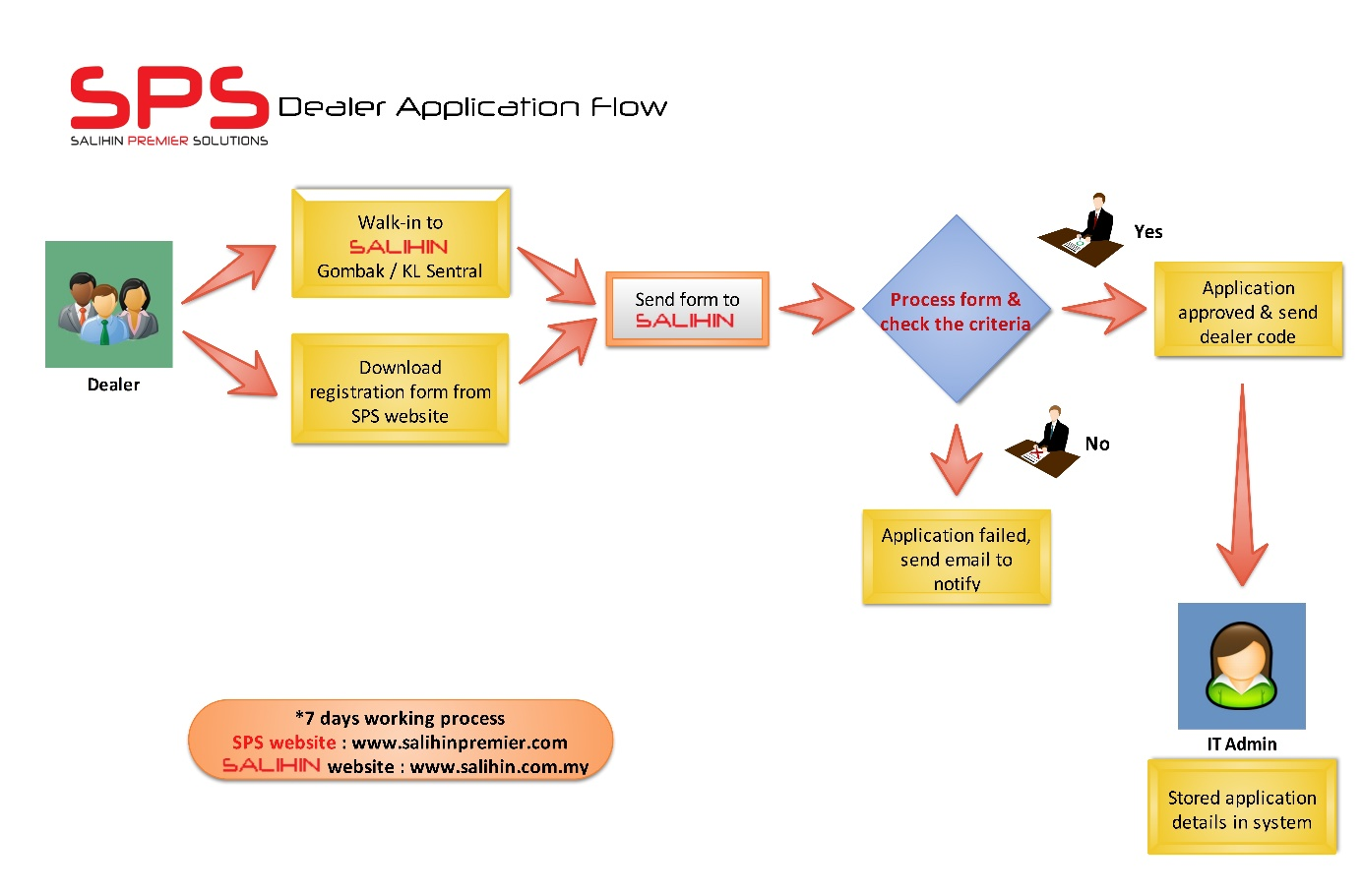
HOW TO BECOME A DEALER?
© SALIHIN 2015. Strictly Private & Confidential

Slide 22
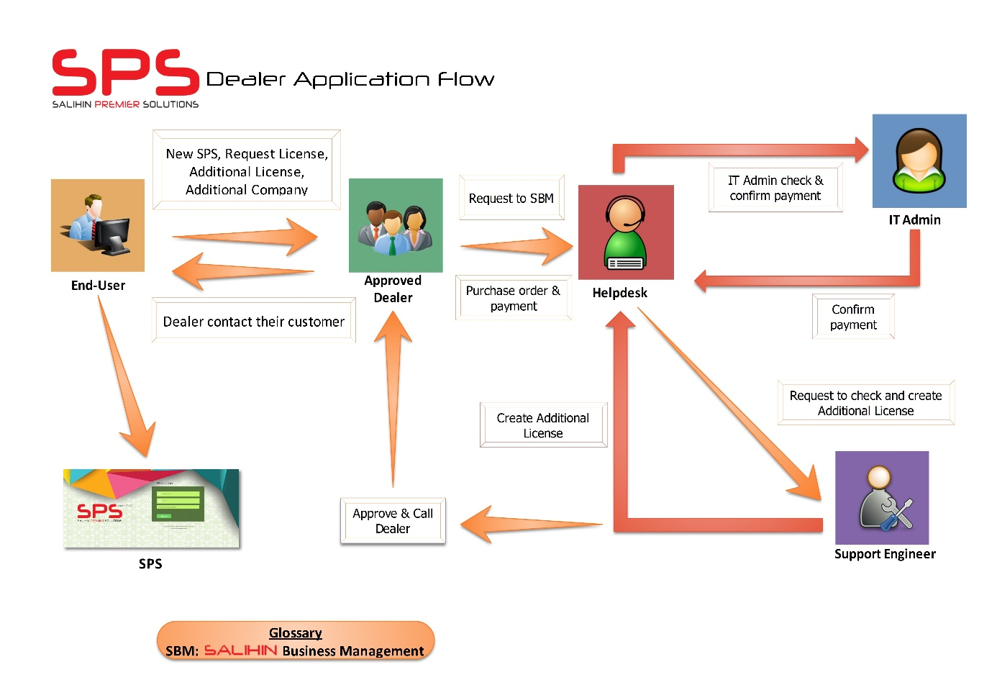
HOW ITS WORK?
© SALIHIN 2015. Strictly Private & Confidential

Slide 23
4.0 PRODUCT PRICING DETAILS
© SALIHIN 2015. Strictly Private & Confidential

Slide 24
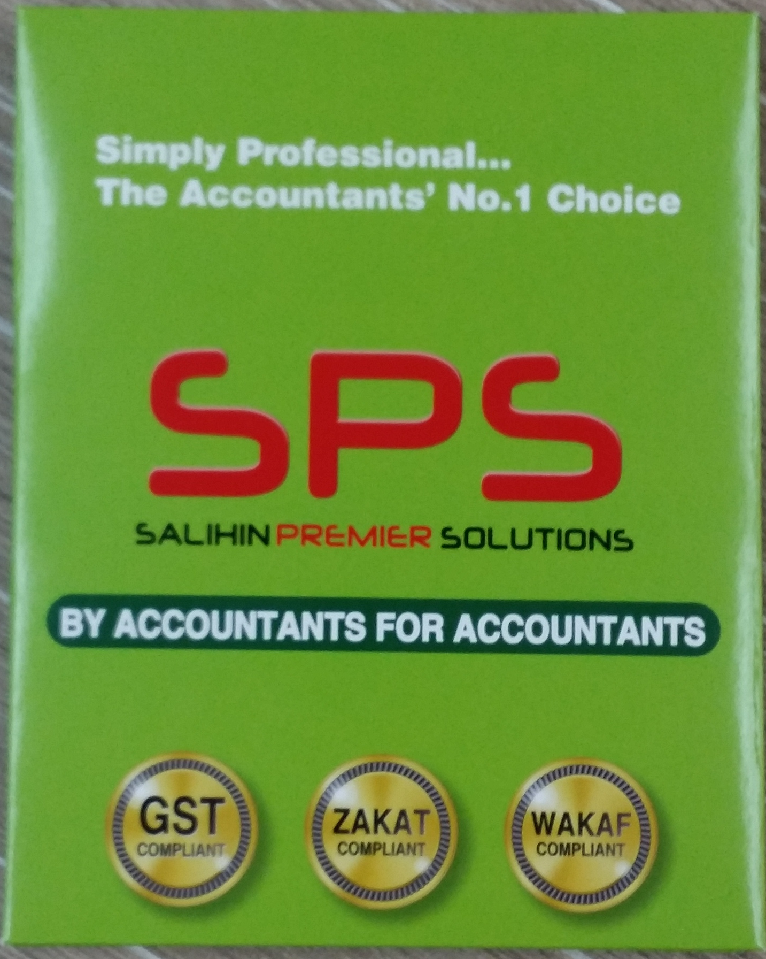
SPS PRODUCT PACKAGE?
PACKAGE 1
3 Companies / 1 User
PACKAGE 2
3 Users / 1 Company
© SALIHIN 2015. Strictly Private & Confidential

Slide 25
SPS PRODUCT PACKAGE?
Training Centre ( Max 3 Person )
I-Support Maintenance ( 1 Year )
                - Free Update Software
- Free Viewer Support ( 5 Cases )
- Free On-Call Support ( 3 Months )
- Free Online Chat Support
  SPS I-PACK
  RM 3052.80
  (INCLUDING GST)
© SALIHIN 2015. Strictly Private & Confidential

Slide 26
SPS PRODUCT PRICING-CONT
BIL | OPTIONAL | PRICE (RM)
1 | INSTALLATION | 200.00
2 | ADDITIONAL USER LICENSE | 500.00
3 | ADDITIONAL COMPANIES LICENSE | 500.00
4 | ON-SITE TRAINING (1 DAY X 3 USER) | 1,500.00
5 | TRAINING CENTRE (1 DAY PER USE) | 300.00
6 | ON-SITE SUPPORT | 500.00
7 | ON-CALL SUPPORT (PER TICKET) | 50.00
8 | TEAM VIEWER SUPPORT (PER CASES) | 150.00
9 | RE-ISSUE LICENSE | 100.00
10 | TRAINING ACCOUNTING GST (PER PACK) | 500.00
11 | I-Support Maintenance (1 Year) - Free update software Version - Free Viewer support (5 Cases) - Free on-call support ( 3 Months) - Free Online chat support | 980.00
12 | I-Care SPS ( 1 year ) - Free update Software Version | 750.00

Slide 27
SPS PRODUCT PRICING-CONT
Commission Table For Reseller.
Based on value of product RM 2,880.
Reseller | Commission Percentage (%) | Amount (RM)
Partner ( Sell >100 pax in 1 year) | 40% | RM 1,152
Dealer ( Sell <100 pax in 1 year) | 35% | RM 1,008

Slide 28
SPS PRODUCT PRICING-CONT
BIL | ITEM | PRICE (RM) | DEALER PORTION (RM) | COMMISSION 35% (RM)
1 | SPS INSTALLER | 2,880.00 | 1,008.00 | 1,008.00
2 | INSTALLATION | 200.00 | 200.00 | -
3 | ADDITIONAL USER LICENSE | 500.00 | 175.00 | 175.00
4 | ADDITIONAL COMPANIES LICENSE | 500.00 | 175.00 | 175.00
5 | ON-SITE TRAINING (1 DAY X 3 USER) | 1,500.00 | 1,200.00 | 300.00
6 | TRAINING CENTRE (1 DAY PER USE) | 300.00 | 250.00 | 50.00
7 | ON-SITE SUPPORT | 500.00 | 500.00 | -
8 | ON-CALL SUPPORT (PER TICKET) | 50.00 | 50.00 | -
9 | TEAM VIEWER SUPPORT (PER CASES) | 150.00 | 150.00 | -
10 | RE-ISSUE LICENSE | 100.00 | 35.00 | 35.00
11 | TRAINING ACCOUNTING GST (PER PACK) | 500.00 | 500.00 | 100.00
12 | I-SUPPORT MAINTENANCE (1 YEAR) - FREE UPDATE SOFTWARE VERSION - FREE VIEWER SUPPORT (5 CASES) - FREE ON-CALL SUPPORT ( 3 MONTHS) - FREE ONLINE CHAT SUPPORT | 980.00 | 603.00 | 203.00
13 | I-CARE SPS ( 1 YEAR ) - FREE UPDATE SOFTWARE VERSION | 750.00 | 240.00 | 250.00

Slide 29
5.0 OUR CREDENTIALS
© SALIHIN 2015. Strictly Private & Confidential

Slide 30
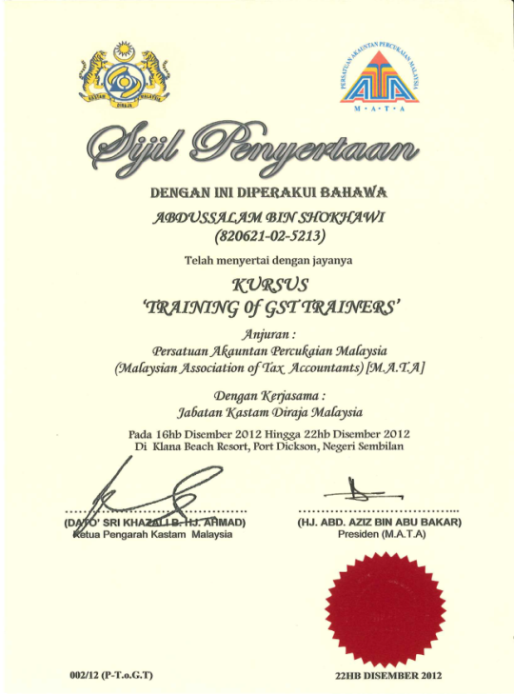
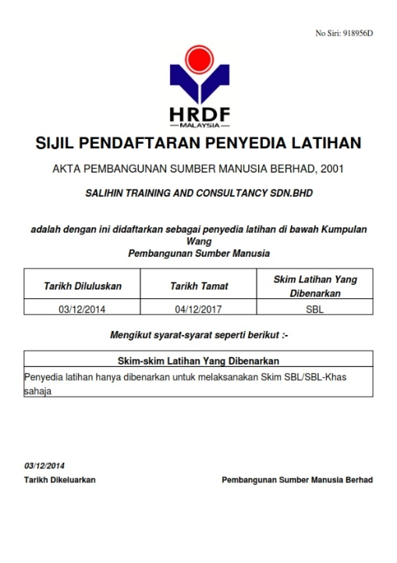
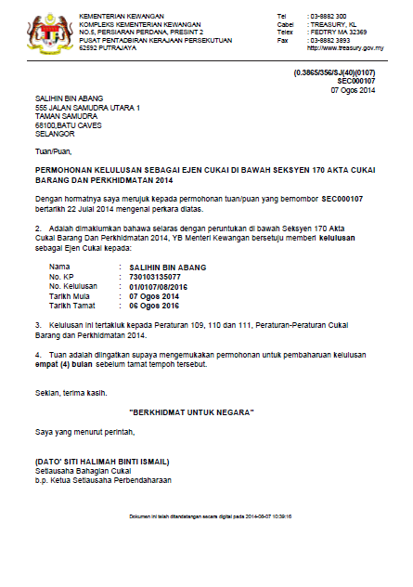

OUR CREDENTIALS
A structured approach with approved HRDF training modules approved by HRDF.
Approved GST Agents and Qualified GST Trainers that have vast GST knowledge and experience of various industries.
Experienced IT consultants that can review and provide technical assistance for GST system compliance; accounting for GST.
© SALIHIN 2015. Strictly Private & Confidential

Slide 31

CONTACT US
OFFICIAL ADDRESS & CONTACT PERSON
CORPORATE CENTRE:
KL Sentral Office
Unit 2A-1, Level 1
Tower 2A, Plaza Sentral
Jalan Stesen Sentral 5
KL Sentral
50470, Kuala Lumpur
Tel: +603 2261 4180
Fax: +603 2261 4182
CONSULTANT: FARHANA BT ZAHARI
EMAIL: farhana@salihin.com.my
Official Website : www.salihin.com.my
Customer Service : www.salihinpremier.com
E-mail : info@salihin.com.my
Careline : 1 300 88 5678
© SALIHIN 2015. Strictly Private & Confidential

Slide 32

www.salihin.com.my | www.salihinpremier.com
1 300 88 5678
Copyright Controlled 2012 @ SALIHIN

