Slide 1



COLLABORATION PROPOSAL FOR GST WORKSHOP
Prepared for:
Prepared by:
© 2014 SALIHIN. All Rights Reserved

Slide 2
  TABLE OF CONTENT
1.0 ABOUT US
2.0 THE PROPOSAL 3.0 PROPOSED FEE 4.0 OUR CREDENTIALS 5.0 CONTACT US
© SALIHIN 2015. Strictly Private & Confidential

Slide 3

1.0 ABOUT US
© SALIHIN 2015. Strictly Private & Confidential

Slide 4




AT THE GLANCE
        ABOUT US
        FIRM’S DESCRIPTION
Founded in 2002, SALIHIN is a professional business consultancy firm specializing in Auditing, Taxation, Advisory and IT Consultancy.
The past decade has witnessed our continuing effort in brand building through commitment to integrity, high quality and business excellence in providing exceptional end-to-end services.
From grass to grace, our endless effort did not go unnoticed when we are certified as MSC status, 1-Innocert and Enterprise 50 company. As we progress, we grow along with our valued clients, looking forward to more maturing business relationship.
We are certified by the Royal Malaysian Customs Department (RMCD as approved GST Trainer and by the Pembangunan Sumber Manusia Berhad (PSMB) as one of the approved trainers under Human Resources Development Fund (HRDF) which allows our clients to claim 100% training expenses.
© SALIHIN 2015. Strictly Private & Confidential

Slide 5
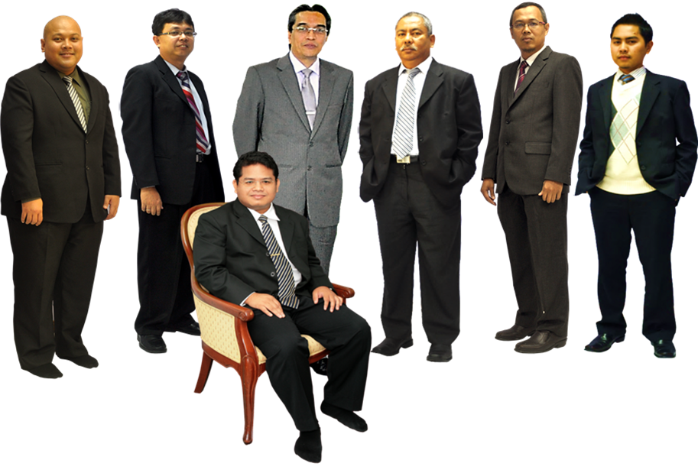
    ABOUT US
    KEY PERSONNAL
  ABOUT US
  KEY PERSONNAL
In Front: Salihin Abang
L-R: Ahmad Izwan Adnan, Faizul Nizan Zulkefli ,
Tuan Haji Abd. Aziz Abu Bakar, Ahmad Aljafree Razalli,
Mohd Faried Jamil, Abdussalam Shokhawi
© SALIHIN 2015. Strictly Private & Confidential

Slide 6

  ABOUT US
  SERVICE AND OFFICES
AUDIT & ASSURANCE
GOODS AND SERVICES TAX (GST)
FINANCIAL ACCOUNTING SERVICES
Financial Statement Audit
Compliance Audit
Operational Audit
Forensic Audit
GST Compliance and Advisory
GST Preparation and Filing
GST Audit and Investigation
GST Training
Accounting System Development and
Implementation
Financial Statements Review
Business Process Outsourcing
TAXATION
CORPORATE SECRETARIAL SERVICES
Tax Compliance
Corporate Tax Advisory
Indirect Tax Services
Tax Audit and Investigation
Real Property Gain Tax
Company Incorporation
Other valuable Secretarial Services
Registration with Ministry of Finance
and other Government Agencies
CORPORATE FINANCE &
TRANSACTION SERVICES
ISLAMIC ACCOUNTING & AUDITING
Due Diligence
Internal Audit and Forensic Accounting
Valuation
Capital Market
Managerial Finance
Mergers & Acquisitions
Shariah Compliance Audit
Advisory Services
Zakat - Alms Giving
Waqf - Islamic Endowment
BATU CAVES . KUALA LUMPUR . JOHOR BAHRU . KUCHING
© SALIHIN 2015. Strictly Private & Confidential

Slide 7





  ABOUT US
  WHY SALIHIN?
The following are key reasons why SALIHIN should be the preferred choice:
We have the right ‘hands-on’ team with vast GST knowledge and training experience.
We would be able to provide complete and comprehensive guidance on GST.
We are certified GST Trainers by RMCD.
We offer ‘value for money’ without compromising on the quality and timeliness of training.
As approved HRDF Training Provider, training expenses are 100% claimable.
© SALIHIN 2015. Strictly Private & Confidential

Slide 8
  ABOUT US
  CLIENTELE OVERVIEW
ABOUT US
CLIENTELE OVERVIEW
SALIHIN serves diverse clients including corporate companies, foundations/non-profit organisations, government bodies and government linked companies. Their diversity spans across different sectors of the economy.
© SALIHIN 2015. Strictly Private & Confidential

Slide 9

ABOUT US
CLIENTELE OVERVIEW (CONTD.)
© SALIHIN 2015. Strictly Private & Confidential
9

Slide 10
ABOUT US
OUR GST CLIENT
Business Sectors | Group of Companies
Cooperative society | KOPETRO Berhad Pertubuhan Peladang Kawasan Kuala Selangor Pertubuhan Peladang Negeri Johor
Oil and Gas | Cotrade Sdn. Bhd. K Shah Energy Resources Sdn. Bhd. Far Frontier (M) Sdn. Bhd. Cakara Maritime Sdn. Bhd.
Food and Beverages | UNI Cherish Sdn. Bhd. Holly Smoke Café Sdn. Bhd. Diiz Universe Sdn. Bhd. Alam Food Industries (M) Sdn. Bhd.
Foundation/Institution | Yayasan Sarawak Yayasan Pembangunan Ekonomi Islam Malaysia Pengurusan Aset Air Berhad
© SALIHIN 2015. Strictly Private & Confidential
10

Slide 11
ABOUT US
OUR GST CLIENT (CONTD.)
Business Sectors | Companies
Property Developer | Sazean Development Sdn. Bhd. TH Properties Sdn. Bhd.
Trading | Naza Tutti Frutti (Malaysia) Sdn. Bhd. Tutti Frutti Trading Sdn. Bhd. Casa Havana Sdn. Bhd. Ken West Sdn. Bhd.
Manufacturing | Item Industrial Engineering Sdn. Bhd. Jordone Corporation Sdn. Bhd. Dongwha Fibreboard (M) Sdn. Bhd.
Training and consultancy | Excell Training & Country Resorts Sdn. Bhd. ICLIF Leadership and Governance Centre
© SALIHIN 2015. Strictly Private & Confidential
11

Slide 12
ABOUT US
OUR GST CLIENT (CONTD.)
Business Sectors | Companies
Property Management | New Western Holding Sdn. Bhd. Alam Maritim Properties (M) Sdn. Bhd. Kopetro Ventures Sdn. Bhd.
Shipping Industry | Alam Maritim (M) Sdn. Bhd. Alam Maritim (L) Inc Alam Hidro (M) Sdn. Bhd.
Services | Nationwide Express Courier Services Berhad Nationwide Express Freight Forwarders Sdn. Bhd. Nationwide Express Metro Sdn. Bhd. KJ Waja Engineering Sdn. Bhd. KJ Waja Services Sdn. Bhd.
Logistic services | Dwi Alam LMS Sdn. Bhd. Nationwide Express Logistics Sdn. Bhd. Alam Offshore Services & Logistics Sdn. Bhd.
© SALIHIN 2015. Strictly Private & Confidential
12

Slide 13

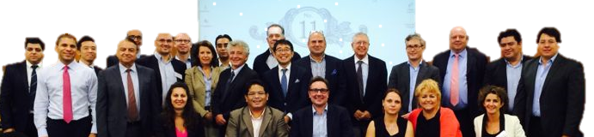

ABOUT US
INTERNATIONAL LINKS/NETWORK
Today’s globalization and increasing complexity in the business environment call for strategic alliances. While providing firms with flexibility, they also allow firms to leverage resources and capabilities to achieve objectives that might otherwise beyond their reach.
http://www.i2an.com/
Eying international reach, SALIHIN now is a member firm of i2an, a reputable global network of financial professionals which currently has over 500 professionals present in the major financial centres in Europe, the United States and Asia.
© SALIHIN 2015. Strictly Private & Confidential

Slide 14
3.0 THE PROPOSAL
© SALIHIN 2015. Strictly Private & Confidential

Slide 15
THE PROPOSAL
BACKGROUND AND OBJECTIVES
The imminent GST in April 2015 would foresee the need of Accounts Department to comprehend and be able to adequate the various GST transactions and adjustments that will produce a correct GST-03 Tax Return. Therefore, the relevance of Book-keeping is no more undervalued due to substantial penalties for erroneous and inadequate Tax Return submissions. Thusly the equitable Book-keeping is vital to claim back Input Tax Credits from the Government.
SALIHIN in partnership with AMCAF (Association of Malay Chartered Accountants Firms Malaysia) feels honoured to endeavor a comprehensive and extensive GST Book-keeping; and also management course for your organisation. The trainers have extensive experience in Malaysian GST and work closely with Royal Malaysian Customs.
This workshop is inclusive of administering a strong GST foundation for Book-Keeping and utilizes Royal Malaysian Customs Certified GST Accounting Software named SPS (Salihin Premier Solutions), as a coaching and hands-on platform.
Participants will experientially involved in hands-on environment in stimulating various GST transactions and modification towards preparing GST Tax Returns by using their laptops. Peculiarly, it does not count on what Accounting Software your Organization currently adopts, the 23 Tax Codes, GST concepts and treatment will eternally remain prevalent.
© SALIHIN 2015. Strictly Private & Confidential

Slide 16
THE PROPOSAL
EXPECTED TRAINING OBJECTIVES
For participants to understand GST and its impact on Co-Operative Societies
To understand GST accounting issues and treatments
© SALIHIN 2015. Strictly Private & Confidential

Slide 17
THE PROPOSAL
SCOPE & TIMING OF TRAINING
The scope of the training will be in line with the GST Guidelines and GST Act 2014 issued by the RMCD and other relevant training compliance requirements. It will be a day’s training as depicted below:
Time | Topics | Days
Morning | GST Impact on | Tuesdays and Thursdays (March, April, May)
 | GST Accounting
Afternoon
 | SPS Training
© SALIHIN 2015. Strictly Private & Confidential

Slide 18
THE PROPOSAL
TRAINING CALENDAR
As indicated earlier, this one day workshop would be conducted on Tuesdays and Thursdays of March, April and May 2015. Indicative dates are provided below:
March 2015
Sunday | Monday | Tuesday | Wednesday | Thursday | Friday | Saturday
1 | 2 | 3 | 4 | 5 | 6 | 7
 |  | GST Workshop |  | GST Workshop
8 | 9 | 10 | 11 | 12 | 13 | 14
 |  | GST Workshop |  | GST Workshop
15 | 16 | 17 | 18 | 19 | 20 | 21
 |  | GST Workshop |  | GST Workshop
22 | 23 | 24 | 25 | 26 | 27 | 28
 |  | GST Workshop |  | GST Workshop
29 | 30 | 31
 |  | GST Workshop
© SALIHIN 2015. Strictly Private & Confidential

Slide 19
THE PROPOSAL
TRAINING CALENDAR
April 2015
Sunday | Monday | Tuesday | Wednesday | Thursday | Friday | Saturday
 |  |  | 1 | 2 | 3 | 4
 |  |  |  | GST Workshop
5 | 6 | 7 | 8 | 9 | 10 | 11
 |  | GST Workshop |  | GST Workshop
12 | 13 | 14 | 15 | 16 | 17 | 18
 |  | GST Workshop |  | GST Workshop
19 | 20 | 21 | 22 | 23 | 24 | 25
 |  | GST Workshop |  | GST Workshop
26 | 27 | 28 | 29 | 30
 |  | GST Workshop |  | GST Workshop
© SALIHIN 2015. Strictly Private & Confidential

Slide 20
THE PROPOSAL
TRAINING CALENDAR
May 2015
Sunday | Monday | Tuesday | Wednesday | Thursday | Friday | Saturday
 |  |  |  |  | 1 | 2
3 | 4 | 5 | 6 | 7 | 8 | 9
 |  | GST Workshop |  | GST Workshop
10 | 11 | 12 | 13 | 14 | 15 | 16
 |  | GST Workshop |  | GST Workshop
17 | 18 | 19 | 20 | 21 | 22 | 23
 |  | GST Workshop |  | GST Workshop
24 | 25 | 26 | 27 | 28 | 29 | 30
 |  | GST Workshop |  | GST Workshop
31
© SALIHIN 2015. Strictly Private & Confidential

Slide 21
4.0 PROPOSED FEE & SHARING RATIO
© SALIHIN 2015. Strictly Private & Confidential

Slide 22
PROPOSED FEE & PROFIT SHARING RATIO
Our fees are based on the complexities of the topics, experience and time spent on the topics by the speakers as well as cost of printing materials, venue and food. The profit sharing ratio is based on expected responsibilities of the parties.
No | Location | Per pax | Cost | Profit | AMCAF (25%) | SALIHIN (75%) | Pax per Session | No. of Sessions | Profit AMCAF | Profit SALIHIN
1 | Batu Caves | 1000 | 175 | 825 | 206.25 | 618.75 | 25 | 26 | 134,063 | 402,188
2 | KL Sentral | 1000 | 175 | 825 | 206.25 | 618.75 | 25 | 26 | 134,063 | 402,188
3 | Shah Alam | 1000 | 175 | 825 | 206.25 | 618.75 | 25 | 26 | 134,063 | 402,188
4 | Johor Bharu | 1000 | 175 | 825 | 206.25 | 618.75 | 25 | 26 | 134,063 | 402,188
5 | Kuching | 1000 | 175 | 825 | 206.25 | 618.75 | 25 | 26 | 134,063 | 402,188
6 | Kota Kinabalu | 1000 | 175 | 825 | 206.25 | 618.75 | 25 | 26 | 134,063 | 402,188
7 | Kuala Terenganu | 1000 | 175 | 825 | 206.25 | 618.75 | 25 | 26 | 134,063 | 402,188
8 | Alor Star | 1000 | 175 | 825 | 206.25 | 618.75 | 25 | 26 | 134,063 | 402,188
9 | Kota Bharu | 1000 | 175 | 825 | 206.25 | 618.75 | 25 | 26 | 134,063 | 402,188
 |  |  |  |  |  |  |  |  | 1,206,563 | 3,619,688
© SALIHIN 2015. Strictly Private & Confidential

Slide 23
PROPOSED FEE & PROFIT SHARING RATIO
Breakdown of Revenue | Per Pax (RM) | RM
Total Revenue: |  | 5,850,000
Cost (Catering): | 50 | 292,500
Cost (Material): | 50 | 292,500
Cost Venue | 75 | 438,750
Profit |  | 4,826,250
Profit to AMCAF: |  | 1,206,563
Profit to SALIHIN |  | 3,619,688
Total No. of Training Centres | 9
No. of Training Sessions Per Centre for 3 Months | 26
Total No. of Training Sessions Across Centre | 234
No. of Pax Per Session | 25
Total Pax Trained | 5,850

Slide 24
PROPOSED APPOINMENT OF AMCAF AS
SPS PARTNER
In connection with this GST Workshop, SALIHIN is further proposing to appoint AMCAS as SALIHIN PREMIER SOLUTIONS (SPS) sales and promotion Partner of Software to SKM members within the period of GST Workshop. This is commission based incentive whereby AMCAF will given a commission of 10% on each software sold.
The actual price of SPS is RM 2,880. It however it will be sold at a discounted price of RM 1,000 to SKM members only. The price is exclusive of training and support maintenance
SPS is an innovative accounting software solution designed by SALIHIN’s professional accountants for accountants. It is tailor-made for Small and Medium Enterprises (SMEs). It is a cutting-edge technology driven software that is smartly all-inclusive, innovative and easy to use.
It is designed to simplify the handling of numerous aspects of accounting including financial accounting, GST, Zakat and Wakaf/Endowment. It is the ONLY premiered accounting software locally conceived and developed to meet the unmet needs of accountants in Malaysia.
© SALIHIN 2015. Strictly Private & Confidential

Slide 25

Salihin Premier Solutions (SPS)
Accounting Software

Slide 26
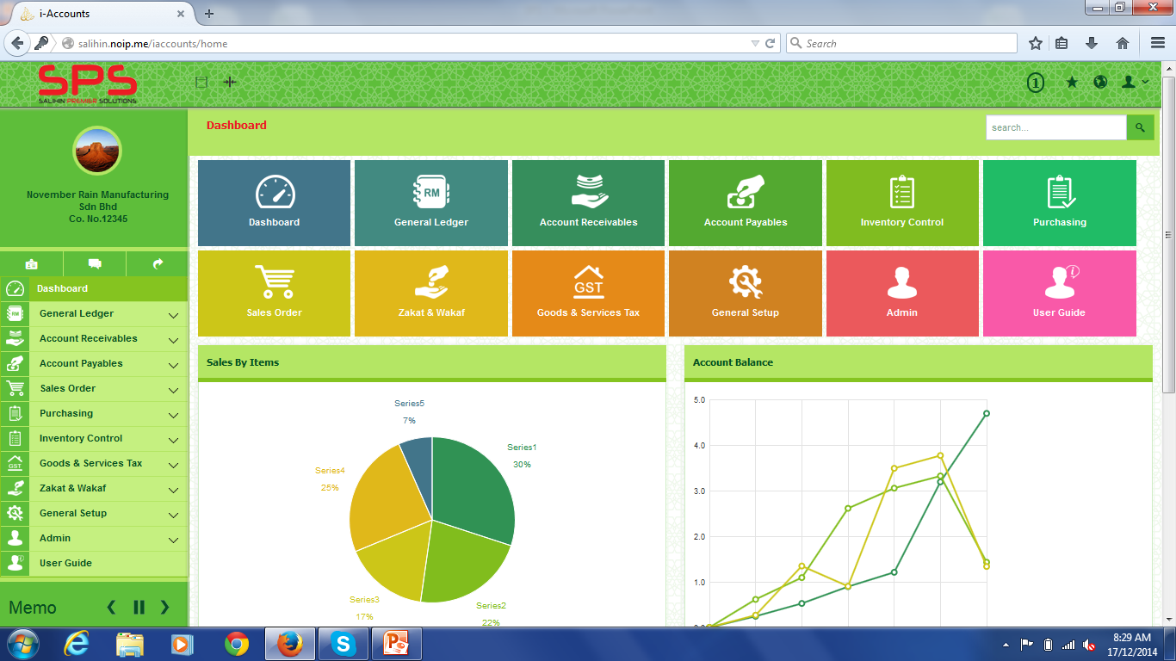
Salihin Premier Solutions (SPS)
Accounting Software

Slide 27
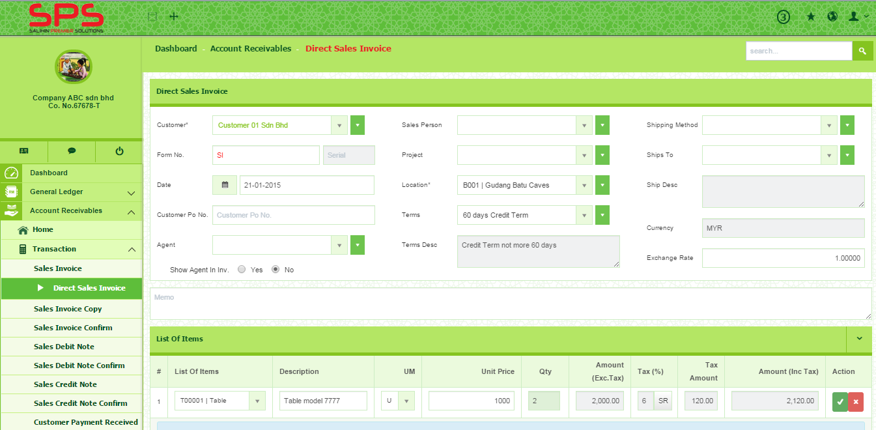
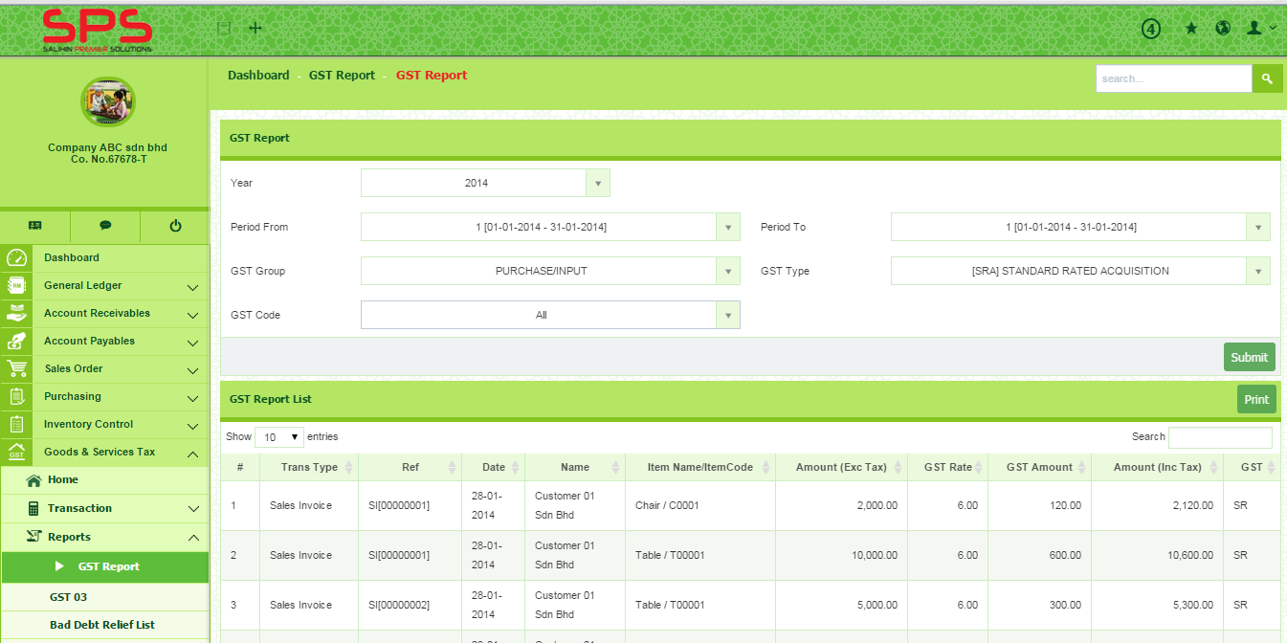
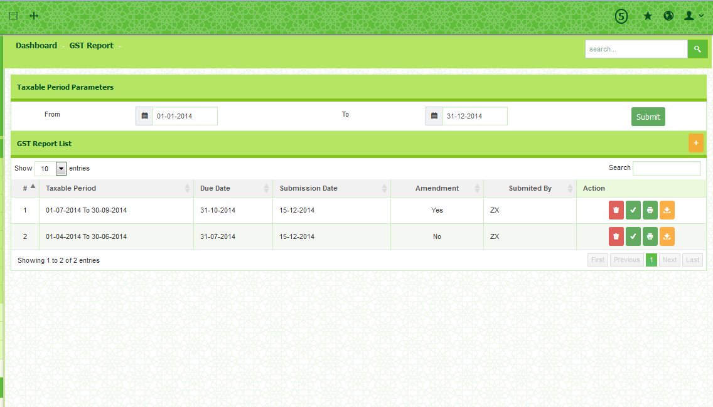
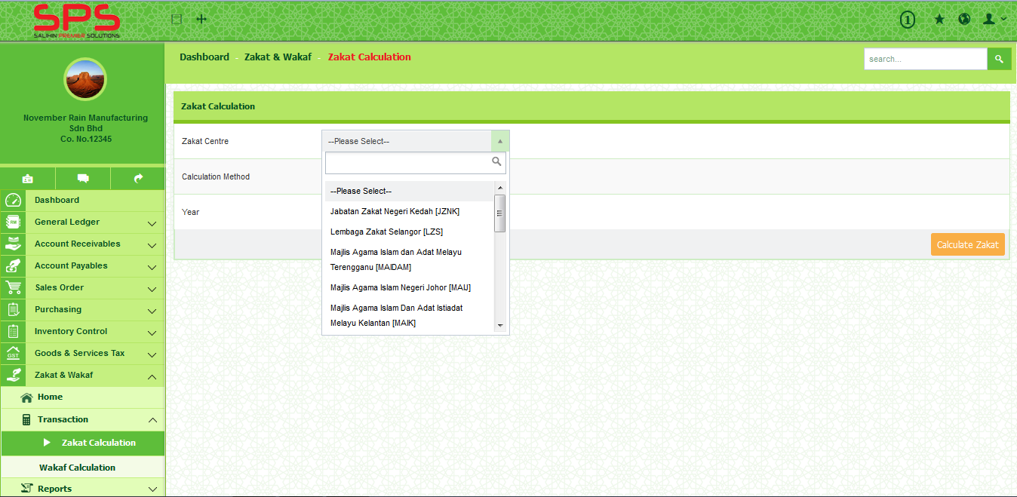
Salihin Premier Solutions (SPS)
Accounting Software

Slide 28
5.0 OUR CREDENTIALS
© SALIHIN 2015. Strictly Private & Confidential

Slide 29
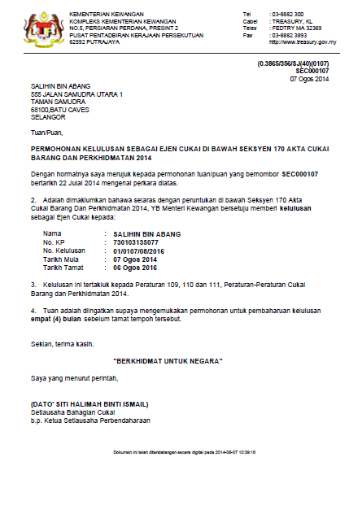
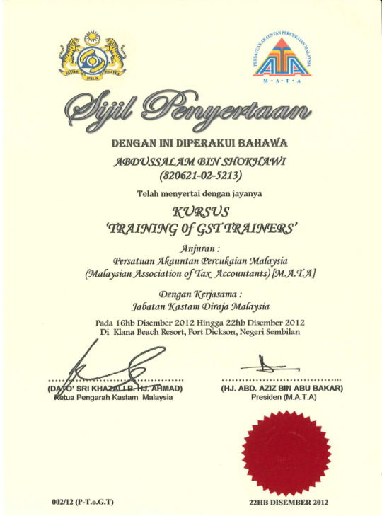
OUR CREDENTIALS
Approved GST Agents and Qualified GST Trainers that have vast GST knowledge and experience of various industries.
A structured approach that includes comprehensive and practical tools to assist the GST Team.
Experienced IT consultants that can review and provide technical assistance for GST system compliance; accounting for GST.
© SALIHIN 2015. Strictly Private & Confidential

Slide 30
OUR CREDIBLE/CERTIFIED GST TRAINERS
The following are the proposed speakers for the GST Workshop.
1. En. Salihin Abang
2. Tuan Haji Abd. Aziz Abu Bakar
3. En. Abdussalam Shokhawi
4. En. Mohd Faried Jamil
5. Pn. Anizah bt Ishak
6. Pn. Norzila Othman
7. En. Mohd Aizat Jamil
8. En. Luqman Hakim Hashim
9. Pn. Rosnita bt. Ahmad
10. En. Hasbi bin. Tangge
11. En. Mohamad Ropaat b. Khamid
12. En. Saizol b. Ismail

Slide 31

CONTACT US
OFFICIAL ADDRESS & CONTACT PERSON
CORPORATE CENTRE:
KL Sentral Office
Unit 2A-1, Level 1
Tower 2A, Plaza Sentral
Jalan Stesen Sentral 5
KL Sentral
50470, Kuala Lumpur
Tel: +603 2261 4180
Fax: +603 2261 4182
CONSULTANT: Abdussalam Shokhawi
EMAIL: salam@salihin.com.my
Official Website : www.salihin.com.my
Customer Service : www.mysalihin.com
E-mail : info@salihin.com.my
Careline : 1 300 88 5678
© SALIHIN 2015. Strictly Private & Confidential

Slide 32

Change…delete IT Consulancy. Insert GST.
www.salihin.com.my | www.mysalihin.com
1 300 88 5678
Copyright Controlled 2012 @ SALIHIN

