Slide 1

A PROPOSAL FOR SETTING UP TEACHING ACCOUNTING FIRM WITH UITM
© 2016 SALIHIN. All Rights Reserved.

Slide 2
About SALIHIN
1

Slide 3
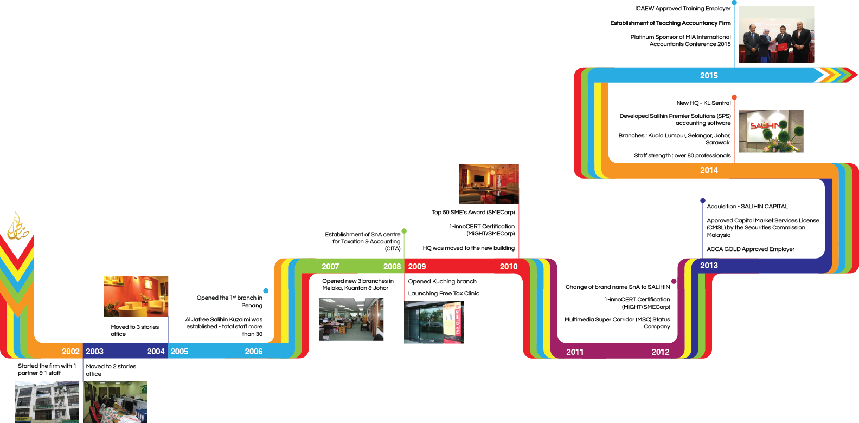
        JOURNEY

Slide 4
        AT GLANCE
FOUNDER
Salihin Abang
FOUNDED
21 January 2002
STRENGTH
127 Employees
LICENSE
Accountants Act 1967
Income Tax Act 1967
CS Act 1993
CMSA 2007
GST Act 2014

Slide 5
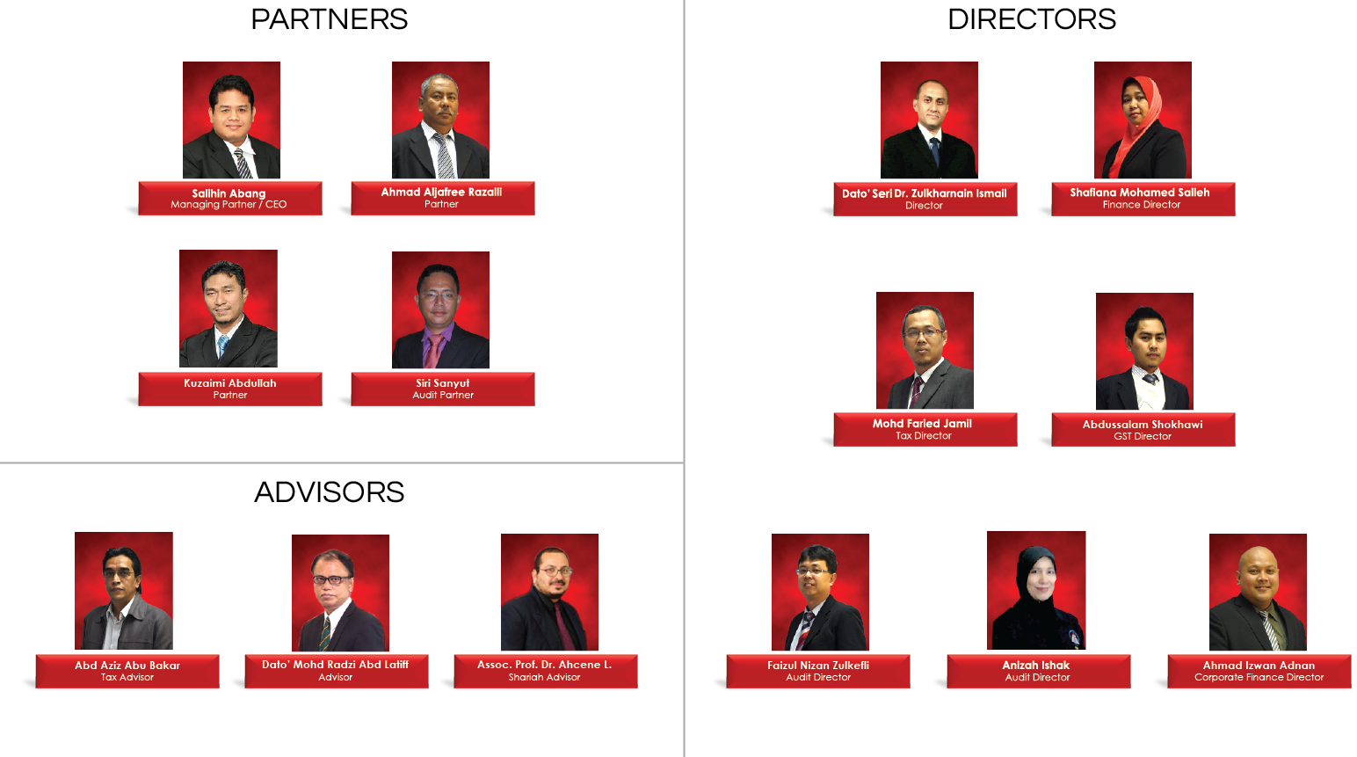
        LEADERSHIP

Slide 6
        SERVICES & OFFICES
AUDIT & ASSURANCE
GOODS & SERVICES TAX (GST)
FINANCIAL ACCOUNTING SERVICES
Financial Statement Audit
Compliance Audit
Operational Audit
Forensic Audit
GST Compliance and Advisory
GST Preparation and Filing
GST Audit and Investigation
GST Training
Accounting System Development and
Implementation
Financial Statements Review
Business Process Outsourcing
TAXATION
IT CONSULTANCY
CORPORATE SECRETARIAL SERVICES
Tax Compliance
Corporate Tax Advisory
Indirect Tax Services
Tax Audit and Investigation
Real Property Gain Tax
IT Application Specification
IT Management and Support
IT Procurement
Company Incorporation
Other valuable Secretarial Services
Registration with Ministry of Finance
and other Government Agencies
TRANSACTION &
CORPORATE FINANCE
ISLAMIC ACCOUNTING & AUDITING
Due Diligence
Internal Audit and Forensic Accounting
Valuation
Capital Market
Managerial Finance
Mergers & Acquisitions
Shariah Compliance Audit
Advisory Services
Zakat - Alms Giving
Waqf - Islamic Endowment
KUALA LUMPUR . JOHOR BAHRU . KUCHING. TERENGGANU

Slide 7

        ACCOUNTING SOFTWARE

Slide 8
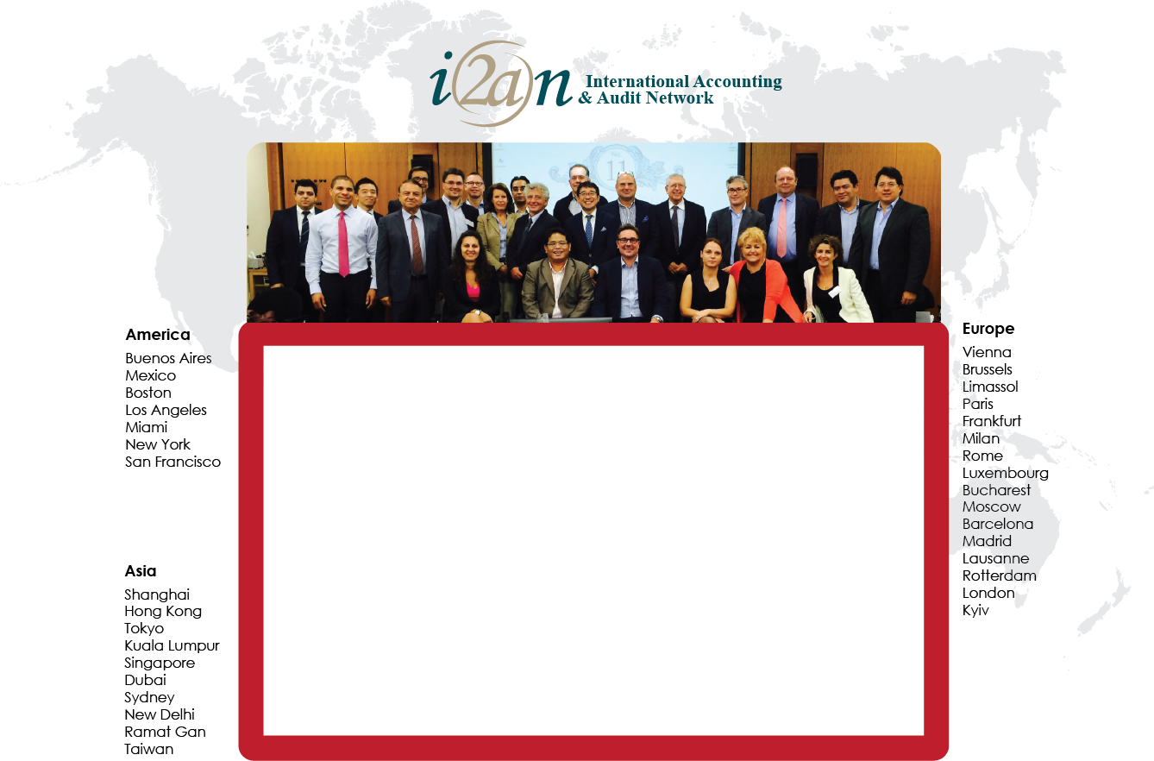
        INTERNATIONAL NETWORK
SALIHIN is a member firm of i2an, a reputable global network of accountants which have presence in America, Asia and Europe as well as all the international financial centres.

Slide 9
























        ACHIEVEMENTS & CLIENTS
ACHIEVEMENTS | DIVERSE CLIENTS
© SALIHIN 2015. Strictly Private & Confidential

Slide 10
Teaching Accountancy Firm
2

Slide 11
ANALYSIS
Perception of the quality of accounting graduates
Accounting, auditing and taxation are practical and dynamic subjects
Universities financial sustainability
Skill-mismatch hinders graduate employability
Deficiency in accounting curriculum and teaching
University, industry and international outlook
The Way Forward – integration of theory and practice
Replication of Teaching Hospital Concept to Accountancy Education

Slide 12
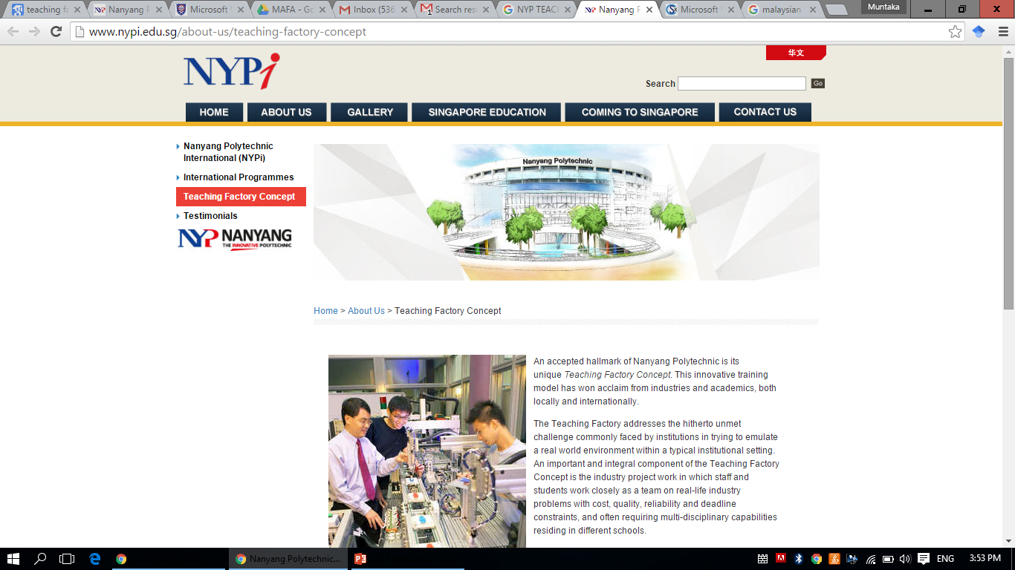


EXISTING APPLICATIONS
The Teaching Factory Concept in Engineering

Slide 13

PIONEER ESTABLISHMENT @ UMT

Slide 14
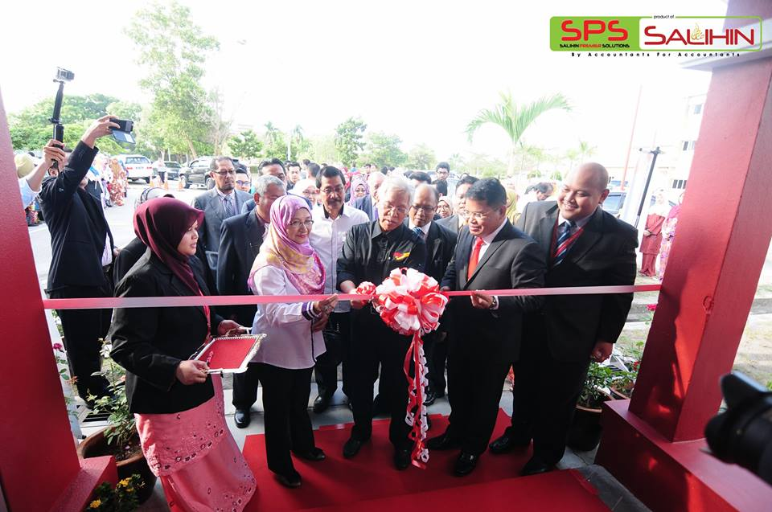
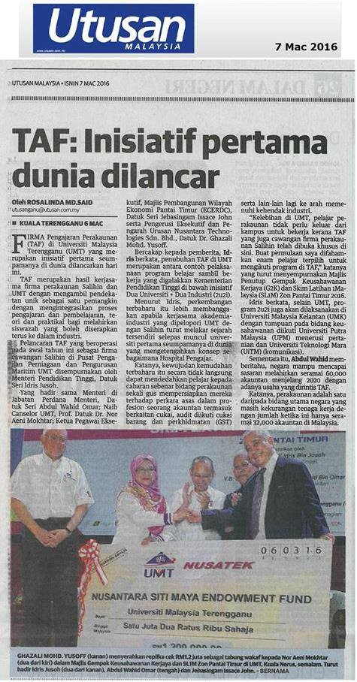
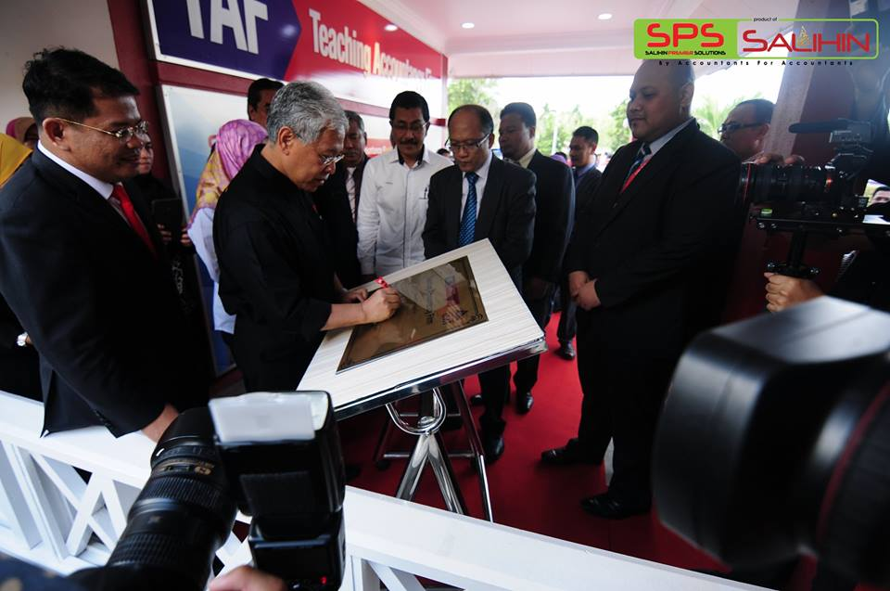
PIONEER ESTABLISHMENT @ UMT

Slide 15
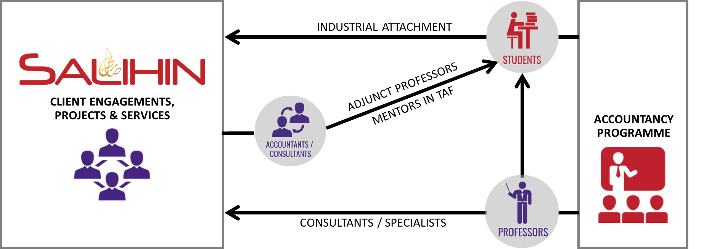

CONCEPT

Slide 16
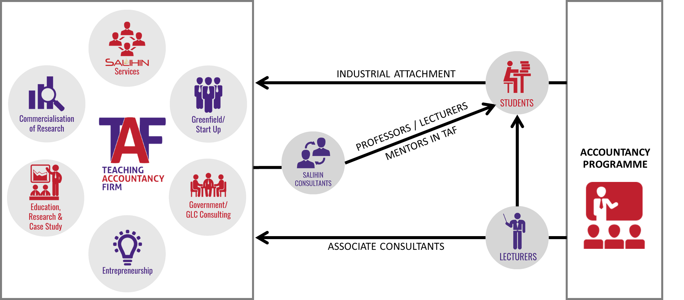
CONCEPT

Slide 17
OBJECTIVES
As avenue for students to be directly involved in the actual working environment within the university and to apply knowledge which has been learnt in the class;
To enhance quality of accounting graduates with necessary technical skills in accounting and others as deemed relevant, primarily involving accounting standards and applicable laws;
To heighten set of soft skills of accounting students i.e. business communication, efficient negotiation and effective report writing prior to commencement of career upon graduation; and
As a platform for academicians to empowering their knowledge with the latest development of accounting related industries and practices.

Slide 18
SERVICES
TAF
Current Practice Areas
Greenfield /Startup
Government/ GLC Consulting
Entrepreneurship
Education, Research & Case study
Commercialization of research
Accounting Services
Integrated Thinking Practice
Audit Assurance
Auditing beyond numbers
GST & Other Tax Services
Minimizing tax risks, maximizing tax savings
Managing Business risks
Secretarial Services
Providing the right context
Sharia Audit Services
Maintaining sharia compliance
Consultancy & Business advisory services

Slide 19
CURRICULUM
TRAINING |  | METHOD | YEAR OF STUDY
 |  |  | YEAR 1 |  | YEAR 2 |  | YEAR 3 |  | YEAR 4
 |  |  | 1 | 2 | 3 | 4 | 5 | 6 | 7 | 8
1 | SPS Training- Accounting Module | 1. Training Workshop 2. Embed in Course Syllabus
2 | SPS Training-Tax & GST Module
3 | Risk-Based Audit
4 | Company Secretarial
5 | Advisory Training
6 | TAF Attachment for: | Attachment with TAF
 | a. Accounting
 | b. Tax & GST
 | c. Audit
 | d. Secretarial
 | e. Advisory

Slide 20
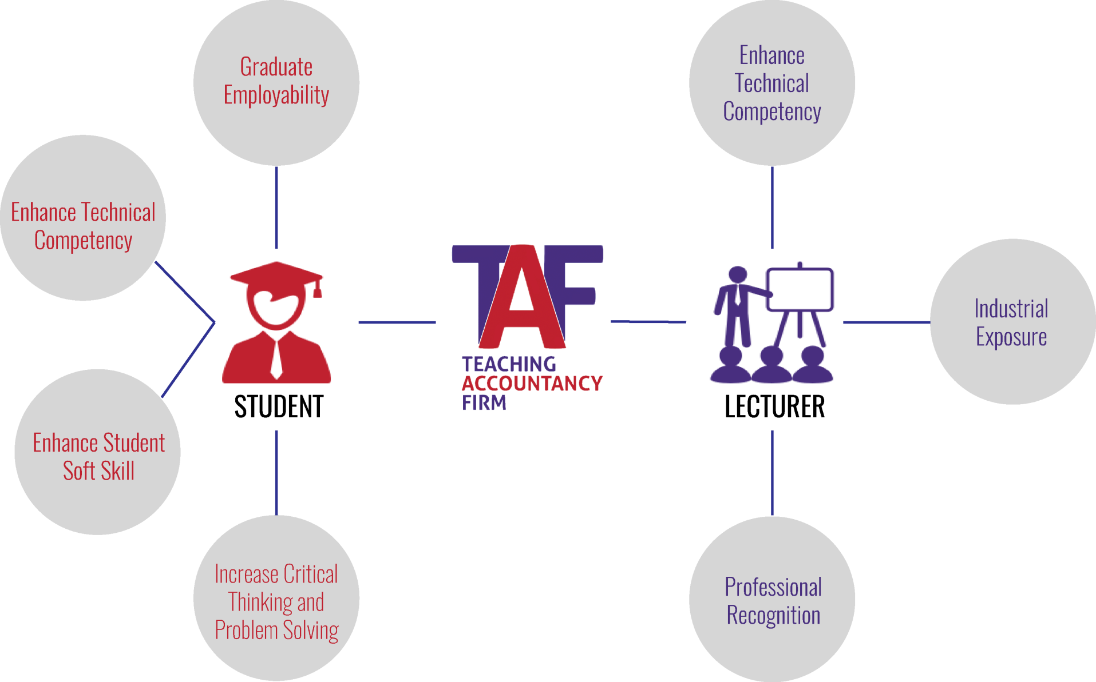
OUTCOMES

Slide 21
SUCCESS FACTORS
Availability and acquisition of clients in both private and public sectors
Supportive university policies
Active participation of students and lecturers
Government friendly policies and supports

Slide 22

www.salihin.com.my | www.salihinpremier.com
1 300 88 5678
Copyright Controlled 2012 @ SALIHIN

