Slide 1



PROPOSAL FOR STRATEGIC COLLABORATION
IN LEARNING & GRADUATE SKILLS ENHANCEMENT
Prepared for:
Prepared by:

Slide 2
EXECUTIVE SUMMARY
Enhancing learning experience with SPS
With the current shift towards efficient governance, the implementation of GST resulted in the requirement of further understanding of the tax structure in accounting. As one of the prestigious university in Malaysia, UITM can lead the shift through utilization of accounting information system(AIS) as a practical tool in demonstrating tax structure in accounting.
This requires certified accounting software, developed with direct input from the customs department, the Salihin Premier Solution (SPS) will provide the competitive edge for UITM to enhance the learning experience of its accounting students in gaining the practical understanding on GST implementations and its impacts in financial reports.
It can be implemented as a learning tool in Accounting Information System subject.

Slide 3
THE PROPOSAL
Main Objective: Enhancing Graduates
CAPACITY BUILDING
SKILLS ENHANCEMENT
INDUSTRIAL
RELEVANCE
To equip UiTM graduate student with value added accounting software skills
To provide avenue for UiTM to enhance graduate skills and accreditations
To provide practical expertise and experience for UiTM in delivering courses relevant to current and future industrial practices.

Slide 4
THE PROPOSAL
SPS As Optional Learning Tool
SPS is used to support the curriculum based on self initiatives by student with the assistance from lecturers.
For better positioning of SPS, exam will be given as an optional (to test student understanding of each particular subject)
Exam, Marking & Certification will be provided by SALIHIN (For those who seat for exam).
Part of
Up Scaling
Not Bound to University Program
Does Not Require Senate Permission
SPS Student Manual & Installer
SPS as Optional Learning Tool
1 Hour Online Exam
Separate Session in Lab
SPS Certification
Lecturer’s Decision
Student’s Willingness
Monitoring & Marking By SALIHIN

Slide 5
THE PROPOSAL
Proposed Modules
Modules | Setup & Operate Admin & General Setup Module Setup General Ledger Module Setup Account Receivables Module Setup Account Payables Module Setup & Operate Sales Order Module Setup and Operate Purchasing Module Setup & Operate Inventory Control Module Setup & Operate GST Module Setup & Operate Zakat & Waqf Modules

Slide 6
THE PROPOSAL
Proposed Set Up
Installation
  SPS will be install at UiTM server and accessible to all PCs/ Laptops as long as connected to the UiTM Network.
  This will ensure minimal trouble shooting and updating the software pack when needed.
  If this mechanism not been granted, then SPS will be install individually on each and every PCs in lab.
Licensing
  SALIHIN will grant student version SPS will unlimited license to be use during learning period and 1 year extended individual license (for those who sit for exam)
Train the Trainer Program
  SAALIHIN will conduct 2 phase of training to each participating lecturers.
    Phase 1: SPS full module training. Duration will be 2 days.
    Phase 2: SPS trouble shooting training. Duration will be 2 days.
  Shall lecturers need extra training, a series of small batch training will be conducted at our training room in Plaza Sentral, KL.

Slide 7
THE PROPOSAL
Proposed Set Up
Learning Process
  SPS will be fully utilized during the lab session to support related subject approved by UiTM. Our recommendations is to attached SPS with AIS based subject such as:
    AIS 130 ( Computers Applications & Communications in Accounting).
    AIS 210 (Computerized Accounting).
    AIS 510 (Accounting Information System).
    AIS630 (Accounting System Analysis & Design).
  Each student will be given attending certification.
Exam & Certification
  For those who want to learn more and testify themselves on SPS, we will conduct an examination and extensive course. Course will be held in 2 weeks and 1 day for exam.
  On initial stage, we will conduct the programme. Later on, the programme will be handover to lecturer respectively.
  Certification (attending & pass) will be given to student respectively.

Slide 8
THE PROPOSAL
Proposed Set Up
Cost & Pricing
  Training
    Cost of trainer to tain lecturers under “Train the Trainer Programme” will be bourne by us. UiTM need to provide training facilities.
    Cost of training in Plaza Sentral for a small batch of UiTM lecturers will be bourne by SALIHIN vice versa.
  SPS Related Materials
    Student manual, student personal version (personal Laptop), extensive course & examination will be provide separately to student at the cost RM68.00
  Target Launch
    Semester II (June-Sep 2016)
    Target Train the Trainer Programme – May 2016

Slide 9
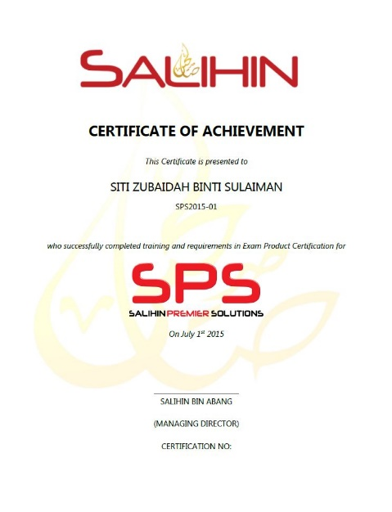
THE PROPOSAL
Expected Outcomes & Deliverables
At the end of the programme, we expected each graduates would be able to:
  Operate and utilize SPS Software (Install, configure & operate).
  Provide consultation & training on SPS.
SALIHIN deliverables to partipated graduates:
  SPS Certifications
    SPS Participation Certificate
    SPS Certified Engineer Certificate
    SPS Consultant Certificate
  1 Year Free SPS License
  1 Year Free SPS Support Service
  SPS Training Kits
    SPS Installer
    SPS Student Manual
    CD Interactive

Slide 10
THE PROPOSAL
Roles & Responsibility
UiTM | SALIHIN
To fully utilized SPS as main teaching tools / software. | To provide education version software
Provide facilities i.e classes & computer lab | Train the trainer (Lecturers) On site (2 -3 Days) In house (30 Days)
Provide trainers/ lecturers | Provide user manual (text book), exam , scoring, marking & certification.
Assist SALIHIN to promote SPS to students | Provide full support & hotline no
Uitm to allow SALIHIN to use UiTM brand, image recognition in promotional and advertising purposes | Assist UiTM in develop new course syllabus.
Expand new coursework program (where applicable)

Slide 11

CONTACT US
OFFICIAL ADDRESS & CONTACT PERSON
CORPORATE CENTRE:
KL Sentral Office
Unit 2A-1, Level 1
Tower 2A, Plaza Sentral
Jalan Stesen Sentral 5
KL Sentral
50470, Kuala Lumpur
Tel: +603 2261 4180
Fax: +603 2261 4182
CONSULTANT: WAN MOHD ISKANDAR B. WAN OMAR
EMAIL: wanmohdiskandar@salihin.com.my
Official Website : www.salihin.com.my
Customer Service : www.salihinpremier.com
E-mail : info@salihin.com.my
Careline : 1 300 88 5678

