Slide 1



PROPOSAL FOR STRATEGIC COLLABORATION
IN LEARNING & GRADUATE SKILLS ENHANCEMENT
Prepared for:
Prepared by:

Slide 2
TABLE OF CONTENTS
1.0 EXECUTIVE SUMMARY 04
2.0 OUR PROPOSAL 05
3.0 ABOUT US 23
4.0 ABOUT SALIHIN PREMIER SOLUTIONS (SPS) 35
5.0 OUR CREDENTIALS 40
6.0 APPENDIXES 44

Slide 3

1.0 EXECUTIVE SUMMARY

Slide 4
EXECUTIVE SUMMARY
Enhancing learning experience with SPS
With the current shift towards efficient governance, the implementation of GST resulted in the requirement of further understanding of the tax structure in accounting. As one of the prestigious university in Malaysia, UiTM can lead the shift through utilization of accounting information system(AIS) as a practical tool in demonstrating tax structure in accounting.
This requires certified accounting software, developed with direct input from the Royal Malaysian Customs Department (RMCD), the Salihin Premier Solution (SPS) will provide the competitive edge for UiTM to enhance the learning experience of its accounting students in gaining the practical understanding on GST implementations and its impacts in financial reports. It can be implemented as a learning tool in Accounting Information System subject OR as a stand alone subject.
It can also be positioned as an elective professional course complete certification by SALIHIN. Our combined efforts in enhancing the graduates can be taken to the next level through specialized GST training, headed by MATA as certified tax advisor in GST.

Slide 5
2.0 OUR PROPOSAL

Slide 6
THE PROPOSAL
MAIN OBJECTIVE: ENHANCING UITM GRADUATES
CAPACITY BUILDING
SKILLS ENHANCEMENT
INDUSTRY RELEVANCY
To equip UiTM graduate student with value added accounting software skills
To provide avenue for UiTM to enhance graduate skills and accreditations
To provide practical expertise and experience for UiTM in delivering courses relevant to current and future industrial practices.

Slide 7
THE PROPOSAL
SPS IN BIGGER PICTURE
Integrated SPS Course
(Accounting Information System)
Professional Certificate
(Optional Courses)
MATA GST Course
Embedded in Curriculum
Part of Learning Tools
SPS Advance Course
(GST in SPS)
SPS Course
Student Up Scaling Initiatives

Slide 8
POSITIONING SPS IN ACCOUNTING SUBJECT

Slide 9
THE PROPOSAL
INTEGRATED: EMBEDDED IN CURRICULUM
SPS Student Manual Book
SPS subject is embedded in course curriculum.
SPS is used to support the curriculum based on self initiatives by student with the assistance from lecturers.
Proposed Subject to be embedded:
  AIS 130 ( Computers Applications & Communications in Accounting).
  AIS 210 (Computerized Accounting).
  AIS 510 (Accounting Information System).
  AIS630 (Accounting System Analysis & Design).
SPS as single topic
SPS Student Version Installer
Embedded in curriculum
SPS as part of AIS teaching chapter
Exam & Marking by University
Optional for student to seat for Exam
(SPS Certification)

Slide 10
THE PROPOSAL
SPS AS AN OPTIONAL LEARNING TOOL
SPS is used to support the curriculum based on self initiatives by student with the assistance from lecturers.
Any applicable subject.
For better positioning of SPS, exam will be given as an optional (to test student understanding of each particular subject)
Exam, Marking & Certification will be provided by SALIHIN (For those who seat for exam).
Educational material will be provided and made available before the semester open.
Part of
Up Scaling
Not Bound to University Program
Does Not Require Senate Permission
SPS Student Manual & Installer
SPS as Optional Learning Tool
1 Hour Online Exam
Separate Session in Lab
SPS Certification
Lecturer’s Decision
Student’s Willingness
Monitoring & Marking By SALIHIN

Slide 11
PROPOSED PROFESSIONAL CERTIFICATION

Slide 12

THE PROPOSAL
PROFESSIONAL CERTIFICATE
SPS Consultant Course
Objective | Aim to produce consultant specialized in the use of SPS for standard accounting function and perform basic accounting services.
Duration | 2 Days Workshop (Saturday-Sunday) 1 Day Exam (Online)
Venue | UiTM Accounting Lab
Target Participant | UiTM Undergraduates
Speaker | UiTM’s Lecturer/ SALIHIN’s Staff
Minimum Participation | 30 Pax
Course Materials | SPS Installer, User Manual, Stationery & Certificate
Modules | Setup & Operate Admin & General Setup Module Setup General Ledger Module Setup Account Receivables Module Setup Account Payables Module Setup & Operate Sales Order Module Setup and Operate Purchasing Module Setup & Operate Inventory Control Module Setup & Operate GST Module Setup & Operate Zakat & Waqf Modules
Collaboration with

Slide 13
THE PROPOSAL
PROFESSIONAL CERTIFICATE
SPS Advance Course (GST)
Objective | Aim to produce consultants specialized in GST Accounting. Able to operate and perform standard accounting function and GST input & output tax.
Time | 8.30am- 4.30pm
Duration | 2 Days Workshop (Saturday-Sunday) 1 Day Exam (Online)
Venue | UiTM Accounting Lab
Target Participant | UiTM Undergraduates
Speaker | UiTM’s Lecturer/ SALIHIN’s Staff
Minimum Participation | 30 Pax
Course Materials | SPS Installer, User Manual, Stationery, SPS Certificate & MATA Membership
Modules | 1. Overview of GST in Malaysia
 | 2. Scope of GST
 | 3. Types of Supply
 | 4. Setup & Operate GST in SPS
 | 5. Understand GST Sub Module & Report (GAF Files Process, Bad Debt Relief, Bad Debt Recover, GST Journal, Supplier Bad Debt Relief, Supplier Bad Debt Recover, GST Report & GST 03 Report)
Collaboration with

Slide 14


THE PROPOSAL
PROFESSIONAL CERTIFICATE
MATA GST COURSE (In Collaboration with RMCD)
Objective | Aim to produce consultants specialized in GST accounting.
TIME | 8.30am- 4.30pm
Duration | 6 Days Class Session (Friday-Sunday) 1 Day Exam
Venue | Seri Pacific Hotel @ UiTM (TBA)
Target Participant | UiTM Undergraduates
Speaker | RMCD Officer
Membership | MATA Membership will be provided
Modules | 1. Overview of GST in Malaysia
 | 2. Scope of GST
 | 3. Types of Supply
 | 4. Accounting for GST
 | 5. Input Tax Credit
 | 6. Transitional Rules
 | 7. Special Scheme Available
Collaboration with

Slide 15
THE PROPOSAL
UPSCALING FEATURE
Benefits of our course and its upscaling features
The opportunity to kick start personal business via our dealership program/ trainer
Student
Practical Certification
Extra Grade Point
Final Year Student
Practical Certification
Extra Grade Point
Entrepreneurship Opportunity
Low scoring students will take short term class to increase CGPA
Practical certification that suits job market needs
Enhance skills and marketability

Slide 16
INTERNSHIP PROGRAMME

Slide 17

INTERNSHIP PROGRAM
INTRODUCTION
The 26-weeks UiTM-SALIHIN Internship Programme focuses on developing the
students’ skills through on-the-job training and by working together with the university’s staff to conduct research and industrial studies.
This initiative is designed to help students prepare for their role in meeting the
demands of an industrialised nation, which remains one of the country’s main aspirations.
It is a highly effective educational strategy
It is a mutually beneficial partnership between university and accounting industry
It is a strong foundation for a student’s lifelong learning

Slide 18


INTERNSHIP PROGRAM
DURATION
INTERSHIP PERIOD 6 MONTH
PEAK period of Internship – January, May, June, July and October
Low period of Internship – April, September, November & December

Slide 19




INTERNSHIP PROGRAM
METHODOLOGIES
Classroom sesssions
On the job Training
Buddy and Mentor Program
SALIHIN Internship
The training methodologies include:
On-the-job Training
Classroom training sessions
Assignment and Projects
Practical accounting skill exposure
Buddy and Mentor Programme
The students are also able to periodically receive feedback on their progress from Mentors and relevant of Heads of Department.

Slide 20
ROLES & RESPONSIBILITY

Slide 21
THE PROPOSAL
ROLES & RESPONSIBILITY
ROLES & RESPONSIBILY
UiTM | SALIHIN
To fully utilize SPS as main teaching tools / software. Provide facilities i.e classes & computer lab Provide trainers/ lecturers Assist SALIHIN to promote SPS to students UiTM to allow SALIHIN to use UiTM brand, image recognition in promotional and advertising purposes Expand new coursework program (where applicable) | To provide education version software Train the trainer On site (2 -3 Days) In house (30 days) Provide student manual (text book), exam , scoring, marking & certification. Provide full support & hotline no Assist UiTM in develop new course syllabus.

Slide 22


CONCLUSION
SALIHIN has the track record, experience, capacity and capability to implement a successful SALIHIN Premier Solutions Program. The goals to be attained are:
With the skill and certification acquired, UiTM graduates are more marketable.
SALIHIN is confident that the program will produce globally benchmarked graduates that are ready to join the industries either locally or internationally.
We look forward in collaborating with UITM in order to achieve our mutual goals in producing professionals in the industry.
We hope that UITM will consider and accept our proposal as a way forward in building a lasting relationship between SALIHIN and UITM.

Slide 23
3.0 ABOUT US

Slide 24




AT A GLANCE
ABOUT US|FIRM’S DESCRIPTION
SALIHIN introduced its name to the world on January, 2002. The genesis of our 12 years’ journey began with an ardent determination to spread our wings and make our presence felt. Since then, each year that passes confirms and demonstrates our commitment to our vision.
The past decade spent witnessed continuing effort to build our brand, which has now become identical to our commitment to integrity and high quality services. SALIHIN is MSC Status Company and a certified company of 1-innocert and Enterprise 50.
In addition, SALIHIN is an established boutique firm specialising in all aspects of corporate finance advisory and investment management, providing services to the Government, Ministries, Multinational Companies, Public Listed Companies and Government Linked Institutions, Commercial Banks and Private Companies.
We are licensed by the Securities Commission Malaysia to advise on Corporate Finance under the Capital Market and Services Act 2007. We have performed various engagements from Strategic Transaction Advisory, Fund Raising Exercise for both Debt & Equity Markets, Strategic and Financial Advisory on Public Private Partnership and Corporate Restructuring.
For further info, visit www.SALIHIN.com.my

Slide 25
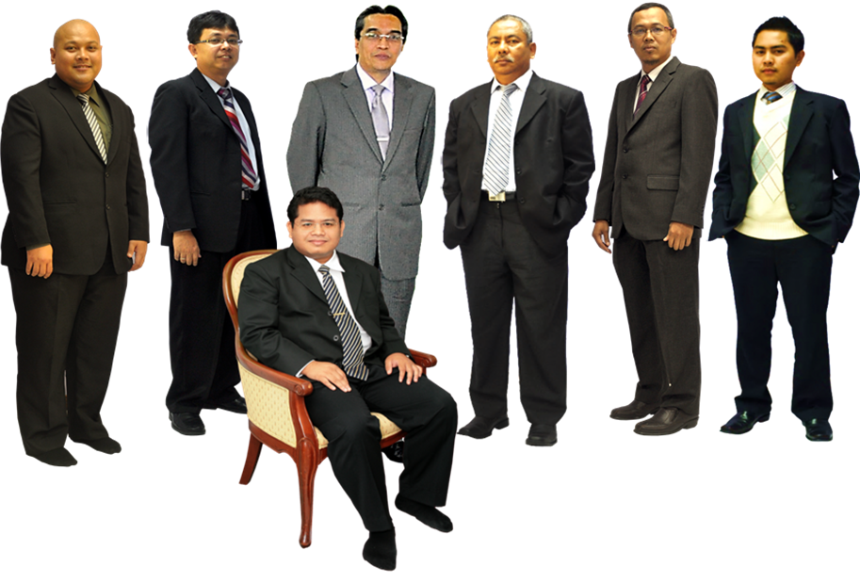
ABOUT US|KEY PERSONNEL
In front: Salihin Abang
Left to right: Ahmad Izwan Adnan, Faizul Nizan Zulkefli, Tuan Haji Abd. Aziz Abu Bakar, Ahmad Aljafree Razalli, Mohd Faried Jamil, Abdussalam Shokhawi

Slide 26


ABOUT US|SERVICE & OFFICES
AUDIT & ASSURANCE
GOODS AND SERVICES TAX (GST)
FINANCIAL ACCOUNTING SERVICES
Financial Statement Audit
Compliance Audit
Operational Audit
Forensic Audit
GST Compliance and Advisory
GST Preparation and Filing
GST Audit and Investigation
GST Training
Accounting System Development and
Implementation
Financial Statements Review
Business Process Outsourcing
TAXATION
CORPORATE SECRETARIAL SERVICES
Tax Compliance
Corporate Tax Advisory
Indirect Tax Services
Tax Audit and Investigation
Real Property Gain Tax
Company Incorporation
Other valuable Secretarial Services
Registration with Ministry of Finance
and other Government Agencies
CORPORATE FINANCE &
TRANSACTION SERVICES
ISLAMIC ACCOUNTING & AUDITING
Due Diligence
Internal Audit and Forensic Accounting
Valuation
Capital Market
Managerial Finance
Mergers & Acquisitions
Shariah Compliance Audit
Advisory Services
Zakat - Alms Giving
Waqf - Islamic Endowment
BATU CAVES . KUALA LUMPUR . JOHOR BAHRU . KUCHING

Slide 27
ABOUT US|VISION & MISSION
VISION
  SALIHIN aspires to become a ‘glocal’ consulting firm serving both local and international clients. Its glocal strategic move is not just to spread its wings but to make its presence felt as the preferred and leading global national firm of Malaysian origin in business consultation and other non-traditional services.
MISSION
  SALIHIN is dedicated to create value by focusing on customer satisfaction and growth, excellent internal business processes and superior human resource development. Without compromising our professional integrity and independence, we strive to offer the highest quality and value added services to our clients.

Slide 28
ABOUT US|CORE VALUES
KNOWLEDGE
Cherish competencies, skills, continuous learning and innovations to better serve dynamism of clients’ expectation
HARMONY
Harmonise knowledge and accountability that will enable us to excel in serving clients
ACCOUNTABILITY
Approach our duties with ownership and responsibility

Slide 29





ABOUT US|CORE VALUES
The following are key reasons why we should be your organization’s preferred choice:
We have the right ‘hands-on’ team with vast knowledge and relevant experience.
We would be able to provide complete and comprehensive reports in tandem to your key areas of concern.
Our Engagement Partner, Board of Advisors and Managers will be involved in closed co-operation to ensure of best services.
We offer ‘value for money’ without compromising on the quality and timeliness of our services.
We will apply our considerable experience to ensure minimal disruption to clients’ daily operations.

Slide 30

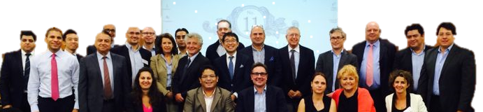

ABOUT US|INTERNATIONA LINKS/NETWORK
Today’s globalization and increasing complexity in the business environment call for strategic alliances. While providing firms with flexibility, they also allow firms to leverage resources and capabilities to achieve objectives that might otherwise beyond their reach.
http://www.i2an.com/
Eying international reach, SALIHIN is a member firm of i2an, a reputable global network of financial professionals which currently has over 500 professionals present in the major financial centres in Europe, the United States and Asia.

Slide 31















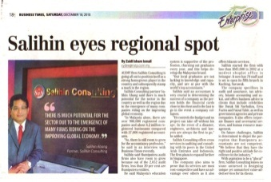
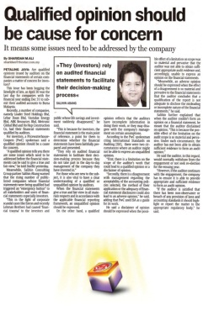



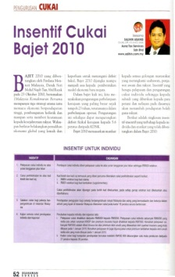

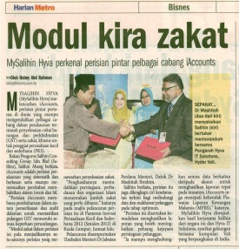

ABOUT US|AWARDS & RECOGNITION
GOLD SPONSOR
MAIN SPONSOR
SILVER SPONSOR
CO- SPONSOR

Slide 32
ABOUT US|CLIENTELE OVERVIEW
serves diverse clients including corporate companies, foundations/non-profit organisations, government bodies and government-linked companies. Their diversity spans across different sectors of the economy.

Slide 33

ABOUT US|SALIHIN CLIENTELE OVERVIEW

Slide 34










ABOUT US|SPS CLIENTELE OVERVIEW

Slide 35
4.0 SALIHIN PREMIER SOLUTIONS (SPS)

Slide 36
ABOUT US|SPS BACKGROUND
The SALIHIN PREMIER SOLUTIONS also know as SPS, the intelligent software in the world that can manage numerous aspects of financial accounting including Goods and Services Tax (GST) and Zakat calculation, customized specially for Small and Medium Enterprises (SMEs).
SPS is an efficient and effective accounting software that accommodates changes affecting invoicing and billing system of the business process. The software is powered by the latest security features to secure data or information for optimal integrity and confidentiality. It is tailor made for small and medium industries by professional accountants.
The Zakat module makes SPS the first comprehensive accounting software with Zakat solution. It will make it easier than ever for Muslim businesses, corporations and organizations to determine the amount payable as Zakat. With Zakat feature built in, it is simply the best accounting software yet.

Slide 37
SPS|MODULES IN SPS
There is 5 main modules that makes the SPS Accounting software like no other’s.
Financial Module
Inventory Module
GST Module
Zakat Module
Waqf / Endowment Module

Slide 38

SPS|CORE FEATURES
SPS Installer Faster & Easier
Predefined Accounting Chart
Default GST Setup
Biz Dashboard
Regulate User Access
GST-03 Online Submission
Dynamic Graph Propagation
Void Unconfirmed Transaction
Auto Notification of
any New Update
Zakat Calculation Enhancement
Simplified Tax Invoice
Auto Calculation Wakaf
Self Billed Tax Invoice

Slide 39

SPS| FUTURE ENHANCEMENT
Cash Book System
POS System
Fixed Asset Management
Payroll System
CRM System

Slide 40
5.0 OUR CREDENTIALS

Slide 41
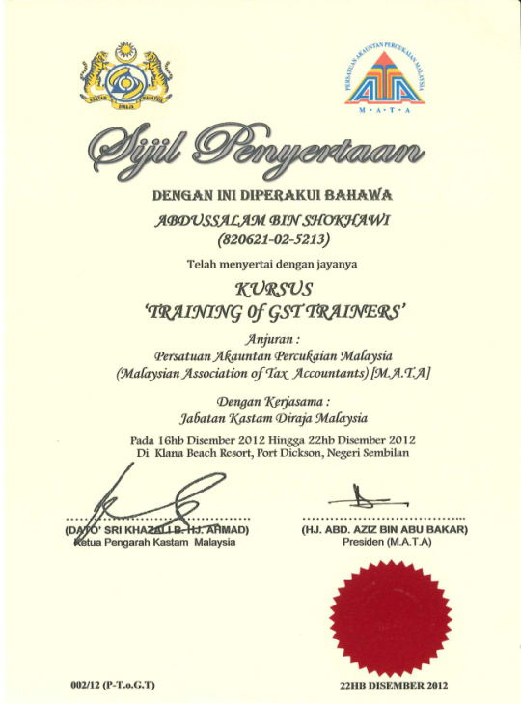
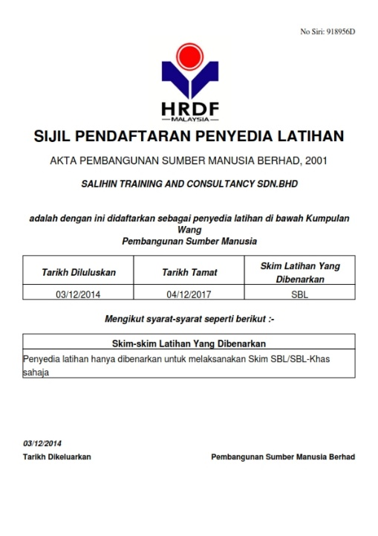
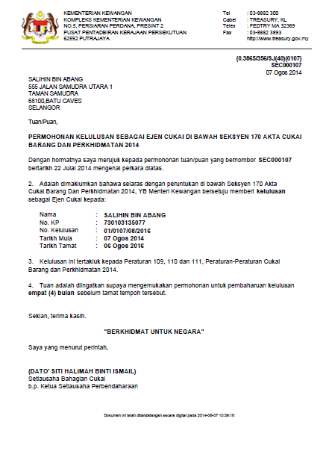

OUR CREDENTIALS
A structured approach with approved HRDF training modules approved by HRDF.
Approved GST Agents and Qualified GST Trainers that have vast GST knowledge and experience of various industries.
Experienced IT consultants that can review and provide technical assistance for GST system compliance; accounting for GST.

Slide 42

CONTACT US
OFFICIAL ADDRESS & CONTACT PERSON
CORPORATE CENTRE:
KL Sentral Office
Unit 2A-1, Level 1
Tower 2A, Plaza Sentral
Jalan Stesen Sentral 5
KL Sentral
50470, Kuala Lumpur
Tel: +603 2261 4180
Fax: +603 2261 4182
CONSULTANT: WAN MOHD ISKANDAR B. WAN OMAR
EMAIL: wanmohdiskandar@salihin.com.my
Official Website : www.salihin.com.my
Customer Service : www.salihinpremier.com
E-mail : info@salihin.com.my
Careline : 1 300 88 5678

Slide 43

www.SALIHIN.com.my | www.SALIHINpremier.com
1 300 88 5678

Slide 44
6.0 APPENDIXES

