Slide 1



PROPOSAL FOR STRATEGIC COLLABORATION
IN LEARNING & GRADUATE SKILLS ENHANCEMENT
Prepared for:
Prepared by:

Slide 2
EXECUTIVE SUMMARY
Enhancing learning experience with SPS
With the current shift towards efficient governance, the implementation of GST resulted in the requirement of further understanding of the tax structure in accounting. As one of the prestigious universities in Malaysia, UiTM can lead the shift through utilization of accounting information system(AIS) as practical tool in demonstrating tax structure in accounting.
This requires certified accounting software, developed with direct input from the Customs department, the Salihin Premier Solutions (SPS) will provide the competitive edge for UiTM to enhance the learning experience of its accounting students in gaining the practical understanding on GST implementations and its impacts in financial reports.
It can be implemented as a learning tool in Accounting Information System subject.

Slide 3
THE PROPOSAL
Main Objective: Enhancing Graduates
CAPACITY BUILDING
SKILLS ENHANCEMENT
INDUSTRIAL
RELEVANCE
To equip UiTM graduate student with value added accounting software skills
To provide avenue for UiTM to enhance graduate skills and accreditations
To provide practical expertise and experience for UiTM in delivering courses relevant to current and future industrial practices.

Slide 4
THE PROPOSAL
SPS Integration In Accounting
Integrated SPS Course
(Accounting Information System)
Part of Learning Tools

Slide 5
THE PROPOSAL
SPS as Optional Learning Tool
SPS is used to support the curriculum-based learning on self initiatives by student with the assistance from lecturers.
For better positioning of SPS, exam will be given as an optional (to test student’s understanding of each particular subject).
Exam, Marking & Certification will be provided by SALIHIN (for those who seat for the exam).
Part of
Up Scaling
Not Bound to University Program
Does Not Require Senate Permission
SPS Student Manual & Installer
SPS as Optional Learning Tool
2 Hours Online Exam
Separate Session in Lab
SPS Certification
Lecturer’s Decision
Student’s Willingness
Monitoring & Marking By SALIHIN

Slide 6
THE PROPOSAL
Proposed Modules
Modules | Setup & Operate Admin & General Setup Module Setup General Ledger Module Setup Account Receivables Module Setup Account Payables Module Setup & Operate Sales Order Module Setup and Operate Purchasing Module Setup & Operate Inventory Control Module Setup & Operate GST Module Setup & Operate Zakat & Waqf Modules

Slide 7
THE PROPOSAL
Proposed Set Up
Installation
  SPS will be installed at UiTM server and accessible to all PCs/ Laptops as long as connected to the UiTM Network.
  This will ensure minimal trouble shooting and updating the software pack when it is needed.
  If this mechanism is not being permissible, then SPS will be installed individually on each and every PCs in lab.
Licensing
  SALIHIN will grant student version of SPS with unlimited license to be used during learning period and 1-year extended individual license with 3 companies license (for those who sits for exam)
Train the Trainer Program
  SALIHIN will conduct 2 phase of training to each participating lecturers.
    Phase 1: SPS full module training. Duration will be within 2 days.
    Phase 2: SPS trouble shooting training. Duration will be within 2 days.
  Shall lecturers need extra training, a series of small batch training will be conducted at our training room at Plaza Sentral, KL or SALIHIN HQ at Batu Caves, Selangor .

Slide 8
THE PROPOSAL
Proposed Set Up
Learning Process
  SPS will be fully utilized during the lab session to support related subject approved by UiTM. Our recommendations is to attach SPS with AIS based subject such as:
    AIS 130 ( Computers Applications & Communications in Accounting).
    AIS 210 (Computerized Accounting).
    AIS 510 (Accounting Information System).
    AIS630 (Accounting System Analysis & Design).
  Each students will be given attending certification.
Exam & Certification
  We will conduct 2-hours online examination on weekend.
  Certification (attending & pass) will be given to lectures and will be passed to students respectively.

Slide 9
THE PROPOSAL
Proposed Set Up
Cost & Pricing
  Training
    Cost of trainer to train lecturers under “Training of Trainer (ToT) Programme” will be borne by SALIHIN. UiTM need to provide training facilities.
    Cost of training in Plaza Sentral for a small batch of UiTM lecturers will be borne by SALIHIN vice versa.
  SPS Related Materials
    Student manual and student license will be charged to student at the cost of RM 88 (TBD) and examination will be provided separately to student at the cost of RM30.00 (TBD) (optional)
  System Update
    UiTM will receive new version system update and cost will be borne by SALIHIN
  Timeline of Target Launch
    Commencing Semester V (Sep 2016 – Jan 2017)
    Target ToT Programme – June 2016

Slide 10
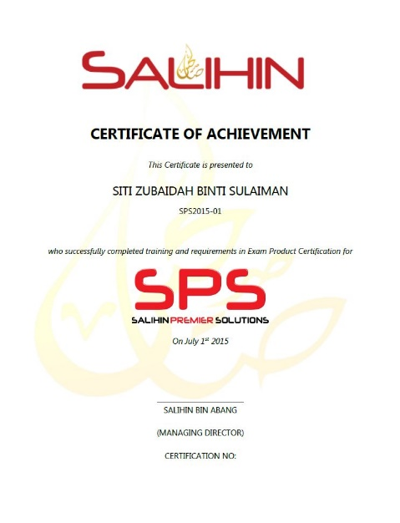
THE PROPOSAL
Expected Outcomes & Deliverables
At the end of the programme, we expected each graduates would be able to:
  Operate and utilize SPS Software ( Setup & operate).
  Provide consultation & training on SPS.
SALIHIN deliverables to partipated graduates:
  SPS Certifications
    SPS Participation Certificate
    SPS Consultant Certificate (for those who sits for exam
    and pass the exam)
  1 Year Free SPS License ( 1 user & 3 Companies License)
  1 Year Free SPS Support Service
  SPS Training Kits
    SPS User License
    SPS Student Manual

Slide 11
THE PROPOSAL
Roles & Responsibility
UiTM | SALIHIN
To fully utilized SPS as main teaching tools / software. | To provide education version software
Provide facilities i.e classes & computer lab | ToT Programme (Lecturers) On site (2 -3 Days) In house (30 Days)
Provide trainers/ lecturers | Provide user manual (text book), exam , scoring, marking & certification.
Assist SALIHIN to promote SPS to students | Provide full support & hotline number
UiTM to allow SALIHIN to use UiTM brand, image recognition in promotional and advertising purposes | Assist UiTM in developing new course syllabus.
Expand new coursework program (where applicable) | Provide UiTM with new version system update

Slide 12
SPS Background
Salihin Premier Solutions
The SALIHIN PREMIER SOLUTIONS also known as SPS, the intelligent software in the world that can manage numerous aspects of financial accounting including Goods and Services Tax (GST) and Zakat calculation, customized specially for Small and Medium Enterprises (SMEs).
SPS is an efficient and effective accounting software that accommodates changes affecting invoicing and billing system of the business process. The software is powered by the latest security features to secure data or information for optimal integrity and confidentiality. It is tailor made for small and medium industries by professional accountants.
The Zakat module makes SPS the first comprehensive accounting software with Zakat solution. It will make it easier than ever for Muslim businesses, corporations and organizations to determine the amount payable as Zakat. With Zakat feature built in, it is simply the best accounting software yet.

Slide 13
SPS Background
The Main Modules
There is 5 main modules of SPS
Financial Module
Inventory Module
GST Module
Zakat Module
Waqf / Endowment Module

Slide 14

SPS Background
Function And Features
SPS
Predefined Accounting Chart
Default GST Setup
Biz Dashboard
Regulate User Access
GST-03 Online Submission
Dynamic Graph Propagation
Void Unconfirmed Transaction
Auto Notification of
any New Update
Zakat Calculation Enhancement
Simplified Tax Invoice
Auto Calculation Wakaf
Self Billed Tax Invoice

Slide 15

Product Comparisons
SPS vs Other Accounting Software

Slide 16

SPS Background
Future Developments
POS System
Fixed Asset Management
Payroll System
CRM System
Cash Book System

Slide 17

CONTACT US
OFFICIAL ADDRESS & CONTACT PERSON
CORPORATE CENTRE:
KL Sentral Office
Unit 2A-1, Level 1
Tower 2A, Plaza Sentral
Jalan Stesen Sentral 5
KL Sentral
50470, Kuala Lumpur
Tel: +603 2261 4180
Fax: +603 2261 4182
CONSULTANT: WAN MOHD ISKANDAR B. WAN OMAR
EMAIL: wanmohdiskandar@salihin.com.my
Official Website : www.salihin.com.my
Customer Service : www.salihinpremier.com
E-mail : info@salihin.com.my
Careline : 1 300 88 5678

