Slide 1





MARA’s Entrepreneurs Big Data
Pre-Implementation Proposal
Utilizing SPS Total Solutions
PREPARED BY:
SUBMITTED TO:
Notes:
Font Type: Open Sans
Font Size: Proposal Title (60), Proposal Details (40)
Business unit & Client logo: Small size

Slide 2

The Proposal
Bumiputera SME Dilemma’s
Open Market Treat & Threat
Solid Accounting Report
Dumping's of Goods & Services from China / India
Business Decision
Training & Upskilling
Weak Domestic Market Sentiment
Analytical Data
GST Issues
Social Media & Ecommerce
Market Threat
Fund Raising Issues
Information
Capital
Notes:
Font Type: Open Sans Light
Font Size: Content (36)

Slide 3


The Proposal
Why SME Importance
98%
Total Business Establishment
27.6%
out of total SME Company in Malaysia is Bumiputra Companies
50%
Gross Domestic Products
Backbone of the economy
90.7 %
Bumi SME
are micro
enterprise
65%
Employment Contribution
99%
Bumiputra Entrepreneurs need the various support from government
Insights
Notes:
Font Type: Open Sans Light
Font Size: Content (36)
Content suggestion: Client and proposal background.

Slide 4
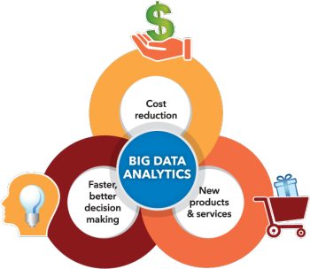
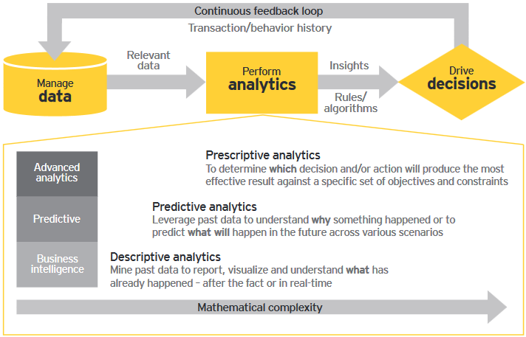
The Proposal
Big Data Analytics. Why It Matters
Notes:
Font Type: Open Sans Light
Font Size: Content (36)
Content suggestion: Client and proposal background.

Slide 5

The Proposal
Big Data Challenges
Ability to Compute/ Analyze
GOVERNANCE
Availability of Data
Technology
Transfer
Deliver / Extract Value
INFRASTRUCTURE
Change
Management
Awareness
Big Data Driver
Risks or Considerations
End Result
Notes:
Font Type: Open Sans Light
Font Size: Content (36)

Slide 6
The Proposal
How We Fit our Roles
Create Business Environment that ready to accept and embrace Big Data (Internal & External)
Prepare the ground battle field by setting up the KKLW / MARA’s Entrepreneurs War Room
Filling up the data derived from our accounting, training & coaching
Sharing the report for the benefits of stakeholders
Big Data
Pre-Implementation
SALIHIN
SPS Total Solutions
Focused Group Training
Business Coaching
Business Monitoring
Data Analytical
Online Reporting
Notes:
Font Type: Open Sans Light
Font Size: Content (36)

Slide 7


The Proposal
Target Participant
Services
Technology
Trading
Retail
Manufacturing
Construction
PRE-REQUISITE
Private Limited Entity
> 500K Sales Turnover?
PUSMA Registered SMEs
Program Usahawan MARA
Steered by
Pusat Usahawan Mara Negeri
(PUSMA)
5,000 Entrepreneurs Nationwide
Notes:
Font Type: Open Sans Light
Font Size: Content (36)

Slide 8
The Proposal
SPS Training Modules & Syllabus
DAY | TRAINING MODULES | METHOD OF TRAINING | SYLLABUS
1. | Basic Business Documentation | Class Room | Basic of business documents Components of business documents (Quotation, Invoice, Delivery Order, Payment Vouchers)
 | SPSLite | Class Room | Basic accounting concepts Objective of book keepings How to operate SPSLite How to produce basic financial report
2. | SPS Accounting | Class Room | Company Setup, User Setup, User Access Right Chart of Account General Setup & Financial Year Calendar SPS Full Set (Sales, Account receivables, Other payment, GST & Financial Report Modules)
3. | Revision | Class Room | Basic Documentations, SPSLite & SPS Full Accounting.
 | Online Examination | Class Room | Basic Documentations, SPSLite & SPS Full Accounting.
Notes:
Font Type: Open Sans Light
Font Size: Content (36)
Please insert the details (in red) accordingly.

Slide 9

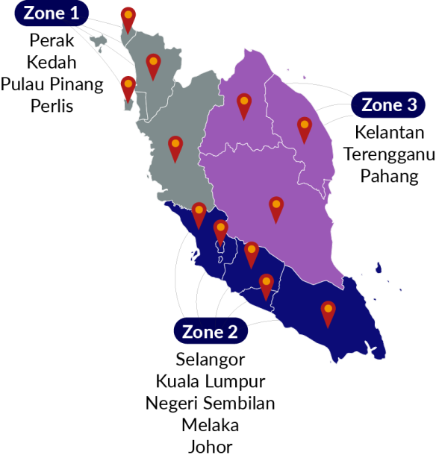

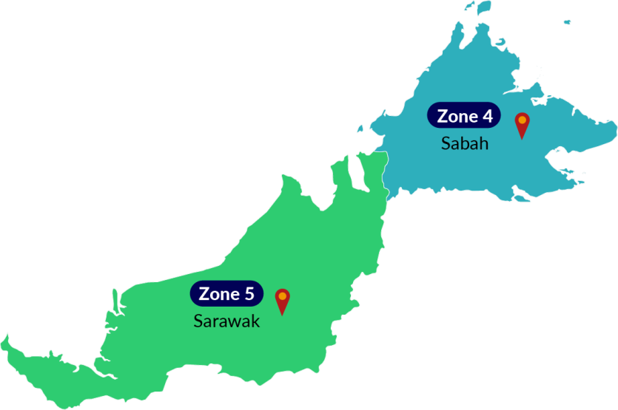


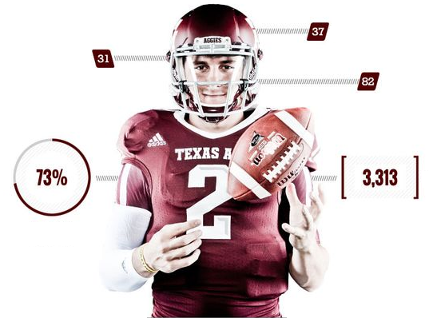
The Proposal
Training Zoning And Mapping
5
Training Team
5
Zone
Financial Management Upskilling Training
Business
Rating & Scoring
5
Training Team
(3 Pax per team)
Notes:
Font Type: Open Sans Light
Font Size: Content (36)

Slide 10








The Proposal
SALIHIN Deliverables
Supported By
&
Powered By Salihin Accounting Solutions
Total Solutions
Holistic Approach
Continuation
Notes:
Font Type: Open Sans Light
Font Size: Content (36)

Slide 11
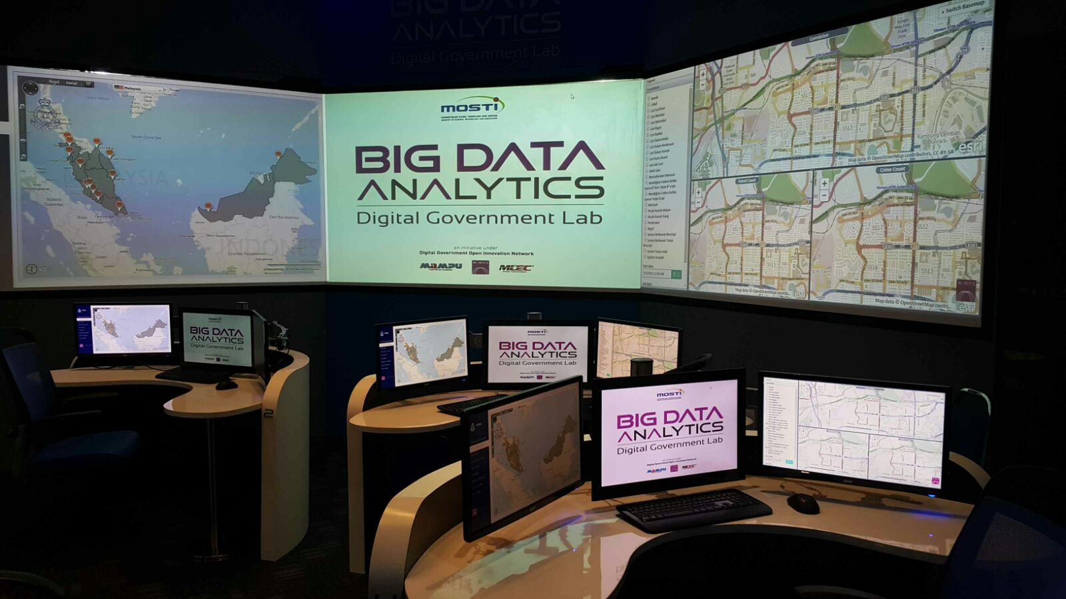
The Proposal
War Room
Notes:
Font Type: Open Sans Light
Font Size: Content (36)

Slide 12
















The Proposal
Business Analytical Data
Industries Relevancy
SME’s Return on Equity
Product Relevancy
SME’s Return on Asset
Business Location Relevancy
SME’s Net Profit Margin
Trending Factor
SME’s Operating Profit Margin
Supplier’s Analysis
SME’s Debt to Equity Ratio
Customer’s Analysis
SME’s Inventory Turnover
Purchase Pattern
SME’s Payable Turnover
Loan Repayment History
SME’s Receivable Turnover
Notes:
Font Type: Open Sans Light
Font Size: Content (36)

Slide 13


The Proposal
Expected Improvement
INSIGHTS FROM INFORMATION IN MAKING BETTER, SMARTER, REAL TIME AND FACT BASED DECISION
FINANCIALLY LITERATE
CRITICAL BUSINESS & FINANCIAL’S INFORMATION IN FINGERTIPS
IMPROVE DECISION MAKING
ENTRY POINT TO BIG DATA..MINING DATA BUSINESS
INCREASE BUSINESS PRESENCE
INCREASE BUSINESS COLLABORATION, CONFIDENCE AND PRODUCTIVITY
STEER ENTREPRENEURS TO
DISTINCTIVE TARGET
Notes:
Font Type: Open Sans Light
Font Size: Content (36)

Slide 14





The Proposal
Benefits to MARA
GTP KPI
5
Comply with Bumiputera Agenda as set out in Government Transformation Program
NBOS KPI
4
Active participations and support from industries
(UMT/ UiTM/ UniKL/ UPM TAF)
TECHNOLOGY
ADOPTION
3
New technology adoption as outlined in TN50
EMPLOYMENT
OPPORTUNITIES
2
New employment and job creation for Bumiputera’s graduates, mostly in rural area
BUSINESS
EMPOWERMENT
1
Foster and empower Bumi SME business via good financial governance and best business practice.
Notes:
Font Type: Open Sans Light
Font Size: Content (36)

Slide 15
The Proposal
Conclusion
Sense of Purpose
National Self reliance
Improvement in living standard
Resource mobilization
Reduces concentration of wealth
Balanced regional development
Improvement on Income per Capita
Generation of employment and capacity
Capital Formation outline and landscape
Notes:
Font Type: Open Sans Light
Font Size: Content (36)

Slide 16
www.salihin.com.my | www.salihinpremier.com
Careline: 1 300 88 5678
Notes:
Attention: Please don’t change any content here. Thank you very much ☺

