Slide 1


SPS Lite Training Program
By
SPS Accounting Solutions
PREPARED BY:
SUBMITTED TO:
Notes:
Font Type: Open Sans
Font Size: Proposal Title (60), Proposal Details (40)
Business unit & Client logo: Small size

Slide 2
Executive Summary
SPS Training Philosophy
SPS Learning & Job Matching Platform aims to deliver Sahabat AIM a learning opportunities as well as job opportunities.
It consists of short, value for money, high quality, and support focused functions and activities for Sahabat AIM to go for extra miles in SPS, SPSLite CashBook and SPSLite Entrepreneurs Web as well as professional and personal development.
Courses are developed by SALIHIN subject matter experts and participated academia from our TAF participating universities.
Notes:
Font Type: Open Sans Light
Font Size: Content (36)
Content suggestion: Client and proposal background.

Slide 3

SPSLite Training
Continuous Learning
SPSLite Accounting Training Platform provide Sahabat AIM a learning opportunities & continuous upskilling opportunities.
  All relevant training materials is made accessible online
  For those who want to test their knowledges and ability, online exam and quizzes are provided and certifications will me.
  For those whom need assistance, online and support are ready to assist them (9am-5.30pm daily on working days)
The 1 days education/ training program it’s not perceived only as 1 days training program, but it is essentially a 1 days fundamental training program + lifetime continuous learning opportunities.
Online
Training Materials
Online
Exam & Quizzes
Online
Tutorial
Online
Support
Phone
Support
Notes:
Font Type: Open Sans Light
Font Size: Content (36)
Please insert the details (in red) accordingly.

Slide 4
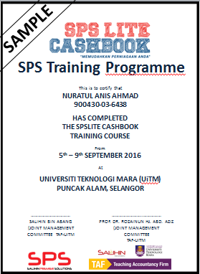

Training Modules
Coverage Scope
TRAINING MODULES | METHOD OF TRAINING | SYLLABUS | DURATION
Basic Business Documentation I | Class Room | Basic accounting concepts Basic of business documents (Quotation, Invoice, DO, PO etc) | 9am-10am (60 Mins)
Basic Business Documentation II | Class Room | Objective of book keeping Best Practice in managing book keeping | 10am-12am (120 Mins)
Accounting software | Class Room | How to Setup and operate general, expenses and sales module | 2pm-4pm (120 Mins)
Accounting software | Class Room | How to produce financial report and read the business dashboard | 4pm-5pm (60 Mins)
Real Business Case Studies
Training will be made available in each and every state training center
Training schedule will be made available via online and/or walk in based.
Training duration 1 day for every session
Basic Business Documentations
Examination & Certifications
(Online)
Notes:
Font Type: Open Sans Light
Font Size: Content (36)

Slide 5

Training Fee
What We Ask from AIM
RM150.00 one time off
Training Fee Per Pax
Minimum participating Sahabat AIM for each session : 15 pax
Notes:
Font Type: Open Sans Light
Font Size: Content (36)

Slide 6
The Proposal
Conclusion
WE believes in providing the best and most efficient business solutions technology and professional services. We look forward to an opportunity to work and service AIM and WE are welcoming any progressive future collaborations.
Notes:
Font Type: Open Sans Light
Font Size: Content (36)

