Slide 1



PROPOSAL FOR STRATEGIC COLLABORATION
Prepared for:
Prepared by:
© 2014 SALIHIN. All Rights Reserved

Slide 2
  TABLE OF CONTENT
1.0 ABOUT US 03
2.0 ABOUT SALIHIN PREMIER SOLUTION (SPS) 02
3.0 OUR PROPOSAL 03
INTRODUCTION 04
MAIN OBJECTIVE 11
TARGET MARKET/AUDIENCE 19
WHAT WE ARE OFFERINGS 33
OUR APPROACH 35
EXPECTED OUTCOME 36
COST & INVESTMENT CONSIDERATION 37
CONCLUSION 39
4.0 OUR CREDENTIALS 48
© SALIHIN 2015. Strictly Private & Confidential

Slide 3

1.0 ABOUT US
© SALIHIN 2015. Strictly Private & Confidential

Slide 4




AT THE GLANCE
        ABOUT US
        FIRM’S DESCRIPTION
SALIHIN introduced its name to the world on January, 2002. The genesis of our 12 years’ journey began with an ardent determination to spread our wings and make our presence felt. Since then, each year that passes confirms and demonstrates our commitment to our vision.
The past decade spent witnessed continuing effort to build our brand, which has now become identical to our commitment to integrity and high quality services. SALIHIN is MSC Status Company and a certified company of 1-innocert and Enterprise 50.
In addition, SALIHIN is an established boutique firm specialising in all aspects of corporate finance advisory and investment management, providing services to the Government, Ministries, Multinational Companies, Public Listed Companies and Government Linked Institutions, Commercial Banks and Private Companies.
We are licensed by the Securities Commission Malaysia to advise on Corporate Finance under the Capital Market and Services Act 2007. We have performed various engagements from Strategic Transaction Advisory, Fund Raising Exercise for both Debt & Equity Markets, Strategic and Financial Advisory on Public Private Partnership and Corporate Restructuring.
For further info, visit www.SALIHIN.com.my
© SALIHIN 2015. Strictly Private & Confidential

Slide 5
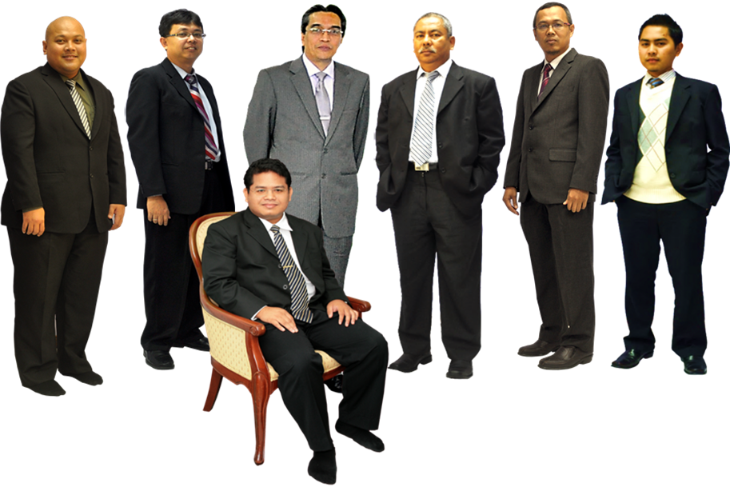
    ABOUT US
    KEY PERSONNEL
In Front: Salihin Abang
L-R: Ahmad Izwan Adnan, Faizul Nizan Zulkefli ,
Tuan Haji Abd. Aziz Abu Bakar, Ahmad Aljafree Razalli,
Mohd Faried Jamil, Abdussalam Shokhawi
© SALIHIN 2015. Strictly Private & Confidential

Slide 6

  ABOUT US
  SERVICE AND OFFICES
AUDIT & ASSURANCE
GOODS AND SERVICES TAX (GST)
FINANCIAL ACCOUNTING SERVICES
Financial Statement Audit
Compliance Audit
Operational Audit
Forensic Audit
GST Compliance and Advisory
GST Preparation and Filing
GST Audit and Investigation
GST Training
Accounting System Development and
Implementation
Financial Statements Review
Business Process Outsourcing
TAXATION
CORPORATE SECRETARIAL SERVICES
Tax Compliance
Corporate Tax Advisory
Indirect Tax Services
Tax Audit and Investigation
Real Property Gain Tax
Company Incorporation
Other valuable Secretarial Services
Registration with Ministry of Finance
and other Government Agencies
CORPORATE FINANCE &
TRANSACTION SERVICES
ISLAMIC ACCOUNTING & AUDITING
Due Diligence
Internal Audit and Forensic Accounting
Valuation
Capital Market
Managerial Finance
Mergers & Acquisitions
Shariah Compliance Audit
Advisory Services
Zakat - Alms Giving
Waqf - Islamic Endowment
BATU CAVES . KUALA LUMPUR . JOHOR BAHRU . KUCHING
© SALIHIN 2015. Strictly Private & Confidential

Slide 7
  ABOUT US
  VISSION & MISSION
VISION
  SALIHIN aspires to become a ‘glocal’ consulting firm serving both local and international clients. Its glocal strategic move is not just to spread its wings but to make its presence felt as the preferred and leading global national firm of Malaysian origin in business consultation and other non-traditional services.
MISSION
  SALIHIN is dedicated to create value by focusing on customer satisfaction and growth, excellent internal business processes and superior human resource development. Without compromising our professional integrity and independence, we strive to offer the highest quality and value added services to our clients.
© SALIHIN 2015. Strictly Private & Confidential

Slide 8
  ABOUT US
  CORE VALUES
KNOWLEDGE
Cherish competencies, skills, continuous learning and innovations to better serve dynamism of clients’ expectation
HARMONY
Harmonise knowledge and accountability that will enable us to excel in serving clients
ACCOUNTABILITY
Approach our duties with ownership and responsibility
© SALIHIN 2015. Strictly Private & Confidential

Slide 9





  ABOUT US
  WHY US?
ABOUT US
CLIENTELE OVERVIEW
The following are key reasons why we should be your organization’s preferred choice:
We have the right ‘hands-on’ team with vast knowledge and relevant experience.
We would be able to provide complete and comprehensive reports in tandem to your key areas of concern.
Our Engagement Partner, Board of Advisors and Managers will be involved in closed co-operation to ensure of best services.
We offer ‘value for money’ without compromising on the quality and timeliness of our services.
We will apply our considerable experience to ensure minimal disruption to clients’ daily operations.
© SALIHIN 2015. Strictly Private & Confidential

Slide 10

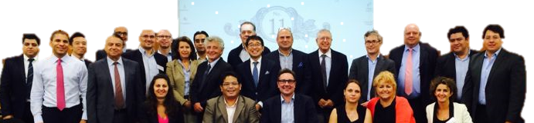

ABOUT US
INTERNATIONAL LINKS/NETWORK
Today’s globalization and increasing complexity in the business environment call for strategic alliances. While providing firms with flexibility, they also allow firms to leverage resources and capabilities to achieve objectives that might otherwise beyond their reach.
http://www.i2an.com/
Eying international reach, SALIHIN is a member firm of i2an, a reputable global network of financial professionals which currently has over 500 professionals present in the major financial centres in Europe, the United States and Asia.
© SALIHIN 2015. Strictly Private & Confidential

Slide 11















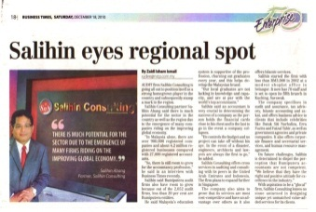
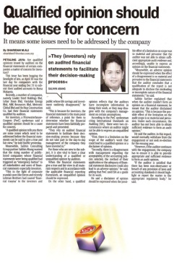



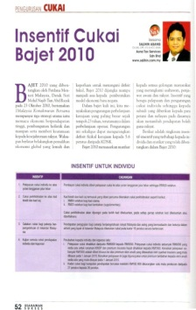
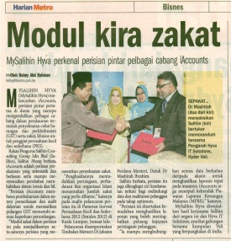


  ABOUT US
  AWARDS AND RECOGNITION
ABOUT US
CLIENTELE OVERVIEW
GOLD SPONSOR
MAIN SPONSOR
SILVER SPONSOR
CO- SPONSOR
© SALIHIN 2015. Strictly Private & Confidential

Slide 12
  ABOUT US
  CLIENTELE OVERVIEW
ABOUT US
CLIENTELE OVERVIEW
SALIHIN serves diverse clients including corporate companies, foundations/non-profit organisations, government bodies and government-linked companies. Their diversity spans across different sectors of the economy.
© SALIHIN 2015. Strictly Private & Confidential

Slide 13

ABOUT US
CLIENTELE OVERVIEW (CONTD.)
© SALIHIN 2015. Strictly Private & Confidential
13

Slide 14
2.0 ABOUT SALIHIN PREMIER SOLUTIONS (SPS)
© SALIHIN 2015. Strictly Private & Confidential

Slide 15
ABOUT US
SALIHIN PREMIER SOLUTIONS BACKGROUND
The SALIHIN PREMIER SOLUTIONS also know as SPS SOFTWARE , the intelligent software in the world that can manage numerous aspects of financial accounting including Goods and Services Tax (GST) and Zakat calculation, customized specially for Small and Medium Enterprises (SMEs).
SPS SOFTWARE is an efficient and effective accounting software that accommodates changes affecting invoicing and billing system of the business process. The software is powered by the latest security features to secure data or information for optimal integrity and confidentiality. It is tailor made for small and medium industries by professional accountants.
The Zakat module makes SPS SOFTWARE the first comprehensive accounting software with Zakat solution. It will make it easier than ever for Muslim businesses, corporations and organizations to determine the amount payable as Zakat. With Zakat feature built in, it is simply the best accounting software yet.
© SALIHIN 2015. Strictly Private & Confidential

Slide 16
SPS
Modules in SPS
There is 5 main modules that makes the SPS Accounting software like no other’s.
Financial Module
Inventory Module
GST Module
Zakat Module
Waqf / Endowment Module
© SALIHIN 2015. Strictly Private & Confidential

Slide 17
SPS
Core Features
1
Easy To Use
With its user friendly interfaces, SPS requires minimum skill knowledge in accounting.
2
Predefined Accounting Chart
SPS comes with 19 industry standards predefined accounting chart and has flexibility to tailor according to business needs.
3
Biz Dashboard
Data updates are real-time for better business decision making.
4
Drill Down
Analysis and investigate from surface report drill down to the source of transaction..
5
Fully Responsive
Interactive and fully responsive for all devices and screen resolutions..
7
Regulate User Access
Provide the double layer security, all the right control of functionality to regulate the user accessibility to each module system.
8
Multi Languages supported
SPS is ready to support latest business nature in multiple languages.
9
Super Search
Provides an integrated search engine that enabled users to find information related to transaction in the fastest and easiest way.
10
Comprehensive Audit Trail
Ensure that an accurate record of activities or events is captured

Slide 18
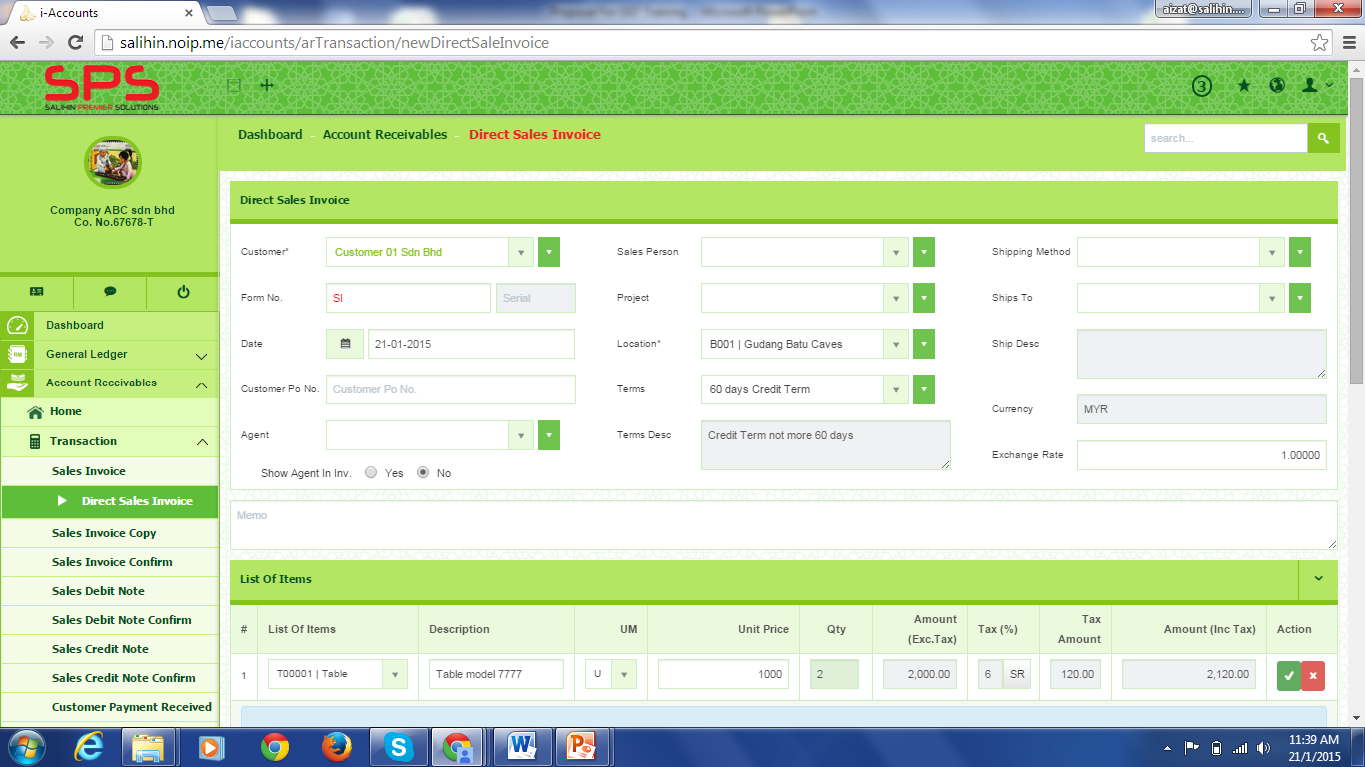
SPS
SPS ACCOUNTING SOFTWARE OVERVIEW
2
3
4
5
6
7
1
SPS Menu Panel
1. Company Profile Logo & Icon
2. Hide Menu Button
3. Enlarge Screen
4. User Log In
5. Language Selection Button
6. Themes & Color Setting Button
7. User Information Button
Numbering
Reference
Remark: Please refer SPS Product Catalogue in the appendix

Slide 19
3.0 OUR PROPOSAL : SPS AS LEARNING TOOLS &
STRATEGIC ALLIANCE BUSINESS PROPOSAL TO
UiTM
© SALIHIN 2015. Strictly Private & Confidential

Slide 20
INTRODUCTION
BUSINESS HIGHLIGHTS
In the competitive job market, graduates with the right skills and credentials will have an edge over other jobseekers. With annual production of 5,000 new accountancy graduates, employers can afford to be selective and only welcome candidates who have vast exposure on corporate & finance experience from the first day of employment. This Work-Oriented training proposition is the difference between Salihin Premier Solutions Certification Program (SPS CP) and most other professional courses in the market. While other programs provide general knowledge that might be useful in the working environment, SPS CP provides all the encompassing skills that are needed to immediately start working.
SPS CP aims to equip students from accountancy & finance backgrounds with industry-based certifications and skills. Complemented with formal tertiary education from UiTM, these graduates will be highly sought after by employers, or with genuine entrepreneural spirits can immediately start own businesses.
With the successful completion of the program, students will be valuable to the System Integration Industry by having the right skills and mentality to excell in future endeavour. SPS CP would like to present a proposal to UiTM for SPS CP to be adopted for year 2016, 2017 and 2018.
© SALIHIN 2015. Strictly Private & Confidential

Slide 21
FRAMEWORK TO THE BUSINESS NEEDS
Knowledge Economy
Intensive focus toward empowering K-Economy represent a visionary institutions
Accountancy Graduates
Knowledge and visionary graduates represents innovative future generations
Bumiputera Entrepreneur
Vigilant entrepreneur represents authority & leadership
Business Need 1
Business Need 2
Business Need 3
Maintain its performance as the model of outstanding innovative educational institution
Maintain its perceived duty to govern, educate and nurture its own generation
Maintain its role to develop economic development to creation of strong companies
These are the issues in perspective that gives rise to the SPS proposal
© SALIHIN 2015. Strictly Private & Confidential

Slide 22
MAIN OBJECTIVE
MACRO
CAPACITY BUILDING
To equip UiTM graduate student with high value added accounting software skill.
SERVICE DELIVERY
Provide solution that foster dedicated bonding between SALIHIN and University
BIZ SUSTAINABILITY
Become the accounting & GST business consulting hub in Malaysia
© SALIHIN 2015. Strictly Private & Confidential

Slide 23
OUR OBJECTIVE
MICRO
SPS as education tools
Offer SPS Structures Courses & Syllabus
Student Marketability
Incorporate in existing Syllabus or Stand Alone Program
Lab
Student Personal Use
Additional Skills
Entrepreneurs
© SALIHIN 2015. Strictly Private & Confidential

Slide 24
OUR PROPOSAL
VALUE PROPOSITION
The edge of SPS CP is it prepares graduates to have a forte in the world of unlimited boundaries of Corporate Finance Services and Audit. Governments through it’s higher education unit and universities have been spending enormous amount of resources and time in providing and preparing the new generation mostly bumiputera to be the next top notch professional consultant which their services could be exported and recognized worldwide.
Service sector are one of the strategic areas which would generate tons of billion new revenue stream to the country. SPS CP prepare the new generation to take this challege in mastering themself the art of finance and accountancy in real business scenarios by prepares them in all aspect of:
Accountancy Software via SALIHIN Premier Solutions (SPS)
GST & Taxation
Islamic Accounting & Auditing
Zakat & Waqf
Others Corporate Services areas
© SALIHIN 2015. Strictly Private & Confidential

Slide 25
BUSINESS POTENTIAL
MARKETABILITY
For a more interesting path, graduates of SPS CP Program are fully equipped with complete knowledge and skills to embark on entrepreneural journey. SALIHIN, as the developer of SPS, does not deal directly with end users. The business are initiated and carried out by appointed dealers.
Once the graduates completed the training successfully, they can apply for a dealership. This dealership will allow them to support various clients in government and private , or nurture a thriving business by dealing directly with other end-users.
AMCAF
MATA
MNCs
MAFA
Dealers
Financial Institutions
Business Partners
© SALIHIN 2015. Strictly Private & Confidential

Slide 26

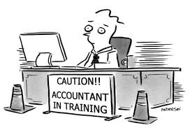
TARGET MARKET/AUDIENCE
UITM Lecturers
Transfer of Knowledge
Transfer of Technology
Train the Trainer
Soft Skills
Certification
Certified SPS Engineer
Certified SPS Consultant
Certified SPS Trainer
UITM Students / Public
© SALIHIN 2015. Strictly Private & Confidential

Slide 27
SPS BUSINESS FRAMEWORK
STRATEGIC THRUST 1
SPS in Accounting Lab
SPS as Student Personal Use
Train the Trainer Programme
Transfer of Knowledge Programme
UiTM
Agreement to engage SALIHIN as business partners
Malaysian
Education, Business& Services Hub
STRATEGIC THRUST 2
SPS Integrate in Existing Syllabus
SPS as Professional Program
Co-Program with MATA
SPS as Educational Tools
Lecturer
Student
Public
Entrepreneurs
Agreement to develop and re-engineer accounting business scope
STRATEGIC THRUST 3
Business Hub
Fund/ Grant Acquisition
Dealerships
SALIHIN
SPS certified Engineer
SPS certified Consultant
SPS Certified Trainer
© SALIHIN 2015. Strictly Private & Confidential

Slide 28


STRATEGIC THRUST 1
Replace Existing Accounting System with SPS
SPS Accounting System
User Manual
Support
Existing Accounting System
User Manual
BRAND X
Stop purchase additional license software of Brand X
Discontinue current software agreement when contract end
© SALIHIN 2015. Strictly Private & Confidential

Slide 29
STRATEGIC THRUST 2
Incorporate SPS in UiTM Accounting Syllabus
Mandatory Subject
Elective Subject
Professional Program
Component
Component
Component
Syllabus
Content
Credit Hours
Exam
Certification
Syllabus
Content
Credit Hours
Exam
Certification
Syllabus
Content
Credit Hours
Exam
Certification
Training & Support
Training & Support
Training & Support
Focus area: SPS Accounting System, GST, Zakat & Waqf
© SALIHIN 2015. Strictly Private & Confidential

Slide 30
PROPOSED SPS SYLLABUS
Syllabus Content (Coverage Area)
1
SALIHIN Premier Solutions (SPS)
2
Goods & Service Tax (GST)
3
Zakat & Waqf
1.0 Introduction to Accounting Information System
2.0 About SPS Accounting System
2.1 Overview of SPS System
2.2 System Requirements
3.0 SPS Modules
3.1 Installation
3.2 Setup process
3.3 Account Payables
3.4 Account Receivables
3.5 Sales Order
3.6 Purchasing
3.7 Inventory Control
3.8 Goods & Services Tax
3.9 Zakat and Waqf
3.10 General Setup
3.11 General Ledger
3.12 Admin
1.0 Introduction to GST
2.0 GST Code Table
3.0 Inventory-GST Code Setup
4.0 Customer Setup
5.0 Supplier Setup
5.1 Self-Billed Invoice Setup
6.0 Issue Tax Invoice
5.0 Purchase Invoice Entry
6.0 Issuance of Credit Note Or Debit Note
6.0 Issuance of Credit Note Or Debit Note
7.0 AR Bad Debt Relief & Recovery Process
8.0 AP Relief & recovery process
9.0 Imported services
10.0 Imported Goods
11.0 Deemed Supply
12.0 21 days Rules
13.0 GST Report Details
14.0 GST-03 Summary
15.0 GST-03 Submission
16.0 Create GST Audit File (GAF)
17.0 Payable/ Claimable Entry
1.0 Introduction to zakat & Waqf
2.0 Zakat Nisab Setup
3.0 Waqf Setup
4.0 Zakat Calculation
5.0 Waqf Calculation
6.0 Zakat Report
7.0 Waqf Letter of Issuance
© SALIHIN 2015. Strictly Private & Confidential

Slide 31





SPS PROFESSIONAL PROGRAM
PROGRAM STAGES
Phase 1 INTRODUCTION
Open for Public
Training ½ Day 1 Day 2 Days
Phase 2 INTERMEDIATE
In- House Program/Customise Program
Training ½ Day 1 Day 2 Days
Phase 3 ADVANCE
GST Specialise
Training 4 Days VIVA
Phase 4 PROFESSIONAL
Certified – SPS Trainer with MATA Membership
Maintain CPD Hour-60hrs a year Paid for GST Membership Qualified SPS Trainer under SALIHIN Trainer Pool
Special Program : SPS Certification Program
Collaboration with
© SALIHIN 2015. Strictly Private & Confidential

Slide 32
SPS PROFESSIONAL PROGRAM
Option A | Option B
Accountancy Finance & Banking Business Administration Marketing Human Resources Management * Exempted for pre Test | Technical Engineering Automotive Medical Agriculture
Entry Requirements
Set for SPS pre exam test fees RM 80.00
NO
YES
Graduates SPS Certification Program | UITM
Register as GST membership – MATA Introduction & Advanced 2/3/4 Days : GST Knowledge – SALIHIN GST Software technical training 1/2/3 Days - SALIHIN
TOT Training
Targeting Grant from KPM
100 pax for Pilot Start
RM 2,500.00 per head.
Fees Structure
GST Membership Fees RM 100 Types of Packages A & B a)Fees per day RM 8,000 and no of pax 25-30 per class b)Fees perday RM 12,000 and no of pax 50-150 per class 3) GST Software Fees and Training a) Software only RM 2,880 + RM 1,000
Targeting Employer Sponsor
RM 2,500.00 per head.
© SALIHIN 2015. Strictly Private & Confidential

Slide 33
MILESTONE
Proposed TOT/TOK Challenges
Proposed Courses Challenges
Train The Trainer (Lecturer/Student)
Setup on-site support
Credit hours
  Timeline/ Duration
Module/ Program/ Subject
  Focus on accounting system
  Focus on theory
  Or both
Syllabus
  Course
  Exam
Accreditation
  MATA
  University
  Salihin
  Royal Custom
  Combination of few
Course Fee/ Pricing
How Much
Who will bear the cost
MQA Accreditation
Duration
Expectation
© SALIHIN 2015. Strictly Private & Confidential

Slide 34
STRATEGIC THRUST 3
We are competing in the business market space where the rules of the games are constantly changing
Business Application
SPS Accounting System
Point of Sales (POS)
Payment Gateway
E-Commerce
Office Productivity
FINANCIAL ACCOUNTING SERVICES
Edu Grant
GOODS AND SERVICES TAX (GST)
R&D Grant
AUDIT & ASSURANCE
Govt Contract
CORPORATE SECRETARIAL SERVICES
TAXATION
Govt Agencies
GLCS
SMES
ISLAMIC ACCOUNTING & AUDITING
CORPORATE FINANCE
© SALIHIN 2015. Strictly Private & Confidential

Slide 35
HUMAN CAPITAL DEVELOPMENT MODEL
National
Perspective
----------------------------------------------------------------------------------------------------------------------------------------------------
Industry
Perspective
----------------------------------------------------------------------------------------------------------------------------------------------------
Higher Learning
Institution
Perspective
----------------------------------------------------------------------------------------------------------------------------------------------------
Learning and
Growth Perspective
Productivity Strategy
Long-Term Human Capital Value
Growth Strategy
Improve Professional Skill
Increase Human Capital Utilization
Expand Opportunities
Enhance Human Resource Value
Industry Value Proposition
Employment
Quality
Availability
Selection
Functionality
Service
Partnership
Brand
Product/Services Attributes
Relationship
Image
Lecture Learning Processes | Tutorial and Assignment Processes | Industrial Training Processes | Professional Certificate Processes
SPS as the software accounting tools Train the trainer | Configuration Course work Assessment | Apply SPS into a real business Entrepreneur programme | Certified SPS Engineer Certified SPS Consultant Certified SPS Trainer
HUMAN CAPITAL
INFORMATION CAPITAL
ORGANIZATION CAPITAL
( Culture , Leadership, Alignment, Teamwork)
© SALIHIN 2015. Strictly Private & Confidential

Slide 36
COLLABORATION MODEL
LECTURER/STUDENT
  Enhancement on the education syllabus
  Value added for lecturer and student
  Create and build the group of expertise in SPS Accounting Software
UNIVERSITY
  Expand new coursework programme
  To provide high quality, comprehensive educational
  To prepare students to enter the work force as skilled and efficient.
SALIHIN
  SPS Training
  Provide the SPS Accounting Software as a accounting tools for office and education purpose
  Fully Support / Upgrade version
  Provide the professional certified SPS certificate

Slide 37
TRAINING & SUPPORT
Training Phase
This course is designed to enable learners to have exposure and experience on how to apply SPS Accounting Software in the area of:
Financial accounting
GST
Zakat
Waqf
We will provide the basic knowledge and to compare between manual and computer-based transaction processing accounting report.
Exam will be set up to evaluate and assess the level of understanding of each participant.
Additional training will be provided in case the output is below the acceptance level
1 Weeks
1 Weeks
Theoretical
Practical
Case Study
Revision
Exam
LECTURER
Training Centre
UiTM Training Centre
UiTM
Training
Centre
© SALIHIN 2015. Strictly Private & Confidential

Slide 38
TRAINING PROPOSAL
OBJECTIVE FOR NEXT 3 YEARS
The objectives of the implementation of SPS CP Program for three years are:
SALIHIN through its SPS CP Program, is targeting to certify about 2,500 of these graduates per year for the next three years.
To offer all the courses to all accountancy & finance student so that more graduates are given the opportunity to harness their value as graduates and at the same time to help them in their employment. The target is to cover the institutions that represent all the regions in Malaysia.
To offer new market-driven courses and certificates that will help the graduates to be certified in these highly demanded skills, which will make them more marketable not only locally but also internationally.
To assist the accountacy & finance student in the institutions to become certified trainer and product consultant.
© SALIHIN 2015. Strictly Private & Confidential

Slide 39
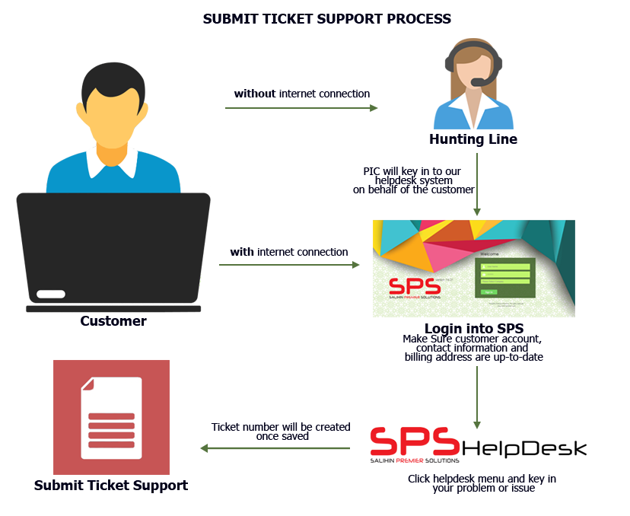
SUPPORT
SYSTEM HELPDESK
Diagram on the right pane illustrates how our support officer handle helpdesk system.
© SALIHIN 2015. Strictly Private & Confidential

Slide 40
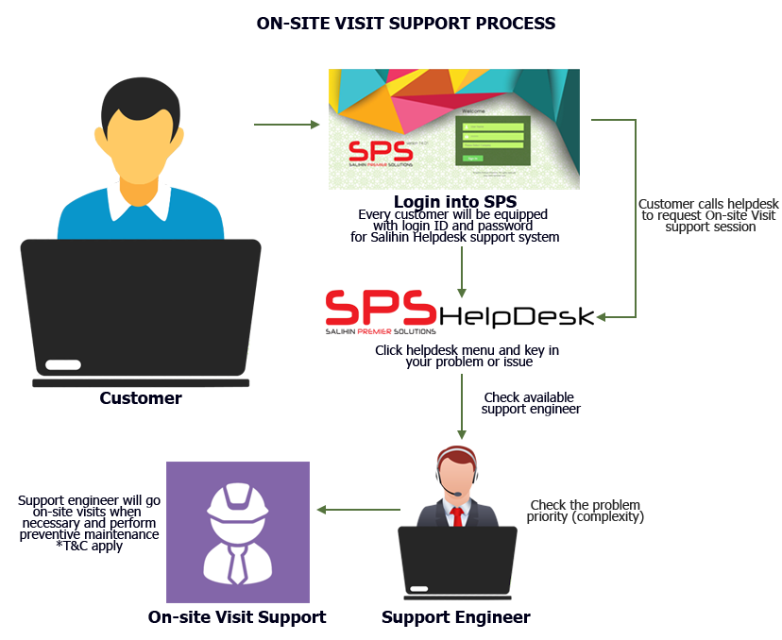
SUPPORT
ON-SITE VISIT SUPPORT
Ad hoc support (on site) Response time: Next business day (Klang Valley), Within 3 days (Peninsular area), Within one week (Sabah Sarawak)
Diagram below illustrates how the mechanism works:
© SALIHIN 2015. Strictly Private & Confidential

Slide 41
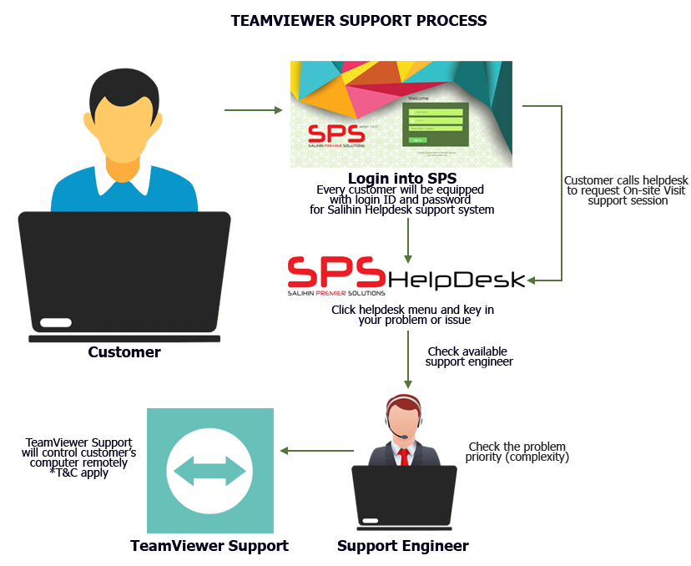
SUPPORT
TEAMVIEWER SUPPORT PROCESS
Diagram below illustrates how teamviewer support process:-
© SALIHIN 2015. Strictly Private & Confidential

Slide 42
CONCLUSION
SALIHIN CONSULTING GROUP has the track record, experience, capacity and capability to implement a successful SPS CP Program for 3 years. The goal to be attained are:
With the skill and certification acquired, our graduates are more marketable.
SALIHIN is confident that the program will produce globally benchmarked graduates that are ready to join the IT organization either locally or internationally.
In moving up the value chain, Professional Certification is becoming more and more important way of promotingg and recoqnizing a highly skilled workforce.
SALIHIN foresees that by the year 2020, after the completion of the program, the IPTAs will take over the running of the program and that the teaching staffs stays abreast with industry needs and supports their effort to integrate industry relevancy into their curriculum.

Slide 43
4.0 OUR CREDENTIALS
© SALIHIN 2015. Strictly Private & Confidential

Slide 44
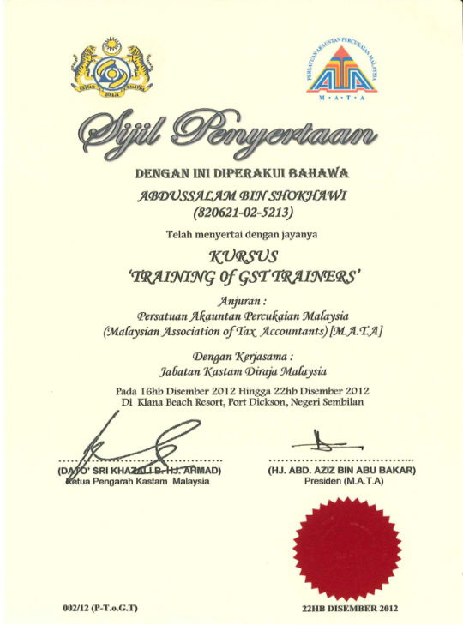
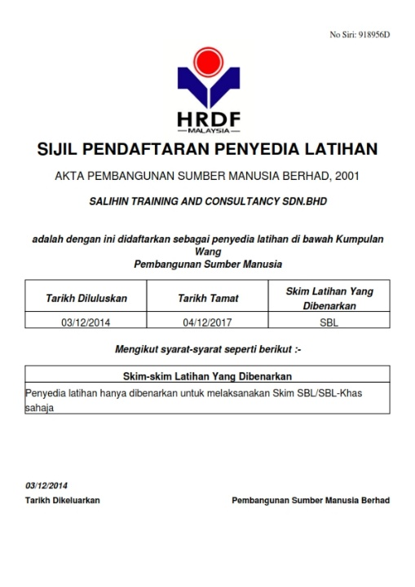
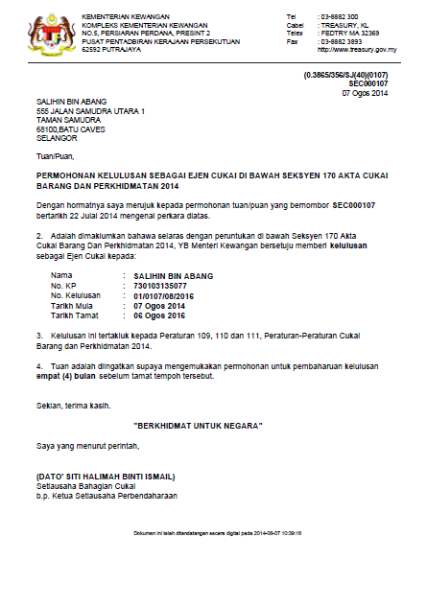

OUR CREDENTIALS
A structured approach with approved HRDF training modules approved by HRDF.
Approved GST Agents and Qualified GST Trainers that have vast GST knowledge and experience of various industries.
Experienced IT consultants that can review and provide technical assistance for GST system compliance; accounting for GST.
© SALIHIN 2015. Strictly Private & Confidential

Slide 45

CONTACT US
OFFICIAL ADDRESS & CONTACT PERSON
CORPORATE CENTRE:
KL Sentral Office
Unit 2A-1, Level 1
Tower 2A, Plaza Sentral
Jalan Stesen Sentral 5
KL Sentral
50470, Kuala Lumpur
Tel: +603 2261 4180
Fax: +603 2261 4182
CONSULTANT: WAN MOHD ISKANDAR
EMAIL: wanmohdiskandar@salihin.com.my
Official Website : www.salihin.com.my
Customer Service : www.salihinpremier.com
E-mail : info@salihin.com.my
Careline : 1 300 88 5678
© SALIHIN 2015. Strictly Private & Confidential

Slide 46
www.salihin.com.my | www.salihinpremier.com
1 300 88 5678
Copyright Controlled 2012 @ SALIHIN

