Slide 1

Table of Contents
Appendixes
a. Previous Presentation Slide (Dated 16 August 2016)
b. Corporate Profile
- FR Mutiara (M) Sdn. Bhd.
c. Execution Plan
d. Training Program, Modules & Certificates
e. Learning & Job Matching Platform
Presentation Slide
Proposal
- Salihin GST Services Sdn. Bhd.
f. Product Catalogue
g. New Digital Online Media

Slide 2


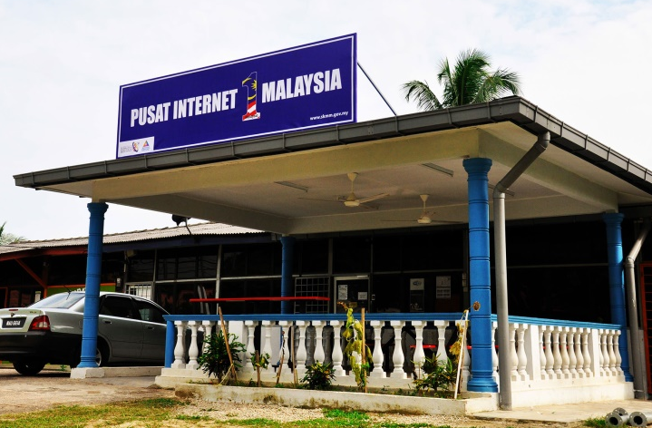


Why we are here today
PI1M CONTENT
ENHANCEMENT & EMPOWERMENT
PI1M CENTRE
VISIBILITY & NEW SERVICE OFFERINGS
Accounting Solutions
Training Program
Certification Program
Continuous Learning (Online & Offline)
Continuous support
Industries Participation
Academia Participation
eLearning & Job Matching Platform
ACCOUNTING
SOFTWARE SOLUTIONS

Slide 3


















Rural Community
500,000 TEKUN Nasional Micro Entrepreneurs
300,000 AIM Micro Entrepreneurs
15,000 Co-operatives i.e Micro Co-Operatives
500 PKK Nationwide
400 Fishermen’s Association Nationwide
Potential accounts to be served via PI1M
PI1M “Accountant”
New Job Creation

