Slide 1






PI1M COMMUNITY CONTENT ENHANCEMENT
BY ACCOUNTING SOLUTIONS
PILOT PROPOSAL
YB DATO’ JAILANI JOHARI
TIMBALAN MENTERI KKMM
Date : 26th January 2017
Time : 02.30 p.m
Venue : Meeting Room, Level 36, KKMM
Prepared for:
Prepared by:

Slide 2
TABLE OF CONTENT
Pilot Project
Section 1
Proposal
Section 2
Appendixes
Corporate Profile – FR Mutiara (M) Sdn Bhd
Section 3
Corporate Profile – SALIHIN
Section 4
SPS Product Info
Section 5
SPSLite Product Info
Section 6
Execution Plan
Section 7
Project Timelines
Section 8
E-Learning & Job Matching Platform
Section 9
Marketing & Promotion Strategy
Section 10

Slide 3

Project directorate
FR Mutiara is an established information & technology consultation company with a mission to be the preferred project management consultant and to become one of the premier player in Malaysia business landscape which provide consultancy services and solutions to different organizations across Malaysia, creating value for clients by leveraging industry knowledge and service offering expertise with an insight into and access to all the emerging technologies.
Company Vision
“Setting standards utilizing best available solutions”
Mission Statement
“Committed to excellence in providing innovative and reliable Information Technology services”

Slide 4



Subject matter expert
SALIHIN is one of the fast growing and leading indigenous brand in Malaysia, which umbrellas a group of distinctive entities tailoring unique and independent consulting services to local and international clientele. SALIHIN offers an integrated and wide spectrum of value for money professional services in the areas of auditing and assurance, taxation (direct and indirect), business advisory, information technology, accounting software and corporate finance.

Slide 5

Pilot proposal executive summary
The purpose of preparing this Pilot Project Proposal is to outline the parameters and the scope of work as anticipated from MCMC to establish the workable action plan with regards to the PI1M Community Content Enhancement by Salihin’s Accounting Solution (SAS).
Due to the fact that the full implementation in our earlier proposal involves a huge budget and investment consideration, we believe a pilot project, would assist KKMM and MCMC to evaluate and justify the investment for the full implementation of our proposal.
Hence, a pilot project is proposed by FR Mutiara and SALIHIN to justify the effectiveness of the “PI1M Community Content Enhancement by Accounting Solutions Proposal”.
HELPDESK
SUPPORT
INDUSTRIES PARTICIPATION
CERTIFICATION
PROGRAMME
ACADEMIA PARTICIPATION
LEARNING & JOB MATCHING PLATFORM
CONTINUOUS
LEARNING
TRAINING
PROGRAM
SALIHIN ACCOUNTING SOLUTIONS (SAS)

Slide 6
Pilot Deliverables parameters
To establish the numbers of participants and the trainings plan for the Pilot Project.
To establish and develop the Project Execution Plan & Timeline with the tentative schedules for the proposed training intended at the proposed date, time & venues. This to be determined by KKMM/MCMC.
To established the teaching duration, training methods, training modules, syllabus and examination criteria and processes.
To outline the value added services availability as set forth by Salihin’s on the continuous e-learning provided by Salihin.
  On-line seminar (Webinar),
  On-line training video and tutorial,
  On-line practical training,
  On-line test and examination,
To established the detail content of the certification certificate for the successful participants.
To discuss and organize the “Acknowledgement Day or Hari Penganugerahan” for all the successful participants.
To discuss and organize the “PI1M SME Award” for successful participating entrepreneurs in this pilot program.
To present to KKMM/MCMC on how SAS intends to evaluate the participants eligibility to the programme and monitor each and every participant progress, right from the start they register for the training.
To ensure that all of the above training programme is acknowledge, certified and endorsed by Salihin’s Teaching Accounting Firm (TAF) partners.
To submit the curriculum vitae of the intended certified trainer for the above.
To outline the programme agenda throughout the training proposed.
To elaborate the Advertising & Promotions to create the programme awareness.
To proposed the reporting process and recording method for progress monitoring.

Slide 7

Pilot evaluation criteria
The evaluation criteria for the Pilot Project are outlined as follows.
  Execution Plan and Programme for at least two (2) Zones / Territories.
  Outline the ease of workflow for the execution and action plan as outline in the proposal.
  Training method, modules and program embedded in the proposal.
  Ability to meet or exceed the outlined criteria in the Pilot Project.
  System Monitoring & Reporting.
  Additional criteria cost plus benefits.
3. Acknowledgement Day
4. PI1M SME Award
2. SAS Training Program & Module
5. System Monitoring & Reporting
1. Project Management &
Execution Plan

Slide 8
Pilot project – delivery plan
Mar 2017 – June 2017
July 2017 – June 2018
Preparation & Planning of Project Execution Plan
Training Session Starts
Pi1M Site Kedah
Pi1M Site Terengganu
2017
Issuance of Pilot project LOA & Contract Agreement
Advertising & Promotion
Event Day –
Acknowledgement day
“Hari Penganugerahan”
Anticipated
Feb - Mar2017
Mar 2017 – June 2017
Anticipated @ 4 - 6 Event days

Slide 9

Pilot project – proposed salient points
Proposed nos. of pax./ license
Proposed no.of pax per training
Total no. of training required
3,000
20
160
Proposed Zones / Territories | Zone Kedah | Zone Terengganu
Proposed Trainings | 80 | 80
Proposed Duration | 1 Year | 1 Year
Hence, we anticipate to reasonably run the PI1M Community Content Enhancement by Accounting Solutions Pilot Project evaluation process will last for at least 12 – 18 months inclusive pre-development period of at least 3-4 months. It comprises of setting up the Salihin Accounting Solutions (S.A.S) into the cloud based and training program to relevant PI1M sites.

Slide 10





Economic Impact outcome
Produce Pi1M Accountant Technician to
Managed Micro Business Accounts
1
Create new job opportunities with better salary and skilled resources
2
Participation from academia (TAF) and industries Players (TEKUN Nasional, AIM & LKIM)
3
Empower Bumiputra agenda as set out
GTP, ETP, NBOS & TP50
4

Slide 11




social & technology Impact outcome
Cultivate a proper and healthy business
Practice amongst underserved communities
5
Nurture new technology adoption and enriched new user experience
6
Extend the knowledges opportunities to underserved communities
7
Build up self confidence & self esteem
amongst rural young generations
8

Slide 12

What is sps?
Equip PI1M Centre with comprehensive SOFTWARE & FREE TRAININGS of high value added accounting software.
Groom & nurture a FINANCIAL, MANAGEMENT & BUSINESS SOUND entrepreneurs in underserved areas.
Increase PI1M BUSINESS RELEVANCY to its respective communities.

Slide 13
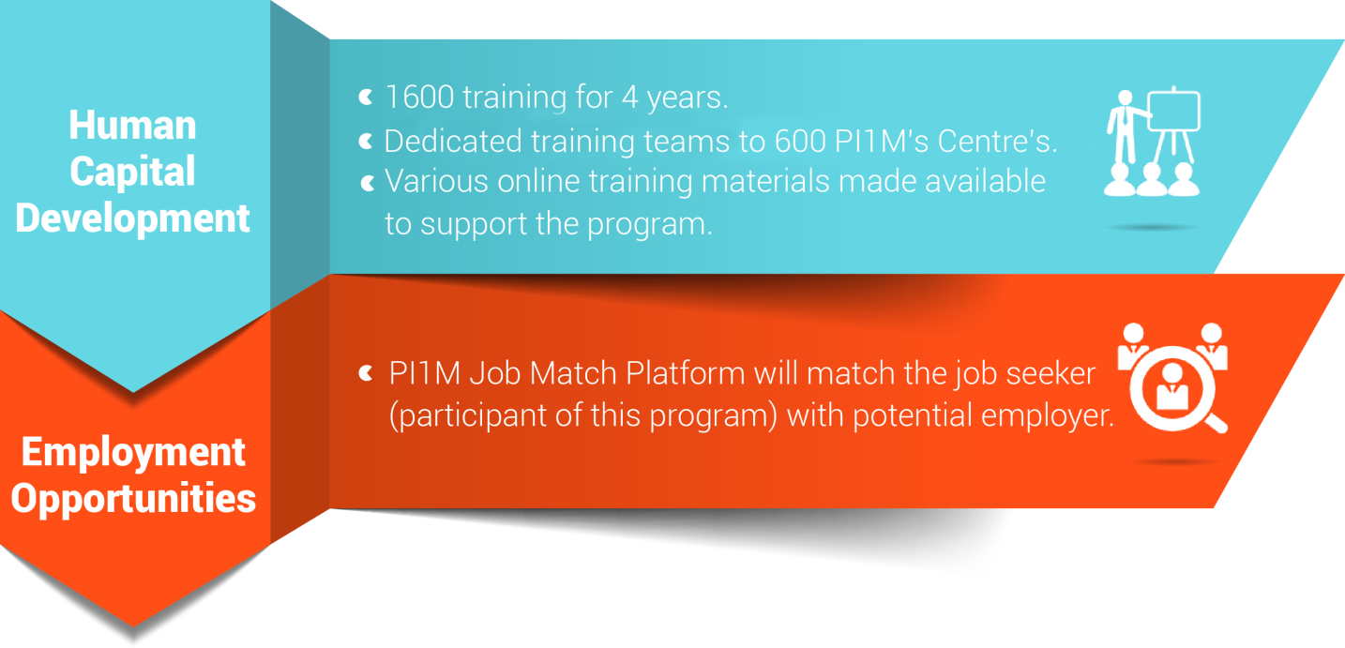
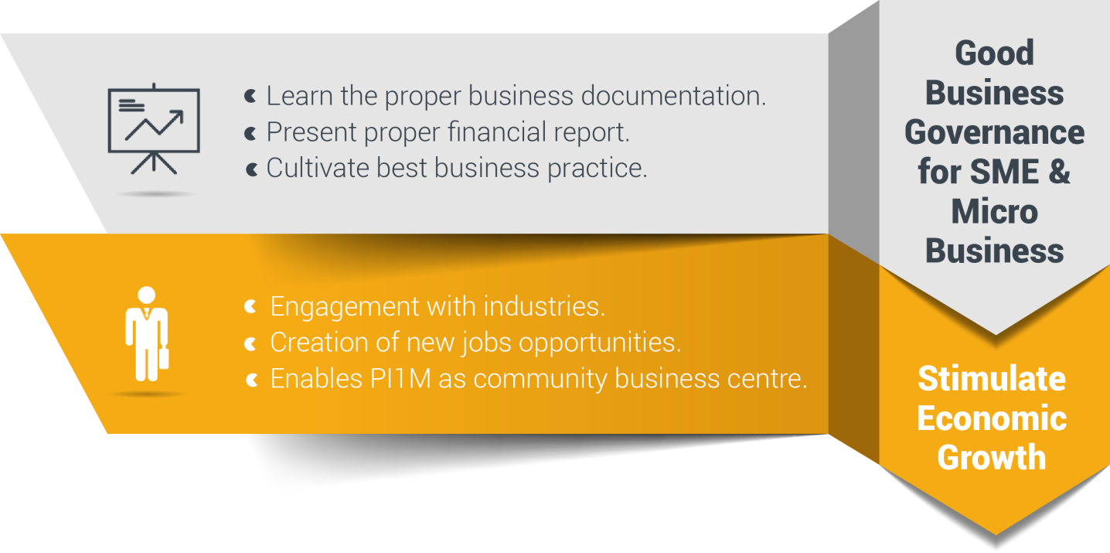
Reaching underserved communities

Slide 14








Target audience
Small & Micro
Entrepreneurs
PRE-REQUISITE
PC Literate
SRP/ PMR Holder
Minimum 10-20 Pax
Registered with PI1M
Women Entrepreneurs
Single Parent
Part-Time Housewife
Student
Under Graduate Student
Graduates
SPM Leavers
Unemployed
Others

Slide 15


















Community content enhancement framework
Rural Community
500,000 TEKUN Nasional Micro Entrepreneurs
300,000 AIM Micro Entrepreneurs
15,000 Co-operatives i.e Micro Co-Operatives
500 PKK Nationwide
400 Fishermen’s Association Nationwide
PI1M “Accounting Technician”
New Job Creation
Potential accounts to be served via PI1M

Slide 16








Targeted deliverables
3,000
Software License
3 Modules
2 Days Training +
½ Day Revision +
½ Day Exam
2 States
Terengganu
Kedah
5 Years
Continuous Support & Learning Platform
3,000
Expected Participations
150
Targeted
Training Sessions
5
Anticipated
Training Team
JOB
Matching Platform
Acknowledgement Day
PI1M SME Award
Manual
SPS, SPSLite & SPS Entrepreneur Web
Training Hand Out & Stationeries

Slide 17


Commercial mileage
In the spirit of business collaboration between SITS and KKMM/SKMM/PI1M, we will support Pi1M in providing quality products and services with the highest degree of customer satisfaction.
PI1M SME BUSINESS AWARD
Launch by KKMM & SKMM
Anticipated Quarterly Event
Event
Organized & Managed by
FR Mutiara & SALIHIN
Support By:

Slide 18





Road to success
Further Studies via SPS Webinar & Online Learning
Program
Kickstart
“PI1M Accounting Technician”
Business
SPS Job Matching Platform
Start
Own
Career
Pathways

Slide 19
Fact sheet
The 3 days education/ training program it’s not perceived only as 3 days training program, but it is essentially a 3 days fundamental training program + 5 years of continuous learning.
E-Learning & Job Matching Platform aims to provide PI1M community a learning opportunities as well as employment opportunities.
  It consists of a short, free, high quality, self-directed, support focused functions and activities for PI1M participants to go for an extra miles in SITS Product Offerings as well as professional and personal development.
  Courses are developed by SITS subject matter experts and participation academician from our TAF participating universities. The Learning platform is made available at all times for all PI1M participants.
  Simultaneously, the above will be made accessible for all potential employers and all academician to assess potential candidates for their further engagement.

Slide 20

Continuous learning
NO. | TRAINING MODULES | METHOD OF TRAINING | SYLLABUS
DAY 1 | Basic Accounting & Business Documentation | Class Room CONTINUOUS LEARNING Online Seminar (Webinar) Online Training Video & Tutorial Online Training Material Online Test & Examinations | Objective: To Maintain Systematic Records of Business Transaction in Order to Generate Various Report. Company Setup User Setup User Access Right Chart of Account System & General Setup Form Setup Financial Year Calendar
 | SPSLite Training & Basic/ Advance SPSLite Website Training
DAY 2 | SPS Training
DAY 3 | Revision Examination
Anticipated Class Room Training for 600 PI1M Min 10-20 Participation Per Training 3 Modules (SPS, SPSLite & SPSWeb) 2 Days Training + 1 Day Exam 5 Years Continuous Learning

Slide 21

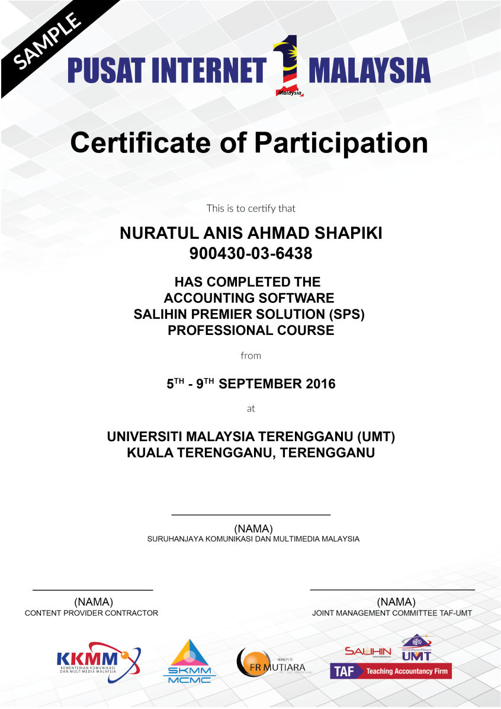
certification

Slide 22

Trainer criteria
Diploma/ Degree Holder in Accounting or Business Management
Certified SPS Trainer
Minimal 2 Years Working Experience
Excellent in Public Speaking

Slide 23

Critical success factor
Support from KKMM
1
5
1
Support from SKMM
2
Coordination from telco’s
(service provider)
3
4
2
Coordination from telco’s technology partner
4
3
Content Solution Provider
5
We have long believed that, over the long term, no institution, idea, or effort of real consequence is ever successful on its own; the most impactful efforts are those approached collaboratively and achieved through close partnership.

Slide 24
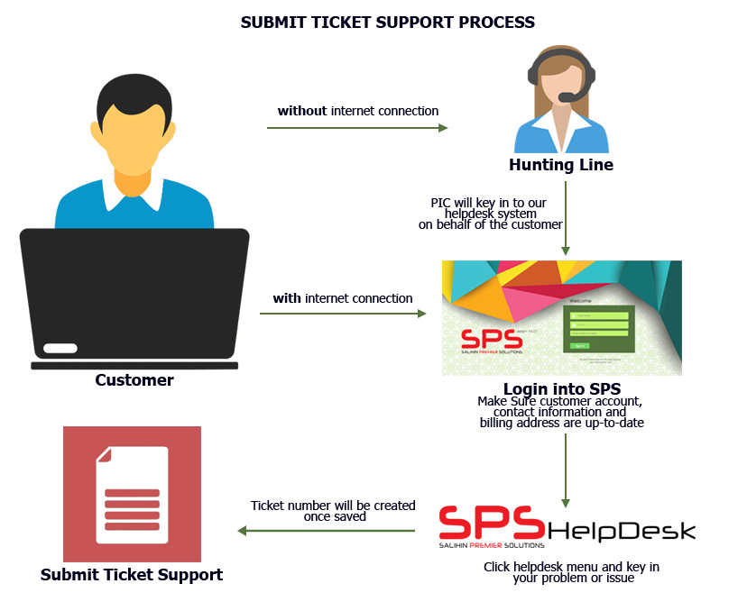
Helpdesk SUPPORT
Response time: Within 24 hours week days (Subject to availability).
Diagram below illustrates process of helpdesk business support.
Working Hours: 8.30am – 5.30pm

Slide 25

EXECUTION PLAN

Slide 26
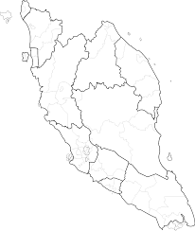
Proposed pi1m ZONING POSITION & ROAD MAPPING
Zone 1
Terengganu
10 PI1M Site
Zone 2
Kedah
10 PI1M Site

Slide 27
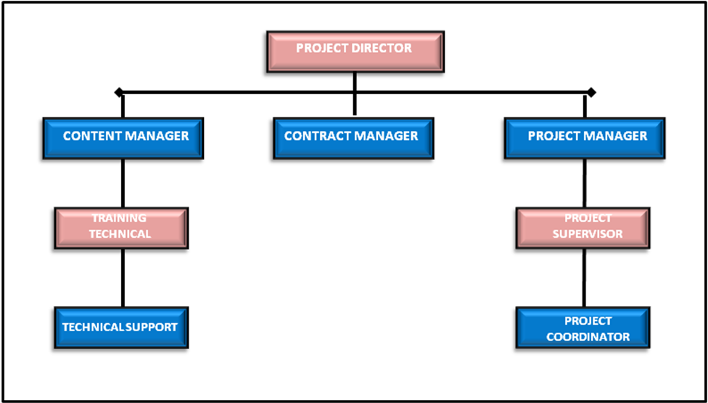
PROJECT MANAGEMENT TEAM
NOTE:
Total = 60 Pax
Management = 5
Executive = 10
Backroom Support = 15
Field Team= 30

Slide 28



METHOD OF STATEMENT
Preparation daily report
Preparation of Weekly report
Preparation of monthly report
Preparation of Checklist & maintenance report
The report consist of attendance record,
Activities program and Status of participant
Submission report to client for approval
Reporting
Step 4
Preparation of arrangement movement by team according to an agreed schedule planning
Arrangement of Transportation by zone
Preparation of meals, arrangement of site & training program
Arrangement team on advertisement & promotion
Site arrangement with SKMM, Service provider and vendor
Step 3
Organizing the Project
Preparation of meeting agenda to discuss on any pre & post development
Preparation of schedule plan during the design & operation phase.
To prepare the safety guideline and all the appropriate acts.
To prepare a team to do the site survey on each PI1M site to clarify on site accessibility & other issues
Step 2
Coordination between all team
Mapping/ garner the critical support from KKMM, SKMM, Telco’s & Telco’s Technology Partner
To list down all 20 PI1M as approved by SKMM
Zoning by 2 Zone
Step 1
Mapping PI1M site

Slide 29



Key MEETING & COORDINATION STRATEGY
Review the monthly practice statistics such as production, adjustments, collections, outstanding claims, unscheduled time units, production by provider, daily production averages, etc.
Review on timeline progress project
Review on weekly report
Discussion on any other matters related to Pi1M activities
Review on deployment activities and problem arise
Discussion on project enhancement activities
Review on resources ,vehicle & training tools & necessary items

Slide 30




REPORTING DELIVERABLES
PI1M ZONE
01
Terengganu
02
Kedah
PI1M
Content Empowerment
Progress Report
Telco’s & Telco’s
Technology Partner
Reporting consist of Weekly, Monthly, Quarterly & Yearly
(Attendance, Activities, Training, Exam, Certification & Other’s Report )

Slide 31
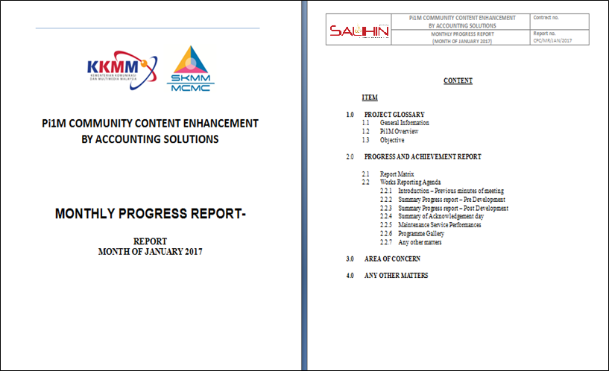
Sample monthly progress report

Slide 32
PARTICIPANT REGISTRATION PROCESS FLOW
Participant Fill a PI1M Registration Program Form
Registration
- By online
By walk in to Pi1M or SITS headquarters
By Booth event / Road show
If No
Check Participant
Status
Minimum Requirement
Registered with Pi1M
PC Literate
Min. academic qualification i.e SRP / PMR / SPM or others
If Yes
Reschedule For Next Training
Confirm
Training Dates &
Location
ACKNOWLEDGEMENT DAY*
Organize by SITS
Launch by KKMM/ SKMM
N/B: Dates & location to be assigned during Steering Meeting
Helpdesk to Counsel & Assists the Unsuccessful Participant
Training Class & Exam
If No
If Pass
Access to Continues
e-Learning
* Participant Received
Certificate
Job Matching Platform

Slide 33
WEB INTERFACE

Slide 34

SKMM PI1M landing page

Slide 35
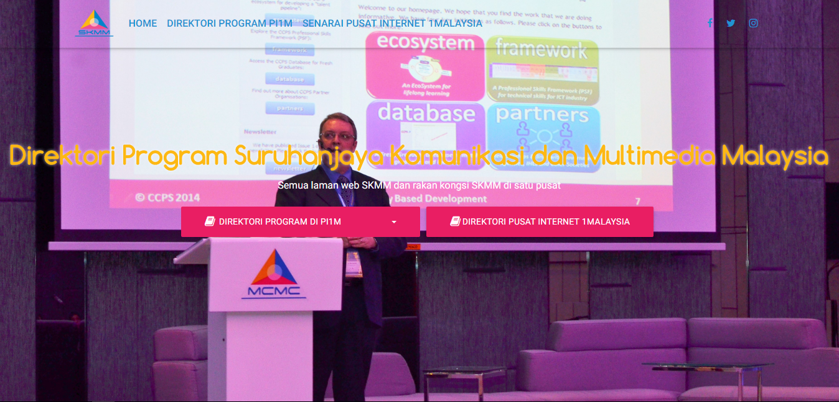
SKMM PI1M content landing page

Slide 36
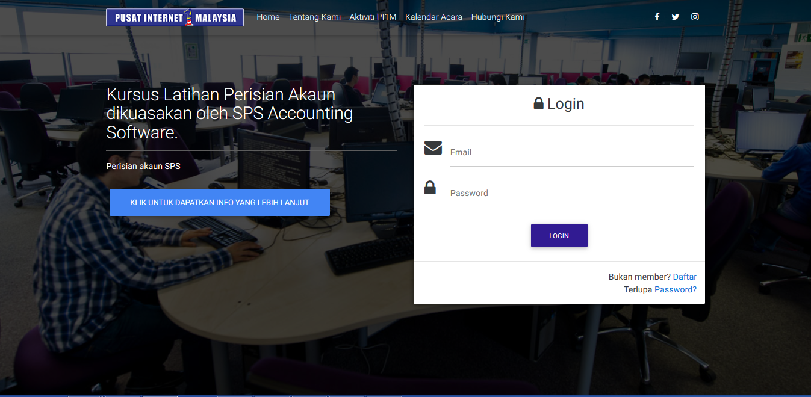
Sits accounting content landing page
Diagram 4.0 Illustrate The Employer Registration Page.

Slide 37
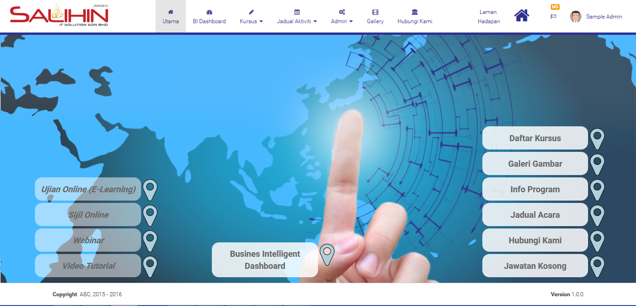
Sits accounting training home page

Slide 38
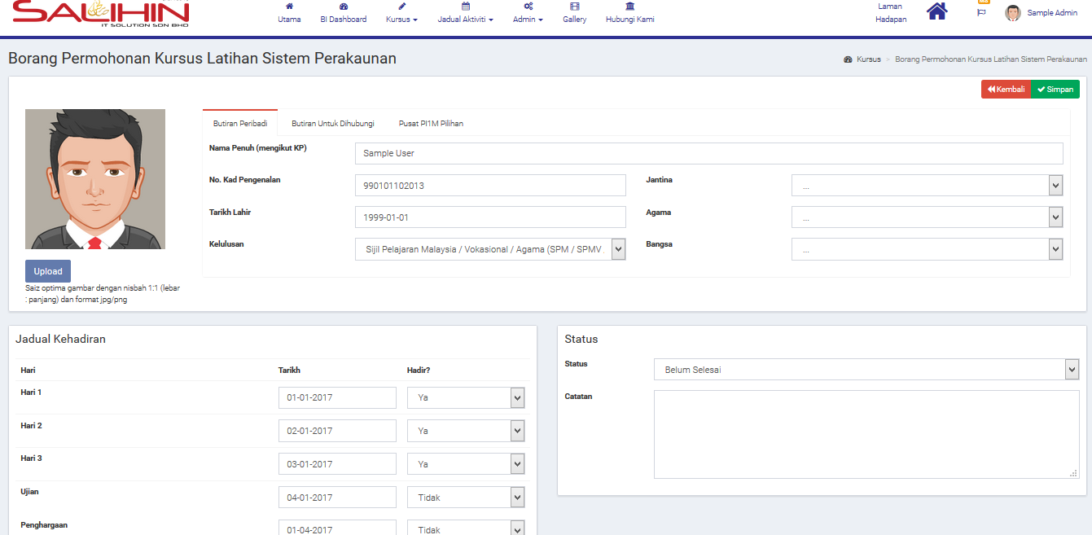
Sits accounting training registration page

Slide 39
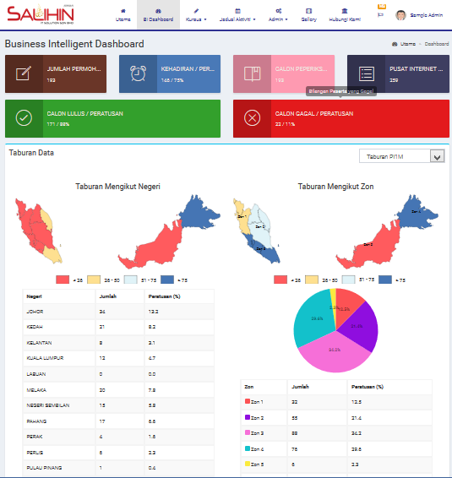
Sits business intelligence page

Slide 40
financial considerations
TOTAL INVESTMENT BY SKMM/ Pi1M FOR PILOT PROJECT | RM 13,938,600.00
The financial considerations are includes an attractive value-for-money proposition to the SKMM which includes:-
Installations, commissioning and maintenance of Salihin Premier Solutions (SPS)’s Cloud Base software license for 3,000 participants inclusive of five (5) years extended software license.
Installations, commissioning and maintenance of SPS-Lite Cash-Book Cloud Base software license for 3,000 participants (including SPS Entrepreneurs Web) inclusive of five (5) years extended software license.
Anticipated approximately 160 no. of training program within 1 years
Inclusive of five (5) years of free access to Salihin’s Continuous Learning Platform (Webinar, On-line Tutorial and Training materials).
Inclusive of five (5) years of free access Salihin Job Matching Platform.
Inclusive of five (5) years of free on-line support (helpdesk)
Inclusive certification and endorsement by Salihin’s partner in Teaching Accounting Firm (TAF)
Anticipated 10-12 sessions of Acknowledgement Day (graduation day) for at least 1,000 pax per session.
Anticipated resources of:
  Management: Five (5) persons.
  Coordinator: five (5) persons.
  Trainers: Ten (10) persons.
  Helpdesk Support: Thirty (30) persons.
  Webinar: Three (3) persons.
  Online Learning Platform: Three (3) persons.
  Job Matching Platform: Three (3) persons.
  Marketing: One (1) person.
  Social Media: One (1) Person.

