Slide 1


EXECUTION PLAN

Slide 2
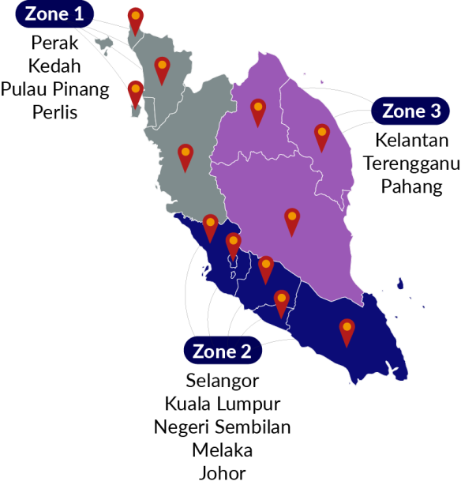
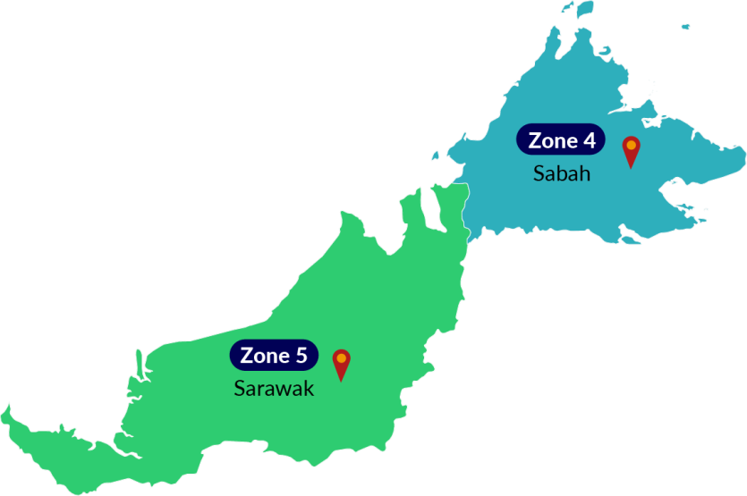
Proposed pi1m ZONING POSITION & ROAD MAPPING

Slide 3
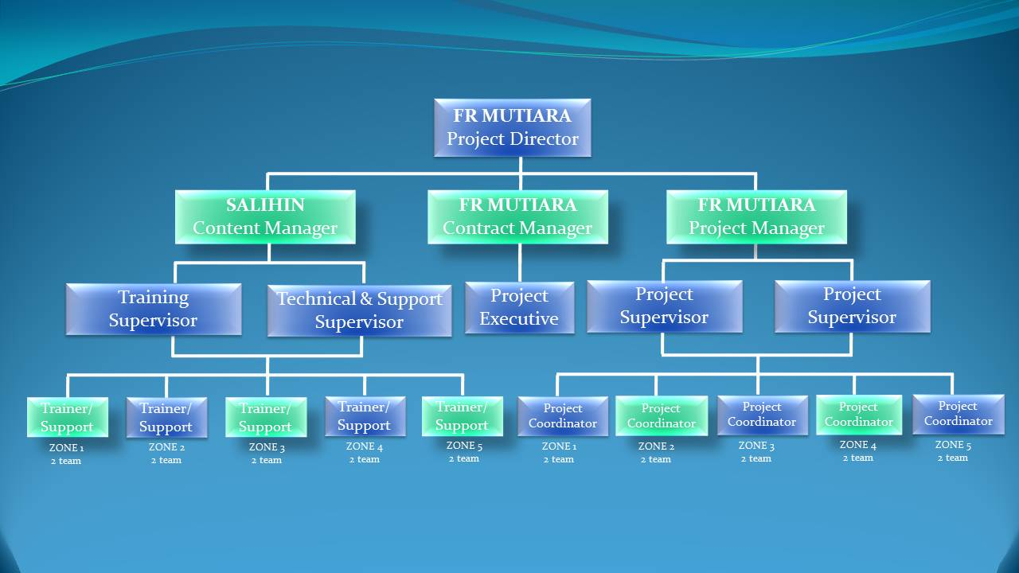
Proposed PROJECT MANAGEMENT TEAM

Slide 4
Proposed JOB SCOPE & RESPONSIBILITIES
POSITION | JOB SCOPE
PROJECT DIRECTOR | To liaise & follow-up with SKMM or KKMM on future & upcoming project To be a lead on Project Steering Committee Meeting To make sure that the project follow according to the schedule & plan
PROJECT MANAGER | To lead & manage the project & meeting Liaise with internal or Salihin deployment team to ensure success deployment of the system Attending Project Steering Committee Meeting
CONTRACT MANAGER | To liaise with bank, Funder, Loan Institution, Insurance, company secretary To prepare project contract & related document Monitoring on project costing Liaise with Authorities Attending Project Steering Committee Meeting
CONTENT MANAGER | Responsible on the content including training module Planning & conduct the training session by classroom, Web based training, Online training, mobile video training Develop technical solution for customer issues related to software setup and configuration Delivered technical support service

Slide 5
CON’T JOB SCOPE & RESPONSIBILITIES
POSITION | JOB SCOPE
PROJECT SUPERVISOR | To monitor movement all project coordinator following the schedule as per agreed To prepare monthly report & related documents To attend all related meeting etc Project Coordination meeting & Project Contractor Meeting & Project Steering Committee Meeting Responsible on arrangement of training session to be in good order etc arrangement of meal, place, liaise with PI1M pengurus wilayah To ensure the system are verified & validate by SKMM & KKMM Provide technical assistance and guidance during Installation & training implementation Prepare the work flow
PROJECT EXECUTIVE | To monitor movement all team following the schedule as per agreed To check & prepare report on project costing To attend all related meeting etc Project Coordination meeting & Project Contractor Meeting & Project Steering Committee Meeting
PROJECT COORDINATOR | To monitor on SALIHIN Team movement on installation & Training implementation To prepare Site weekly report, Service & Maintenance checklist & report To assist on training session arrangement To liaise with PI1M pengurus wilayah Attending Project Contractor Meeting To setup booth & registration

Slide 6
CON’T JOB SCOPE & RESPONSIBILITIES
POSITION | JOB SCOPE
TRAINER SUPERVISOR | Responsible on the content including training module and material To plan and supervise training session To prepare SPS certification Attending Project Steering Committee Meeting
TECHNICAL & SUPPORT SUPERVISOR | Liaise with the Project Manager and the deployment team to ensure the success of the system deployment. To prepare SOP and monitor the problem and support activities Develop technical solution for customer issues related to software setup and configuration via SPS Helpdesk Attending Project Steering Committee Meeting
TRAINER | Conduct training session Conduct SPS exam Assist and support Web based training, Online training and mobile video training Assist SPS Helpdesk
TECHNICAL & SUPPORT ENGINEER | Deploy the system Delivered technical support service Assist trainer during training and exam session Assist SPS Helpdesk

Slide 7
PROPOSED METHOD OF STATEMENT
METHOD | DESCRIPTION
1. Mapping PI1M site | To list down all 600PI1M as approved by SKMM Zoning by 5 zoned which is; a) Zone 1 (Perak, Kedah, Penang, Perlis) b) Zone 2 (Negeri Sembilan, Melaka, Johor, Selangor, Kuala Lumpur, Putrajaya) c) Zone 3 (Kelantan, Terengganu, Pahang) d) Zone 4 (Sabah) e) Zone 5 (Sarawak)
2. Coordination between all team | To prepare a team to do the site survey on each PI1M site to clarify on site accessibility & other issues To prepare the safety guideline and all the appropriate acts. Preparation of schedule plan during the design & operation phase Discussion to finalize the plan during a project Coordination Meeting Preparation for meeting agenda and any issue regarding implementation for SPS system for each PI1M
3. Organizing the Project | Preparation of arrangement movement by team according to agreed schedule Plan Preparation of meals & arrangement of site & training programme. Arrangement site arrangement with SKMM, Service provider and vendor Arrangement on advertisement plan
4. Reporting | Preparation daily report Preparation of Weekly report Preparation of Monthly report Preparation of Checklist & maintenance report * The report consist of attendance record, Activities programme and Status of participant

Slide 8

Trainer criteria
DIPLOMA / DEGREE HOLDER IN ACCOUNTING OR BUSINESS
CERTIFIED SPS TRAINER
WORKING EXPERINCED ATLEAST 2 YEARS
EXCELLENCT IN PUBLIC SPEAKING

Slide 9
PROPOSED TIMELINE FOR 5 YEARS
NO | TASK NAME | YEAR 1 |  |  |  |  |  |  |  |  |  |  |  |  | YEAR 2 | YEAR 3 | YEAR 4 |  | YEAR 5
 |  | M 1 | M 2 | M 3 | M 4 | M 5 | M 6 | M7 | M8 | M 9 | M10 |  | M 11 | M 12
1 | Received LOA
2 | Preparations of Documentation
3 | Advertising Session
4 | Delivery & Installation of SPS System
5 | Commissioning & Handover Pi1M
6 | Training programme
7 | Maintenance support
8 | Invoice upon completion of Works

Slide 10
PROPOSED PAYMENT SCHEDULE
No | Payment Percentage % | Amount
1 | 5% upon Letter of Award | RM 3,456,000.00
2 | 5% upon 1st Steering Committee Meeting | RM 3,456,000.00
3 | 85% upon completion of Installation for each PI1M;
 | 1st Claim – Month 7 (100 Site PI1M) | RM 9,792,000.00
 | 2nd Claim – Month 8 (100 Site PI1M) | RM 9,792,000.00
 | 3rd Claim – Month 9 (100 Site PI1M) | RM 9,792,000.00
 | 4th Claim – Month 10 (100 Site PI1M) | RM 9,792,000.00
 | 5th Claim – Month 11 (100 Site PI1M) | RM 9,792,000.00
 | 6th Claim – Month 12 (100 Site PI1M) | RM 9,792,000.00
 | Note ( RM 97,920.00 per each PI1M) * Refer attached PI1M cost breakdown
4 | 5% upon after completion of works | RM 3,456,000.00
TOTAL CLAIM |  | RM 69,120,000.00

Slide 11
PROPOSED price breakdown
No | Item Description | Price /Unit | Qty | Total Claim | Remarks
1 | 1st Claim for 5% from total of contract | - | - | RM3,456,000.000 | Upon LOA
2 | 2nd Claim for 5% from total of contract | - | - | RM3,456,000.000 | Upon 1st Steering Committee Meeting c/w submission documentation
3 | 3rd Claim – Installation of PI1M Site | RM97,920.00 | 600 site | RM58,752,000.00 | Claim by monthly (6 times)
 | Claim consist of ;
 | - SPS Installer pack
 | - Installation
 | - Help-desk
 | - Team viewer Support
 | Free Online chat support
 | On-Site Training
4 | 4th Claim – 5% from total of Contract price |  |  | RM 3,456,000.00 | Upon completion of training ( 4 years)

Slide 12

PROPOSED STEERING COMMITTEE MEMBER
Representative from
KKMM
Representative from
FR MUTIARA
Representative from
Service Provider
PROPOSED STEERING COMMITTEE MEMBER
(Once every 4 month)
Representative from
Vendor
Representative from
SKMM

Slide 13
PROPOSED MEETING SESSION
Steering Committee Member Meeting
(Once every 4 Month)
Project Contractor Meeting
(Every 2nd Week of the month)
PROPOSED MEETING SESSION
Project Coordination Committee Meeting
(Once a month)

Slide 14
PROPOSED MEETING AGENDA
PROPOSED MEETING SESSION | FREQUENCY | MEETING AGENDA
Proposed of Steering Committee Member Meeting Representative from KKMM Representative from SKMM Representative from FR MUTIARA Representative from Service Provider Representative from Vendor | Once every 4 month | Review the monthly practice statistics such as production, adjustments, collections, outstanding claims, unscheduled time units, production by provider, daily production averages, etc. Review the incomplete action items from the previous month(s) and check for progress Discuss the new agenda items
B) Proposed of Project Coordination Committee Meeting Representative from FR MUTIARA Representative from Service Provider Representative from Vendor | Once a month | Status project Status Report Discussion & finalize on site issue
C) Proposed of Project Contractor Meeting Representative from FR MUTIARA Representative from SALIHIN | 2nd Week every month | Management review Review on reporting Status project Status payment

