Slide 1





PI1M COMMUNITY CONTENT ENHANCEMENT
BY ACCOUNTING SOLUTIONS
Date : 27th October 2016
Time : 02.30 p.m
Venue : Angkasapuri, RTM
Prepared for:
Prepared by:

Slide 2

PI1M COMMUNITY CONTENT ENHANCEMENT
BY ACCOUNTING SOLUTIONS
SELAMAT DATANG
Date : 27th October 2016
Time : 02.30 p.m
Venue : Angkasapuri, RTM

Slide 3

FR MUTIARA
FR is an established information & technology consultation company with a mission to be the preferred project management consultant and to become one of the premier player in Malaysia business landscape which provide consultancy services and solutions to different organizations across Malaysia, creating value for clients by leveraging industry knowledge and service offering expertise with an insight into and access to all the emerging technologies.
Company Vision
“Setting standards utilizing best available solutions”
Mission Statement
“Committed to excellence in providing innovative and reliable Information Technology services”

Slide 4




SALIHIN
SALIHIN is one of the fast growing and leading indigenous brand in Malaysia, which umbrellas a group of distinctive entities tailoring unique and independent consulting services to local and international clientele. SALIHIN offers an integrated and wide spectrum of value for money professional services in the areas of auditing and assurance, taxation (direct and indirect), business advisory, information technology, accounting software and corporate finance.

Slide 5






Pi1m overview
Pusat Internet 1 Malaysia (PI1M) is one of the earliest initiative under Universal Service Provision (USP), the first PI1M was built in 2007. It is an initiative to bring positive social and economic impact to the community in underserved areas.
OBJECTIVE
Established related ICT services in the rural and underserved area where the internet access is poor and inaccessible.
Focus of PI1M expanded from 2013 onwards to include the underserved groups in urban areas. PI1Ms in urban areas are built in low-cost housing areas such as at the People’s Housing Project (PPR) and the Government’s Support Staff housing areas.
All PI1M centres are equipped with 20 units of computer and the centre provides basic internet access as well as ICT-related trainings that are conducted by full-time Manager and Assistant Manager.
Branded as Knowledge Community Centre by providing and establishing ICT and other training for surrounded PI1M community
These PI1Ms are equipped with special facilities for people with disabilities (OKU) to browse the internet and there is special area for toddlers.

Slide 6
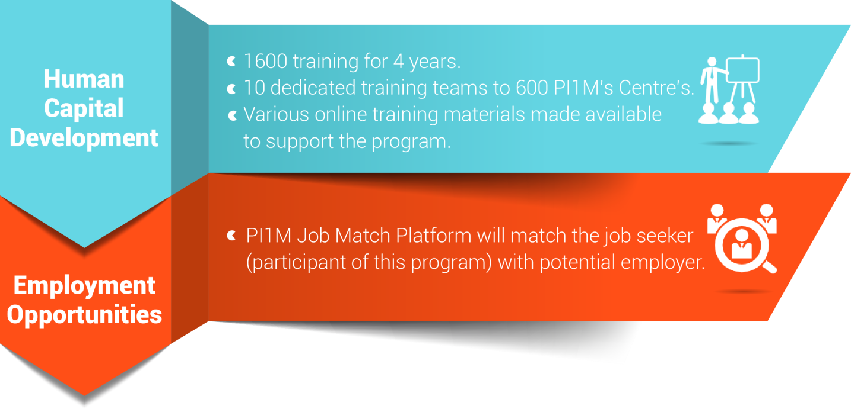
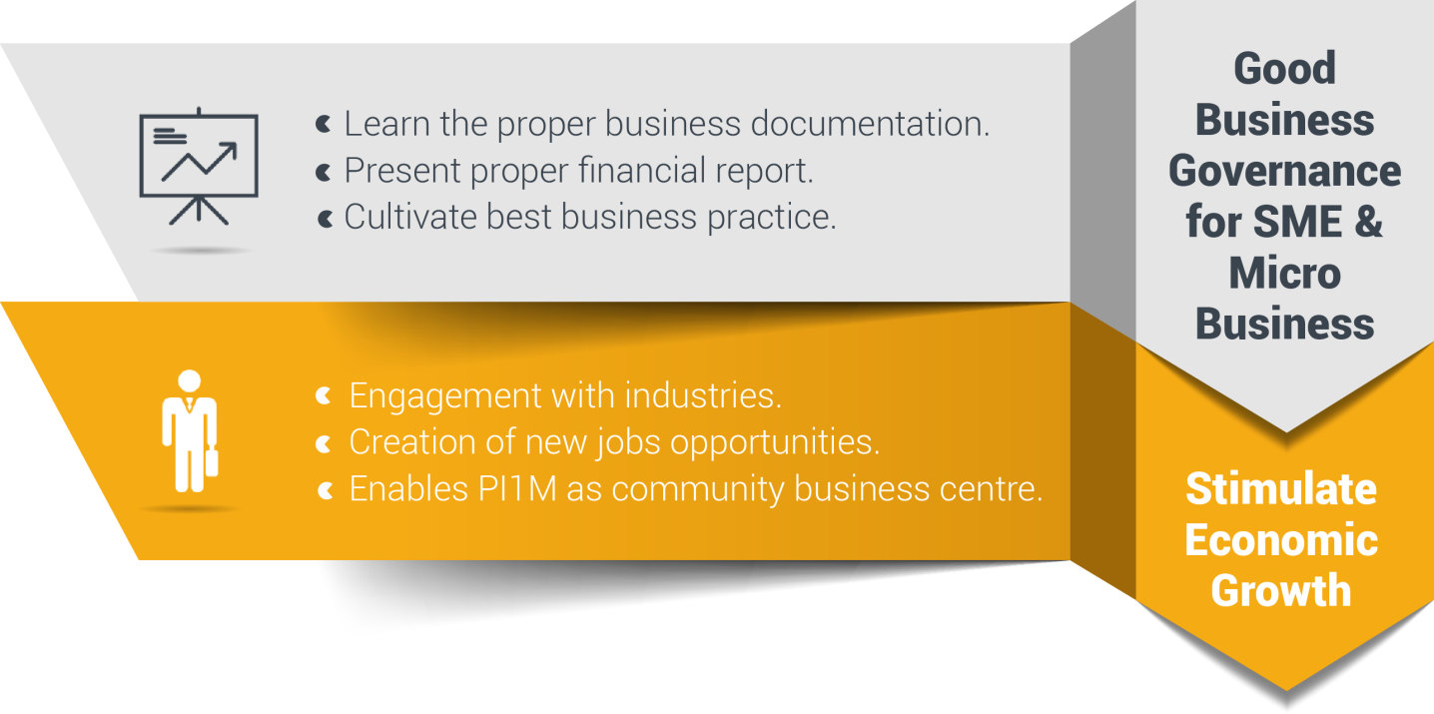
Reaching underserved communities

Slide 7

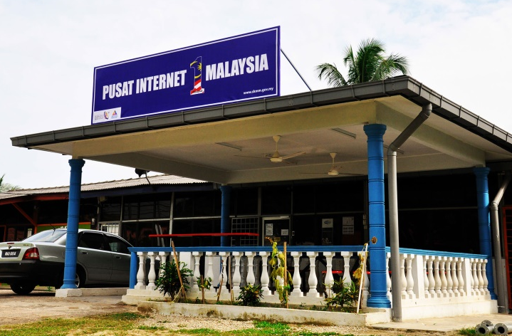

Why we are here today
PI1M CONTENT
ENHANCEMENT & EMPOWERMENT
PI1M CENTRE
VISIBILITY & NEW SERVICE OFFERINGS
Accounting Solutions
Training Program
Certification Program
Continuous Learning (Online & Offline)
Continuous support
Industries Participation
Academia Participation
eLearning & Job Matching Platform
ACCOUNTING
SOFTWARE SOLUTIONS

Slide 8

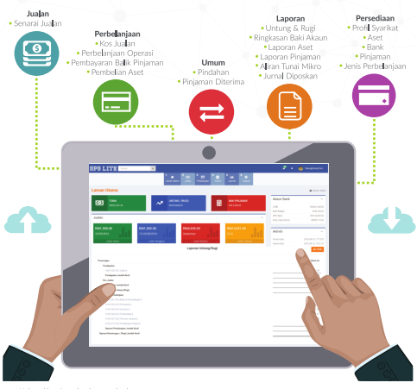
Sps overview

Slide 9

What is sps?

Slide 10


Sps accounting offerings
30,000 FREE Licenses for 5 Years
SPS, SPSLite CashBook & Entrepreneurs Web @ 600 PI1M
  1,600 FREE Training Session with examination for 4 Years
SPS, SPSLite CashBook & Entrepreneurs Web @ 600 PI1M
  30,000 Accreditation & Certifications
SPS, SPSLite CashBook & Entrepreneurs Web @ 600 PI1M
  eLearning & Job Matching Platform for participants to engage with potential employers
  Free PI1M Entrepreneurs Event Awards with Media Coverage in Major Malay Newspaper for 1 Years
  (Schedule and Timetable – TBD)

Slide 11
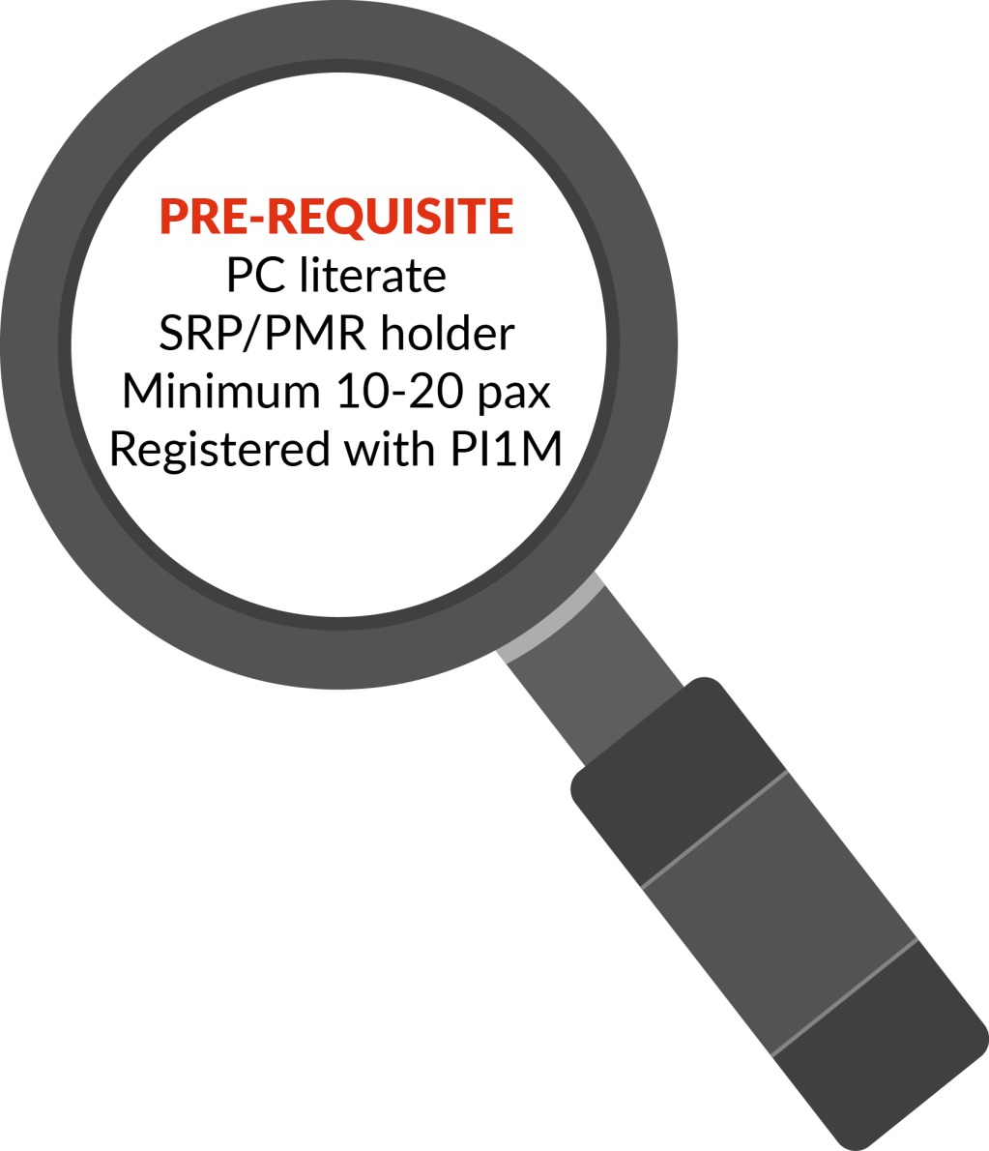







Target audience
Small & Micro
Entrepreneurs
Women Entrepreneurs, Single Mother, Part-Time Housewife
Under Graduate Student/ Graduates
Student/
SPM Leavers

Slide 12
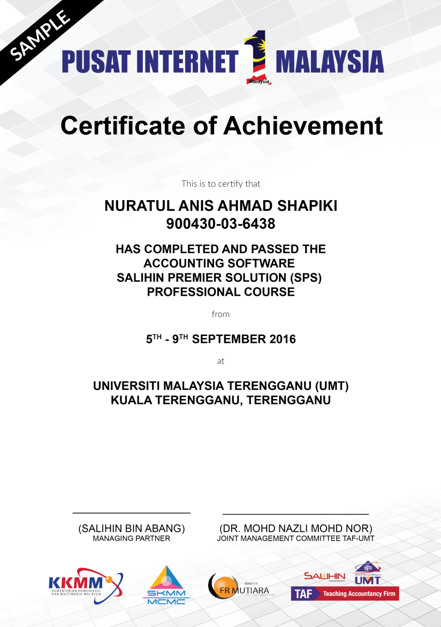
Catalyze underserved growth
NO. | TRAINING MODULES | METHOD OF TRAINING | SYLLABUS
DAY 1 | Basic Accounting & Business Documentation | Class Room Online Seminar (Webinar) Online Training Video & Tutorial Online Training Material Online Test & Examinations | Objective: To Maintain Systematic Records of Business Transaction in Order to Generate Various Report. Company Setup User Setup User Access Right Chart of Account System & General Setup Form Setup Financial Year Calendar
 | SPSLite Training & Basic/ Advance SPSLite Website Training
DAY 2 | SPS Training
DAY 3 | Revision Examination | 4 Hours 4 Hours
Class Room Training for 600 PI1M Min 10-20 Participation 3 Modules (SPS, SPSLite & SPSWeb) 2 Days Training + ½ Day Revision + ½ Day Exam Online Certification (.pdf format)

Slide 13




Training deliverables
10 Teams
3 Modules
2 Days Training +
½ Day Revision +
½ Day Exam
10 Dedicated Team will conduct training to assigned regions.
Assigned Zone
  Zone 1
    Perak, Kedah, Penang, Perlis
  Zone 2
    Selangor, Kuala Lumpur, Malacca, N. Sembilan, Johor
  Zone 3
    Kelantan, Terengganu, Pahang
  Zone 4
    Sarawak
  Zone 5
    Sabah
30,000
Expected Participations
1,600
Targeted
Training Sessions

Slide 14


















OUR ROAD TO SUCCESS
Rural Community
500,000 TEKUN Nasional Micro Entrepreneurs
300,000 AIM Micro Entrepreneurs
15,000 Co-operatives i.e Micro Co-Operatives
500 PKK Nationwide
400 Fishermen’s Association Nationwide
Potential accounts to be served via PI1M
PI1M “Accountant”
New Job Creation

Slide 15
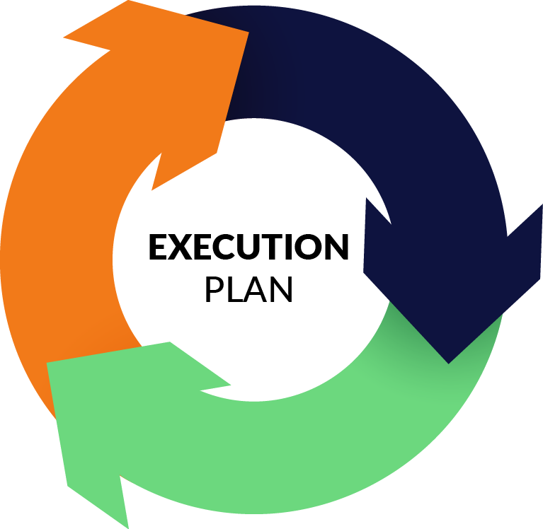

Slide 16
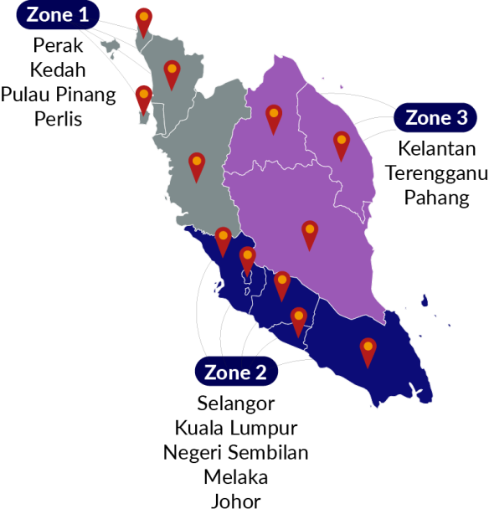
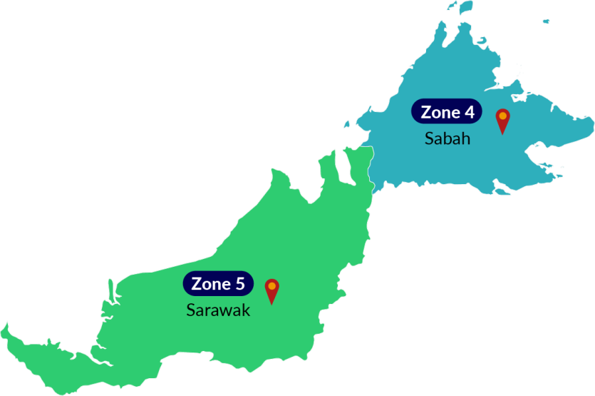
Proposed pi1m ZONING POSITION & ROAD MAPPING

Slide 17
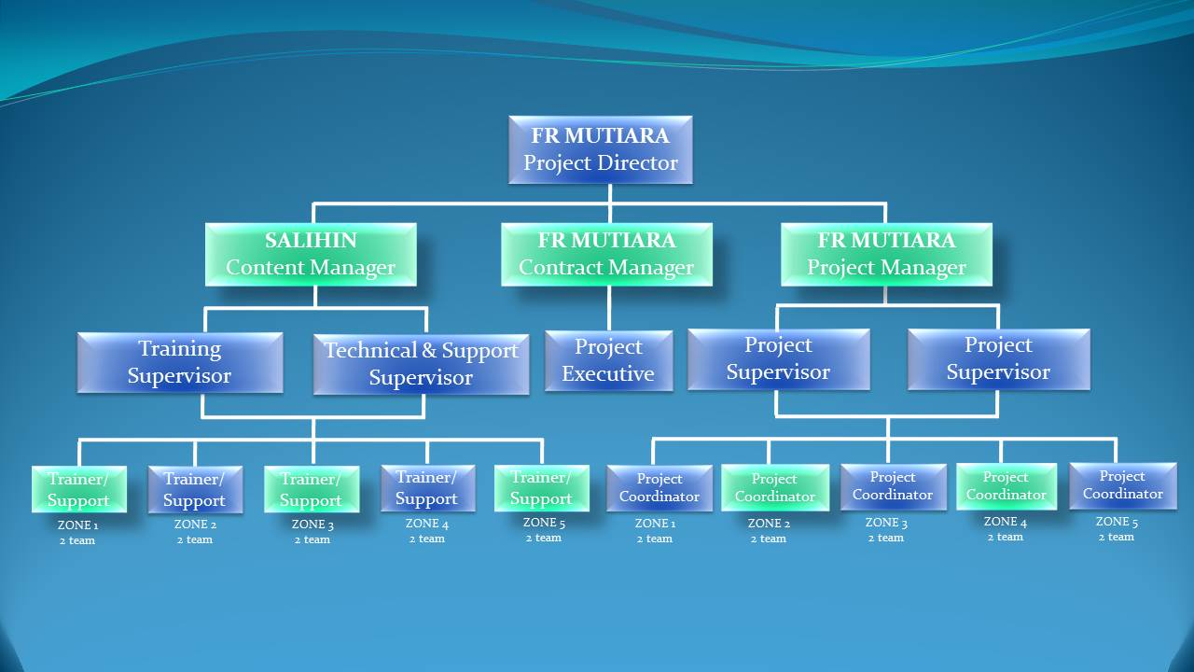
Proposed PROJECT MANAGEMENT TEAM
*
*
*
*
*
**
**
**
**
**
Note;
Numbers of pax = 50

Slide 18



PROPOSED METHOD OF STATEMENT
Preparation daily report
Preparation of Weekly report
Preparation of monthly report
Preparation of Checklist & maintenance report
The report consist of attendance record,
Activities programme and Status of participant
Submission report to client for approval
Reporting
Step 4
Preparation of arrangement movement by team according to an agreed schedule planning
Arrangement of Transportation by zone
Preparation of meals, arrangement of site & training programme
Arrangement team on advertisement & promotion
Site arrangement with SKMM, Service provider and vendor
Step 3
Organizing the Project
Preparation of meeting agenda to discuss on any pre & post development
Preparation of meeting agenda to discuss on any pre & post development
Preparation of schedule plan during the design & operation phase.
To prepare the safety guideline and all the appropriate acts.
To prepare a team to do the site survey on each PI1M site to clarify on site accessibility & other issues
Step 2
Coordination between all team
Step 1
Mapping PI1M site
To list down all 600PI1M as approved by SKMM
Zoning By 5 Zone

Slide 19
PROPOSED TIMELINE FOR 5 YEARS
NO | TASK NAME | YEAR 1 |  |  |  |  |  |  |  |  |  |  |  |  |  | YEAR 2 | YEAR 3 | YEAR 4 | YEAR 5
 |  | M 1 | M 2 | M 3 | M 4 | M 5 | M 6 | M7 | M8 | M 9 | M10 |  | M 11 |  | M 12
1 | Pre-Development
1.1 | Received LOA/Performance bond / Contract
1.2 | Preparations & approval of Documentation
1.3 | Advertising & promotion
1.4 | Procurement, delivery & Installation of SPS System (Hardwares / Softwares)
1.5 | Commissioning & Handover Pi1M
1,6 | Maintenance Support
2 | Post-Development
2.1 | Training programme
2.2 | * Training support
* Training support ;
Webinar, / Video Training & Tutorials / Online Training Material / Online Test & Examination / Online Certification

Slide 20







PROPOSED MEETING SESSION
Steering
Committee
MEETING AGENDA
Review the monthly practice statistics such as progressive project, adjustments, collections, outstanding claims, unscheduled time units, involvement by provider, daily activities averages, etc.
Review the incomplete action items from the previous month and check for progress.
Discussion on the new agenda related to PI1M enhancement.

Slide 21





PROPOSED MONITORING SYSTEM
ZONE 1
KKMM
ZONE 2
Daily report
Weekly report
Monthly report
Maintenance
Report
Checklist
SKMM
ZONE 3
SERVICE
PROVIDER
ZONE 4
ZONE 5
Reporting consist of attendance record,
Activities programme and Status of participant

Slide 22
PROPOSED MILESTONE PROGRESS SCHEDULE
MONTH | DESCRIPTION | DELIVERABLE | PERCENTAGE %
1 | Letter of Award (LOA) / Preliminary | Contractor to submit Performance Bond (PB) in the form of Bank Guarantee (BG) PB / BG is 5 % from the total contract value of the Letter of Award (LOA) | 5%
4 | 1st Steering Committee Meeting | Contractor to submit to the Steering Committee; Project Management Team Organisation Chart Project scope deliverables Project Implementation Programme & Schedule Project SPS (Pi1M Training Module & Programme) Proposed Certification programme and mileage programme Trainer & Staff detail of CV Checklist, Maintenance & Monthly report Training Module | 5%
7 | Month 7 (100 PI1M) | Claim consist of ; SPS Installer pack Installation Help-desk Team viewer Support Free online chat Support On site Training (Anticipated 100 PI1M / month) | 15%
8 | Month 8 (100 PI1M) |  | 15%
9 | Month 9 (100 PI1M) |  | 15%
10 | Month 10 (100 PI1M) |  | 15%
11 | Month 11 (100 SPI1M) |  | 15%
12 | Month 12 (100 Site PI1M) |  | 15%

Slide 23


Slide 24


Slide 25
financial considerations
TOTAL INVESTMENT BY MCMC/ Pi1M | RM 69,120,000.00
The financial considerations are includes an attractive value-for-money proposition to the MCMC which includes:-
  Installations, commissioning and maintenance of 1,200 Salihin Premier Solutions (SPS)’s software license of at 600 PI1M Centre’s
  Installations, commissioning and maintenance of SPSLite CashBook Cloud Based Software License made accessible to 600 PI1M Centres
  30,000 SPS User license for the use of 600 PI1M Centre’s.
  30,000 SPSLite cashBook User license (including entrepreneur web access) for the use of 600 PI1M Centre’s.
  1,600 training program during 4 years
  30,000 certifications for PI1M participant
  Learning & Job Matching Platform

