Slide 1








Proposed Site Team Uniform Design
Content Provider Contractor
TRAINING
TEAM
Pi1M COMMUNITY CONTENT ENHANCEMENT
BY ACCOUNTING SOLUTIONS
FRONT VIEW
BACK VIEW
Content Provider Contractor
MANAGEMENT
TEAM
FRONT VIEW
BACK VIEW

Slide 2
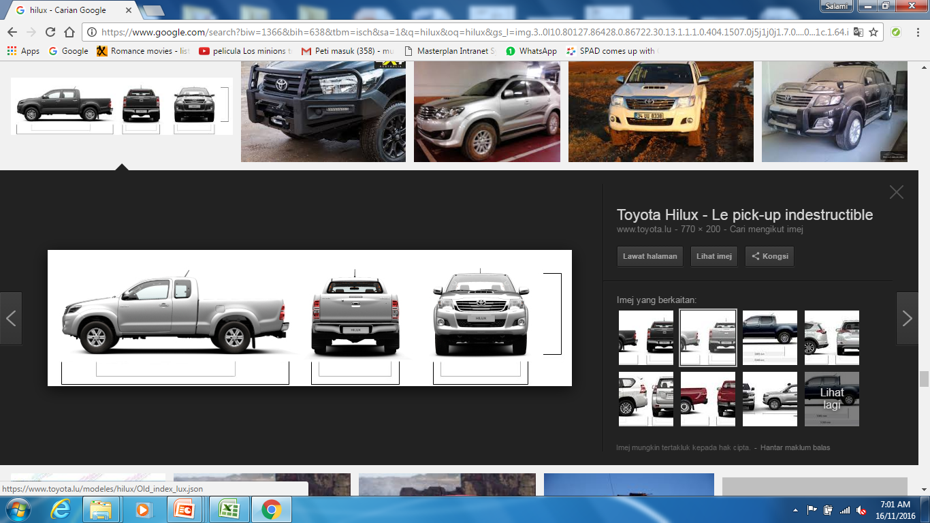

Proposed Project Vehicle design
Content Provider Contractor

Slide 3
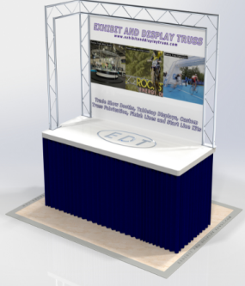
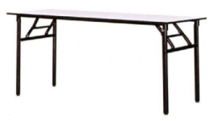
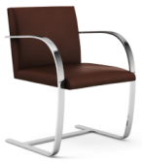
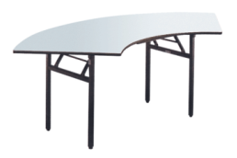
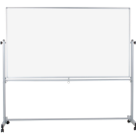
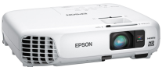

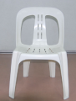
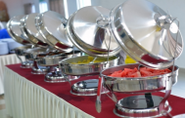
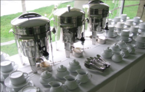
Proposed Registration Counter
1 unit of Table top display
2nos of table banquet
3 nos of chairs
1 nos of stand white board
1 nos of projector
stationery
Content Provider Contractor
- Table banquet (4nos)
- Chair (5nos)
- Plate
- Glass
- Fork & spoon
- Trolley
- Deluxe roll top chafer Outdoor Catering equipment
- Sink basin
- Water Container
- Table cloth
- Broom
- Food storage container
- Small Size canopy
- 1nos of pickup truck
Proposed Food & beverage Counter

Slide 4
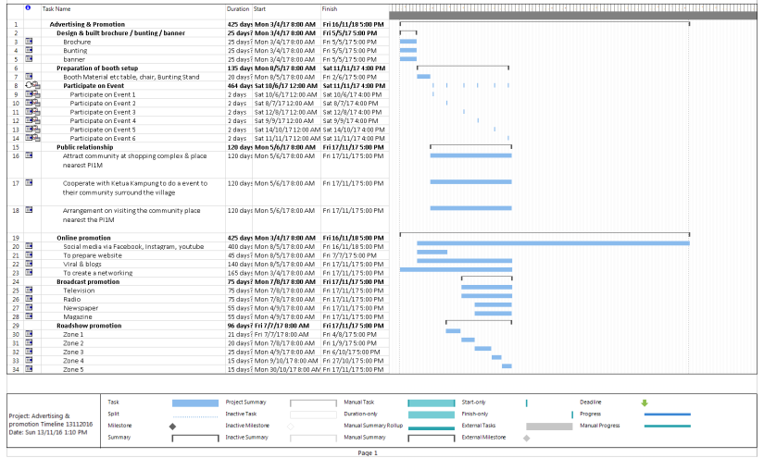
Proposed Advertising & Promotion plan

Slide 5
Reporting Process flow (Monthly Progress Report)
Monthly report
- Send via email & by hand
Summarize the issue/activities by weekly report
Checked by
Vendor
If not
approved
Checked by
Service Provider
The Monthly progress report consist of;
Project Information
List of PI1M covered
Progressive & achievement
Site activities
Resources performances
  Team viewer
  Help Support
Organization Chart
Maintenance Service performance
Photograph
Approved by
SKMM
Submitted to KKMM
for record

Slide 6
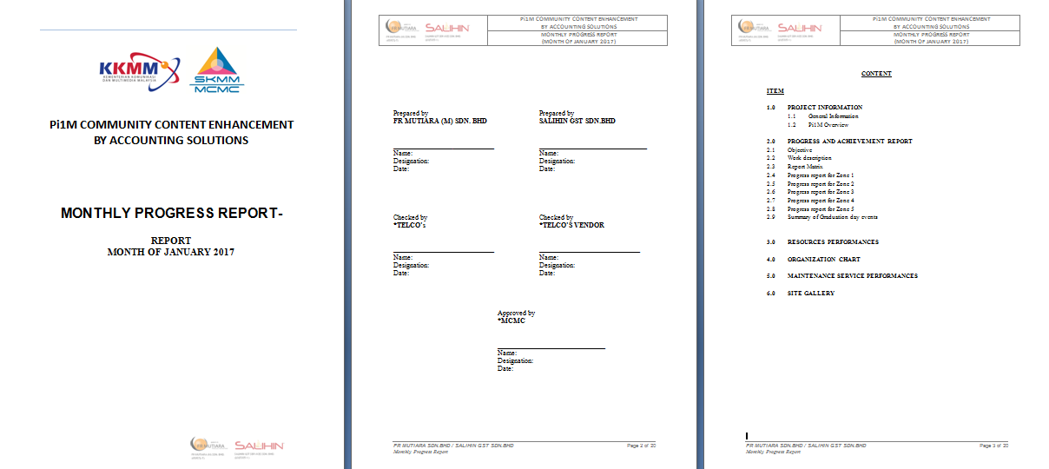
Sample of Monthly Progress Report

Slide 7
Reporting Process flow (Weekly Report)
Weekly report
- Send via email & by hand
Clarify the issue/activities everyday
If not
approved
Checked by
Service Provider / Vendor
Approved by
SKMM
The weekly report consist of;
Daily activities
Resources involved
Vehicle Maintenance Checklist
Material handling equipment Checklist
- Attendances record
Photograph
Submitted to KKMM
for record

Slide 8
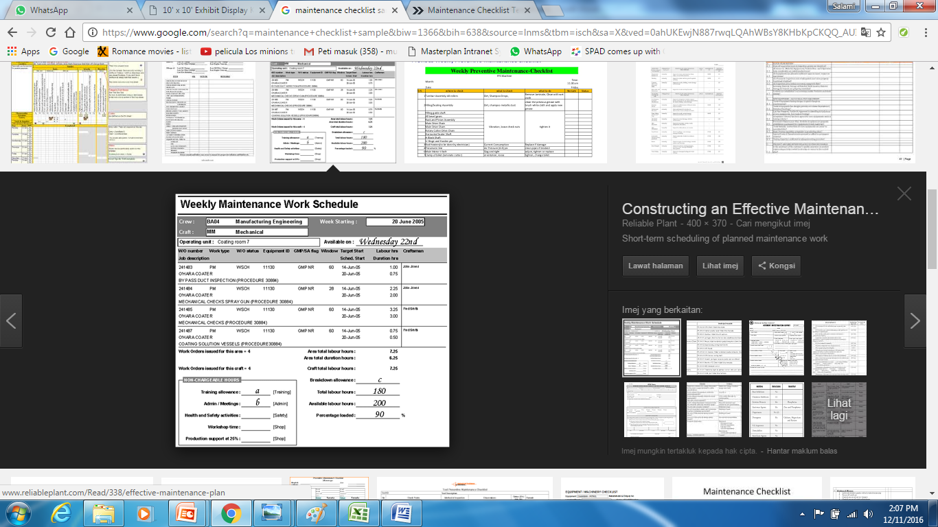




Example Weekly report
WEEKLY REPORT

Slide 9
Reporting Process flow (Maintenance Checklist Report)
Maintenance Checklist report
Send via email & by hand
To submit every month
Summarize the maintenance activities
Checked by
Vendor
If not
approved
Checked by
Service Provider
The maintenance report consist of;
Software parts
Hardware parts
Vehicle condition
Photograph before, during & after
Approved by
SKMM
Submitted to KKMM
for record

Slide 10
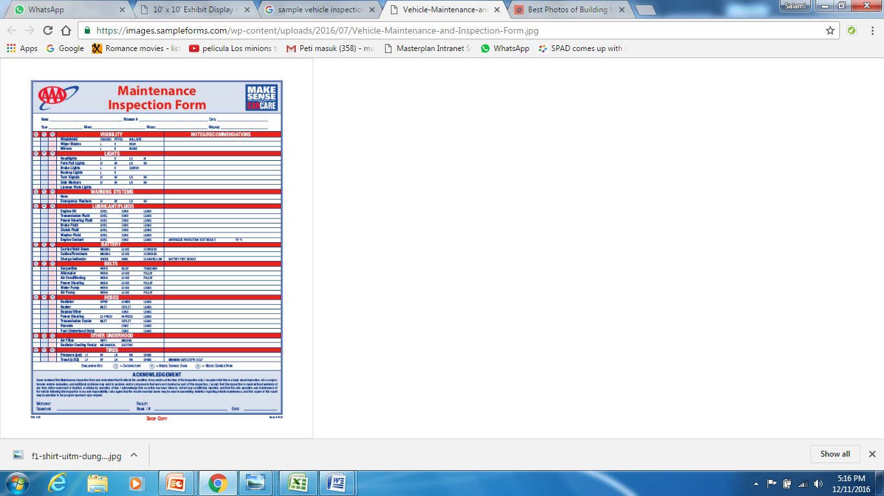



Example Maintenance Checklist form
MAINTENANCE CHECKLIST
REPORT

Slide 11
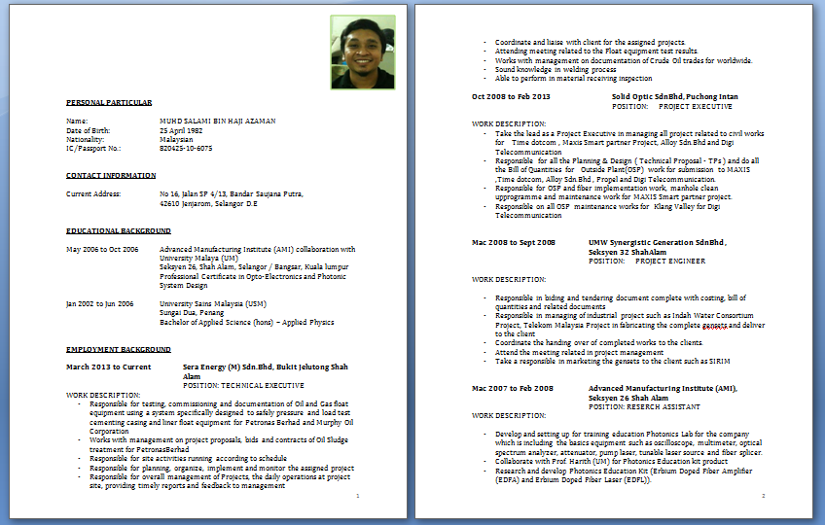
Proposed Staff CV format

Slide 12
Proposed Participant Progress Report
No | Zone | State | PI1M location | Promotion Status |  | Training Status |  |  |  | Remarks
 |  |  |  | Date | Activities | Total pax | Passed | Failed | Activities
1 | 1 | Perak | Kuala Kangsar | 15/3/2017 | Public relationship status | 22 | 20 | 2
5 |  | Kedah | Yan | 12/4/2016 | Public relationship status | 21 | 15 | 6
6 |  | Perlis | Kangar | 22/3/2017 | Participation event | 20 | 17 | 4
7 |  | Pulau Pinang | Goergetown | 19/4/2016 | Broadcast promotion | 23 | 20 | 3
8 | 2 | Selangor | Tanjung Karang | 20/5/2016 | Online promotion - Facebook / Instagram | 20 | 20 | 0
9 |  |  | Gombak | 17/5/2017 | Road show | 20 | 18 | 2 |  | Roadshow to Sekolah Tanjung Karang
10 |  | K.Lumpur | Bangsar | 4/5/2017 | Broadcast promotion | 20 | 11 | 9 | Training on 12/6/17
11 |  | Negeri Sembilan | Kuala Pilah | 25/5/2016 | Participation event | / | / | / | Training will be conduct on 25/8/17 | To be disscused on training session plan
12 |  | Melaka | Air Molek | 28/5/2016 | Participation event | / | / | / | Training will be conduct on 5/8/17 | To be disscused on training session plan
13 |  | Johor | Johor Bahru | 3/6/2016 | Online promotion - Facebook / Instagram | / | / | / | Training will be conduct on 28/8/17 | To be disscused on training session plan
14 | 3 | Kelantan | Pasir Mas | 5/6/2016 | Online promotion - Facebook / Instagram | / | / | / | Training will be conduct on 12/9/17 | To be disscused on training session plan
15 |  | Terengganu | Kemamaman | 17/6/2016 | Broadcast promotion | / | / | / | Training will be conduct on 17/9/17 | To be disscused on training session plan
16 |  | Pahang | Jenderam Hilir | 25/6/2016 | Participation event | / | / | / | Training will be conduct on 23/9/17 | To be disscused on training session plan
17 | 4 | Sabah | Kota Kinabalu | 23/7/2016 | Roadshow | / | / | / | Training will be conduct on 24/10/17 | To be disscused on training session plan
18 | 5 | Sarawak | Kuching | 28/7/2016 | Roadshow | / | / | / | Training will be conduct on 29/10/17 | To be disscused on training session plan

Slide 13
Proposed Site Mapping for each Zone
Title: Mapping PI1M Zone 1 (Perak / Perlis / Kedah / Pulau Pinang)
Date: 15/12/2016 8:03:06 AM Updated
No | Zone | State | Site ID | Location ID | Site Name | Landlord Name | Longitude | Latitude | Pi1M Incharge person | Pi1M PC Status | Deployment Hardware | Deployment Software
1 | 1 | Perlis | CW50286 | W01131 | KG_PANTAI_ DALAM | (1) TAN KEE TIONG (2) TAN KEE CHONG | 3.08707 | 101.68438
2 | 1 | Perlis | G0015 | W00006 | JLN SYED PUTRA | GANAD MEDIA SDN BHD | 3.29693 | 101.4086
3 | 1 | Perlis | G0384 | W00047 | JLN ROBSON | WISMA BELIA SDN BHD | 3.25465 | 101.4056
4 | 1 | Perlis | G0855 | W00097 | MENARA SEPUTIH (APT UNIT) | SHIREEN MARDZIAH HASHIM | 3.13642 | 101.6294
5 | 1 | Perlis | G0855 | W00097 | MENARA SEPUTIH (APT UNIT) | NATARJAYA MANAGEMENT | 3.16406 | 101.531882
6 | 1 | Pulau Pinang | G1599 | W00272 | PANTAI DALAM 2 | DEANS REAL ESTATE | 2.99814 | 101.3588
7 | 1 | Pulau Pinang | H0124 | W00292 | KERINCHI SL | SENI JAYA SDN BHD | 2.6581 | 101.5172
8 | 1 | Pulau Pinang | M1625 | W00447 | IBC | KEMENTERIAN PENERANGAN MALAYSIA | 3.5781 | 101.4624
9 | 1 | Pulau Pinang | G1625 | W00622 | IBC RTM | KETUA SETIAUSAHA KEMENTERIAN PENERANGAN | 2.93024 | 101.568
10 | 1 | Pulau Pinang | G1805 | W00685 | IPTAR RTM | PESURUHJAYA TANAH PERSEKUTUAN | 2.8092 | 101.55919

Slide 14
List of items need to be prepared for food & beverage arrangement
Table banquet (20nos)
Chair (50nos)
Plate
Glass
Fork & spoon
Trolley
Deluxe roll top chafer Outdoor Catering equipment
Sink basin
Water Container
Table cloth
Broom
Food storage container
Small Size canopy

