Slide 1





PI1M COMMUNITY CONTENT ENHANCEMENT
BY ACCOUNTING SOLUTIONS
Date : 17th november 2016
Time : 02.30 p.m
Venue : cyberjaya
Prepared for:
Prepared by:

Slide 2

Project directorate
FR Mutiara is an established information & technology consultation company with a mission to be the preferred project management consultant and to become one of the premier player in Malaysia business landscape which provide consultancy services and solutions to different organizations across Malaysia, creating value for clients by leveraging industry knowledge and service offering expertise with an insight into and access to all the emerging technologies.
Company Vision
“Setting standards utilizing best available solutions”
Mission Statement
“Committed to excellence in providing innovative and reliable Information Technology services”

Slide 3




Subject matter expert
SALIHIN is one of the fast growing and leading indigenous brand in Malaysia, which umbrellas a group of distinctive entities tailoring unique and independent consulting services to local and international clientele. SALIHIN offers an integrated and wide spectrum of value for money professional services in the areas of auditing and assurance, taxation (direct and indirect), business advisory, information technology, accounting software and corporate finance.

Slide 4
Introduction CPC

Slide 5

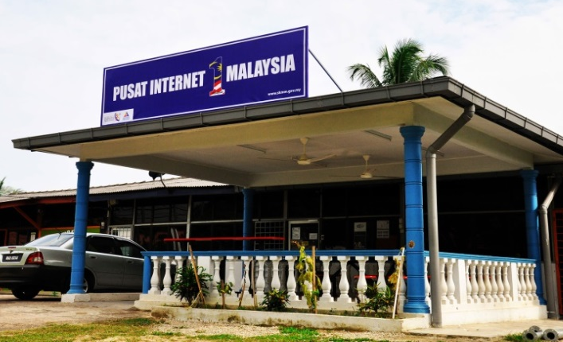

OUR OBJECTIVE
PI1M CONTENT
ENHANCEMENT & EMPOWERMENT
PI1M CENTRE VISIBILITY & NEW SERVICE OFFERINGS
ACCOUNTING SOLUTIONS
INDUSTRIES PARTICIPATION
TRAINING PROGRAM
ACADEMIA PARTICIPATION
CERTIFICATION PROGRAMME
LEARNING & JOB MATCHING PLATFORM
CONTINUOUS LEARNING
(ONLINE & OFFLINE
CONTINUOUS SUPPORT
ACCOUNTING
SOFTWARE SOLUTIONS

Slide 6
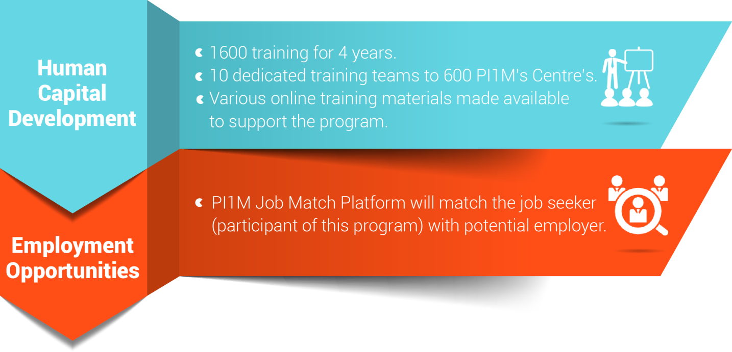
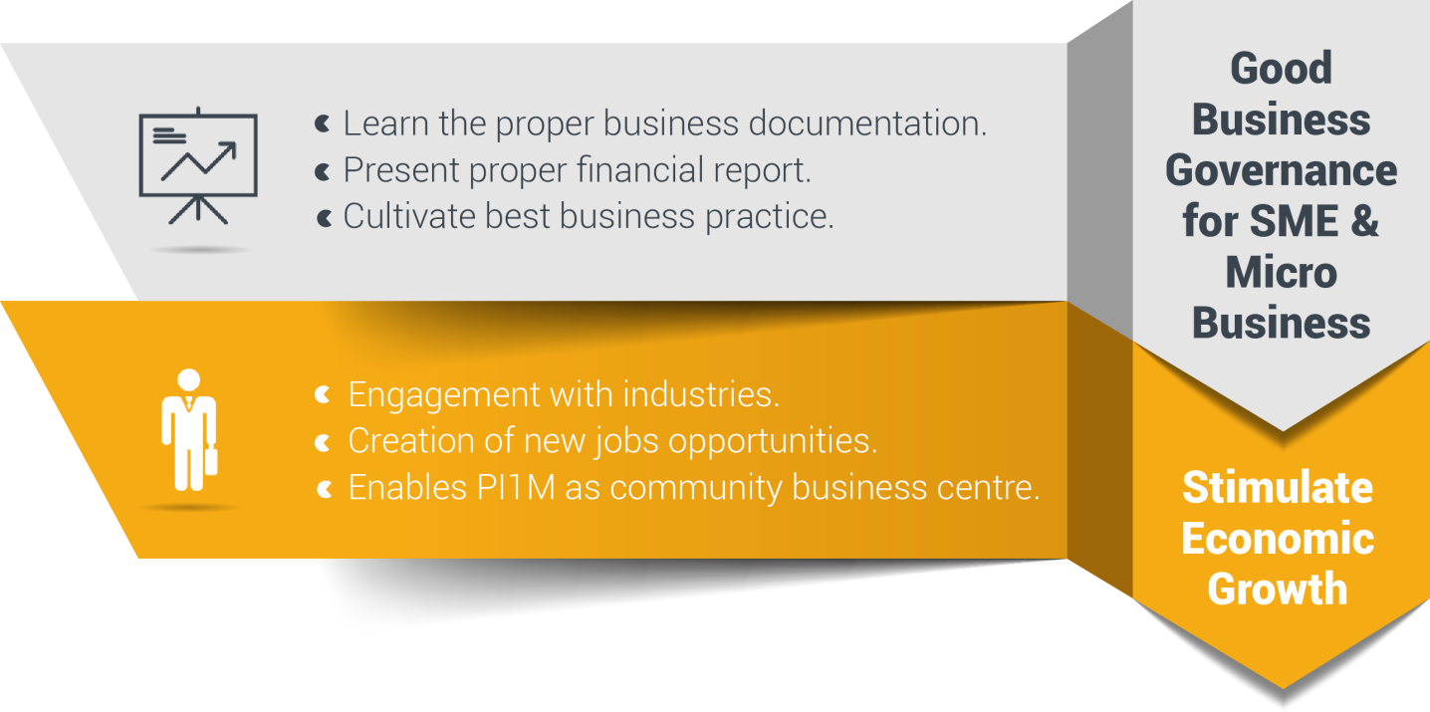
Reaching underserved communities

Slide 7




Training deliverables
1,200
Graduates
3 Modules
2 Days Training +
½ Day Revision +
½ Day Exam
Dedicated Team will conduct training to assigned regions / zone.
Assigned Zone
  Zone 1
    Perak, Kedah, Penang, Perlis
  Zone 2
    Selangor, Kuala Lumpur, Malacca, N. Sembilan, Johor
  Zone 3
    Kelantan, Terengganu, Pahang
  Zone 4
    Sarawak
  Zone 5
    Sabah
30,000
Expected Participations
1,600
Targeted
Training Sessions

Slide 8
Critical success factor
Support from KKMM & MCMC
1
5
1
Coordination from telco’s
2
Coordination from telco’s vendors
3
4
2
Good syllabus & program
4
3
Marketing & promotion
5
We have long believed that, over the long term, no institution, idea, or effort of real consequence is ever successful on its own; the most impactful efforts are those approached collaboratively and achieved through close partnership.

Slide 9

SPS
TRAINING
MODULE

Slide 10

What is sps?
Equip PI1M Centre with comprehensive SOFTWARE & FREE TRAININGS of high value added accounting software.
Groom & nurture a FINANCIAL, MANAGEMENT & BUSINESS SOUND entrepreneurs in underserved areas.
Increase PI1M BUSINESS RELEVANCY to its respective communities.

Slide 11


















Rural Community
500,000 TEKUN Nasional Micro Entrepreneurs
300,000 AIM Micro Entrepreneurs
15,000 Co-operatives i.e Micro Co-Operatives
500 PKK Nationwide
400 Fishermen’s Association Nationwide
Potential accounts to be served via PI1M
PI1M “Accountant”
New Job Creation

Slide 12


Sps accounting offerings
30,000 FREE Licenses for 5 Years
SPS, SPSLite CashBook & Entrepreneurs Web @ 600 PI1M
  1,600 FREE Training Session with examination for 4 Years
SPS, SPSLite CashBook & Entrepreneurs Web @ 600 PI1M
  30,000 Accreditation & Certifications
SPS, SPSLite CashBook & Entrepreneurs Web @ 600 PI1M
  Learning & Job Matching Platform for participants to engage with potential employers
  Free PI1M Entrepreneurs Event Awards with Media Coverage in Major Malay Newspaper for 1 Years
  (Schedule and Timetable – TBD)

Slide 13
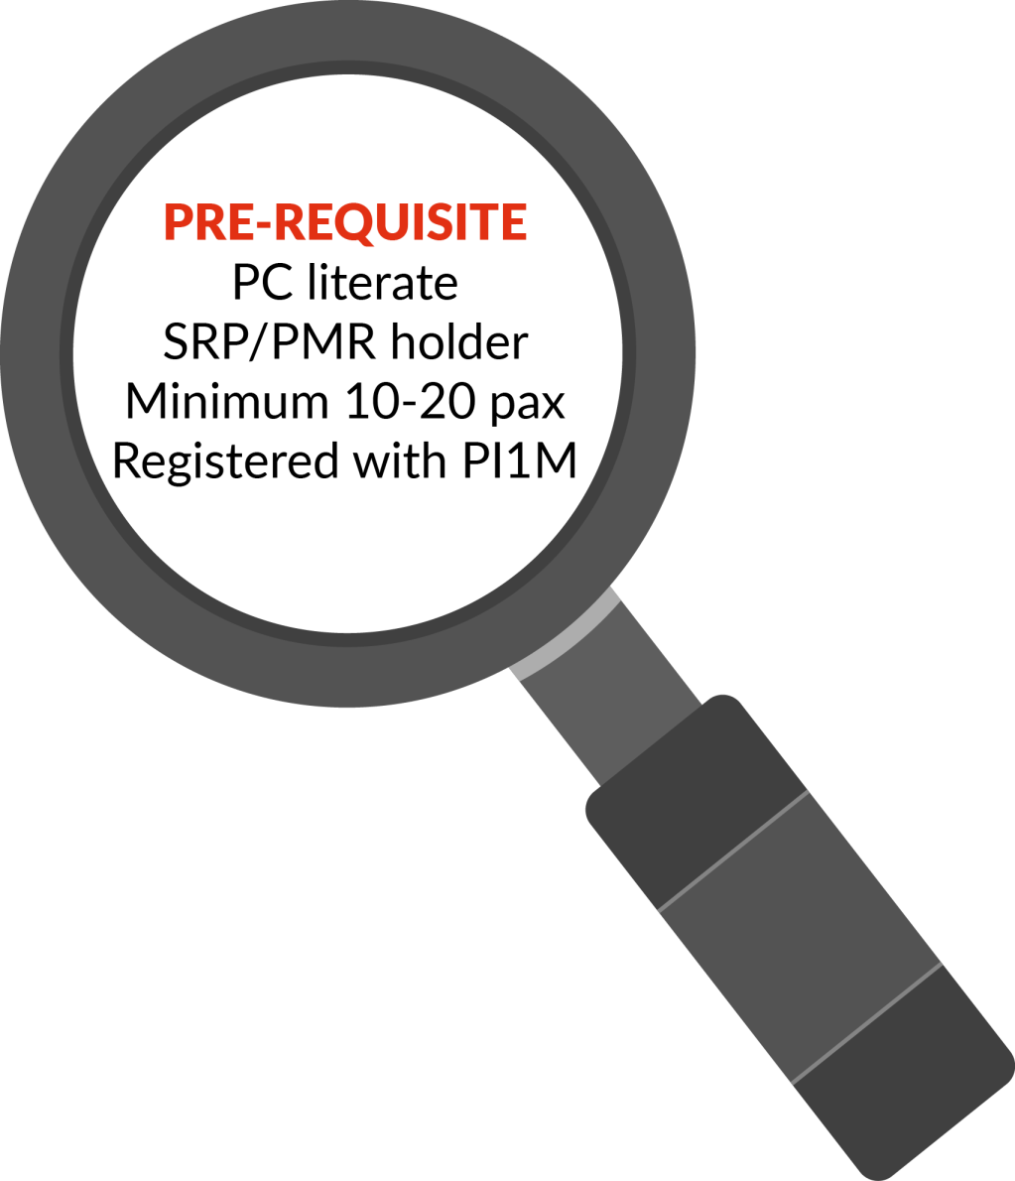







Target audience
Small & Micro
Entrepreneurs
Women Entrepreneurs
Single Parent
Part-Time Housewife
Student
Under Graduate Student
Graduates
SPM Leavers
Unemployed

Slide 14
SPS training & Certification
Salihin Training Program is part of FR Mutiara 5 Years Pi1M Content Empowerment Proposal submitted to MCMC via USP Fund initiative to help grow local economies and bring about greater shared prosperity and social change by providing underserved communities with a business and accounting upskilling opportunities via Pi1M.
We at Salihin believe that such an investment can have a significant multiplier effect; These education can lead not only to increased revenues and job creation, but also to healthier, better educated families and, ultimately, more prosperous communities and nations. Put more simply, by helping to transform the lives of promising underserved target communities, we in turn transform the lives of those around them.
Communities
Transformation
Catalyze underserved growth
Closing
Skills
Gaps
Bridging skills and knowledge gap
Accelerate
Rate of
Change
Bringing industries close to communities
Economy
vs Education
Demand

Slide 15


Sps training & certification
Salihin’s Training & Certification Program entail an aggressive educational program that tests the level of competence in the principles and practices of SALIHIN PREMIER SOLUTIONS (SPS) & SPSLite CashBook Softwares.
The Certification will only be issued to participants whom passed the exam, while others will be issued the participation certificates.
These principles and practices are closely monitor by reputable bodies .

Slide 16

SPS Training Syllabus
NO. | TRAINING MODULES | METHOD OF TRAINING | SYLLABUS
DAY 1 | Basic Accounting & Business Documentation | Class Room Online Seminar (Webinar) Online Training Video & Tutorial Online Training Material Online Test & Examinations | Objective: To Maintain Systematic Records of Business Transaction in Order to Generate Various Report. Company Setup User Setup User Access Right Chart of Account System & General Setup Form Setup Financial Year Calendar
 | SPSLite Training & Basic/ Advance SPSLite Website Training
DAY 2 | SPS Training
DAY 3 | Revision Examination | 4 Hours 4 Hours
Class Room Training for 600 PI1M Min 10-20 Participation 3 Modules (SPS, SPSLite & SPSWeb) 2 Days Training + 1 Day Exam Online Certification (.pdf format)

Slide 17
SPS certification

Slide 18
COMERCIAL
MILEAGE
&
GRADUATION

Slide 19





Commercial mileage
In the spirit of business collaboration between FR MUTIARA/ SALIHIN and KKMM/MCMC/PI1M, we will support Pi1M in providing quality products and services with the highest degree of customer satisfaction.
PI1M BUSINESS AWARD
Joint program between
FR Mutiara-SALIHIN-KKMM-MCMC- PI1M
MCMC is required to share the success stories of PI1M business & entrepreneurs on monthly basis in Utusan/ Sinar Harian. (subject to negotiations terms & conditions between us and respective parties).
FR Mutiara/ SALIHIN will do the selection of the SME award winner lists based on good financial management & governance and MCMC internal criteria.
An event will be held to celebrate the winners.
Award will be sponsored by FR Mutiara/ SALIHIN.
FR Mutiara/ SALIHIN will sponsor the 1st year event and entrepreneurs segment in Utusan/ Sinar Harian.
Support By:

Slide 20
ACKNOWLEDGEMENT DAY

Slide 21
CONTINOUS
EDUCATION

Slide 22
ROAD
TO
SUCCESS

Slide 23
EXTENSIVE
SUPPORT

Slide 24
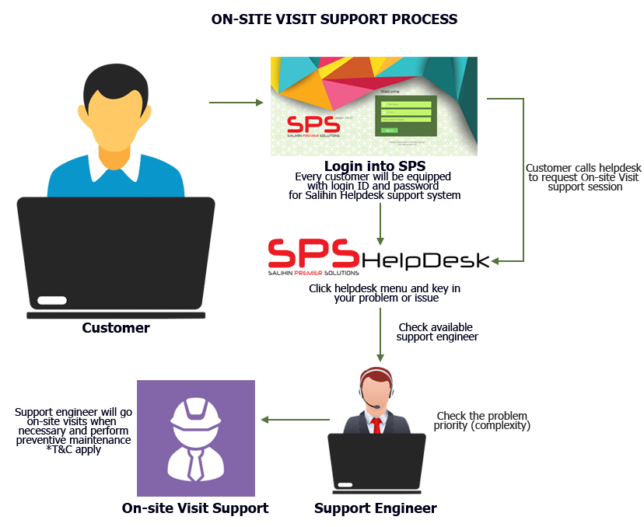
ON-SITE SUPPORT
Response time: Next business day (Klang Valley), Within 5 days (Peninsular area), Within one week (Sabah & Sarawak).
Diagram below illustrates how the mechanism works.

Slide 25
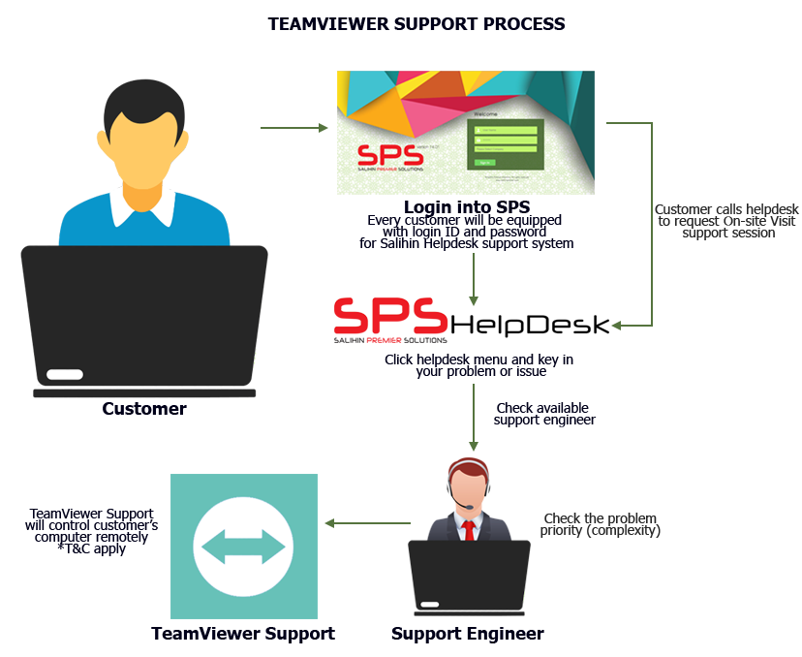
TEAM VIEWeR SUPPORT
Response time: Within 24 hours (Subject to availability).
Diagram below illustrates process of team viewer support.

Slide 26
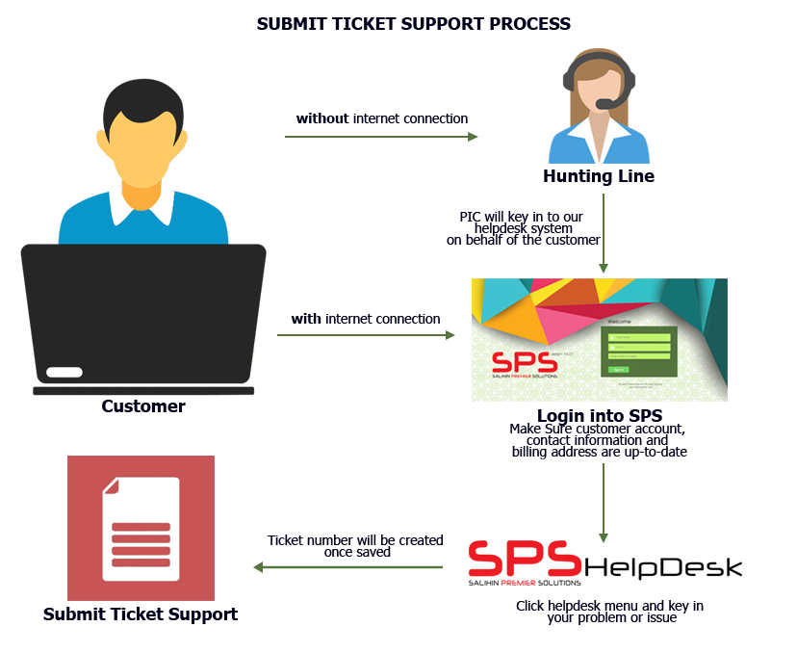
Helpdesk business SUPPORT
Response time: Within 24 hours (Subject to availability).
Diagram below illustrates process of helpdesk business support.

Slide 27
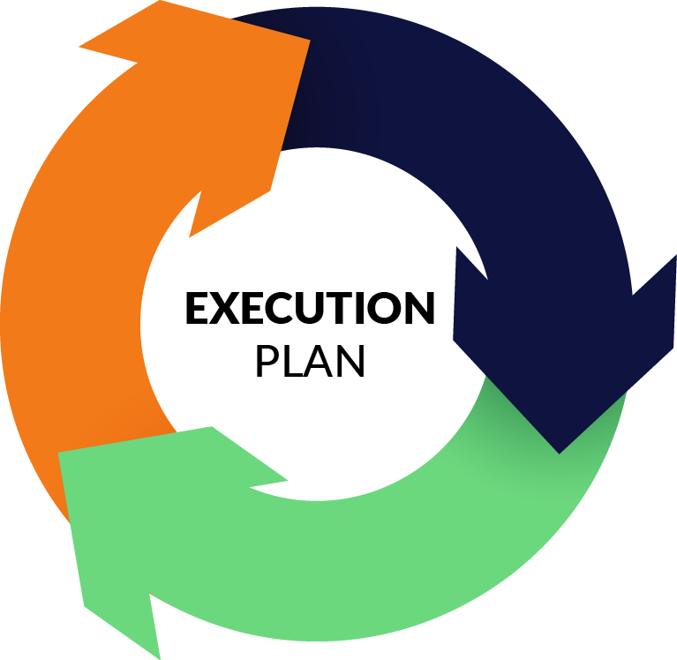

Slide 28
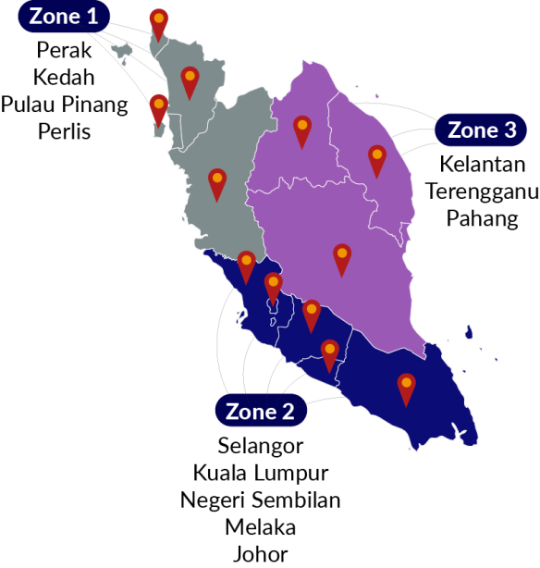
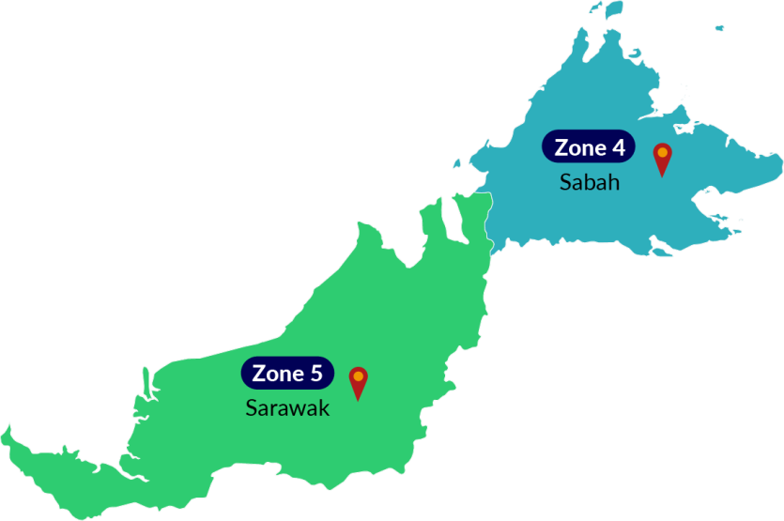
Proposed pi1m ZONING POSITION & ROAD MAPPING

Slide 29
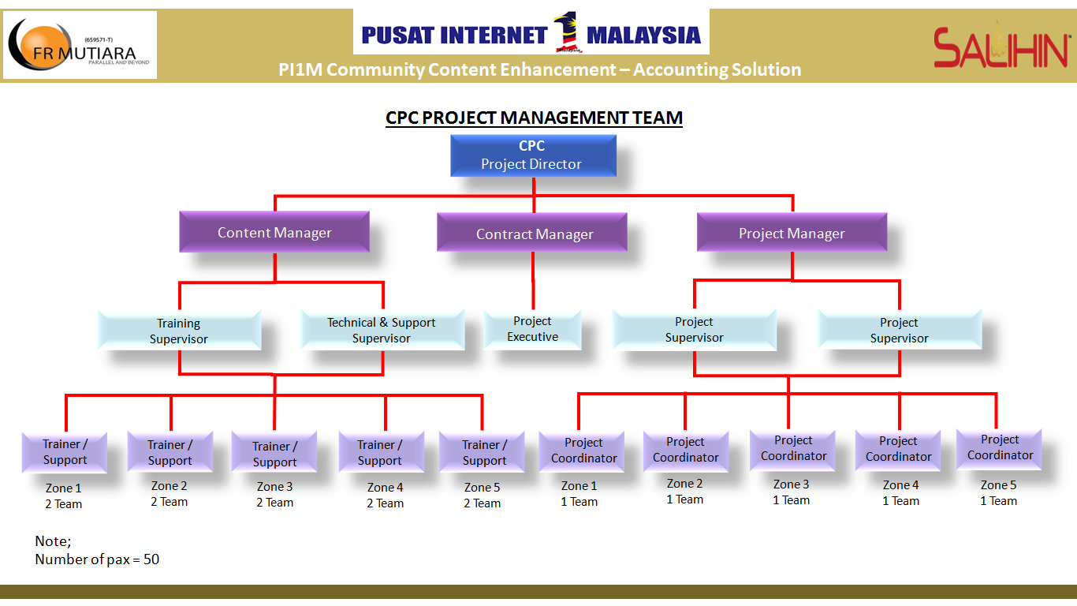
CPC PROJECT MANAGEMENT TEAM

Slide 30
Proposed JOB DESCRIPTION & RESPONSIBILITIES
POSITION | JOB DESCRIPTION
PROJECT DIRECTOR | To liaise & follow-up with SKMM or KKMM on future & upcoming project To be a lead on Project Steering Committee Meeting To make sure that the project follow according to the schedule & plan
PROJECT MANAGER | To lead & manage the project & meeting Liaise with internal or Salihin deployment team to ensure success deployment of the system Attending Project Steering Committee Meeting
CONTRACT MANAGER | To liaise with bank, Funder, Loan Institution, Insurance, company secretary To prepare project contract & related document Monitoring on project costing Liaise with Authorities Attending Project Steering Committee Meeting
CONTENT MANAGER | Responsible on the content including training module Planning & conduct the training session by classroom, Web based training, Online training, mobile video training Develop technical solution for customer issues related to software setup and configuration Delivered technical support service

Slide 31
CON’T JOB SCOPE & RESPONSIBILITIES
POSITION | JOB DESCRIPTION
PROJECT SUPERVISOR | To monitor movement all project coordinator following the schedule as per agreed To prepare monthly report & related documents To attend all related meeting etc Project Coordination meeting & Project Contractor Meeting & Project Steering Committee Meeting Responsible on arrangement of training session to be in good order etc arrangement of meal, place, liaise with PI1M pengurus wilayah To ensure the system are verified & validate by SKMM & KKMM Provide technical assistance and guidance during Installation & training implementation Prepare the work flow
PROJECT EXECUTIVE | To monitor movement all team following the schedule as per agreed To check & prepare report on project costing To attend all related meeting etc Project Coordination meeting & Project Contractor Meeting & Project Steering Committee Meeting
PROJECT COORDINATOR | To monitor on SALIHIN Team movement on installation & Training implementation To prepare Site weekly report, Service & Maintenance checklist & report To assist on training session arrangement To liaise with PI1M pengurus wilayah Attending Project Contractor Meeting To setup booth & registration

Slide 32
CON’T JOB SCOPE & RESPONSIBILITIES
POSITION | JOB DESCRIPTION
TRAINER SUPERVISOR | Responsible on the content including training module and material To plan and supervise training session To prepare SPS certification Attending Project Steering Committee Meeting
TECHNICAL & SUPPORT SUPERVISOR | Liaise with the Project Manager and the deployment team to ensure the success of the system deployment. To prepare SOP and monitor the problem and support activities Develop technical solution for customer issues related to software setup and configuration via SPS Helpdesk Attending Project Steering Committee Meeting
TRAINER | Conduct training session Conduct SPS exam Assist and support Web based training, Online training and mobile video training Assist SPS Helpdesk
TECHNICAL & SUPPORT ENGINEER | Deploy the system Delivered technical support service Assist trainer during training and exam session Assist SPS Helpdesk

Slide 33



PROPOSED METHOD OF STATEMENT
Preparation daily report
Preparation of Weekly report
Preparation of monthly report
Preparation of Checklist & maintenance report
The report consist of attendance record,
Activities programme and Status of participant
Submission report to client for approval
Reporting
Step 4
Preparation of arrangement movement by team according to an agreed schedule planning
Arrangement of Transportation by zone
Preparation of meals, arrangement of site & training programme
Arrangement team on advertisement & promotion
Site arrangement with SKMM, Service provider and vendor
Step 3
Organizing the Project
Preparation of meeting agenda to discuss on any pre & post development
Preparation of schedule plan during the design & operation phase.
To prepare the safety guideline and all the appropriate acts.
To prepare a team to do the site survey on each PI1M site to clarify on site accessibility & other issues
Step 2
Coordination between all team
Mapping of PI1M site & to gainer all the
critical support
Step 1
To list down all 600PI1M as approved by SKMM
Seeking appproval & support from all parties
Zoning By 5 Zone

Slide 34
Proposed Site Mapping for each Zone
Title: Mapping PI1M Zone 1 (Perak / Perlis / Kedah / Pulau Pinang)
Date: 15/12/2016 8:03:06 AM Updated
No | Zone | State | Site ID | Location ID | Site Name | Landlord Name | Longitude | Latitude | Pi1M Incharge person | Pi1M PC Status | Deployment Hardware | Deployment Software | Status
1 | 1 | Perlis | CW502 | W01131 | KG_PANTAI_ DALAM | (1) TAN KEE TIONG (2) TAN KEE CHONG | 3.08707 | 101.68438
2 | 1 | Perlis | G0015 | W00006 | JLN SYED PUTRA | GANAD MEDIA SDN BHD | 3.29693 | 101.4086
3 | 1 | Perlis | G0384 | W00047 | JLN ROBSON | WISMA BELIA SDN BHD | 3.25465 | 101.4056
4 | 1 | Perlis | G0855 | W00097 | MENARA SEPUTIH (APT UNIT) | SHIREEN MARDZIAH HASHIM | 3.13642 | 101.6294
5 | 1 | Perlis | G0855 | W00097 | MENARA SEPUTIH (APT UNIT) | NATARJAYA MANAGEMENT | 3.16406 | 101.531882
6 | 1 | Pulau Pinang | G1599 | W00272 | PANTAI DALAM 2 | DEANS REAL ESTATE | 2.99814 | 101.3588
7 | 1 | Pulau Pinang | H0124 | W00292 | KERINCHI SL | SENI JAYA SDN BHD | 2.6581 | 101.5172
8 | 1 | Pulau Pinang | M1625 | W00447 | IBC | KEMENTERIAN PENERANGAN MALAYSIA | 3.5781 | 101.4624
9 | 1 | Pulau Pinang | G1625 | W00622 | IBC RTM | KETUA SETIAUSAHA KEMENTERIAN PENERANGAN | 2.93024 | 101.568
10 | 1 | Pulau Pinang | G1805 | W00685 | IPTAR RTM | PESURUHJAYA TANAH PERSEKUTUAN | 2.8092 | 101.55919

Slide 35
PROPOSED TIMELINE FOR 5 YEARS
NO | TASK NAME | YEAR 1 |  |  |  |  |  |  |  |  |  |  |  |  |  | YEAR 2 | YEAR 3 | YEAR 4 | YEAR 5
 |  | M 1 | M 2 | M 3 | M 4 | M 5 | M 6 | M7 | M8 | M 9 | M10 |  | M 11 |  | M 12
1 | Pre-Development
1.1 | Received LOA/Performance bond / Contract
1.2 | Preparations & approval of Documentation
1.3 | Advertising & promotion
1.4 | Procurement, delivery & Installation of SPS System (Hardwares / Softwares)
1.5 | Commissioning & Handover Pi1M
1,6 | Maintenance Support
2 | Post-Development
2.1 | Training programme
2.2 | * Training support
* Training support ;
Webinar, / Video Training & Tutorials / Online Training Material / Online Test & Examination / Online Certification

Slide 36
PRE-DEVELOPMENT TIMELINE
No | Task Description | Year |  |  | 1
 |  | Month |  |  | 1 |  |  |  | 2 |  |  |  | 3 |  |  |  | 4 |  |  |  | 5 |  |  |  | 6 |  |  |  | 7 |  |  |  | 8 |  |  |  | 9 |  |  |  | 10 |  |  |  | 11 |  |  |  | 12
 |  | Week |  |  | 1 | 2 | 3 | 4 | 1 | 2 | 3 | 4 | 1 | 2 | 3 | 4 | 1 | 2 | 3 | 4 | 1 | 2 | 3 | 4 | 1 | 2 | 3 | 4 | 1 | 2 | 3 | 4 | 1 | 2 | 3 | 4 | 1 | 2 | 3 | 4 | 1 | 2 | 3 | 4 | 1 | 2 | 3 | 4 | 1 | 2 | 3 | 4
 |  | Duration | Start | End
A | Pre-development
A1 | Receive a Letter of Award (LOA) | 1 day | M1 W1 | M1 W1
B | Preparation and Approval of documentation; | 56 days
B1 | Performance bond / Bank guarantee / Contract Project | 21 days | M1 W2 | M1 W4
B2 | Preparation & approval of Method of Statement / Project scope deliverables | 49 days | M1 W2 | M3 W1
B3 | Participant Checklist Report / Monthly report / Maintenance report / Weekly report | 49 days | M1 W2 | M3 W1
B4 | Project Implementation Programme & Schedule | 49 days | M1 W2 | M3 W1
B5 | Project SPS (Pi1M Training Module & Programme) | 49 days | M1 W2 | M3 W1
B6 | Project Organization Chart / Trainer & Staff detail of CV | 49 days | M1 W2 | M3 W1
C | Advertising and promotion
C1 | Broadcast advertising
C2 | Roadshow
D3 | Promotion
C4 | Reqruitment
C5 | Online advertising
D | Procurement of Software & equipment | 91 days | M2 W1 | M5 W1
E | Delivery & Installation of SPS Accounting System | 203 days
E1 | Zone 1 | 63 days | M5 W2 | M7 W2
E2 | Zone 2 | 63 days | M6 W2 | M8 W2
E3 | Zone 3 | 63 days | M7 W2 | M9 W2
E4 | Zone 4 | 91 days | M8 W2 | M11 W2
E5 | Zone 5 | 91 days | M9 W2 | M12 W2
F | Commisioning & hand Over PI1M / Invoice upon Installation completion of each PI1M centre | 42 days
G | Maintenance Support

Slide 37
No | Task Description | Year |  |  | 2 - 5
 |  | Month |  |  | 1 |  |  |  | 2 |  |  |  | 3 |  |  |  | 4 |  |  |  | 5 |  |  |  | 6 |  |  |  | 7 |  |  |  | 8 |  |  |  | 9 |  |  |  | 10 |  |  |  | 11 |  |  |  | 12
 |  | Week |  |  | 1 | 2 | 3 | 4 | 1 | 2 | 3 | 4 | 1 | 2 | 3 | 4 | 1 | 2 | 3 | 4 | 1 | 2 | 3 | 4 | 1 | 2 | 3 | 4 | 1 | 2 | 3 | 4 | 1 | 2 | 3 | 4 | 1 | 2 | 3 | 4 | 1 | 2 | 3 | 4 | 1 | 2 | 3 | 4 | 1 | 2 | 3 | 4
 |  | Duration | Start | End
A | Post-Development
B | Training programme (3 Modules c/w Exam test)
B1 | Zone 1 | 112 days | M1W1 | M4W4
B2 | Zone 2 | 112days | M4W1 | M7W4
B3 | Zone 3 | 112days | M7W1 | M10W4
B4 | Zone 4 | 56 days | M10W1 | M11W4
B5 | Zone 5 | 56 days | M11W1 | M12W4
C | Training Support
C1 | Webinar
C2 | Video Training & Tutorials
C3 | Online Training Material
C4 | Online Test & Examination
D | Intensive Support
D1 | On site Support
D2 | Team viewer Support
D3 | Helpdesk business Support
E | Participant Graduation & acknowlegement

Slide 38
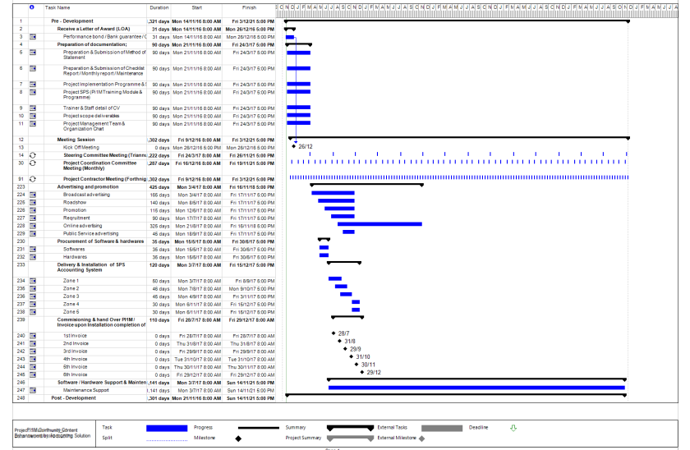

Slide 39
PROPOSED MILESTONE PROGRESS SCHEDULE
MONTH | DESCRIPTION | DELIVERABLE | PERCENTAGE %
1 | Letter of Award (LOA) / Preliminary | Contractor to submit Performance Bond (PB) in the form of Bank Guarantee (BG) PB / BG from the total contract value of the Letter of Award (LOA) If required | 5%
4 | 1st Steering Committee Meeting | Contractor to submit to the Steering Committee; Project Management Team Organisation Chart Project scope deliverables Project Implementation Programme & Schedule Project SPS (Pi1M Training Module & Programme) Proposed Certification programme and mileage programme Trainer & Staff detail of CV Checklist, Maintenance & Monthly report Training Module | 5%
7 | Month 7 (100 PI1M) | Claim consist of ; SPS Installer pack Installation Help-desk Team viewer Support Free online chat Support On site Training (Anticipated 100 PI1M / month) | 15%
8 | Month 8 (100 PI1M) |  | 15%
9 | Month 9 (100 PI1M) |  | 15%
10 | Month 10 (100 PI1M) |  | 15%
11 | Month 11 (100 SPI1M) |  | 15%
12 | Month 12 (100 Site PI1M) |  | 15%

Slide 40
PROPOSED
PROJECT
COORDINATION

Slide 41







MEETING & COORDINATION STRATEGY
Steering
Committee
MEETING AGENDA
Review the monthly practice statistics such as progressive project, adjustments, collections, outstanding claims, unscheduled time units, involvement by provider, daily activities averages, etc.
Review the incomplete action items from the previous month and check for progress.
Discussion on the new agenda related to PI1M enhancement.

Slide 42
STEERING COMMITTEE AGENDA
PROPOSED MEETING SESSION | FREQUENCY | MEETING AGENDA
Proposed of Steering Committee Member Meeting Representative from KKMM Representative from SKMM Representative from CPC Representative from Telco’s Representative from Telco’s Vendor | Once every 4 month | Review the monthly practice statistics such as production, adjustments, collections, outstanding claims, unscheduled time units, production by provider, daily production averages, etc. Review the incomplete action items from the previous month(s) and project progressive Review on summary of reporting Proposed participant graduation dates

Slide 43
PROJECT COORDINATION COMMITTEE
AGENDA
PROPOSED MEETING SESSION | FREQUENCY | MEETING AGENDA
B) Proposed of Project Coordination Committee Meeting Representative from CPC Representative from Telco’s Representative from Telco’s Vendor | Once a month | Review on timeline progressive project Review on weekly report Review on Maintenance progressive report Discussion on any other matters related to Pi1M activities Review on progressive payment status

Slide 44
Cpc PROJECT CONTRACTOR COMMITTEE AGENDA
MEETING SESSION | FREQUENCY | MEETING AGENDA
C) CPC Project Contractor Meeting Representative from FR MUTIARA Representative from SALIHIN | 2nd Week every month | Review on deployment activities and problem arise Discussion on project enhancement activities Review on reporting Review on resources ,vehicle & training tools & necessary items Coordinate on payment deliverables

Slide 45





cpc REPORTING DELIVERABLES
ZONE 1
KKMM
ZONE 2
Daily report
Weekly report
Monthly report
Maintenance
Report
- Participant Progress Report
SKMM
ZONE 3
SERVICE
PROVIDER
ZONE 4
ZONE 5
Reporting consist of attendance record,
Activities programme and Status of participant

Slide 46

Sample of Monthly Progress Report

Slide 47
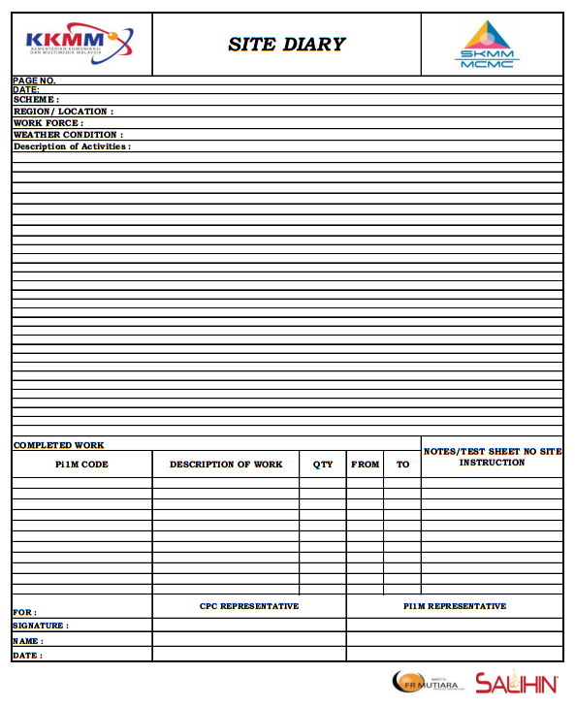

Sample of Weekly report

Slide 48
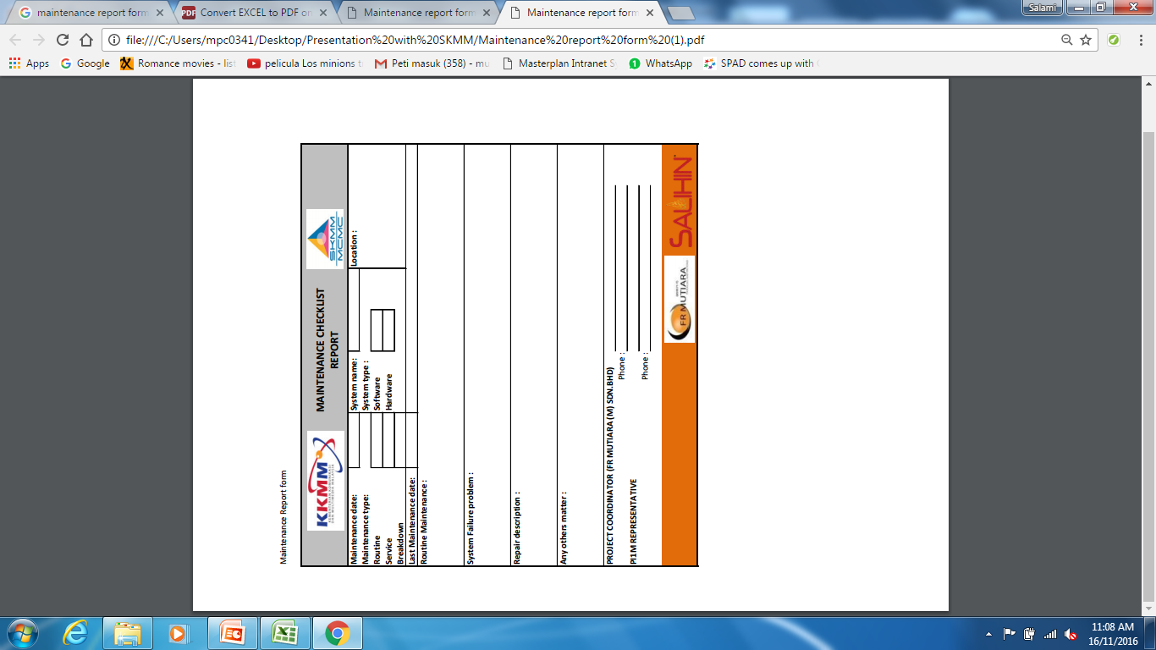

Sample of Maintenance Checklist form

Slide 49
Sample of Participant Progress Report
No | Zone | State | PI1M location | Promotion Status |  | Training Status |  |  |  | Remarks
 |  |  |  | Date | Activities | Total pax | Passed | Failed | Activities
1 | 1 | Perak | Kuala Kangsar | 15/3/2017 | Public relationship status | 22 | 20 | 2
5 |  | Kedah | Yan | 12/4/2016 | Public relationship status | 21 | 15 | 6
6 |  | Perlis | Kangar | 22/3/2017 | Participation event | 20 | 17 | 4
7 |  | Pulau Pinang | Goergetown | 19/4/2016 | Broadcast promotion | 23 | 20 | 3
8 | 2 | Selangor | Tanjung Karang | 20/5/2016 | Online promotion - Facebook / Instagram | 20 | 20 | 0
9 |  |  | Gombak | 17/5/2017 | Road show | 20 | 18 | 2 |  | Roadshow to Sekolah Tanjung Karang
10 |  | K.Lumpur | Bangsar | 4/5/2017 | Broadcast promotion | 20 | 11 | 9 | Training on 12/6/17
11 |  | Negeri Sembilan | Kuala Pilah | 25/5/2016 | Participation event | / | / | / | Training will be conduct on 25/8/17 | To be disscused on training session plan
12 |  | Melaka | Air Molek | 28/5/2016 | Participation event | / | / | / | Training will be conduct on 5/8/17 | To be disscused on training session plan
13 |  | Johor | Johor Bahru | 3/6/2016 | Online promotion - Facebook / Instagram | / | / | / | Training will be conduct on 28/8/17 | To be disscused on training session plan
14 | 3 | Kelantan | Pasir Mas | 5/6/2016 | Online promotion - Facebook / Instagram | / | / | / | Training will be conduct on 12/9/17 | To be disscused on training session plan
15 |  | Terengganu | Kemamaman | 17/6/2016 | Broadcast promotion | / | / | / | Training will be conduct on 17/9/17 | To be disscused on training session plan
16 |  | Pahang | Jenderam Hilir | 25/6/2016 | Participation event | / | / | / | Training will be conduct on 23/9/17 | To be disscused on training session plan
17 | 4 | Sabah | Kota Kinabalu | 23/7/2016 | Roadshow | / | / | / | Training will be conduct on 24/10/17 | To be disscused on training session plan
18 | 5 | Sarawak | Kuching | 28/7/2016 | Roadshow | / | / | / | Training will be conduct on 29/10/17 | To be disscused on training session plan

Slide 50
MARKETING
&
PROMOTION
STRATEGY

Slide 51
Marketing & promotion
PI1M DATABASE
FB Ads
Program will be shared to communities via internal business database own by each PI1M center run each PI1M Manager
FB Advertisement and special program will be run as part of marketing program to support the promotion of this program.
PI1M
DAYABASE
Email
Marketing
Paper
Advertisement
Paper Advertisement
Email Marketing
DIGITAL ONLINE MEDIA
Digital
Online
Media
FB Ads
FR Mutiara will run an email blasting program based on email database from PI1M and also from our internal resources.
An advertisement impressions will be propagate to browser at each PI1M center automatically as and when user connected or utilize PI1M internet services.
FR Mutiara will utilize the advertisement in Utusan & Sinar Harian as part of promotion channel to embark this new service @ PI1M nationwide.
FR Mutiara & SALIHIN will coordinate multiple marketing & promotional approach to attract target audience participation in this program. Lists of method use is shown on the diagram above.

Slide 52
PROPOSED MARKETING TOOLS & STRATEGY
Marketing Strategy
To prepare a booth by participating any events
To prepare brochure & bunting
Public Relationship
  Promote to every shopping complex & nearest place surround PI1M
  Engage with Ketua Kampung to do a free event to promote their community
  To visit community place surround the PI1M
Online promotion (Internet)
  Social media etc Facebook, Instagram, youtube
  website, Viral, blogs, networking
Broadcast promotion thru Television, radio, newspaper, magazines
Roadshow promotion by visiting school, College & University

Slide 53
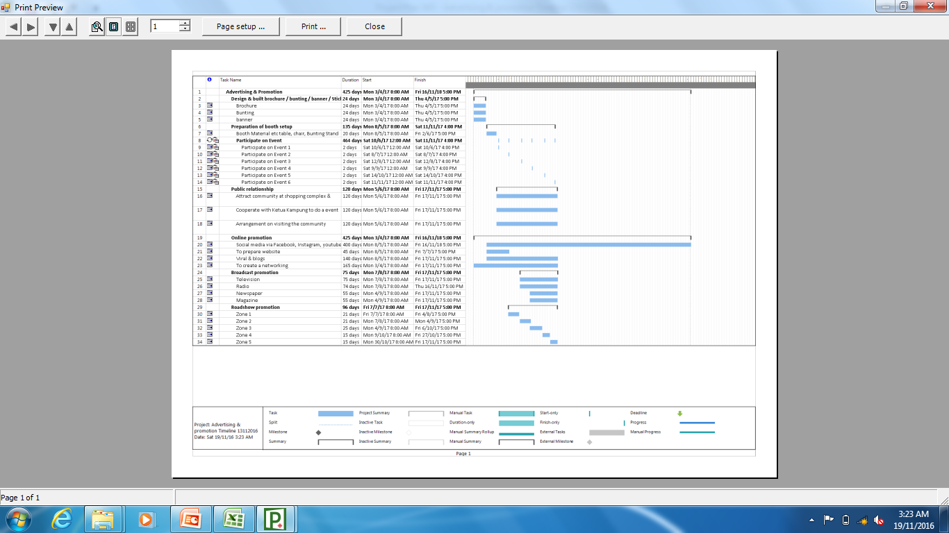
ADVERTISING AND PROMOTION TIMELINE

Slide 54









CPC UNIFORM DESIGN
CPC
CPC
TEAM
Pi1M COMMUNITY CONTENT ENHANCEMENT
BY ACCOUNTING SOLUTIONS
FRONT VIEW
BACK VIEW
CPC
CPC
INSTRUCTOR
CPC
MANAGEMENT
TEAM
FRONT VIEW
BACK VIEW

Slide 55

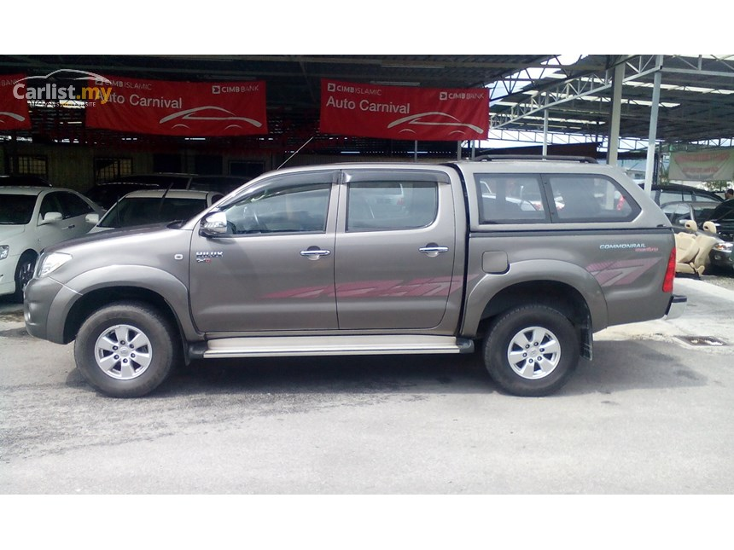
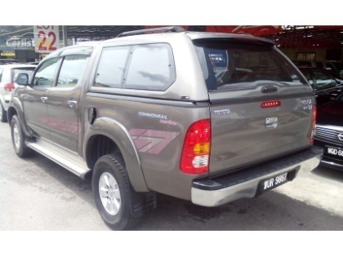

CPC PROJECT VEHICLE DESIGN
PI1M Enhancement
Programme
Content Provider Contractor

Slide 56
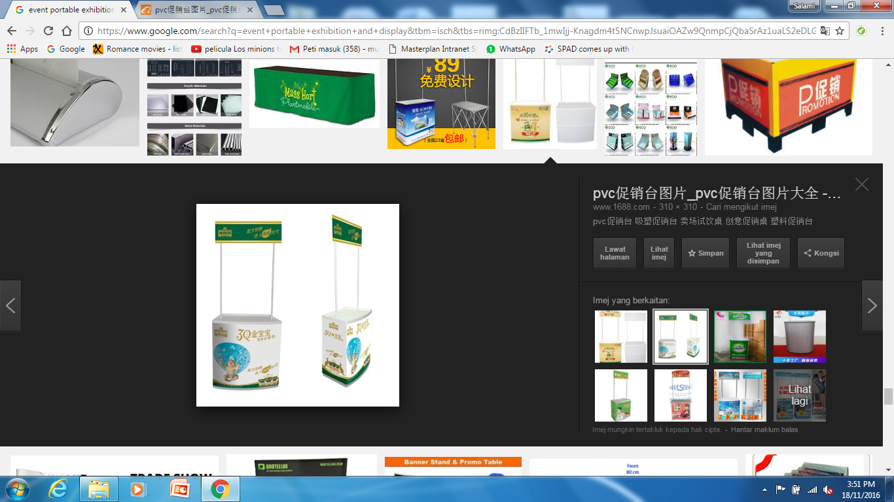

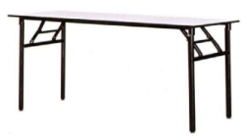




CPC COUNTER REGISTRATION
Pi1M COMMUNITY CONTENT ENHANCEMENT
BY ACCOUNTING SOLUTIONS
1 unit of table top display
4 nos of table banquet
4 nos of chairs
Stationery
Content Provider Contractor

Slide 57
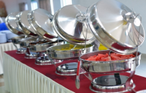
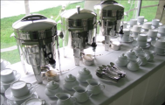

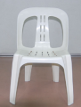
CPC FOOD & BEVERAGE COUNTER
- Table banquet (4nos)
- Chair (5nos)
- Plate
- Glass
- Fork & spoon
- Trolley
- Deluxe roll top chafer Outdoor Catering equipment
- Sink basin
- Water Container
- Table cloth
- Broom
- Food storage container
- Small Size canopy
- 1nos of pickup truck

Slide 58
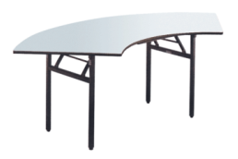
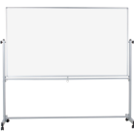
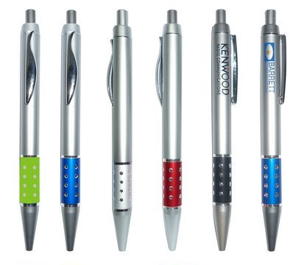
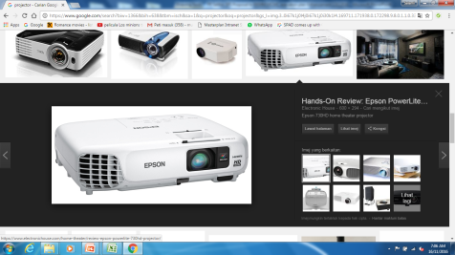
CPC TRAINING SESSION / CLASS
- Table banquet Instructor (2nos)
- LCD projection c/w stand
- White board stand
- Stationery
- Participant Training bag c/w accessories
- Video camera for real time class recording
- Souvenirs gift etc key chain or pendrive or pen

Slide 59


Sample bunting / brochure / sticker design
PROGRAM MEMPERKASAKAN RAKYAT - ACCOUNTING SOLUTION
PI1M COMMUNITY CONTENT ENHANCEMENT
BY ACCOUNTING SOLUTIONS

Slide 60
PROJECT
FINANCIAL
CONSIDERATION

Slide 61
financial considerations
TOTAL INVESTMENT BY MCMC/ Pi1M | RM 69,120,000.00
The financial considerations are includes an attractive value-for-money proposition to the MCMC which includes:-
  Installations, commissioning and maintenance of 1,200 Salihin Premier Solutions (SPS)’s software license of at 600 PI1M Centre’s
  Installations, commissioning and maintenance of SPSLite CashBook Cloud Based Software License made accessible to 600 PI1M Centres
  30,000 SPS User license for the use of 600 PI1M Centre’s.
  30,000 SPSLite cashBook User license (including entrepreneur web access) for the use of 600 PI1M Centre’s.
  1,600 training program during 4 years
  30,000 certifications for PI1M participant
  Learning & Job Matching Platform

Slide 62
PARTICIPANT REGISTRATION PROCESS FLOW
Participant fill a registration
Programnme form & PI1M
Registration online:
by walk in to Pi1M or CPC headquarters
by Booth event / Road show
If No
Minimum requirement;
PC Literate
SRP/PMR Holder
Registered with Pi1M
Check status
participant
If yes
Reschedule for next raining
Ensure on
training dates &
location
* Acknowledgement day
Helpdesk to ensure on
record the numbers &
consult participant who
Fail
Training Class & exam
If pass
Access to continues
e-learning
* Participant received
certificate
Job Matching Platform

Slide 63
Reporting Process flow (Monthly Progress Report)
Monthly report
- Send via email & by hand by 1st week of the month
Summarize the issue/activities by weekly report
Checked by
Vendor
If not
approved
Checked by
Service Provider
The Monthly progress report consist of;
Project Information
List of PI1M covered
Progressive & achievement
Site activities
Resources performances
  Team viewer
  Help Support
Organization Chart
Maintenance Service performance
Photograph
Approved by
SKMM
Submitted to KKMM
for record

Slide 64
Reporting Process flow (Weekly Report)
Weekly report
- Send via email & by hand BY end of the week
Clarify the issue/activities everyday
If not
approved
Checked by
Service Provider / Vendor
Approved by
SKMM
The weekly report consist of;
Daily activities
Resources involved
Vehicle Maintenance Checklist
Material handling equipment Checklist
- Attendances record
Photograph
Submitted to KKMM
for record

Slide 65
Reporting Process flow (Maintenance Report)
Maintenance Checklist report
Send via email & by hand by 1st week of the month
To submit every month
Summarize the maintenance activities
Checked by
Vendor
If not
approved
Checked by
Service Provider
The maintenance report consist of;
Software parts
Hardware parts
Vehicle condition
Photograph before, during & after
Approved by
SKMM
Submitted to KKMM
for record

Slide 66
PAYMENT PROCESS FLOW
Preparation of
documentation
Document consist of;
Monthly report
Weekly report
Maintenance report
If not completed
Documentation checked
by Telco’s
Approved by SKMM
Prepare an Invoice
If not completed
Checked by SKMM
Endorsed by KKMM
CPC received payment

