Slide 1

SALIHIN PREMIER SOLUTIONS
PRODUCT INFO

Slide 2
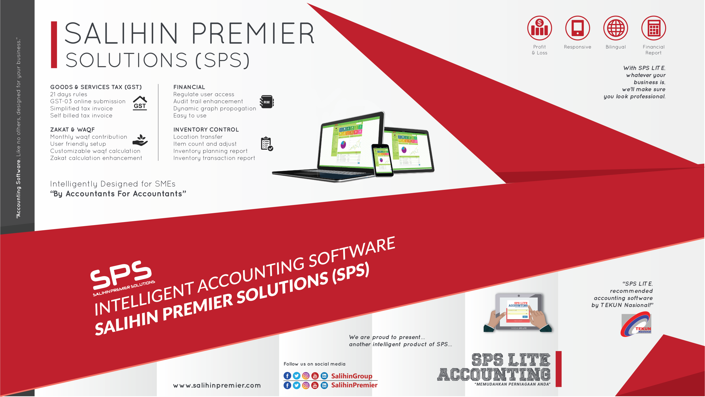
Salihin premier solutions (sps)

Slide 3
SPS Background
Salihin Premier Solutions
SALIHIN PREMIER SOLUTIONS also know as SPS, is an intelligent accounting software in the world that can manage numerous aspects of financial accounting including Goods and Services Tax (GST) and Zakat calculation, customized specially for Small and Medium Enterprises (SMEs).
SPS is an efficient and effective software that accommodates changes affecting invoicing and billing system of the business process. The software is powered by the latest security features to secure data or information for optimal integrity and confidentiality. It is tailor made for small and medium industries by professional accountants.
The Zakat module makes SPS the first comprehensive accounting software with Zakat solution. It will make it easier than ever for Muslim businesses, corporations and organizations to determine the amount payable as Zakat. With Zakat feature built in, it is simply the best accounting software yet.

Slide 4
SPS Background
The Main Modules
There are 5 main modules of SPS
Financial Module
Inventory Module
GST Module
Zakat Module
Waqf / Endowment Module

Slide 5
SPS Background
The Main Modules
Module 1
Admin & general setup
Module 2
general ledger
Module 3
Account receivables
Module 4
account payables
Module 5
sales order
Module 6
purchasing
Module 7
inventory
Module 8
goods & service tax (gst)
Module 7
zakat & waqf

Slide 6
SPS Background
The Main Modules
General Set Up Module
  Set up a company
  Set up employee
  Set up agent
  Set up master code
  Set up project
  Set up terms
  Set up bank
  Set up ship to (location)
  Set up a graph
Admin Module
  Add/edit & authorization of access for each user
  Search & produce log report
  Perform a backup
  Upgrade license & version

Slide 7
SPS Background
The Main Modules
General Ledger Module
  Set up financial year, chart of account, opening balance & other sub modules
  Perform transaction
  Generate and produce report
4. Account Receivables Module
  Set up customers
  Set up historical customer invoice
  Perform sales transaction
  Generate & produce report
5. Account Payables Module
  Set up supplier
  Set up historical supplier invoice
  Perform purchases transaction
  Generate & produce report

Slide 8
SPS Background
The Main Modules
6. Sales Order Module
  Set up sales price
  Perform sales quotation & delivery order
  Generate & produce report
Purchasing Module
  Set up purchase price & supplier lists
  Perform purchase order & purchase receive
  Generate & produce report
Inventory Control Module
  Set up inventory items
  Perform location transfer & stock take
  Generate & produce report

Slide 9
SPS Background
The Main Modules
GST Module
  Set up GST requirement
  Perform GST transaction
  Generate & produce GST report
  Generate & submit GST-03
Zakat & Waqf Modules
  Set up zakat nisab & centre
  Set up waqf & waqf centre
  Perform zakat calculation
  Perform waqf calculation
  Generate & produce zakat & waqf report

Slide 10
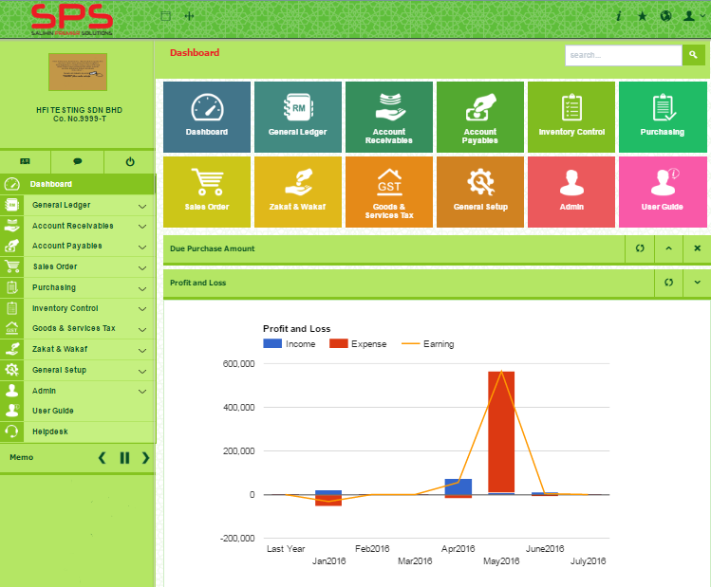
SPS Background
Main Page

Slide 11

SPS Background
Function And Features
SPS
Predefined Accounting Chart
Default GST Setup
Biz Dashboard
Regulate User Access
GST-03 Online Submission
Dynamic Graph Propagation
Void Unconfirmed Transaction
Auto Notification of
any New Update
Zakat Calculation Enhancement
Simplified Tax Invoice
Auto Calculation Waqf
Self Billed Tax Invoice

Slide 12
SPS Pricing Lists
Recommended Retail Pricing (RRP)
BIL | OPTIONAL | PRICE (RM)
1 | SPS LICENSE | 2,880.00
2 | INSTALLATION | 200.00
3 | ADDITIONAL USER LICENSE | 500.00
4 | ADDITIONAL COMPANIES LICENSE | 500.00
5 | ON-SITE TRAINING (1 DAY X 3 USER) | 1,500.00
6 | TRAINING CENTRE (1 DAY PER USE) | 300.00
7 | ON-SITE SUPPORT | 500.00
8 | ON-CALL SUPPORT (PER TICKET) | 50.00
9 | TEAM VIEWER SUPPORT (PER CASES) | 150.00
10 | RE-ISSUE LICENSE | 100.00
11 | TRAINING ACCOUNTING GST (PER PACK) | 500.00
12 | I-Support Maintenance (1 Year) - Free update software Version - Free Viewer support (5 Cases) - Free on-call support ( 3 Months) - Free Online chat support | 980.00

Slide 13

Product Comparisons
SPS vs Other Accounting Software

