Slide 1


BUSINESS SUPPORT

Slide 2
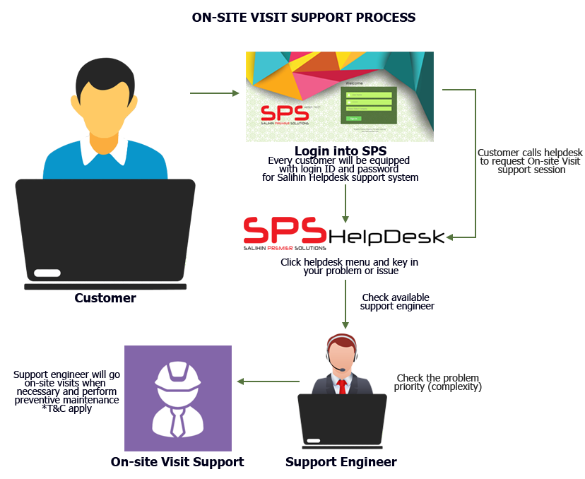
ON-SITE SUPPORT
Response time: Next business day (Klang Valley), Within 5 days (Peninsular area), Within one week (Sabah & Sarawak).
Diagram below illustrates how the mechanism works.
Working Hours: 8.30am – 5.30pm

Slide 3
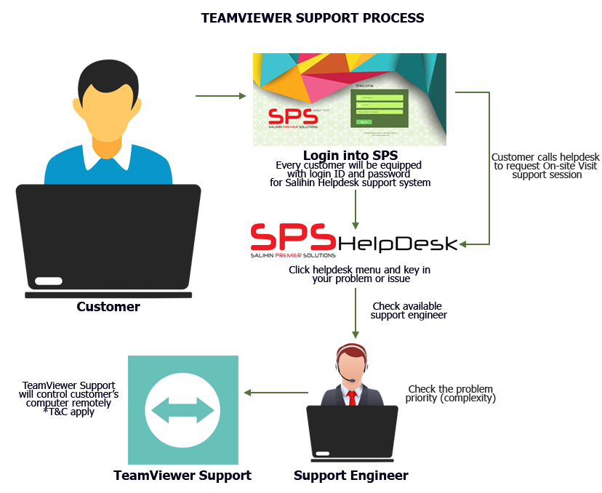
TEAM VIEWeR SUPPORT
Response time: Within 24 hours (Subject to availability).
Diagram below illustrates process of team viewer support.
Working Hours: 8.30am – 5.30pm

Slide 4
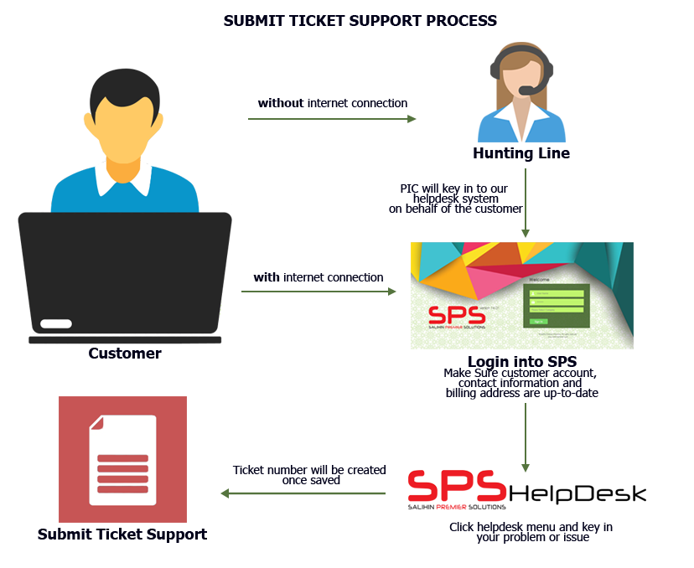
Helpdesk business SUPPORT
Response time: Within 24 hours week days (Subject to availability).
Diagram below illustrates process of helpdesk business support.
Working Hours: 8.30am – 5.30pm

