Slide 1

MEDIA & COMMERCIAL MILEAGE

Slide 2





Commercial mileage
In the spirit of business collaboration between FR MUTIARA/ SALIHIN and KKMM/MCMC/PI1M, we will support Pi1M in providing quality products and services with the highest degree of customer satisfaction.
PI1M BUSINESS AWARD
Joint program between
FRMutiara-KKMM/MCMC/ PI1M
MCMC is required to share the success stories of PI1M business & entrepreneurs on monthly basis in Utusan/ Sinar Harian. (subject to negotiations terms & conditions between us and respective parties).
FR Mutiara/ SALIHIN will do the selection of the SME award winner lists based on good financial management governance and MCMC internal criteria.
An event will be held to celebrate the winners.
Award will be sponsored by FR Mutiara/ SALIHIN.
FR Mutiara/ SALIHIN will sponsor the 1st year event and entrepreneurs segment in Utusan/ Sinar Harian.
Support By:

Slide 3

Sinar Harian
Media Coverage Planning

Slide 4

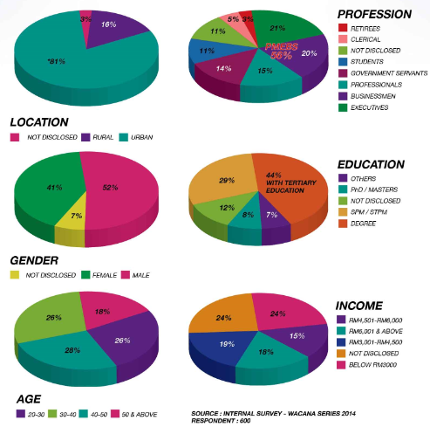
Proposed advertisement medium
SINARHARIAN DEMOGRAPHICS
One Page
8 col
6 cm
Proposed Ads Placement
160,000 ARE PUBLISHED DAILY

Slide 5
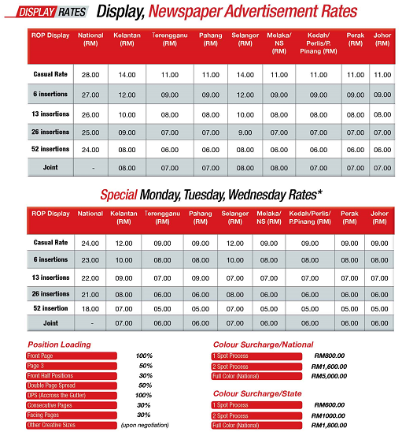

Budget allocation
Proposed A&P budget allocation in Sinar Harian RM297,984.00

Slide 6
Proposed ADS CYCLE
Days | SUN | MON | TUE | WED | THU | FRI | SAT | SUN | MON | TUE | WED | THU | FRI
SINAR
SINAR HARIAN - 4 days each week (Monday, Wednesday, Friday & Saturday/Sunday)

Slide 7
Utusan Malaysia
Media Coverage Planning

Slide 8



Proposed advertisement medium
UTUSAN MALAYSIA CIRCULATIONS
One Page
8 col
6 cm
180,000 ARE PUBLISHED DAILY
Proposed Ads Placement

Slide 9
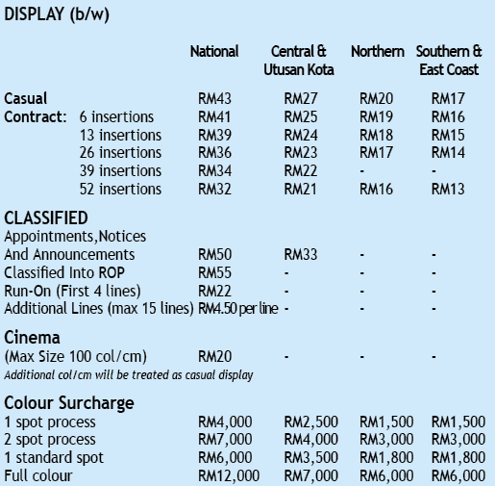
Budget allocation
Proposed A&P budget allocation in Utusan Malaysia RM639,648.00

Slide 10
Proposed ADS CYCLE
Days | SUN | MON | TUE | WED | THU | FRI | SAT | SUN | MON | TUE | WED | THU | FRI
UTUUSAN
UTUSAN - 3 days each week (Monday, Tuesday & Wednesday)

