Slide 1

LEARNING & JOB MATCHING PLATFORM

Slide 2
Fact sheet
The 3 days education/ training program it’s not perceived only as 3 days training program, but it is essentially a 3 days fundamental training program + 5 years of continuous learning.
SPS Learning & Job Matching Platform aims to provide PI1M community a learning opportunities as well as employment opportunities.
  It consists of a short, free, high quality, self-directed, support focused functions and activities for PI1M participants to go for an extra miles in CPC Product Offerings as well as professional and personal development.
  Courses are developed by CPC subject matter experts and participation academician from our TAF participating universities. The Learning platform is made available at all times for all PI1M participants.
  Simultaneously, the above will be made accessible for all potential employers and all academician to assess potential candidates for their further engagement.

Slide 3
E-Learning Materials
No | LIST OF TRAININGS
1. | Business Documentation Training
2. | SPS Basic Training
3. | SPSLite Training
4. | SPSLite Website Training (Basic)
5. | SPSLite Website Training (Advance)
No | TYPE OF CONTENT
1. | Web Online Seminar (Webinar)
2. | Video Training & Tutorial
3. | Online Training Materials (Web & Mobile)
4. | Online Test & Examination
5. | Online Certification

Slide 4
The SYSTEM modules
Proposed Modules :-
  User Registration & Management Module
  Employer Registration & Management Module
  E-Learning Management Module
  Exam & Certification Management Module
  Job Matching Management Module
  Reporting Management Modules
Proposed Database
  MySql
Proposed Service Repository
  Cloud Based/ Web Hosting Service
User Registration
Employer Registration
E-Learning
Exam & Certification
Job Match
Reporting

Slide 5
E-Learning Components
1
Online Seminar (Webinar)
2
Online Training Video & Tutorial
3
Online Training Material
4
Online Registration
5
Training Schedule
6
Online Examination

Slide 6


Development principles
In the development process of learning & job matching platform , we will emphasize on best practice to ensure the service delivery would not compromised the KKMM, SKMM and PI1M standards and expectation.
We also will ensure that the operation of learning & matching platform will give a better experience for PI1M participant in term of functional, Content, Technical, Business, Usability and Responsiveness.
01
Service Enhancement
03
Service Presentation
01
03
All the global best practice sites solicit participant feed back through comments or feedback sections. This constant check from the end users helps learning & job matching system to improve the services they are providing continuously.
The online service offered can be fully completed online. A participant does not need to complete any off-line activities such as printing a document to be submitted except for his/ her own record.. Fully executable services results in potential savings in terms of money, time and labor.
02
Service Delivery
04
Service Assistance
02
04
Simple UI Design and Ease of Navigation. A consistent look and feel would reduce the time user need to familiarize themselves with a system’s functionalities.
System support are provided during office hours (Applicable for minor problems & system modification only) .

Slide 7






Learning & Job Matching DIAGRAM
Reporting
Entrepreneurs
MySql Database
Entrepreneurs
Potential Employers
PI1M
Participants
Participant Registration Module
Employer Registration Module Module
Registration
Assessment
Training & E-Learning Module
Job Posting Module
members
Exam & Certification Module
Reporting Management Module
members
Match Make & Recommendation
members
Diagram 1.0 illustrate the overall concepts of Learning & Job Matching Platform.

Slide 8

User interface
Diagram 2.0 illustrate the main page of Learning & Job Matching Platform

Slide 9
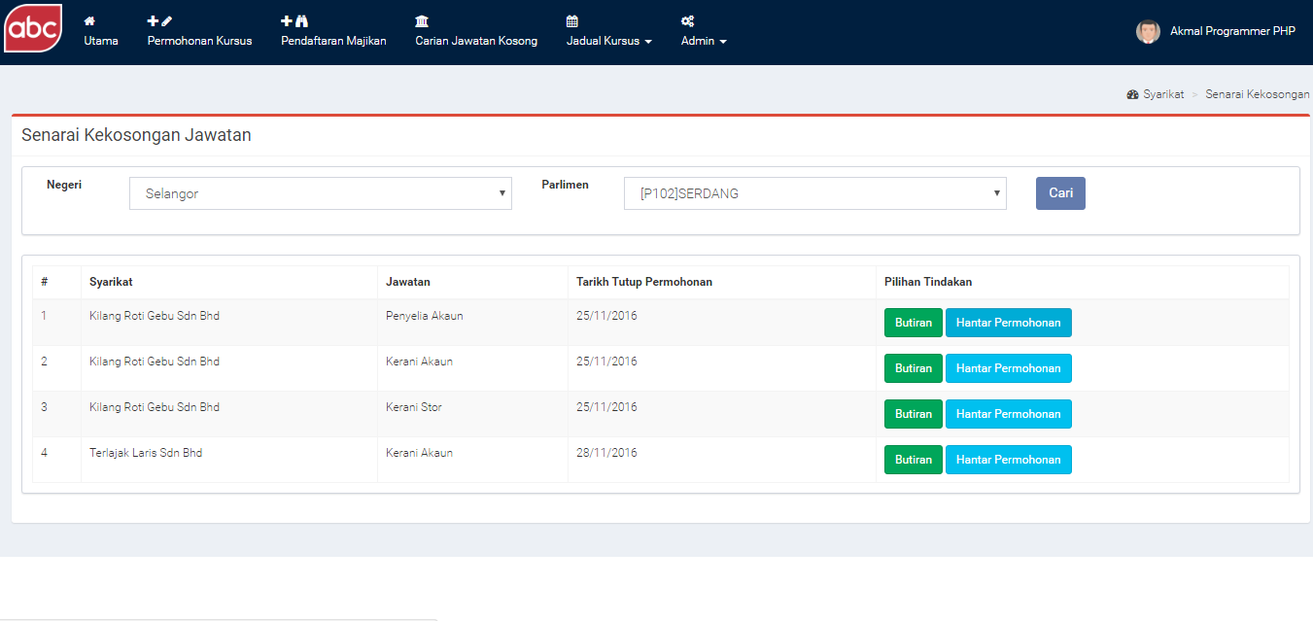
Mock up interface
Diagram 3.0 illustrate the latest job offering page
Diagram 2.0 illustrate the main page of Learning & Job Matching Platform

Slide 10
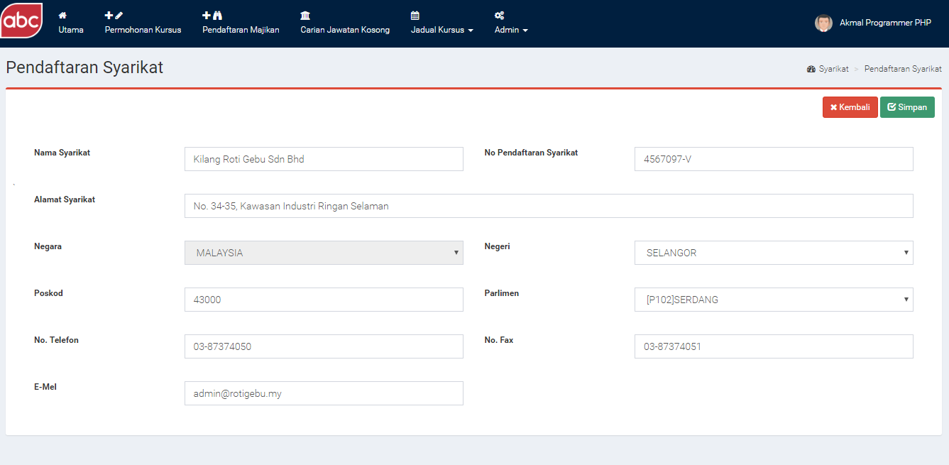
Mock up interface
Diagram 4.0 illustrate the employer registration page

Slide 11
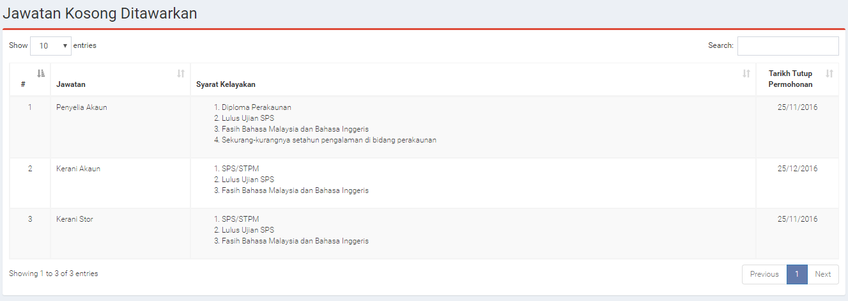
Mock up interface
Diagram 5.0 illustrate the new job posting by employer

Slide 12
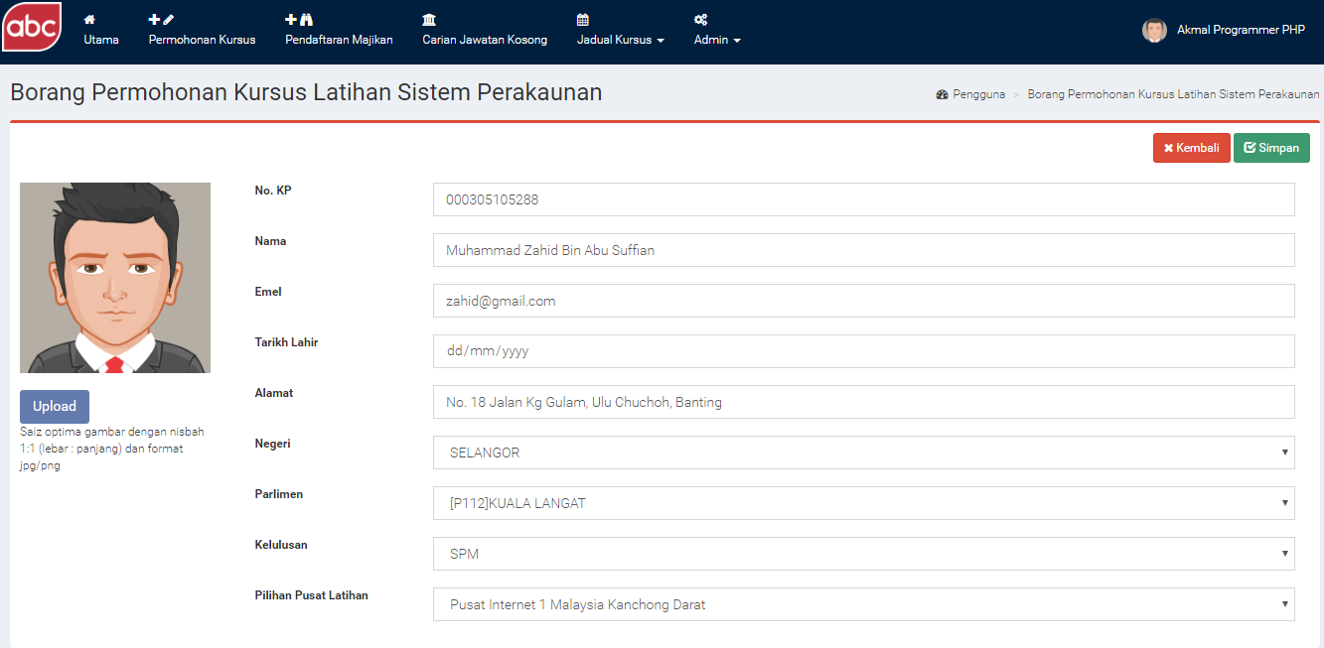
Mock up interface
Diagram 6.0 illustrate the SPS training registration form

Slide 13
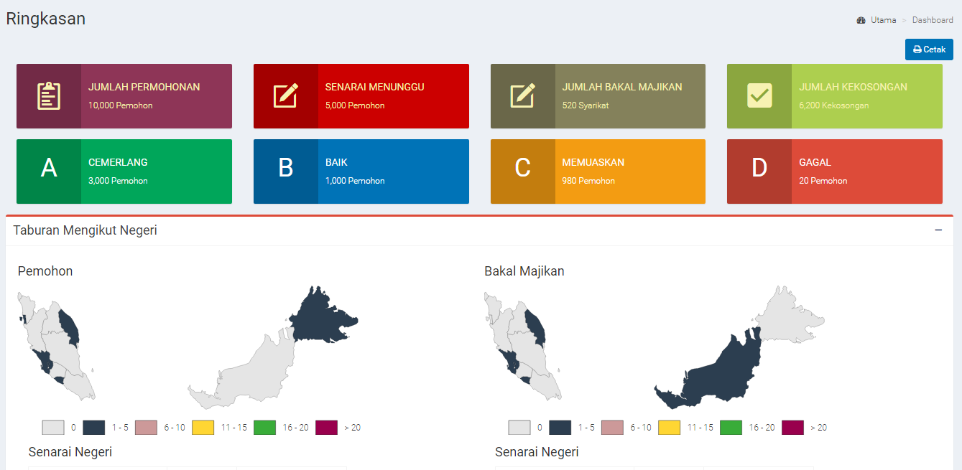
Mock up interface
Diagram 7.0 illustrate the SPS training intelligent dashboard

Slide 14
Mock up interface
Diagram 7.0 illustrate the SPS training intelligent dashboard

