Slide 1

HARDWARE, INFRASTRUCTURE & MAINTENANCE

Slide 2
Project REQUIREMENT
We plan to provide a comprehensive internetworking infrastructure for SPS cloud-ready application system. The plan will mainly focus on the SPS’s Portal availability. The portal is a crucial application system which requires an agile, scalable and robust infrastructure to ensure its accessible 24x7.
The proposed baseline configurations are based on the generic deployments, solution size and capability and are independent of the target application. The recommendations focus on hardware capacity and software features; they do not attempt to prescribe a particular server model or chipset, as these preferences may vary or to be changed later based on customer requirements and detailed requirement gathering.
The following table describes the recommended components for the proposed configuration as follows;

Slide 3
Reference architecture for virtual infrastructure
The following table describes the recommended components for the proposed configuration as follows;
CPU BASELINE CONFIGURATION
TOTAL CPU CORE (pCPU) | TOTAL VIRTUAL CORE (vCPU)
96 | 288
 | More than 50% buffer
MEMORY BASELINE CONFIGURATION
TOTAL RAM | TOTAL VIRTUAL RAM (vRAM)
512 | 512
 | More than 50% buffer
STORAGE BASLINE CONFIGURATION
TOTAL STORAGE (TB) | FLASH DISKS FOR PERFORMANCE
10 | Yes

Slide 4
Reference architecture for virtual infrastructure
NETWORKING BASELINE CONFIGURATION
NETWORKING INTERFACE
2 x 10 GbE
VIRTUALIZATION BASELINE CONFIGURATION
VIRTUALIZATION
HYPERVISOR | VMWare VSphere
NUMBER OF ESX HOSTS | 4
# OF FAILURE TO TOLERATE | 1
BACKUP
Disk Based | Yes
Deduplication | Yes

Slide 5
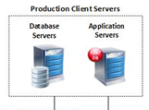
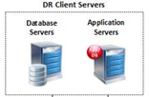



Proposed system architecture
INTERNET
SPS
Production Application Farm
SPS
DR Application Farm
Virtualization Infrasturcture
Virtualization Infrasturcture
replication
Disks Backup Appliance / VTL
Disks Backup Appliance / VTL

Slide 6



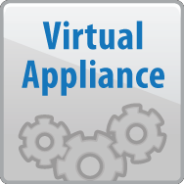


Proposed solution
VIRTUALIZATION ARCHITECTURE
Web Svr1
Web Svr2
App
01
App
02
DB
01
DB
02
Dev
Training
  Software-based storage built in ESXi
  Aggregates local Flash and HDDs
  Shared datastore for VM consumption
  Converged compute + storage
  Distributed architecture, no single point of failure
  Deeply integrated with VMware stack
Virtualization
esxi-01
esxi-02
esxi-03
esxi-04
Backup Appliance

Slide 7
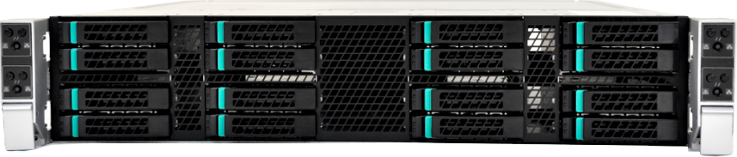
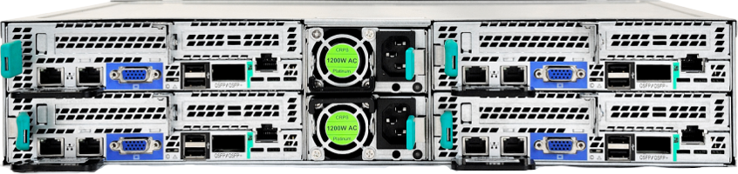
Proposed hardware & software
Hardware Infrastructure
**Note : This proposal is the preliminary design and may required changes with the depth
of the details supplied in at a later stage .The hardware sizing was based on table as the
previous slide
Processor Per Node
Intel Ivy Bridge (Up to 130W)
Dual Processor
Chassis
2U chassis supporting 4 hot swap nodes w/half-width MBs.
2 x 1200W (80+ & CS Platinum) redundant hot-swap PS
Dedicated cooling / node (no SPoF) – 3 x 40mm dual rotor fans
Front Panel w/separate power control per node
17.24” x 30.35” x 3.46”
Memory | Processor Per Node
4 Channels of Native DDR3(1333)
Up to 8 DDR3 ECC R-DIMMS per server node
I/O’s Per Node
Dual GbE ports onboard
Optional IB QDR/FDR or 10GbE integrated
1x 8 PCIe Gen3 I/O Mezz Option (Quad GbE or Dual 10GbE)
1 x 16 PCIe Gen3HBA slots
Integrated BMC with RMM4 support
Disk
Integrated 4-Port SAT/SAS controller (SW RAID)
Up to 16 (4 per node) 2.5” HDD
NODE 1
NODE 3
NODE 2
NODE 4

Slide 8
hardware & software maintenance
1
Preventive maintenance
  House keeping and disk utilities (every 4 months)
  Database re-indexing and performance tuning (every 2 months)
  Anti-virus upgrade (Auto)
Corrective
  Software upgrade (every 6 month)
  Major Upgrade
  Minor Upgrade
  Emergency Upgrade
Major Release
New version or major changes made to current system
Types of software updates (release)
2
3
Minor Release
Emergency Release
Partial changes, improvement and upgrading in one of system modules
Enhancement made due to defect found in any software components

