Slide 1
TRAINING AND CERTIFICATION PROGRAMME

Slide 2

SPS training & Certification
Salihin Training Program is part of FR Mutiara 5 Years Pi1M Content Empowerment Proposal submitted to MCMC via USP Fund initiative to help grow local economies and bring about greater shared prosperity and social change by providing underserved communities with a business and accounting upskilling opportunities via Pi1M.
We at Salihin believe that such an investment can have a significant multiplier effect; These education can lead not only to increased revenues and job creation, but also to healthier, better educated families and, ultimately, more prosperous communities and nations. Put more simply, by helping to transform the lives of promising underserved target communities, we in turn transform the lives of those around them.
Communities
Transformation
Catalyze underserved growth
Closing
Skills
Gaps
Bridging skills and knowledge gap
Accelerate
Rate of
Change
Bringing industries close to communities
Economy
vs Education
Demand

Slide 3

Key competencies
Increase skills & Proficiency
Demonstrate Personal & Professional Accomplishment
Real Business Case Exposure
Endorsed by Reputable Bodies
(TAF UMT-UniKL-UiTM-UPM)
Certification and Assessment
Structured & Practical Modules

Slide 4





Training approach
Main Approach-Class Room Training
  Min 10-20 Participation
  3 Modules (SPS, SPSLite & SPSWeb)
  2 Days Training + 1 Day Exam
  Online Certification (.pdf format)
Optional Training Approach
  Web Based Training Seminar (Webinar)
  Video Training & Tutorials
  Mobile Video Training & Tutorials
  Online Training Materials

Slide 5


Training modules
We are proud to offer training and certification to support Pi1M needs including:
Business
Documentation
SPS Certification
SPS Basic Training
SPSLite
CashBook
SPSLite
Website Basic
SPSLite
Website Advance

Slide 6
Training modules……cont
No | LIST OF TRAINING | Class Room | Web/ Mobile Training Video & Tutorial | Webinar | Online Training Materials | Online Test & Examination
1 | Business Documentation Training | √ | √ | √ | √ | √
2 | SPS Basic Training | √ | √ | √ | √ | √
3 | SPSLite Training | √ | √ | √ | √ | √
4 | SPSLite Website Training (Basic) | √ | √ | √ | √ | √
5 | SPSLite Website Training (Advance) | √ | √ | √ | √ | √

Slide 7
Target audience…...cont
No. | TRAINING MODULES | TARGET USER | FREQUENCY | DURATION | RESOURCES
DAY 1 | Basic Accounting & Business Documentation | Micro Entrepreneurs SPS Leavers Under Graduates Graduates | Weekly | 1 1/2 Hours | 3 Persons
 | SPSLite Training & Basic/ Advance SPSLite Website Training |  |  | 1 1/2 Hours
DAY 2 | SPS Training |  |  | 3 hours
DAY 3 | 1 Full Day Examination

Slide 8
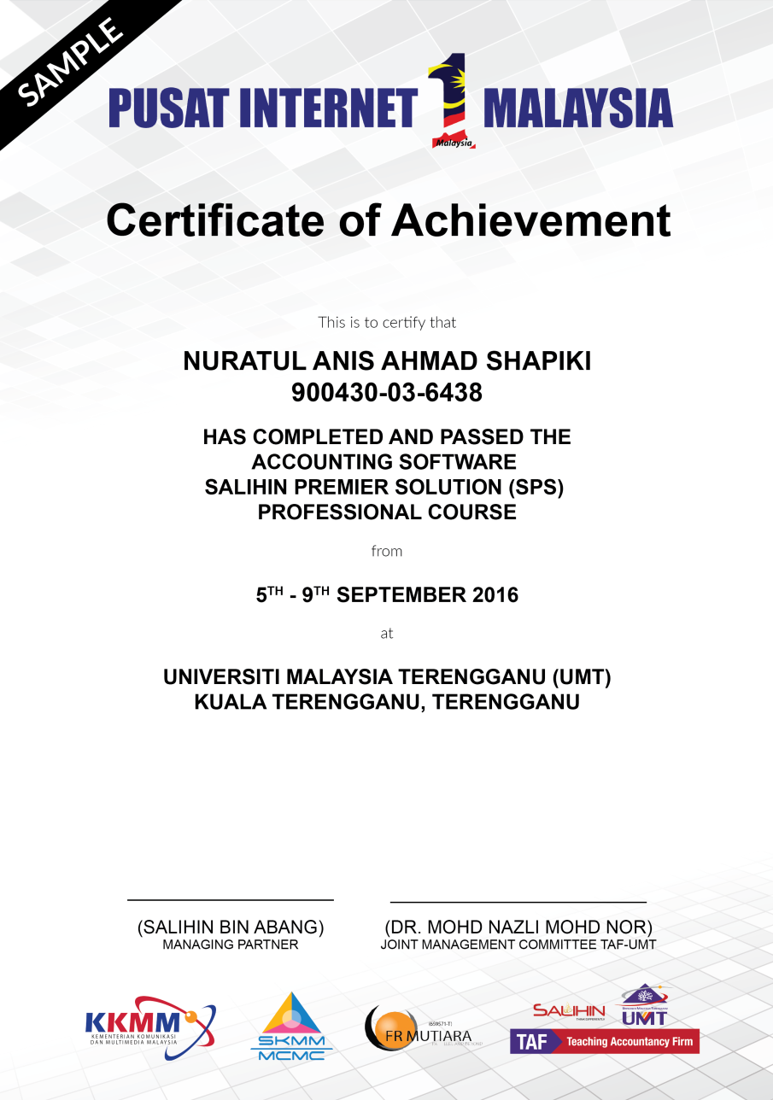
certification
SPS Training Participation
&
SPS Completion Participation
Samples of Certification

Slide 9
PROPOSED PROGRAM & TTRAINING MODULE

Slide 10
PROGRAMME SCHEDULE
Details | 8.00 - 9.00 | Session I 9.00-10.30 | 10.30 - 11.00 | Session II 11.00-13.00 | 13.00 - 14.30 | Session III 14.30-17.00
Day 1 | Registration & Breakfast | Basic Accounting & Business Documentation | Tea Break | SPS Lite (Overview, Set Up Process & Expenses Modules) | Lunch | SPS Lite (Sales, general & Report Modules) SPS Web (Overview & Setup Modules)
Day 2 | Breakfast | SPS Full Set (Overview & Set Up Process Modules) |  | SPS Full Set (Inventory, Purchase & Account Payable Modules) |  | SPS Full Set (Sales, Account receivables, Other payment, GST & Financial Report Modules)
Day3 | Breakfast | Examination & Assessment |  |  | Lunch | Dismiss

Slide 11
Program breakdown
SPS Training Module Details
Day | Subjects
1 | Basic Accounting Knowledge Objective: To Expose the normal business process as well as basic accounting knowledge to participants. Flow of Accounting Documents Double Entry Balance Sheet Income Statement | SPS Lite Objective: To Familiarize participants with the basic book keeping system. Overview of SPS Lite Setup Process Company Setup Fixed Asset Bank Loan Expenses Expenses COGS Operating Expenses Purchase of Fixed Assets

Slide 12
Program breakdown
SPS Training Module Details
Day | Subjects
1 | Sales General Bank Transfer Loan Repayment Loan Receive Reports Profit & Loss Account Balance Summary Fixed Assets Report Loan Report SME Cash Flow Posted Journal | SPS Personal Web Objective: To Empower Business Marketing Tools Through Website. Overview of Personal Web Setup Process Front Page Menu About Product Testimoni Contact Us

Slide 13
Program breakdown
SPS Training Module Details
Day | Subjects
2 | SPS Accounting Software Objective: To Maintain Systematic Records of Business Transaction in Order to Generate Various Report. SPS Overview Overview of SPS Product Setup Process Company Setup User Setup User Access Right Chart of Account System & General Setup Form Setup Financial Year Calendar | Purchasing Supplier Setup Purchase Order Purchase receive Account Payable Purchase Invoice Purchase Debit/Credit Note Supplier Payment Report

Slide 14
Program breakdown
SPS Training Module Details
Day | Subjects
2 | Sales Customer Setup Sales Quotation Sales Order Delivery Order Account Receivables Sales Invoice Sales Debit & Credit Note Customer Payment Received Account Receivable Report | Other Payment & Other Receive Goods & Services Tax GST Setup Bad Debt Relief & Bad Debt Recover GST Report, GST -03 & Relevant Report Financial Report Trial Balance Profit & Loss Balance Sheet Zakat & Wakaf

