Slide 1

SPSLite CashBook
PRODUCT INFO

Slide 2

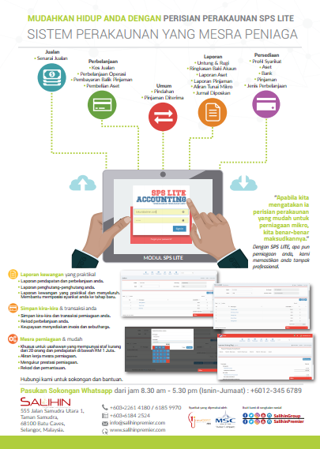
SPSLite CashBook
SPSLite CashBook Brochure

Slide 3
SPSLite CashBook Background
The Main Modules
There are 5 main modules of SPSLite
Sales Module
General Module
Report Module
Entrepreneur Web Module
Expenses Module

Slide 4
SPSLite CashBook Background
Main and Sub Modules
Set Up Module
  Set up a company
  Set up a fixed asset
  Set up bank
  Set up loan
  Set up expenses type
  Set up entrepreneur’s website
Sales Module
  Add sales
  Edit sales
  Confirm sales
  View sales
Expenses Module
  Add, edit, delete, confirm & print cost of goods sold (COGS)
  Add, edit, delete, confirm & print operating Expenses
  Add, edit, delete, confirm & print of purchase fixed asset

Slide 5
SPSLite CashBook Background
Main and Sub Modules
4. General Module
  Add, edit, delete, confirm & print new bank transfer
  Add, edit, delete, confirm & print loan repayment
  Add, edit, delete, confirm & print new loan received
5. Report Module
  Print & view profit & loss account
  Print & view account balance summary
  Print & view fixed asset summary
  Print & view loan report
  Print & view SME cash flow
  Print & view posted journal

Slide 6
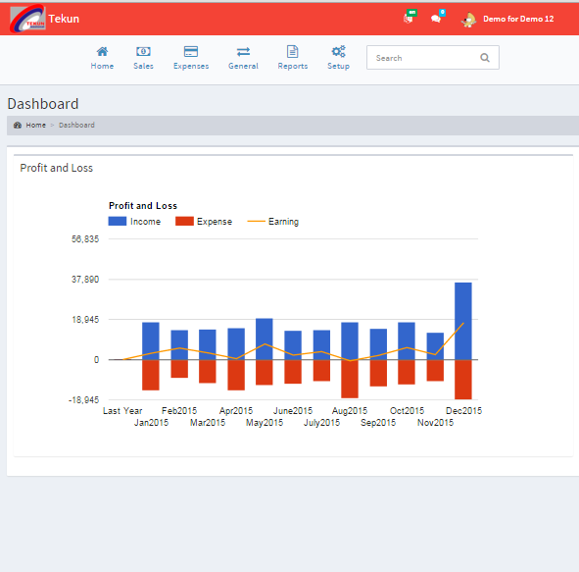
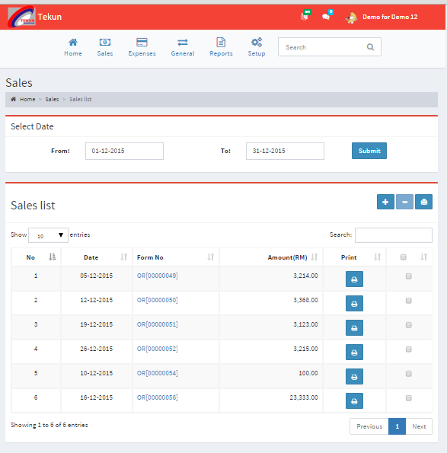
SPSLite CashBook Background
SPSLite CashBook Dashboard
MAIN PAGE/ LANDING PAGE
SALES MENU

Slide 7
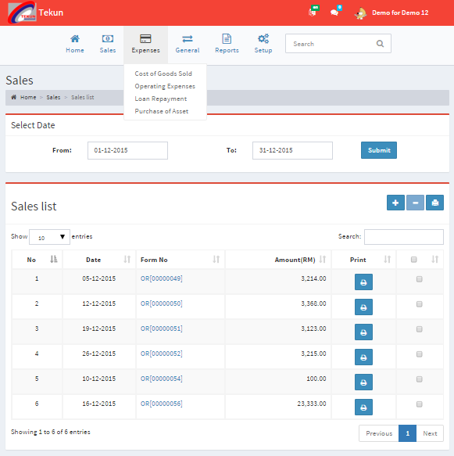
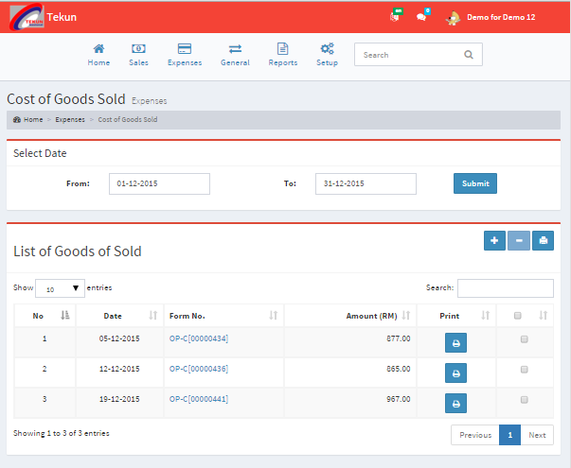
SPS LITE
SPS Micro Accounting Dashboard
EXPENSES MENU
COST OF GOOD SOLD MENU

Slide 8
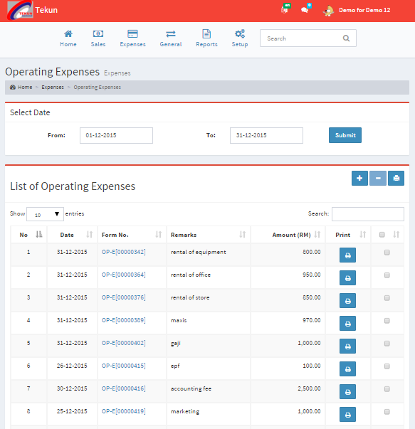
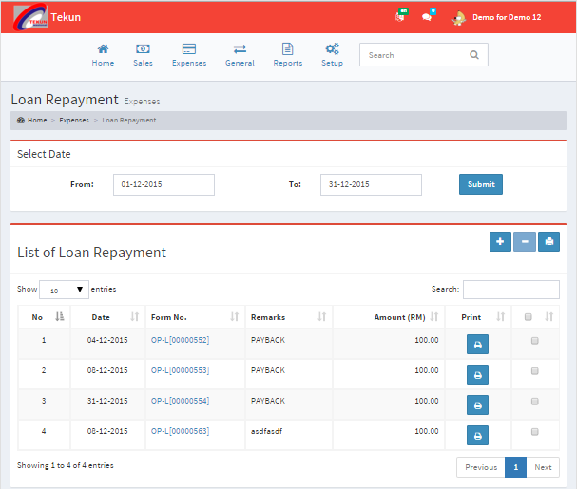
SPS LITE
SPS Micro Accounting Dashboard
LISTS OF OPERATING EXPENSES
COST OF GOOD SOLD

Slide 9
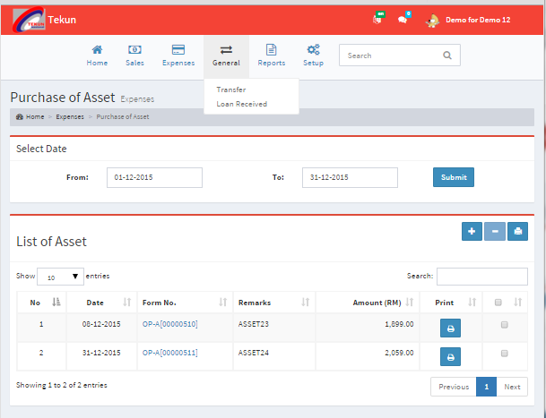
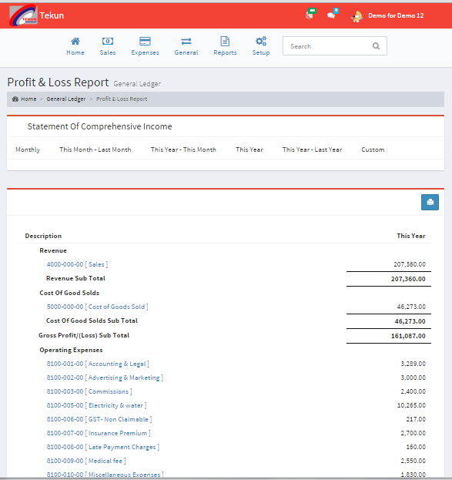
SPS LITE
SPS Micro Accounting Dashboard
GENERAL MENU
REPORT MENU

Slide 10
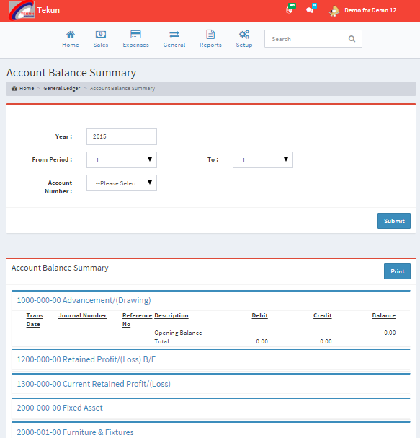
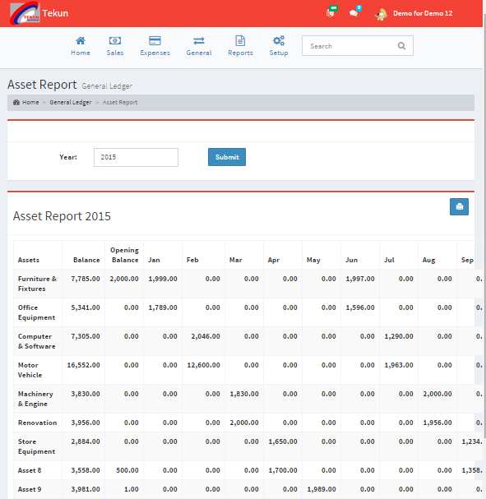
SPS LITE
SPS Micro Accounting Dashboard
ACCOUNT BALANCE
ASSETS REPORT

Slide 11
SPS LITE
SPS Micro Accounting Dashboard
ACCOUNT BALANCE
ASSETS REPORT

Slide 12
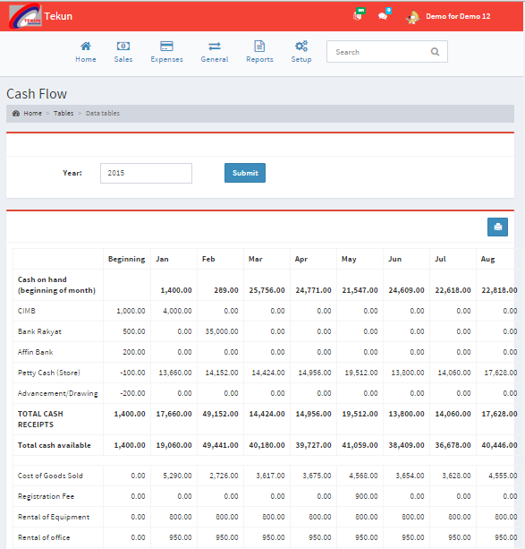
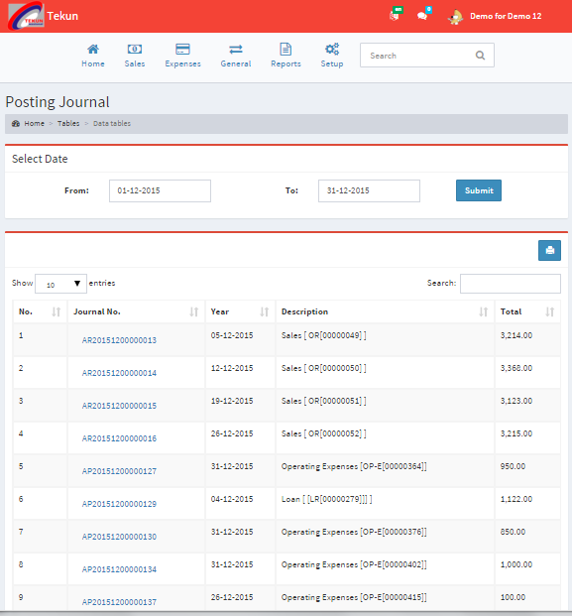
SPS LITE
SPS Micro Accounting Dashboard
CASH FLOW
POSTING JOURNALS

Slide 13
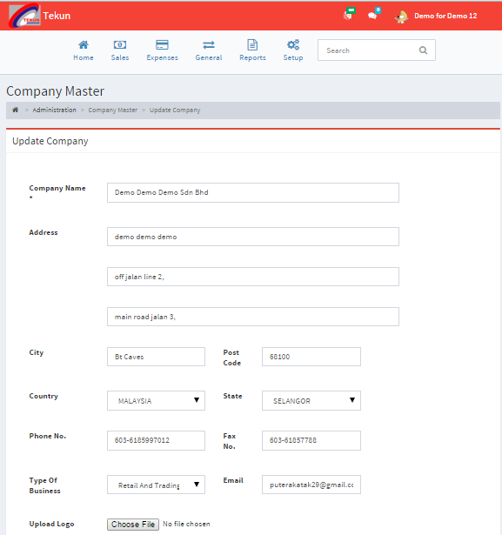
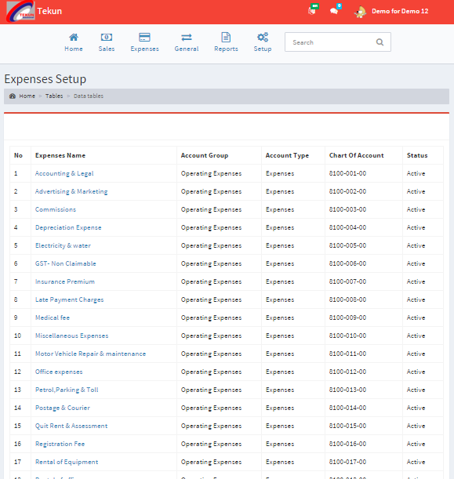
SPS LITE
SPS Micro Accounting Dashboard
SET UP MENU
EXPENSES SET UP

