Slide 1
SPS CERTIFICATION

Slide 2



SPS certification introduction
SPS Certification are categorized as follows:
Certificate of Completion
Certification of Achievement
SPS PI1M training certification will be endorsed by below reputable institution depending on the location of the SPS PI1M program situated:
TAF UMT
TAF UniKL
TAF UiTM
TAF UNITEN

Slide 3
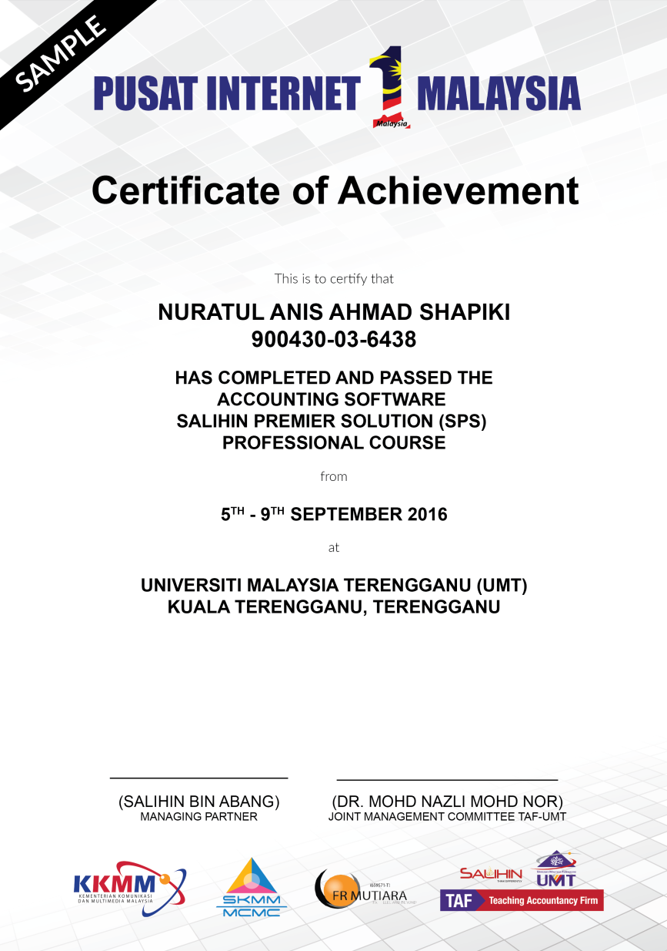
Certification of achievement
SPS Certification of achievement will be given for those participant whom full participate in the SPS PI1M training program and achieve minimum marking level set up in the examination.

Slide 4
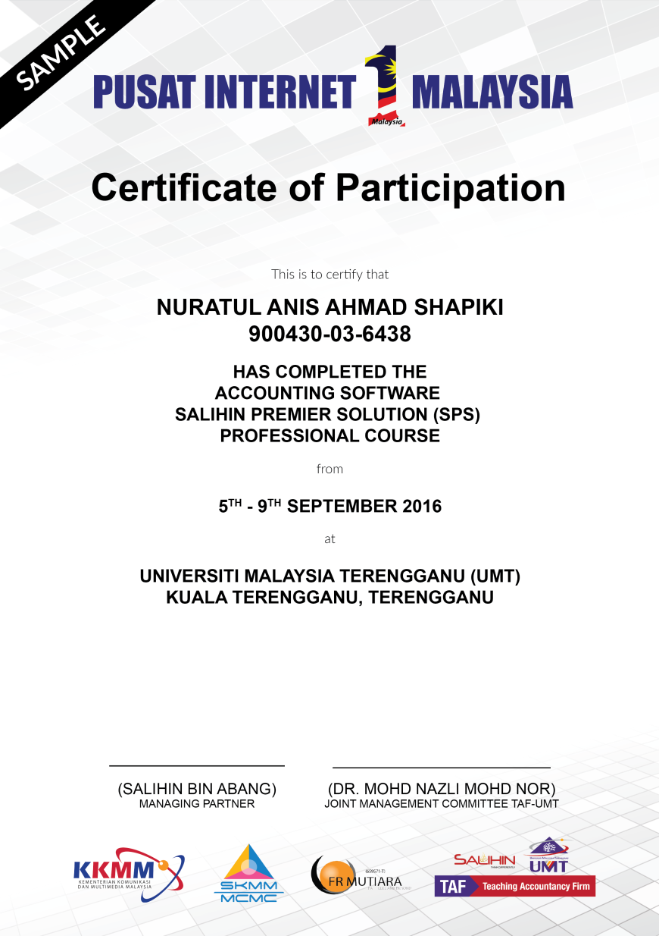
Certification of participation
While on the other hand, SPS Certification of participation will be given for those participant whom full participate in the SPS PI1M training program and did not achieve minimum marking level set up in the examination.

