Slide 1
New Digital Online Media
Advertising Platform

Slide 2
EXECUTIVE SUMMARY
The current movement of utilizing the internet for media consumption will eventually replace the traditional broadcasting medium for television and radio programs. The consumers have control over the contents and thus the traditional advertising faces very segmented and diluted audience which leads to ineffective advertising.
While most advertising agents beginning to utilize the online media as their main advertising tool, it lacks one crucial factor in any business, the economic of scale.
Due to highly segmented and narrow coverage, the online media requires a dedicated team in analyzing (guessing) the latest trends and keywords to get that extra mileage in advertising. While many others still focuses on web advertising, the touch point of these advertisements usually requires two or more clicks to deliver the intended message
The New Digital Online Media aims to bring the economies of scale of traditional broadcast advertising with the effectiveness of online advertising.

Slide 3
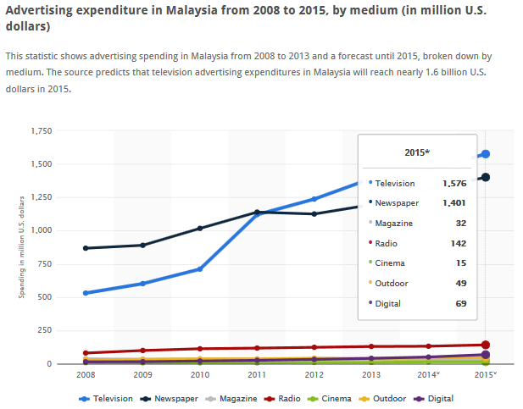
background analysis
The advertising industry today is showing a change in the traditional media to include the digital media in order to reach audience more effectively. The interactive media of Internet, mobile and gaming as well as increased use and availability of improved handsets, less expensive laptops, faster broadband, and extensive Wireless Fidelity (Wi-Fi) connections, provide support for expectations of further growth in global digital advertising. This type of advertising share of the total advertising spend is expected to rise from 6% in 2005 to 15% in 2009.

Slide 4
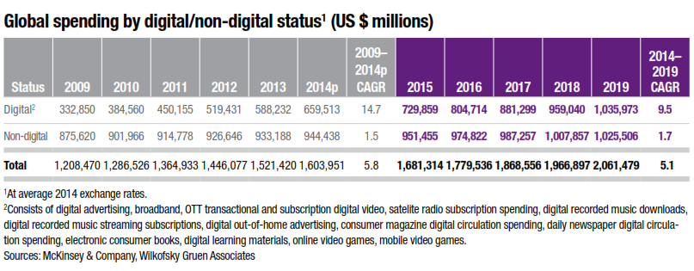
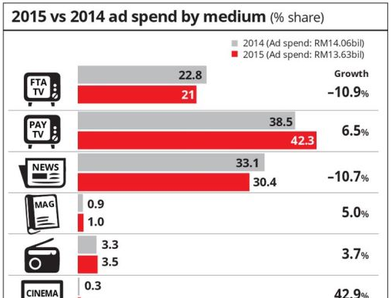
background analysis cont…
Although the global economy is facing increased economic pressures, analysts forecast that global advertising spend is to grow 6.7% in 2008 from 5.3% in 2007. The Asia Pacific region is expected to post advertising spend growth of almost 10%. Meanwhile, the first quarter of 2008 showed global advertising spend grew over 4% with main contributors coming from the television medium, representing 60% of the global advertising market share.
The changing advertising-agency relationship sees the advertising process today evolving from existing models of planning and negotiating purchase of media space to meeting the clients’ or advertisers’ communication needs. This is by providing clients with insights on brand, consumer media and integrated solutions and strategies to engage consumers.
http://www.skmm.gov.my/skmmgovmy/files/attachments/Ad_Dev_Malaysia.pdf

Slide 5
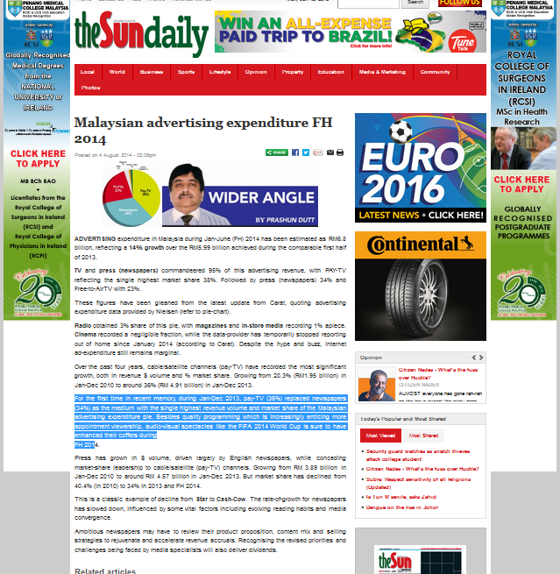
background analysis cont…
For the first time in recent memory, during Jan-Dec 2013, pay-TV (36%) replaced newspapers (34%) as the medium with the single highest revenue volume and market share of the Malaysian advertising expenditure pie. Besides quality programming which is increasingly enticing more appointment viewership, audio-visual spectacles like the FIFA 2014 World Cup is sure to have enhanced their coffers during FH 201
http://www.thesundaily.my/news/1130640

Slide 6



PAST & PRESENT scenario
News paper
TV
Radio
“major broadcast channel control by government”

Slide 7

current scenario
What about internet
“a totally different ball game”

Slide 8
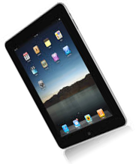






current scenario
“reach information at you finger tips anywhere and anytime ”
“beyond goverment control”

Slide 9
Key Comparisons
New Digital Advertising
Advantages | Disadvantages
Strong segmentation | New and unproven in certain cases
Easy to measure and monitor results | Constant change of online advertising
Online becoming more a part of people’s lives | Higher ignore rate by consumers than traditional advertising
Easier to change Cost Flexibility Good for interaction | Growing levels of competition
Traditional Advertising
Disadvantages | Advantages
Higher cost than online advertising | Large reach to multiple consumer segments
Impersonal form of advertising | Proven success rate
Less targeted then online advertising | Strong creative potential
Large levels of competition | High Level of Engagement

Slide 10
Our proposed Solutions
The New Digital Online Media utilizes the source of internet network from respective NOC center to propagate advertisement to all participant.
Unlike current internet advertising that comes from the web hosting servers, our advertisements comes from NOC servers which increases the coverage to all participant.
The model is almost similar to broadcast advertising where the advertisement comes from the broadcaster, however our model utilizes the PI1M networks as the main source of advertisements.
With this concept, we can bring back the traditional advertising advantage of wide coverage, while having the flexibility of updating latest contents end information of the current online advertising feature

Slide 11
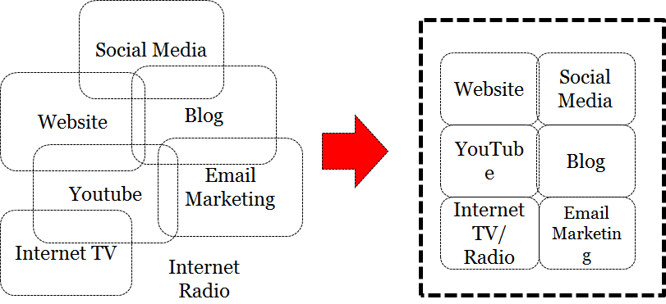
Our proposed Solutions
Current Situation: Narrowed & disintegrated media ads channel requires extra miles for advertisers to choose best platform.
What We Proposed: New Digital Online Media Platform surpasses all mediums and made the ads visible upon clicking the browser.

Slide 12

In short..what we offer
A solutions which help government to :-
Gain control over the internet
Provide a venue for businesses to promote products/ services at reasonable price
Allocate a venue for entrepreneurs to venture into new advertising business segments
"Entrepreneurs must use advanced technology and always question ourselves how we can boost our business through the latest technology”
- Datuk Seri Najib, Prime Minister Of Malaysia. GREAT 2016, Kuching, Sarawak

Slide 13
Product offering
FR Mutiara and Salihin (FR Salihin) would like to propose a development, commissioning, manages and maintenance of Digital Online Media Advertising Platform utilizing ADVEDIA SOLUTIONS to all 600 PI1M Centre nationwide.
Holistic, entrepreneurial and balance services

Slide 14

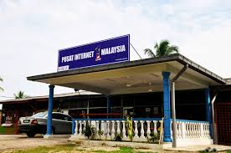
Our objective
OUR OBJECTIVE
To provide Innovative Digital Online Media platform for distribution of information to PI1M.
Provide a venue for businesses to promote products/ services at reasonable price
Allocate a venue for local entrepreneurs to venture into new advertising business segments
DIGITAL ONLINE MEDIA PLATFORM

Slide 15
BENEFITS & VALUE PROPOSITION
FR Salihin
ADVEDIA SOLUTIONS
GOVERNMENT
ENTREPRENEURS
ADVERTISER
Uphold Bumiputera economy agenda □
During National Crisis □
Event □
Alert □
Encounter Issue □
Awareness Campaigns □
Announcement □
Notification □
□ New promotion avenue
□ Direct touch point
□ New job creation
□ Rich format
□ Strong brand
□ Qualified segmentation
□ Unique integration of content & website
□ Customized sponsorship
□ Customized placement
□ Syndication of contents
□ Enhance brick and mortar business model

Slide 16

Why us?
Our Own Developed Software
Server Hosting at Local Data Center
High Security
24x7 Standby Locally
Customization
Reporting and Analytic
Behavior and Access Statistic
we give a solutions, not just a system

Slide 17

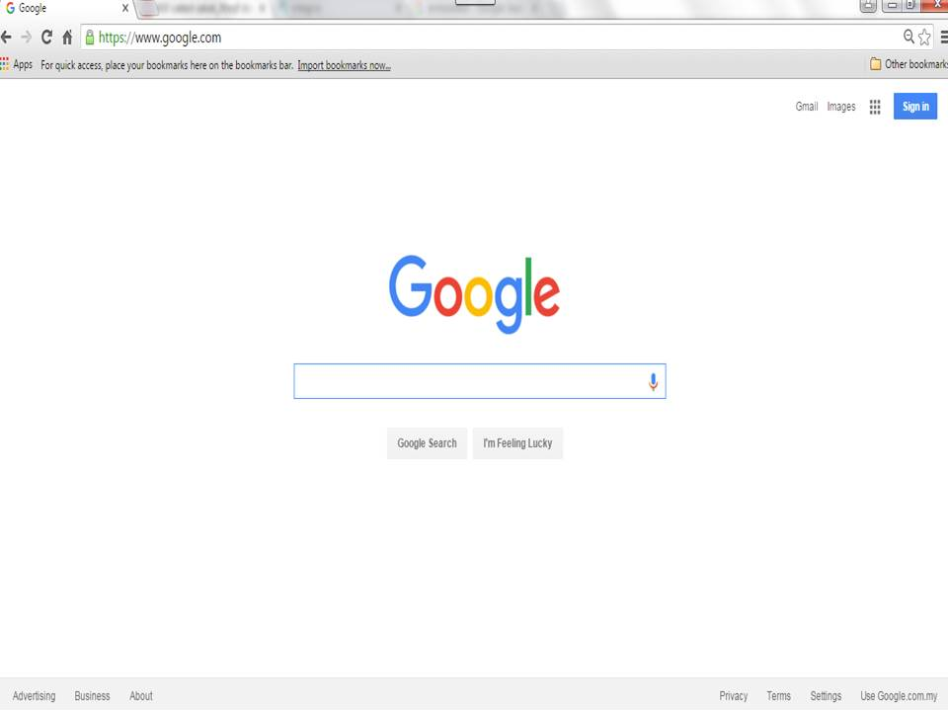
How it works?
Screen Sample
BEFORE the Ads Injection

Slide 18

How it works?
Screen Sample
AFTER the Ads Injection

Slide 19

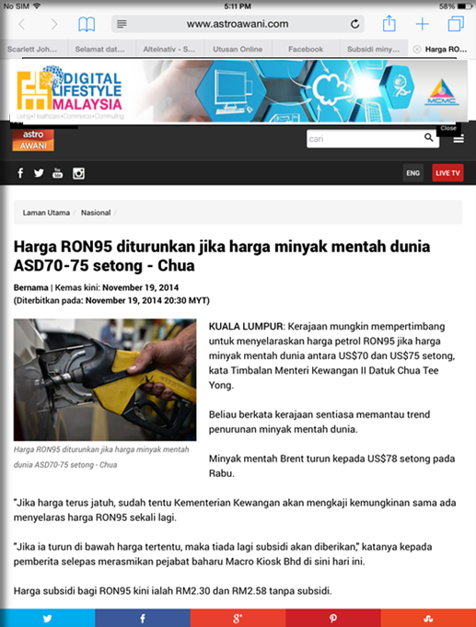
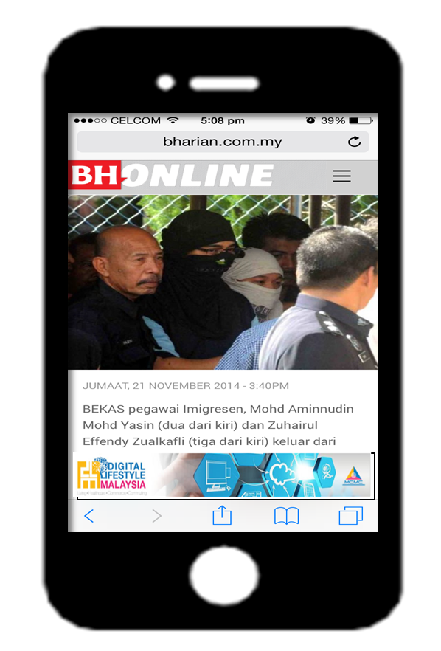
responsive ads injection
Ads Injection
Mobile Phone
Screen Size
Ads Injection
Tablet Screen Size

Slide 20
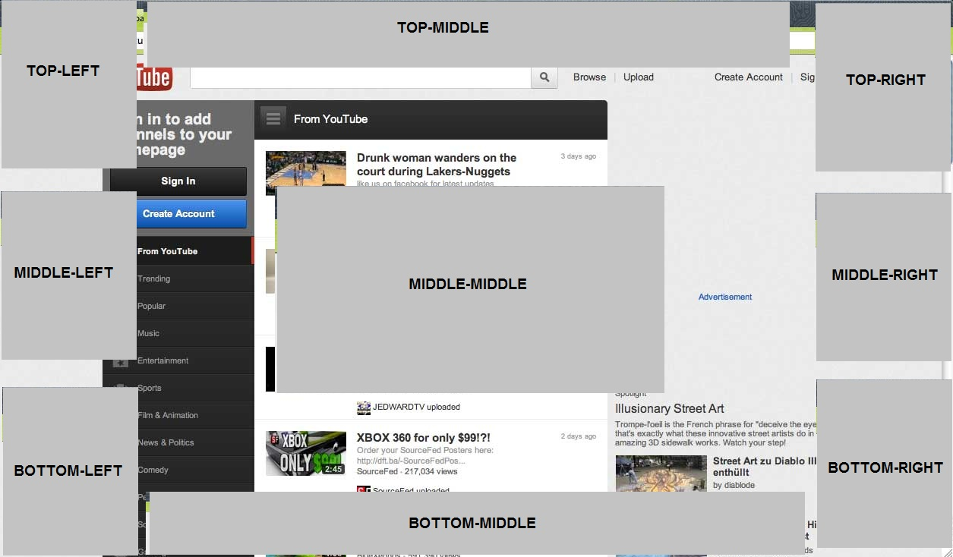
floating position options
Ads Injection are able to be position at anywhere on the screen panel

Slide 21

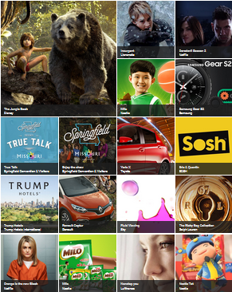
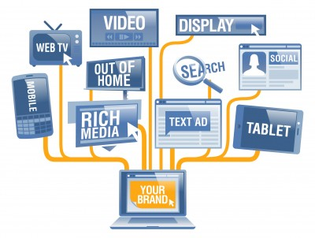
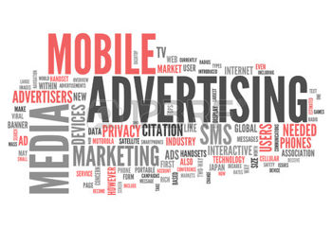
Rich media support
Static
(Text / Picture)
Animation? Flash
Running Text
Video

Slide 22


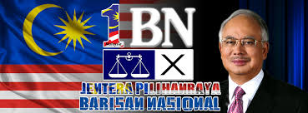
Sample banner injections

Slide 23
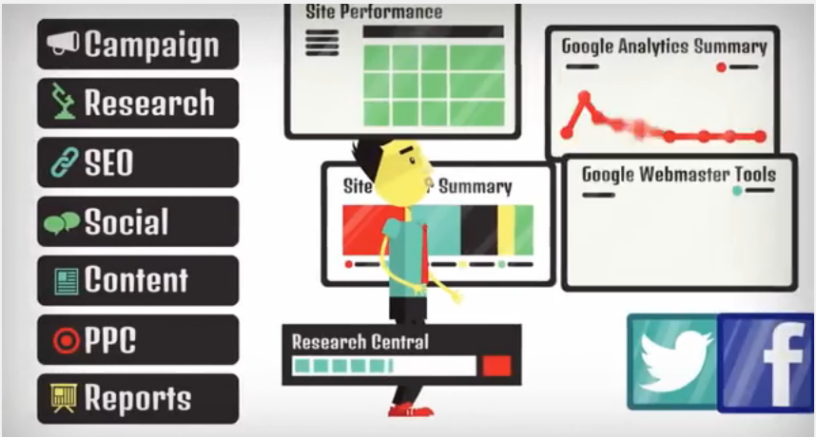
Optimized reports
Injection
  No. of injection
  Type of injection (banner, video)
  Time of injection
  Clients name of injection
Users URLs Access Behavior
    Sport, News, Social etc.
Users Access Statistic
    Devices, Time, Area etc.
MCMC able to extract report anytime from FR Salihin AdVedia. Records can be sorted based on many types of time frame, from daily basis, weekly basis, monthly or specific dates. FR Salihin AdVedia also updating their records in real time, but pooling their update into website interface every 2 hours.
Equipped with user-friendly graphic diagrams until easy spreadsheet that available to retrieve 24/7 to help Advertiser in measure their campaign effectiveness.

Slide 24

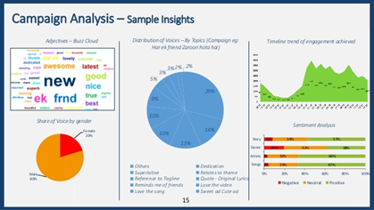
Ads Analytics
Custom Dashboards
No more digging through reports. Put all the information you need on a custom Dashboard that you can email to others.
Actionable insight into your advertising and website design
Ads analytics helps Government, advertisers & entrepreneurs to find out what advertising copy pulled the most responses, and what landing pages and content make the most money for them.
Tracks all campaigns
FR Salihin Ads Analytics tracks all online campaigns, from small text based to full fledge campaign, regardless of time, size, period and budget.
Sophisticated Analytics
Our analytics has all the features you'd expect from the high-end analytics offering. It also provides tightly integrated support.

Slide 25
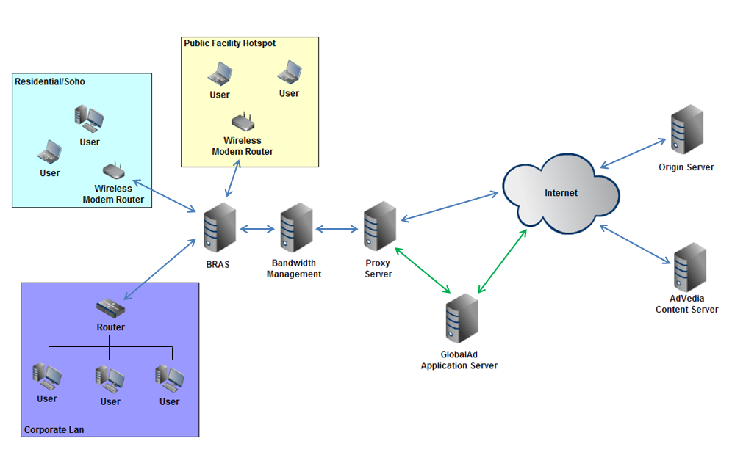
System architecture
We develop application server that able to be installed on PI1M NOC. By implementing centralize server, PI1M focus in power of FR Salihin Ads Vedia server without need to monitor distributed gateways that place near subscriber place.
Diagram 1: FR Salihin Ads Architecture
PI1M server must be robust and reliable enough to support data traffics. Since the amount of traffic is huge, careful load balancing, clustering server and backup server need to be install and made ready.

Slide 26
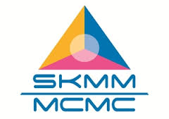



Proposed workflow
KKMM via MCMC as the PI1M Project Owner appoint FR Salihin to kick start new digital media project
PI1M allow
FR Salihin to
Install & commissioning New Digital Online Media Platform to their NOC.
FR Salihin will be appointed as turn key technology partner in install & commissioning the system and solutions and consult KKMM & MCMC in operate and manage the Ads platform.

Slide 27
PI1M COMMUNITY CONTENT
ENHANCEMENT & EMPOWERMENT
NEW DIGITAL MEDIA
PRESENTATION SLIDES

Slide 28
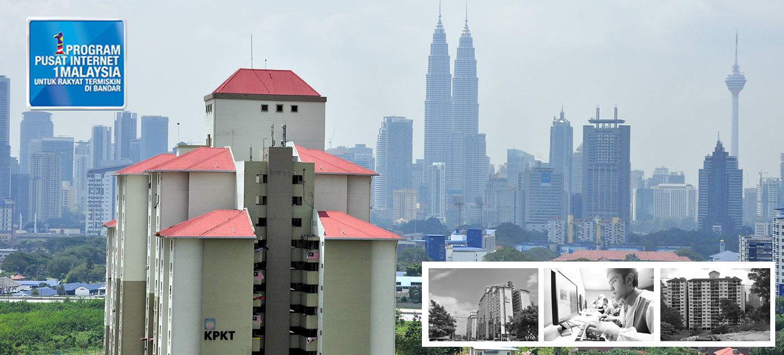
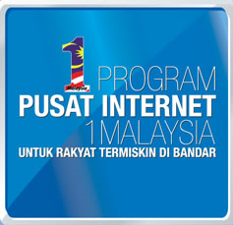

Monetization of PI1M Wi-Fi Network with Digital Online Media Platform as New Revenue and Communication Channel
Advedia

Slide 29



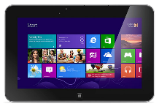


Introduction- current scenario
People using WiFi to access Internet for Work, Social and Entertainment with any devices
Work
Social
Entertainment

Slide 30









Introduction- current scenario
Work
Social
Entertainment

Slide 31
Introduction- current scenario
Work
Social
Entertainment

Slide 32


Introduction- current scenario
Work
Social
Entertainment

Slide 33

How much these website pay to pi1m or mcmc as wi-fi provider?

Slide 34

Introduction- current scenario
Work
Social
Entertainment

Slide 35
How it work?
DEMO

Slide 36
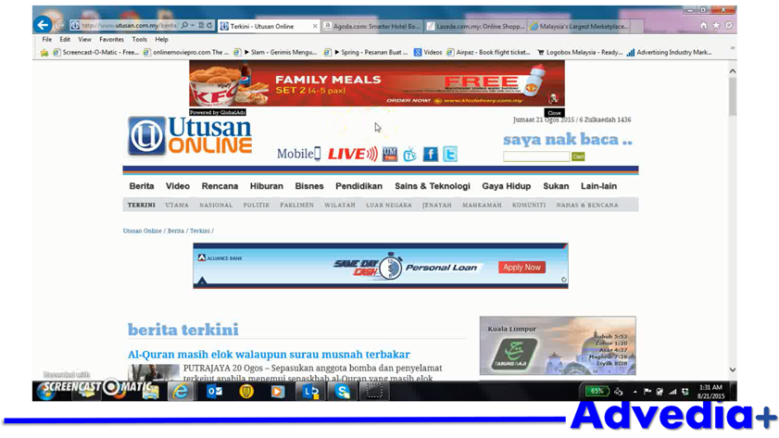
How it work?
Once user connected to the PI1M WiFi we will inject the banner
(1st page – Utusan Online)

Slide 37
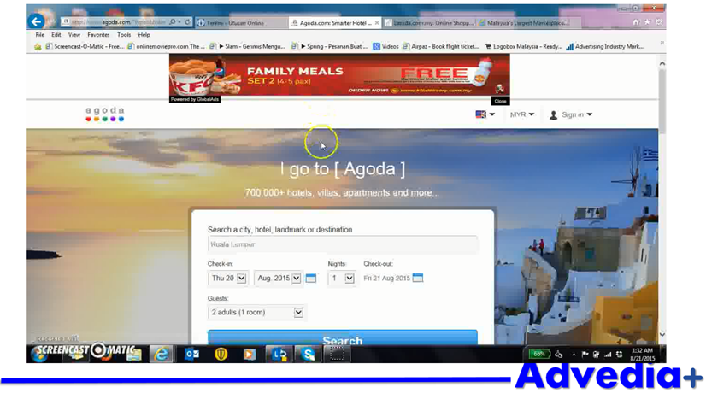
How it work?
Even the user change the website page the banner will still appeared
(2nd page – Agoda Website)

Slide 38
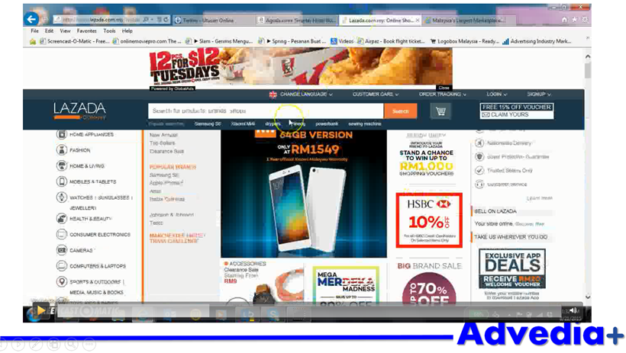
How it work?
User change the website page the banner will still appeared
(3rd page – Lazada Website)

Slide 39
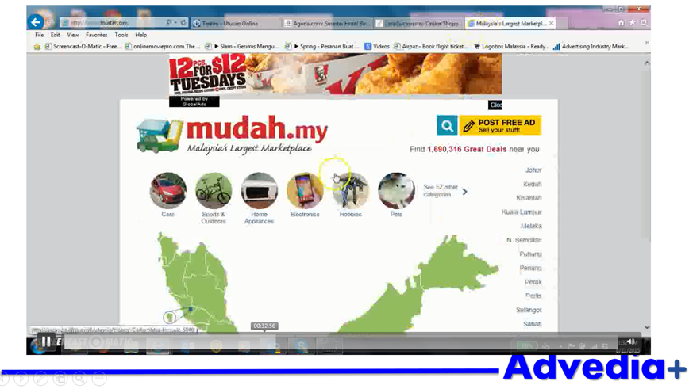
How it work?
User change the website page the banner will still appeared
(4th page – Mudah.my)

Slide 40
How it work?
We provide the close button if the user don’t want to see the advertising
(1st page – Utusan Online)

Slide 41
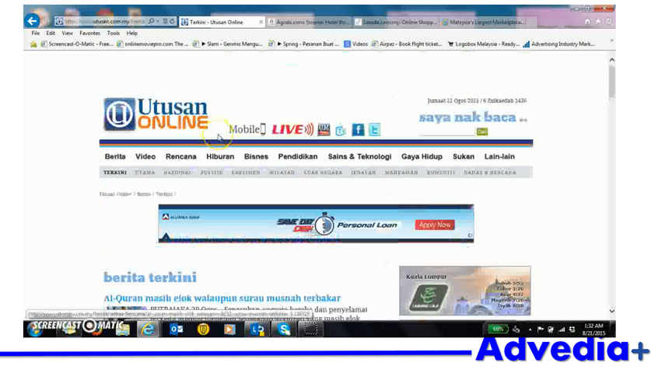
How it work?
Banner not available
(1st page – Utusan Online)

Slide 42
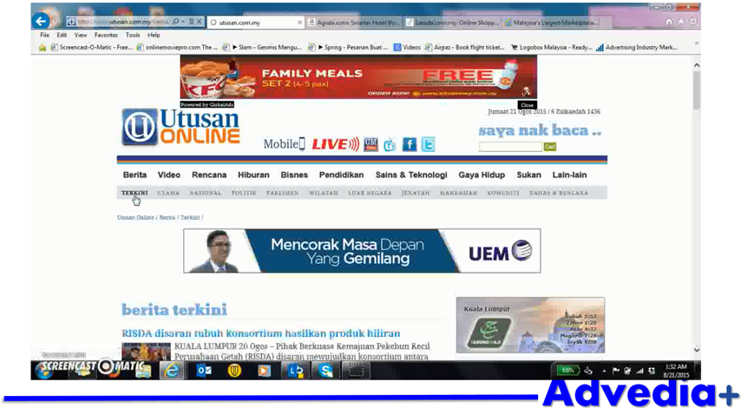
How it work?
When user open new page the banner will appear again
(2nd page – Utusan Online)

Slide 43
How it work?
User can click the banner and will direct to the advertiser website

Slide 44
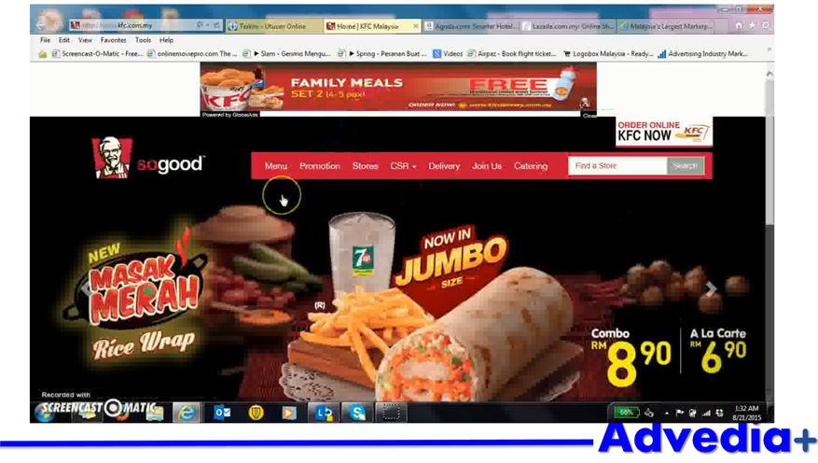
How it work?

Slide 45
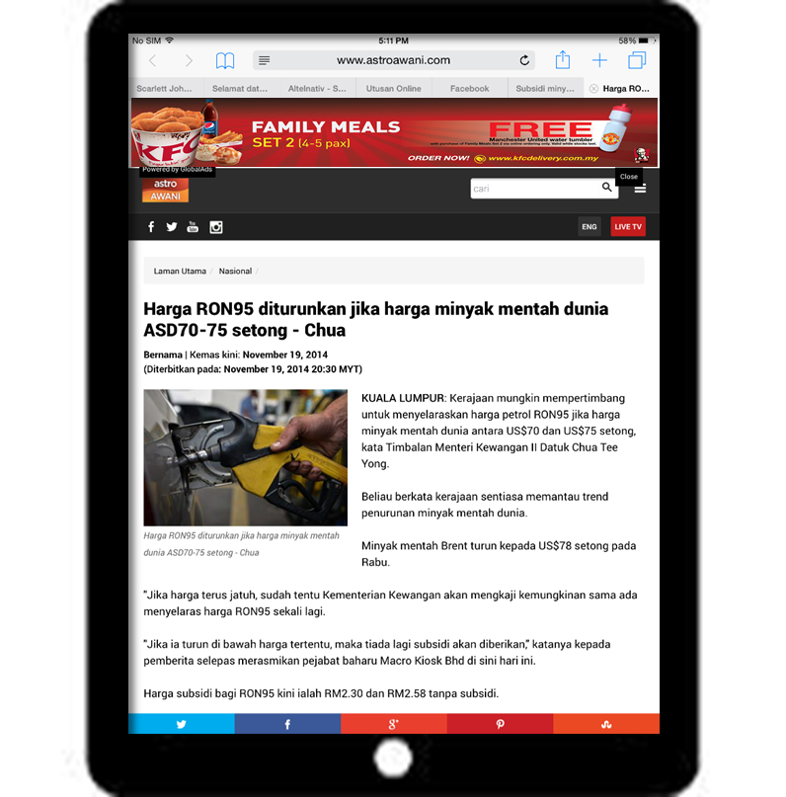
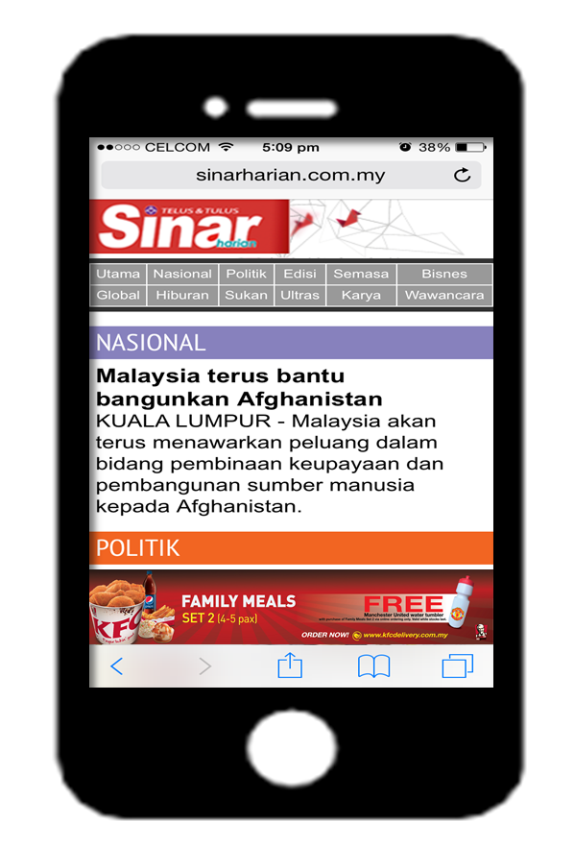
Support any type of device

Slide 46
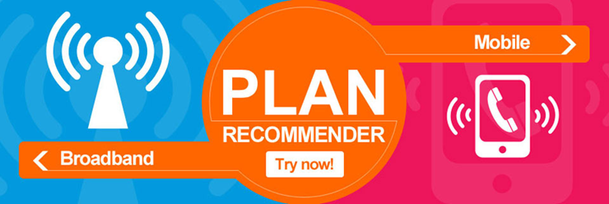
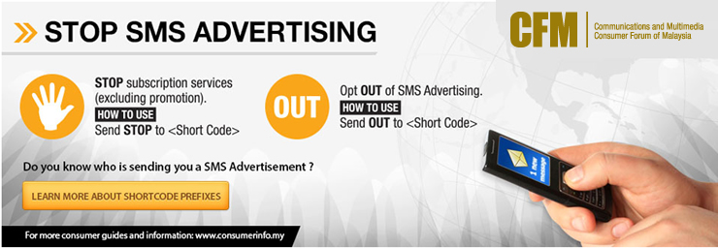

Sample pi1m information injections

Slide 47


Sample advertisement injections

Slide 48
Benefits & opportunities to pi1m
Easy dissemination of information direct to the PI1M Community
Effective broadcasting of News, Event, Incident, Reminder, Advertising to PI1M Community
Able to understand PI1M Community internet usage behavior and access statistics
PI1M can generate revenue from advertising income
Return of investment for WiFi infrastructure cost

