Slide 1
LEARNING & JOB MATCHING PLATFORM

Slide 2
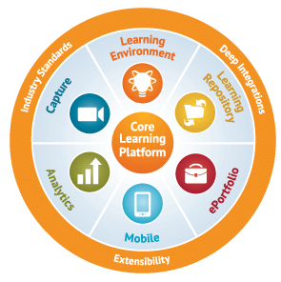
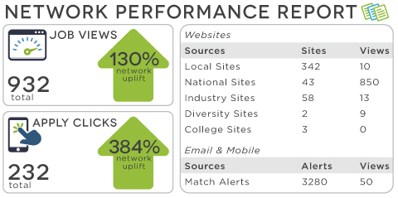
EXECUTIVE SUMMARY
SPS Learning & Job Matching Platform aims to deliver PI1M community a learning opportunities as well as job opportunities.
It consists of short, free, high quality, self-directed and support focused functions and activities for PI1M participants to go for extra miles in SPS, SPSLite CashBook and SPSLite Entrepreneurs Web as well as professional and personal development.
Courses are developed by SALIHIN subject matter experts and participated academia from our TAF participating universities. The Learning platform is available to be used by all PI1M participated users.
At the same time, It will be made accessible for the potential employers and also academia to assess the potential candidates for further engagement.

Slide 3
E-Learning Materials
No | LIST OF TRAININGS
1. | Business Documentation Training
2. | SPS Basic Training
3. | SPSLite Training
4. | SPSLite Website Training (Basic)
5. | SPSLite Website Training (Advance)
No | TYPE OF CONTENT
1. | Web Online Seminar (Webinar)
2. | Video Training & Tutorial
3. | Online Training Materials (Web & Mobile)
4. | Online Test & Examination
5. | Online Certification

Slide 4
Development principles
In the development process of learning & job matching platform , we will emphasize on best practice to ensure the service delivery would not compromised the KKMM, MCMC and PI1M standards and expectation.
We also will ensure that the operation of learning & matching platform will give a better experience for PI1M participant in term of functional, Content, Technical, Business, Usability and Responsiveness.
The online service offered can be fully completed online. A participant does not need to complete any off-line activities such as printing a document to be submitted except for his/ her own record.. Fully executable services results in potential savings in terms of money, time and labor.
SERVICE ENHANCEMENT
All the global best practice sites solicit participant feed back through comments or feedback sections. This constant check from the end users helps learning & job matching system to improve the services they are providing continuously.
SERVICE PRESENTATION
SERVICE DELIVERY
System support are provided during office hours (Applicable for minor problems & system modification only) .
Simple UI Design and Ease of Navigation. A consistent look and feel would reduce the time user need to familiarize themselves with a system’s functionalities.
SERVICE ASSISTANCE

Slide 5






Learning & Job Matching DIAGRAM
Reporting
Entrepreneurs
MySql Database
Entrepreneurs
Potential Employers
PI1M
Participants
Participant Registration Module
Employer Registration Module Module
Registration
Assessment
Training & E-Learning Module
Job Posting Module
members
Exam & Certification Module
Reporting Management Module
members
Match Make & Recommendation
members
Diagram 1.0 illustrate the overall concepts of Learning & Job Matching Platform.

Slide 6
SYSTEM modules
User Registration
Employer Registration
E-Learning
Exam & Certification
Job Match
Reporting
Proposed development Modules :-
  User Registration & Management Module
  Employer Registration & Management Module
  E-Learning Management Module
  Exam & Certification Management Module
  Job Matching Management Module
  Reporting Management Modules
Proposed database
  MySql
Proposed Service Repository
  Cloud Based/ Web Hosting Service

Slide 7

User interface
Diagram 2.0 illustrate the main page of Learning & Job Matching Platform

Slide 8
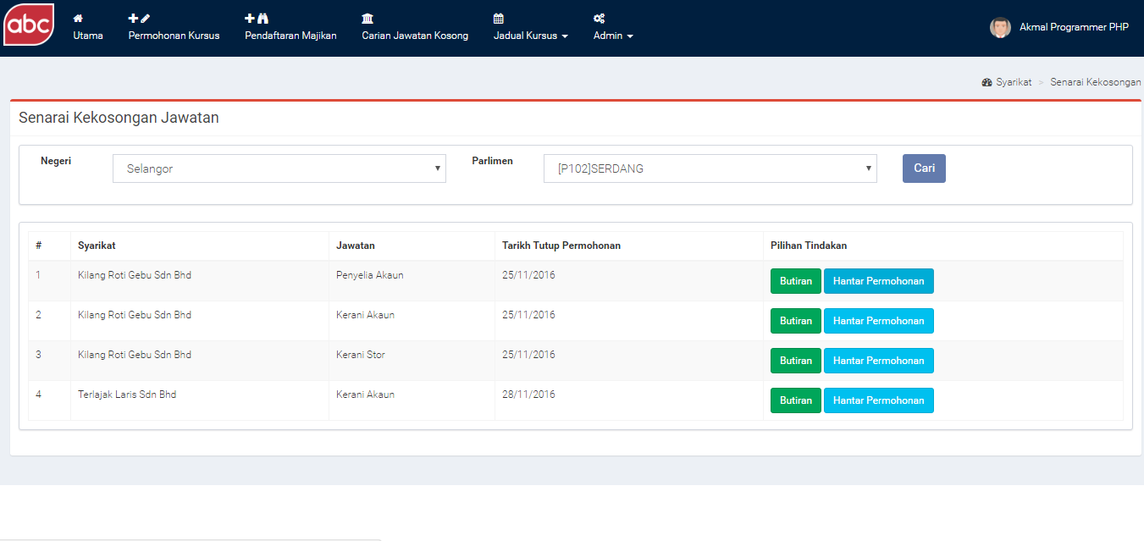
Mock up interface
Diagram 3.0 illustrate the latest job offering page
Diagram 2.0 illustrate the main page of Learning & Job Matching Platform

Slide 9
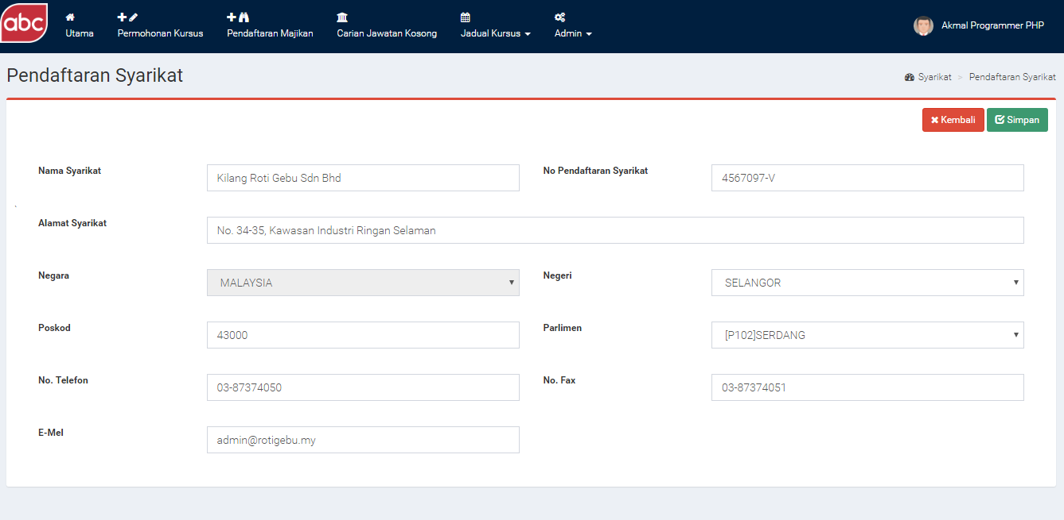
Mock up interface
Diagram 4.0 illustrate the employer registration page

Slide 10
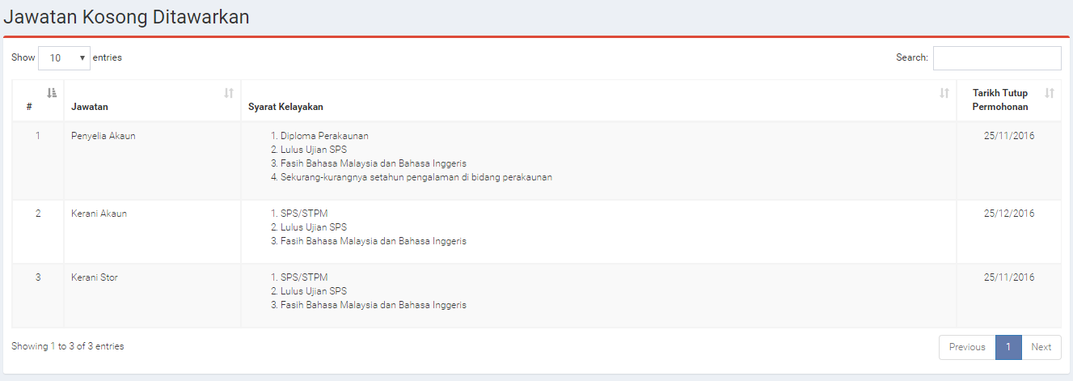
Mock up interface
Diagram 5.0 illustrate the new job posting by employer

Slide 11
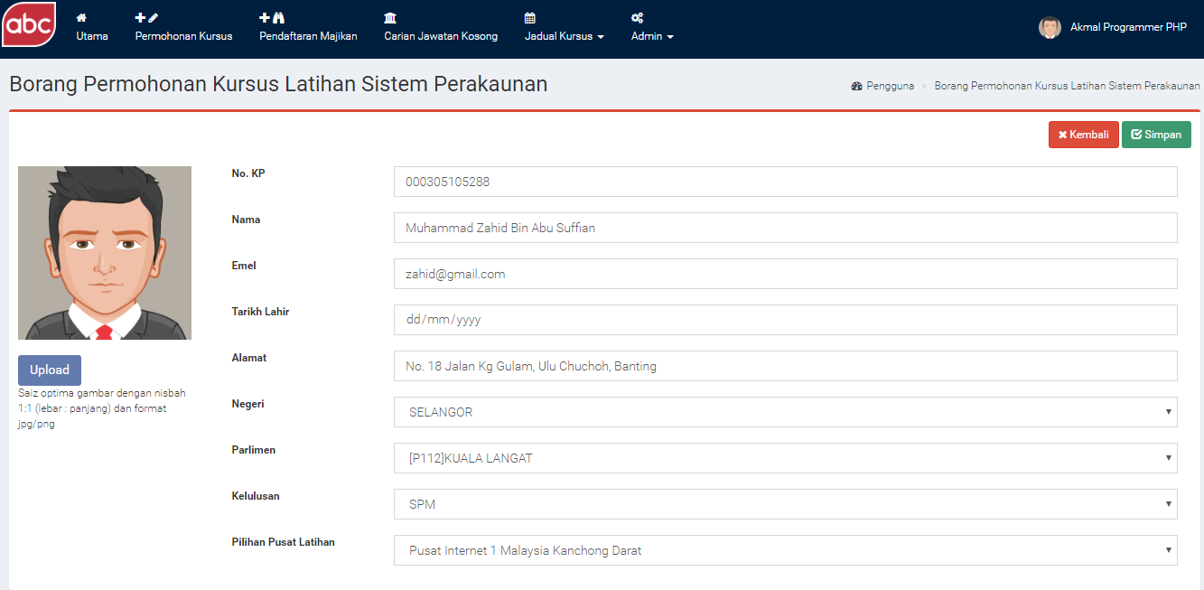
Mock up interface
Diagram 6.0 illustrate the SPS training registration form

Slide 12
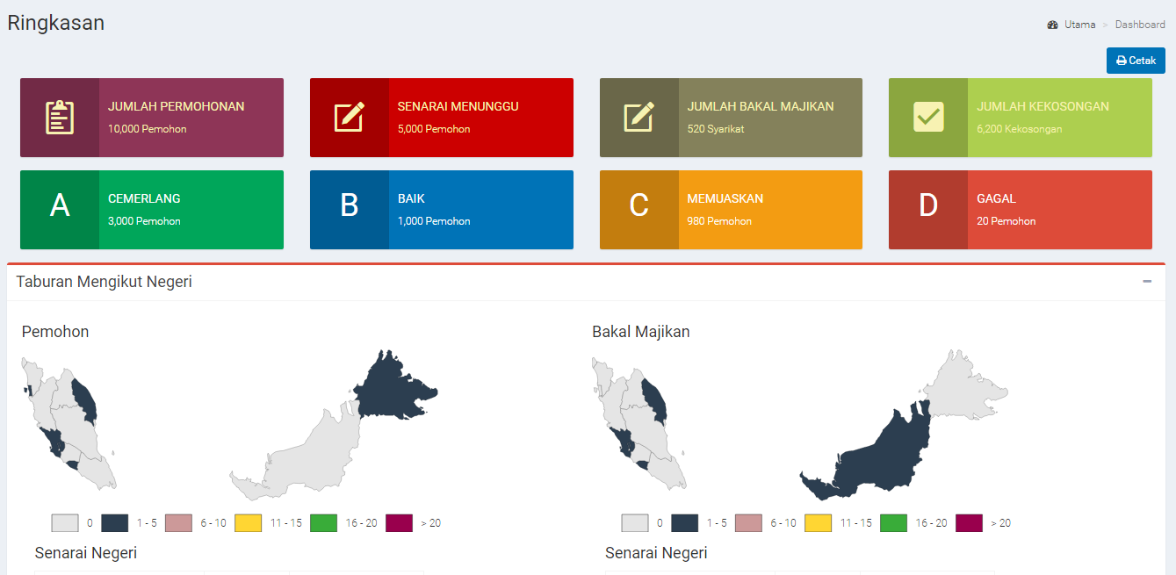
Mock up interface
Diagram 7.0 illustrate the SPS training intelligent dashboard

Slide 13
Mock up interface
Diagram 7.0 illustrate the SPS training intelligent dashboard

