Slide 1

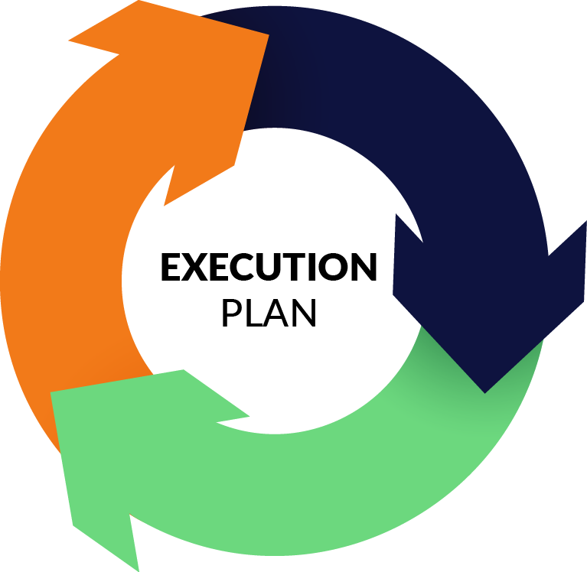

Slide 2
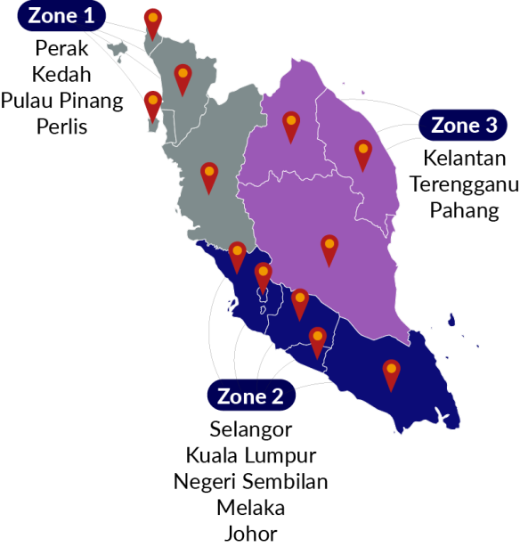
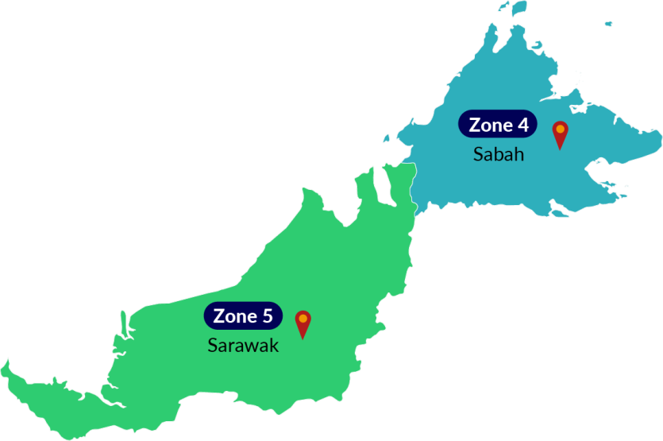
Proposed pi1m ZONING POSITION & ROAD MAPPING

Slide 3
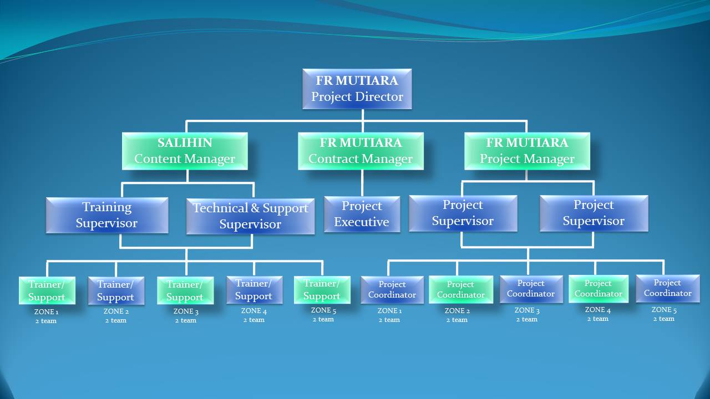
Proposed PROJECT MANAGEMENT TEAM
*
*
*
*
*
**
**
**
**
**
Note;
* 2 pax / team
** 1 pax Project Coordinator / team
Note;
Numbers of pax = 50

Slide 4
Proposed JOB SCOPE & RESPONSIBILITIES
POSITION | JOB SCOPE
PROJECT DIRECTOR | To liaise & follow-up with SKMM or KKMM on future & upcoming project To be a lead on Project Steering Committee Meeting To make sure that the project follow according to the schedule & plan
PROJECT MANAGER | To lead & manage the project & meeting Liaise with internal or Salihin deployment team to ensure success deployment of the system Attending Project Steering Committee Meeting
CONTRACT MANAGER | To liaise with bank, Funder, Loan Institution, Insurance, company secretary To prepare project contract & related document Monitoring on project costing Liaise with Authorities Attending Project Steering Committee Meeting
CONTENT MANAGER | Responsible on the content including training module Planning & conduct the training session by classroom, Web based training, Online training, mobile video training Develop technical solution for customer issues related to software setup and configuration Delivered technical support service

Slide 5
CON’T JOB SCOPE & RESPONSIBILITIES
POSITION | JOB SCOPE
PROJECT SUPERVISOR | To monitor movement all project coordinator following the schedule as per agreed To prepare monthly report & related documents To attend all related meeting etc Project Coordination meeting & Project Contractor Meeting & Project Steering Committee Meeting Responsible on arrangement of training session to be in good order etc arrangement of meal, place, liaise with PI1M pengurus wilayah To ensure the system are verified & validate by SKMM & KKMM Provide technical assistance and guidance during Installation & training implementation Prepare the work flow
PROJECT EXECUTIVE | To monitor movement all team following the schedule as per agreed To check & prepare report on project costing To attend all related meeting etc Project Coordination meeting & Project Contractor Meeting & Project Steering Committee Meeting
PROJECT COORDINATOR | To monitor on SALIHIN Team movement on installation & Training implementation To prepare Site weekly report, Service & Maintenance checklist & report To assist on training session arrangement To liaise with PI1M pengurus wilayah Attending Project Contractor Meeting To setup booth & registration

Slide 6
CON’T JOB SCOPE & RESPONSIBILITIES
POSITION | JOB SCOPE
TRAINER SUPERVISOR | Responsible on the content including training module and material To plan and supervise training session To prepare SPS certification Attending Project Steering Committee Meeting
TECHNICAL & SUPPORT SUPERVISOR | Liaise with the Project Manager and the deployment team to ensure the success of the system deployment. To prepare SOP and monitor the problem and support activities Develop technical solution for customer issues related to software setup and configuration via SPS Helpdesk Attending Project Steering Committee Meeting
TRAINER | Conduct training session Conduct SPS exam Assist and support Web based training, Online training and mobile video training Assist SPS Helpdesk
TECHNICAL & SUPPORT ENGINEER | Deploy the system Delivered technical support service Assist trainer during training and exam session Assist SPS Helpdesk

Slide 7

Trainer criteria
DIPLOMA / DEGREE HOLDER IN ACCOUNTING OR BUSINESS
CERTIFIED SPS TRAINER
WORKING EXPERINCED ATLEAST 2 YEARS
EXCELLENCT IN PUBLIC SPEAKING

Slide 8



PROPOSED METHOD OF STATEMENT (TRAINING PROGRAMME)
Preparation daily report
Preparation of Weekly report
Preparation of monthly report
Preparation of Checklist & maintenance report
The report consist of attendance record,
Activities programme and Status of participant
Submission report to client for approval
Reporting
Step 4
Preparation of arrangement movement by team according to an agreed schedule planning
Arrangement of Transportation by zone
Preparation of meals, arrangement of site & training programme
Arrangement team on advertisement & promotion
Site arrangement with SKMM, Service provider and vendor
Step 3
Organizing the Project
Preparation of meeting agenda to discuss on any pre & post development
Preparation of meeting agenda to discuss on any pre & post development
Preparation of schedule plan during the design & operation phase.
To prepare the safety guideline and all the appropriate acts.
To prepare a team to do the site survey on each PI1M site to clarify on site accessibility & other issues
Step 2
Coordination between all team
Step 1
Mapping PI1M site
To list down all 600PI1M as approved by SKMM
Zoning By 5 Zone

Slide 9
PROPOSED MILESTONE PROGRESS SCHEDULE
MONTH | DESCRIPTION | DELIVERABLE | PERCENTAGE %
1 | Letter of Award (LOA) / Preliminary | Contractor to submit Performance Bond (PB) in the form of Bank Guarantee (BG) PB / BG is 5 % from the total contract value of the Letter of Award (LOA) | 5%
4 | 1st Steering Committee Meeting | Contractor to submit to the Steering Committee; Project Management Team Organisation Chart Project scope deliverables Project Implementation Programme & Schedule Project SPS (Pi1M Training Module & Programme) Proposed Certification programme and mileage programme Trainer & Staff detail of CV Checklist, Maintenance & Monthly report Training Module | 5%
7 | Month 7 (100 PI1M) | Claim consist of ; SPS Installer pack Installation Help-desk Team viewer Support Free online chat Support On site Training (Anticipated 100 PI1M / month) | 15%
8 | Month 8 (100 PI1M) |  | 15%
9 | Month 9 (100 PI1M) |  | 15%
10 | Month 10 (100 PI1M) |  | 15%
11 | Month 11 (100 SPI1M) |  | 15%
12 | Month 12 (100 Site PI1M) |  | 15%

Slide 10
PROPOSED PROJECT TIMELINE FOR 5 YEARS
NO | TASK NAME | YEAR 1 |  |  |  |  |  |  |  |  |  |  |  |  |  | YEAR 2 | YEAR 3 | YEAR 4 | YEAR 5
 |  | M 1 | M 2 | M 3 | M 4 | M 5 | M 6 | M7 | M8 | M 9 | M10 |  | M 11 |  | M 12
1 | Pre-Development
1.1 | Received LOA/Performance bond / Contract
1.2 | Preparations & approval of Documentation
1.3 | Advertising & promotion
1.4 | Procurement, delivery & Installation of SPS System (Hardwares / Softwares)
1.5 | Commissioning & Handover Pi1M
1,6 | Maintenance Support
2 | Post-Development
2.1 | Training programme
2.2 | * Training support
* Training support ;
Webinar, / Video Training & Tutorials / Online Training Material / Online Test & Examination / Online Certification

Slide 11

PROPOSED STEERING COMMITTEE MEMBER’S
(ONCE EVERY 4 MONTHS)
MEETING AGENDA
Representative
from
FR Mutiara
SALIHIN
Representative
From
KKMM
1
Review the monthly practice statistics such as progressive project, adjustments, collections, outstanding claims, unscheduled time units, involvement by provider, daily activities averages, etc.
STEERING
COMMITTEE
MEMBER’S
Representative
from Service
Provider’s
Vendor
Representative
From
SKMM
2
Review the incomplete action items from the previous month(s) and check for progress
Representative
From
Service Provider
3
Discussion on the new agenda related to PI1M enhancement.

Slide 12
PROPOSED PROJECT MONITORING COORDINATION MEETING
(oNce a month)
Representative
from
Service
Provider
MEETING AGENDA
Representative
FR MUTIARA
SALIHIN
1
Status project
PROJECT
COORDIDATION
COMMITTEE
2
Status Reporting
3
Discussion & finalize on site issue
Representative
from
Service
Provider’s
Vendor
4
Coordination movement between Service provider , Vendor & FR Mutiara/ SALIHIN

Slide 13
PROPOSED MEETING AGENDA
PROPOSED MEETING SESSION | FREQUENCY | MEETING AGENDA
Proposed of Steering Committee Member Meeting Representative from KKMM Representative from SKMM Representative from FR MUTIARA Representative from Service Provider Representative from Vendor | Once every 4 month | Review the monthly practice statistics such as production, adjustments, collections, outstanding claims, unscheduled time units, production by provider, daily production averages, etc. Review the incomplete action items from the previous month(s) and check for progress Discuss the new agenda items
B) Proposed of Project Coordination Committee Meeting Representative from FR MUTIARA Representative from Service Provider Representative from Vendor | Once a month | Status project Status Report Discussion & finalize on site issue Coordination movement between Service provide or Vendor & FR Mutiara
C) Proposed of Project Contractor Meeting Representative from FR MUTIARA Representative from SALIHIN | Every fortnightly | Management review Review on reporting Status project Status payment

Slide 14





PROPOSED MONITORING SYSTEM
ZONE 1
KKMM
ZONE 2
Daily report
Weekly report
Monthly report
Maintenance
Report
- Checklist
SKMM
ZONE 3
SERVICE
PROVIDER
ZONE 4
ZONE 5
Reporting consist of attendance record,
Activities programme and Status of participant

