Slide 1





PI1M COMMUNITY CONTENT ENHANCEMENT
BY ACCOUNTING SOLUTIONS
Prepared for:
Prepared by:

Slide 2
TABLE OF CONTENT
Project Executive Summary
Page 3-10
SPS Training Module
Page 11
Continuous Learning & Support
Page 22
Execution Plan
Page 28
SAS & Web Interface
Page 36

Slide 3

Project directorate
FR Mutiara is an established information & technology consultation company with a mission to be the preferred project management consultant and to become one of the premier player in Malaysia business landscape which provide consultancy services and solutions to different organizations across Malaysia, creating value for clients by leveraging industry knowledge and service offering expertise with an insight into and access to all the emerging technologies.
Company Vision
“Setting standards utilizing best available solutions”
Mission Statement
“Committed to excellence in providing innovative and reliable Information Technology services”

Slide 4




Subject matter expert
SALIHIN is one of the fast growing and leading indigenous brand in Malaysia, which umbrellas a group of distinctive entities tailoring unique and independent consulting services to local and international clientele. SALIHIN offers an integrated and wide spectrum of value for money professional services in the areas of auditing and assurance, taxation (direct and indirect), business advisory, information technology, accounting software and corporate finance.

Slide 5




Introduction of Content Provider Contractor (SIPS)
Powered By Salihin Accounting System (SAS)
Managed By Salihin IT Solution Sdn. Bhd.
(SITS)

Slide 6

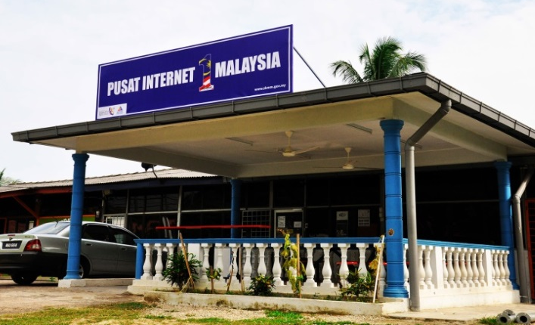

OUR OBJECTIVE
PI1M CONTENT
ENHANCEMENT & EMPOWERMENT
PI1M CENTRE VISIBILITY & NEW SERVICE OFFERINGS
ACCOUNTING SOLUTIONS
INDUSTRIES PARTICIPATION
TRAINING PROGRAM
ACADEMIA PARTICIPATION
CERTIFICATION PROGRAMME
LEARNING & JOB MATCHING PLATFORM
CONTINUOUS LEARNING
(ONLINE & OFFLINE
CONTINUOUS SUPPORT

Slide 7
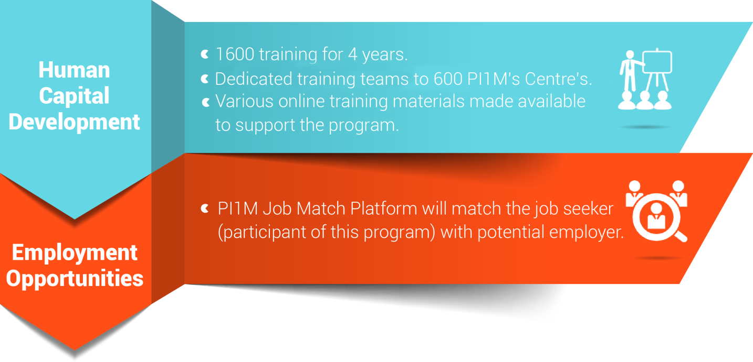
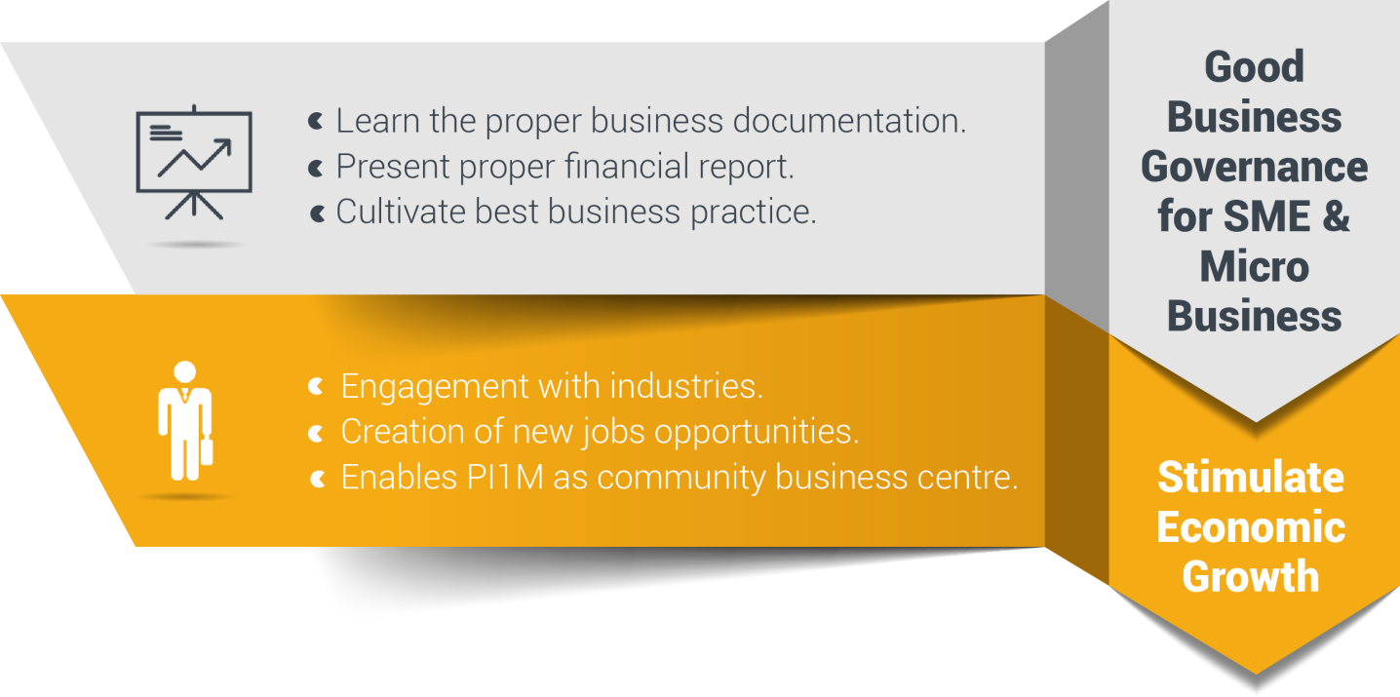
Reaching underserved communities

Slide 8




Targeted deliverables
1,200
PI1M Accounting Technician
3 Modules
2 Days Training +
½ Day Revision +
½ Day Exam
Dedicated Team Will Conduct Training to Assigned Zone.
Zone 1
  Perak, Kedah, Penang, Perlis
Zone 2
  Selangor, Kuala Lumpur, Malacca, N. Sembilan, Johor
Zone 3
  Kelantan, Terengganu, Pahang
Zone 4
  Sarawak
Zone 5
  Sabah
30,000
Expected Participations
1,600
Targeted
Training Sessions

Slide 9





Road to success
Further Studies via SPS Webinar & Online Learning
Program
Kickstart
“PI1M Accounting Technician”
Business
SPS Job Matching Platform
Start
Own
Career
Pathways

Slide 10
Critical success factor
Support from KKMM
1
5
1
Support from SKMM
2
Coordination from telco’s
(service provider)
3
4
2
Coordination from telco’s technology partner
4
3
SITS – Content Provider Contractor
5
We have long believed that, over the long term, no institution, idea, or effort of real consequence is ever successful on its own; the most impactful efforts are those approached collaboratively and achieved through close partnership.

Slide 11

SPS TRAINING MODULE

Slide 12

What is sps?
Equip PI1M Centre with comprehensive SOFTWARE & FREE TRAININGS of high value added accounting software.
Groom & nurture a FINANCIAL, MANAGEMENT & BUSINESS SOUND entrepreneurs in underserved areas.
Increase PI1M BUSINESS RELEVANCY to its respective communities.

Slide 13

















Community content enhancement framework
Rural Community
500,000 TEKUN Nasional Micro Entrepreneurs
300,000 AIM Micro Entrepreneurs
15,000 Co-operatives i.e Micro Co-Operatives
500 PKK Nationwide
400 Fishermen’s Association Nationwide
PI1M “Accounting Technician”
New Job Creation
Potential accounts to be served via PI1M

Slide 14


SITS accounting offerings
30,000 FREE Licenses for 5 Years
SPS, SPSLite CashBook & Entrepreneurs Web @ 600 PI1M
  1,600 FREE Training Session with examination for 4 Years
SPS, SPSLite CashBook & Entrepreneurs Web @ 600 PI1M
  30,000 Accreditation & Certifications
SPS, SPSLite CashBook & Entrepreneurs Web @ 600 PI1M
  Learning & Job Matching Platform for participants to engage with potential employers
  Free PI1M Entrepreneurs Event Awards with Media Coverage in Major Malay Newspaper for 1 Years
  (Schedule and Timetable – TBD)

Slide 15








Target audience
Small & Micro
Entrepreneurs
PRE-REQUISITE
PC Literate
SRP/ PMR Holder
Minimum 10-20 Pax
Registered with PI1M
Women Entrepreneurs
Single Parent
Part-Time Housewife
Student
Under Graduate Student
Graduates
SPM Leavers
Unemployed
Others

Slide 16

SITS continuous learning
NO. | TRAINING MODULES | METHOD OF TRAINING | SYLLABUS
DAY 1 | Basic Accounting & Business Documentation | Class Room Online Seminar (Webinar) Online Training Video & Tutorial Online Training Material Online Test & Examinations | Objective: To Maintain Systematic Records of Business Transaction in Order to Generate Various Report. Company Setup User Setup User Access Right Chart of Account System & General Setup Form Setup Financial Year Calendar
 | SPSLite Training & Basic/ Advance SPSLite Website Training
DAY 2 | SPS Training
DAY 3 | Revision Examination
Anticipated Class Room Training for 600 PI1M Min 10-20 Participation Per Training 3 Modules (SPS, SPSLite & SPSWeb) 2 Days Training + 1 Day Exam 5 Years Continuous Learning

Slide 17

Trainer criteria
Diploma/ Degree Holder in Accounting or Business Management
Certified SPS Trainer
Minimal 2 Years Working Experience
Excellent in Public Speaking

Slide 18

SITS Training kits
Softwares Access
SPS, SPSLite & SPS Entrepreneur Web
01
02
Training Hand Out & Stationery
Manual
SPS, SPSLite & SPS Entrepreneur Web
03

Slide 19
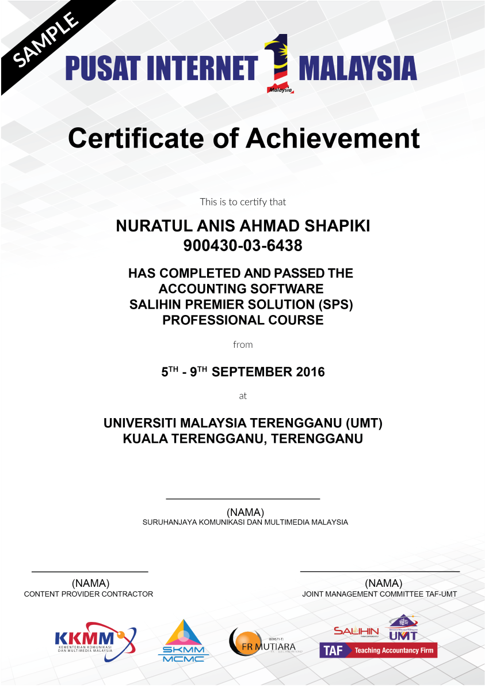

SITS certification

Slide 20

ACKNOWLEDGEMENT DAY
Anticipated Quarterly Event
Anticipated 1,000++ Graduates
Event Organized & Managed by SITS
Launch by KKMM & SKMM

Slide 21

Commercial mileage
In the spirit of business collaboration between SITS and KKMM/SKMM/PI1M, we will support Pi1M in providing quality products and services with the highest degree of customer satisfaction.
PI1M BUSINESS AWARD
Joint program between
SITS - KKMM – SKMM - PI1M
SKMM is required to share the success stories of PI1M business & entrepreneurs on monthly basis in Utusan/ Sinar Harian. (subject to negotiations terms & conditions between us and respective parties).
SITS will do the selection of the SME award winner lists based on good financial management & governance and SKMM internal criteria.
An event will be held to celebrate the winners.
Award will be sponsored by SITS.
SITS will sponsor the 1st year event and entrepreneurs segment in Utusan/ Sinar Harian.
Support By:

Slide 22
CONTINUOUS LEARNING & SUPPORT

Slide 23
Fact sheet
The 3 days education/ training program it’s not perceived only as 3 days training program, but it is essentially a 3 days fundamental training program + 5 years of continuous learning.
E-Learning & Job Matching Platform aims to provide PI1M community a learning opportunities as well as employment opportunities.
  It consists of a short, free, high quality, self-directed, support focused functions and activities for PI1M participants to go for an extra miles in SITS Product Offerings as well as professional and personal development.
  Courses are developed by SITS subject matter experts and participation academician from our TAF participating universities. The Learning platform is made available at all times for all PI1M participants.
  Simultaneously, the above will be made accessible for all potential employers and all academician to assess potential candidates for their further engagement.

Slide 24
E-Learning Components
1
Online Seminar (Webinar)
2
Online Training Video & Tutorial
3
Online Training Material
4
Online Registration
5
Training Schedule
6
Online Examination

Slide 25
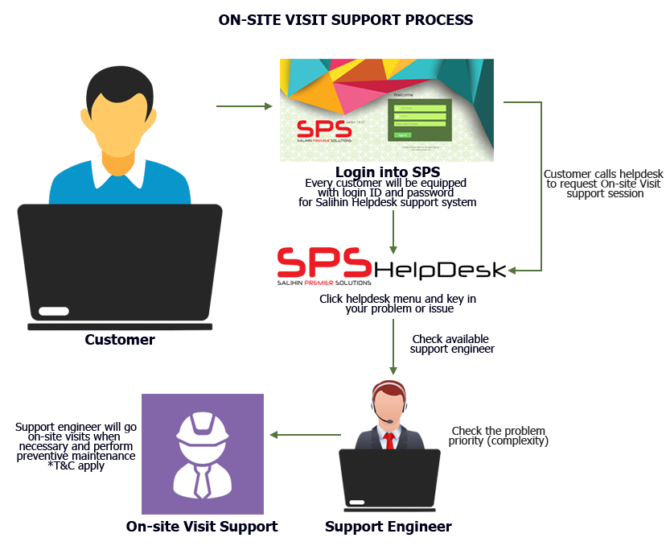
ON-SITE SUPPORT
Response time: Next business day (Klang Valley), Within 5 days (Peninsular area), Within one week (Sabah & Sarawak).
Diagram below illustrates how the mechanism works.
Working Hours: 8.30am – 5.30pm

Slide 26
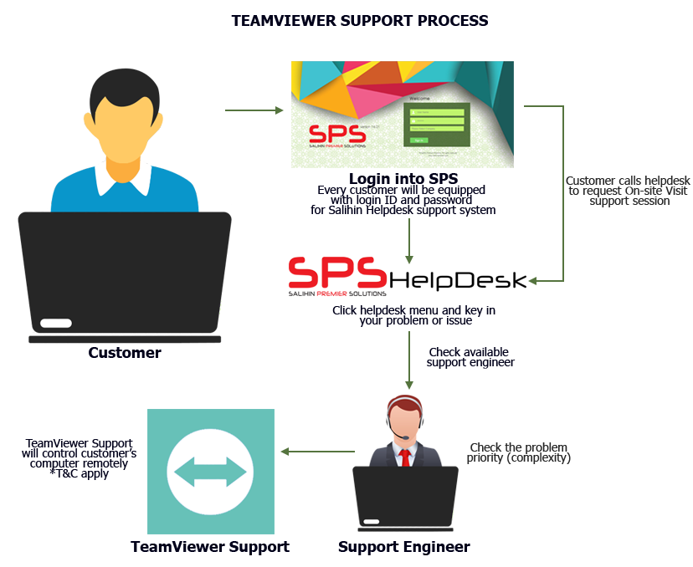
TEAM VIEWeR SUPPORT
Response time: Within 24 hours (Subject to availability).
Diagram below illustrates process of team viewer support.
Working Hours: 8.30am – 5.30pm

Slide 27
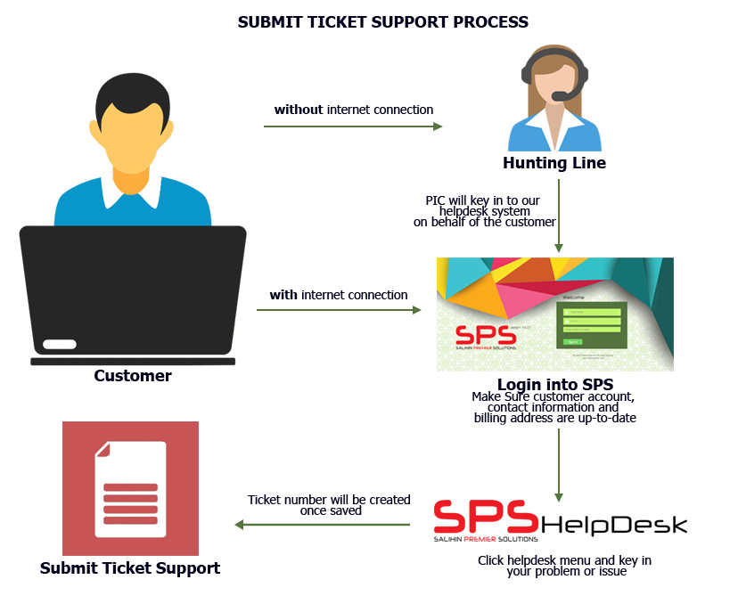
Helpdesk business SUPPORT
Response time: Within 24 hours week days (Subject to availability).
Diagram below illustrates process of helpdesk business support.
Working Hours: 8.30am – 5.30pm

Slide 28
EXECUTION PLAN

Slide 29
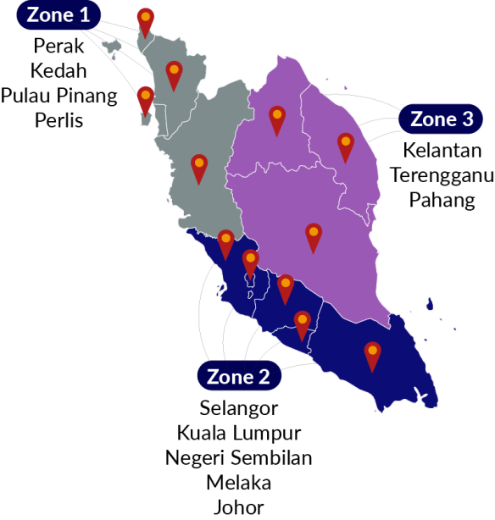
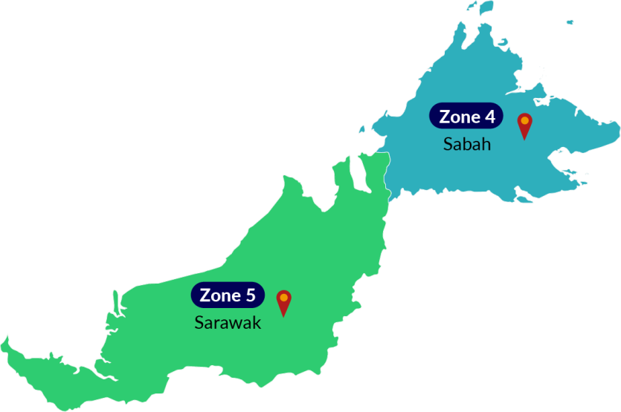
Proposed pi1m ZONING POSITION & ROAD MAPPING

Slide 30
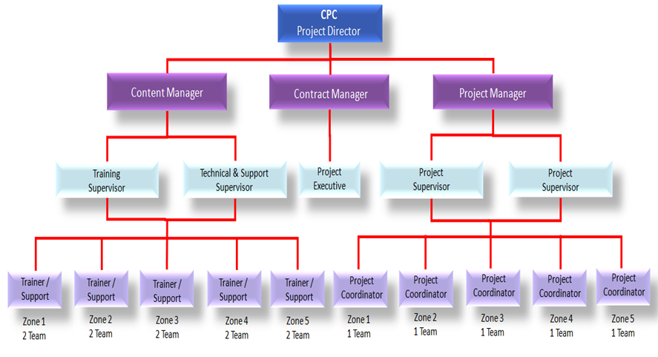
SITS PROJECT MANAGEMENT TEAM
NOTE:
Total = 60 Pax
Management = 5
Executive = 10
Backroom Support = 15
Filed Team= 30

Slide 31



SITS METHOD OF STATEMENT
Preparation daily report
Preparation of Weekly report
Preparation of monthly report
Preparation of Checklist & maintenance report
The report consist of attendance record,
Activities program and Status of participant
Submission report to client for approval
Reporting
Step 4
Preparation of arrangement movement by team according to an agreed schedule planning
Arrangement of Transportation by zone
Preparation of meals, arrangement of site & training program
Arrangement team on advertisement & promotion
Site arrangement with SKMM, Service provider and vendor
Step 3
Organizing the Project
Preparation of meeting agenda to discuss on any pre & post development
Preparation of schedule plan during the design & operation phase.
To prepare the safety guideline and all the appropriate acts.
To prepare a team to do the site survey on each PI1M site to clarify on site accessibility & other issues
Step 2
Coordination between all team
Mapping/ garner the critical support from KKMM, SKMM, Telco’s & Telco’s Technology Partner
To list down all 600 PI1M as approved by SKMM
Zoning by 5 Zone
Step 1
Mapping PI1M site

Slide 32



Key MEETING & COORDINATION STRATEGY
Review the monthly practice statistics such as production, adjustments, collections, outstanding claims, unscheduled time units, production by provider, daily production averages, etc.
Review on timeline progress project
Review on weekly report
Discussion on any other matters related to Pi1M activities
Review on deployment activities and problem arise
Discussion on project enhancement activities
Review on resources ,vehicle & training tools & necessary items

Slide 33




SITS REPORTING DELIVERABLES
PI1M ZONE
01
02
03
PI1M
Content Empowerment
04
Progress Report
Telco’s & Telco’s
Technology Partner
05
Reporting consist of Weekly, Monthly, Quarterly & Yearly
(Attendance, Activities, Training, Exam, Certification & Other’s Report )

Slide 34
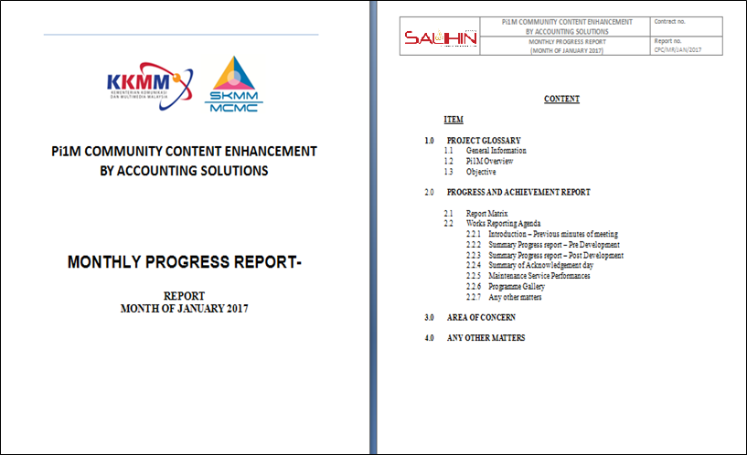
Sample monthly progress report

Slide 35
PARTICIPANT REGISTRATION PROCESS FLOW
Participant Fill a PI1M Registration Program Form
Registration
- By online
By walk in to Pi1M or SITS headquarters
By Booth event / Road show
If No
Check Participant
Status
Minimum Requirement
Registered with Pi1M
PC Literate
Min. academic qualification i.e SRP / PMR / SPM or others
If Yes
Reschedule For Next Training
Confirm
Training Dates &
Location
ACKNOWLEDGEMENT DAY*
Organize by SITS
Launch by KKMM/ SKMM
N/B: Dates & location to be assigned during Steering Meeting
Helpdesk to Counsel & Assists the Unsuccessful Participant
Training Class & Exam
If No
If Pass
Access to Continues
e-Learning
* Participant Received
Certificate
Job Matching Platform

Slide 36
WEB INTERFACE

Slide 37

SKMM PI1M landing page

Slide 38
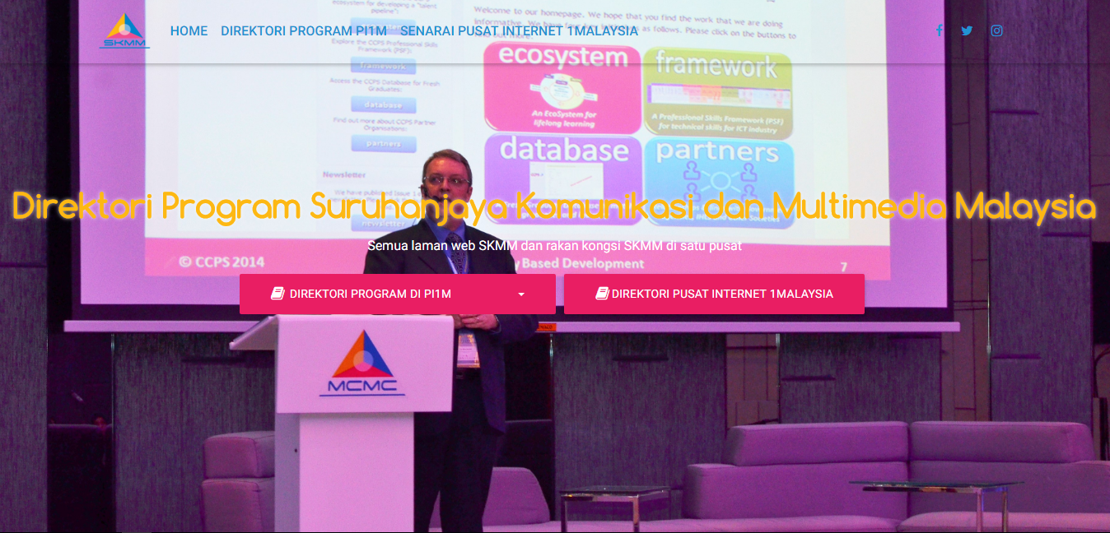
SKMM PI1M content landing page

Slide 39
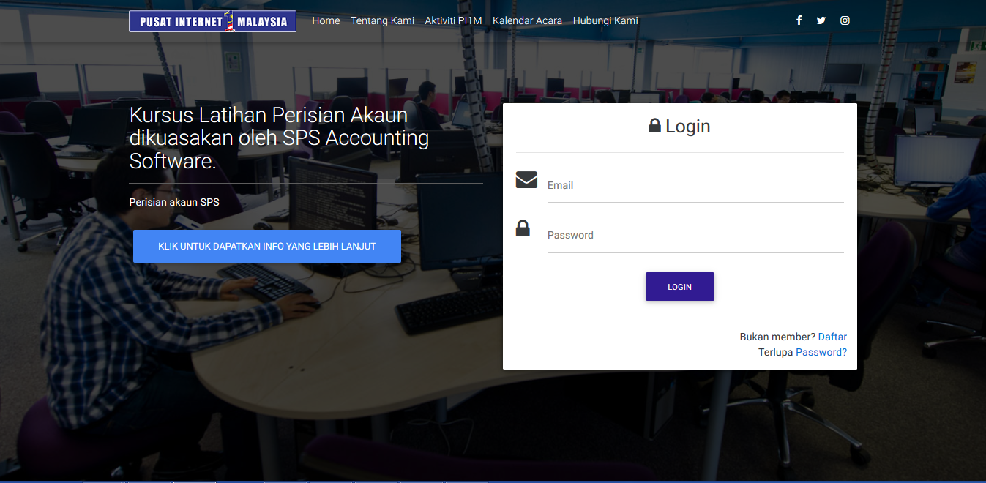
Sits accounting content landing page
Diagram 4.0 Illustrate The Employer Registration Page.

Slide 40
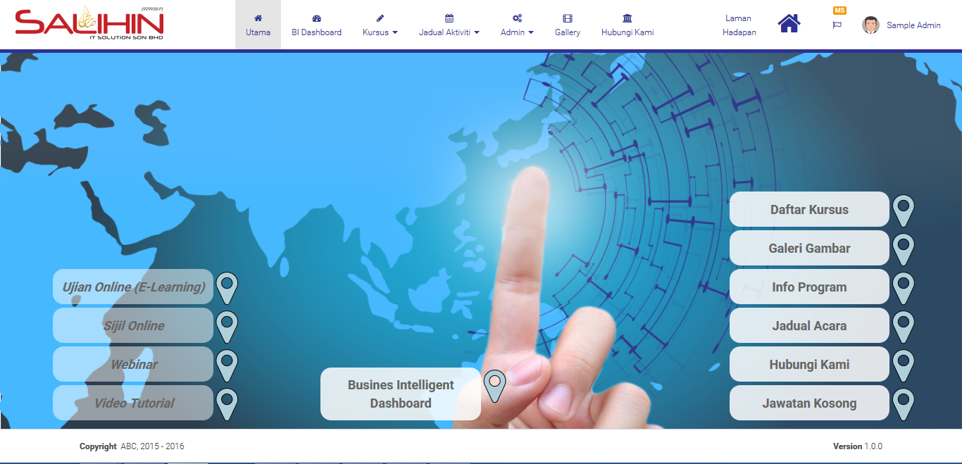
Sits accounting training home page

Slide 41
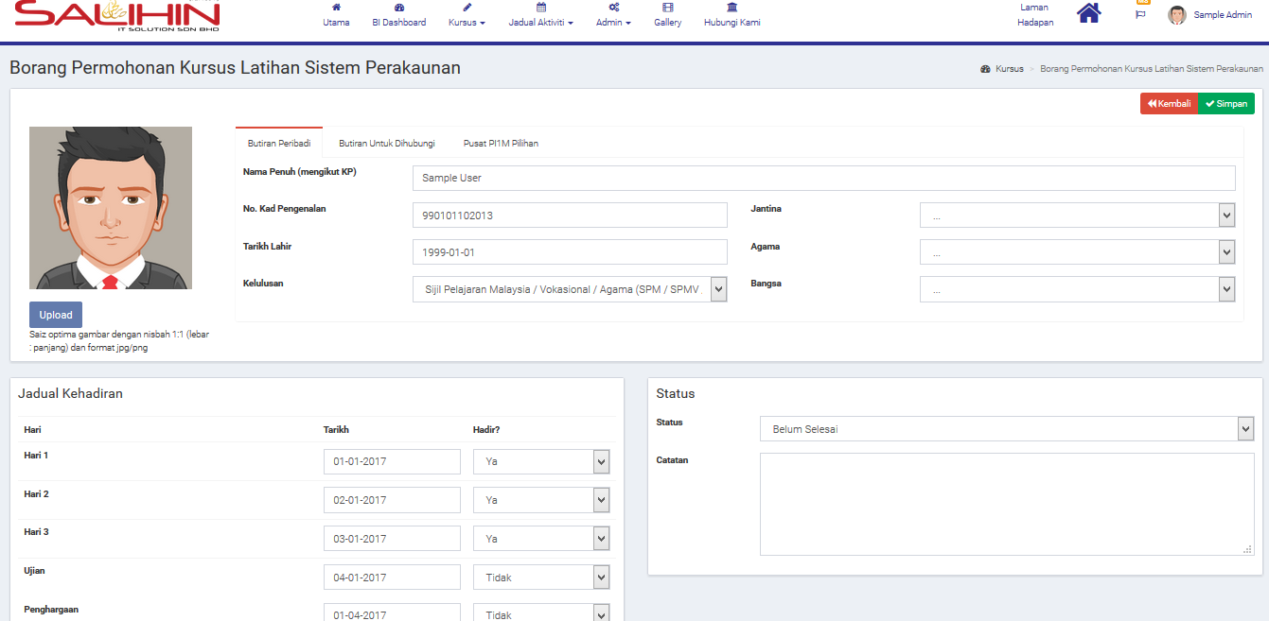
Sits accounting training registration page

Slide 42
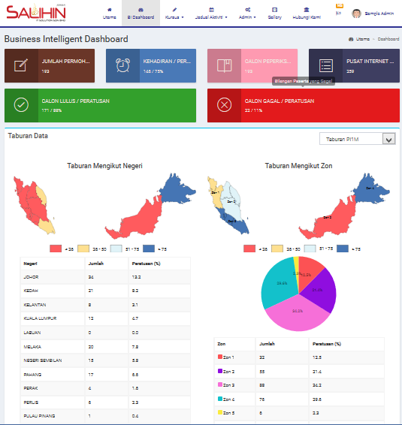
Sits business intelligence page

Slide 43
SYSTEM DEMOSTRATION

Slide 44
Q & A

