Slide 1





PI1M COMMUNITY CONTENT ENHANCEMENT
BY ACCOUNTING SOLUTIONS
Prepared for:
Prepared by:

Slide 2
TABLE OF CONTENT
Project Directorate
Page 3
Subject Matter Expert
Page 4
Content Provider Contractor Introduction
Page 5
Our Objective
Page 6
Reaching Underserved Communities
Page 7
Targeted Deliverables
Page 8
Road To Success
Page 9
Critical Success Factor
Page 10
SPS Training Program
Page 11
Continuous Learning
Page 24
SAS & Web Interface
Page 29
SPS Extensive Support
Page 37
Hardware, Infrastructure & Maintenance
Page 41
Execution Plan
Page 49
Proposed Project Coordination
Page 58
Flowcharts & Timelines
Page 64
Marketing & Promotion Strategy
Page 73
Financial Consideration
Page 81

Slide 3

Project directorate
FR Mutiara is an established information & technology consultation company with a mission to be the preferred project management consultant and to become one of the premier player in Malaysia business landscape which provide consultancy services and solutions to different organizations across Malaysia, creating value for clients by leveraging industry knowledge and service offering expertise with an insight into and access to all the emerging technologies.
Company Vision
“Setting standards utilizing best available solutions”
Mission Statement
“Committed to excellence in providing innovative and reliable Information Technology services”

Slide 4




Subject matter expert
SALIHIN is one of the fast growing and leading indigenous brand in Malaysia, which umbrellas a group of distinctive entities tailoring unique and independent consulting services to local and international clientele. SALIHIN offers an integrated and wide spectrum of value for money professional services in the areas of auditing and assurance, taxation (direct and indirect), business advisory, information technology, accounting software and corporate finance.

Slide 5




Introduction of Content Provider Contractor (CPC)
CPC

Slide 6

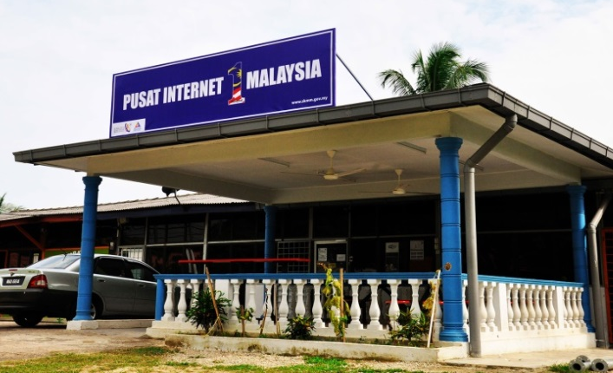


OUR OBJECTIVE
PI1M CONTENT
ENHANCEMENT & EMPOWERMENT
PI1M CENTRE VISIBILITY & NEW SERVICE OFFERINGS
ACCOUNTING SOLUTIONS
INDUSTRIES PARTICIPATION
TRAINING PROGRAM
ACADEMIA PARTICIPATION
CERTIFICATION PROGRAMME
LEARNING & JOB MATCHING PLATFORM
CONTINUOUS LEARNING
(ONLINE & OFFLINE
CONTINUOUS SUPPORT
ACCOUNTING
SOFTWARE SOLUTIONS

Slide 7
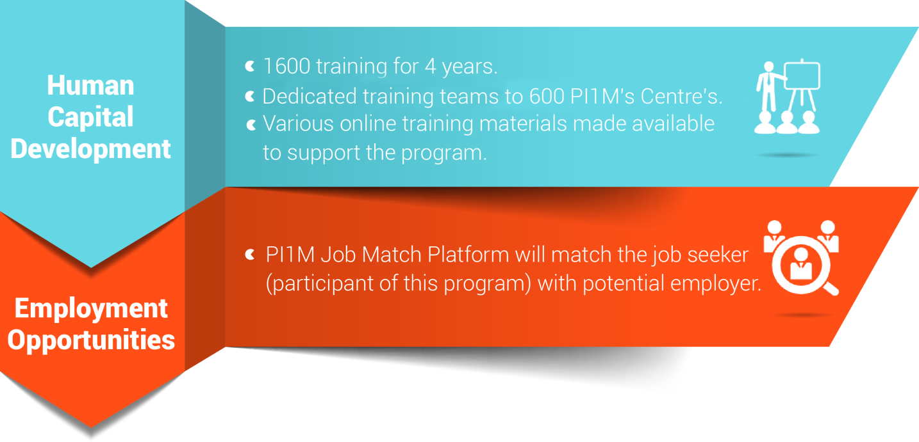
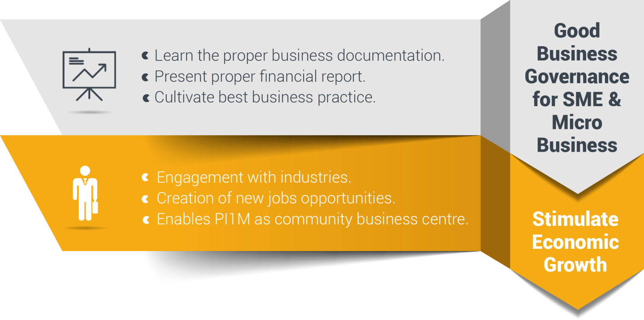
Reaching underserved communities

Slide 8




Targeted deliverables
1,200
PI1M Accountant
3 Modules
2 Days Training +
½ Day Revision +
½ Day Exam
Dedicated Team Will Conduct Training to Assigned Zone.
Zone 1
  Perak, Kedah, Penang, Perlis
Zone 2
  Selangor, Kuala Lumpur, Malacca, N. Sembilan, Johor
Zone 3
  Kelantan, Terengganu, Pahang
Zone 4
  Sarawak
Zone 5
  Sabah
30,000
Expected Participations
1,600
Targeted
Training Sessions

Slide 9





Road to success
Further studies via SPS Webinar & Online Learning
Program
Kickstart
“PI1M Accountant”
Business
SPS Job Matching Platform
Start
Own
Career
Pathways

Slide 10
Critical success factor
Support from KKMM & SKMM
1
5
1
Coordination from telco’s
(service provider)
2
Coordination from telco’s technology partner
3
4
2
Salihin – subject matter expert (SME)
4
3
FR Mutiara – Project management consultant (PMC)
5
We have long believed that, over the long term, no institution, idea, or effort of real consequence is ever successful on its own; the most impactful efforts are those approached collaboratively and achieved through close partnership.

Slide 11
SPS TRAINING MODULE
CPC

Slide 12

What is sps?
Equip PI1M Centre with comprehensive SOFTWARE & FREE TRAININGS of high value added accounting software.
Groom & nurture a FINANCIAL, MANAGEMENT & BUSINESS SOUND entrepreneurs in underserved areas.
Increase PI1M BUSINESS RELEVANCY to its respective communities.

Slide 13


















Community content enhancement framework
Rural Community
500,000 TEKUN Nasional Micro Entrepreneurs
300,000 AIM Micro Entrepreneurs
15,000 Co-operatives i.e Micro Co-Operatives
500 PKK Nationwide
400 Fishermen’s Association Nationwide
PI1M “Accountant”
New Job Creation
Potential accounts to be served via PI1M

Slide 14


cpc accounting offerings
30,000 FREE Licenses for 5 Years
SPS, SPSLite CashBook & Entrepreneurs Web @ 600 PI1M
  1,600 FREE Training Session with examination for 4 Years
SPS, SPSLite CashBook & Entrepreneurs Web @ 600 PI1M
  30,000 Accreditation & Certifications
SPS, SPSLite CashBook & Entrepreneurs Web @ 600 PI1M
  Learning & Job Matching Platform for participants to engage with potential employers
  Free PI1M Entrepreneurs Event Awards with Media Coverage in Major Malay Newspaper for 1 Years
  (Schedule and Timetable – TBD)

Slide 15








Target audience
Small & Micro
Entrepreneurs
PRE-REQUISITE
PC Literate
SRP/ PMR Holder
Minimum 10-20 Pax
Registered with PI1M
Women Entrepreneurs
Single Parent
Part-Time Housewife
Student
Under Graduate Student
Graduates
SPM Leavers
Unemployed
Others

Slide 16
cpc training & Certification
To nurture local economies and bring about greater shared prosperity and social change to underserved communities
CPC Training Program is part of Content Provider Contractor (CPC) 5 Years Pi1M Content Empowerment Proposal
01
Catalyze underserved growth
Communities
Transformation
02
Closing
Skills
Gaps
Bridging skills and knowledge gap
Accelerate
Rate of
Change
03
Economy
vs Education
Demand
Bringing industries close to communities

Slide 17


CPC training & certification
CPC’s Training & Certification Program entail an aggressive educational program that tests the level of competence in the principles and practices of SALIHIN PREMIER SOLUTIONS (SPS) & SPSLite CashBook Softwares.
The Certification will only be issued to participants whom passed the exam, while others will be issued the participation certificates. These principles and practices are closely monitor by reputable bodies.

Slide 18

CPC continuous learning
NO. | TRAINING MODULES | METHOD OF TRAINING | SYLLABUS
DAY 1 | Basic Accounting & Business Documentation | Class Room Online Seminar (Webinar) Online Training Video & Tutorial Online Training Material Online Test & Examinations | Objective: To Maintain Systematic Records of Business Transaction in Order to Generate Various Report. Company Setup User Setup User Access Right Chart of Account System & General Setup Form Setup Financial Year Calendar
 | SPSLite Training & Basic/ Advance SPSLite Website Training
DAY 2 | SPS Training
DAY 3 | Revision Examination
Anticipated Class Room Training for 600 PI1M Min 10-20 Participation Per Training 3 Modules (SPS, SPSLite & SPSWeb) 2 Days Training + 1 Day Exam 5 Years Continuous Learning

Slide 19

CPC Training kits
Softwares Access
SPS, SPSLite & SPS Entrepreneur Web
01
02
Training Hand Out & Stationery
Manual
SPS, SPSLite & SPS Entrepreneur Web
03

Slide 20

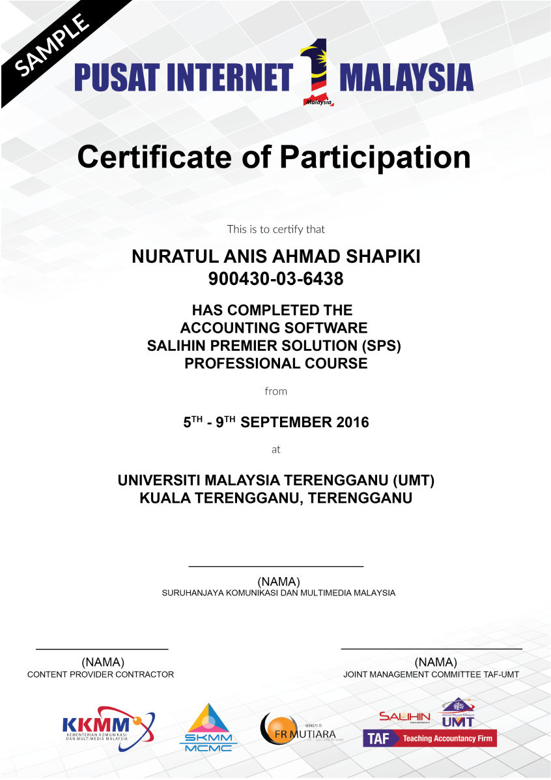
CPC certification

Slide 21

ACKNOWLEDGEMENT DAY
Anticipated Quarterly Event
Anticipated 1,000++ Graduates
Event Organized & Managed by CPC
Launch by KKMM & SKMM

Slide 22

Commercial mileage
In the spirit of business collaboration between CPC and KKMM/SKMM/PI1M, we will support Pi1M in providing quality products and services with the highest degree of customer satisfaction.
PI1M BUSINESS AWARD
Joint program between
CPC - KKMM – SKMM - PI1M
SKMM is required to share the success stories of PI1M business & entrepreneurs on monthly basis in Utusan/ Sinar Harian. (subject to negotiations terms & conditions between us and respective parties).
CPC will do the selection of the SME award winner lists based on good financial management & governance and SKMM internal criteria.
An event will be held to celebrate the winners.
Award will be sponsored by CPC.
CPC will sponsor the 1st year event and entrepreneurs segment in Utusan/ Sinar Harian.
Support By:

Slide 23





Learning & Job Matching DIAGRAM
Reporting
Entrepreneurs
MySql Database
Entrepreneurs
Potential Employers
PI1M
Participants
Participant Registration Module
Employer Registration Module Module
Registration
Assessment
Training & E-Learning Module
Job Posting Module
members
Exam & Certification Module
Reporting Management Module
members
Match Make & Recommendation
members
Diagram 1.0 illustrate the overall concepts of Learning & Job Matching Platform.

Slide 24
CONTINUOUS LEARNING
CPC

Slide 25
Fact sheet
The 3 days education/ training program it’s not perceived only as 3 days training program, but it is essentially a 3 days fundamental training program + 5 years of continuous learning.
SPS Learning & Job Matching Platform aims to provide PI1M community a learning opportunities as well as employment opportunities.
  It consists of a short, free, high quality, self-directed, support focused functions and activities for PI1M participants to go for an extra miles in CPC Product Offerings as well as professional and personal development.
  Courses are developed by CPC subject matter experts and participation academician from our TAF participating universities. The Learning platform is made available at all times for all PI1M participants.
  Simultaneously, the above will be made accessible for all potential employers and all academician to assess potential candidates for their further engagement.

Slide 26
The SYSTEM modules
Proposed Modules :-
  User Registration & Management Module
  Employer Registration & Management Module
  E-Learning Management Module
  Exam & Certification Management Module
  Job Matching Management Module
  Reporting Management Modules
Proposed Database
  MySql
Proposed Service Repository
  Cloud Based/ Web Hosting Service
User Registration
Employer Registration
E-Learning
Exam & Certification
Job Match
Reporting

Slide 27
E-Learning Components
1
Online Seminar (Webinar)
2
Online Training Video & Tutorial
3
Online Training Material
4
Online Registration
5
Training Schedule
6
Online Examination

Slide 28
Development principles
In the development process of learning & job matching platform , we will emphasize on best practice to ensure the service delivery would not compromised the KKMM, SKMM and PI1M standards and expectation.
We also will ensure that the operation of learning & matching platform will give a better experience for PI1M participant in term of functional, Content, Technical, Business, Usability and Responsiveness.
01
Service Enhancement
03
Service Presentation
01
03
All the global best practice sites solicit participant feed back through comments or feedback sections. This constant check from the end users helps learning & job matching system to improve the services they are providing continuously.
The online service offered can be fully completed online. A participant does not need to complete any off-line activities such as printing a document to be submitted except for his/ her own record.. Fully executable services results in potential savings in terms of money, time and labor.
02
Service Delivery
04
Service Assistance
02
04
Simple UI Design and Ease of Navigation. A consistent look and feel would reduce the time user need to familiarize themselves with a system’s functionalities.
System support are provided during office hours (Applicable for minor problems & system modification only) .

Slide 29
WEB INTERFACE
CPC

Slide 30

User interface
Diagram 2.0 Illustrate The Main Page of SPS e=Learning & Job Matching Platform.

Slide 31
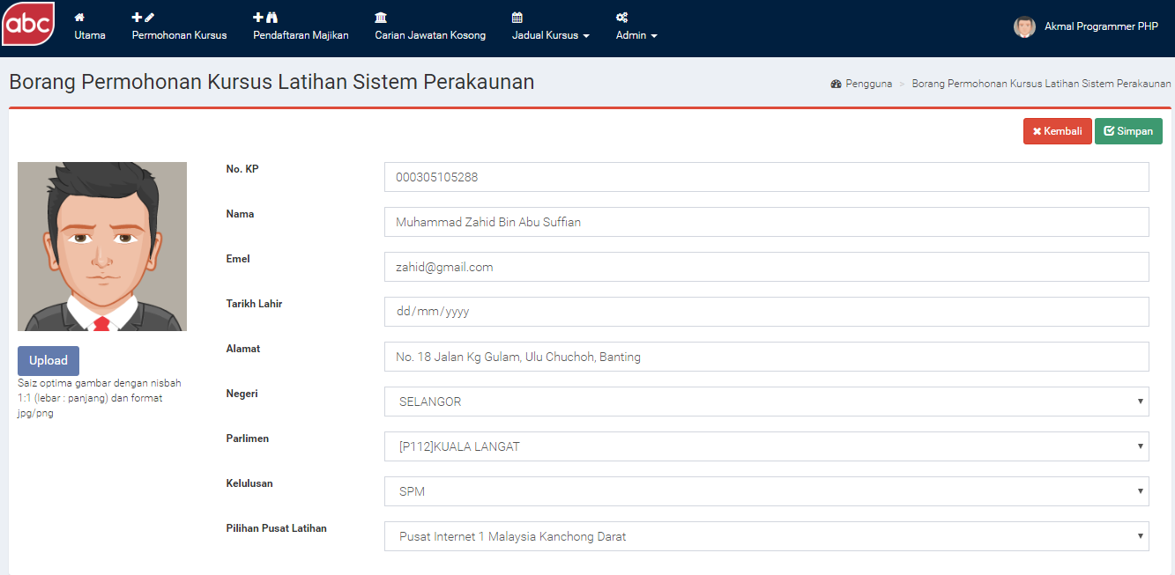
Registration page
Diagram 3.0 Illustrate The SPS Training Registration Form.

Slide 32
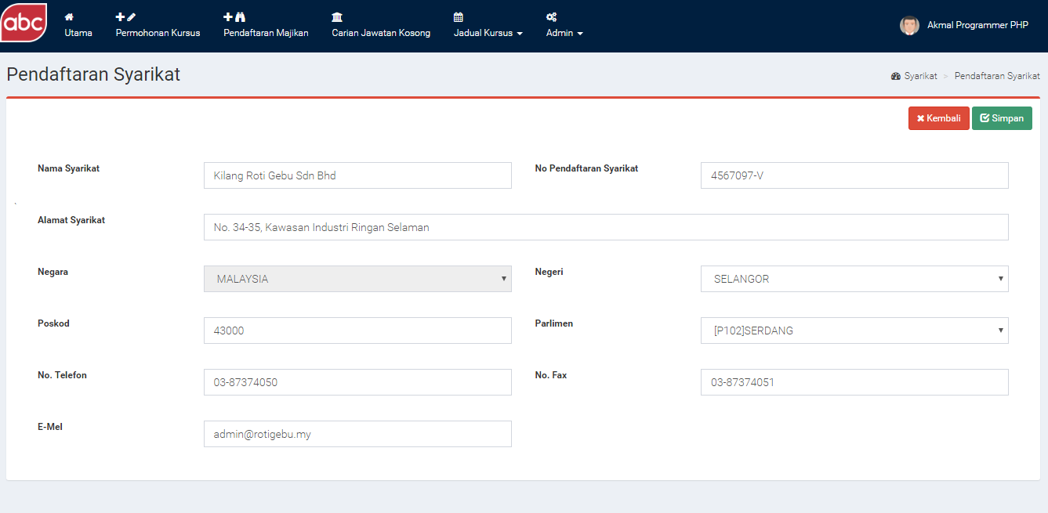
Employer registration page
Diagram 4.0 Illustrate The Employer Registration Page.

Slide 33
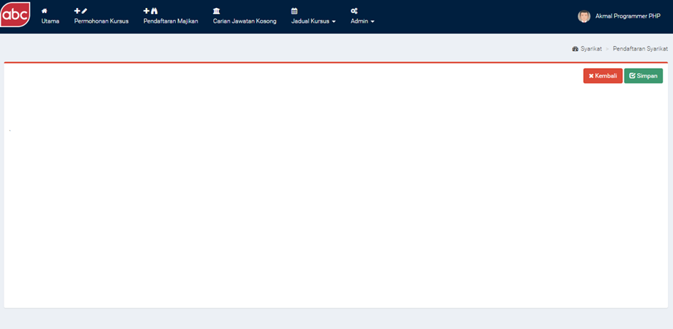





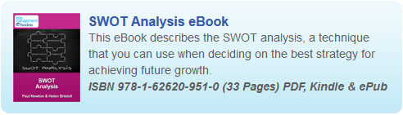
E-Learning page
E-Pembelajaran
Diagram4.0 illustrate the SPS E-Learning Knowledge Sharing Page.

Slide 34
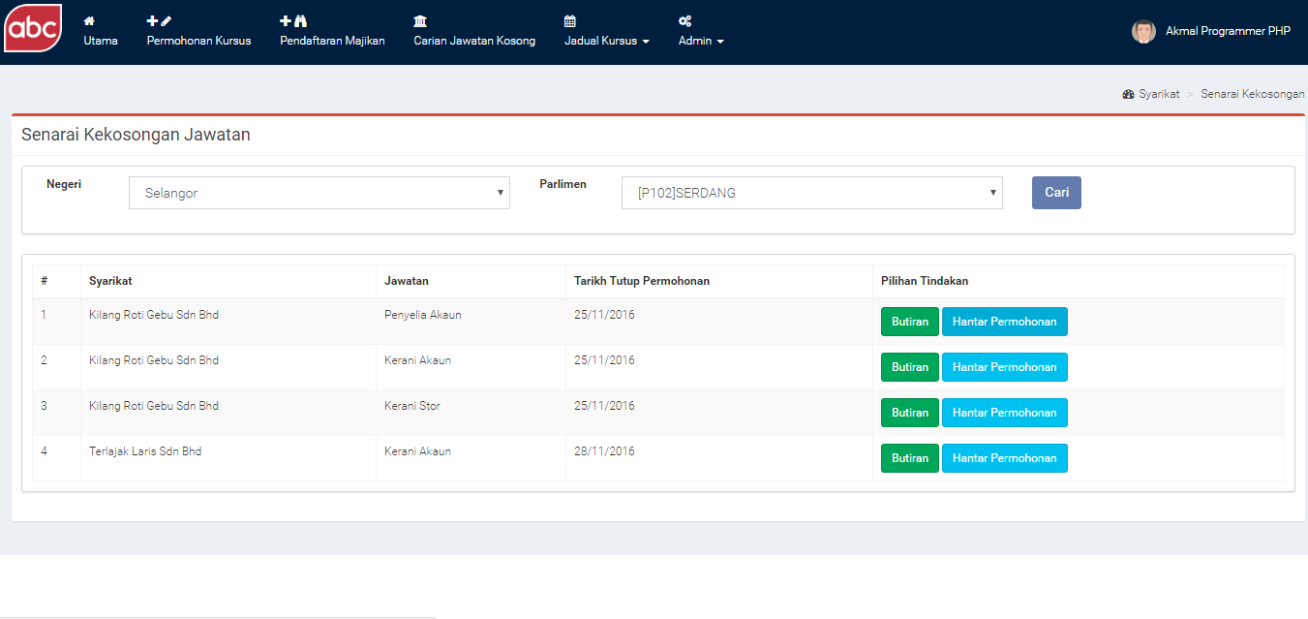
Job vacant page
Diagram 5.0 Illustrate The Latest Job Offering Page.
Diagram 2.0 illustrate the main page of Learning & Job Matching Platform

Slide 35
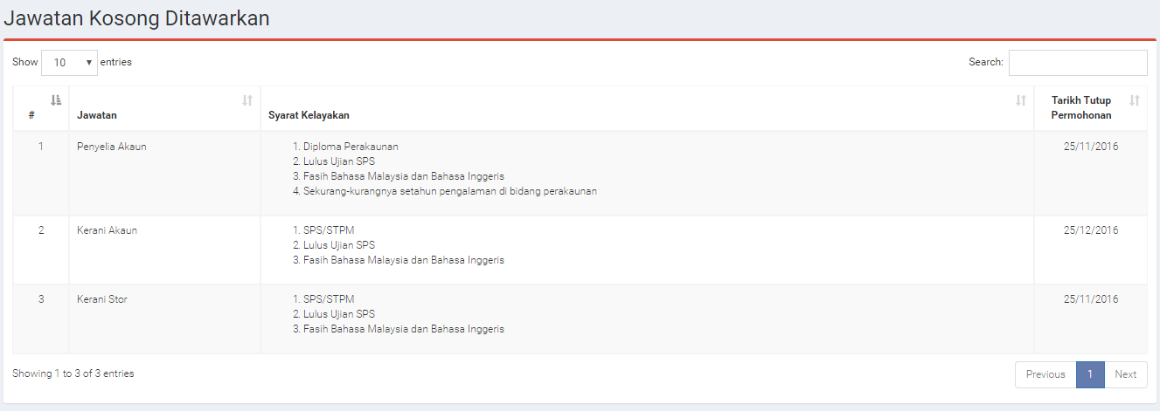
Job Details page
Diagram 6.0 Illustrate The Details Of New Job Posting By Employer.

Slide 36
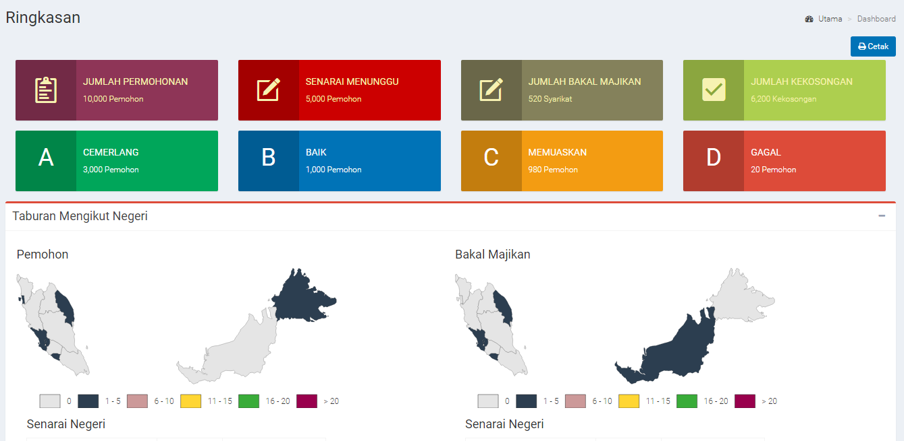
Business Intelligent dashboard
Diagram 7.0 Illustrate The SPS e-Learning & Job Matching Business Intelligent Dashboard Page.

Slide 37
SPS EXTENSIVE SUPPORT
CPC

Slide 38
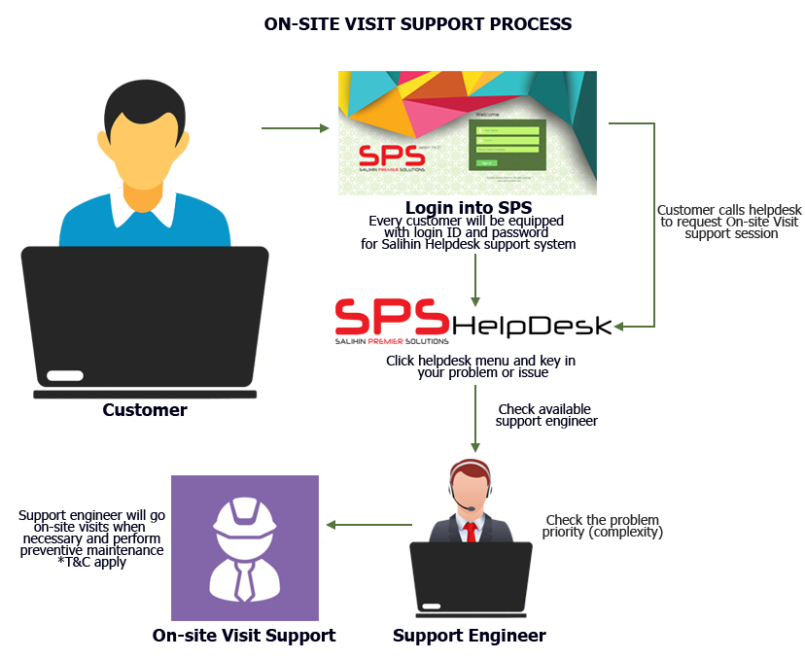
ON-SITE SUPPORT
Response time: Next business day (Klang Valley), Within 5 days (Peninsular area), Within one week (Sabah & Sarawak).
Diagram below illustrates how the mechanism works.
Working Hours: 8.30am – 5.30pm

Slide 39
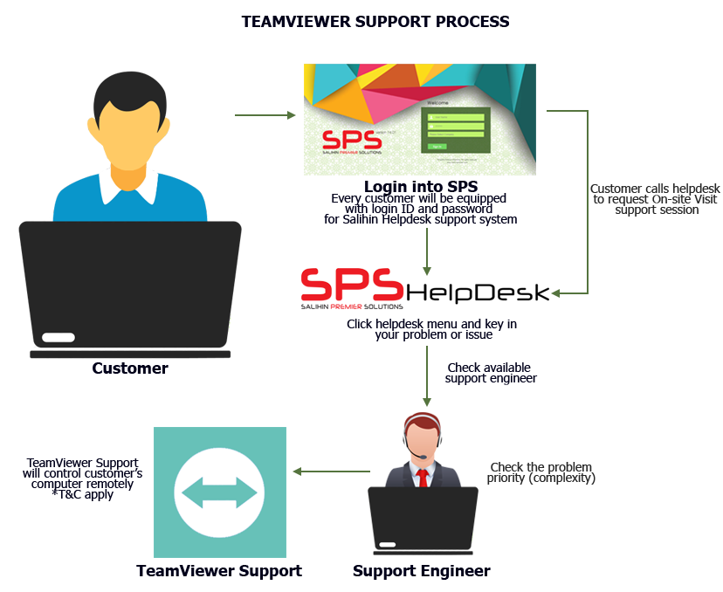
TEAM VIEWeR SUPPORT
Response time: Within 24 hours (Subject to availability).
Diagram below illustrates process of team viewer support.
Working Hours: 8.30am – 5.30pm

Slide 40
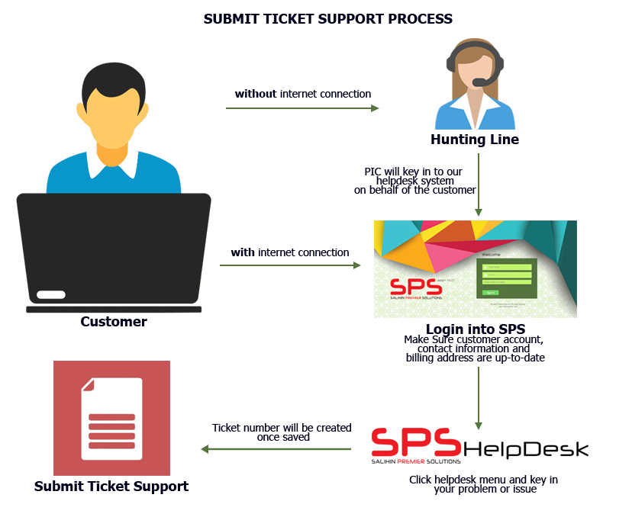
Helpdesk business SUPPORT
Response time: Within 24 hours week days (Subject to availability).
Diagram below illustrates process of helpdesk business support.
Working Hours: 8.30am – 5.30pm

Slide 41
HARDWARE, INFRASTRUCTURE & MAINTENANCE
CPC

Slide 42
Project REQUIREMENT
We plan to provide a comprehensive inter-networking infrastructure for SPS cloud-ready application system. The plan will mainly focus on the SPS’s Portal availability. The portal is a crucial application system which requires an agile, scalable and robust infrastructure to ensure its accessible 24x7.
The proposed baseline configurations are based on the generic deployments, solution size and capability and are independent of the target application. The recommendations focus on hardware capacity and software features; they do not attempt to prescribe a particular server model or chipset, as these preferences may vary or to be changed later based on customer requirements and detailed requirement gathering.
The following table describes the recommended components for the proposed configuration as follows;

Slide 43
Reference architecture for virtual infrastructure
The following table describes the recommended components for the proposed configuration as follows;
CPU BASELINE CONFIGURATION
TOTAL CPU CORE (pCPU) | TOTAL VIRTUAL CORE (vCPU)
96 | 288
 | More than 50% buffer
MEMORY BASELINE CONFIGURATION
TOTAL RAM | TOTAL VIRTUAL RAM (vRAM)
512 | 512
 | More than 50% buffer
STORAGE BASLINE CONFIGURATION
TOTAL STORAGE (TB) | FLASH DISKS FOR PERFORMANCE
10 | Yes

Slide 44
Reference architecture for virtual infrastructure
NETWORKING BASELINE CONFIGURATION
NETWORKING INTERFACE
2 x 10 GbE
VIRTUALIZATION BASELINE CONFIGURATION
VIRTUALIZATION
HYPERVISOR | VMWare VSphere
NUMBER OF ESX HOSTS | 4
# OF FAILURE TO TOLERATE | 1
BACKUP
Disk Based | Yes
Deduplication | Yes

Slide 45
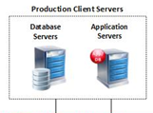
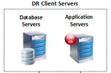



Proposed system architecture
INTERNET
SPS
Production Application Farm
SPS
DR Application Farm
Virtualization Infrasturcture
Virtualization Infrasturcture
replication
Disks Backup Appliance / VTL
Disks Backup Appliance / VTL

Slide 46






Proposed solution
VIRTUALIZATION ARCHITECTURE
Web Svr1
Web Svr2
App
01
App
02
DB
01
DB
02
Dev
Training
  Software-based storage built in ESXi
  Aggregates local Flash and HDDs
  Shared datastore for VM consumption
  Converged compute + storage
  Distributed architecture, no single point of failure
  Deeply integrated with VMware stack
Virtualization
esxi-01
esxi-02
esxi-03
esxi-04
Backup Appliance

Slide 47


Proposed hardware & software
Hardware Infrastructure
**Note : This proposal is the preliminary design and may required changes with the depth
of the details supplied in at a later stage .The hardware sizing was based on table as the
previous slide
Processor Per Node
Intel Ivy Bridge (Up to 130W)
Dual Processor
Chassis
2U chassis supporting 4 hot swap nodes w/half-width MBs.
2 x 1200W (80+ & CS Platinum) redundant hot-swap PS
Dedicated cooling / node (no SPoF) – 3 x 40mm dual rotor fans
Front Panel w/separate power control per node
17.24” x 30.35” x 3.46”
Memory | Processor Per Node
4 Channels of Native DDR3(1333)
Up to 8 DDR3 ECC R-DIMMS per server node
I/O’s Per Node
Dual GbE ports onboard
Optional IB QDR/FDR or 10GbE integrated
1x 8 PCIe Gen3 I/O Mezz Option (Quad GbE or Dual 10GbE)
1 x 16 PCIe Gen3HBA slots
Integrated BMC with RMM4 support
Disk
Integrated 4-Port SAT/SAS controller (SW RAID)
Up to 16 (4 per node) 2.5” HDD
NODE 1
NODE 3
NODE 2
NODE 4

Slide 48
hardware & software maintenance
1
Preventive maintenance
  House keeping and disk utilities (every 4 months)
  Database re-indexing and performance tuning (every 2 months)
  Anti-virus upgrade (Auto)
Corrective
  Software upgrade (every 6 month)
  Major Upgrade
  Minor Upgrade
  Emergency Upgrade
Major Release
New version or major changes made to current system
Types of software updates (release)
2
3
Minor Release
Emergency Release
Partial changes, improvement and upgrading in one of system modules
Enhancement made due to defect found in any software components

Slide 49
EXECUTION PLAN
CPC

Slide 50
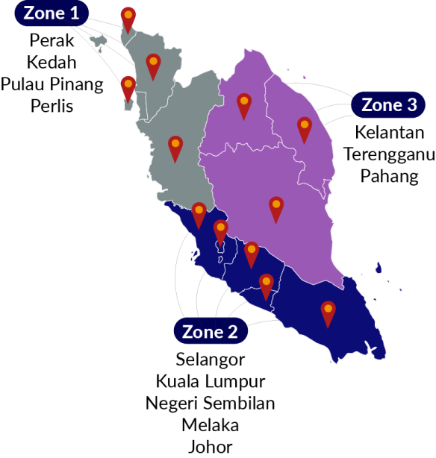
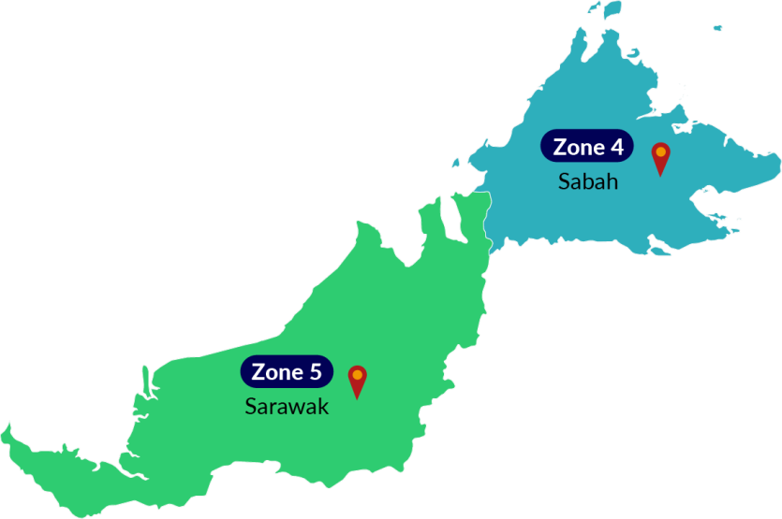
Proposed pi1m ZONING POSITION & ROAD MAPPING

Slide 51
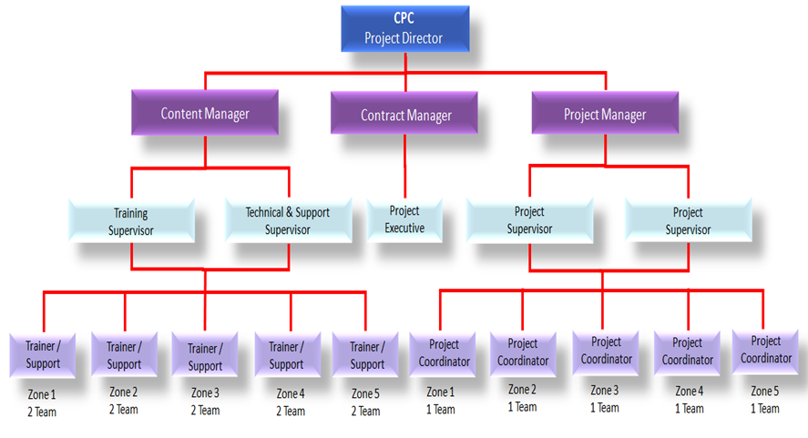
CPC PROJECT MANAGEMENT TEAM
NOTE:
Total = 60 Pax
Management = 5
Executive = 10
Backroom Support = 15
Filed Team= 30

Slide 52
Proposed JOB DESCRIPTION & RESPONSIBILITIES
POSITION | JOB DESCRIPTION
PROJECT DIRECTOR | To liaise & follow-up with SKMM or KKMM on future & upcoming project To be a lead on Project Steering Committee Meeting To make sure that the project follow according to the schedule & plan
PROJECT MANAGER | To lead & manage the project & meeting Liaise with internal or Salihin deployment team to ensure success deployment of the system Attending Project Steering Committee Meeting
CONTRACT MANAGER | To liaise with bank, Funder, Loan Institution, Insurance, company secretary To prepare project contract & related document Monitoring on project costing Liaise with Authorities Attending Project Steering Committee Meeting
CONTENT MANAGER | Responsible on the content including training module Planning & conduct the training session by classroom, Web based training, Online training, mobile video training Develop technical solution for customer issues related to software setup and configuration Delivered technical support service

Slide 53
CON’T JOB SCOPE & RESPONSIBILITIES
POSITION | JOB DESCRIPTION
PROJECT SUPERVISOR | To monitor movement all project coordinator following the schedule as per agreed To prepare monthly report & related documents To attend all related meeting etc Project Coordination meeting & Project Contractor Meeting & Project Steering Committee Meeting Responsible on arrangement of training session to be in good order etc arrangement of meal, place, liaise with PI1M pengurus wilayah To ensure the system are verified & validate by SKMM & KKMM Provide technical assistance and guidance during Installation & training implementation Prepare the work flow
PROJECT EXECUTIVE | To monitor movement all team following the schedule as per agreed To check & prepare report on project costing To attend all related meeting etc Project Coordination meeting & Project Contractor Meeting & Project Steering Committee Meeting
PROJECT COORDINATOR | To monitor on SALIHIN Team movement on installation & Training implementation To prepare Site weekly report, Service & Maintenance checklist & report To assist on training session arrangement To liaise with PI1M pengurus wilayah Attending Project Contractor Meeting To setup booth & registration

Slide 54
CON’T JOB SCOPE & RESPONSIBILITIES
POSITION | JOB DESCRIPTION
TRAINER SUPERVISOR | Responsible on the content including training module and material To plan and supervise training session To prepare SPS certification Attending Project Steering Committee Meeting
TECHNICAL & SUPPORT SUPERVISOR | Liaise with the Project Manager and the deployment team to ensure the success of the system deployment. To prepare SOP and monitor the problem and support activities Develop technical solution for customer issues related to software setup and configuration via SPS Helpdesk Attending Project Steering Committee Meeting
TRAINER | Conduct training session Conduct SPS exam Assist and support Web based training, Online training and mobile video training Assist SPS Helpdesk
TECHNICAL & SUPPORT ENGINEER | Deploy the system Delivered technical support service Assist trainer during training and exam session Assist SPS Helpdesk

Slide 55



Cpc METHOD OF STATEMENT
Preparation daily report
Preparation of Weekly report
Preparation of monthly report
Preparation of Checklist & maintenance report
The report consist of attendance record,
Activities program and Status of participant
Submission report to client for approval
Reporting
Step 4
Preparation of arrangement movement by team according to an agreed schedule planning
Arrangement of Transportation by zone
Preparation of meals, arrangement of site & training program
Arrangement team on advertisement & promotion
Site arrangement with SKMM, Service provider and vendor
Step 3
Organizing the Project
Preparation of meeting agenda to discuss on any pre & post development
Preparation of schedule plan during the design & operation phase.
To prepare the safety guideline and all the appropriate acts.
To prepare a team to do the site survey on each PI1M site to clarify on site accessibility & other issues
Step 2
Coordination between all team
Mapping/ garner the critical support from KKMM, SKMM, Telco’s & Telco’s Technology Partner
To list down all 600 PI1M as approved by SKMM
Zoning by 5 Zone
Step 1
Mapping PI1M site

Slide 56
cpc site mapping deliverables
Title: Mapping PI1M Zone 1 (Perak / Perlis / Kedah / Pulau Pinang)
Date: 15/12/2016 8:03:06 AM Updated
No | Zone | State | Site ID | Location ID | Site Name | Landlord Name | Longitude | Latitude | Pi1M Incharge person | Pi1M PC Status | Deployment Hardware | Deployment Software
1 | 1 | Perlis | CW502 | W01131 | KG_PANTAI_ DALAM | (1) TAN KEE TIONG (2) TAN KEE CHONG | 3.08707 | 101.68438
2 | 1 | Perlis | G0015 | W00006 | JLN SYED PUTRA | GANAD MEDIA SDN BHD | 3.29693 | 101.4086
3 | 1 | Perlis | G0384 | W00047 | JLN ROBSON | WISMA BELIA SDN BHD | 3.25465 | 101.4056
4 | 1 | Perlis | G0855 | W00097 | MENARA SEPUTIH (APT UNIT) | SHIREEN MARDZIAH HASHIM | 3.13642 | 101.6294
5 | 1 | Perlis | G0855 | W00097 | MENARA SEPUTIH (APT UNIT) | NATARJAYA MANAGEMENT | 3.16406 | 101.531882
6 | 1 | Pulau Pinang | G1599 | W00272 | PANTAI DALAM 2 | DEANS REAL ESTATE | 2.99814 | 101.3588
7 | 1 | Pulau Pinang | H0124 | W00292 | KERINCHI SL | SENI JAYA SDN BHD | 2.6581 | 101.5172
8 | 1 | Pulau Pinang | M1625 | W00447 | IBC | KEMENTERIAN PENERANGAN MALAYSIA | 3.5781 | 101.4624
9 | 1 | Pulau Pinang | G1625 | W00622 | IBC RTM | KETUA SETIAUSAHA KEMENTERIAN PENERANGAN | 2.93024 | 101.568
10 | 1 | Pulau Pinang | G1805 | W00685 | IPTAR RTM | PESURUHJAYA TANAH PERSEKUTUAN | 2.8092 | 101.55919

Slide 57
PROPOSED MILESTONE PROGRESS SCHEDULE
MONTH | DESCRIPTION | DELIVERABLE | PERCENTAGE %
1 | Letter of Award (LOA) / Preliminary | Contractor to submit Performance Bond (PB) in the form of Bank Guarantee (BG) PB / BG from the total contract value of the Letter of Award (LOA) If required | 5%
4 | 1st Steering Committee Meeting | Contractor to submit to the Steering Committee; Project Management Team Organisation Chart Project scope deliverables Project Implementation Programme & Schedule Project SPS (Pi1M Training Module & Programme) Proposed Certification programme and mileage programme Trainer & Staff detail of CV Checklist, Maintenance & Monthly report Training Module | 5%
7 | Month 7 (100 PI1M) | Claim consist of ; SPS Installer pack Installation Help-desk Team viewer Support Free online chat Support On site Testing & Commissioning Hand Over of PI1M (Anticipated Installation @ 100 PI1M / month) | 15%
8 | Month 8 (100 PI1M) |  | 15%
9 | Month 9 (100 PI1M) |  | 15%
10 | Month 10 (100 PI1M) |  | 15%
11 | Month 11 (100 SPI1M) |  | 15%
12 | Month 12 (100 Site PI1M) |  | 15%

Slide 58
PROPOSED PROJECT COORDINATION
CPC

Slide 59



Key MEETING & COORDINATION STRATEGY
Review the monthly practice statistics such as production, adjustments, collections, outstanding claims, unscheduled time units, production by provider, daily production averages, etc.
Review on timeline progress project
Review on weekly report
Discussion on any other matters related to Pi1M activities
Review on deployment activities and problem arise
Discussion on project enhancement activities
Review on resources ,vehicle & training tools & necessary items

Slide 60





cpc REPORTING DELIVERABLES
PI1M ZONE
01
02
03
PI1M
Content Empowerment
04
Progress Report
Telco’s & Telco’s
Technology Partner
05
Reporting consist of Weekly, Monthly, Quarterly & Yearly
(Attendance, Activities, Training, Exam, Certification & Other’s Report )

Slide 61

Sample monthly progress report

Slide 62

Sample weekly report

Slide 63

Sample maintenance checklist report

Slide 64
FLOW CHARTS & TIME LINE
CPC

Slide 65
PARTICIPANT REGISTRATION PROCESS FLOW
Participant Fill a PI1M Registration Program Form
Registration
- By online
By walk in to Pi1M or CPC headquarters
By Booth event / Road show
If No
Check Participant
Status
Minimum Requirement
Registered with Pi1M
PC Literate
Min. academic qualification i.e SRP / PMR / SPM or others
If Yes
Reschedule For Next Training
Confirm
Training Dates &
Location
ACKNOWLEDGEMENT DAY*
Organize by CPC
Launch by KKMM/ SKMM
N/B: Dates & location to be assigned during Steering Meeting
Helpdesk to Counsel & Assists the Unsuccessful Participant
Training Class & Exam
If No
If Pass
Access to Continues
e-Learning
* Participant Received
Certificate
Job Matching Platform

Slide 66
REPORTING PROCESS FLOW (MONTHLY PROGRESS REPORT)
Progress Information & Report from Project Coordinator
To be submitted to CPC Head Quarters Weekly After Each Training Session
Summarize and Consolidation for Monthly Report
Monthly Report to be Deliberated During Monthly Coordination Meeting
If Not
Review & Verified by Members
If Yes
Submit to SKMM
for Record

Slide 67
REPORTING PROGRESS FLOW (WEEKLY PROGRESS REPORT)
Preparation Details of Weekly Report
Send via Email & by Hand by End of the Week
Clarify the Issue/ Daily Activities
Checked by
Telco’s Vendor
Submit to SKMM for Records

Slide 68
REPORTING PROCESS FLOW (MAINTENANCE REPORT)
Preparation of Maintenance Checklist Report
Send via Email & by Hand by 1st Week of the Month
To Submit Every Month
Summarize the Maintenance Activities
If Not
Completed
Review by
Telco’s Vendor
The Maintenance Report Consist of;
Software Parts
Hardware Parts
Vehicle Condition
Maintenance Gallery
Review by
Telco’s
Review by
SKMM
Submitted to KKMM
for Record

Slide 69
Pre-development invoicing FLOW chart
Preparation of Installation Completion Report
Documentation Checked
and Verified by PI1M Manager
Prepare and Submission of Invoice
Process by
SKMM
Payment
Notes: Payment Term to be agreed upon

Slide 70
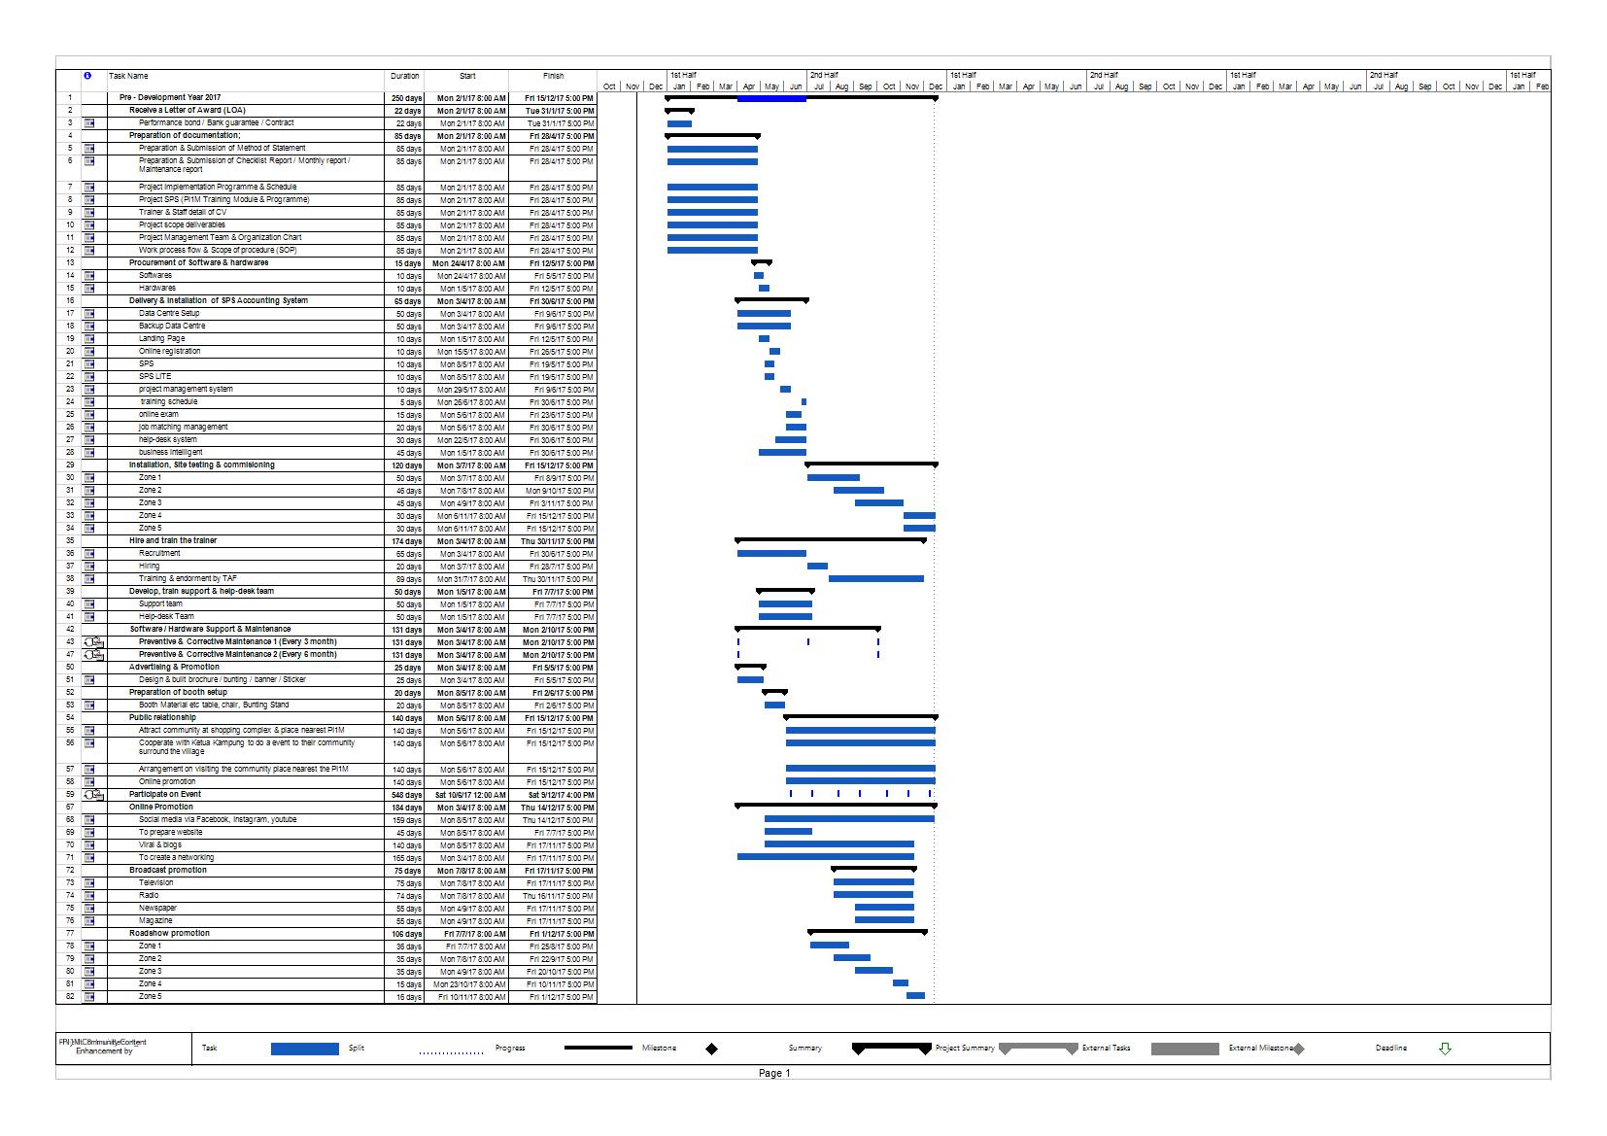
PROJECT PRE-DEVELOPMENT TIMELINE

Slide 71
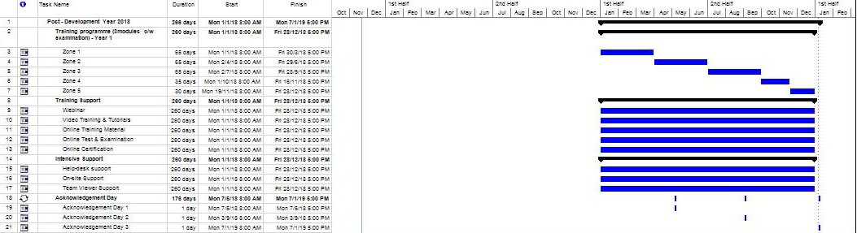
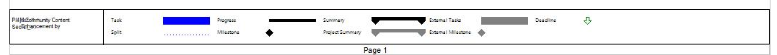
PROJECT POST-DEVELOPMENT TIMELINE

Slide 72
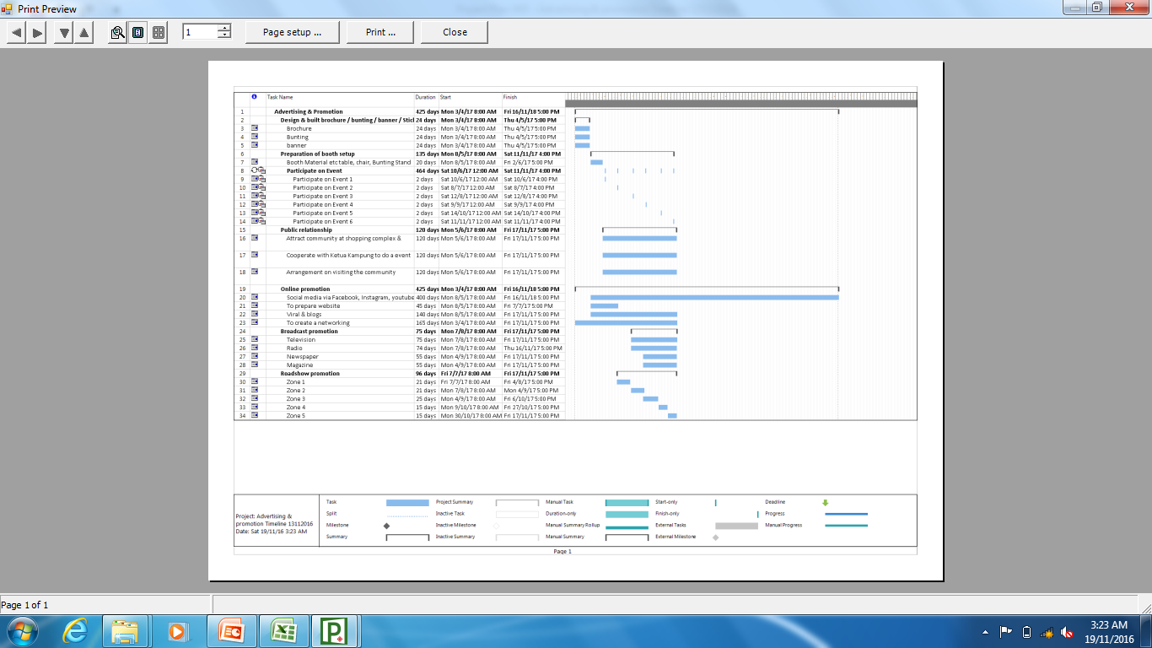
Advertising & promotion timeline

Slide 73
MARKETING & PROMOTION STRATEGY
CPC

Slide 74




PROPOSED MARKETING TOOLS & STRATEGY
1
Conventional Approach
  To prepare a booth by participating any events
  To prepare brochure & bunting
  Promote to shopping complex & nearest point of interest nearby PI1M vicinity
  Engage with village chieftain to assist the promotion to his subject.
  Roadshow promotion via visiting Schools, College & University
Online Promotion
  Social Media i.e Facebook, Instagram, YouTube
  Web & email marketing
Mass Media
  Mass broadcast via TV, Radio, Newspaper & Magazines
PI1M Database Marketing
PI1M Database
Mass Broadcast
Paper Advertisement
Social Media
Email Marketing
2
3
4

Slide 75








CPC UNIFORM DESIGN
CPC
CPC
CPC
TEAM
INSTRUCTOR
Pi1M COMMUNITY CONTENT ENHANCEMENT
BY ACCOUNTING SOLUTIONS
FRONT VIEW
BACK VIEW
FRONT VIEW
BACK VIEW

Slide 76


CPC PROJECT VEHICLE DESIGN

Slide 77


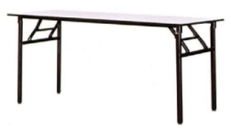
CPC COUNTER REGISTRATION
1 unit of table top display
4 nos of table banquet
4 nos of chairs
Stationery

Slide 78



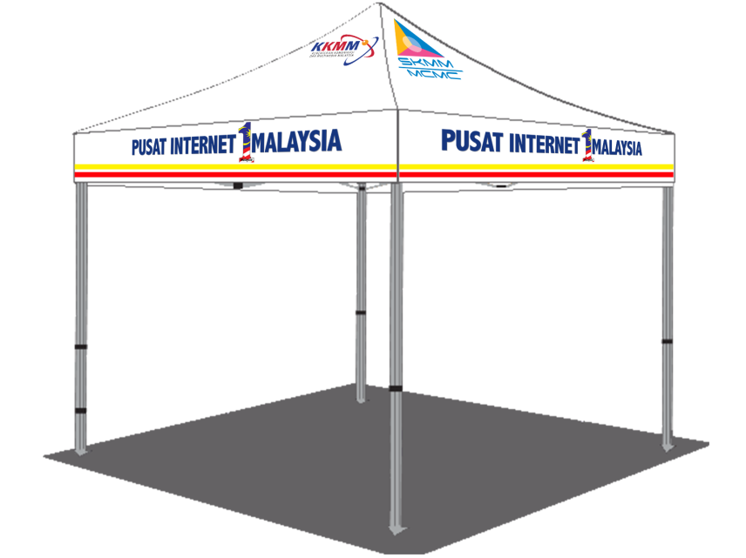

CPC FOOD & BEVERAGE COUNTER
- Table banquet (4nos)
- Chair (5nos)
- Plate
- Glass
- Fork & spoon
- Trolley
- Deluxe roll top chafer Outdoor Catering equipment
- Sink basin
- Water Container
- Table cloth
- Broom
- Food storage container
- Small Size canopy
- 1nos of pickup truck

Slide 79

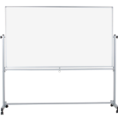
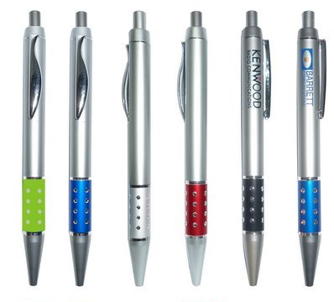
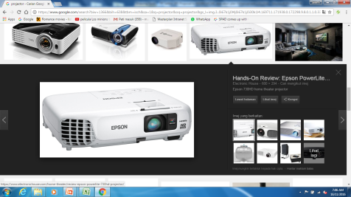



CPC TRAINING SESSION CLASS TOOLS
- Table banquet Instructor (2nos)
- LCD projection c/w stand
- White board stand
- Stationery
- Participant Training bag c/w accessories
- Video camera for real time class recording
- Souvenirs gift etc key chain or pendrive or pen

Slide 80


SAMPLE BUNTING, BROCHURE & STICKER DESIGN
PROGRAM MEMPERKASAKAN RAKYAT - ACCOUNTING SOLUTION
PI1M COMMUNITY CONTENT ENHANCEMENT
BY ACCOUNTING SOLUTIONS

Slide 81
FINANCIAL PROJECT CONSIDERATION
CPC

Slide 82
financial considerations
TOTAL INVESTMENT BY SKMM/ Pi1M | RM 69,120,000.00
The financial considerations are includes an attractive value-for-money proposition to the SKMM which includes:-
  Installations, commissioning and maintenance of 1,200 Salihin Premier Solutions (SPS)’s software license of at 600 PI1M Centre’s
  Installations, commissioning and maintenance of SPSLite CashBook Cloud Based Software License made accessible to 600 PI1M Centres
  30,000 SPS User license for the use of 600 PI1M Centre’s.
  30,000 SPSLite CashBook User license (including entrepreneur web access) for the use of 600 PI1M Centre’s.
  1,600 training program during 4 years
  30,000 certifications for PI1M participant
  Learning & Job Matching Platform

