Slide 1
LEARNING & JOB MATCHING PLATFORM

Slide 2
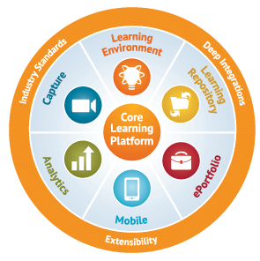
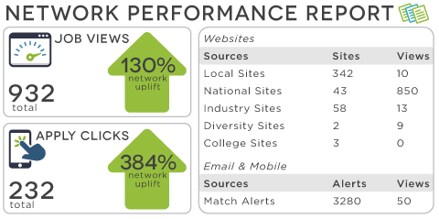
EXECUTIVE SUMMARY
SPS Learning & Job Matching Platform aims to deliver PI1M community learning opportunities as well as job opportunities.
It consists of short, free, high quality, self-directed and support focused functions and activities for PI1M participants to go for extra miles in SPS, SPSLite CashBook and SPSLite Entrepreneurs Web as well as professional and personal development.
Courses are developed by SALIHIN subject matter experts, participated universities and graduate student. The Learning platform is available to be used by all PI1M participated users.
At the same time, It will be made accessible for the potential employers and also academia to assess the potential candidates for further engagement.

Slide 3
E-Learning Materials
No | LIST OF TRAININGS
1. | Business Documentation Training
2. | SPS Basic Training
3. | SPSLite Training
4. | SPSLite Website Training (Basic)
5. | SPSLite Website Training (Advance)
No | TYPE OF CONTENT
1. | Web Online Seminar (Webinar)
2. | Video Training & Tutorial
3. | Online Training Materials (Web & Mobile)
4. | Online Test & Examination
5. | Online Certification

Slide 4
Development principles
In the development process of learning & job matching platform , we will emphasize on best practice to ensure the service delivery would not compromised the KKMM, MCMC and PI1M standards and expectation.
We also will ensure that the operation of learning & matching platform will give a better experience for PI1M participant in term of functional, Content, Technical, Business, Usability and Responsiveness.
The online service offered can be fully completed online. A participant does not need to complete any off-line activities such as printing a document to be submitted except for his/ her own record.. Fully executable services results in potential savings in terms of money, time and labor.
SERVICE ENHANCEMENT
All the global best practice sites solicit participant feed back through comments or feedback sections. This constant check from the end users helps learning & job matching system to improve the services they are providing continuously.
SERVICE PRESENTATION
SERVICE DELIVERY
During the program tenure, system support are provided during office hours (Applicable for minor problems & system modification only) .
Simple UI Design and Ease of Navigation. A consistent look and feel would reduce the time user need to familiarize themselves with a system’s functionalities.
SERVICE ASSISTANCE

Slide 5






Learning & Job Matching DIAGRAM
Reporting
Entrepreneurs
MySql Database
Entrepreneurs
Potential Employers
PI1M
Participants
Participant Registration Module
Employer Registration Module Module
Registration
Assessment
Training & E-Learning Module
Job Posting Module
members
Exam & Certification Module
Reporting Management Module
members
Match Make & Recommendation
members
Diagram 1.0 illustrate the overall concepts of Learning & Job Matching Platform.

Slide 6
SYSTEM modules
User Registration
Employer Registration
E-Learning
Exam & Certification
Job Match
Reporting
Proposed development Modules :-
  User Registration & Management Module
  Employer Registration & Management Module
  E-Learning Management Management Module
  Exam & Certification Management Module
  Job Matching Management Module
  Reporting Management Modules
Proposed database
  MySql
Proposed Service Repository
  Cloud Based/ Web Hosting Service

Slide 7
User interface

Slide 8
SYSTEM Development
Application Design Specifications
Testing
Functional Specifications
Information Architecture
Build
Test Plan
Test
Approach
Business Process Model
User Interface
Development, Construction, Customisation, Testing, Installation and Configuration
Test Environment and Cases
- components and assembly
Test
Components
Test
Assembly
Database Design Specifications
Logical Design
Physical Design
Programming
Coding
Test Results
- analysis and Fixes
Sripting
Adapters
Data Conversion Processes
User Interface
UAT
Acceptance
Certificate
Deploy
Diagram 2.0 illustrate the system development for TEKUN Corp E-Hub system.

Slide 9
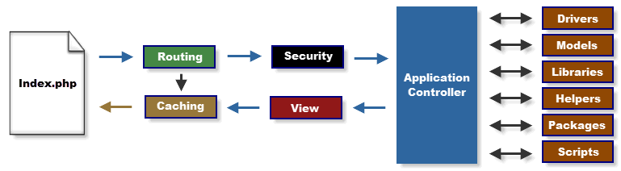
CodeIgniter development framework
PI1M Learning & Job Matching Platform will be develop using CodeIgniter Framework.
CodeIgniter is considered as the most demanding framework in PHP as well as highly popular in developers’ community. It’s also known as Micro PHP Framework.
PHP coders consider CodeIgniter as a simple and elegant toolkit to create full-featured web applications.
This lightweight core system needs only small yet powerful set of libraries and additional libraries are filled dynamically as per the requirement in development process.
This framework has simple application programming interface (API) and logical structure so that the libraries and database can be accessed.
Through MVC pattern, you get simple and clean development that paves way for great separation between logic and presentation.

