Slide 1

ACCOUNTING FOR GST
JOURNAL ENTRIES
GST - 03
DONGWHA FIBREBOARD SDN BHD

Slide 2
  TOPICS
IMPORTED GOODS
IMPORTED SERVICES
DEPOSIT RECEIVED
DEEMED SUPPLIES

Slide 3

1. IMPORTED GOODS
3

Slide 4
IMPORTED GOODS
a. Import Purchase of Goods are generally charged at standard rated.
b. GST is charged at the time of custom clearance.
c. Tax Base amount will be the amount calculated by Customs (Value of Goods + Freight + Import Duty and any other charges).
4

Slide 5
2. IMPORTED SERVICES
5

Slide 6
IMPORTED SERVICES
Importation of services are generally charged at standard rated (6%)
The GST on imported services is payable by the recipient of the services using the reverse charge mechanism.
Reverse charge is accounted at the time of payment made on total vendor invoice value.
The GST paid on deductible transaction can be claimed in the input tax credit during the GST-03 submission.
The expected double entry during logistics invoice verification for standard rated deductible imports is as below
6

Slide 7
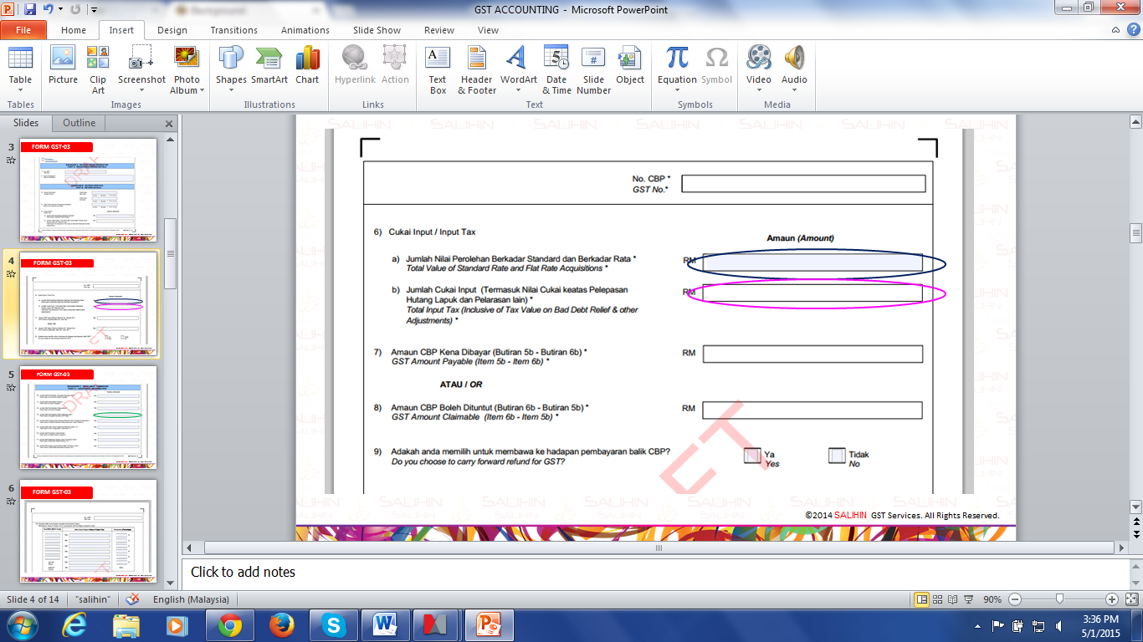
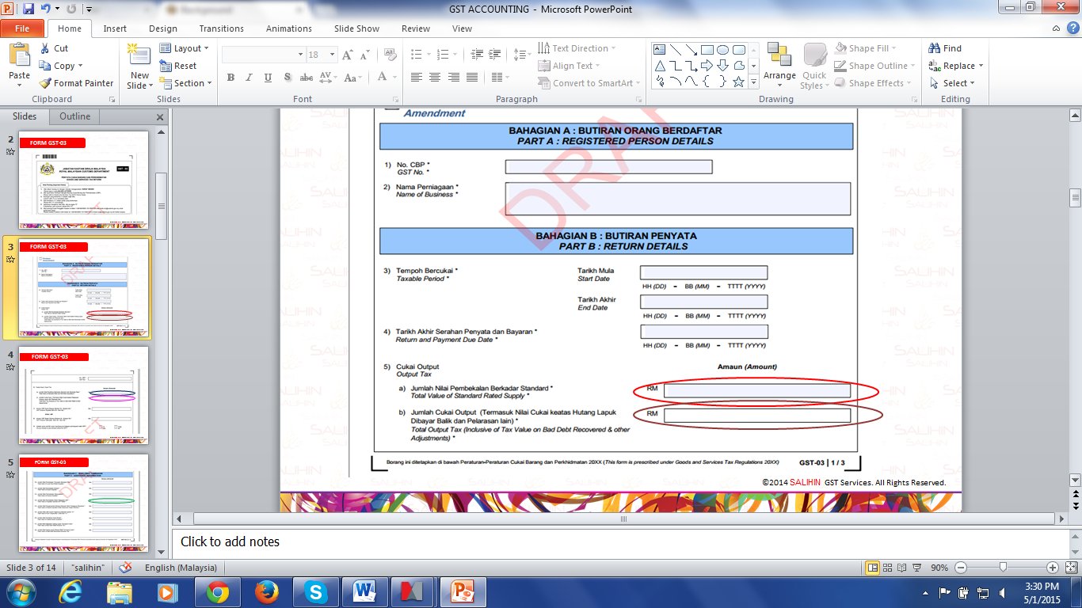
IMPORTED SERVICES
On 20.4.2015, Syarikat Maju Sdn. Bhd. makes a payment to their foreign consultant for RM30,000
Chart of Account | Detail | Dr | Cr | GST Tax Code | Rate | GST-03
 | Account Payable GST Input Tax | 30,000 1,698.11 |  | TX | 6% | 6a 6b
 | Bank GST Output Tax |  | 30,000 1,698.11 | DS | 6% | 5a 5b
7

Slide 8
3. DEPOSIT RECEIVED FROM CUSTOMERS
8

Slide 9
DEPOSIT RECEIVED FROM CUSTOMERS
There are two situations for deposit received which are :
Deposit received and tax invoice issued in April 2015
Deposit received in April 2015 and tax invoice issued in July 2015
9

Slide 10
4. DEEMED SUPPLIES
10

Slide 11



DEEMED SUPPLIES
Deemed supplies
  Imported services
  Gift costing more than RM500
  Disposal of business assets
  Private use of business asset
GST charged on:
11

Slide 12
DEEMED SUPPLY
– Gift Rule
A separate tax code will be created for deemed supplies and the amount of GST will be included in both the Input GST and output GST for the deductible supplies
For instance, Gifts worth more than RM 500 per person per year, the GST portion should be deemed supply. In these cases, this GST code will be utilized.
12

Slide 13
DEEMED SUPPLY - GIFT (GST EXCLUSIVE)
  A hand phone dealer sells a Blackberry for RM2,000 exclusive of GST. He gives a Blackberry to his long time customer for free. The value of the free Blackberry is RM2,000 (GST RM120.00).
  Account for GST output tax RM120.00 (RM2,000 x 6%)
Journal : Purchase of Gift
Chart of account | Detail | Dr | CR | GST Tax Code | Rate | GST-03
 | Purchase GST Input Tax | 2,000 120 |  | TX TX | 6% 6% | 6a 6b
 | Bank |  | 2,120 | TX | 6%
13

Slide 14
DEEMED SUPPLY - GIFT (GST EXCLUSIVE) Cont.
Journal : Deemed supply
Chart of account | Detail | Dr | CR | GST Tax Code | Rate | Tax Base amount | GST-03
 | GST Expenses | 120 |  | DS | 6% | 2,000 - | 5a
 | GST Output Tax |  | 120 | DS | 6% | - | 5b

Slide 15
DEEMED SUPPLY - GIFT (GST INCLUSIVE)
  A hand phone dealer sells a Blackberry for RM2,080 inclusive of GST. He gives a Blackberry to his long time customer for free. The value of the free Blackberry is RM1,962.26 (GST RM2,080 x 100/106).
  Account for GST output tax RM117.74 (RM2,080 x 6/106)
Journal : Purchase of Gift
Chart of account | Detail | Dr | CR | GST Tax Code | Rate | GST-03
 | Expenses GST Input Tax | 1,962.26 117.74 |  | TX TX | 6% 6% | 6a 6b
 | Bank |  | 2,080 | TX | 6%

Slide 16
DEEMED SUPPLY - GIFT (GST INCLUSIVE) Cont.
Journal : Deemed supply
Chart of account | Detail | Dr | CR | GST Tax Code | Rate | Tax Base amount | GST-03
 | Expenses | 117.74 |  | DS | 6% | 1,962.26 | 5a
 | GST Output Tax |  | 117.74 | DS | 6% |  | 5b

Slide 17
DEEMED SUPPLY
– Disposal of Business Asset
  In regard to the transfer or disposal of goods which form part of business asset by or under the direction of the person carrying on the business, whether or not for a consideration, the time of supply is at the time when the goods are transferred or disposed of.
  i.e On 1 March 2016, the company disposed an asset at RM 10,600.00 inclusive of GST 6%
17

Slide 18
DEEMED SUPPLY
– Disposal of Business Asset (Cont.)
Journal : Deemed supply
Chart of account | Detail | Dr | CR | GST Tax Code | Rate | Tax Base amount | GST-03
 | Disposal Asset | 600.00 |  | DS | 6% | 10,000.00 | 5a
 | GST Output Tax |  | 600.00 | DS | 6% |  | 5b

Slide 19
DEEMED SUPPLY
– Private use of business asset
  Company A purchased computer on 1/5/2015 RM2,120 inclusive of GST. On 5/6/2016, the Company gives a computer to their employee. The market value of the computer on 5/6/2016 is RM1,060 GST inclusive RM60 (6/106 x RM1,060).
Purchased computer
(RM 2,120 inclusive GST 6%)
1/5/2015
5/6/2016
19

Slide 20
DEEMED SUPPLY
– Private use of business asset (Cont.)
Journal : Deemed supply
Chart of account | Detail | Dr | CR | GST Tax Code | Rate | Base amount | GST-03
 | Expenses | 60.00 |  | DS | 6% | 1,000.00 | 5a
 | GST Output Tax |  | 60.00 | DS | 6% |  | 5b

Slide 21

T
H
A
N
K
Y
O
U
www.salihin.com.my | www.mysalihin.com
1 300 88 5678
Copyright Controlled 2015 @ SALIHIN
©2015 SALIHIN GST Services. All Rights Reserved.

