Slide 1



Campus Nexus Student System
GST Module Related Report
23 August 2017
PREPARED BY:
SUBMITTED TO:
SWINBURNE UNIVERSITY OF TECHNOLOGY SARAWAK

Slide 2
  Check list for GST Elements
Item | Issues | Impact | Appendix
GST Number
GST Code Setup
Set GST Code to Billing Method module
GST code in Post Charges module
GST code in Post Payment module
Debit Note
Credit Note
Receipt

Slide 3
Item | Issues | Impact | Appendix
Tax Invoice
Simplified Tax Invoice
Student Portal
Account detail
Statement
GST Report by Tax Code
GST Report by Transaction
Discount
Student Portal

Slide 4
  Question No. 2
Within GST rates, do you have a concept of tax on tax?

Slide 5
  Answer No. 2
No tax on tax within the Malaysian GST model.

Slide 6
  Question No. 3
For compliance of receipts and invoices, should the GST be called out a consolidated line item or will there be breakups based on the component. E.g., I have tuition fee and Mess fee. In the receipt, do we print a consolidated GST amount or do we print GST component of each fee separately.

Slide 7
  Answer No. 3 - GST TAX INVOICE
  REQUIREMENTS
For GST in Malaysia, we have 2 kinds of Tax Invoices;
  Full tax invoice
  Simplified Tax invoice (Issuance of this invoice normally involves retailers who generate large volume of invoices such as hypermarkets, mini markets, restaurants, beauty salons, petrol kiosks, motor workshops and other point of sales outlets.)

Slide 8

  Answer No. 3 - GST TAX INVOICE
  REQUIREMENTS
No. | Items | Full Tax Invoice | Simplified Tax Invoice
1 | The words “tax invoice” in a prominent place
2 | Serially tax invoice number
3 | Date of issuance of the invoice
4 | Name, address and identification number of the supplier
5 | Name and address of the person to whom the goods or services are supplied
6 | A description sufficient to identify the goods or services supplied
7 | For each description, the quantity of the goods or the extent of the services and the amount payable, excluding tax
8 | Any discount offered
9 | The total amount payable excluding tax, the rate of tax and the total tax chargeable shown as a separate amount
10 | The total amount payable including the total tax chargeable
  **any amount referred to in subparagraphs (i) and (j), expressed in a currency, other than Ringgit, shall also be expressed in Ringgit in accordance with paragraph 5 of the Third Schedule of the GSTA 2014

Slide 9
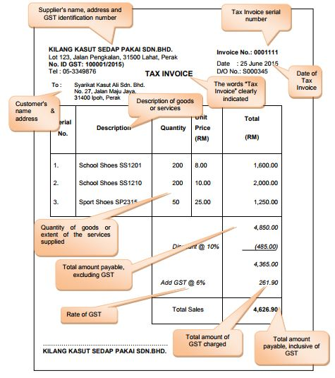
  Answer No. 3 - GST TAX INVOICE
  FULL TAX INVOICE - SAMPLE

Slide 10

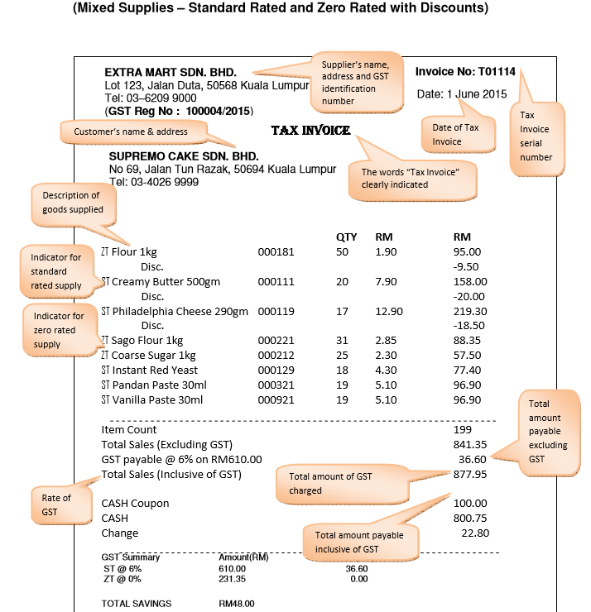
  Answer No. 3 - GST TAX INVOICE
  MIXED SUPPLIES TAX INVOICE – SAMPLE 1

Slide 11
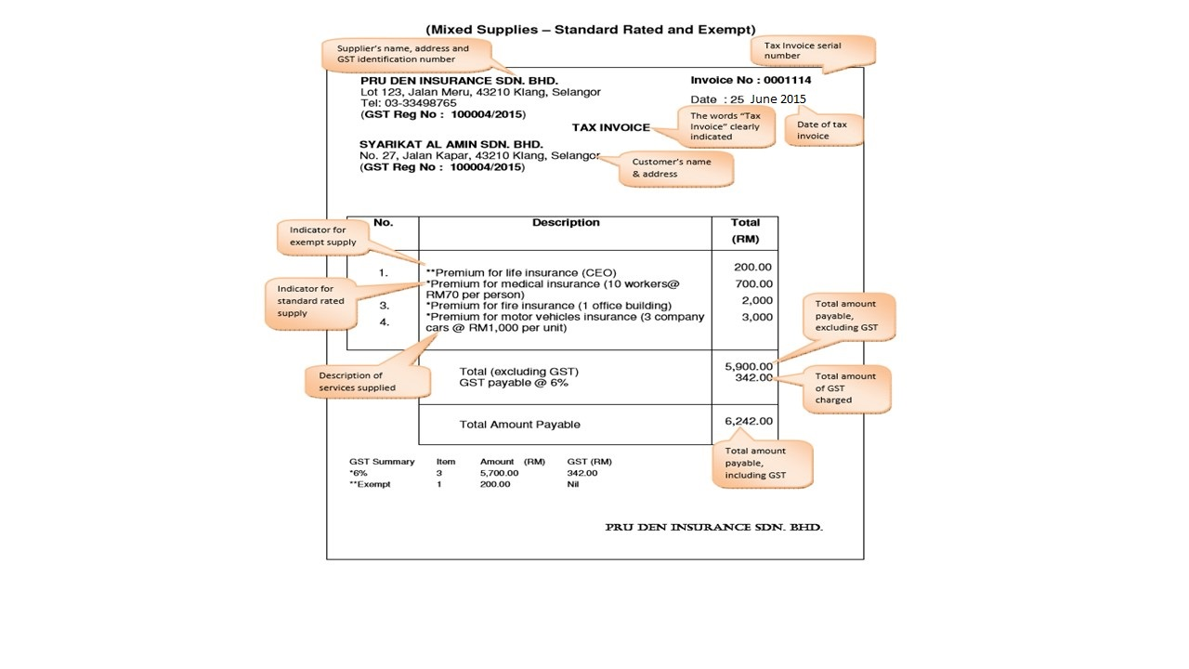
  Answer No. 3 - GST TAX INVOICE
  MIXED SUPPLIES TAX INVOICE – SAMPLE 2
GST TAX INVOICE
MIXED SUPPLIES TAX INVOICE - SAMPLE 2

Slide 12
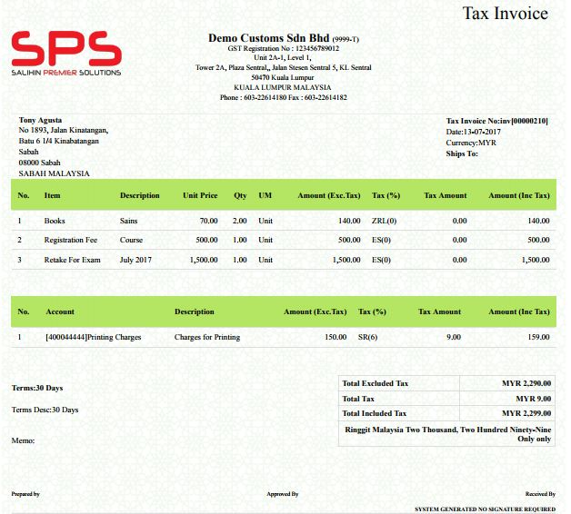

  Answer No. 3 - GST TAX INVOICE
  MIXED SUPPLIES TAX INVOICE – SAMPLE 3
GST TAX INVOICE
MIXED SUPPLIES TAX INVOICE - SAMPLE 2

Slide 13
  Question No. 4
In case of a discount, is the GST adjusted proportionately to the discount?

Slide 14
  Answer No. 4 - Discount
Type of Discounts
Discount on Tax Invoice
Discount after issuance of Tax Invoice (Usually when student makes payment)
  Within type of Supply
  Mixed type of supply

Slide 15
  Answer No. 4 – Discount
  1. Discount on Tax invoice
GST will be charge after discount. No need to GST adjusted proportionately to the discount.
Particulars | RM
Rental | 550.00
Miscellaneous cost | 50.00
Discount | (100.00)
Total payable | 500.00
GST 6% | 30.00
Total Including GST | 530.00

Slide 16
  Answer No. 4 - Discount
  2. Discount after issuance of Tax Invoice
GST need to be adjust proportionately to the discounted price.
Example; Student granted discount of RM100 from total Invoice RM624.00
Item | Amount Before GST | GST Amount | Amount After GST
Student fee | 200.00 | 0.00 | 200.00
Rental | 400.00 | 24.00 | 424.00
Total Payables |  |  | 624.00
100/624*24
Item | Amount Discount | GST Amount | Discount Included GST
Discount | 96.15 | 3.85 | 100.00

Slide 17
  Question No. 5
In case of a refund, is the GST adjusted proportionately to the quantum of refund?
Is there a timeline beyond which the GST component cannot be refunded? E.g. across financial years or GST remittance periods?

Slide 18
  Answer No. 5
University has to refund the full amount (inclusive GST amount) but it has to issue a Credit Note using the same tax code to get GST amount already declared in the GST report.
Refundable amount is subject to University. But any refund amount must include GST amount as per Credit Note above.

