Slide 1
SETTING UP GST IN MICROSOFT DYNAMICS GP
Presented by: Daniel Wong
Dynamicbiz GST Training dd: 2nd January 2015

Slide 2
Setup
Tax Details (GST Tax Code)
Tax Schedule
Company Setup
Receivable Management
Sales Order Processing
Purchase Order Processing
Payable Management
Inventory Management

Slide 3
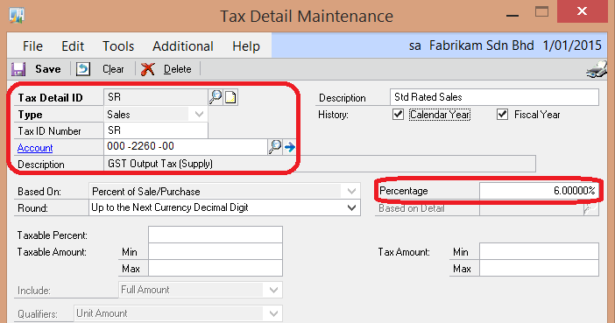
GST Tax Code
Path: Tools>>Setup>>Company>>Tax Details
Tax Detail ID = GST Tax Code (should follow Custom recommended Tax Code but not compulsory)
Type = Sales
Tax ID Number – enter the recommended Tax Code by Custom. This is for mapping purposes in case Customers are not using the recommended Tax Code.
Account – enter the relevant Accounts code for this Tax Code
Description – enter the description of this Tax Detail ID
Enter the Percentage of Tax

Slide 4
Tax Schedule
Tax schedules provide a method of grouping the tax details that apply to companies, items, customers, or vendors.
You can assign more than 1 Tax Details to a single Tax Schedule. Not applicable to Malaysia. For Malaysia’s GST, we will have 1 Tax Details tie to 1 Tax Schedule only
Taxes will be calculated based all the Tax Details assigned to the Tax Schedule.
Path: Tools>>Setup>>Company>>Tax Schedules

Slide 5
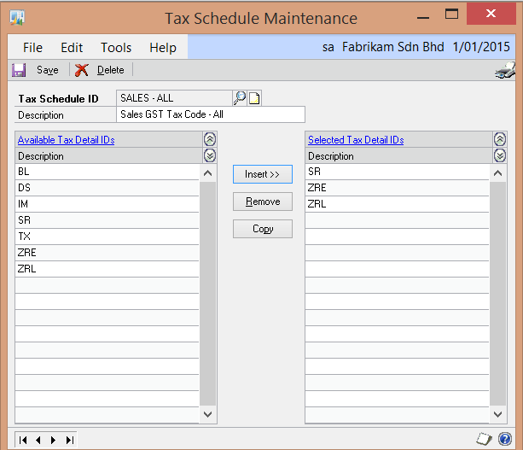
Tax Schedule (SALES – ALL)
Create a Tax Schedule ID called “SALES – ALL”
Select all the Tax Details ID (ie. GST Tax Code) that will be used in the Sales Order Processing and Receivable Management module.
You will need to assign this Tax Schedule to the Sales Order Processing and Receivable Management module setup.

Slide 6

Tax Schedule (PURCHASES – ALL)
Create a Tax Schedule ID called “PURCH – ALL”
Select all the Tax Details ID (ie. GST Tax Code) that will be used in the Purchase Order Processing and Payable Management module.
You will need to assign this Tax Schedule to the Purchase Order Processing and Payable Management module setup.

Slide 7
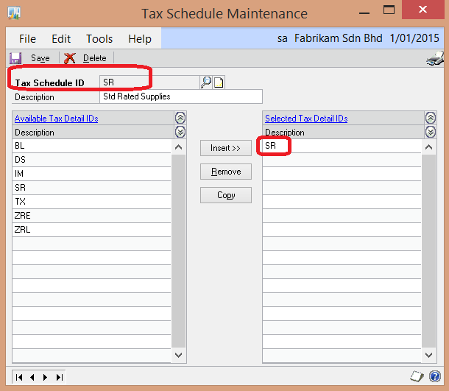
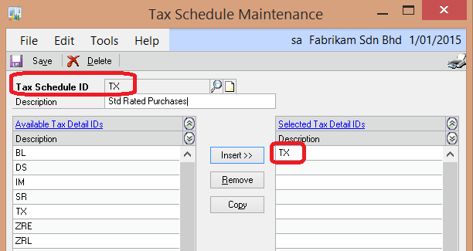
Tax Schedule – Individual GST Tax Code
You will need to create a Tax Schedule for every Tax Details in the system – 1 to 1. Example Tax Detail ID “SR”, you will need to create a Tax Schedule ID “SR”. For Tax Detail ID “TX”, you will also create a Tax Schedule ID “TX”.

Slide 8
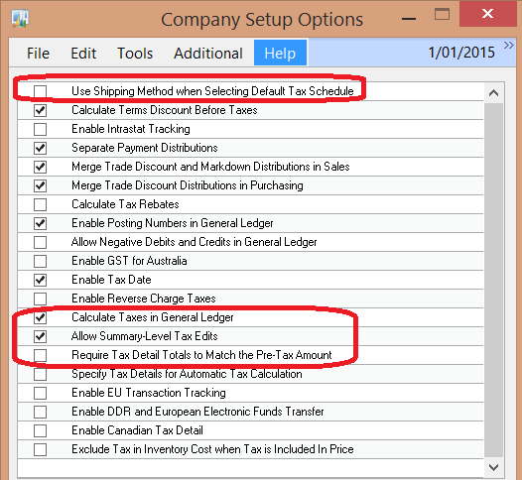
Company Setup
Path: Tools>>Setup>>Company>>Company>>Option
Unmark “Use Shipping Method when Selecting Default Tax Schedule
Mark “Calculate Taxes in General Ledger”
Mark “Allow Summary-Level Tax Edits
Unmark “Require Tax Detail Total to Match the Pre-Tax Amount
Caution: Screenshot only focus on GST related requirement which is Item 2 to 5 above. Other options in screenshot – whether is marked or unmarked will varies according to customers requirement.

Slide 9
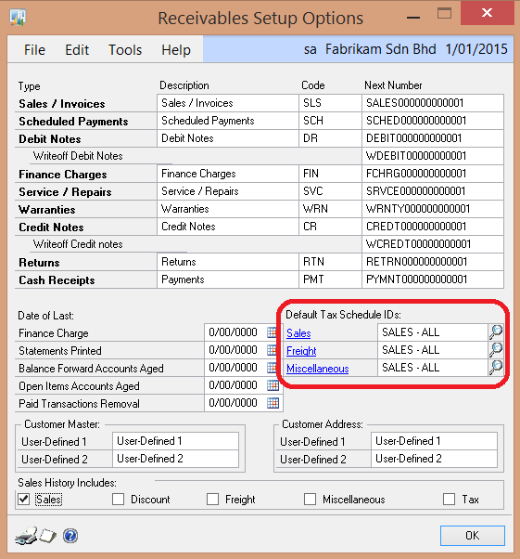
Receivable Management Setup
Path: Tools>>Setup>>Sales>>Receivables>>Option
Assign the Default Tax Schedule ID “SALES – ALL”
The Tax Schedule ID assigned here will default to the Receivable Transaction Entry
If you didn’t assign any Default Tax Schedule ID, GST will not be automatically calculated when users enter invoice in the Receivable Transaction Entry.

Slide 10
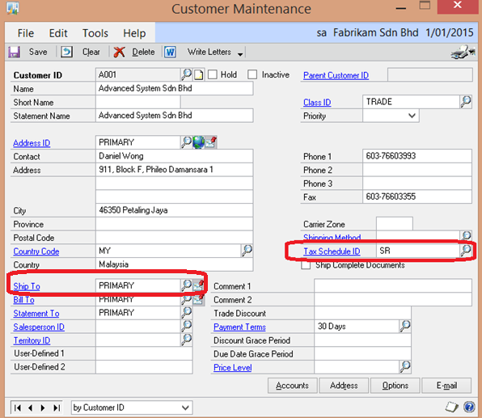
Customer Master
Path: Cards>>Sales>>Customer
Enter the default Tax Schedule ID for the customer.
The Tax Schedule ID will default when entering invoices in the Receivable Transaction Entry or creating invoices in the Sales Transaction Entry
You can also set the default Tax Schedule ID in the Class ID and then roll down to the respective customers in the class.
The Address ID that you have assigned as the “Ship To” address and the relevant Tax Schedule ID will be defaulted in the Sales Transaction Entry

Slide 11
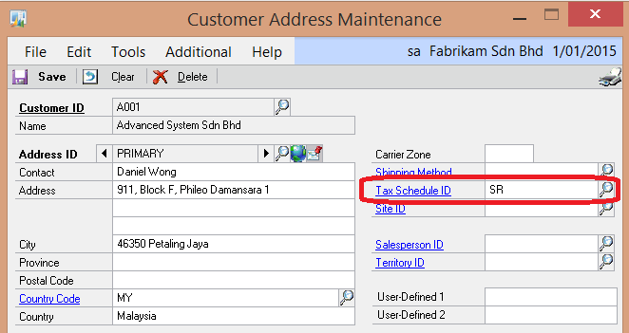
Customer Address Maintenance
Path: Cards>>Sales>>Customer, Address
Assign the default Tax Schedule ID for each of the customer addresses.
This is required for the purposes of generating Sales Invoices or Credit Note from the Sales Order Processing module.

Slide 12
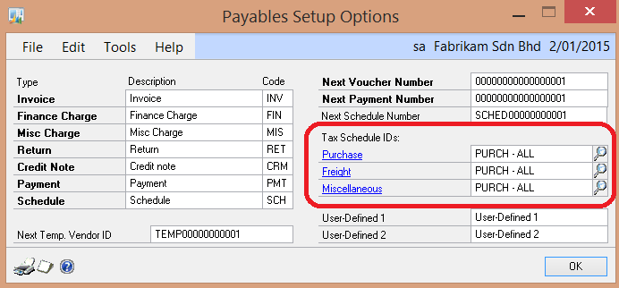
Payable Management Setup
Path: Tools>>Setup>>Purchasing>>Payables>>Option
Assign the Default Tax Schedule ID “PURCH – ALL”
The Tax Schedule ID assigned here will default to the Payable Transaction Entry
If you didn’t assign any Default Tax Schedule ID, GST will not be automatically calculated when users enter invoice in the Payable Transaction Entry.

Slide 13
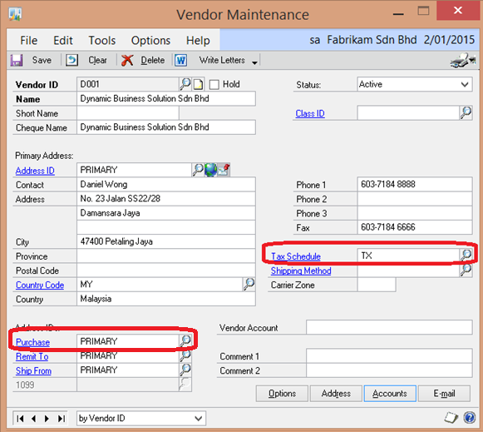
Vendor Master
Path: Cards>>Purchasing>>Vendor
Enter the default Tax Schedule ID for the vendor.
The Tax Schedule ID will default when entering invoices in the Payable Transaction Entry or creating PO and Receiving.
You can also set the default Tax Schedule ID in the Class ID and then roll down to the respective vendors in the class.
The Address ID that you have assigned as the “Purchase” address and the relevant Tax Schedule ID will be defaulted in the Purchase Order Entry

Slide 14
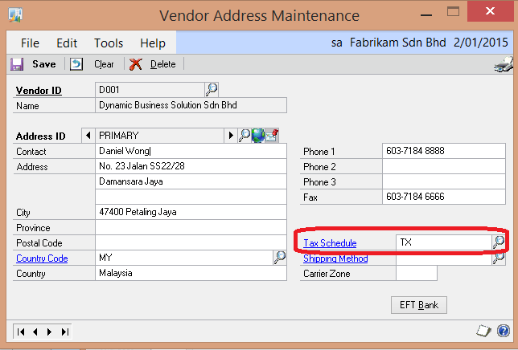
Vendor Address Maintenance
Path: Cards>>Purchasing>>Vendor, Address
Assign the default Tax Schedule ID for each of the vendor addresses.
This is required for the purposes PO creation and entering Receiving (Shipment/Invoice) or Invoice Matching

Slide 15
Definition of Inventory and Non-Inventory Item
Inventory Items are created in the Item Master and includes both Sales Inventory (stock balances are kept) and Service Item (system don’t track stock balances). Service Item can used for both Sales Invoicing and Purchasing.
Non-Inventory Items are not created in the Item Master and are free text entered during Sales Invoicing or PO creation (including receiving).

Slide 16
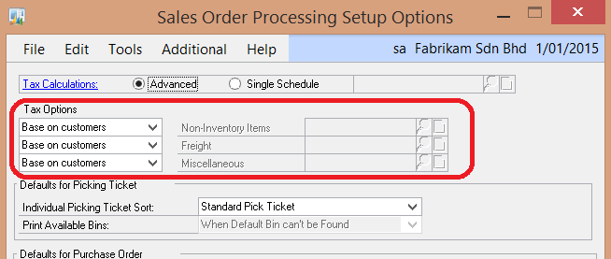
Sales Order Processing Setup
Path: Tools>>Setup>>Sales>>Sales Order Processing>>Options
Select Tax Options “Based on Customers” for Non-Inventory Items, Freight & Miscellaneous
When creating a Sales Invoice or Credit Note for Non-Inventory Items, Freight & Miscellaneous, the system will default the Tax Schedule ID set in the Customer Master.

Slide 17
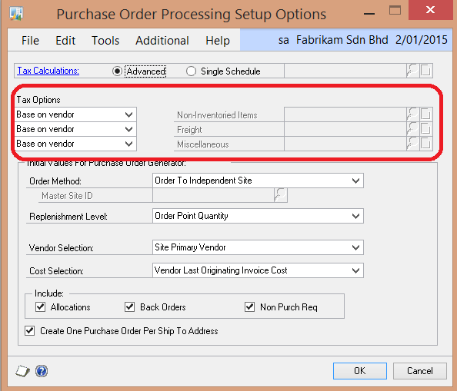
Purchase Order Processing Setup
Path: Tools>>Setup>>Purchasing>>Purchase Order Processing>>Options
Select Tax Options “Based on vendor” for Non-Inventory Items, Freight & Miscellaneous
When creating a PO, Receiving (Shipment/Invoice) or Credit Note for Non-Inventory Items, Freight & Miscellaneous, the system will default the Tax Schedule ID set in the Vendor Master.

Slide 18
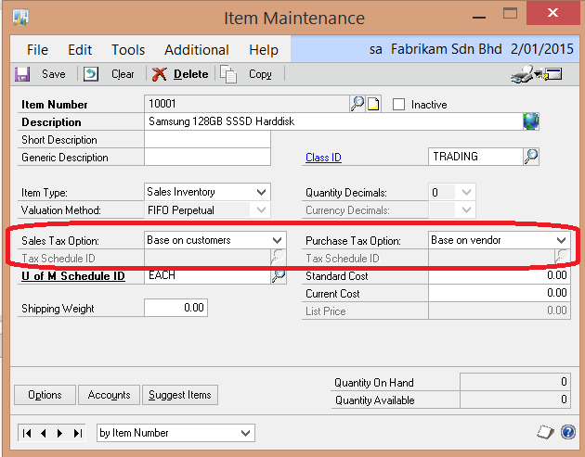
Inventory Item Setup
Path: Cards>>Inventory>>Item
Sales Tax Option
- Taxable (enter the Tax Schedule ID to default when entering Sales Invoices)
- Nontaxable (item is not subject to GST)
- Based on customers (system will default from Customer Master
3) Purchase Tax Option
- Taxable (enter the Tax Schedule ID to default when creating PO and receiving)
- Nontaxable (item is not subject to GST)
- Based on vendor (system will default from Vendor

Slide 19
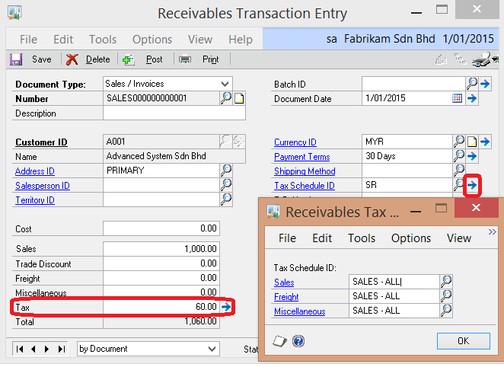
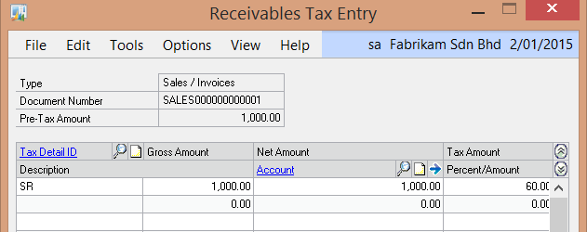
Enter Sales Invoice in Receivable Transaction Entry
Path: Transactions>>Sales>>Transaction Entry
Tax Schedule ID is defaulted from the Customer Master.
The Tax Schedule ID in the Receivable Tax Schedule Entry (click on the expansion button next to the Tax Schedule ID) which is “SALES – ALL” is defaulted from the Receivable Management Setup.
The system will only auto calculate the GST if the Tax Details in the defaulted Tax Schedule ID (in this eg is “SR”) matches with the Tax Details included in the Tax Schedule ID “SALES – ALL”
You can also manually assign the Tax Details or changed the calculated taxes in the Receivables Tax Entry

Slide 20
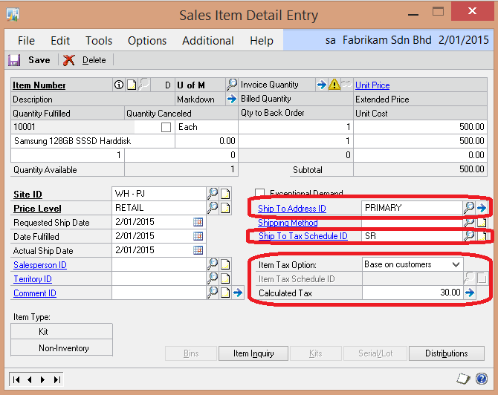
Creating Sales Invoice in Sales Transaction Entry
Path: Transactions>>Sales>>Sales Transaction Entry
When issuing Sales Invoices (or CN) via Sales Order Processing module, the Ship to Tax Schedule ID is defaulted from the Ship To Address ID. The Ship To Address is setup in the Customer Master. You can change the defaulted Ship to Address ID.
Item Tax Option is based on the Sales Tax Option setup for the item you are selling in the Item Master. If this is a non-inventory item, the Item Tax Option will default from the Sales Order Processing Setup.
The system will only auto calculate the GST if the Tax Details included in the Ship To Tax Schedule ID (in this eg is “SR”) matches with the Tax Details included in the Item Tax Option. In this example the Item Tax Option is set to “Base on customers”, the system will look at the Tax Schedule ID assigned to this Customer’s Ship To Address ID.
You can also manually assign the Tax Details or changed the calculated taxes in the Sales Line Item Tax Detail Entry

Slide 21
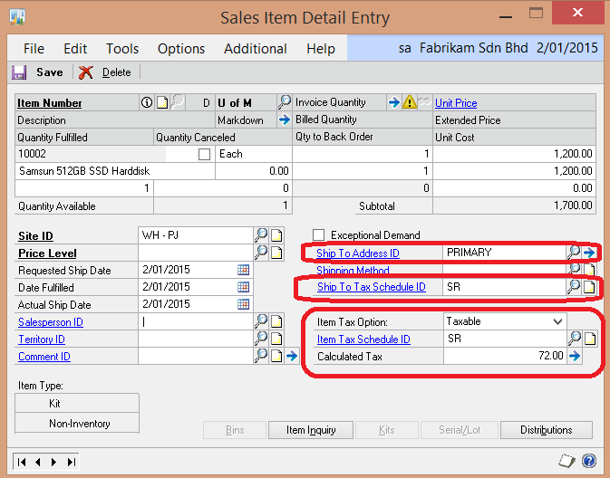
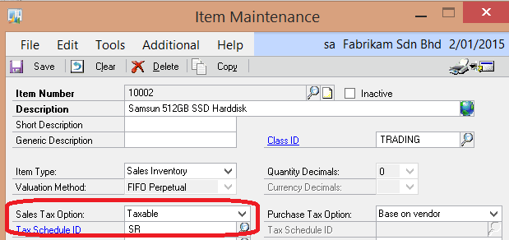
Creating Sales Invoice in Sales Transaction Entry
This example, the Item Number “10002”, the Sales Tax Option is set as “Taxable” and a Tax Schedule ID is specified in the Item Master.
When creating the Sales Invoice, the Item Tax Option will be set as “Taxable” with the Item Tax Schedule ID defaulted from the Item Master.
You can also manually assign the Tax Details or changed the calculated taxes in the Sales Line Item Tax Detail Entry

Slide 22
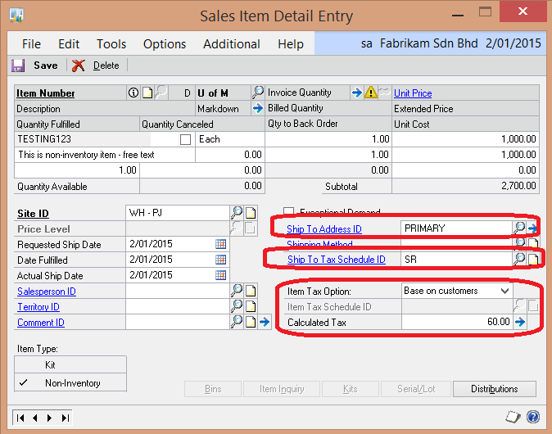
Creating Sales Invoice in Sales Transaction Entry
1) This example is a non-inventory item, the Item Tax Option will default from the Sales Order Processing Setup Options for “Non-Inventory Items. In this case, it is setup as “Base on customers”.
2) The system will compare the Tax Details (via Tax Schedule ID) setup in the Customer’s Ship To Address ID with the Tax Details in the Ship to Tax Schedule ID to determine the tax.
3) You can also manually assign the Tax Details or changed the calculated taxes in the Sales Line Item Tax Detail Entry

Slide 23
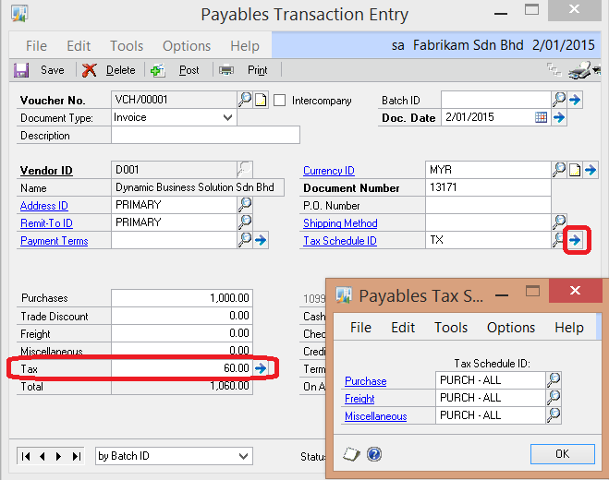
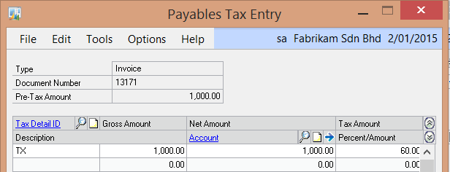
Entering Purchase Invoice in Payable Transaction Entry
Path: Transactions>>Purchasing>>Transaction Entry
Tax Schedule ID is defaulted from the Vendor Master.
The Tax Schedule ID in the Payable Tax Schedule Entry (click on the expansion button next to the Tax Schedule ID) which is “PURCH – ALL” is defaulted from the Payable Management Setup.
The system will only auto calculate the GST if the Tax Details in the defaulted Tax Schedule ID (in this eg is “TX”) matches with the Tax Details included in the Tax Schedule ID “PURCH – ALL”
You can also manually assign the Tax Details or changed the calculated taxes in the Payable Tax Entry

Slide 24
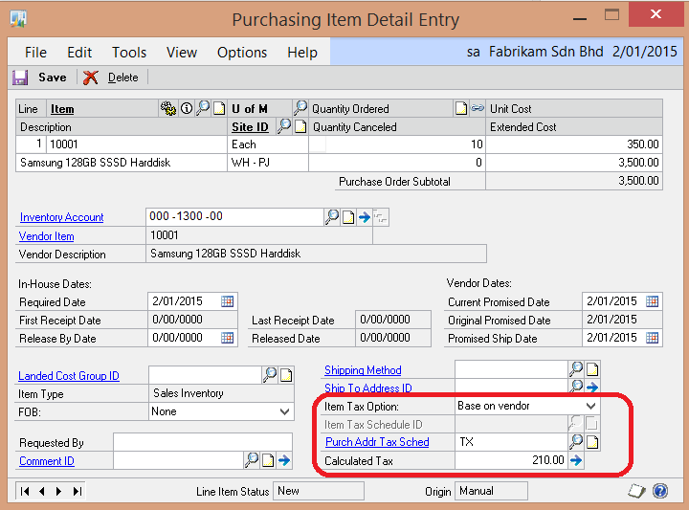
Creating Purchase Order
Path: Transactions>>Purchasing>>Purchase Order Entry
When creating a PO, the Purch Addf Tax Sched is defaulted from the Tax Schedule ID setup in the Vendor’s Purchase Address.
Item Tax Option is based on the Purchase Tax Option setup for the item you are purchasing in the Item Master. If this is a non-inventory item, the Item Tax Option will default from the Purchase Order Processing Setup.
The system will only auto calculate the GST if the Tax Details included in the Purch Addr Schedule ID (in this eg is “TX”) matches with the Tax Details included in the Item Tax Option. In this example the Item Tax Option is set to “Base on vendor”, the system will look at the Tax Schedule ID assigned to this Vendor’s Purchase Address ID.
You can also manually assign the Tax Details or changed the calculated taxes in the Purchase Order Line Item Tax Detail Entry

Slide 25
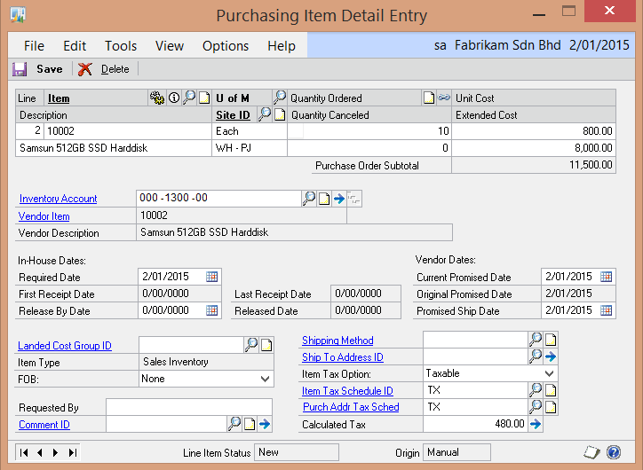
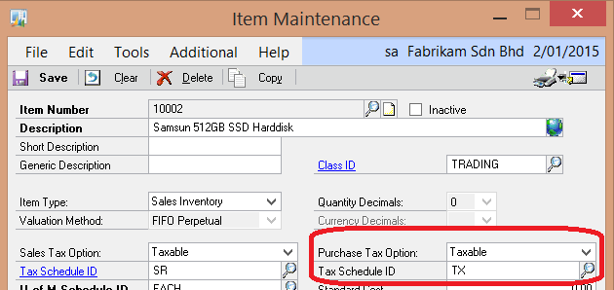
Creating Purchase Order
This example, the Item Number “10002”, the Purchase Tax Option is set as “Taxable” and a Tax Schedule ID is specified in the Item Master.
When creating the PO, the Item Tax Option will be set as “Taxable” with the Item Tax Schedule ID defaulted from the Item Master.
You can also manually assign the Tax Details or changed the calculated taxes in the Purchase Order Line Item Tax Detail Entry

Slide 26
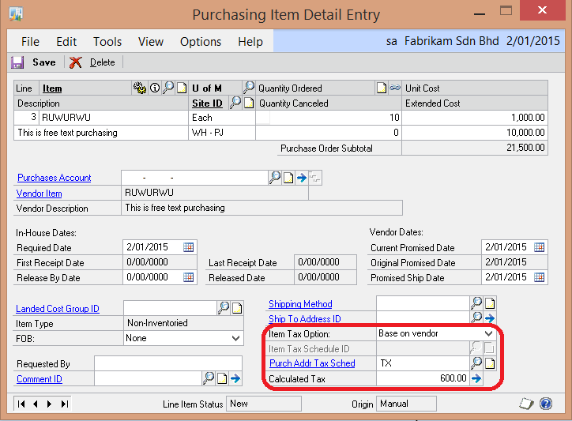
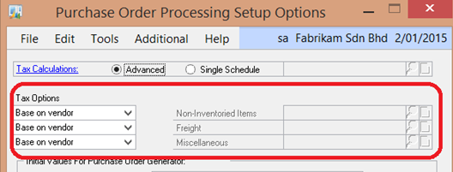
Creating Purchase Order
1) This example is a non-inventory item, the Item Tax Option will default from the Purchase Order Processing Setup Options for “Non-Inventory Items. In this case, it is setup as “Base on vendor”.
2) The system will compare the Tax Details (via Tax Schedule ID) setup in the Vendor’s Purchase Address ID with the Tax Details in the Purch Addr Tax Schedule ID to determine the tax.
3) You can also manually assign the Tax Details or changed the calculated taxes in the Purchase Order Line Item Tax Detail Entry

Slide 27
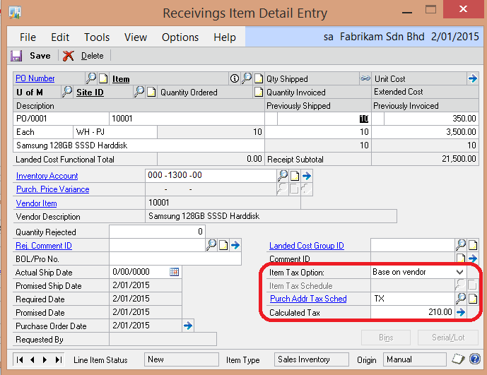
2-Way Matching to PO (Shipment/Invoice)
Path: Transactions>>Purchasing>>Receivings Transaction Entry (Type = Shipment/Invoice)
When you do a 2 way match (PO to Invoice (Receiving – Shipment/Invoice), the system will default all the tax information from the Purchase Order.
You can still amend the GST defaulted in the Receiving for each line or at the Receivings Tax Summary Entry

Slide 28
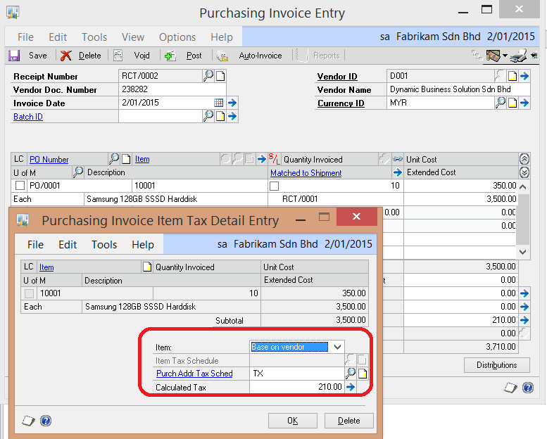
3 Matching to PO (PO/Receiving/Invoice Match)
Path: Transactions>>Purchasing>>Enter/Match Invoices
No GST at the Receiving level. GST is recognised upon Invoice Matching.
The system will default the GST from the Purchase Order.
You can still amend the GST in the Purchasing Invoice Item Detail Entry for each line or Purchasing Invoice Tax Summary Entry.

Slide 29
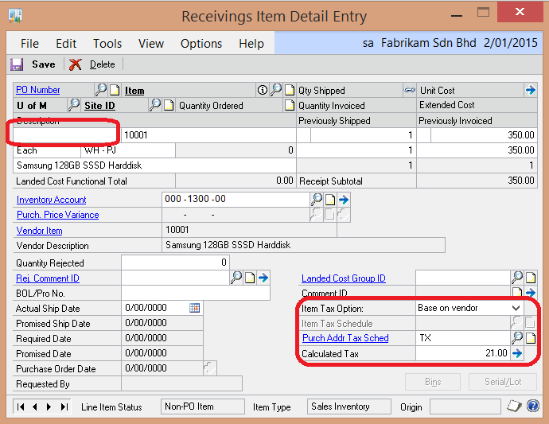
Entering Non-PO Invoices in Receiving Transaction Entry
Transactions>>Purchasing>>Receivings Transaction Entry
(Type = Shipment/Invoice)
System will default the GST similar to PO creation.
You can still amend the GST defaulted in the Receiving for each line or at the Receivings Tax Summary Entry

